Slide 1
Columbia River Bar Closures
CAPT Douglas Kaup, USCG
Sector Columbia River
Captain of the Port

Slide 2
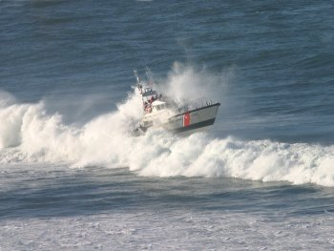
History
39 vsls capsized; 66
fatalities since 1992
TAKI-TOOO incident
Previous regulations deemed insufficient
New 33 CFR Part
165.1325 implemented
Notes:
-Since 1992 there have been 39 vessels that have capsized on or near the Washington and Oregon bars resulting in at least 66 fatalities.
-The Taki-Tooo incident is one example: the inspected charter vessel capsized resulting in the loss of 11 lives on June 14, 2003.
-CG and National Transportation Safety Board casualty investigations indicated a need for additional regulations to mitigate the risks associated with the bars.
-33 CFR Part 165; RNAs; Bars Along the Coasts of OR & WA was implemented in Dec 2009. 33 CFR 165.1325(c)(ii) states that bars “will be closed to all vessels when environmental conditions exceed the operational limitations of the relevant CG search and rescue resources as determined by the COTP.”

Slide 3
Issue
CG Rescue Capabilities in Hazardous Conditions
Appropriate Notifications
Timeliness of Bar Reopening
Impact on Marine Transportation System
Accessing Weather and Wave Buoy Data
Sector Columbia River Policy
Notes:
-Bars are closed based on the rescue capabilities of the CG stations. The rescue assets can only deploy in less than 20’ breaking seas, therefore the bar can not be opened to vessel traffic when conditions are more severe. However, the CG does have the authority to allow vessels to transit on a case by case basis.
-Bar pilots need appropriate notifications of bar closures in order to suspend operations on the Lower Columbia River. Transit times for deep draft vessels on the LCR need 10hrs notice of bar closures.
-During a flood tide, the bar can lay down making it able to transit. Having the ability to access wave buoy data, particularly wave height, can assist the CG in making a determination to reassess the bars status.
-Reopening the bar in a timely manner facilitates the flow of commerce on the Columbia River. Early bar closures allow the fishing industry access and the movement of deep draft vessels. Reducing the impact on the Marine Transportation System on the CR is important, however, safety of persons and vessels is priority.
-Currently the CG uses the NWS forecasts and wave buoy data to access the condition of the bar. The information is not always accurate however, and is not a substitute for a visual observation. This information is important in providing the “whole picture” when making a bar closure/reopening decision.
-New policy on the reopening procedures of the bar are being drafted. This will hopefully alleviate some of the issues that have been addressed by the C/V industry and the Bar Pilots.

Slide 4
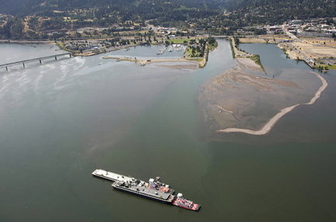
Columbia River Vessel Groundings
Tidewater Barge
NEW DAWN
Hood River Shoaling
ACOE Federally
Maintained Channel
Only Small Part of River
NOAA Surveyed Area
Summer 2010
Notes:
July 9, 2009; 0315- Tank Barge NEW DAWN was heading upriver loaded w/ 1 mil gallons of gasoline. Grounded at confluence of Hood River and Columbia River. Now submerged shoal off of the grounded vsls’s stbd bow (Reference picture). Existing charts showed over 20’ of water (barge draft was 12’), actual depth due to growth of this shoal was 6’. The barge was outside of the federally maintained channel (ACOE’s dredging responsibility) however, it was still depicted as navigable water on the chart. Fortunately the barge did not have any damage and no spill occurred.
A NM (13/10) was sent out depicting changes to the hydrography (Filled in area to say “area subject to change” due to shoal), as well as additional information regarding the shoal from Hood River in the Coast Pilot. The CG also moved the Hood River Red Nun Buoy 36 (LLNR 11932) to better mark the channel. It was requested that a survey be conducted after the grounding and the charts be updated. Due to the request/approval process, this survey was not conducted until this summer, a year after the incident.

Slide 5
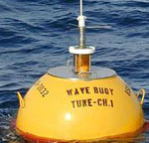
NOAA Requests
Additional Wave Buoy Data
Improved Accuracy of Data
Frequent Surveys of
Regularly Changing Shoals
Notes:
-Additional Wave Buoy Data: Additional buoys placed near the Columbia River Bar will provide more data on the sea state. This will assist the Station and COTP on making more confident decisions based off of the wave buoy data.
-Improved Accuracy-Improve buoys/data displays which are able to take into account bigger wave heights and rogue waves.
-NOAA can assist by keeping charts updated in rapidly changing areas such as Hood River. The Tug Operators and Pilots in the HSC can notify NOAA of suspected problem areas. By keeping the charts updated mariners will have a better idea of non-navigable areas. If chart corrections cannot be put out in a timely manner, notifications to the CG are requested and broadcasts or LNM can be used to inform the boating public of hazardous shoaling areas.

Slide 6
Questions?

