Slide 1
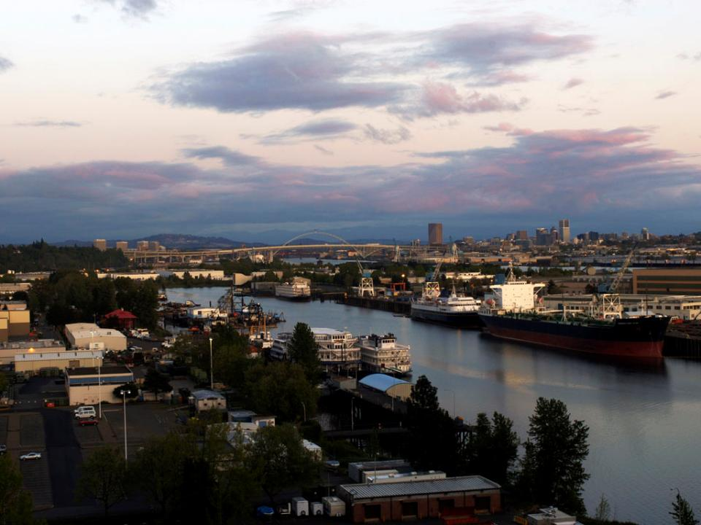
Columbia River LOADMAX/ PORTS
Sebastian Degens, Port of Portland
Columbia River Stakeholders Panel
10-12-2010

Slide 2
Loadmax System Overview
LOADMAX provides the maritime industry with real-time and forecast river level data
Data is used to assist in making vessel loading and sailing decisions
LOADMAX is a cooperative effort between Port of Portland & NW River Forecast Center, National Ocean Service/ PORTS
LOADMAX first deployed in 1984/85, became NOAA PORTS system in 2006/07

Slide 3
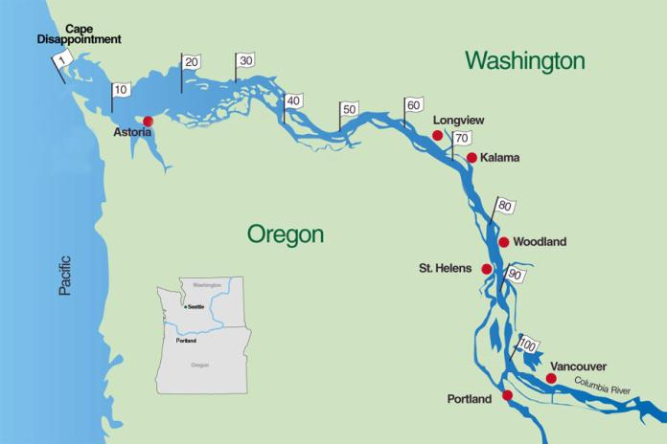
Existing Stations
Skamokawa Tide Station
Beaver Tide Station
Longview Tide Station
Hammond Tide Station
Astoria Tide Station
Wauna Tide Station
St. Helens Tide Station
Vancouver Tide Station
Portland Tide Station
(Morrison Bridge)

Slide 4
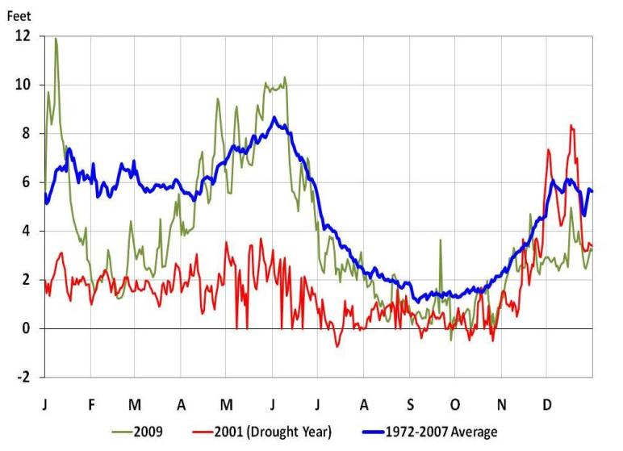
Columbia River Daily Minimum Vancouver Gauge

Slide 5
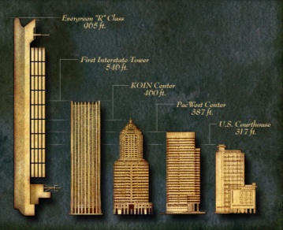

Slide 6
Source: USCG, ASACE, Columbia River Pilots in NOAA, 2010

Slide 7
Source: USCG, ASACE, Columbia River Pilots in NOAA, 2010

Slide 8
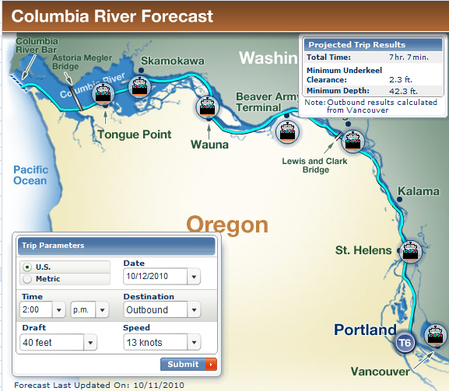

Slide 9
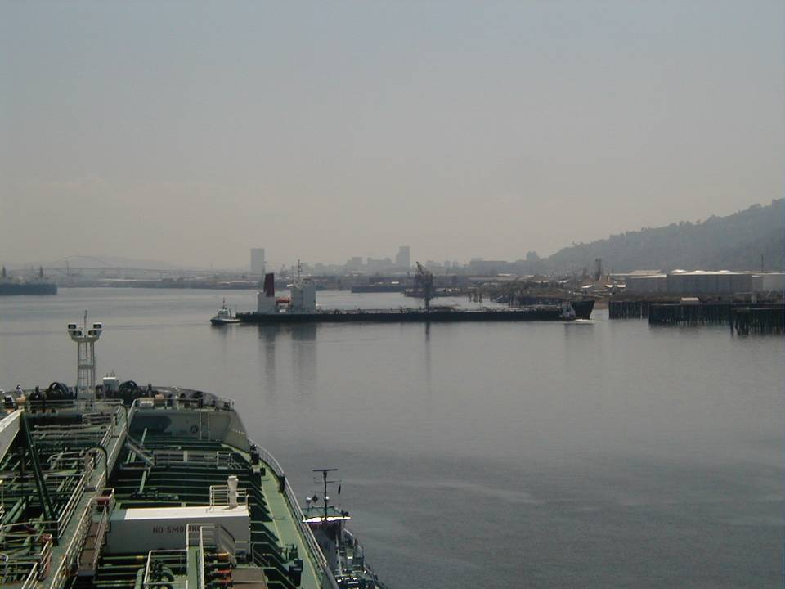
What is a foot of draft worth?
One foot vessel draft = 2,000 tons of cargo, valued at $180,000
Investment in Columbia River Deepening was $66 million per foot
NOAA Study Estimates value of river level reporting system at $6.4 million/year

Slide 10
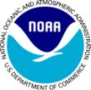
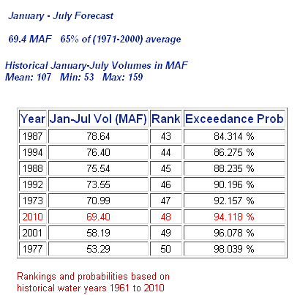
2010 Lower Columbia Low Flows
The Dalles
Jan-Jul
Volume Fcst
Drought results in fewer sailing windows & draft restrictions
2001(JUL/14) 1973(SEP)
VANW1 -.74 ft -.7
PRTO3 -.58 ft
NWS ~ NorthWest River Forecast

Slide 11
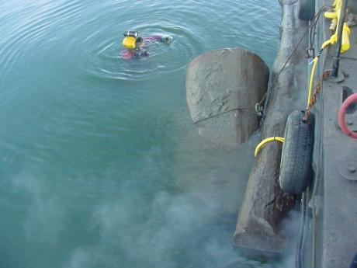
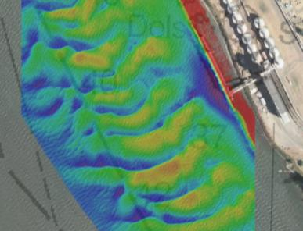
Actions to deal with Low Water
Disseminating the information for use within the maritime industry and other stakeholders in a timely manner
Advancing bathymetric surveys
Increasing the frequency of surveys
Advancing the timing of dredging, obstruction removal & other berth maintenance
Coordinating to assure the availability of dredge capability

Slide 12
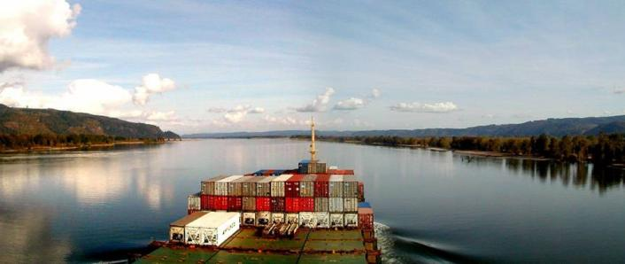
New Developments:
Long-Term low flow forecast annually
New Gauge under development at Hammond (RM 8.5)
24 hour local response service through Merchants Exchange switchboard

Slide 13
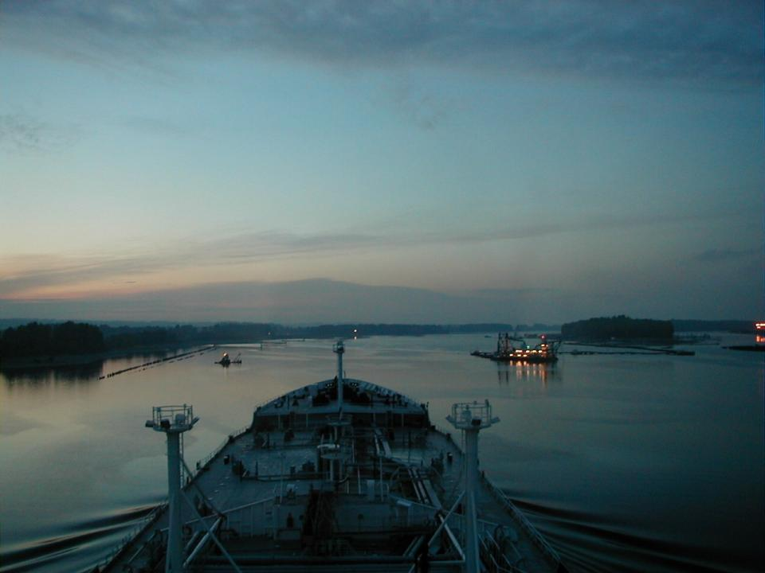
Suggestions for Improvement:
Greater reliability of the Voice Data Response system
Implement the AIS features for the data delivery shipboard
Recognize that system is being used 24/7 by maritime industry
Notes:
The Port has an important, though limited role in federal navigation projects-
Provide upland disposal sites
Advocate for adequate funding to carry out navigation mission
Cost-share sponsor for improvement studies and projects
Partner in Long-Range Dredged Material Management Planning
The challenges here from the port’s perspective are of funding, perseverance, endurance, and of developing effective & lasting partnerships. The technical challenges are probably best described by our federal partners and are discussed by others in the program.

Slide 14
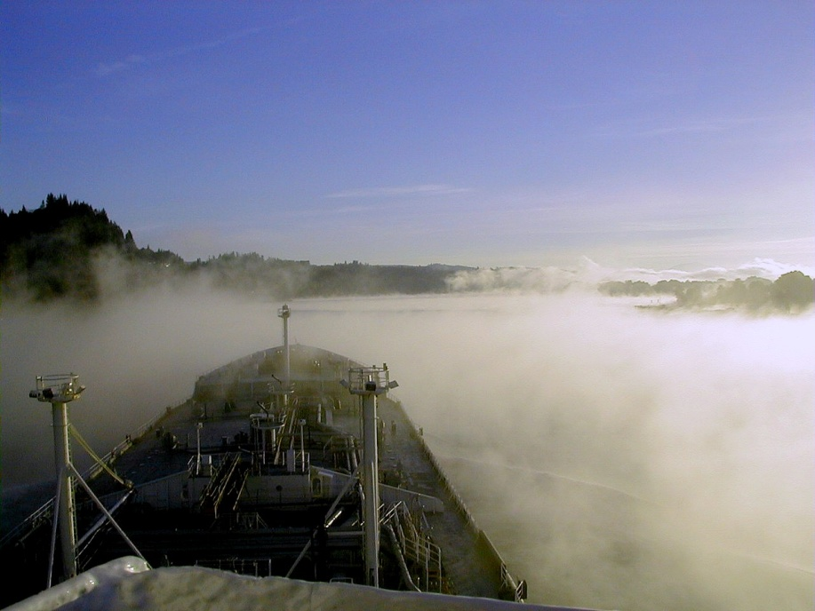
Fog Sensors & Air Gap sensors

Slide 15
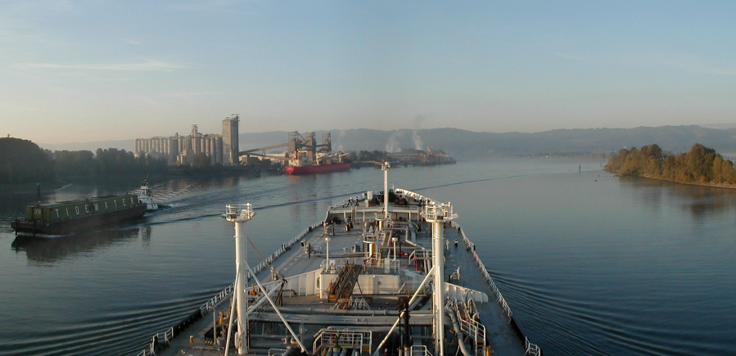
Questions?

