Slide 1
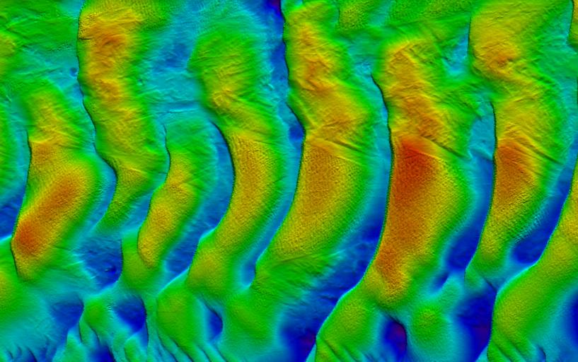
2010 HSRP Public Meeting
Columbia River Mapping Efforts
Michael Christy
October 13, 2010
Notes:
1

Slide 2
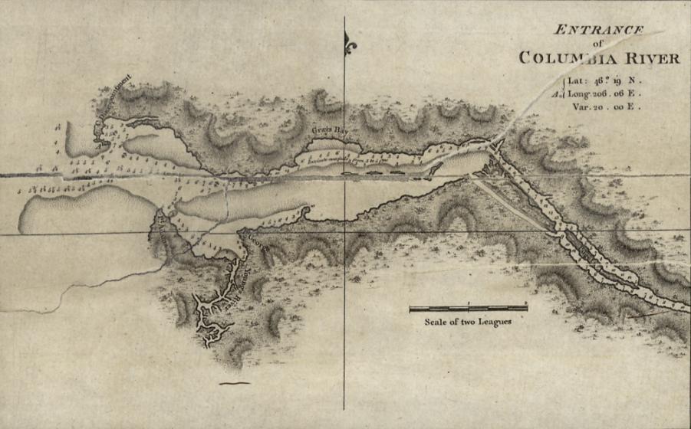
Broughton’s Survey of the Columbia River in 1792
Notes:
2

Slide 3
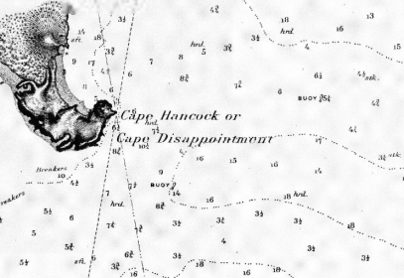
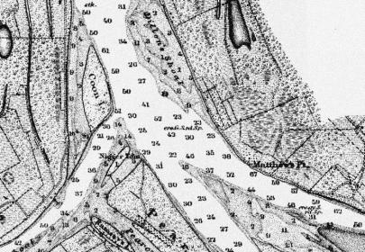
Historic NOAA Surveys
1888
1854
1998
Over 150 years of mapping the Columbia River.
Notes:
3

Slide 4
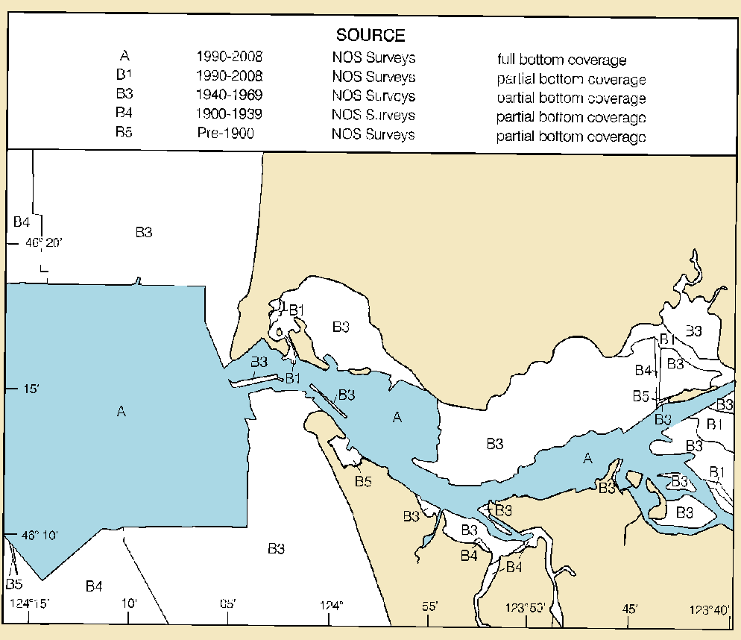
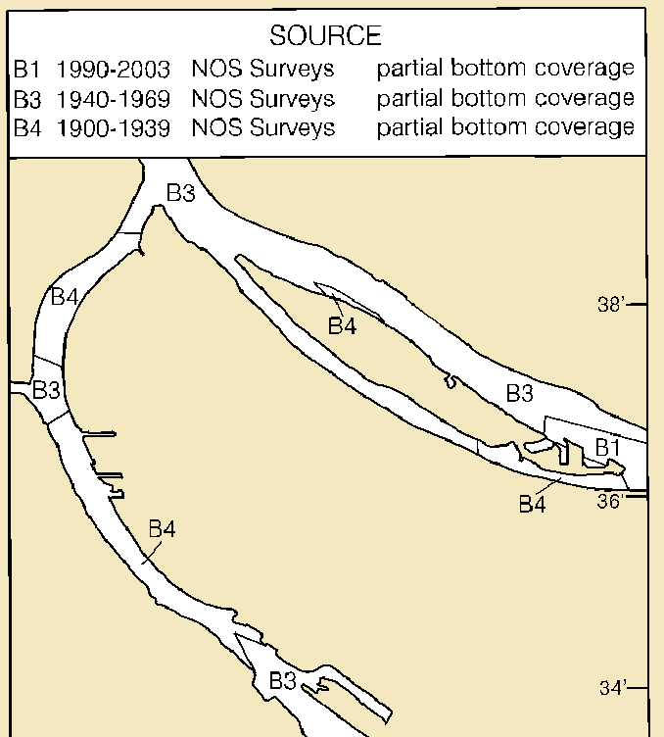
Survey Dates on the Columbia River
Last surveyed in over 100 years in places.
Notes:
With partial bottom coverage. Note Willamette River B4 areas.
Why is a new survey important? List stats on $ amount of traffic to Ports on the Columbia.
4

Slide 5
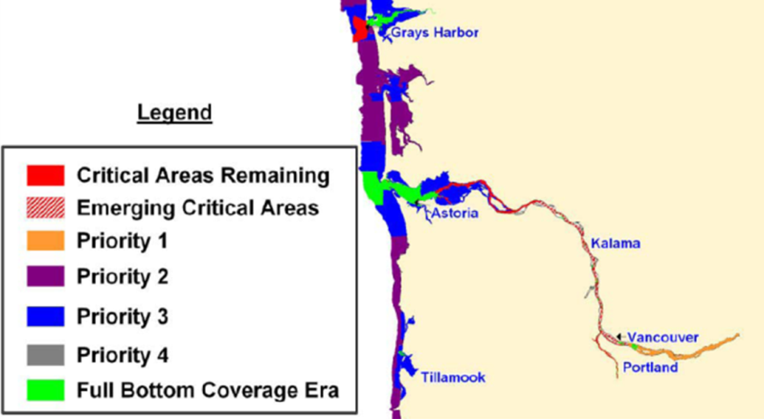
Designated as a Critical Survey Area
Notes:
Lower Columbia is designated as a critical survey area. Much of the Oregon Coast as Priority 2 and 3.
Navigationally significant areas are subdivided based on the need for hydrographic surveys. The highest priority areas are called critical areas. Critical survey areas are defined as waterways with high commercial traffic volumes (cargo, fishing vessels, cruise ships, ferries, etc.), extensive petroleum or hazardous material transport, compelling requests from users, and/or transiting vessels with low under-keel clearance over the seafloor. A new category, named emerging critical area, was created in 2004 to allow for designation of additional areas that now meet the definition of critical area, but were not included in previous editions of the NHSP. The area surveyed by DEA was comprised of critical and emerging critical areas.
5

Slide 6
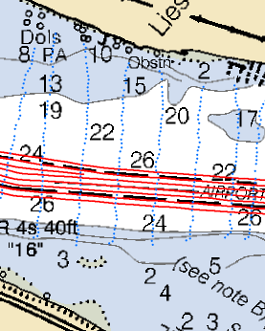
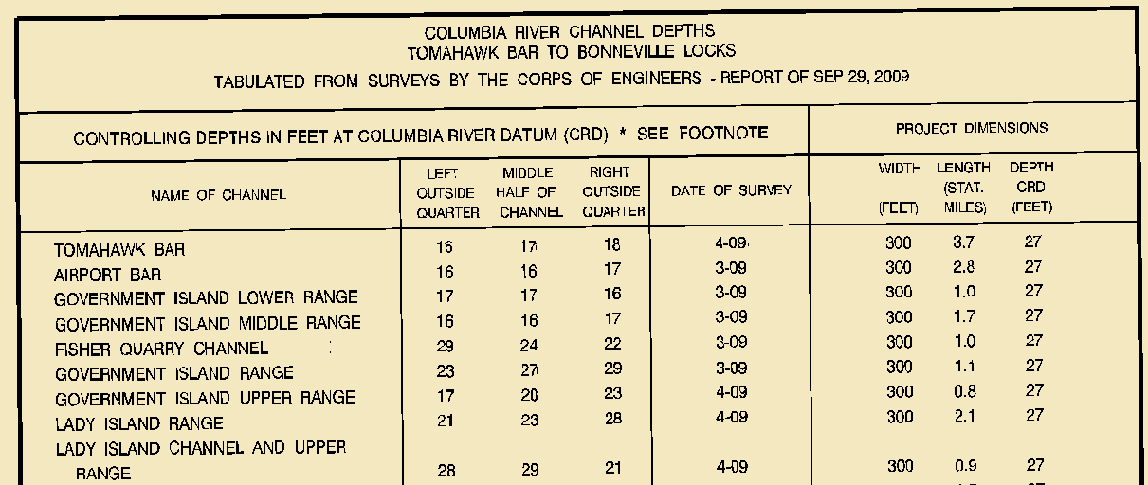
USACE Role – Channel Maintenance
USACE surveys the channel regularly for maintenance and occasional crossline surveys not intended to detect obstructions
USACE provides channel surveys in a table format which NOAA posts on nautical charts
Notes:
Pilots navigate using Corps charts, not NOAA charts. Only items inside the channel are updated.
6

Slide 7
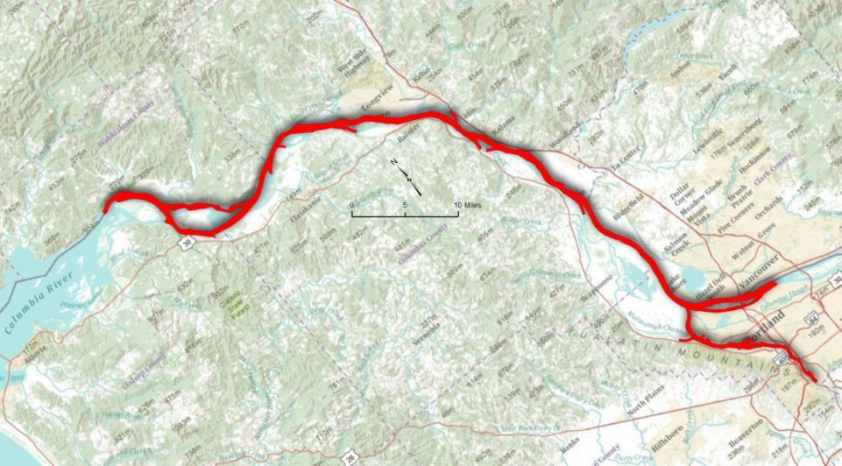
NOAA’s Survey of the Columbia
Columbia River
RM 30.4
RM 110
6 Sheets
100 nautical miles
Full bottom coverage to 4m (13ft)
Set line spacing to 2m (6.5ft)
Willamette River
RM 17
Notes:
DEA conducted hydrographic survey operations on the Columbia River, Oregon. Complete, Object Dectection, and Set Line Spacing coverage were required. In water depths greater than four meters, complete mbes was required. Twenty-eight bottom samples were required. Inshore limit of hydrography was defined as the seaward most extent of the largest scale nautical chart from the MHW line.
7

Slide 8
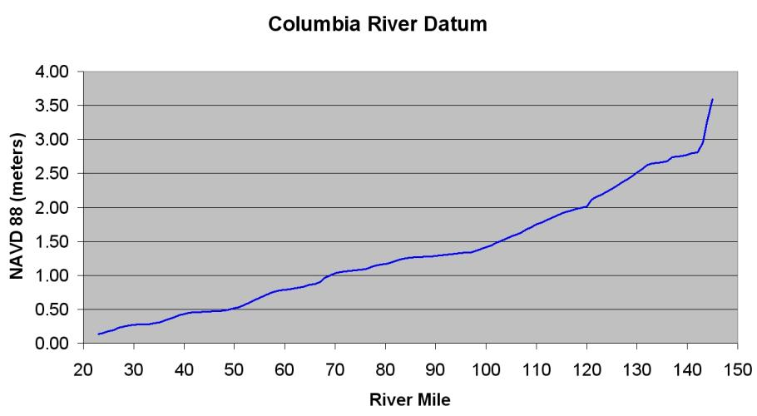
Unique Charting Datum
Notes:
Conventional NOAA hydrographic surveys along the Columbia River Datum use discrete tidal zoning for providing water level correctors. Reference water level stations for zoning is provided by 5 permanent water level stations over a 100-mile reach from Harrington Point to Portland with up to 25 miles between stations (Figure 3). Zones may be over 12 miles from a reference station. The Portland District uses tide staffs at an approximate 2-mile interval along the river to control survey and dredging operations which were established by GPS observations or differential leveling.
8

Slide 9
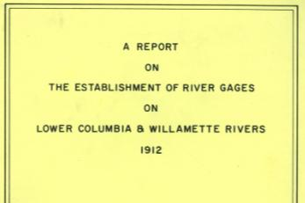
Columbia River Datum
Defined by R.E. Hickson
from the Portland District
U.S. Army Corps of Engineers
in 1912.
Later refined and related to NGVD29.
USACE Portland District published Columbia River Datum Elevations CL-03-116 which defined CRD and Ordinary High Water relative to River Mile in 1978.
Current effort to define relative to NAVD88.
Notes:
9

Slide 10
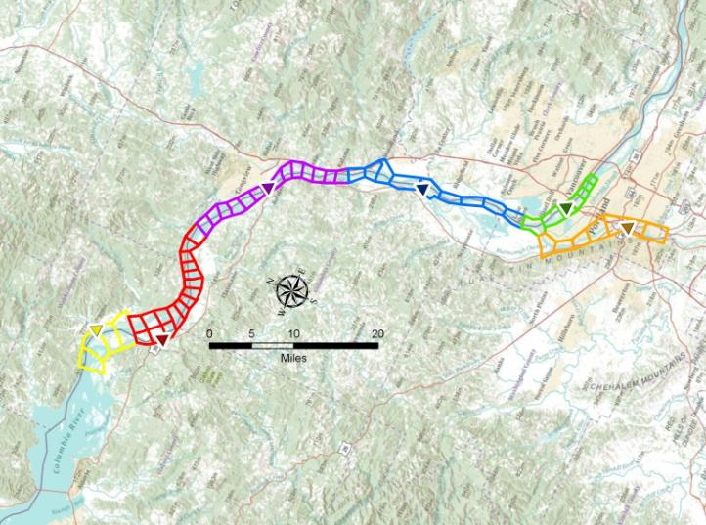
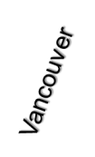
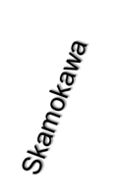
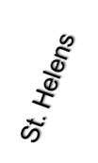
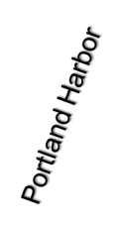
Columbia River Datum – Discrete Tidal Zoning
Notes:
Conventional NOAA hydrographic surveys along the Columbia River Datum use discrete tidal zoning for providing water level correctors. Reference water level stations for zoning is provided by 5 permanent water level stations over a 100-mile reach from Harrington Point to Portland with up to 25 miles between stations . Zones may be over 12 miles from a reference station. A sixth gauge was recovered at Portland Harbor during the recent NOAA survey.
The Portland District uses tide staffs at an approximate 2-mile interval along the river to control survey and dredging operations which were established by GPS observations or differential leveling.
Skamokawa, Wauma, Longview, St. Helens, Vancouver and Portland Harbor (subordinate)
10

Slide 11
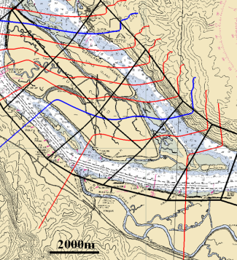
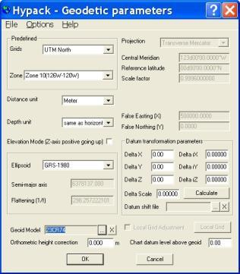
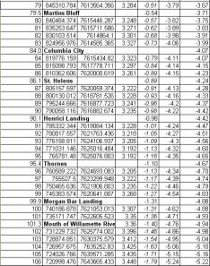
Columbia River Datum – Real-Time GPS Water Levels
Notes:
he U. S. Army Corps of Engineers, Portland District is the steward of Columbia River Datum and is in the final process of establishing the relationship between CRD and NAVD 88. They provided the profile of Columbia River Datum relative to NAVD 88 in mile increments along the center of the channel.
The first step in generation of the model was to convert the profile down the river into a Triangular Irregular Network (TIN) spatial model of CRD relative to NAVD 88. Note the multiple 1 cm contours that pass through discrete tidal zones. Some zones have more than 7 cm of gradient change across the zone which is not captured in the application of discrete zoning. Data points that define the CRD surface relative to NAVD 88 were converted to NAD 83 ellipsoid heights using Geoid 03. The converted data was inserted back into the TIN model. The final step was to convert the TIN model into a high resolution grid model. The grid model used the same format as geoid grid models generated by the National Geodetic Survey which can be used in hydrographic software such as Hypack and Caris HIPS to convert ellipsoid heights directly to a mapping datum. A series of three models were generated at a 3-second arc resolution (Figure 8) in order to capture the high definition of the TIN model in small channels and at the confluence with the Willamette River.
11

Slide 12
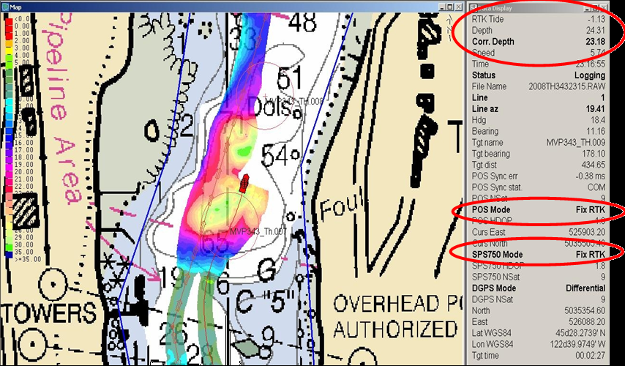
Columbia River Datum – Real-Time GPS Water Levels
Notes:
GPS base stations were established along the project at intervals not greater than 18 kilometers. This allowed for a maximum range from a base station of not more than one half of the base station spacing or not more than 10 kilometers. Base stations logged 1-second epoch GPS observables and broadcast real-time carrier phase correctors to the two survey vessels every second. A repeater radio was used to relay the signal to reach the 10- kilometer range in some areas. Aboard the survey vessels, the correctors were received and processed by a POS/MV with dual frequency (L1/L2) receivers. As a redundant observation, the correctors were processed with a Trimble MS750 receiver which provided Hypack with real-time ellipsoid heights. The CRD separation model was input in Hypack for real-time water levels
To verify correctors were providing position data within survey specifications, a Trimble DSM132 receiving differential correctors from the U.S. Coast Guard beacon at Fort Stevens was used for a real-time comparison to RTK position data. As the survey vessels would switch between base stations, the RTK positions and elevations were logged as the vessel was static and a comparison was made from the values obtained from each station. Typical comparison values were sub 2 cm. Figure 10 shows a water level corrected multibeam swath painting in real time with a data display of real time water levels and status of RTK and differential positions. The real-time coverage display was color coded for a distinct color change at the 2-meter and 4-meter depth curves. Survey specifications called for full multibeam coverage to the 4-meter curve and 25-meter skunk striping or single beam coverage inshore of the 2-meter curve. Whereas the swath was corrected to chart datum in real-time, the colored depth curves could be used during the survey to verify coverage requirements were exceeded.
12

Slide 13
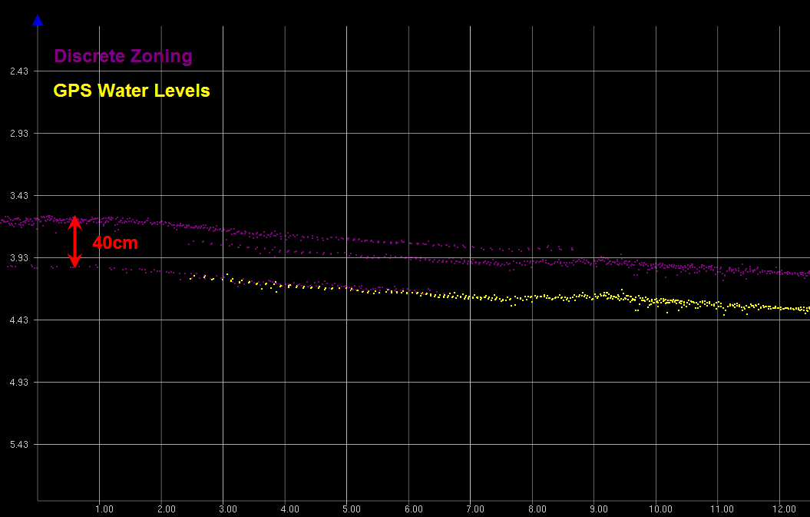
Columbia River Datum – Zoning vs. GPS Water Levels
1.3ft
Notes:
In order to evaluate the performance of the two methods a sample dataset with depths reduced using GPS water levels was compared to a duplicate dataset using discrete zoning with verified CO-OPS water levels relative to CRD.
Comparisons between the two datasets showed differences caused by discrepancies in CRD between the model used to compute GPS water levels and the water level station as well as differences (errors) caused by the inability of zoning from a stationary gauge to capture water level changes at the vessel. As previously mentioned some water level gauges are currently outputting water levels using an incorrect CRD to NAVD88 relationship. For areas where significant discrepancies between published CRD (used by the water level gauges) and interim CRD (used in the model) were present swath to swath agreement between survey lines was evaluated rather than computing a difference surface between the two datasets. Typically, survey line agreement was evaluated between overlap from lines acquired under varying stages of the tide cycle or flow conditions.
13

Slide 14
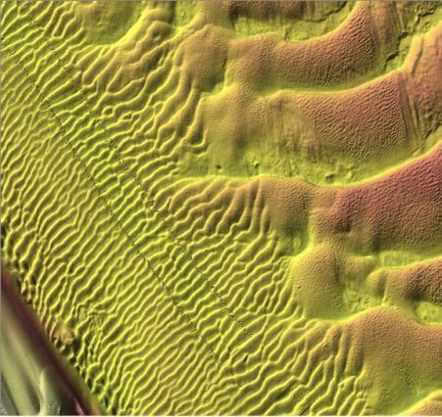
Columbia River Datum – Zoning vs. GPS Water Levels
Zoned tides
GPS water levels
Notes:
In order to evaluate the performance of the two methods a sample dataset with depths reduced using GPS water levels was compared to a duplicate dataset using discrete zoning with verified CO-OPS water levels relative to CRD.
Comparisons between the two datasets showed differences caused by discrepancies in CRD between the model used to compute GPS water levels and the water level station as well as differences (errors) caused by the inability of zoning from a stationary gauge to capture water level changes at the vessel. As previously mentioned some water level gauges are currently outputting water levels using an incorrect CRD to NAVD88 relationship. For areas where significant discrepancies between published CRD (used by the water level gauges) and interim CRD (used in the model) were present swath to swath agreement between survey lines was evaluated rather than computing a difference surface between the two datasets. Typically, survey line agreement was evaluated between overlap from lines acquired under varying stages of the tide cycle or flow conditions.
Tide zoning artifacts are conspicuous in the final products of a hydrographic survey. Figure 13 illustrates these discontinuities with a 40 cm difference between two lines in which discrete tidal zoning was applied. Figure 14 shows a small portion of a sun illuminated bathymetric grid where a single line of the survey is offset nearly 30 cm from the adjacent survey lines due to the use of discrete tidal zoning. Figure 15 shows the same survey area after application of GPS water levels using the Applanix POSPac Single Base solution.
14

Slide 15
Columbia River Datum – Zoning vs. GPS Water Levels
Reduction of uncertainty achieved through the
use of GPS water levels.
Notes:
The use of GPS water levels can drastically reduce the vertical total propagated uncertainty of surveyed depths by removing several vertical uncertainty components from total propagated uncertainty calculations.
Under typical scenarios tidal uncertainty is the largest vertical uncertainty component of a hydrographic survey with published recommended values of up to 40 cm used for zoning uncertainty. By removing the need to use discrete zoning and making water level measurements directly at the survey vessel significant reductions in vertical uncertainty can be made. In addition, since GPS height measurements are being made in real-time on the survey platform there is no need to account for changes in vessel loading, draft, and settlement and squat using traditional processing methodology or accounting for these components when computing total propagated uncertainty.
GPS derived water levels provide previously unmeasured water levels at the survey platform and vastly improved vertical accuracy to hydrographic surveys over discrete tidal zoning. Since the phase center of the GPS antenna and the acoustic center of the multibeam sonar are at a fixed distance and move in unison with vessel loading, settlement and squat, vertical uncertainties in static draft and dynamic draft are eliminated. However, the prudent hydrographer should maintain a log of static draft observations and squat table such that conventional tides may be applied as a backup method or water level data from the survey can be used to verify or improve modeling of ellipsoid heights relative to chart datum and wind driven water level models used for forecasting water levels
Application of GPS water levels relative to a separation model to convert ellipsoid heights to chart datum can always be altered as better models become available. However, there are many areas where this relationship is well defined and should be implemented.
Traditional ranges from NOAA Field Procedures Manual 2008, Chapter 4 Appendices
15

Slide 16
Survey of the Lower Columbia and Willamette
RM 30.4
RM 110
What did we find?
RM 17
Notes:
DEA conducted hydrographic survey operations on the Columbia River, Oregon. Complete, Object Dectection, and Set Line Spacing coverage were required. In water depths greater than four meters, complete mbes was required. Twenty-eight bottom samples were required. Inshore limit of hydrography was defined as the seaward most extent of the largest scale nautical chart from the MHW line.
16

Slide 17
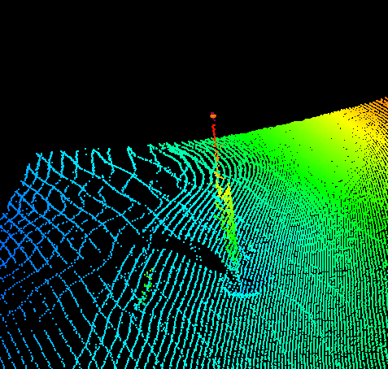
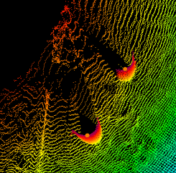
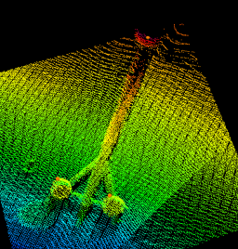
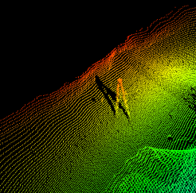
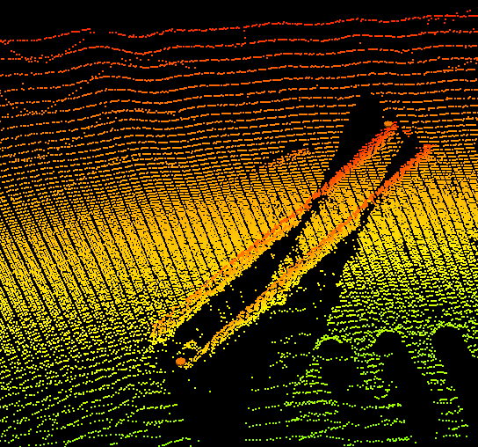
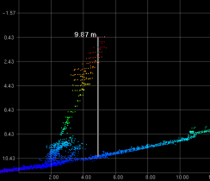
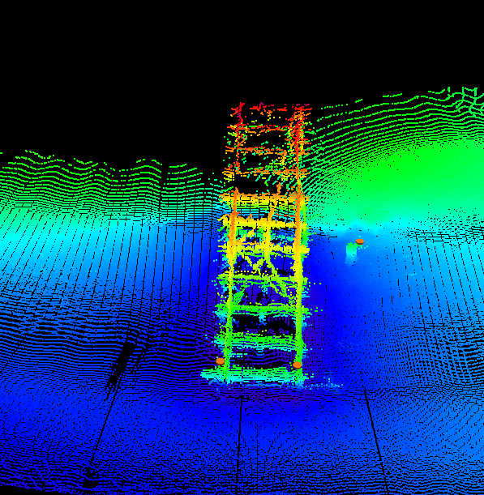
Survey of the Lower Columbia and Willamette
65 Uncharted Dangers to Navigation
1400+ Significant Features
400+ Disproved Features
Notes:
H11854 – 8 DtoNs
H11855 – 0 DtoNs
H11856 – 3 DtoNs
H11857 – 0 DtoNs – 1 broadcast LNM
H11858 – 3 DtoNs
H11859 – 50 DtoNs (45 DEA / 5 NOAA)
H11859 has a lot of additional features that were not submitted as dtons at the request of PHB. We’ll want to determine this number as well. I have this info locally so I can do it.
17

Slide 18
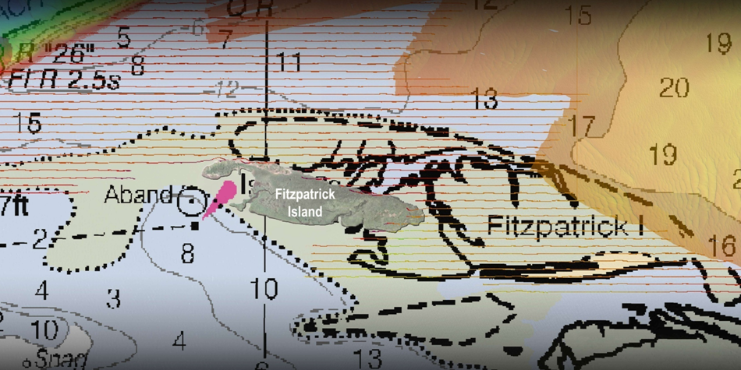
Survey of the Lower Columbia and Willamette
0.5 miles
Notes:
18

Slide 19
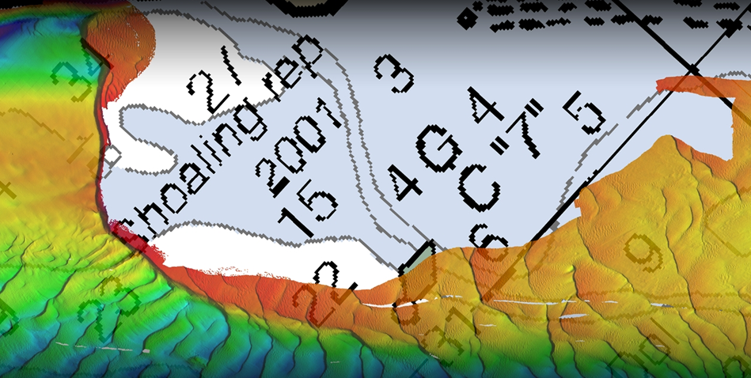
Survey of the Lower Columbia and Willamette
Notes:
19

Slide 20
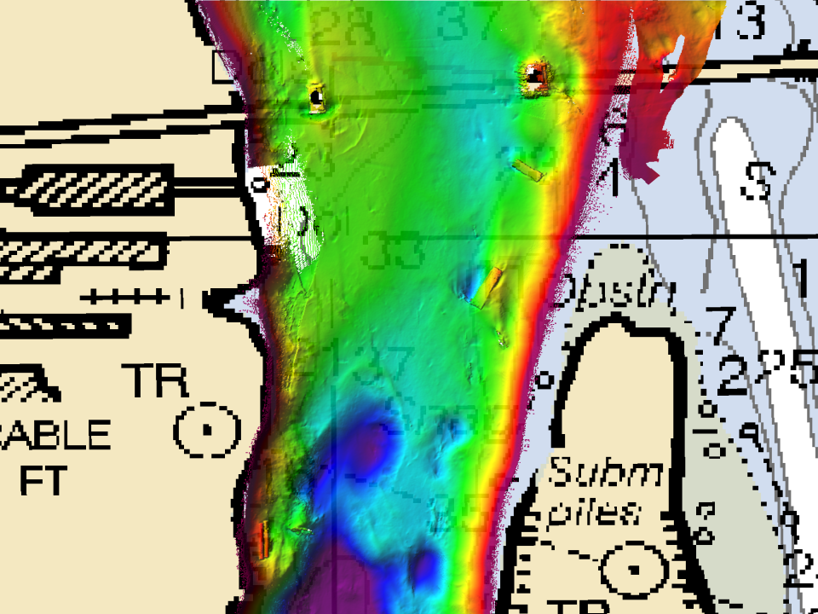
Charting Survey for NOAA on the Lower Columbia
Ross Island Bridge
Sunken Barge
Insert sample DtoNs and hazards – see Kathleen
Submerged Pipes
Submerged Sail Boat
Notes:
20

Slide 21
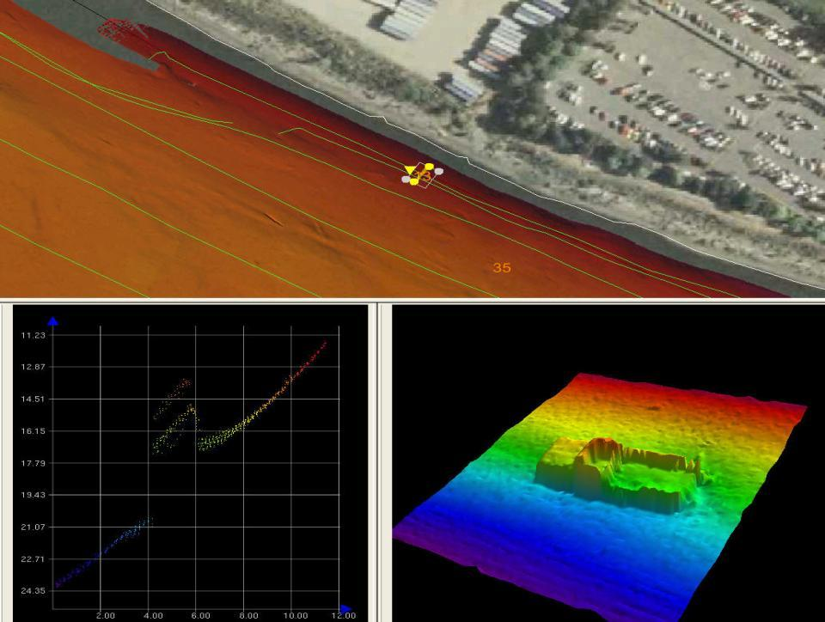
Charting Survey for NOAA on the Lower Columbia
Notes:
21

Slide 22
Columbia River Mapping – Interagency Use
“Map Once…Use Many Times”
Notes:
NOAA Integrated Ocean and Coastal Mapping
22

Slide 23
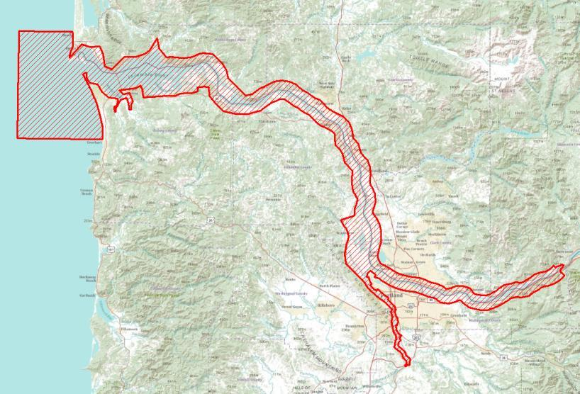
Columbia River Treaty – Lower Columbia River
Notes:
To support hydraulic modeling efforts related to the Columbia River Treaty negotiation of 2014, the U.S. Army Corps of Engineers, Portland District (CENWP) requests a combined topographic and bathymetric digital terrain model (DTM) for the Lower Columbia River. This scope covers the generation of a DTM from data that already exists in the study area. This model will be used to establish a base dataset and to identify areas of insufficient existing data coverage for future additional survey work.
23

Slide 24
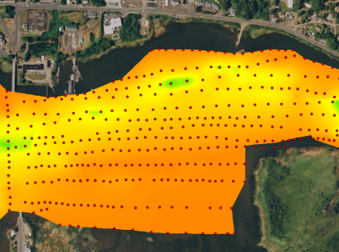
Columbia River Treaty – Lower Columbia River
2010 – LCREP singlebeam
2009 – USACE singlebeam
2009 – NOAA multibeam
1988-2007 – Various USACE
1851-2003 – Historic NOAA
(1935 earliest use)
Notes:
24

Slide 25
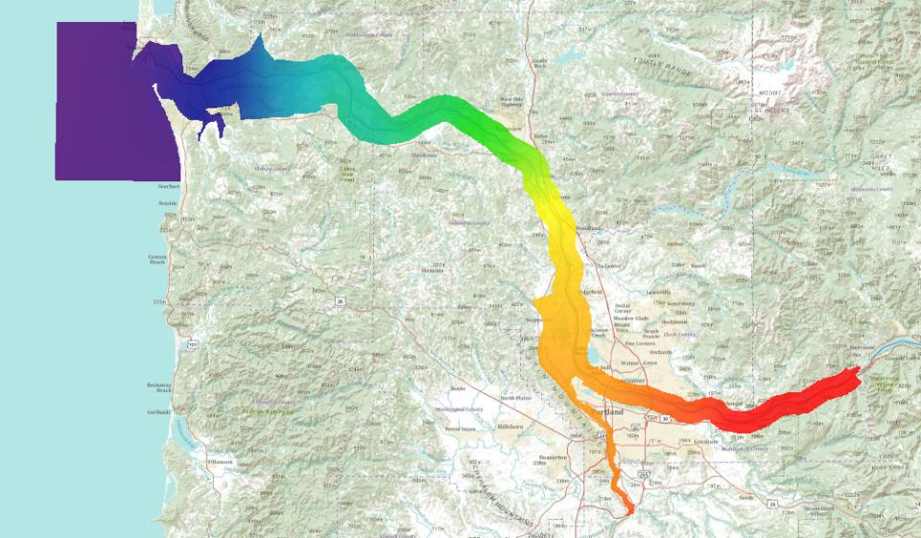
CRD/MLLW to NAVD88
Harrington Point
MLLW
CRD
Notes:
The CRD to NAD83 elliopsoid model was merged with MLLW to ellipsoid data points and converted from ellipsoid heights to NAVD88 using GEOID09.
ESRI geodatabase Terrain Data Model defining the separation between Columbia River Datum (CRD) from Columbia River Mile (CRM) 23 - 145 and Willametter River Miles (WRM) from Willamette Falls in Oregon City to WRM 27 or Mean Lower Low Water (MLLW) downstream of CRM 25 to the North American Vertical Datum of 1988 (NAVD 88) using GEOID09.
The values in this terrain can be added to CRD elevations to obtain NAVD 88 elevations, that is, they are NAVD 88 elevations of CRD.
Maintain a 3D separation model between CRD/MLLW and NAVD 88 suitable for transforming datasets between vertical datums.
The U. S. Army Corps of Engineers, Portland District provided the profile of Columbia River Datum relative to NAVD 88. The National Oceanic and Atmospheric Adminstration provided the separation of Mean Lower Low Water relative to NAVD 88 through VDatum.
The first step in generation of the model was to convert the CRD to NAVD 88 profile from CRM 23 to 145 and the Willamette from WRM 27 to Willamette Falls into a Triangular Irregular Network (TIN) spatial model of CRD relative to NAVD 88. The river profile was offset at 2,000-foot intervals perpendicular to the profile and modeled down back channels of islands. From CRM 23 to -3 VDatum was used to obtain the separation between MLLW and NAVD 88. This was accomplished by using a high resolution 3-arc second grid. Artifacts in the VDatum model near shoreline islands in the estuary were edited out of the TIN.
The TIN model was converted into a high resolution grid model. The grid model used the same format as geoid grid models generated by the National Geodetic Survey which can be used in hydrographic software such as Hypack, Caris HIPS, and CorpsCon to convert between vertical datums. A model was generated at a 3-second arc resolution in order to capture the high definition of the TIN model in small channels and at the confluence with the Willamette River.
The high resolution 3-arc second grid was transformed to UTM10N, NAD83 using CorpsCon and imported into ArcGIS. An ArcGIS Terrain was generated using a 2D bounding polygon.
25

Slide 26
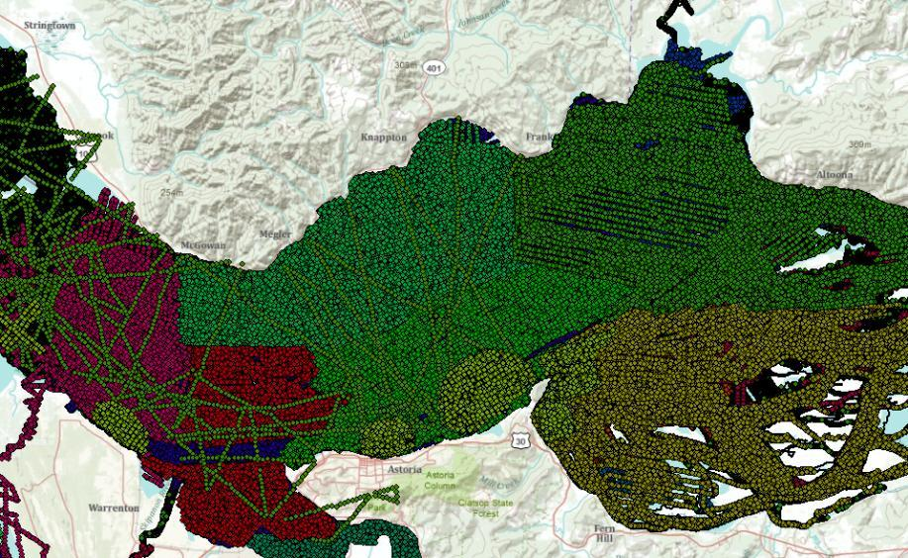
Columbia River Treaty – Lower Columbia River
Notes:
26

Slide 27
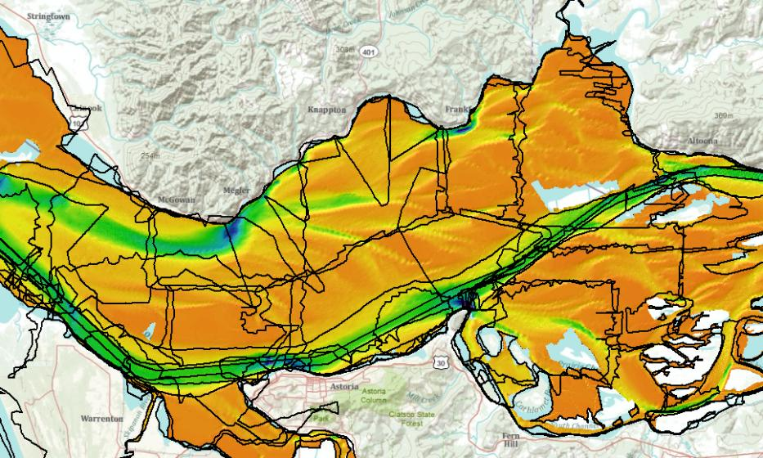
Columbia River Treaty – Lower Columbia River
Notes:
20 recent surveys (1990 or newer)
68 historic surveys (from 1851)
27

Slide 28
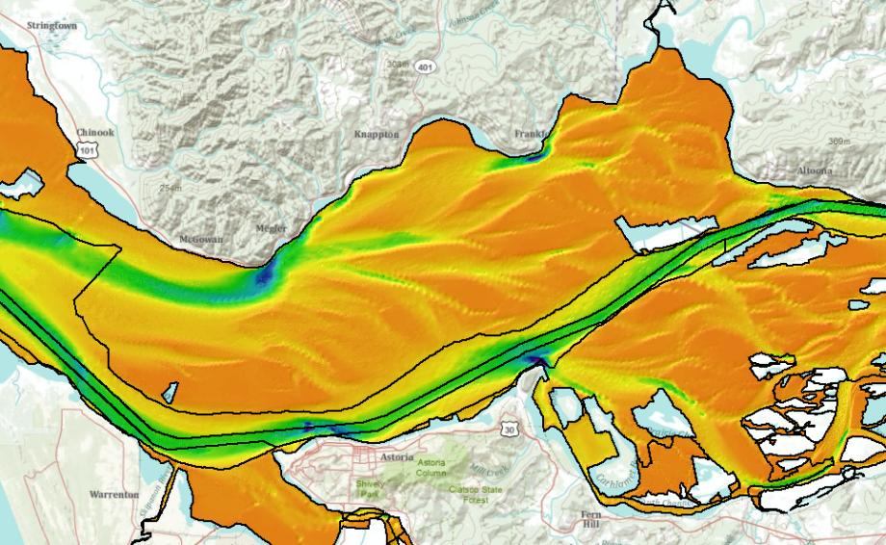
Columbia River Treaty – Lower Columbia River
2009
USACE
2003 USACE
2009 USACE
2003
USACE
2009
LCREP
2003 USACE
Notes:
Merged into one composite DTM.
28

Slide 29
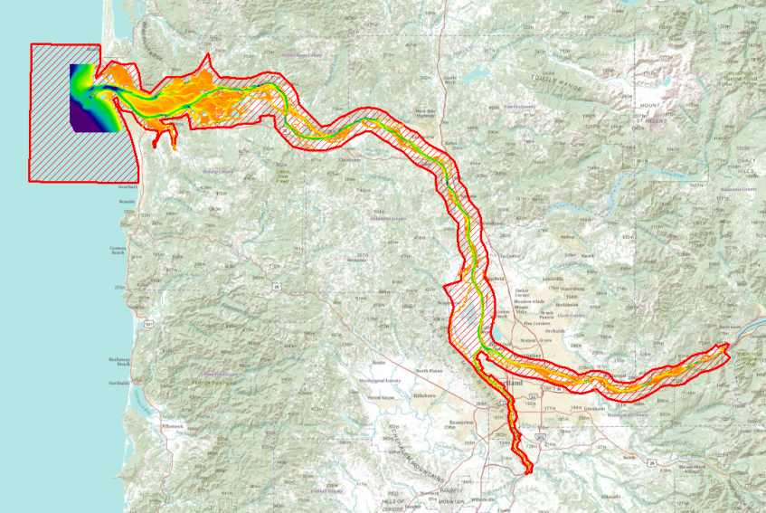
Columbia River Treaty – Lower Columbia River
Notes:
29

Slide 30
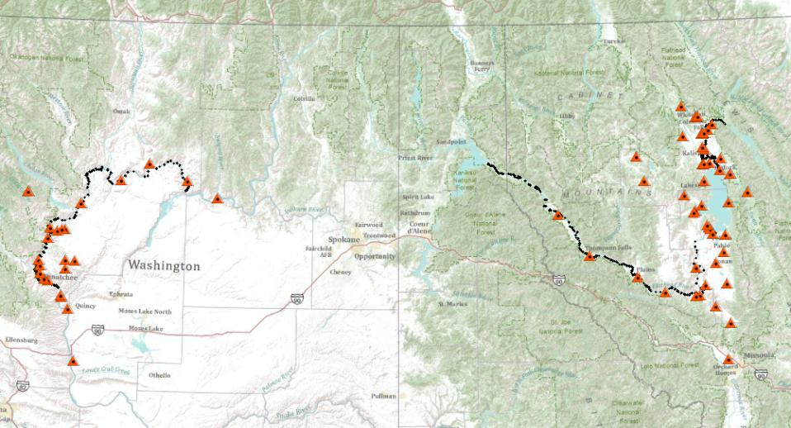
Columbia River Treaty - Upper Columbia River Basin
Notes:
Hydraulic modeling efforts related to the Columbia River Treaty negotiation of 2014, CENWS requested hydraulic cross-sections and related data within the Columbia River from Priest Rapids to the U.S. – Canada border, the Pend Oreille, Clark Fork and Flathead Rivers.
Approx ?? (450?) cross-sections.
2-foot water depth, 5-foot along track, photos for all cross-sections in a GIS database. Detailed bridge sketches.
Horizontal accuracy – stated is 5ft RMSE, Absolute 0.5ft vertical RMSE.
Controlled using OPUS network for the entire project (NAVD88 using GEOID09).
Jet skis
30

Slide 31
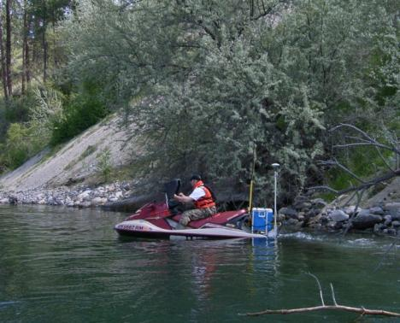
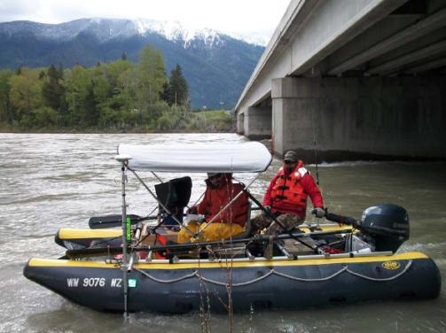
Columbia River Treaty - Upper Columbia River Basin
Notes:
Hydraulic modeling efforts related to the Columbia River Treaty negotiation of 2014, CENWS requested hydraulic cross-sections and related data within the Columbia River from Priest Rapids to the U.S. – Canada border, the Pend Oreille, Clark Fork and Flathead Rivers.
Approx ?? (450?) cross-sections.
2-foot water depth, 5-foot along track, photos for all cross-sections in a GIS database. Detailed bridge sketches.
Horizontal accuracy – stated is 5ft RMSE, Absolute 0.5ft vertical RMSE.
Controlled using OPUS network for the entire project (NAVD88 using GEOID09).
Vessels specifically designed for shallow river survey (how?)
31

Slide 32
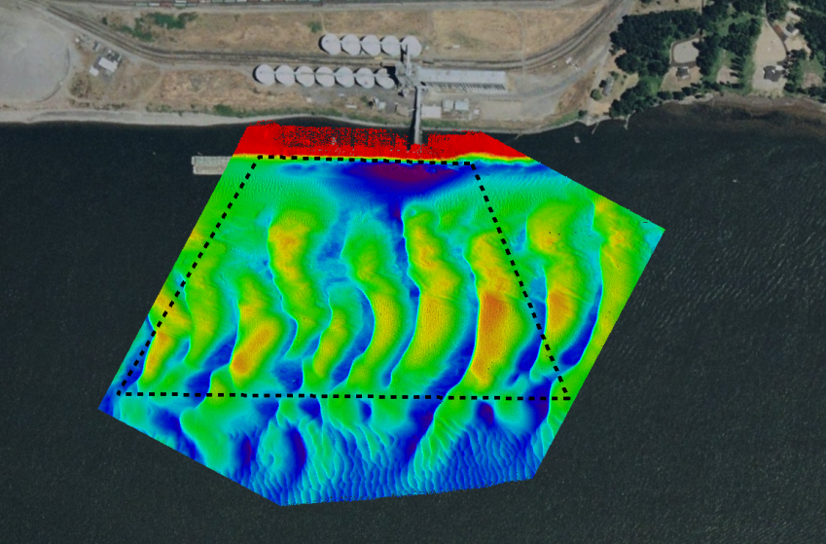
Columbia River Mapping – Multiple Use
Possible Strikes
Notes:
Port of Kalama
32

Slide 33
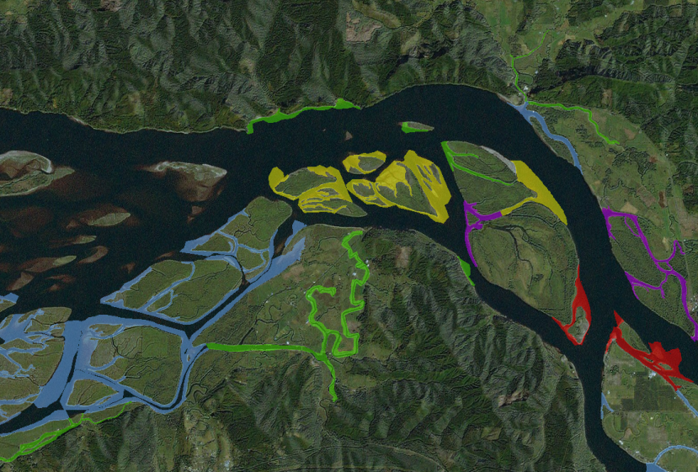
Columbia River Mapping – Multiple Use
Notes:
33

Slide 34
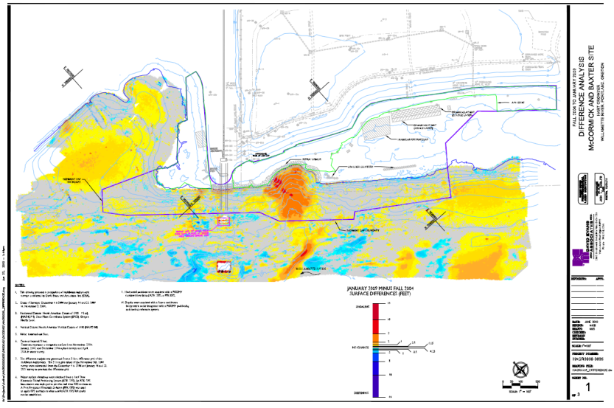
Columbia River Mapping – Multiple Use
Notes:
34

Slide 35
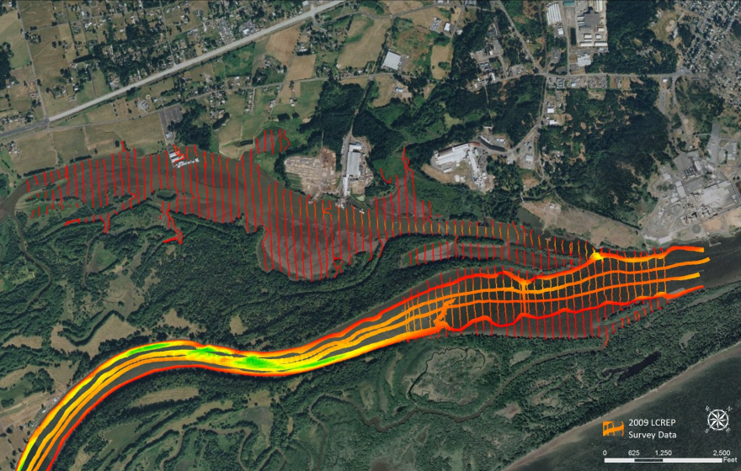
Columbia River Mapping
Notes:
35

Slide 36
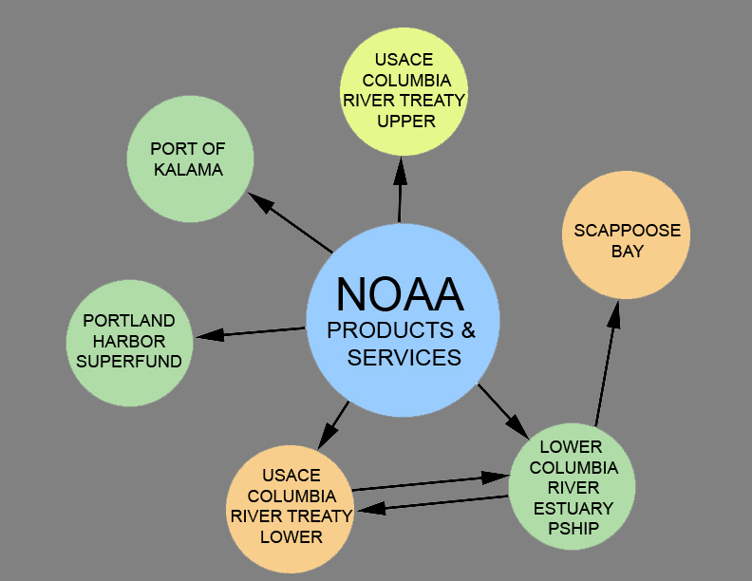
Columbia River Mapping – Multiple Use
Notes:
36

