Slide 1
Welcome
Hydro Survey Chart Modernization
Notes:
ML

Slide 2
Hydro Survey Chart Modernization
History
CADD Approach
2009 GIS Approach
New GIS (Geographic Information Systems) Approach
Introduction
The New Process
Chart Presentation
Notes:
ML

Slide 3
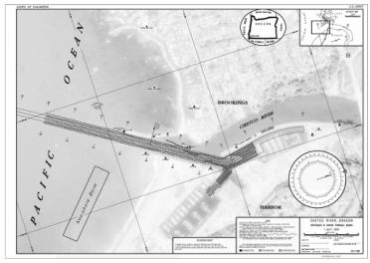
History – CADD Approach
Existing Process
Terramodel for processing and Contours, Labels, Hatching
MicroStation for Review and Plotting
Plotted for Visual Inspection of All Features
Channel Status Sounding Labels “Eyeballed”
Charts were a “stand-alone” Product
Different Units
Different Data
Notes:
ML

Slide 4
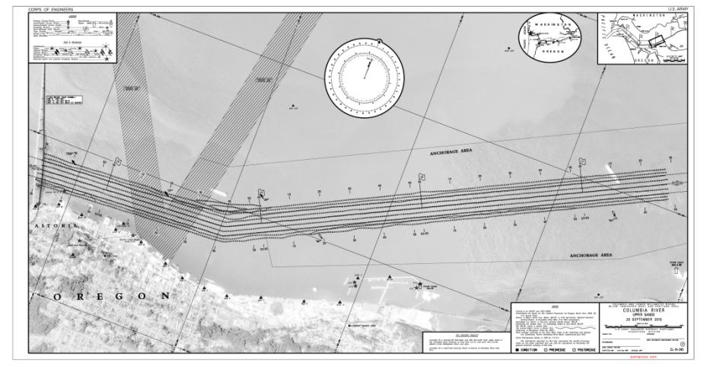
History – CADD Approach
Notes:
ML

Slide 5
History – 2009 GIS Approach
2009 Approach tried to Eliminate Operator Input
ESRI’s Model Builder Touted as Robust
Used Automatically Updated Data (IE: Imagery, Buoys)
Used Automated Processes (IE: Labeling)
Advantage - Great in Theory! No Operator Input, Automated Data
Disadvantage - Relied on Others (Network, Data Stewards), Slow
Positive Results - Procedural Improvements, Carto, RD&E
Notes:
ML

Slide 6
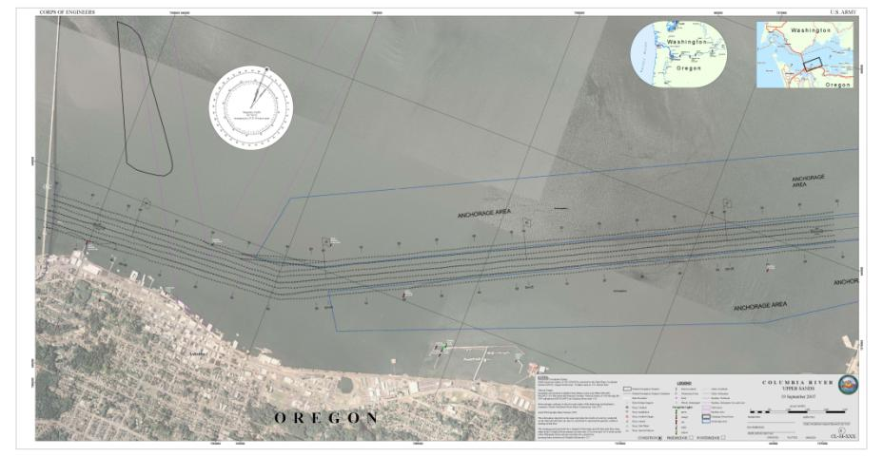
History – 2009 GIS Approach
Notes:
ML

Slide 7
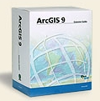
New GIS Approach
Improve 2009 Methodology
Apply New Methodology to All Charts
ARRA Funded NCDB Team Provided Invaluable Support
Accomplished Using Two Parallel Tasks
Data Processing
Simultaneous Evaluation of ModelBuilder & Python
Extensive Data Manipulation & Business Process Improvements Required
Each step of process with OD-NWH Oversight and QA/QC
Cartography
Each Chart being Created in GIS with OD-NWH Oversight and QA/QC
Costliest part of Process – Also Most Visible (Product for Public)
Replicate Existing Chart Features Using New Storage Technique (GDB)
Notes:
ML

Slide 8
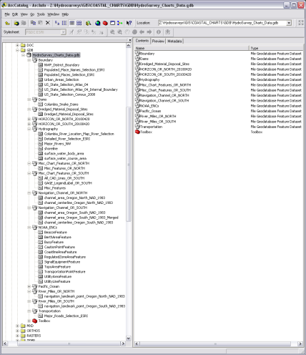
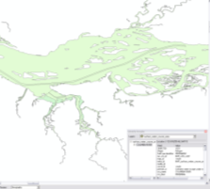
New GIS Approach
Geodatabase is a GIS Data Storage Type
Hydrographic Survey Geodatabase Improves Chart Performance by Directing all Data
to One Central Repository
Independent from other Corps GIS Databases
Data Updates can Easily Replace Existing/Old Data Displayed on Charts
Notes:
JW

Slide 9
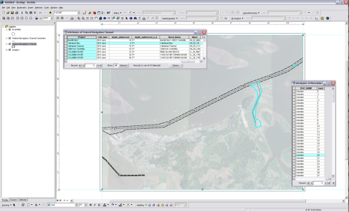
New GIS Approach
USACE Data Verification Process
Creation of GIS Data Sets Allowed for Analysis of Existing NWP Data
OD-NWH Approved GIS Data Include:
Federal Navigation Channel Framework
River Miles
Horizontal Control Points
Dredged Material Placement Areas
Notes:
JW

Slide 10
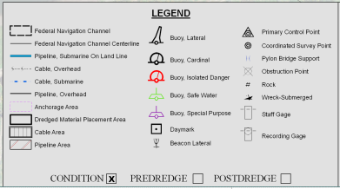
New GIS Approach
Multi-Agency Data Usage
Allows for Standardization of Data and Symbols
Allows for Periodic Updating of Features on Charts
Removes Duplication of Efforts to Collect Data
NOAA Electronic Navigation Charts (ENC’s) Data
USDA/FSA 2009 NAIP (National Agriculture Imagery Program) Aerial Imagery
USGS National Hydrography Dataset (NHD)
Notes:
JW

Slide 11
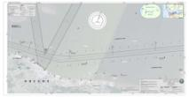
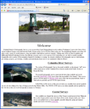
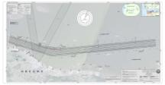
New GIS Approach
Cartography
Data Processing
GDB
Channel Geometry
& Data
.XYZ Files
Python Script
GDB
XYZ Points,
Contour Lines,
Shoaling Polys
.DAT Files,
CAD Contours,
Channel Status
Numbers
Notes:
JW

Slide 12
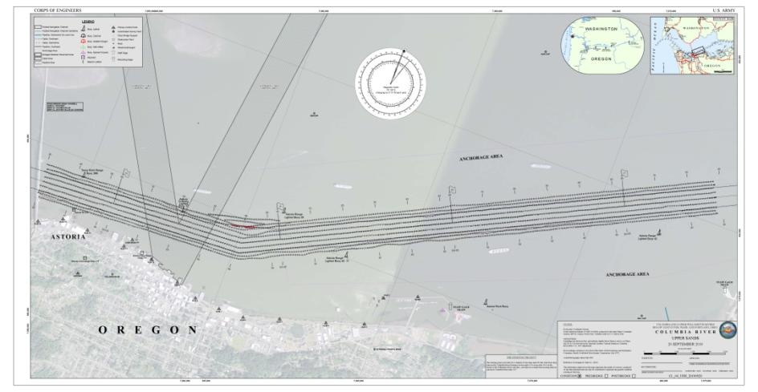
GIS Chart Presentation
Notes:
JW

Slide 13
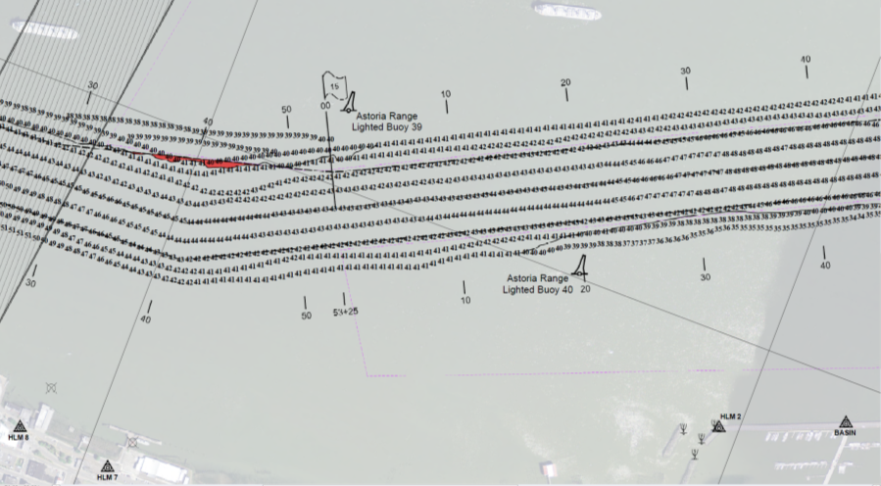
GIS Chart Presentation
Notes:
JW

Slide 14
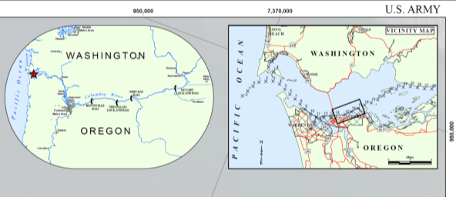
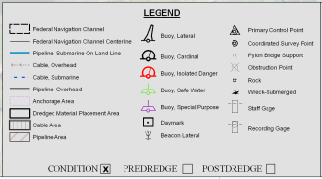
GIS Chart Presentation
Inset Maps
Title, Scale Bar &
Notation
Notes:
JW

Slide 15
Thank You
Notes:
JW/ML

