Slide 1
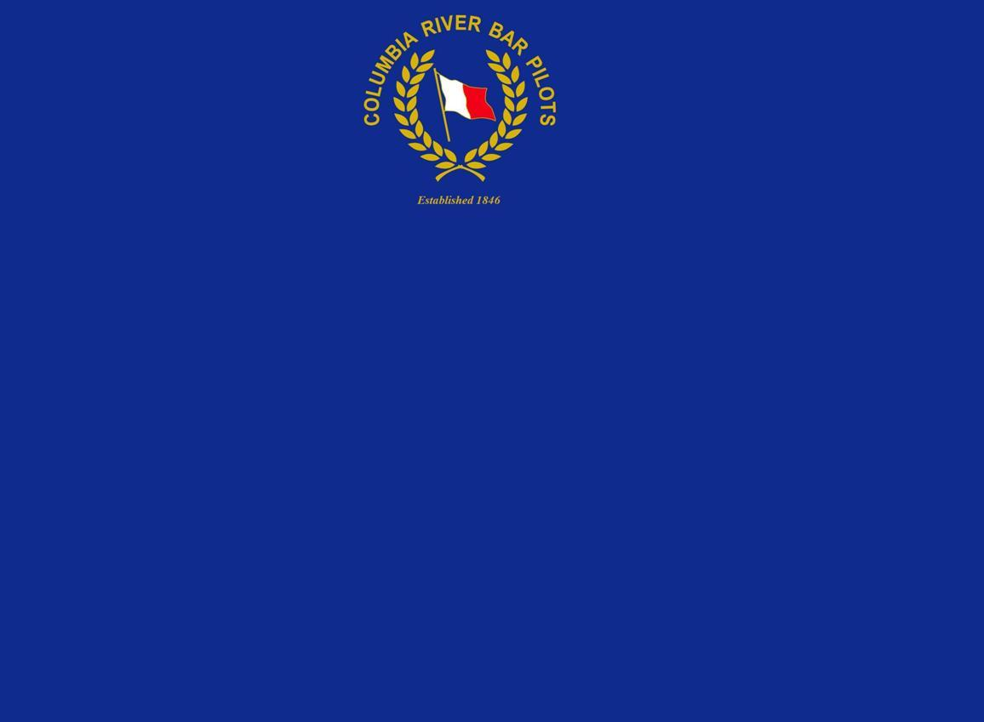
Navigating the Columbia River Bar
Captain Dan Jordan
Notes:
Pilotage throughout the world has many similarities
I’ll talk about a few of the unique aspects and tools available on the Columbia River Bar.

Slide 2
Ebb current
Ocean swell
Coastal current
Notes:
The most notable aspect of the Columbia River Bar is how swells change when they encounter the river currents in shallow water.
When swells meet an opposing ebb current that can reach 5-7 knots, they become short and steep with breakers.

Slide 3
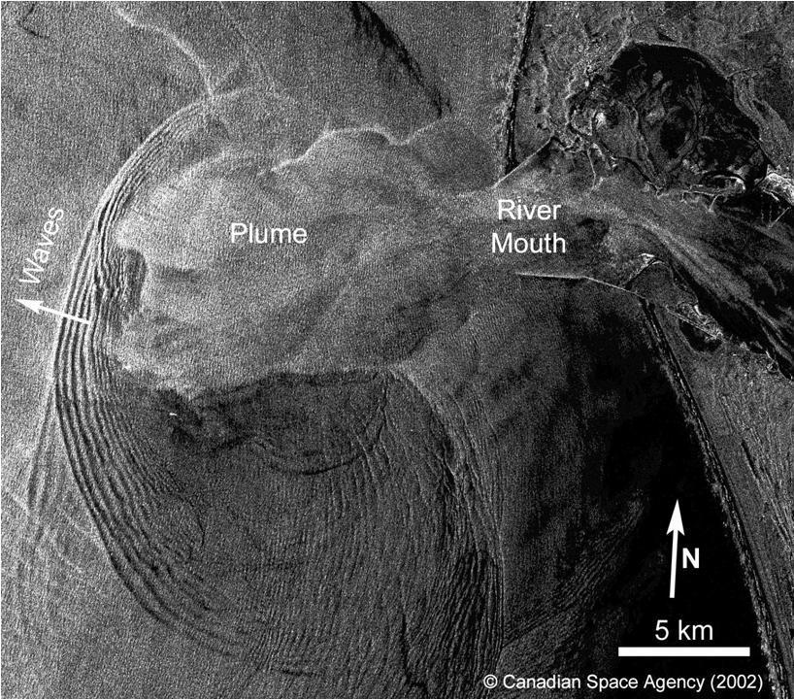
11 miles

Slide 4
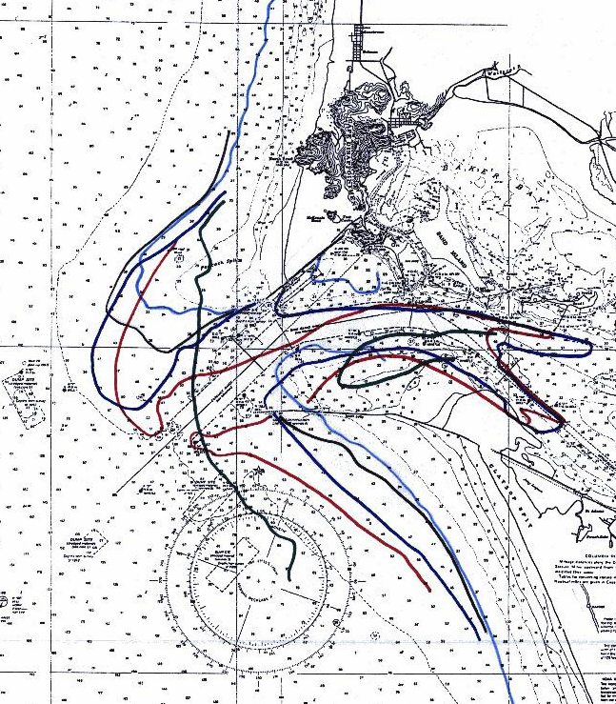

Change in the 40-ft depth Contour thru Time
A
2000
The underwater shoals at MCR are eroding, affecting the stability of the jetties and the inlet
Peacock Spit
2009
Baker Bay
1993
1930
1919
1919
Shore line: Pre- jetty
3 km
1930
2000
Notes:
NOAA Ship Rainier recently completed a full survey of chart 18521

Slide 5
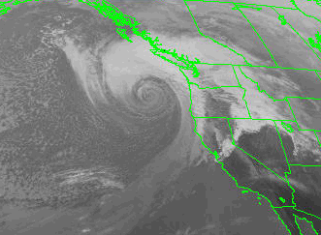

BC
WA
Pacific
Ocean
OR
CA
3 MAR 1999 - Extr Trop Low
image courtesy of NOAA
29 AUG 2005 – Hurricane Katrina
image courtesy of NOAA
Notes:
This phenomenon become most notable during the winter storm.

Slide 6
Total Storm Power and Maximum Wave Height Trends
Pacific Northwest Coast, USA
The yellow columns are highlighted to illustrate a grouping of high intensity years. Number of events tracks along similar trend line.
Notes:
Storm intensity is steadily increasing

Slide 7
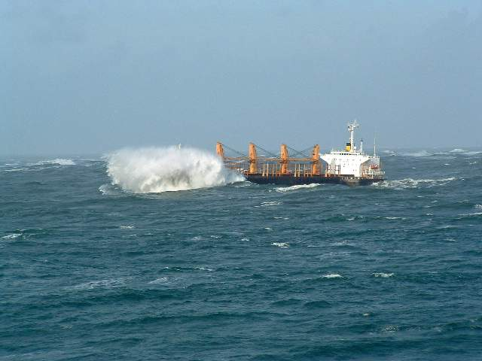
A major part of a bar pilot’s job
is to know when its safe to cross the Bar

Slide 8
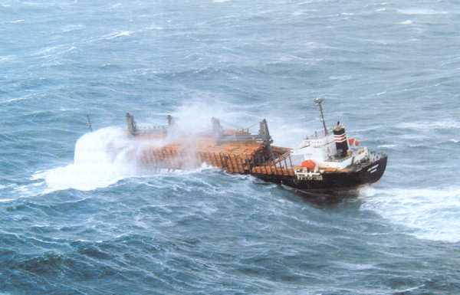

Slide 9
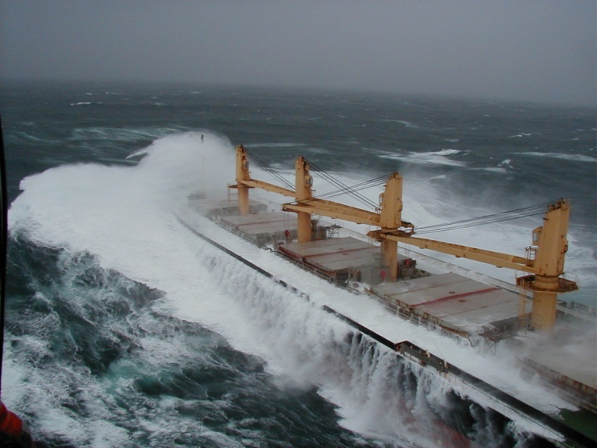

Slide 10
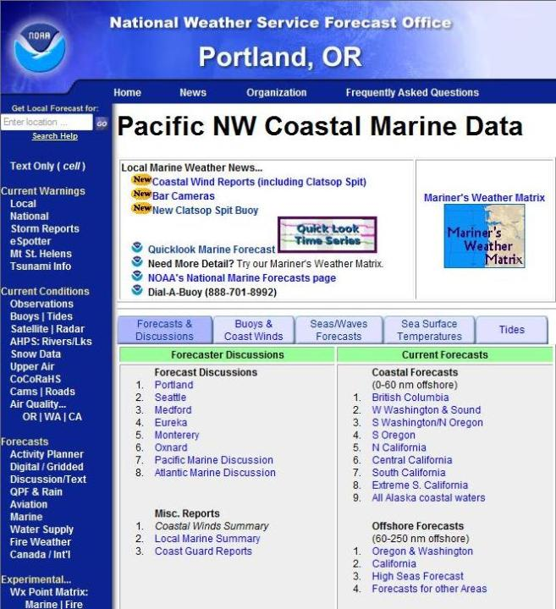

Slide 11
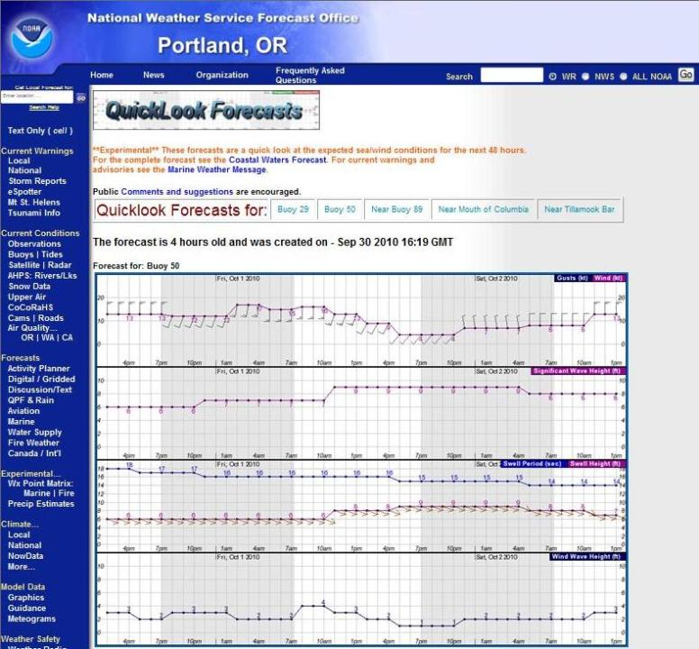

Slide 12
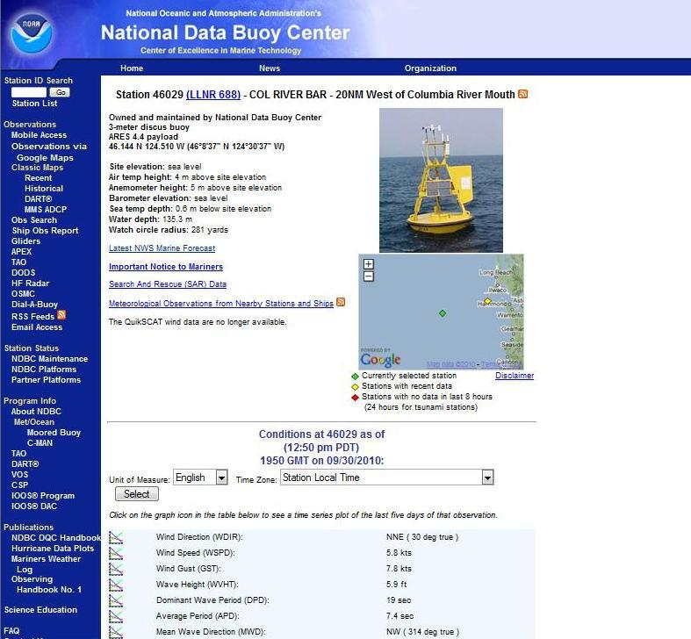

Slide 13
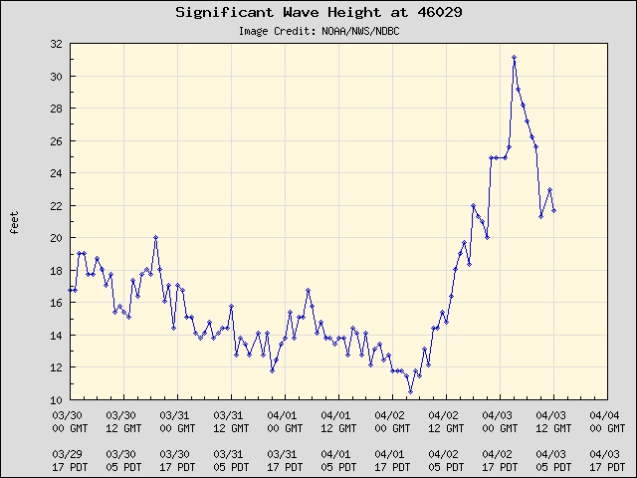
Notes:
A falling trend is a good indication that the storm has passed that buoy.
We follow these trends when determining when to stop and then resume ship traffic.

Slide 14
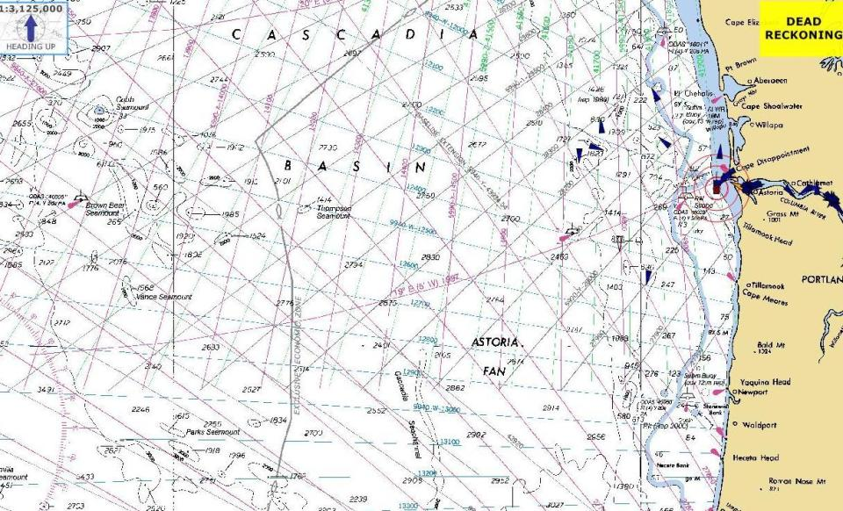
46041
46089
71 nm @ 5 hrs
46029
18 nm @ 1 hr
46005
287 nm @ 19 hrs
46243
46050
92 nm @ 6 hrs
Notes:
We have to start a ship from Portland 10 hours before crossing the bar.

Slide 15
Pacific Northwest Buoy Meeting
Thursday, June 18th 2009
10 AM – 2 PM
Lewis and Clark Interpretive Center
Ilwaco, WA
Purpose: Explore ways to improve the current buoy system and provide better wave, wind and weather information and predictions for the region.
Goals and Outcomes:
  Understand the status, capabilities, and gaps in the current data buoy systems.
  Understand needs, drivers and opportunities for new buoys at the Mouth of the Columbia River.
  Build consensus on new buoys needed for the region:
    How will data be used by various stakeholders?
    What are the needed system components and location(s)?
    How do we incorporate new buoys into existing data networks?
    What are the funding needs and opportunities for placing and maintaining new buoys?
  Develop strategy for funding and partnerships for new buoys at the Mouth of the Columbia River.
Background: This meeting was a recommendation from the recent workshop held on April 27 and 28 on wave conditions and navigational safety at the Mouth of the Columbia River related particularly to dredging activities.
Organizers: Portland District Corps of Engineers, Columbia River Bar Pilots, Columbia River Crab Fisherman’s Association and the Washington Department of Ecology
Notes:
This meeting was convened primarily due to the poor reliability of the NDBC buoys.

Slide 16
Pacific Northwest Buoy Meeting
Participating Stakeholders
National Weather Service, Portland
National Weather Service, Seattle
National Data Buoy Center
U.S. Army Corps of Engineers, Portland District
U.S. Coast Guard, Sector Portland
U.S. Coast Guard, District 13
Scripps Institution of Oceanography
Golder Associates Inc.
Port of Illwaco
CREST/Port of Astoria
Columbia River Bar Pilots
Washington Department of Ecology
Oregon Sea Grant
Columbia River Pilots
Port of Portland
Columbia River Steamship Operators Assoc.
Merchants Exchange
Pacific County
Office of Senator Murray
Office of Congressman Wu
Office of Congressman Baird
The Oregonian
The Daily Astorian
Crowley Petroleum Services
NANOOS
Oregon fishermen's Cable Committee
Foss Maritime
Office of Senator Cantwell
Washington State Representiitve, 19th District
WSU Extension/Washington Sea Grant
Washington Dungeness Crab Fishermen's Assoc.
Columbia River Crab Fishermen's Assoc.

Slide 17
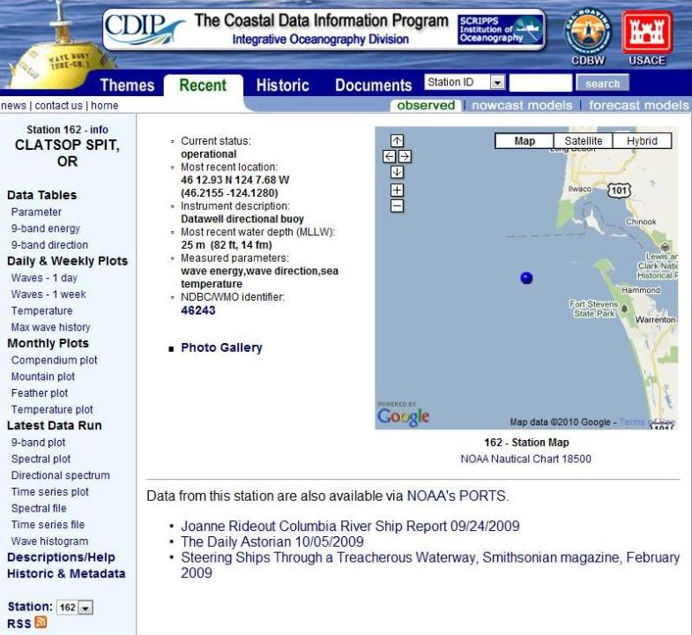
Notes:
The outcome of the Wave Buoy Meeting was a Corps’ funded CDIP wave buoy on the bar.

Slide 18
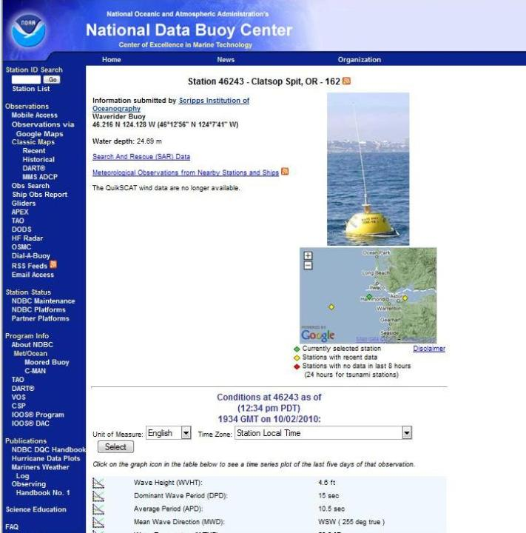
Notes:
NDBC includes the CDIP buoy data on their web site in similar format as the other buoys.

Slide 19
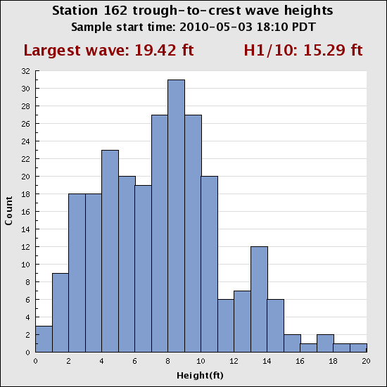
Notes:
Additional CDIP presentations show a 30 minute wave history.

Slide 20
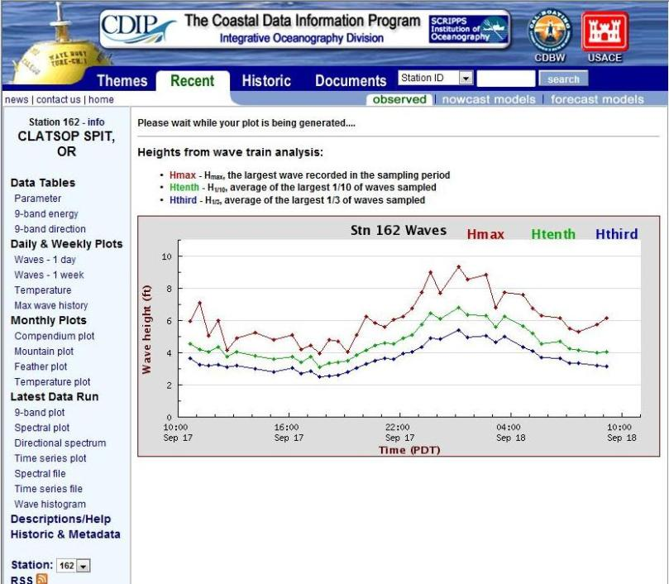
Notes:
Blue Hthird line is NDBC significant wave height
Green Hthenth is CDIP significant wave height
Red Hmax is peak wave height

Slide 21
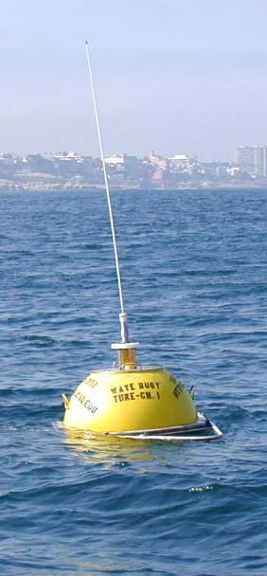
The Coastal Wave Network Template
Regional waves are monitored by a pair of Outer & Inner Shelf Buoys.
outer
inner
Shelf
Break
SHELF CROSS-SECTION
Notes:
The bar pilots were awarded a Connect Oregon III grant for a second outer wave buoy and a spare.

Slide 22
The Coastal Wave Network Template
Outer/Inner wave buoys are placed at wave model boundaries for assimilation and validation.
Global
Model
Shelf
Model
Local
Model
Shelf Model
Shelf
Break
Local
Harbor
Model
CROSS SECTION
PLAN VIEW

Slide 23
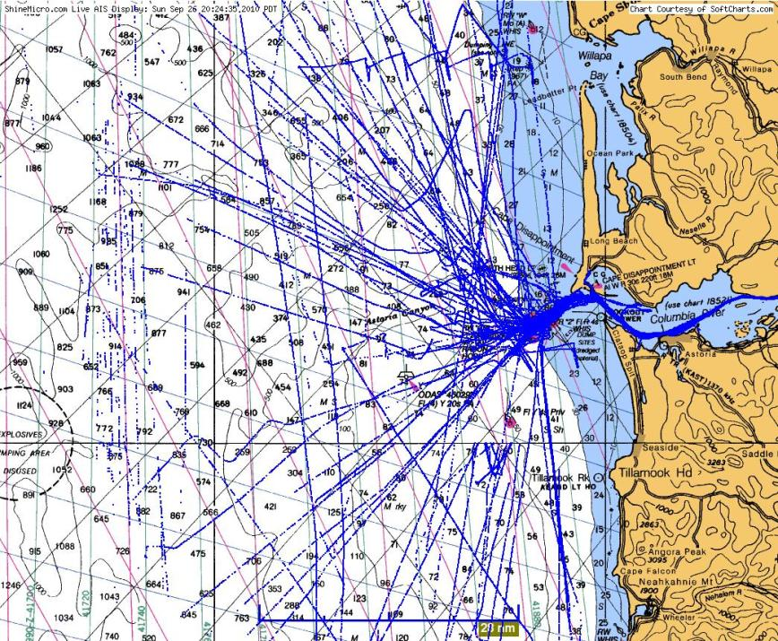
Proposed Outer Buoy
200 Fathoms
CDIP Inner Buoy
46029
Notes:
CDIP proposed the outer buoy location before seeing the imposed vessel tracks.

Slide 24
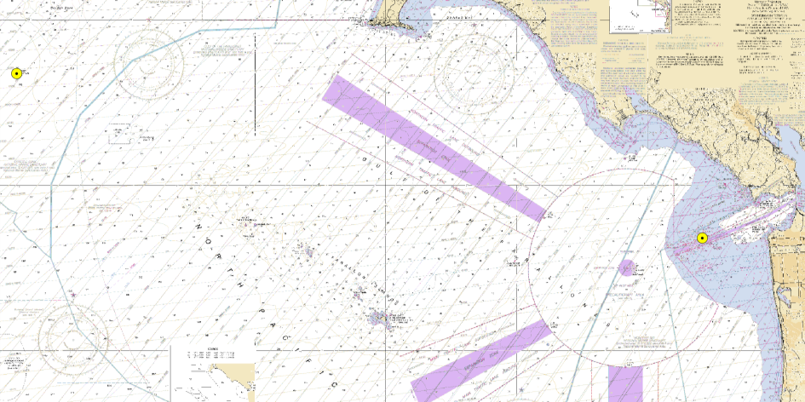
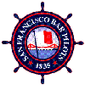





SAN FRANCISCO BAR BUOY
Buoy-driven wave model predictions
CDIP Point Reyes Buoy
Long Period Swell
CDIP Bar Buoy
Short Period Seas
Swell + Sea
Prediction
NOAA 46026
Notes:
24

Slide 25
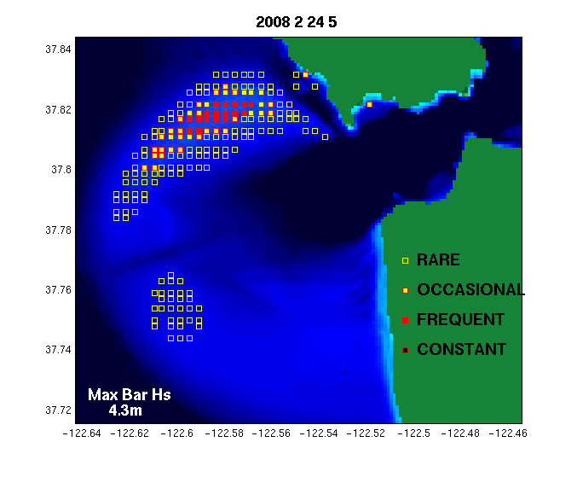
Breaking Waves on the San Francisco Bar

Slide 26
Marine Incidents
near
SF Bar
Incidents in the Vicinity of SF Bar
Notes:
80% decrease of incidents in 6 years

Slide 27

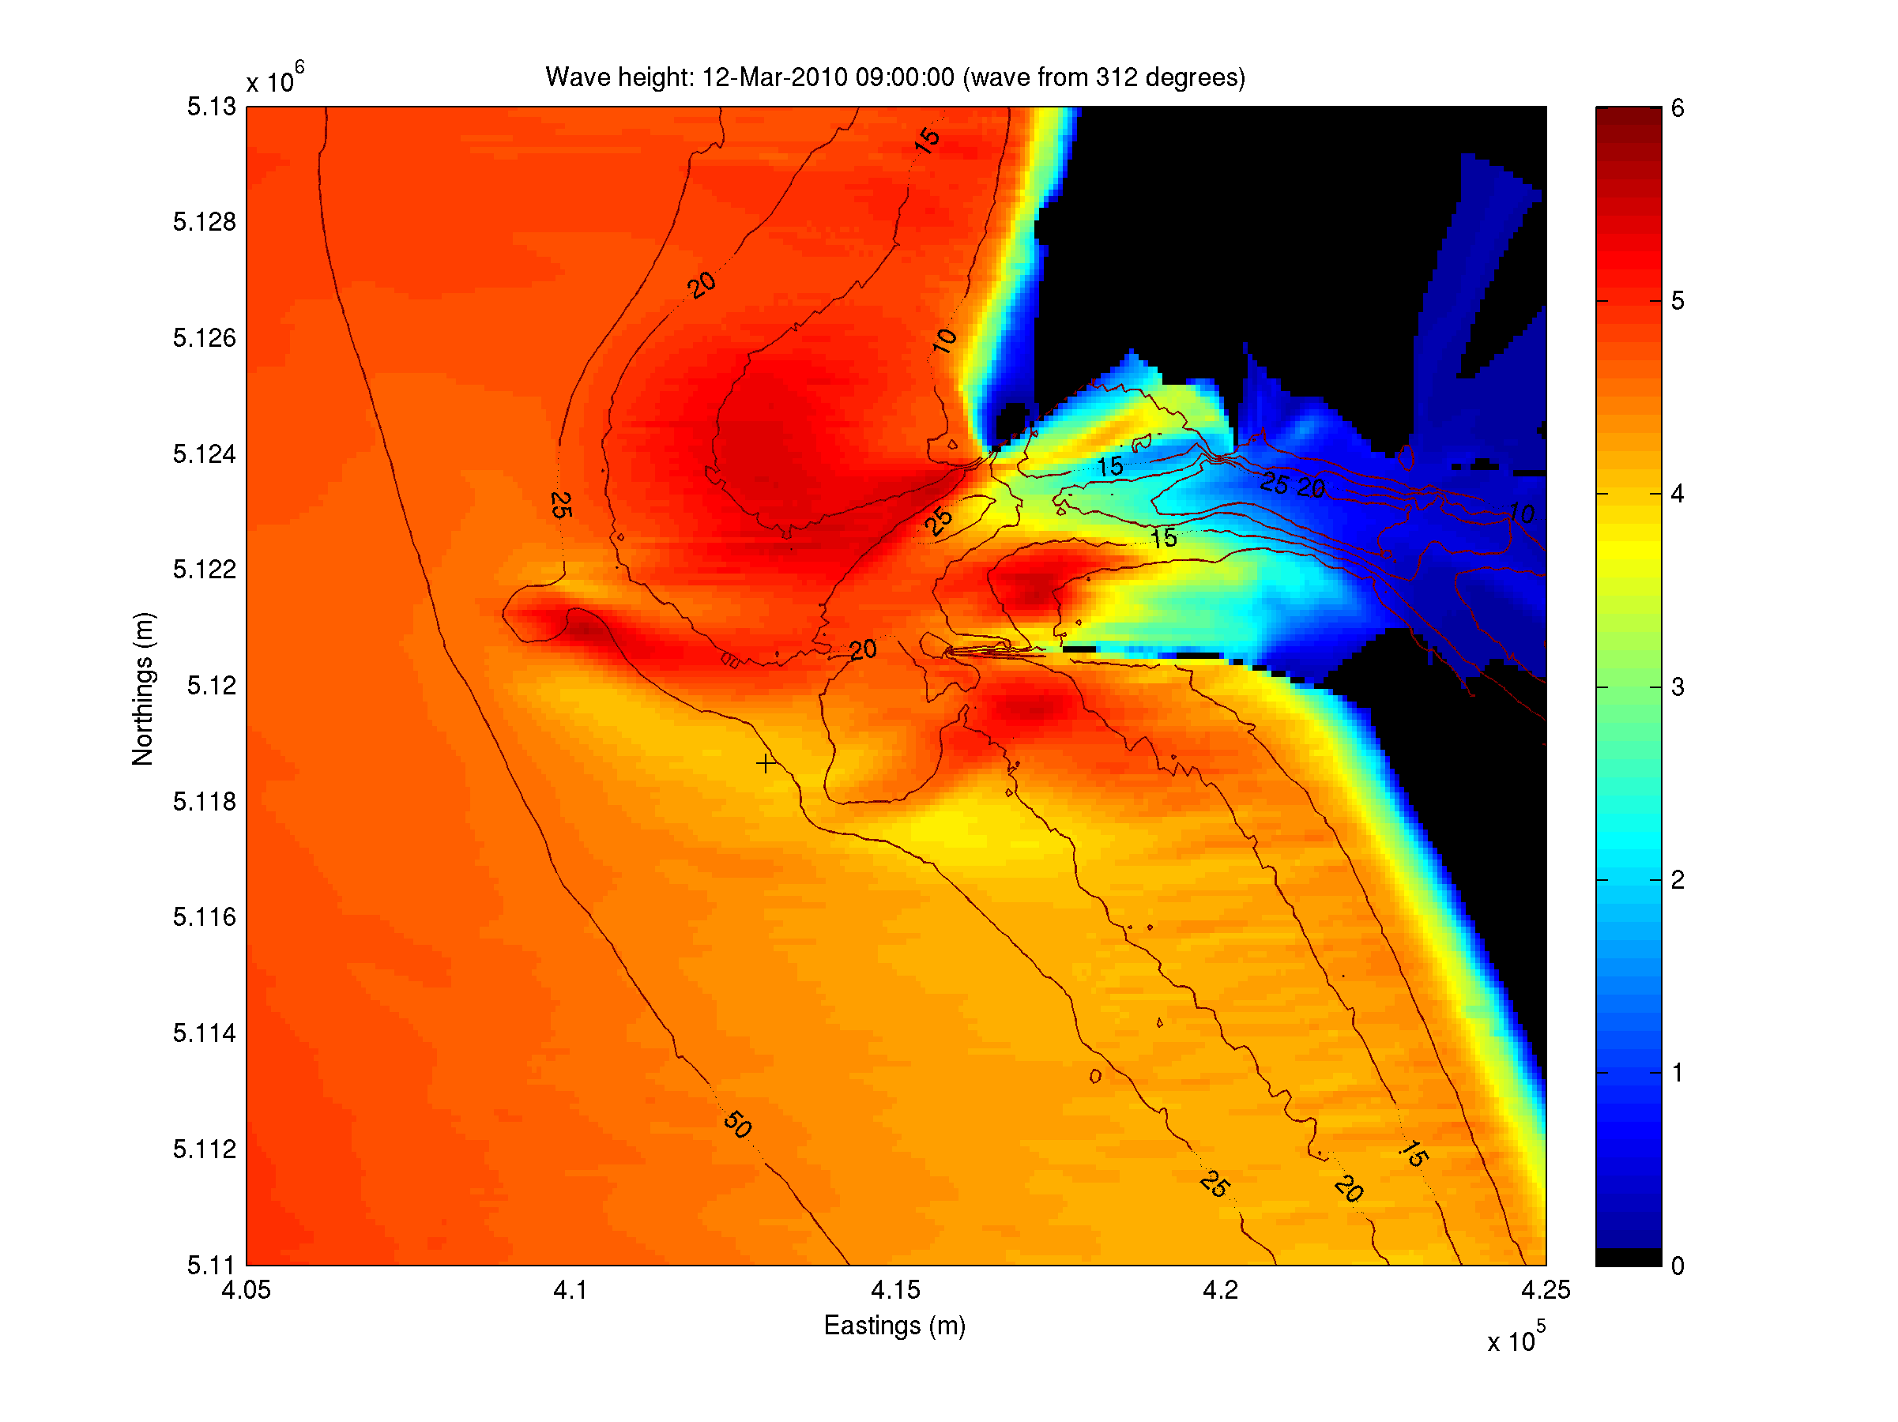
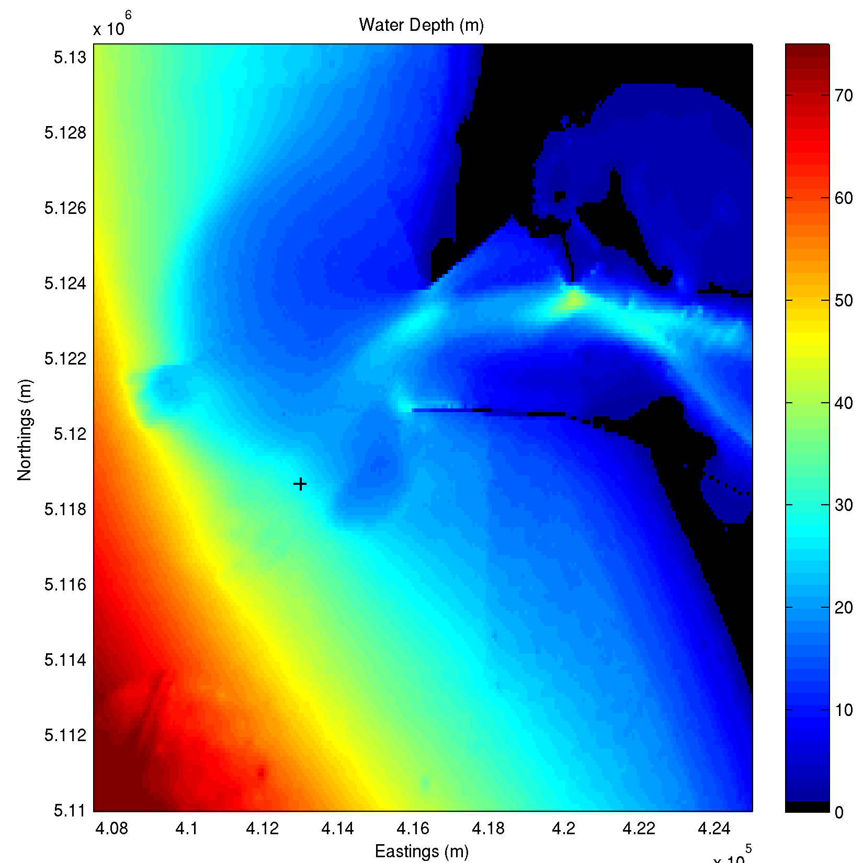
Wave Models
Mean wave direction
Wave height
Notes:
No current input

Slide 28

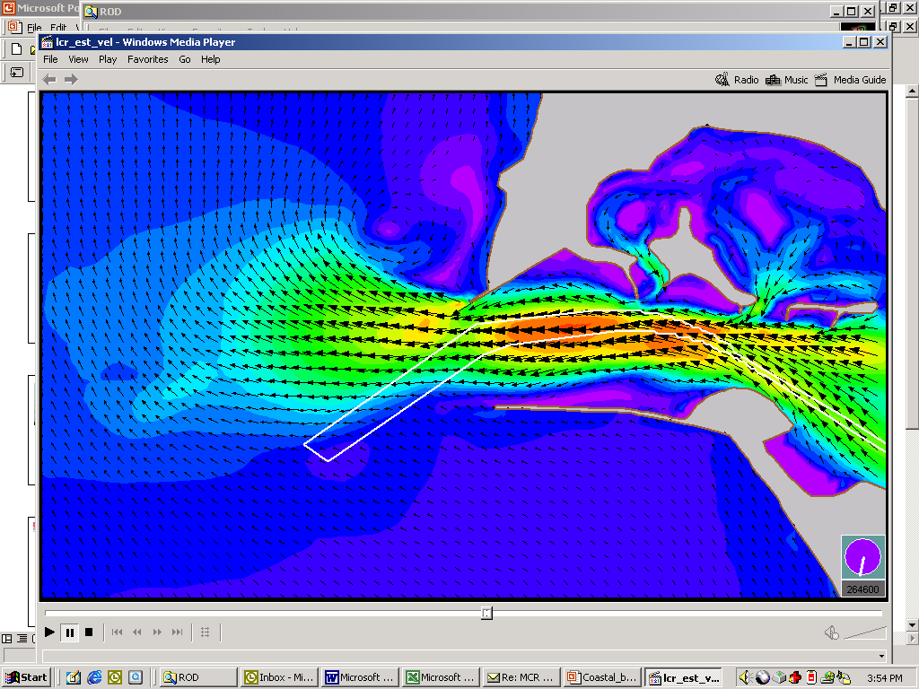
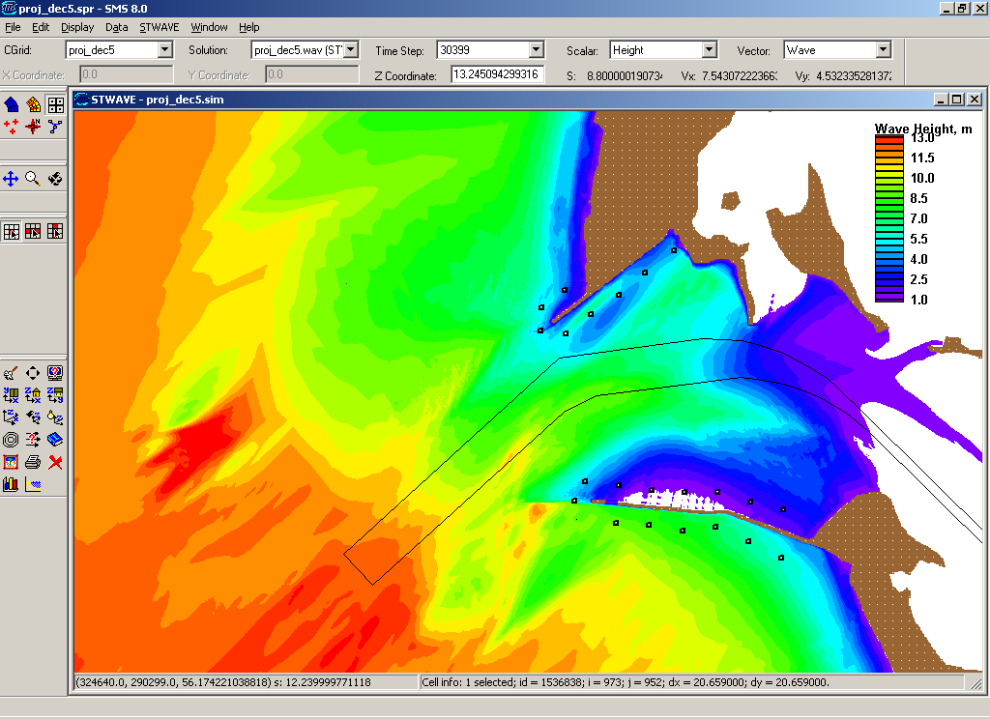
MODEL Generated Wave Field at MCR Inlet
Ebb Current Wave Height
Offshore wave conditions for Winter Storm: Ht= 13.5 m, Tp=16.7 sec, Dir =222 deg, Wind=20 m/s @ 182 deg
180
225 deg
WA
270 deg
315
Peacock Spit
Channel
MCR Navigation
Clatsop Spit
OR
Notes:
The NWS Portland is working on a model as well, but no picture available.

Slide 29


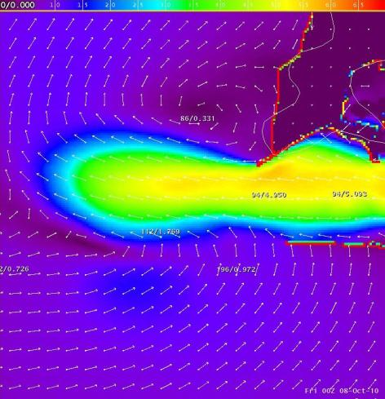
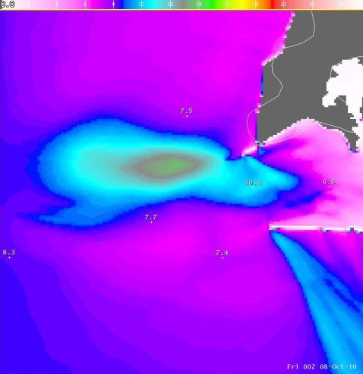
Ebb Current Wave Height

Slide 30
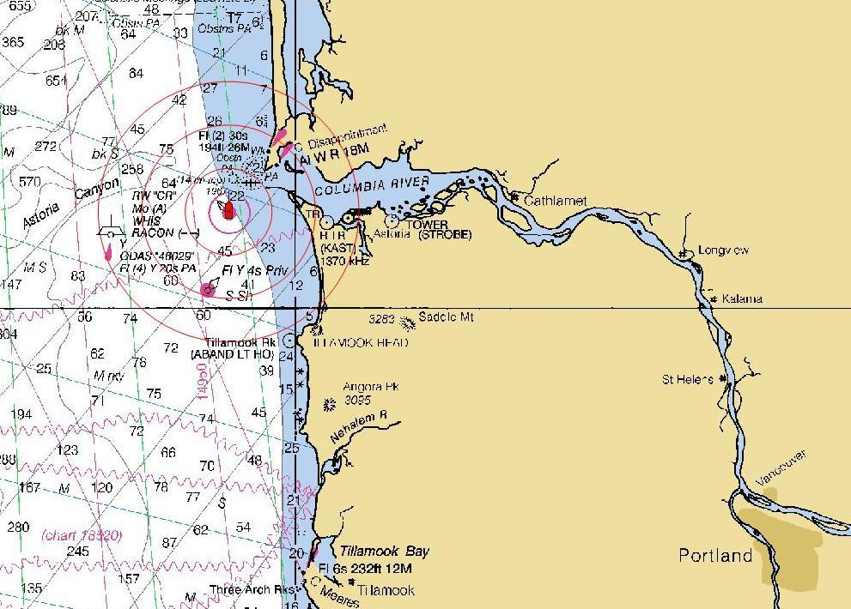
Another unique aspect of the Columbia River is the 100 mile, 600 ft wide improved channel
Notes:
Channel deepening to 43 ft is near completion

Slide 31
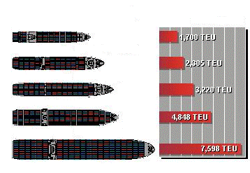
Container Ship Evolution
Container capacity
1st Generation (Pre 1960 -1970)
2nd Generation (1970 – 1980)
3rd Generation (1985)
4th Generation (1986 – 2000)
5th Generation (2000 - ?)
Notes:
Ships are getting larger

Slide 32
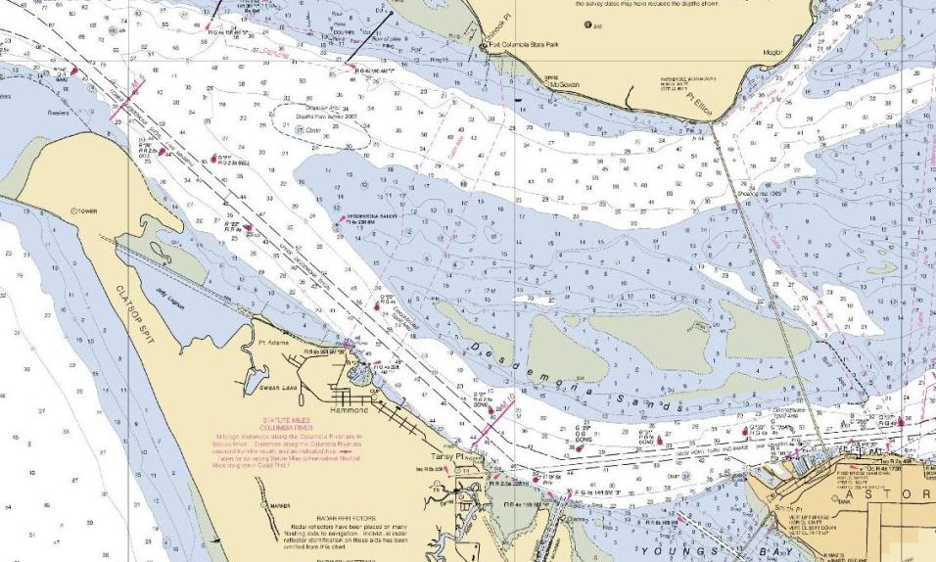
43 ft Improved Channel
Notes:
600 ft wide channel
Deepened to 43 ft this year

Slide 33

40 ft Contour
Notes:
Blue contour is 20 ft

Slide 34
30 ft Natural Channel
Notes:
Blue contour is 30 ft
Natural channel is more than twice the width of the improved channel.

Slide 35
20 ft Natural Channel
Notes:
Blue contour is 20 ft

Slide 36
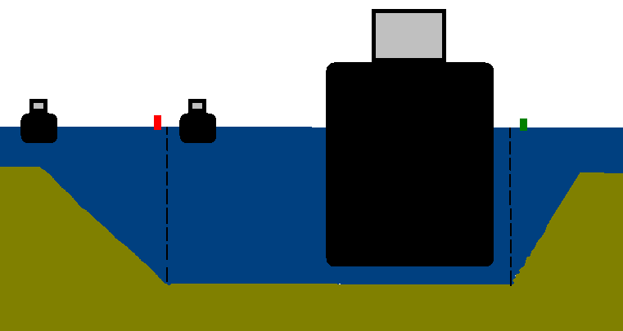
An increasing trend of smaller or light draft vessels navigating only within the improved channel causes more closer quarter situations than necessary.
Vessel B
Vessel A
Notes:
Contributing factors for smaller vessels or ships in ballast with light drafts to navigate within the improved channel are:
SMS required voyage plans
Ease of plotting one track line for inbound and outbound passages
Broken lines of the improved channel boarders are much darker than the contour lines
Electronic chart systems make it easier for operators and home offices to follow the vessels track
Tendency to find fault with an operator who has an incident outside the improved channel.

Slide 37
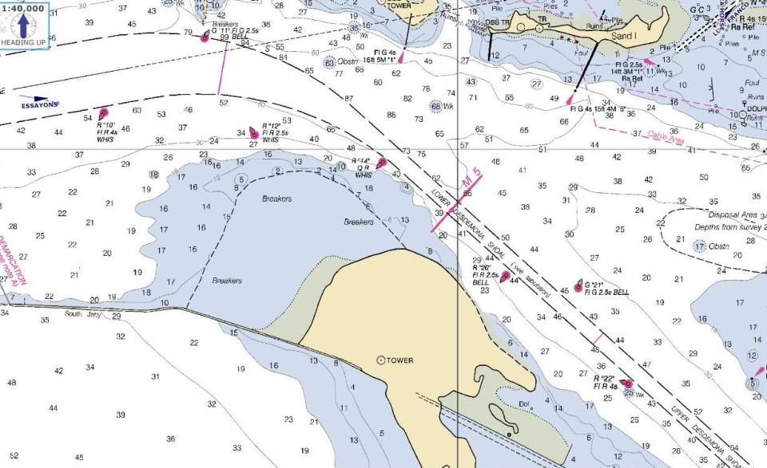
Flood current
Vessel B
Vessel A
Notes:
Vessel A is outbound and believes he is “nearly out of the channel”
Vessel B made room for a safer meeting situation.

Slide 38
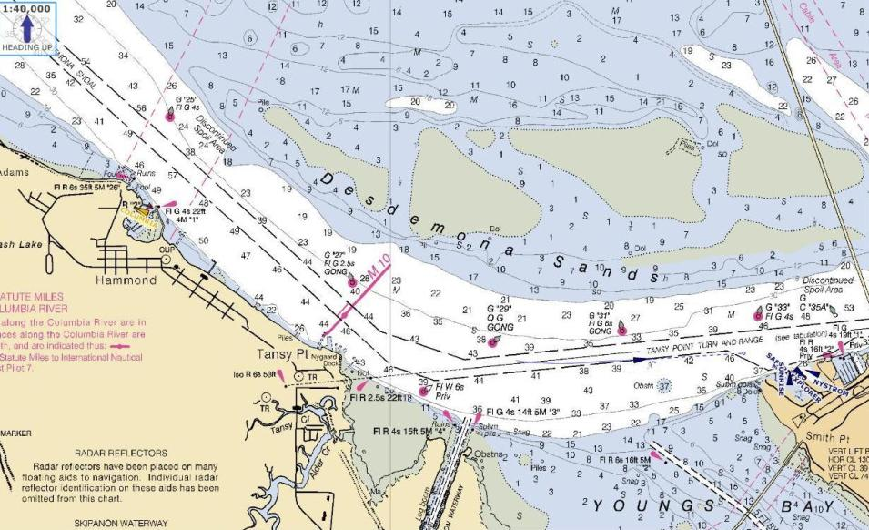
Vessel B
Vessel A
Notes:
Vessel A is outbound and believes he is “nearly out of the channel”
Vessel B made room for a safer meeting situation.

Slide 39
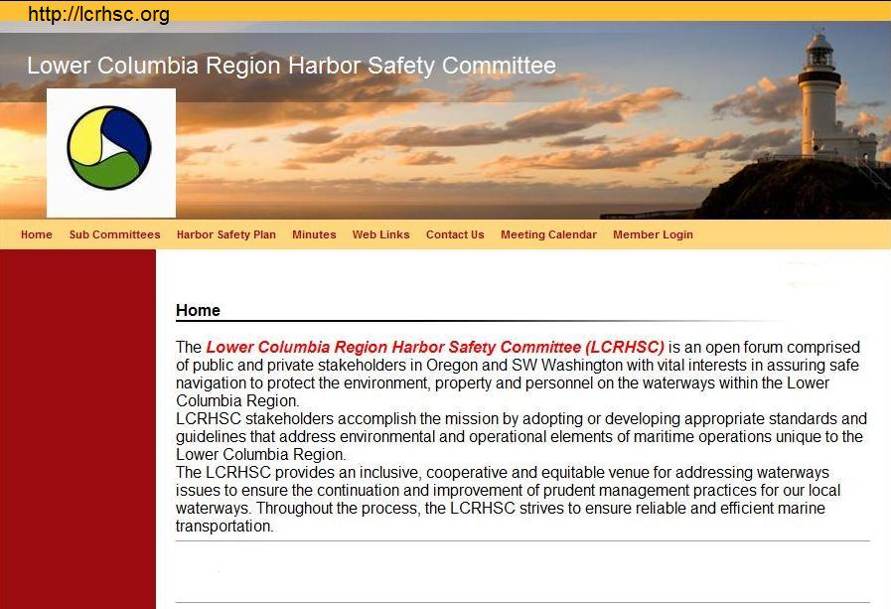

Slide 40
Summary
There is a wide range of outstanding forecast tools.
The Bar Pilots appreciate the continued support of the NWS, Portland.
NDBC buoy reliability is imperative.
Support efforts for breaking wave bar forecasts.
NOAA and USCG are encouraged to explore solutions to the increasing trend of dotted line navigation.
  i.e. note on charts, paragraph in the Coast Pilot, modify charted graphics of the improved channel and contours, etc.

Slide 41
“Caution and common sense
are continuing requirements
for safe navigation”
U.S. Coast Pilot, Chapter 1

