Slide 1
The Columbia River Pilots
How we use NOAA data
Notes:
Ship, Pilot insignia

Slide 2
The Columbia River Pilots
An association of 42 Professional Mariners licensed by the State and Federal governments to provide navigational and ship-handling expertise to Commercial Vessels calling in the Columbia River System
38 unlimited licensed pilots
6 pilots in various stages of training
1 Apprentice
It is our responsibility to Protect the Public, Environment and Economy by insuring ships calling in the Columbia River System are navigated in a safe and efficient manner

Slide 3
Our Route
The Columbia River Pilotage Ground
Astoria to Portland – 85 miles
Up the Columbia to Hanford
Up the Snake to Lewiston – 425 miles
Channel width – 600 feet
Channel depth – 40 feet
Notes:
The shipping channel was first authorized in 1878 with a 20-foot minimum depth. The channel was dug down to 25 feet in 1899 and to 30 feet -- and 300 feet wide -- in 1912. In 1962, Congress agreed to the most massive change to the shipping channel: a plan to deepen it to 40 feet and double its width to 600 feet. The project was finished in 1976.
Pilot ground extends from below Astoria to the head of navigation On the Columbia and Willamette Rivers (Lewiston Idaho).
46 unlimited state licensed pilots, all hold USCG Unlimited masters license with unlimited pilotage endorsement.
Average over 17 years experience on the river prior to entry in the pilots.
New pilots selected by OBMP as needed.
2 plus year training program.
Continuing Professional development includes manned model, simulator, classroom and practical experience.

Slide 4
MV Hyundai Commodore
902’ LOA
122’ Beam
44.6 Ft Max Draft
189.9 Ft Max Air Draft
4577 TEU’s (Twenty Foot Equivalent Units)
This ship is 50% longer than the channel is wide
Notes:
Built in Korea in 1992 67,080 HP - 25.5 knots speed
Displaces 83,155 tons (the weight of water displaced by a ship floating in a given condition; a measure of ship's size )
61152 DWT (total weight of cargo, stores, fuel and water needed to submerge a ship from her light draught to her maximum permitted draught; )
Canal Lock Chambers are 110 Wide X 1000 long (106 X 965 maximum Ship Dimensions)

Slide 5
If loaded on rail cars they would equal….
…up to 21.7 Miles of Unit Trains
Notes:
Well over 10 miles of train on a double stack - 8 plus unit trains, 21 miles on a single stack (15 unit trains)
An average unit train of containers is about 1.4 miles long (7500 feet). Depending on the mix of 20’ vs 40’ containers you can estimate about 300 TEU’s per unit train. 4651/300 = this ship can hold about 15.5 unit trains of containers or 21.7 miles of train length!

Slide 6
Wells Fargo Tower, 546', 40 stories
US Bancorp Tower, 536', 40 stories
KOIN Tower, 509', 35 stories
Notes:
Ship next to Wells Fargo Tower

Slide 7
We are primarily a bulk port
Largest exporter of wheat in the USA
Third largest gateway for grain exports in the world

Slide 8
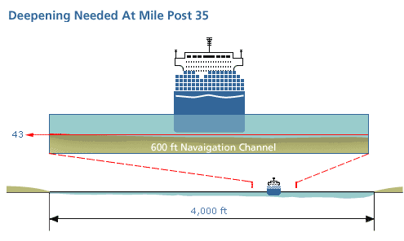
Which means we have a lot of deep draft ships
We work with a minimum under keel clearance
of just 2 feet
!

Slide 9
The Need for COE Surveys & Recent Data

Slide 10
Working with the Volpe Center in Boston, Mass we developed a Vessel Traffic Information System (VTIS) using custom made software
called TV32
All ships and commercial vessels are required to carry an Automatic Identification System (AIS) which is the equivalent of the “Black Box” on airplanes
Using the AIS we are able track all vessels on the river who are in compliance with the law
We can also monitor the position of our own vessel in the channel

Slide 11
We have two relay towers that allow us to see the entire length of our route and monitor traffic using the waterway

Slide 12
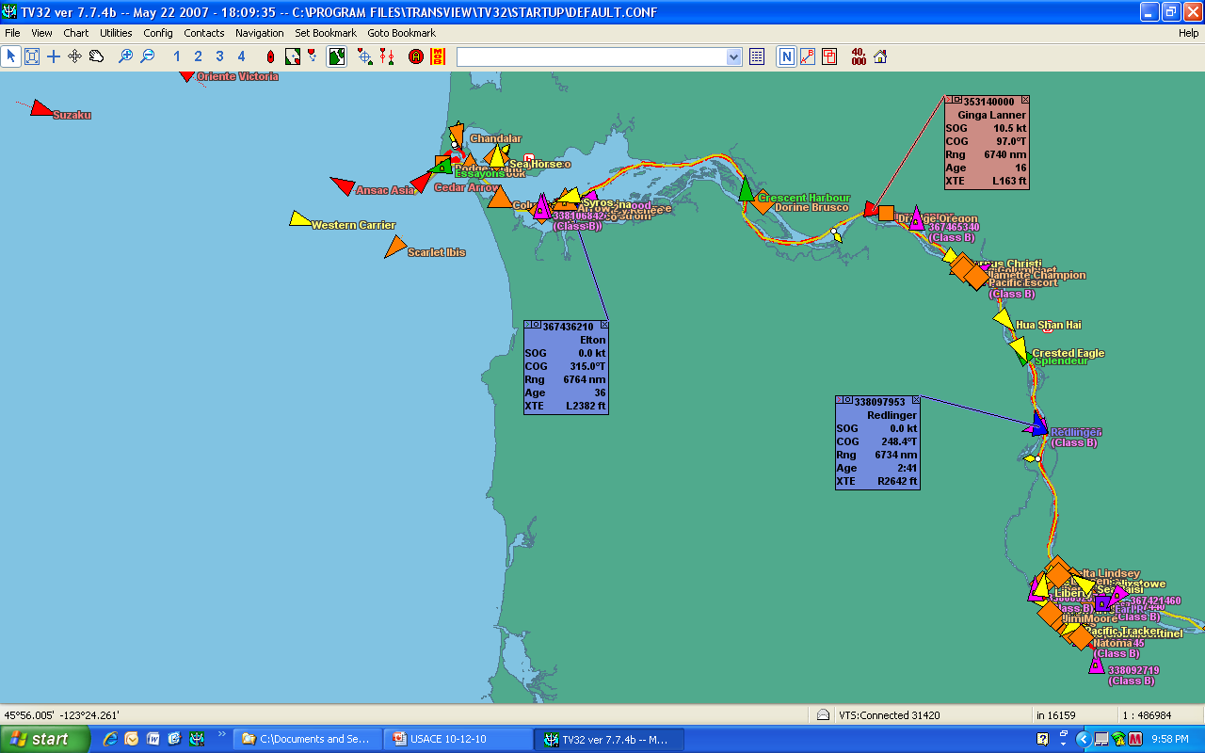
We can identify each vessel by name and pull up a wide variety of information about each one

Slide 13
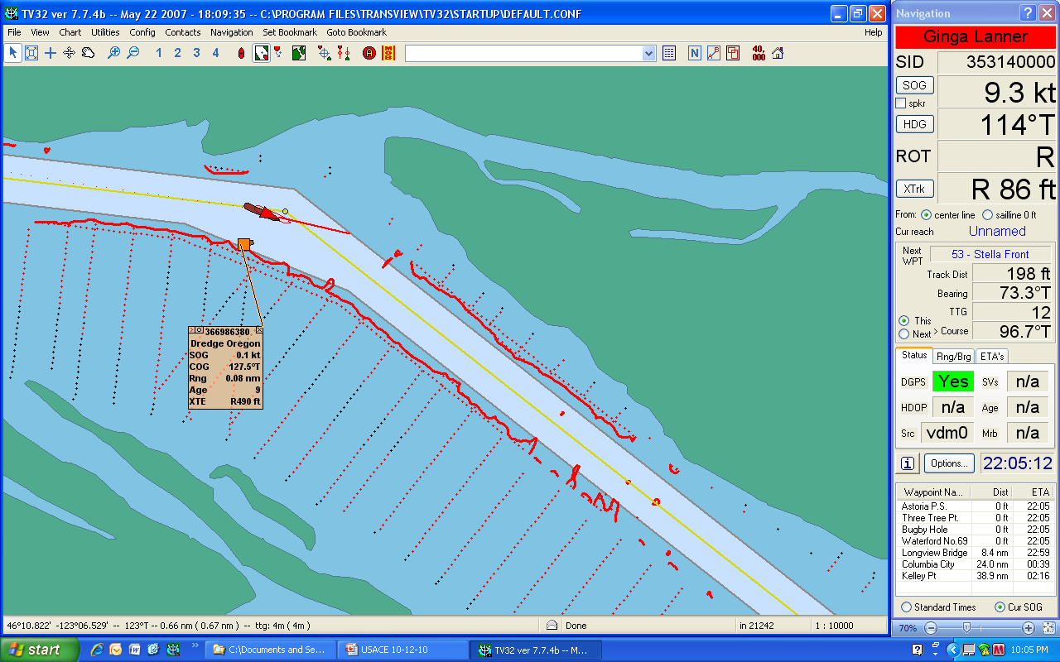
The most unique feature of TV32 is the ability to download and display the most recent COE surveys. This is vital information to us!

Slide 14
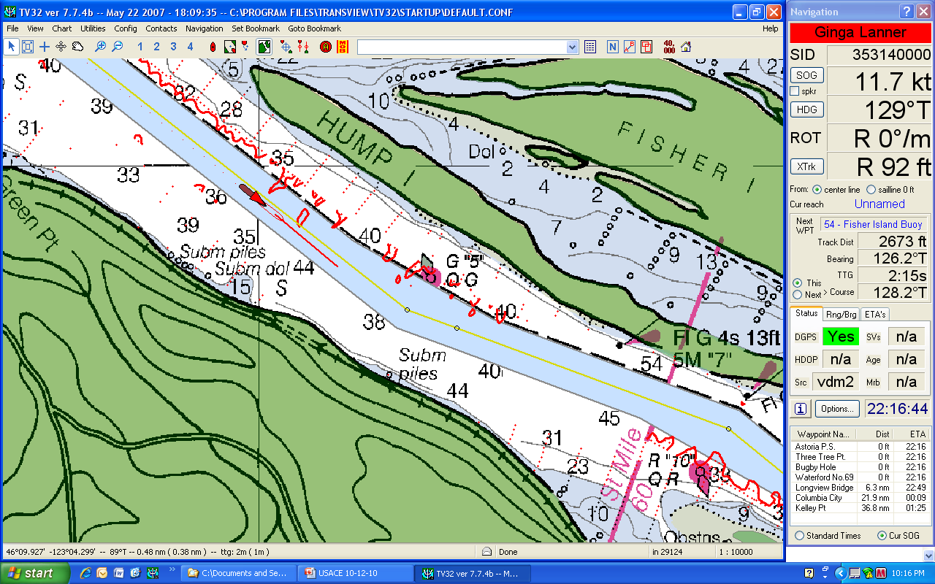
We can also overlay a NOAA chart and retain the COE surveys.

Slide 15
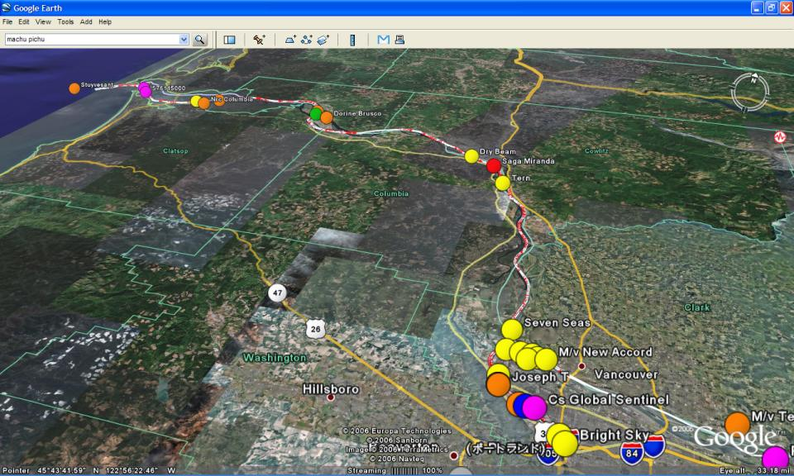
Using KML files, we can apply our signals to Google Earth and again, retain the COE surveys

Slide 16
NOAA offers a wide variety of products and services that provide us with equally important information
These products compliment the USACOE surveys and make it possible for us to maximize the available channel depths to better serve local commerce and the regional economy
Notes:
Obviously, NOAA provides users with a multitude of products and services. In the time I have I will focus on a few that have become very important to COLRIP

Slide 17
NOAA Products and Services we use most frequently include:
Charts
Tide and Current Predictions
National Weather Service Forecasts
Loadmax – Predicted River Levels
Extreme Low Water Predictions
All indispensible tools for planning.

Slide 18
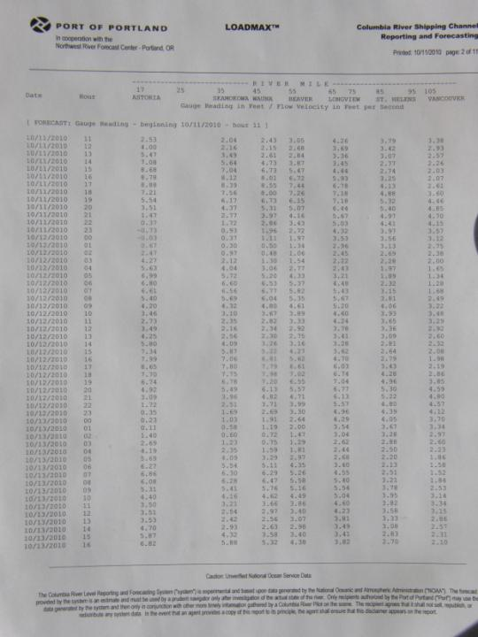
We can then draw a line from Portland to Astoria and get a reasonable idea of river levels we can expect along the route
Assume a transit time from Portland to Astoria of 7 hours

Slide 19
NOAA also provides great services for executing & monitoring the plan:
PORTS
Mobile Tides & Currents
These tools have generated quite a bit of excitement among pilots
Here are some innovative ways we have found to use a few of them

Slide 20
Binary Messaging
Ms. Irene Gonin, of the Coast Guard R&D Dept. Dr. Gregory Johnson, of Alion Sciences
Exploring possibilities of using AIS signals with the PORTS to carry environmental messages directly to shipboard users, such as pilots
Sensors placed at multiple locations along the river transmit local conditions
Testing in Tampa, FL and on the Columbia River

Slide 21
Tampa Bay Test
Slide courtesy Capt. Jorge Viso & Dr. Lee Alexander

Slide 22
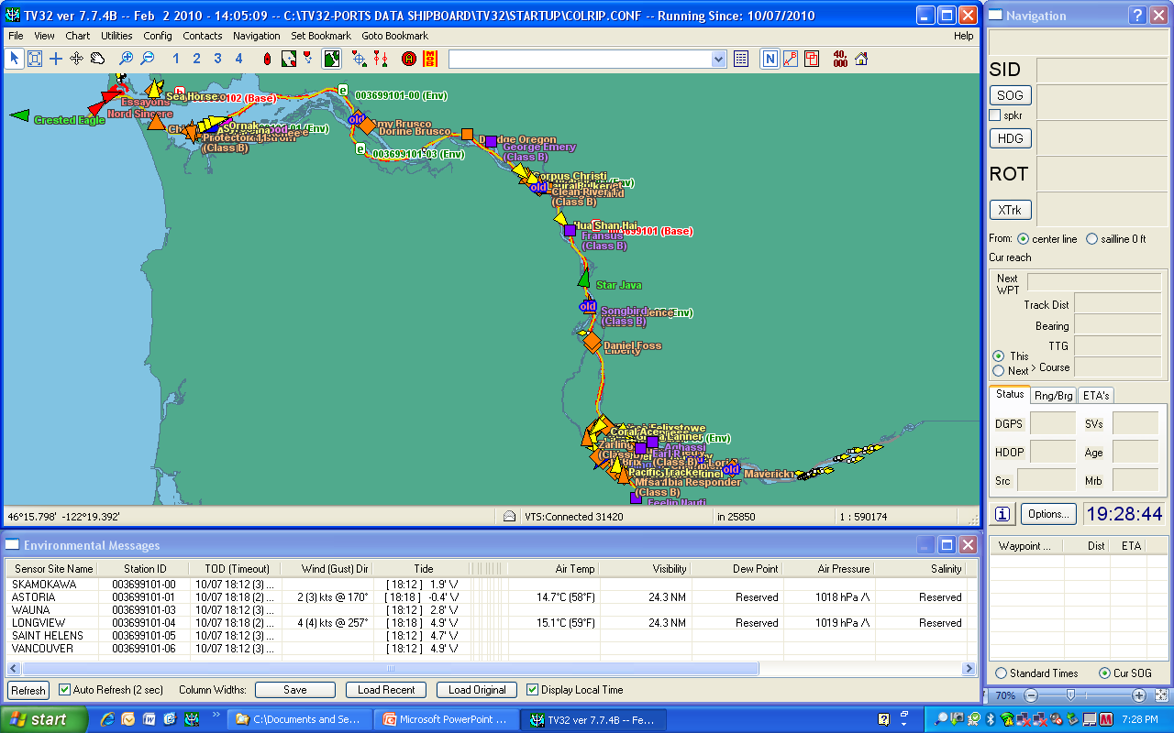
The Columbia River Display

Slide 23
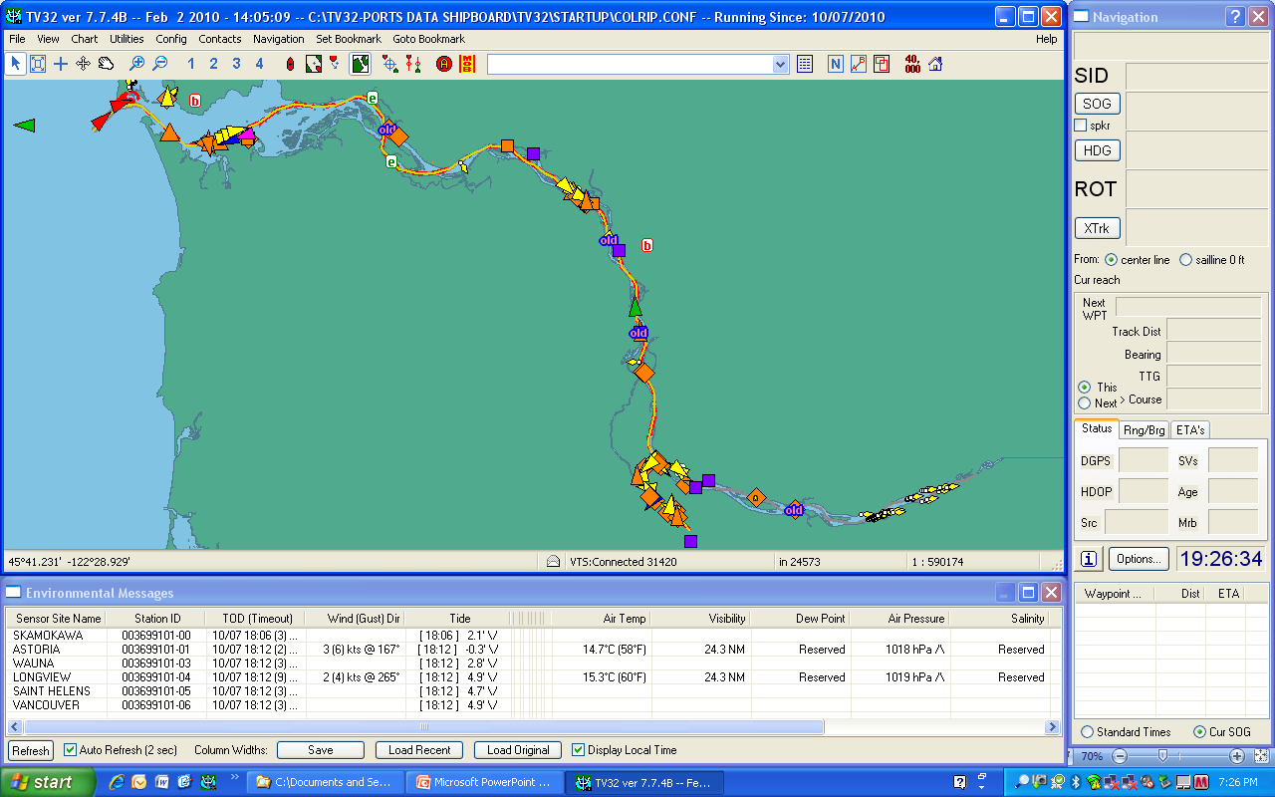
Because the binary messages are carried by the AIS signal we can access the data generated by each sensor at any location along the route and display it graphically on our laptops.

Slide 24
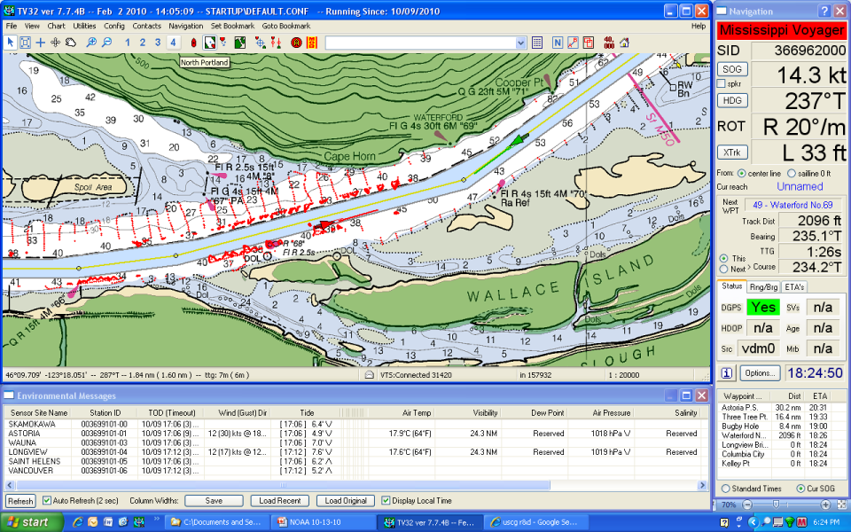
This gives us real time info at our current locations.

Slide 25
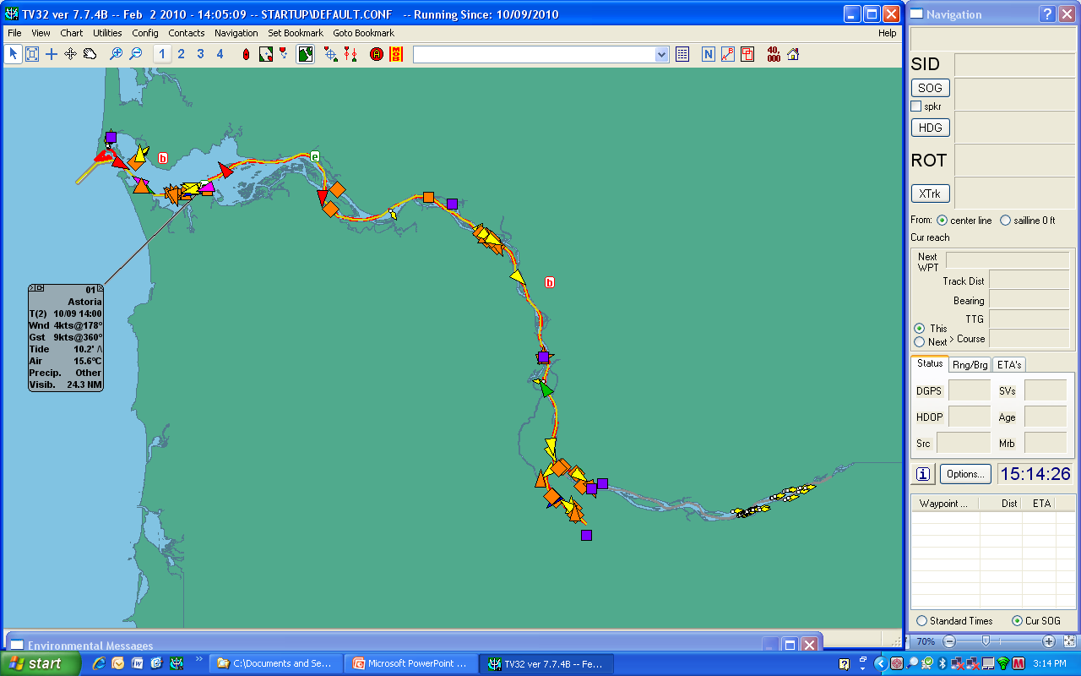
A variety of display options allow access to individual stations…

Slide 26
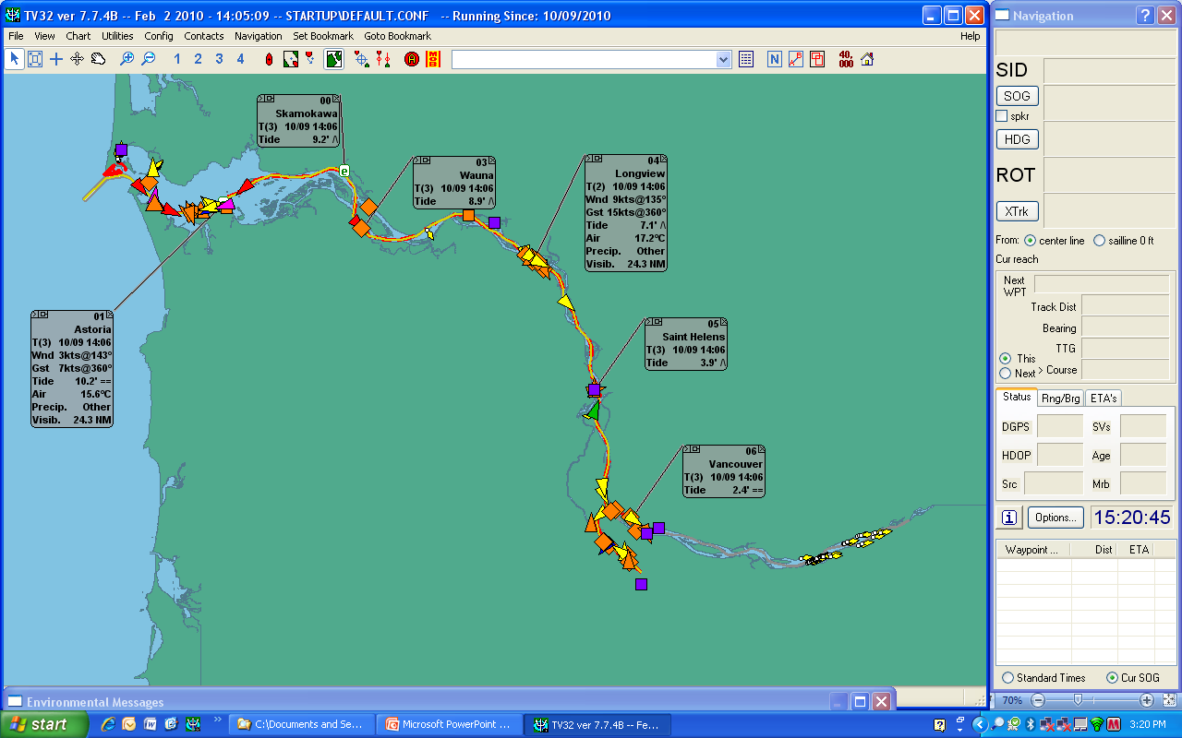
…or each station selectively

Slide 27
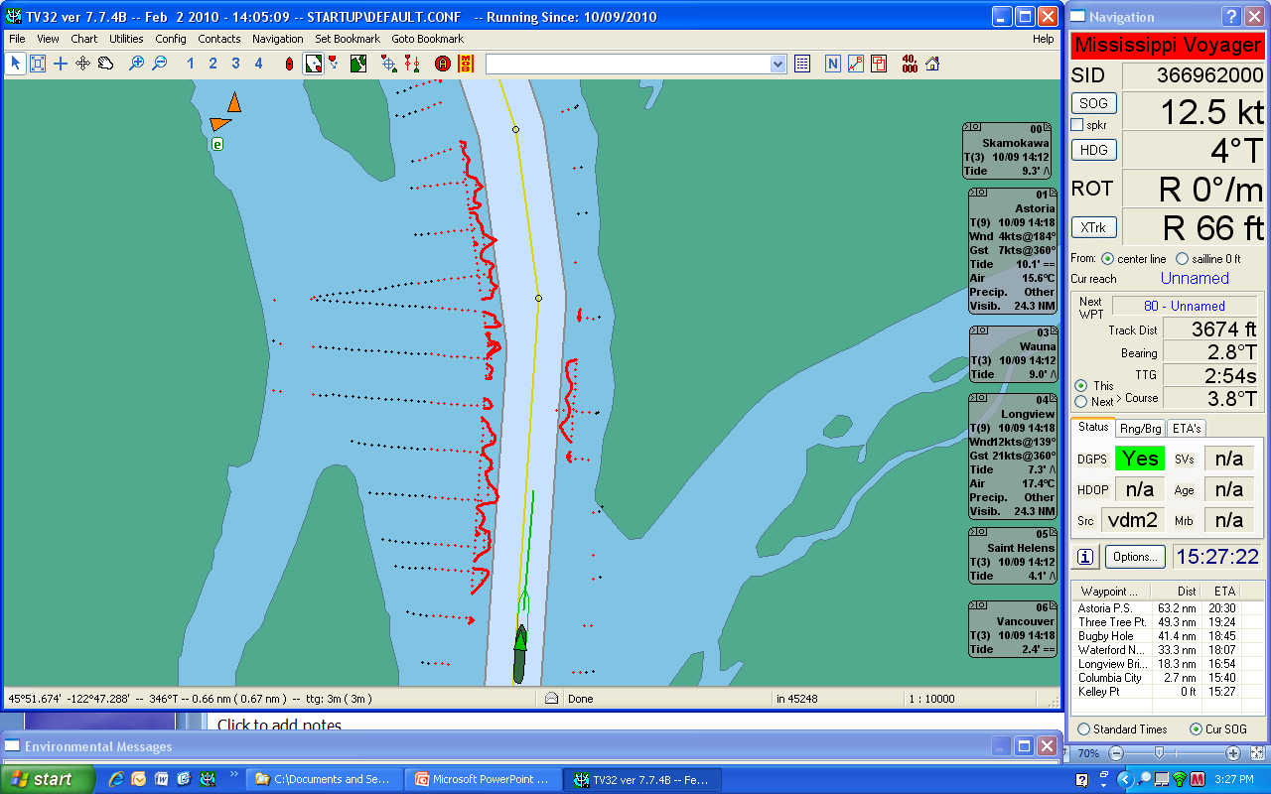
This arrangement allows the user to have a larger screen area displayed

Slide 28
Courtesy Dr. Lee Alexander
Using this same technology other info such as air gaps on bridges can be delivered directly to working pilots

Slide 29
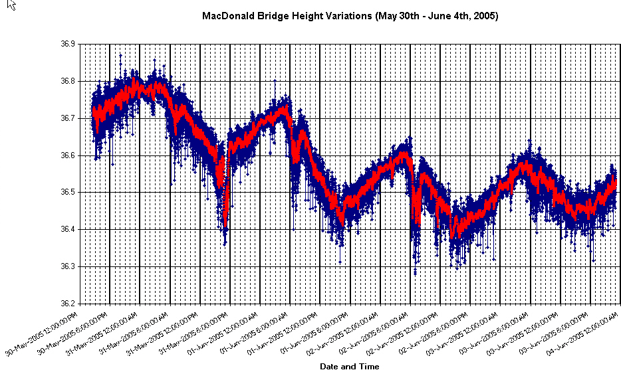
Another representation of bridge height variations
Courtesy Dr. Lee Alexander

Slide 30
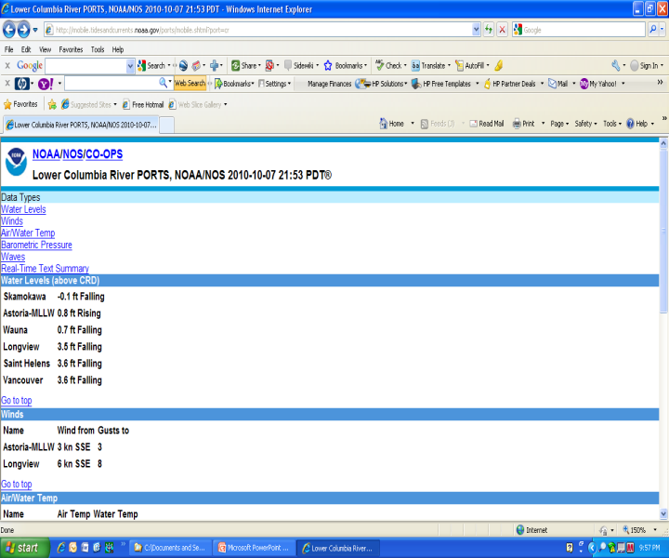
Mobile Tides and Currents
Currently the most popular new service among river pilots!
Cell phone access

Slide 31
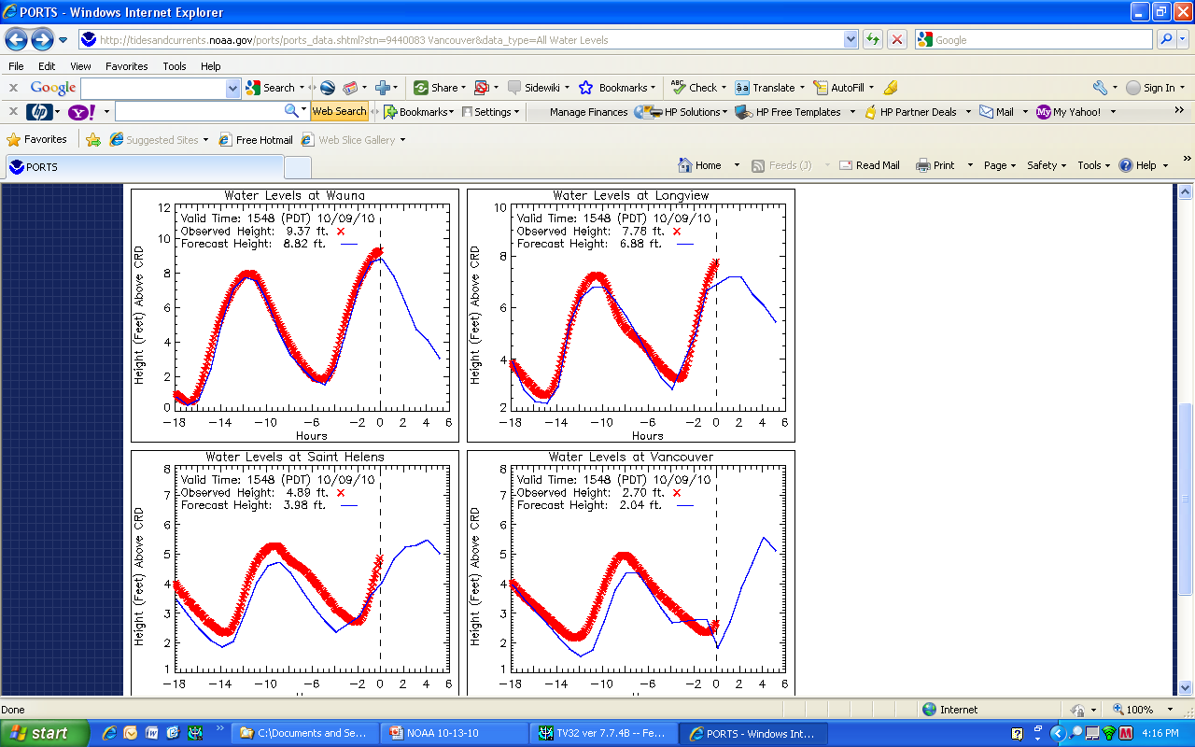
PORTS
Excellent tool to compare and validate predictions

Slide 32
The Future

Slide 33
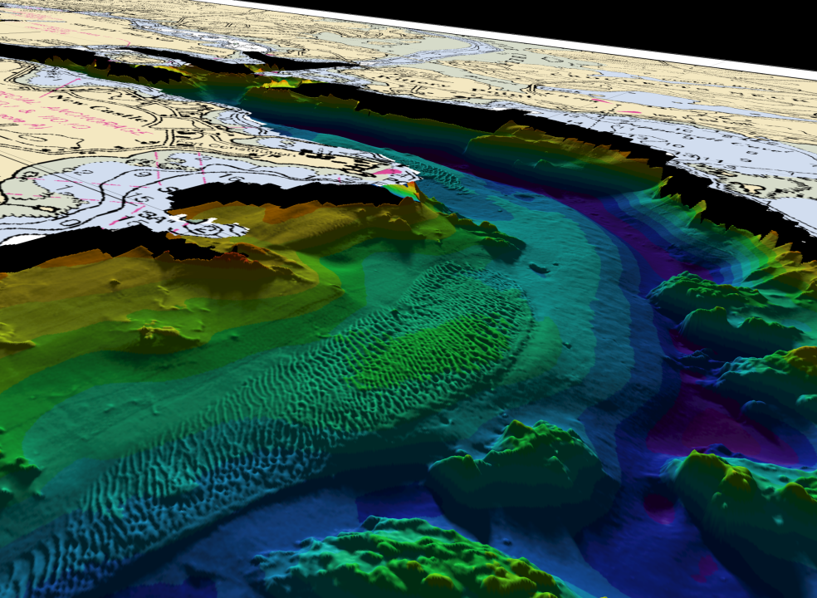
New ways to display data – more graphical formats

Slide 34
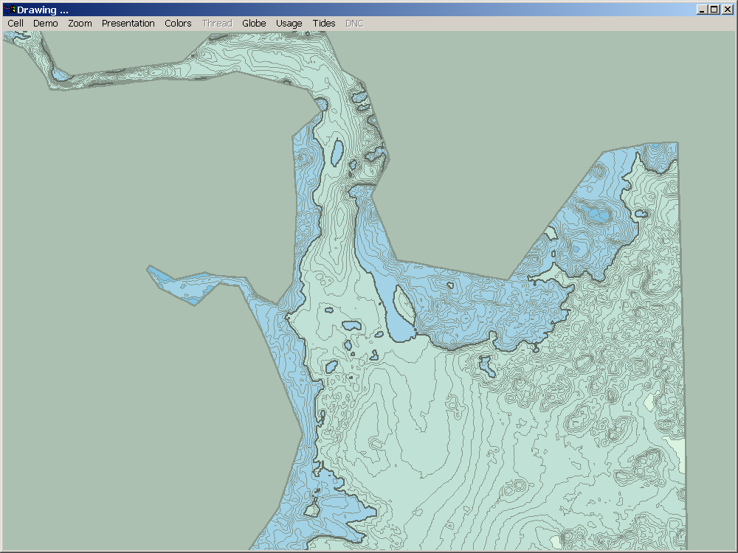
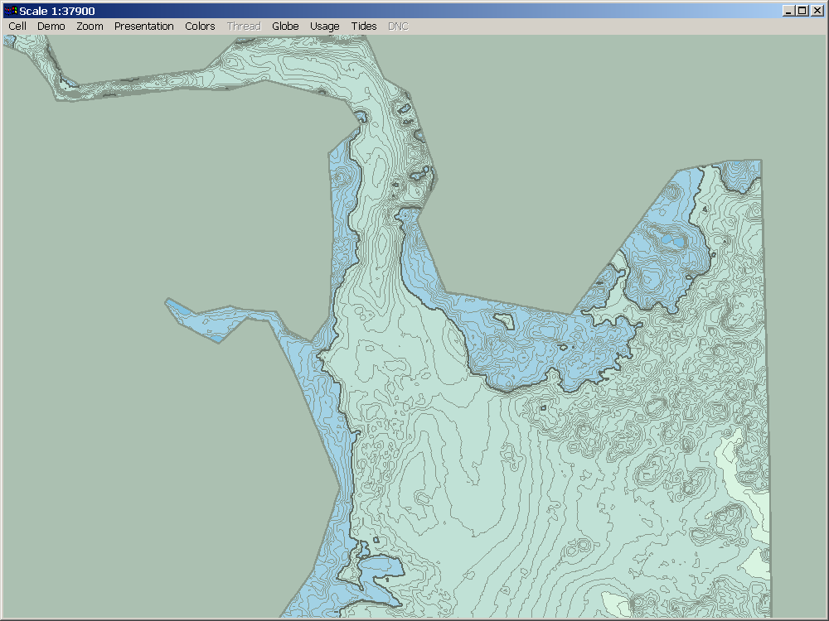
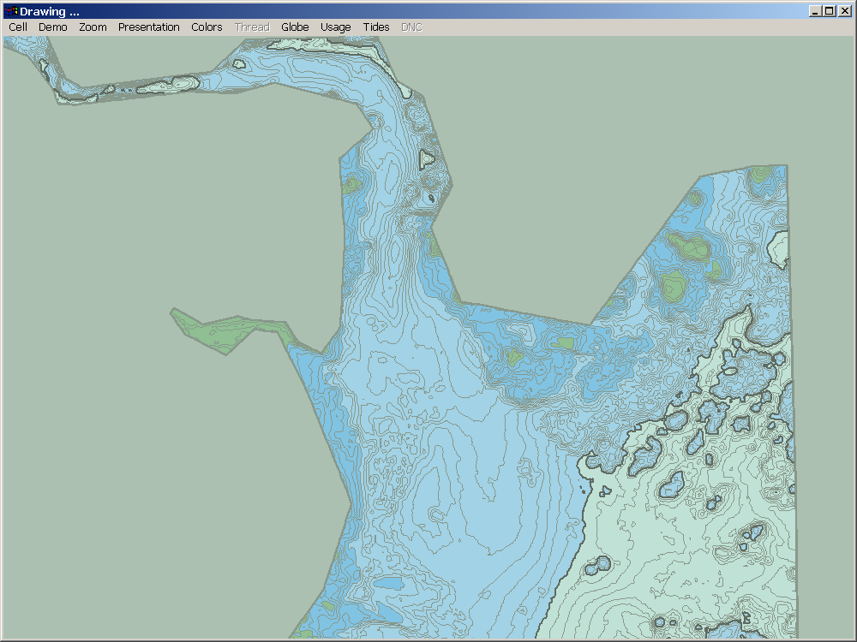
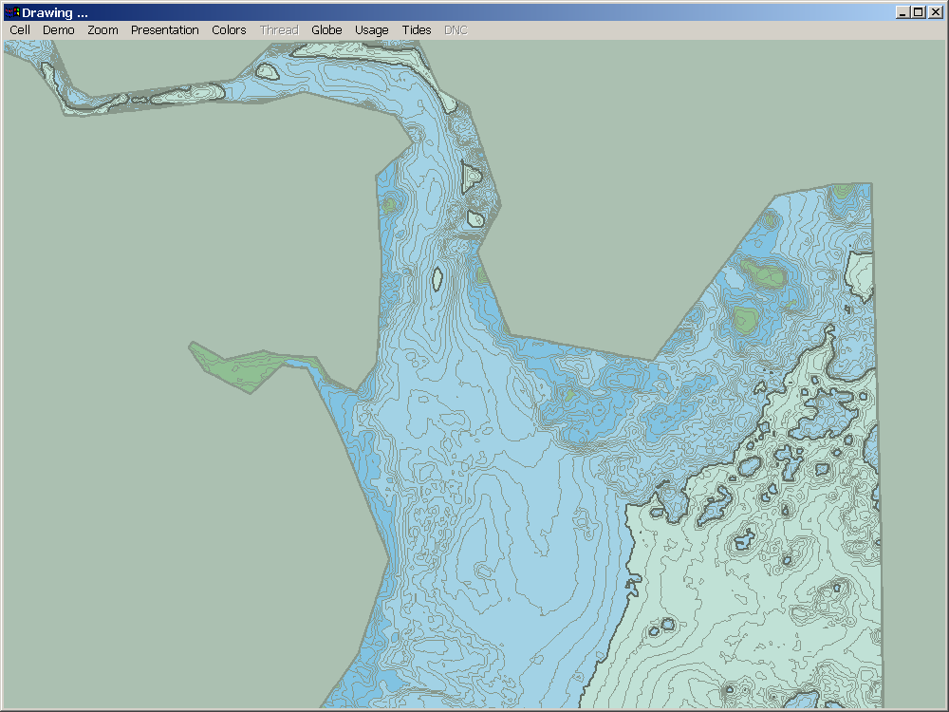
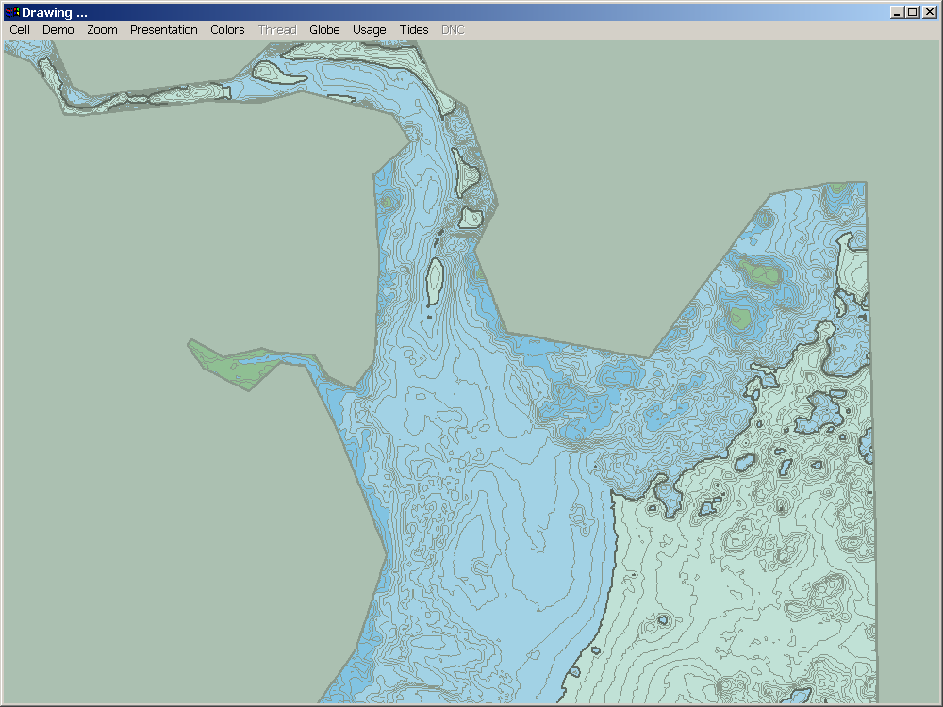
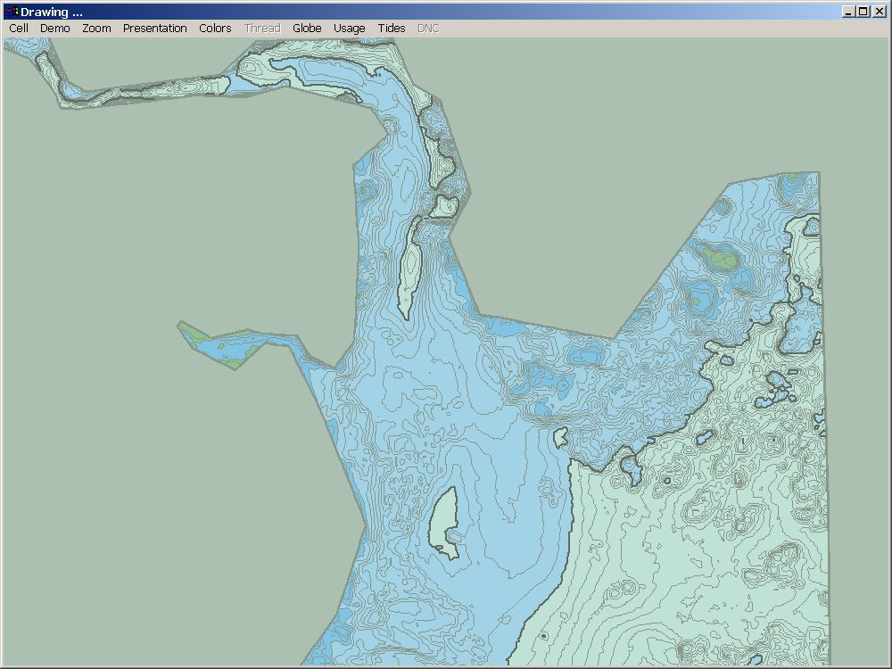
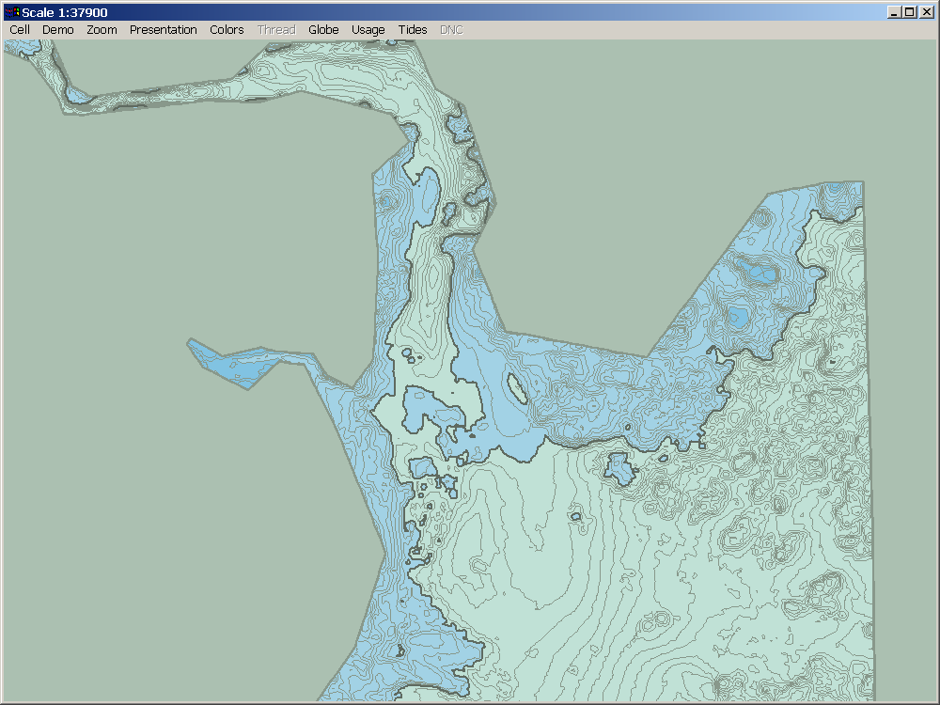
Tide Aware ENC
Courtesy Dr. Lee Alexander

Slide 35
Problems & Frustrations
Frequent outages of sensors and polling stations
Discrepancies in river level data
Past problems with different datum on the same river. (MLLW vs CRD)
Unable to get recent multibeam surveys
We would LOVE to have them!

Slide 36
Problems & Frustrations
Most disappointing of all – Coast Guard has cut funding to the R&D Center which was doing the research!
What we now use is workable, but not a finished product
Ironically, it’s a very inexpensive project with huge returns on the investment.
Seems to be due to internal politics within the CG. We are working with the PNWA and our Congressional delegation to locate funding

Slide 37
Our Goals
Safe Navigation
Efficient Movement of vessels
Marine Environmental Protection
With the tools you have developed and made available to us we have been successful. With your help, we expect to continue to improve our efforts

Slide 38
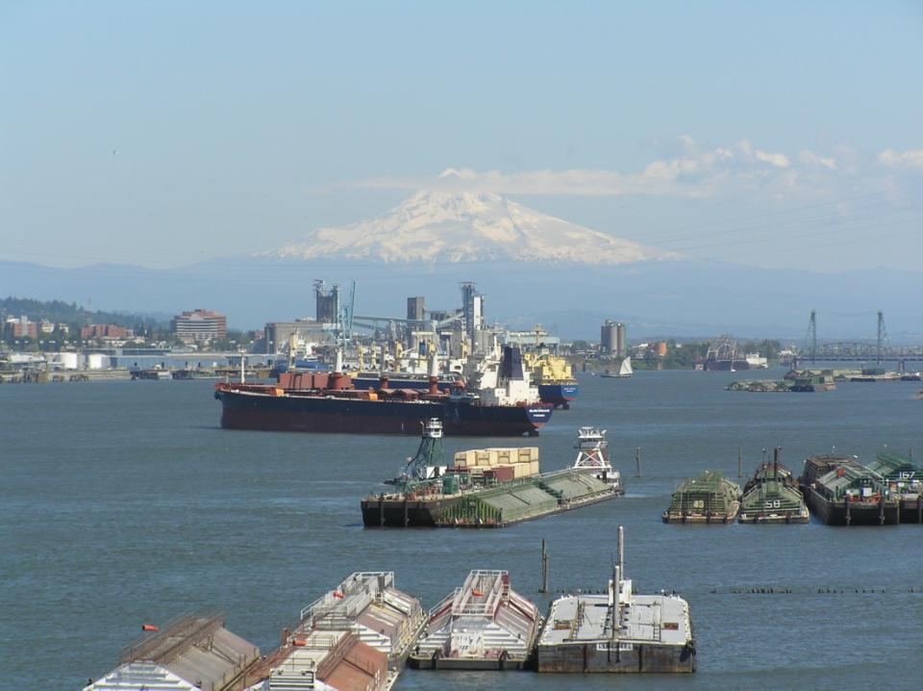
Thank you for all you do and for your kind attention!

