Slide 1
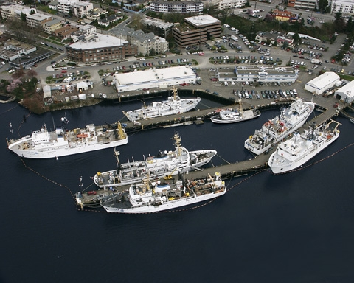
Hydrographic Services Review Panel October 12-13, 2010 Portland, OR
Captain Donald Haines, NOAA
Commanding Officer
NOAA Ship Rainier

Slide 2
Overview
Fleet Overview
Pacific Vessel Future Homeport: Newport, Oregon

Slide 3
Office of Marine and Aviation Operations
NOAA Organization

Slide 4
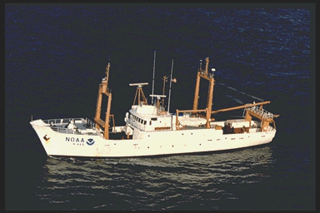
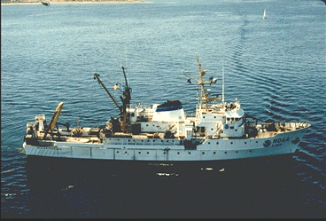
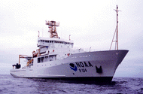
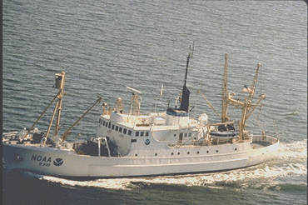
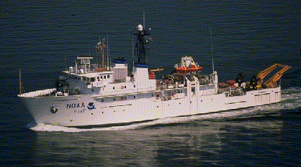
NOAA Ships and Homeports
KETCHIKAN , AK (1)
19 Ships
11 Homeports
KODIAK , AK (1)
FERDINAND R. HASSLER
DELAWARE II
FAIRWEATHER
MOC-PACIFIC
SEATTLE, WA
(4)
Woods Hole (2)
OSCAR DYSON
New Castle, NH (1)
Davisville, RI (1)
HENRY B. BIGELOW
MISSIONS
MILLER FREEMAN
RAINIER
Nautical Charting
Fisheries Research
Oceanographic Research
Coastal Monitoring
Ocean Exploration
MOC-ATLANTIC NORFOLK, VA
(1)
OKEANOS EXPLORER
BELL M. SHIMADA
McARTHUR II
SAN DIEGO
CHARLESTON (2)
THOMAS JEFFERSON
PASCAGOULA
(3)
HI’IALAKAI
GORDON GUNTER
RONALD H. BROWN
NANCY FOSTER
OSCAR ELTON SETTE
PEARL HARBOR (3)
KA’IMIMOANA
PISCES
OREGON II
4
4
4

Slide 5
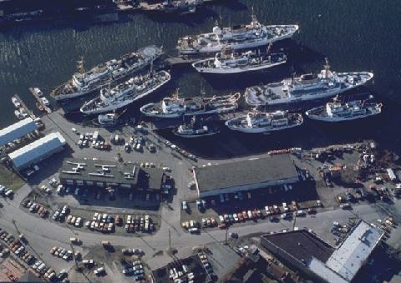
Marine Operations Center Pacific - Seattle
Management Oversight and Support for West Coast, Alaska and Hawaii fleet of 9 active ships and 2 subordinate Port Offices.
63 Shoreside employees.
Homeport for 4 active ships
Surge capacity is needed for additional ships as shown.
Leased facility. Picture is before the July 5, 2006 pier fire.
Lease expires in June 2011.

Slide 6
Relocation History
NOAA followed a competitive solicitation process in Washington and Oregon to award a new lease.
On August 23, 2009 NOAA awarded a 20‐year lease with the Port of Newport, Oregon.
Bellingham and Seattle protested.
NOAA completed internal assessment of floodplain issues at the request of the Government Accountability Office (GAO), May 2010.
DOC IG investigation completed June 29, 2010.

Slide 7
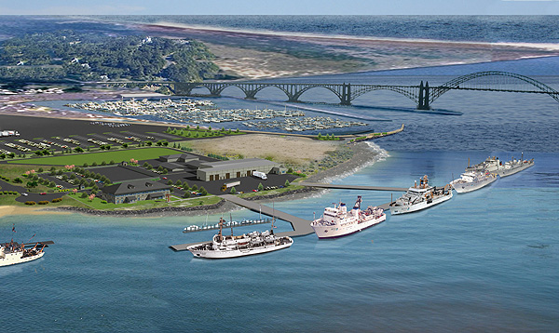
Marine Center – Pacific New location in 2011

Slide 8
Why the Relocation?
Piers destroyed in 2006 fire not rebuilt to date
Vessels and support personnel no longer co-located creates inefficiencies
Current lease expires in 2011 and law requires competition to establish new lease
No federal facilities available in 2011 time frame
Locating at Sand Point or present facility required Capital Investment with at least 5 year lead time and money up front
Newport was selected based on highest rating in technical evaluation factors and lowest price

Slide 9
Challenges
Pacific Maritime Institute navigation model completed
Newport Fly Thru
Next step to model NOAA ship
Train bridge officers (Chart 18580)
Continuity of Operations
Relocation Plan
Hiring in Newport
Programmatic impacts
Potential for some increase costs and some cost reduction
Vessel repairs/drydocks
Alongside work will continue
Drydocks will be competitively bid

Slide 10
Relocation Timeline

Slide 11
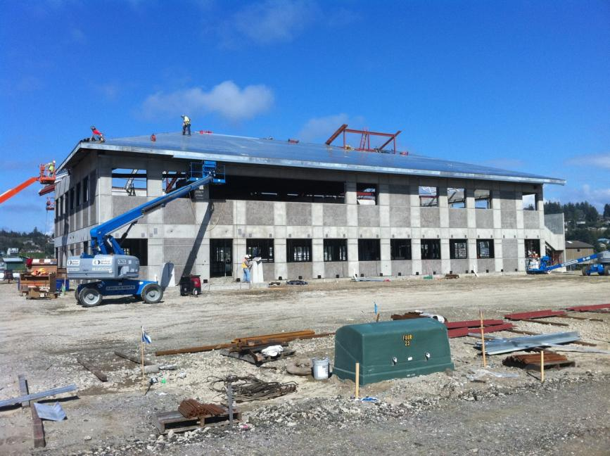
Current Construction Progress

Slide 12
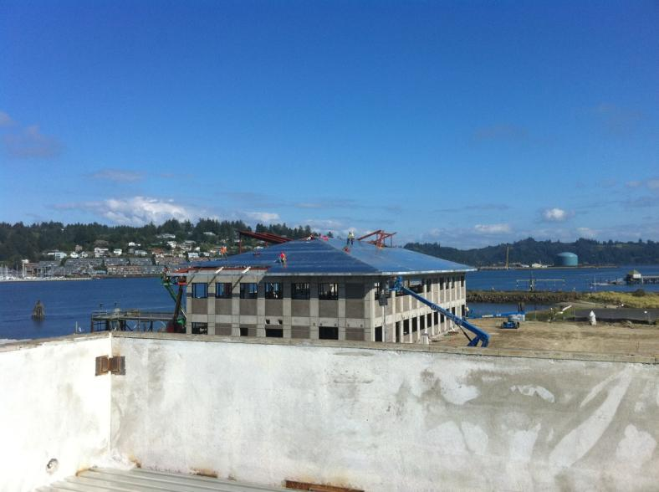
Roof of Administration Building

Slide 13
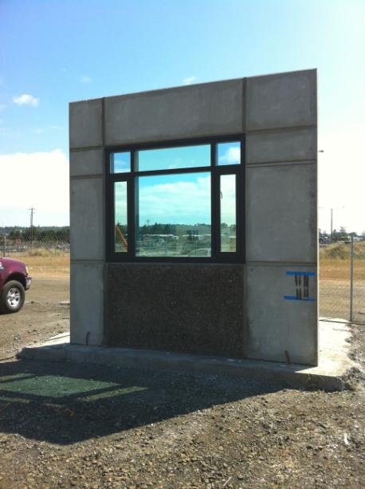
Mock up for window installation

Slide 14
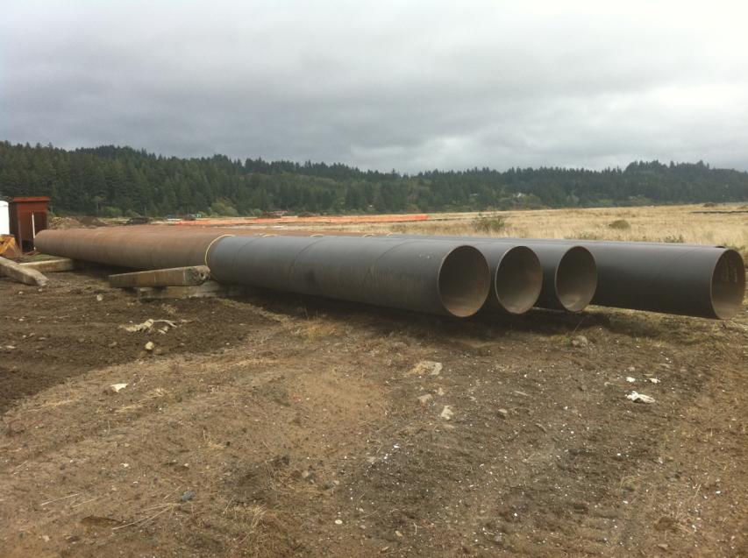
Three foot Pier Piles

Slide 15
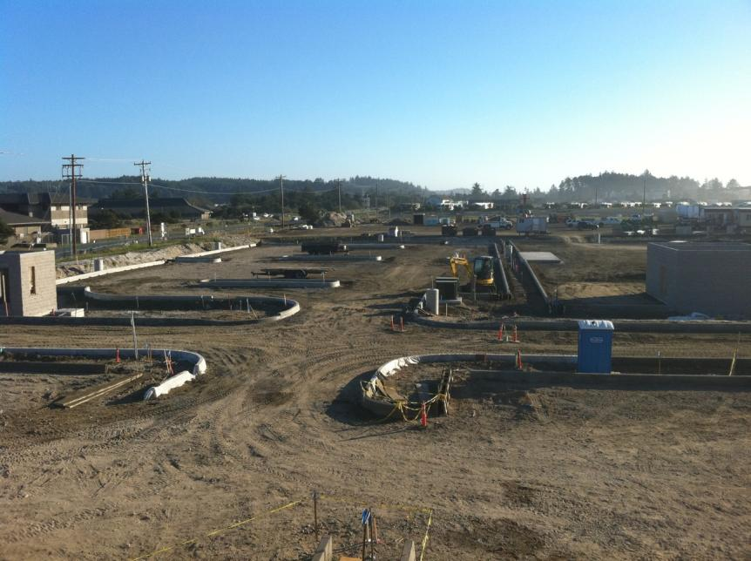
View from Conference Room Window

Slide 16
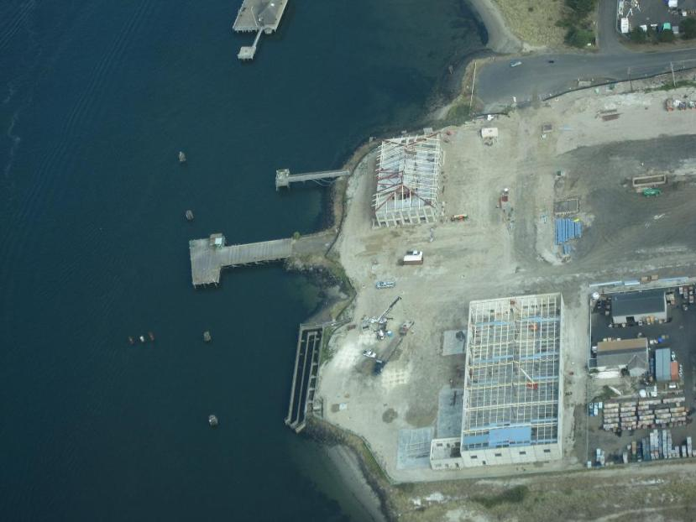
Aerial View of Construction – September 2010

Slide 17
Value to the Nation
NOAA Ships and Aircraft are National Assets:
Highly mobile and responsive to national emergencies
Collect data that support the protection of life and property and the economic health of the nation
Have unique capabilities that support all NOAA programs and the Nation
Seafood Trade - $8 billion
Cargo trade - over $1trillion
Coral reef protection - $578 million economic benefit
El Nino monitoring - $300 million in agriculture
Notes:
Current Ship Outputs and Outcomes:
Stock assessment surveys that facilitate management decisions under MSRA, MMPA, and ESA
Supports healthy fisheries. U.S. consumers spent $69.5 billion on fishery products in 2006.
Promotes sustainable management of domestic fish stocks. U.S. imports 70% of its seafood annually. The U.S. seafood trade deficit is estimated at $8 billion.
Hydrographic surveys
Facilitates 60,000 port calls per year by vessels required to carry NOAA charts
Supports movement of 2.5 billion short tons of cargo through U.S. ports valued at over $1 trillion
Annual health assessments of Pacific coral reefs
Informs management decisions that protect the estimated $578 million of economic benefit from coral reefs to the Pacific Islands
Deployment, maintenance, and upgrades to NOAA’s TAO/TOGA buoys
Provides climate and weather data worth an estimated $300 million to the Nation’s agricultural economy
Tracks the development of El Niño/La Niña and anticipates their probable influence on the Atlantic hurricane season

Slide 18
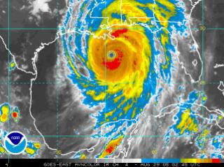
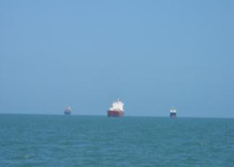
OMAO Service to the Country
Hurricane Katrina
- NOAA P-3 and G-IV flew into and above the storm acquiring critical forecast data
- NOAA Ship Thomas Jefferson re-charted major shipping lanes in the Gulf of Mexico allowing aid to reach shores and commerce to continue

Slide 19
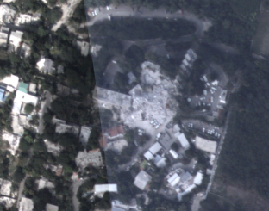
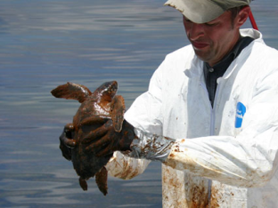
OMAO in the News
2010 Earthquake in Haiti
- NOAA Citation flew over acquiring imagery to asses damage and needs
BP Gulf of Mexico Oil Spill
- USCG Liaison to the DCO Incident Support Team
- Provide ships and aircraft in support of NOAA environmental assessment

Slide 20
Office of Marine and Aviation Operations
Thank you and fly or sail safely!

Slide 21
Newport and Approaches
Return

Slide 22
http://www.youtube.com/watch?v=ACXF4Fh9S-M&feature=player_embedded

