Slide 1
2010 Accomplishments Center for Operational Oceanographic Products and Services
2011 Outlook
Richard Edwing, Director Hydrographic Services Review Panel
Fall Meeting
October 13, 2010
Notes:
HSRP Recommendations
Aggressively Map the Nation’s Shorelines and Navigationally Significant Waters
Integrate Coastal Mapping Efforts and Ensure Federally Maintained Channels, Approaches, and Anchorages Are Surveyed to the Highest Standard
Modernize Heights and Implement Real-time Water Level and Current Observing Systems in All Major Commercial Ports
Strengthen NOAA’s Navigation Services Emergency Response and Recovery Capabilities
Disseminate NOAA’s Hydrographic Services Data and Products to Achieve Greatest Public Benefit

Slide 2
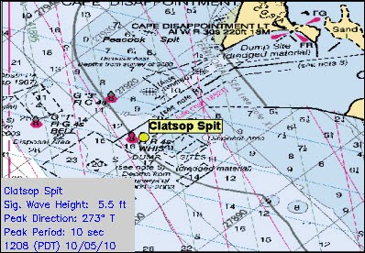
Physical Oceanographic Real-Time System PORTS®
FY2010
Integrated wave buoy data into PORTS
Partnership with USACE and SCRIPPS
LA/Long Beach, San Francisco Bay, Lower Chesapeake Bay and Lower Columbia River
Installed two visibility sensors at Mobile Bay PORTS
Pinto Island and Middle Bay Port
Published Columbia River PORTS Economic Study
Estimated $4.9 million in direct annual economic benefits
FY2011
New London (21st PORTS)
Jacksonville ?
Humboldt Bay ?
Waves at Clatsop Spit, Lower Columbia River PORTS

Slide 3
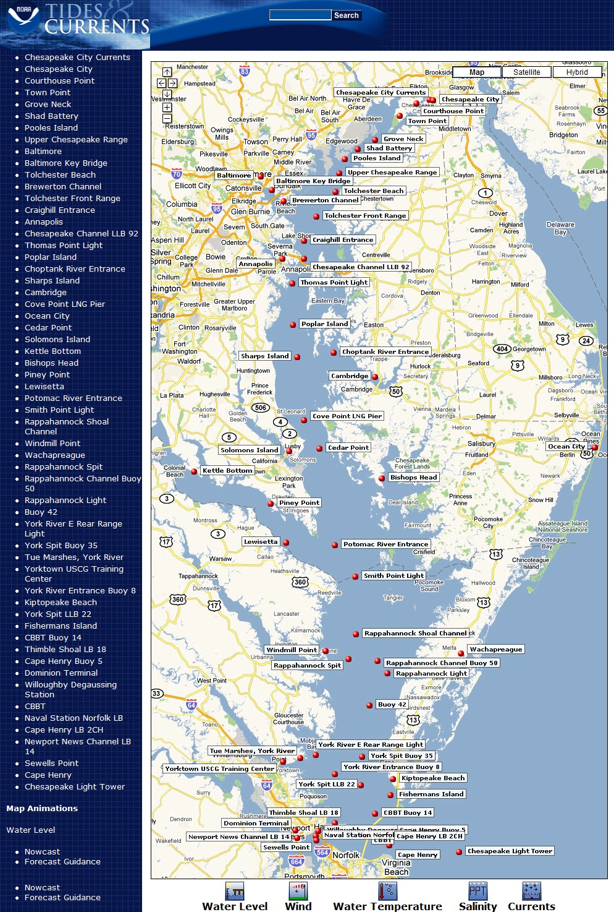
National Coastal Modeling
Operational Nowcast and Forecast Hydrodynamic Model Systems
FY2010
New and Improved Models
Chesapeake Bay (Improved)
Delaware Bay
Texas Harmful Algal Bloom operational forecast bulletins
FY2011
New Models
Tampa Bay
Northern Gulf of Mexico
Columbia River
Notes:
Water levels, currents, salinity, temperature
HAB model provides location, extent, and potential for bloom development or movement in the Gulf of Mexico

Slide 4
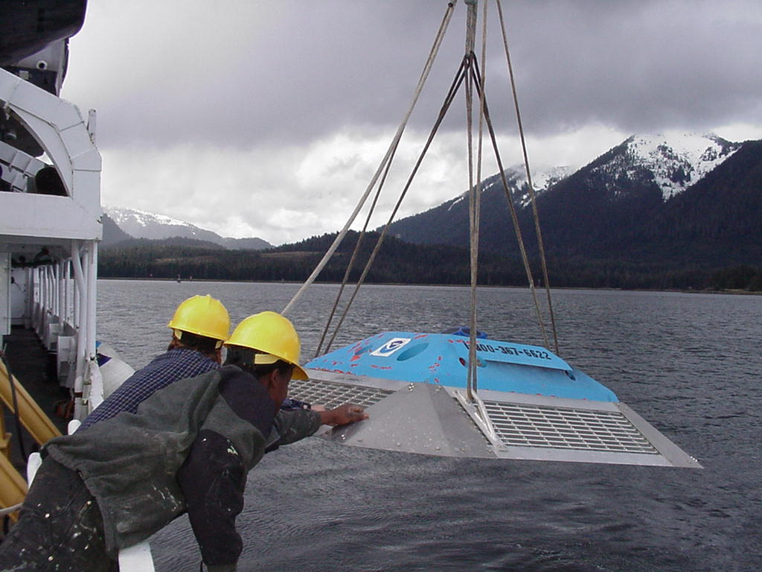
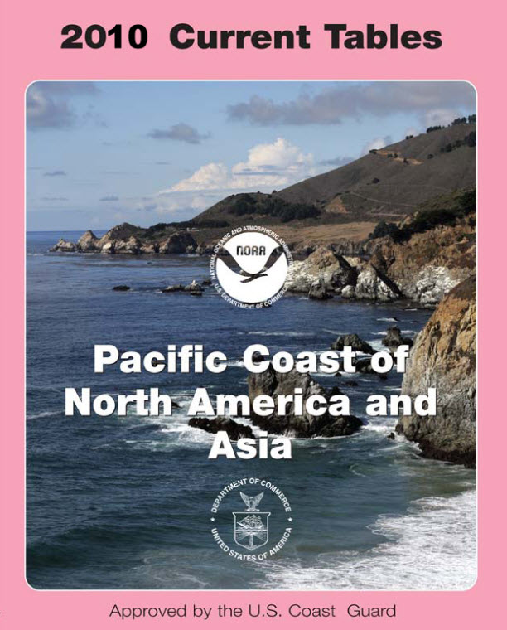
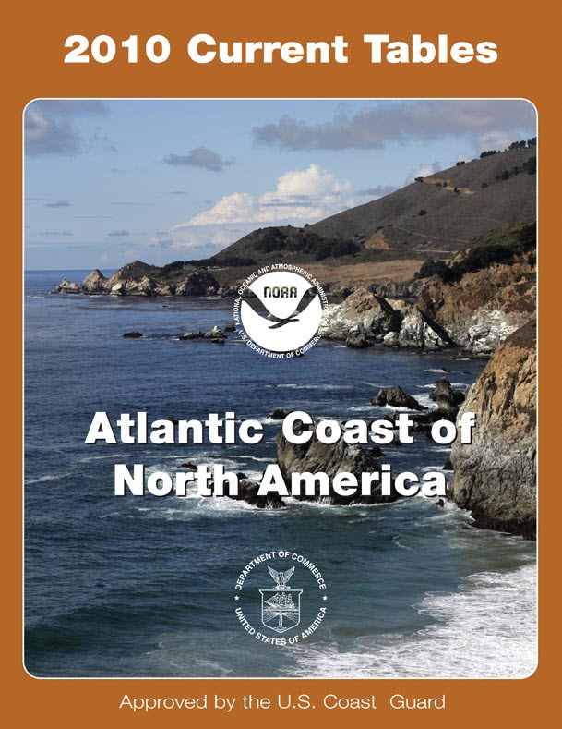
Updating Tidal Current Predictions
FY2010
Long Island Sound, CT/NY (38)
Dutch Harbor, AK (Unimak, Akutan) (24)
Glacier Bay and Cross Sound, AK (10)
FY2011
Hawaii (30)
Boston (35)
Mobile Bay (6)

Slide 5
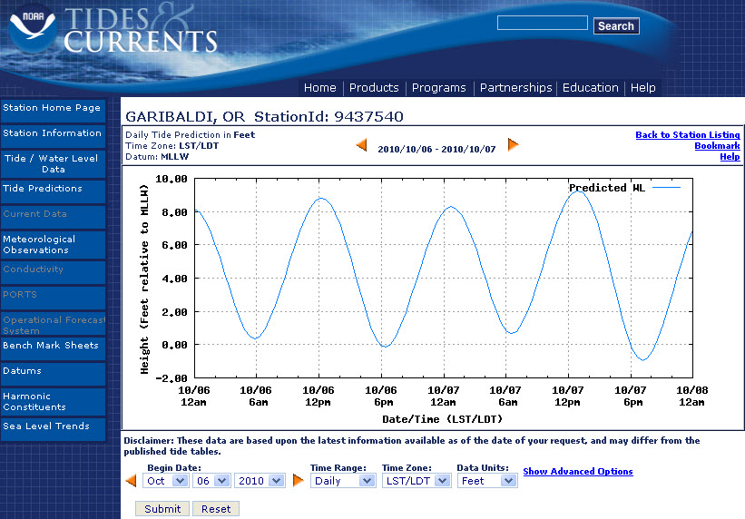
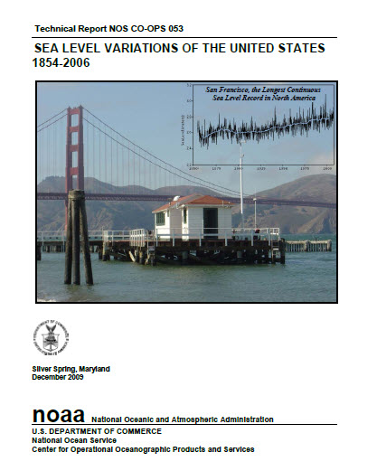
Improved Data and Products
FY2010
NOAA Tide Predictions
3,000 locations easily accessible via the Web
Real-Time Active Current Station Data
Technical reports
“Technical Considerations for Use of Geospatial Data in Sea Level Change Mapping and Assessment”
“Sea Level Variations of the United States: 1854-2006”
“Effects of the November 2009 Nor’easter on Water Levels”
NOAA Tide Predictions
Notes:
HSRP Recommendation #5: Disseminate NOAA’s Hydrographic Services Data and Products to Achieve Greatest Public Benefit
NOAA Tide Predictions: is the official NOAA tide predictions for nearly 3,000 locations easily accessible via the Web. It provides customizable tide predictions
Currents plot: near surface current speed (red line) and direction (green symbols) at Sunshine Skyway Bridge. X-axis is date/time, Y-axis is speed (knots) and Z-axis is Direction (degrees true).

Slide 6
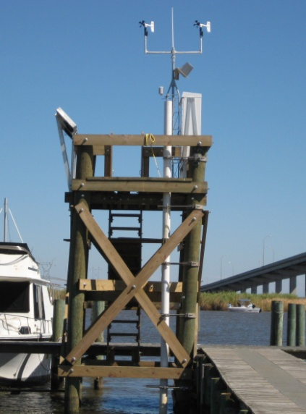
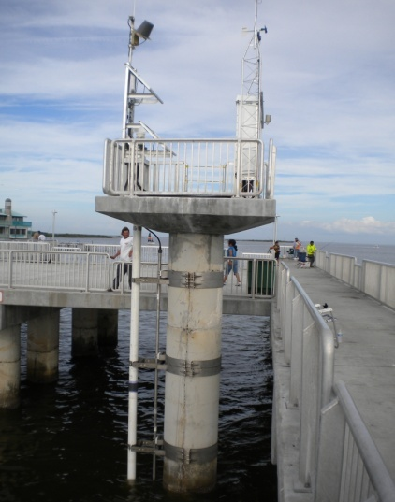
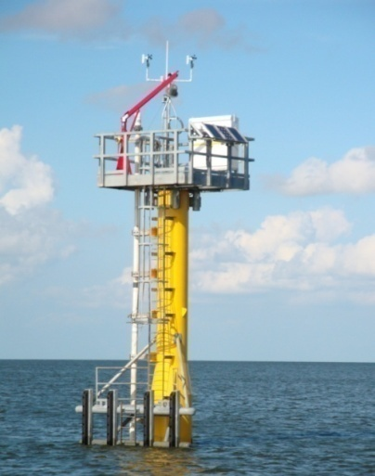
Preparing for Extreme Events
Station Upgrades
FY2010
6 stations strengthened
A total of 181 of 207 water level stations have meteorological sensors
FY2011
2 Sentinels planned
7 stations will be strengthened
Real-Time Storm Surge Observing Network in Mobile Bay
Upgraded Station at Apalachicola, FL
Upgraded Station at Cedar Key, FL
Sentinel Station
Notes:
FY10
- Stations upgraded in FY10 were Hatteras, Lake Worth, Fort Meyers, Cedar Key, Apalachicola, Holland
- 15 met upgrades completed in 2010
FY11
Sentinel info: 2 Sentinel stations – CO-OPS collaborating with USACE; other sentinel stations have 1 inch thick single piles, but the sentinels planned in FY11 may be designed at 2 inches thick because the sites are more exposed and in deeper water.
Mobile Bay Storm Surge
- Congressional earmark to provide storm surge information
- Project will incorporate new technology → Microwave water level sensors
- Station installations scheduled in late Fall
- Baseline information for inundation and sea level rise impact models, hydrodynamic models, sediment and biological transport models
Coincides with NOAA collaborative survey

Slide 7
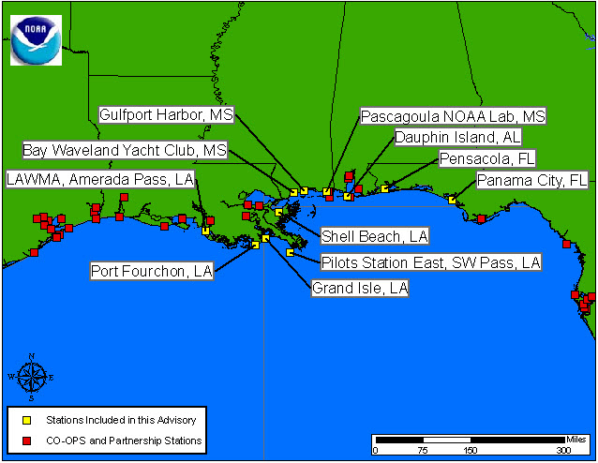
Deepwater Horizon Oil Spill Response
Specialized MyPORTS application
Oil Spill QuickLook
Accelerated development of a northern Gulf of Mexico hydrodynamic model
3 CO-OPS volunteers assisted research vessels in the Gulf

Slide 8
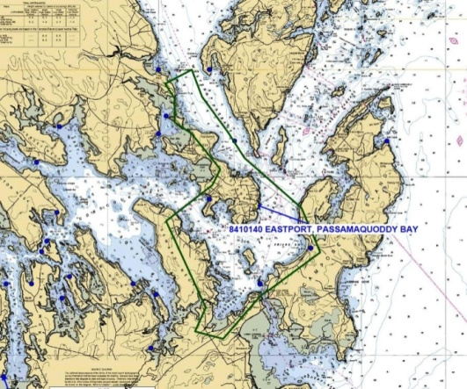
Mapping and Charting Support
FY2010
46 hydro / shoreline surveys supported
Improved technology and increased inventory
Conducted 3 training events
NOS VDatum Program surveys (ME, MA, AK)
FY2011
36 hydro / shoreline projects planned
Annual training
VDatum surveys (AK, GA, PR, VI)
Notes:
January training in Seattle: Office of Coast Survey Field Procedures Workshop
February training in Seattle: Tides for Hydrography new employee training for OCS and guest technicians from USACE
Another February training in Chesapeake: Tides/Hydrographic Operations training class
Shoreline Mapping: Over the years, CO-OPS has supported 17 on-going projects and will continue to do so in FY11
Hydro surveys in FY2011: 18 are planned and funded; 14 projects are yet to be determined
FY2011 Vdatum gauges (AK, PR, VI, GA) will be based on cost estimates. Alaska is the first priority because it’s been paid for. Puerto Rico is the next priority, followed by Georgia. These gauges are planned, but will be based on costs.
VDatum Project Locations
Water level station locations in Alaska: Gambell, Niyrakpak Lagoon Entrance, St. Lawrence Island, AK; Punuk Island, AK; Kawanak, AK; Unalakleet Eastern Norton Sound, AK; Kwalik, Kotzebue Sound, AK
Water level station locations in Puerto Rico and Virgin Islands: Fredericksted, St. Croix; Botany Bay, St. Thomas; Playa De Humacao; Santa Isabel
Water level station locations in Georgia: Range A Light, Icww, Bear R.; Sunbury, Sunbury Ch., Medway R.; S, Ossabaw Is, Bear R., St. Cath. S.; Daymark #135, South Newport R.; Daymark #185, Rockdedundy R. Entrance; Brunswick; Bailey Cut (.9 mile west of Of); Raccoon Key Spit
USACE Support
FY2010
Tri-lateral Datums Working Group
NOAA, USGS, USACE
Comprehensive Evaluation of Project Datums
Supported USACE projects
Alaska District
Norfolk District

Slide 9
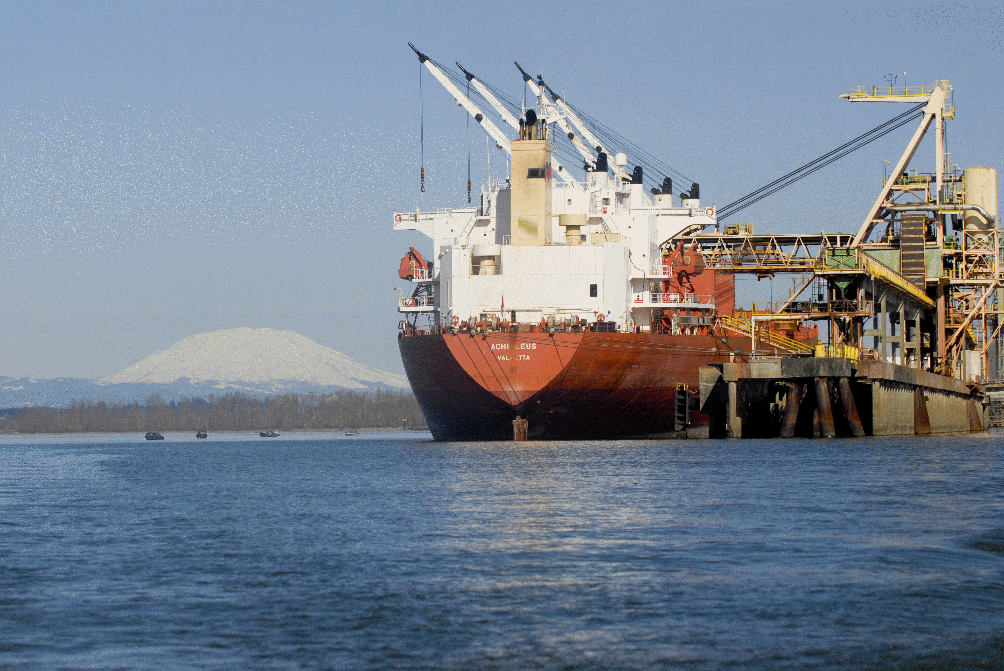
2010 Accomplishments & 2011 Outlook Center for Operational Oceanographic Products and Services
Questions
Photo Courtesy of the Port of Portland

