Slide 1
NGS HSRP Update
Ronnie Taylor, Acting Director
National Geodetic Survey, NOAA
October 13, 2010

Slide 2
Overview
Top NGS Accomplishments for FY2010
Program and Activity Updates
2011 Budget and Milestones
Upcoming Events

Slide 3
Top NGS Accomplishments - 2010
NGS Introduced Modernization Plans for National Spatial Reference System with the First Federal Geospatial Summit
NGS hosted a summit in May, 2010, to share information with other federal mapping agencies proposed improvements to the National Spatial Reference System (NSRS) including plans for replacement of NAD 83 and NAVD 88. Over 200 federal and nonfederal stakeholders participated, including representatives from 3 international agencies.
Proceedings under review. Info and updates available at:
http://www.ngs.noaa.gov/2010Summit/
Supports HSRP “Most Wanted” Finding 3: “Modernize Heights and Implement Real-Time Water Level and Current Observing Systems in all major commercial ports.”
Recommendation 3 to “improve the Nation’s vertical reference system.”
Notes:
Supports elements HSRP “Most Wanted” Finding 3 / Recommendation 3 to “improve the Nation’s vertical reference system”

Slide 4
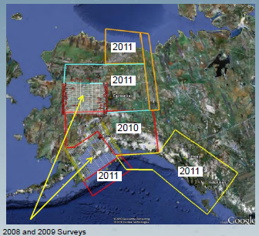
Top NGS Accomplishments - 2010
NGS Began Operational Phase of Gravity for the Redefinition of the American Vertical Datum (GRAV-D)
Airborne gravity data was collected over almost 300,000 square kilometers of Alaska.
Will continue to focus on Alaska in FY2011 as well as CONUS Coastal areas.
http://www.ngs.noaa.gov/GRAV-D/
Supports HSRP “Most Wanted” Finding 3: “Modernize Heights and Implement Real-Time Water Level and Current Observing Systems in all major commercial ports.”
Recommendation 3 to “improve the Nation’s vertical reference system.”

Slide 5
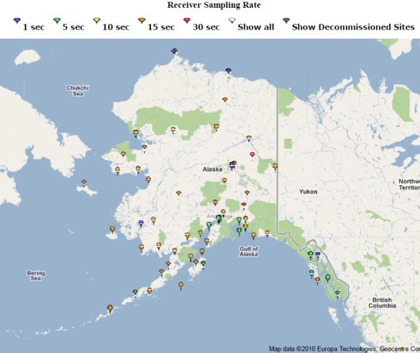
Top NGS Accomplishments - 2010
NGS Improved Infrastructure for Precise Positioning in Alaska
NGS worked with partners to add CORS stations to fill some critical gaps in coverage for the region.
In 2010, NGS added over 20 stations primarily owned and operated by the Plate Boundary Observatory to the NOAA CORS Network in Alaska. Up to 50 more could be added in FY2011 and beyond.
Supports many elements of HSRP “Most Wanted” Findings and Recommendations for the Alaska/Arctic region by providing the basic geodetic positioning infrastructure for all mapping and charting applications.
http://www.ngs.noaa.gov/CORS/GoogleMap/Alaska.html

Slide 6
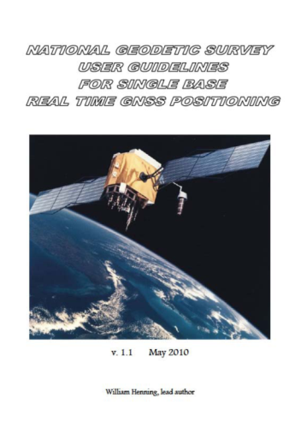
Top NGS Accomplishments - 2010
NGS Released Real Time Guidelines
Guidelines provide definitive criteria to achieve various specific tiers of precision, with high confidence, using Global Navigation Satellite Systems (GNSS).
Real time GNSS positioning is rapidly becoming the favored method for obtaining centimeter-level coordinates and will continue as a dynamic technology, due to:
advances in hardware and software
additional GNSS constellations
new signals available to the user.
Guidelines available at:
http://www.ngs.noaa.gov/PUBS_LIB/NGSRealTimeUserGuidelines.v1.1.pdf
Supports many elements of HSRP “Most Wanted” Findings and Recommendations by facilitating improvements in the speed and efficiency with which users can access precise positioning information for mapping and charting applications.

Slide 7
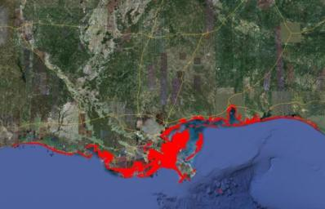
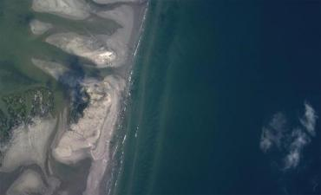
Top NGS Accomplishments - 2010
NGS Deepwater Horizon Aerial Imagery of Impacted Areas
NOS’ National Geodetic Survey (NGS) collected over 60,000 baseline (pre-impact) shore and damage assessment images of coastal areas in response to Deepwater Horizon oil spill.
NGS also provided remotely sensed imagery from previous mapping projects to help response personnel assess shoreline features that were present prior to the spill.
Imagery available at: http://ngs.woc.noaa.gov/deepwh/
Highlights HSRP “Most Wanted” Finding 4: “Strengthen NOAA’s Navigation Services Emergency Response and Recovery Capabilities” and Recommendations.

Slide 8
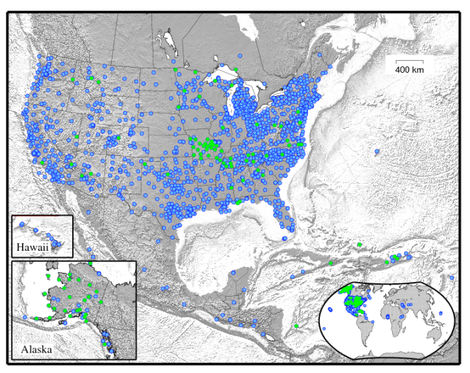
CORS Program
CORS Network
Update
more than 1,500 stations
Added >100 (green dots) in FY09-10
CORS reprocessing completed 1994-2010
Finalizing quality control on velocities and coordinates
Updated web page to NGS template
Notes:
10th Annual CORS User Forum CGSIC/ION
Date: September 20 – September 24, 2010
Location: Portland, OR
Goals: The Forum is an integral part of the Civil GPS Service Interface Committee (CGSIC) meeting, September 20-21, 2010.
Additionally, the Institute of Navigation's Global Navigation Satellite System (GNSS) Conference convened from September 21 - 24, 2010
in Portland. The Forum is designed to provide users with the latest information about CORS, its partners, its tools, and its support for
real-time positioning, while hearing from these users about their experiences and what NGS can do to improve its products and
services. Technically, the CORS Users Forum is called the Surveying, Mapping, and Geosciences Session of the Civil GPS Service
Interface Committee. CGSIC website with detailed agenda available at: http://www.navcen.uscg.gov/?pageName=cgsicMeetings
POC: Giovanni Sella

Slide 9
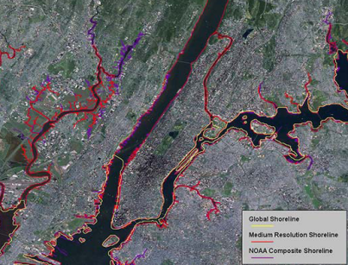
Shoreline FY10 Production
Shoreline Mapping Production Update
Updated Shoreline in Priority Ports = 21
Analyzed Priority Ports for Change = 28
US Shoreline Miles = 5,511 statute miles
Shoreline PlannedFY11 Production
Update Shoreline in Priority Ports = 30*
Analyze Priority Ports for Change = 28
US Shoreline Miles = 10,749* statute miles
*Includes 21 ports from ARRA projects
*Includes 5,953 miles from ARRA projects
Notes:
Updated Shoreline in Priority Ports = 21 new shoreline compilation of the 150 top ports as listed by the USACE
Analyzed Priority Ports for Change = 28 using satellite/aircraft imagery to look at the 150 ports to see if and how much new shoreline compilation is needed
US Shoreline Miles = 3.3% of total US shoreline (95000) collected each year based on funding levels. Usually AROUND 3%

Slide 10
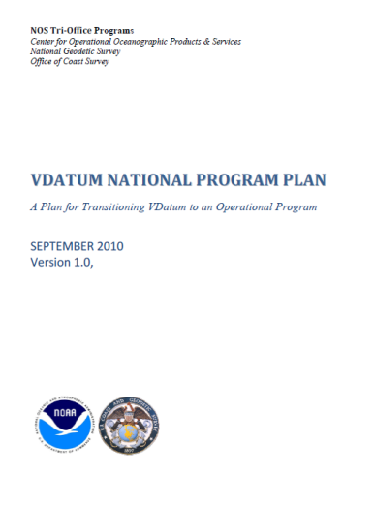
VDatum Update
VDatum Program Plan submitted and approved by Tri-Office Directors in September, 2010.
Plan describes a process for instituting an operational infrastructure by which VDatum models are to be produced, maintained and made accessible in a cost-effective manner such that all validated user needs are met.
Expansion of National VDatum planned for 2011. New VDatum Models for
Texas
Maine
Massachusetts
http://vdatum.noaa.gov/

Slide 11
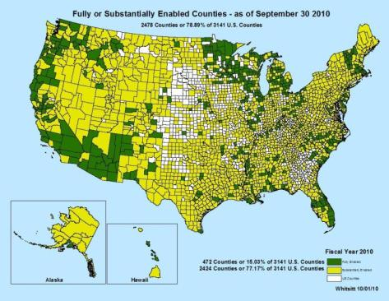
County Scorecard Update
A metric to assess how NGS is enabling local capacity for accurate positioning
Percentage of U.S. counties rated as fully enabled or substantially enabled with accurate positioning capacity.
FY2010 Goal = 77%
FY2010 Actual: 78.89%
In Sept, 2010, sent web-based survey to over 400 county “geospatial representatives” across the country. Survey questions specifically focusing on infrastructure, NGS models and tools, NGS capacity building and outreach, and overall satisfaction.
http://www.ngs.noaa.gov/scorecard/

Slide 12
FY 2011 President’s Budget
NGS - Geodesy:
Base: $26,895 million (includes $3 million for GRAV-D)
Change from FY 2010 Enacted: + $478K
National Height Modernization: $2.541 million
Change from FY 2010 Enacted: None
NGS - MTS:
Mapping and Charting Base: $3.95 million
Change from FY 2010 Enacted: None
Shoreline Mapping: $2.424 million
Change from FY 2010 Enacted: None
Notes:
These figures will likely be amended by Congress.

Slide 13
Some Planned NGS 2011 Milestones
Increase to 83% the Percentage of U.S. counties rated as fully enabled or substantially enabled with accurate positioning capacity
Update 6.4% of the US shoreline
Analyze 29 priority ports for shoreline changes
Expansion of National VDatum. New VDatum Models for Texas, Maine and Massachusetts
Install one foundation CORS site (including a local site survey), supporting the improvement of the International Terrestrial Reference Frame (ITRF)
Collaborate with partners to establish and connect Continuously Operating Reference Stations (CORS) at tide and water level stations
Compete socio-economic benefit study of NGS remote sensing products and services

Slide 14
Upcoming Event: 2010 North American Intercomparison of Absolute Gravimeters
Date: October 18 – October 22, 2010
Location: Longmont, CO
Goal: A regularly scheduled North American Intercomparison of Absolute Gravimeters. Regular comparisons between the few absolute gravimeters in the world is necessary to validate the achievable accuracy of each meter relative to the group mean.
POC: Dru Smith, NGS Chief Geodesist Dru.Smith@noaa.gov
http://www.ngs.noaa.gov/INFO/conferences.shtml
Notes:
http://www.ngs.noaa.gov/INFO/conferences.shtml

