Slide 1
National Ocean Policy
A National Policy for the Stewardship of the Oceans, Our Coasts and the Great Lakes –
Established by Presidential Executive Order on July 19, 2010

Slide 2
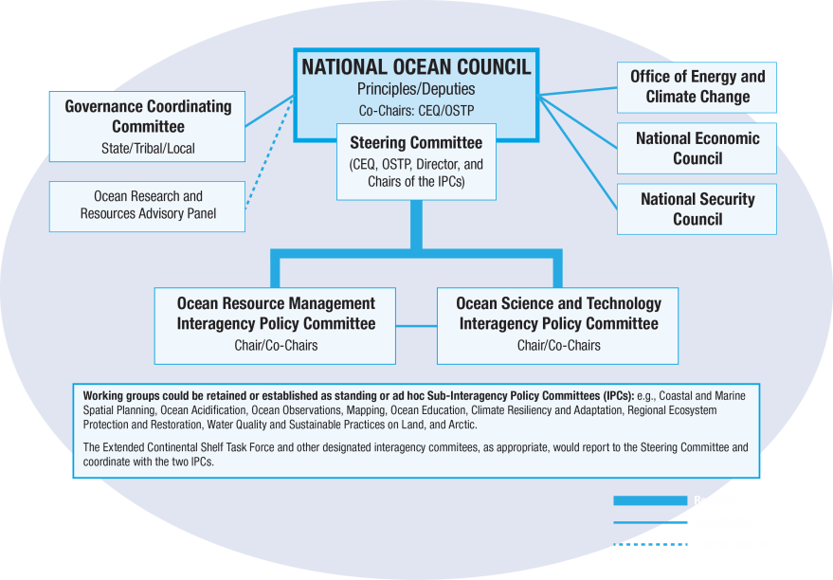
The National Ocean Council
Notes:
To improve national coordination and leadership, the Policy establishes a National Ocean Council to be led by CEQ and Office of Science and Technology Policy. Made up of 27 federal Cabinet level entities with the goal of to ensuring that national priorities are in sync with the concerns of the American people, and make certain working relationships among federal agencies run smoothly.
In addition to the Department of Commerce, NOAA has its own seat on the Council given its unique and important role in coastal and ocean research, planning and management.
Although the Council will be the primary body for U.S. ocean policy, to assist in day-to-day operations, the National Ocean Policy also establishes Interagency Policy Committees for Ocean Resource Management as well as Ocean Science and Technology that are the successors to the Subcommittee on Integrated Management of Ocean Resources (SIMOR) and the Joint Subcommittee on Ocean Science and Technology (JSOST) under the previous governance structure.
In addition, the National Ocean Policy also creates a Governance Coordinating Committee of the National Ocean Council to improve coordination and collaboration with State, tribal, and local authorities.
The National Ocean Council will have dedicated staff to support it consisting of a Director, Deputy Director, and 8-10 policy advisors. The staff office will administratively be housed between CEQ and OSTP in the Executive Office of the President.

Slide 3
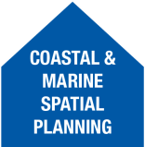
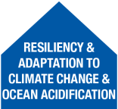
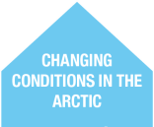
Moving Towards Implementation Nine Priority Objectives
1
2
3
4
5
6
7
8
9
Notes:
Under the NOCC, 9 Senior career staff have been appointed to serve as NOAA wide liaisons for each of the 9 objectives.
They are responsible for NOAA wide coordination and interagency engagement under the new NOC. They will report to and be held accountable by the NOCC.
The NOAA Priority Objective Teams are teams with a composition across line offices and staff offices that are focused on each priority objective set forth in the Final Recommendations.
Currently these Priority Objective Teams are developing strategies for how NOAA wants to engage in the interagency forum as strategic action plans are developed for each priority over the next 6-12 months. These engagement strategies include the top priorities that NOAA would like to advance and outcomes they would like to see.
Although we would like to lead all the priority objectives, due to limited resources, NOAA leadership has identified 4 priority objectives that we will focus on taking a lead role in: Ecosystem-Based Management, Coastal and Marine Spatial Planning, Resiliency and Adaptation to Climate Change and Ocean Acidification, and Ocean, Coastal, and Great Lakes Observations, Mapping, and Infrastructure.

Slide 4
National Ocean Policy Nine Priority Objectives & NOAA’s Draft NGSP
HOW WE DO BUSINESS
3 OF NOAA’S NEXT GENERATION STRATEGIC PLAN GOALS ARE ALIGNED WITH NOP
AREAS OF SPECIAL EMPHASIS
Resiliency & Adaptation to Climate Change & Ocean Acidification
Ecosystem-Based Management
1.
Climate Adaptation & Mitigation
Regional Ecosystem Protection & Restoration
Coastal & Marine Spatial Planning
2.
Water Quality & Sustainable Practices on Land
Inform Decisions & Improve Understanding
Healthy Oceans
Changing Conditions in the Arctic
3.
Coordinate & Support
Resilient Coastal Communities
Ocean, Coastal, & Great Lakes Observation, Mapping & Infrastructure
Notes:
The National Ocean Policy has 9 Priority Objectives for implementation listed here.
They are divided into two categories. The first one is “how we do business” found on the left hand side of this slide and it represents overarching ways in which the USG must operate differently to better improve stewardship. NOAA has been practicing elements of EBM and CMSP for quite some time now, but this calls upon other agencies to take this approach.
The second category is the “areas of special emphasis” found on the right hand side of the slide which represent a substantive area of particular importance to achieving the National Policy.
In the middle, you will see 3 of the 4 goals from the NOAA Draft Next Generation Strategic Plan – which we are in the last stages of finalizing. This slide demonstrates how closely NOAA’s strategic goals align with the National Ocean Policy priority objectives. Of note, CMSP was one of 4 priorities that Dr. Lubchenco outlined when she arrived at NOAA as its Administrator.
The Policy outlines that the National Ocean Council would develop strategic action plans for each one of these priority objectives over the course of 6-12 months.

Slide 6
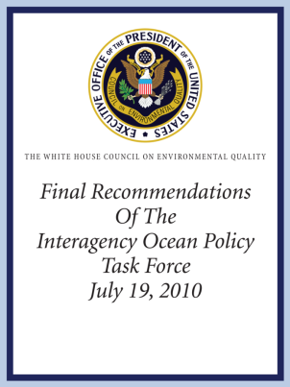
Building Blocks
National Ocean Policy
National Ocean Council
9 National Priority Objectives
Framework for Coastal and Marine Spatial Planning (CMSP)
Regional Planning Bodies
Notes:
To build our shared values into reality, the Final Recommendations of the Interagency Ocean Policy Task Force create four basic pieces:
Our Nation’s first ever National Policy for the Stewardship of the Ocean, Our Coasts, and the Great Lakes (National Policy);
A National Ocean Council formed of twenty-seven federal entities, charged with coordination, setting goals for implementing ocean policy, and measuring outcomes to ensure that ocean policy serves America’s communities;
Nine National Priority Objectives that embrace coordination and integration among all levels of government to address pressing issues such as climate change and ocean acidification; and
CMSP as a public policy process to help us better determine how the ocean, coasts and Great Lakes are sustainably used and protected now and for future generations.
The Framework for CMSP includes Regional Planning Bodies for CMSP that to ensure that the unique needs of each region of the United States are met in a way that respects regional objectives and priorities.

