Slide 1
Data Models and the Role of NOAA Hydrographic Services Products in the Lower Columbia River and Estuary
Keith Marcoe,
GIS and Data Management Specialist,
Lower Columbia River Estuary Partnership
Oct 13, 2010

Slide 2
Estuary Partnership Background
One of 28 National Estuary Programs – Estuaries of “National Significance”
Focus on tidally influenced portion of the Columbia River
(RM 0 – RM 146 at Bonneville Dam)
Bi State – Federal Partnership: OR/WA and U.S. E.P.A
501(c)(3) Non-Profit, Community Based
Lower Columbia River Management Plan was completed in 1999

Slide 3
Estuary Partnership Background
Columbia River Management Plan Objectives
Provide information about the river to a range of audiences
Compiling and evaluating data, offering education programs for children and building public and private partners.
Reduce toxic and conventional pollution
Conducting long term monitoring
Protect the ecosystem and species
Currently 13 ESA listed salmon populations utilize the lower
Columbia River and Estuary (LCRE)

Slide 4
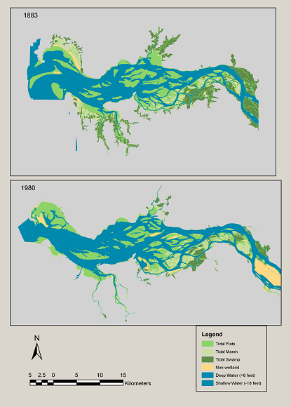
Historic Change in the LCRE, 1883 to Present
Habitat Loss, as a result of:
- Diking for agriculture, forestry, and
urban development.
- Loss of complexity due to
channelization and development.
- Hydrologic alteration due to
operation of federal hydropower
system.
¹Estimated combined loss of 62% of
available shallow water habitat area
(SHWA) to juvenile salmonids during
the spring freshet period.
Expected increase in SWHA loss due
to effects of climate change.
1) Kukulka, T. and D.A. Jay. 2003b. Impacts of Columbia River Discharge on salmonid habitat: Changes in shallow water habitat. J. Geophys. Res. 108:3294.
Source: J. Burke (UW), OSU Modification of D. Thomas, 1983.

Slide 5
Historic Change in the LCRE, 1883 to Present

Slide 6
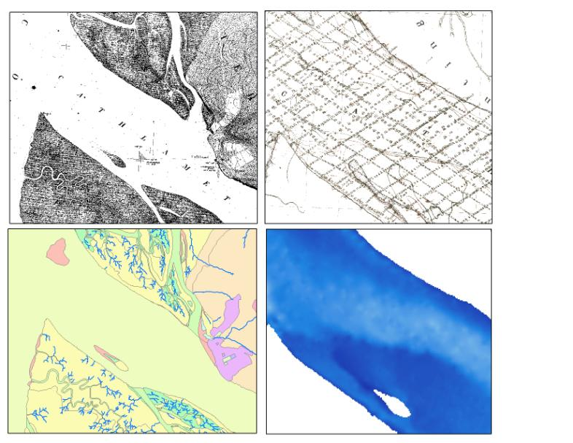
Historic Change in the LCRE, 1883 to Present

Slide 7
Implications of Habitat Loss in the LCRE
Effects on salmon populations
Reduced amount of shallow water habitat for juvenile rearing, which serves a variety of functions as fish transform from freshwater to saline environment:
Food supply, current relief, refuge from predators
- ² “Diking and filling activities that decrease the tidal prism and eliminated wetlands
and floodplain habitats have likely reduced the estuary’s salmon-rearing capacity.”
- ² “Restoration of estuarine habitats, particularly diked emergent and forested
wetlands, and flow manipulations to restore historical flow patterns might
significantly enhance the estuary’s productive capacity for salmon.”
In a 1997 comparative risk ranking, the loss of habitat and wetlands was identified as the number one risk to public health, ecological health, and quality of life in the lower river and estuary.
2) Bottom, D.L. et. Al. 2005. Salmon at River’s End: The Role of the Estuary in the Decline and Recovery of Columbia River Salmon. NOAA Technical Memorandum NMFS-NWFSC-68.

Slide 8
Species Recovery Efforts in the LCRE
Northwest Power and Conservation Council (NPCC)
Columbia River Basin Fish and Wildlife Program: Lower Columbia Sub Region
NOAA Fisheries
Columbia River Estuary ESA Recovery Plan Module for Salmon and Steelhead
Bonneville Power Administration/US Army Corps/US Bureau of Reclamation
Federal Columbia River Power System Biological Opinion (FCRPS BiOP)
Federal, State, and Tribal Fish and Wildlife Programs
City, County, Local efforts

Slide 9
Estuary Partnership Recovery Efforts
Habitat Restoration Program
LCREP Funds have contributed to 50 projects, with over 85 partners.
Primary focus: LCRE floodplain lands with historic tidal influence.
Primary funding partners: NPCC/Bonneville Power Administration, NOAA, EPA, USACOE
Long Term Ecosystem Monitoring Strategy
Objective: Track ecosystem condition over time
Indicators for measurement: Conventional Pollutants
Toxic Contaminants
Habitat Condition
Fish
Exotic Species
Nutrients, Primary Productivity, Food Web
Habitat Mapping and Data Products

Slide 10
The Role of Elevation Data
Assessing Available Shallow Water Habitat
Current baseline
Measuring changes over time
Supports Habitat Restoration and Ecosystem Monitoring Efforts
Habitat Suitability Models utilizing depth, velocity, temperature, and salinity criteria
Localized hydrologic modeling to support restoration design
Selection of monitoring locations
GIS habitat mapping (Columbia River Estuarine Ecosystem Classification)
Sediment Transport
Transport Modeling
Sediment Management (Lower Columbia Solutions Group)

Slide 11
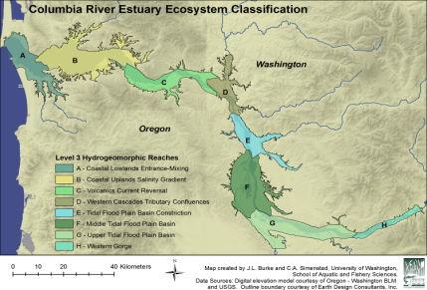
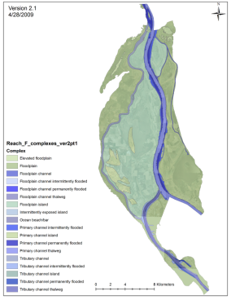
Columbia River Estuarine Ecosystem Classification
In estuaries, structures formed by hydrologic and geomorphic processes vary spatially and temporally and influence habitat conditions and biological communities.
Research and monitoring programs develop “classifications” to categorize and stratify these structures and to provide a framework for structuring efforts.
In 2004, EP and partners determined that no existing classification could describe the CRE’s large tidal-freshwater zone and recommended development of new classification.
CRE Ecosystem Classification by UW, USGS, & LCREP

Slide 12
Columbia River Estuarine Ecosystem Classification
6 Hierarchical levels to be used for sampling design and restoration prioritization
Level | Name | Definition | Data Needed | Status
1 | Ecosystem Province | EPA Level II Ecoregions |  | Complete
2 | Ecoregion | EPA Level III Ecoregions |  | Complete
3 | Hydro- geomorphic Reach | EPA Level III and IV Ecoregions modified to reflect transitions in strong, large-scale hydrogeomorphic and tidal fluvial forcing, e.g. : a) Maximum (historic) salinity intrusion; (b) transitions in max flood (pre-regulation) tide level; (c) upstream extent of current reversal; and (d) convergences with major tributaries and slough systems. |  | Complete
4 | Ecosystem Complex | Units representing distinct channel and floodplain features, e.g., floodplain island, tributary channel | Shallow water bathymetry | Anticipated completion 2011
5 | Geomorphic Catena | Ecosystem structures reflecting geomorphic processes (various maturity stages of emergent marsh, high vs. low order dendritic channels) | Shallow water bathymetry, topography, substrate/ vegetation cover | Anticipated completion 2011
6 | Primary Cover Class | Vegetation cover (i.e. forested, herbaceous, scrub-shrub) with wetland/upland and diked/tidal/upland modifiers. | Vegetation cover | Expected 2011

Slide 13
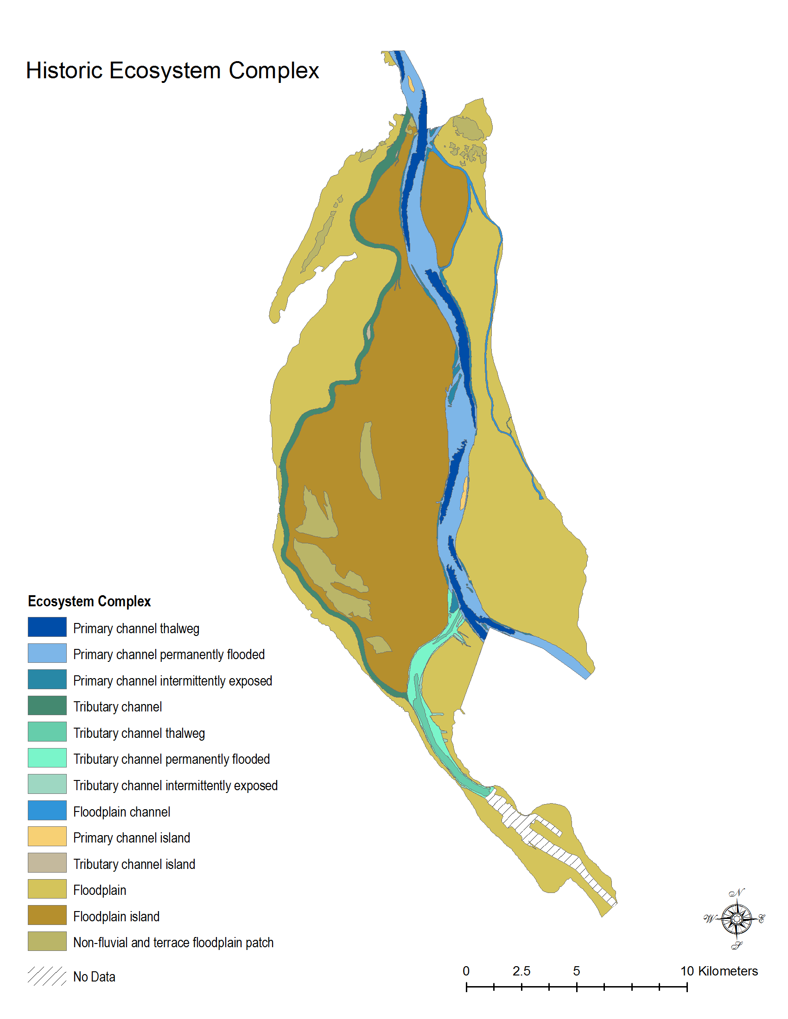
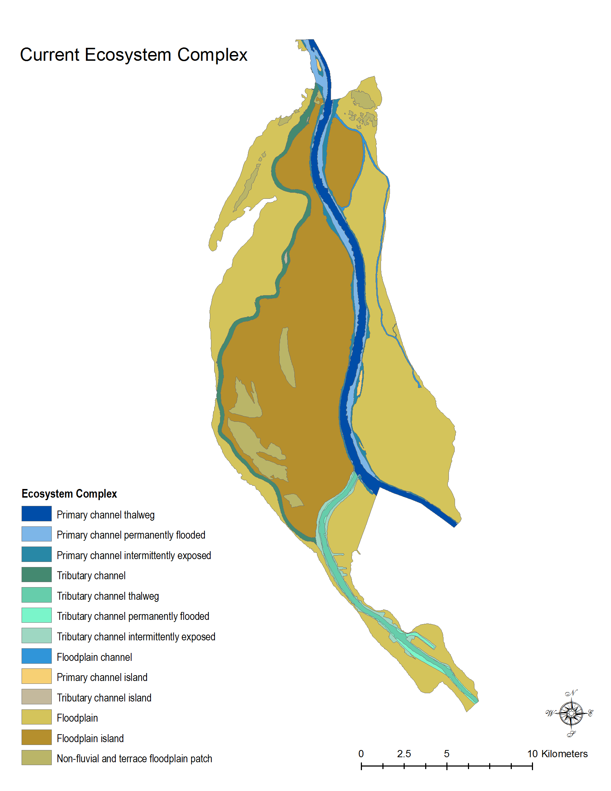
Columbia River Estuarine Ecosystem Classification
(Level IV)
(Level IV)

Slide 14
Estuary Partnership Bathymetric Data Collection
Data Gaps identified in 2006
Data Gaps prioritized for collection in 2007 workshop
Over 40 participants from several agencies, universities, consulting and research organizations evaluated gap areas and strategies for data collection
Bonneville Power Administration provided funding, as part of Estuary Partnership monitoring contract
$400,000 over 2 years.
Contracted with David Evans and Associates (2009- 2010)
Experience with Lower Columbia surveys
Cost effective shallow water methods
Ability to leverage 2008 multi-beam data collected for NOAA to reduce necessary coverage and create an up to date, high resolution data set.

Slide 15
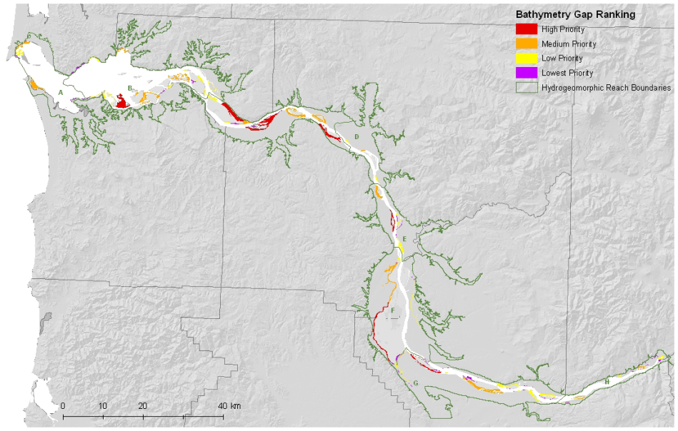
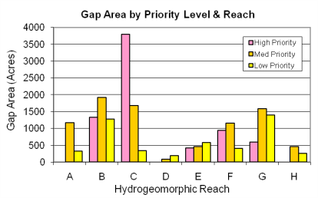
Bathymetric Data Gaps Identified in 2006
Totals:
High and Medium Priority: 15,570 acres
Low Priority: 4,700 acres
Focused on Main Stem & Mult. Channel

Slide 16
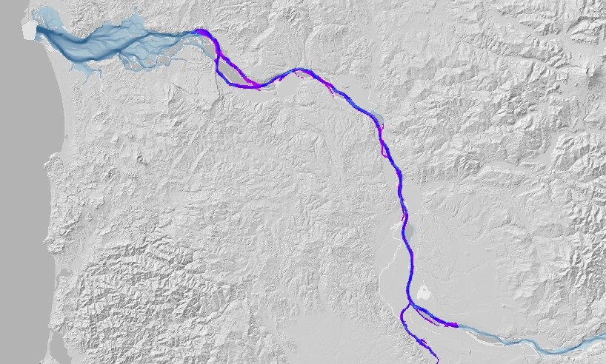
NOS/DEA data coverage
2008 Multi-beam data coverage (NOAA/David Evans & Associates)
Surveys extend to 2m
contour in many locations
(Covers some of the SHWA)

Slide 17
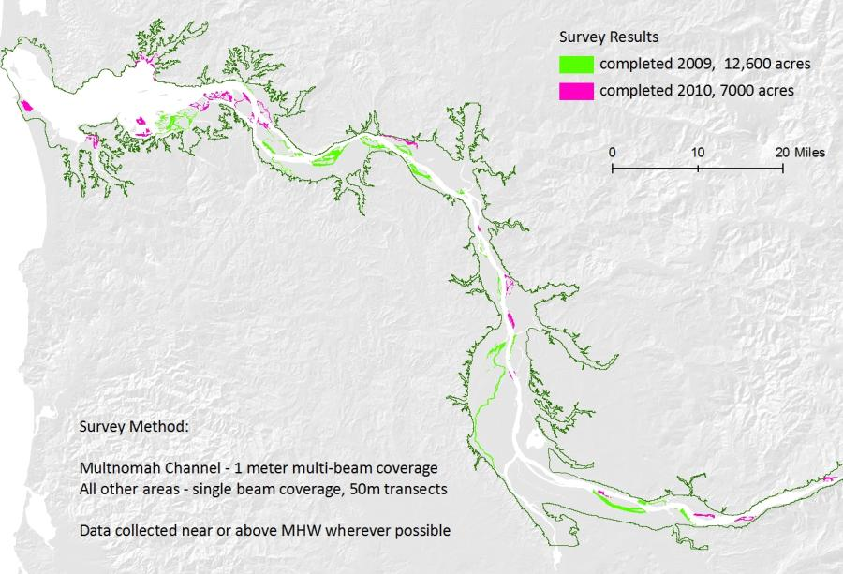
Bathymetric Data Collection Results, 2009-2010

Slide 18
Data Collaboration and Terrain Model Development
2010 Integrated Seamless Terrain Model for the Lower Columbia
USACOE product, funded by Columbia River Treaty work.
Incorporated recent LCREP and NOAA data collected by David Evans & Associates
Easy to update Terrain model within an ArcGIS geo-database framework
Eliminates narrow gaps between topographic and bathymetric data sets
Data sources
Year | Source
2010 | USACOE Topographic LiDAR
2009-2010 | LCREP/DEA single and multibeam bathymetry
2008 | NOAA/DEA multibeam bathymetry
1997 – 2009 | USACOE channel and crossline bathymetry
1930s – 1940s | NOAA historic bathymetry

Slide 19
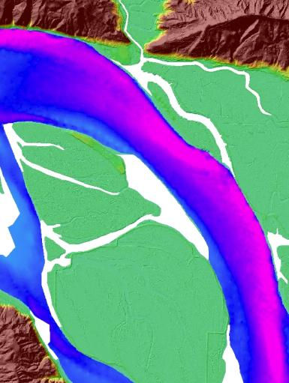
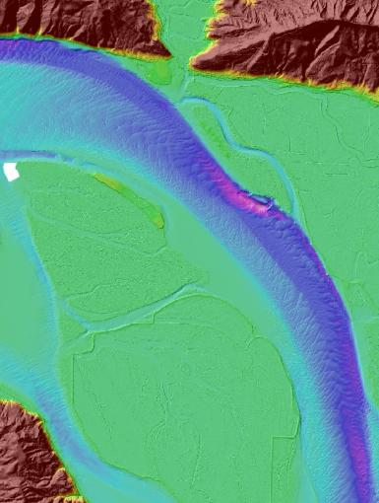
Data Comparison
Older data sets 2010 Terrain Model

Slide 20
Additional LCRE Data Models Utilizing Bathymetric Data
USGS/Deltares Delft-3D: hydrodynamic & sediment transport (Gelfenbaum/Elias)
Center for Coastal Margin Observation & Prediction (CMOP): Virtual Columbia River Model – 3D simulations of water level, salinity, temp. velocity (Baptista, et. al)
Portland State University: Shallow Water Habitat Area Assessments (Jay, et. al)
Pacific Northwest National Laboratories: Habitat connectivity and restoration modeling (Coleman)
Pacific Northwest National Laboratories: Eelgrass restoration modeling (Judd)
LCREP/Pacific Northwest National Laboratories/CMOP: Juvenile Salmon Habitat Suitability (Judd, et. al)

Slide 21
Looking Forward
Continued Shallow Water Surveys
Fill remaining gap areas to replace historic NOAA data in current Terrain model. Will likely require new funding sources
Repeated surveys of shallow water areas to monitor changes
Extend data collection to tributaries where restoration is occurring (Young’s, Lewis & Clark, Gray’s, Clatskanie Rivers)
Continued collaboration with USACOE, NOAA, David Evans & Associates
Use of Terrain model as a framework to maintain and upgrade data sets

Slide 22
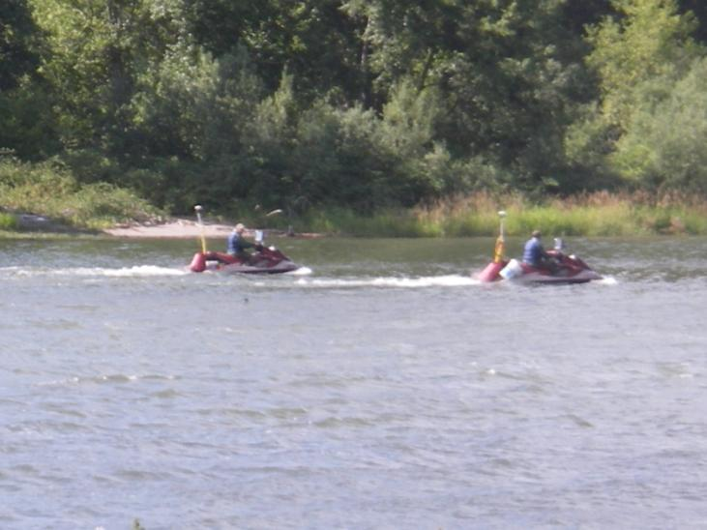
Acknowledgements
David Evans & Associates Marine Services Division
NOAA Hydrographic Services
US Army Corps of Engineers
David Smith Mapping
Cam Patterson
Bonneville Power Administration

