Slide 1
2010 Hydrographic Services Review Panel
David Steele, PLS
DNR Geodetic Survey Director
& Spatial Reference Center of Washington
Notes:
Introduction for myself and the Washington HM Program and SRCW.

Slide 2
Height Modernization in Washington State
Background and organization
Activities in Washington
Notes:
Topics that will be discussed during my presentation

Slide 3
The SRCW
The Spatial Reference Center of Washington (SRCW), a nonprofit organization, was organized in 2004 to oversee the funding, development and implementation of geodetic network modernization.
Notes:
Describe the organization and how it functions as an advisory group to the DNR program.

Slide 4
Program Management
The Washington Department of Natural Resources’, Geodetic Survey Program was chosen to manage the program and collaborates with the SRCW while managing height modernization.
NGS grants have been received in FY 2004, 2005, 2007, 2008 and 2009.
Notes:
Further describe the relationship between the DNR and the SRCW

Slide 5
Height Modernization Activities
Develop a GPS, Active Control Network
Inventory existing geodetic control monuments
Develop a Primary Base Station Network
Run differential leveling projects to replace lost monuments and establish heights on new monuments and GPS stations
Assist the NGS GRAV-D project

Slide 6
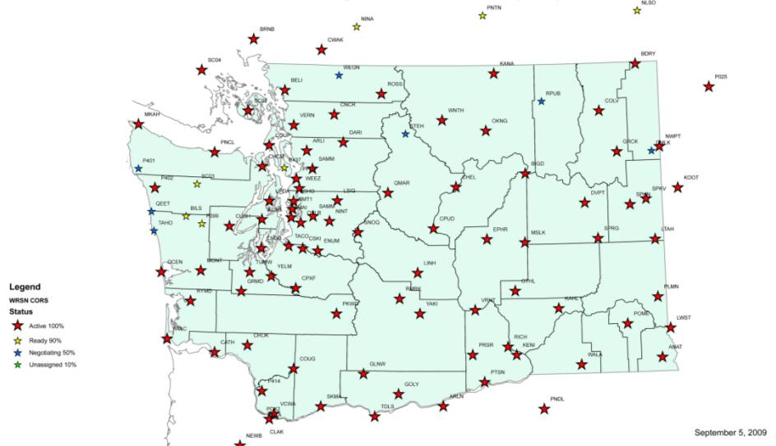
Washington State Reference Network
Notes:
The Washington State Reference Network
The WSRN is a complex integration of Federal CORS and local base stations. The data from all stations is sent through the Internet to the City of Seattle, where they perform integrity monitoring of all stations to less than 1 cm across the state. The Ionospheric models are constantly updated and active, corrected positioning data is sent to users through the Internet in real-time.
This is a true collaboration with Federal, State, local, and private partners
A small team collaborates to distribute information about the network through education and outreach activities to teach about the system and proper use

Slide 7
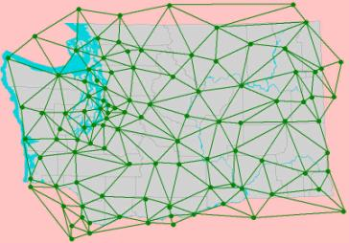
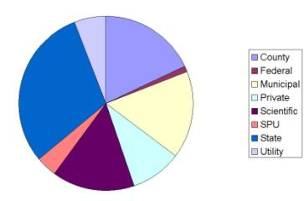
The Washington State Reference Network
Quick Stats
89 of 102 Stations Completed
600+ Active Accounts
114,280 Minutes Avg. Monthly Fixed Solutions
NAD83 (CORS 96) Epoch 2002.00
Cooperative – Public/Private
70+ Infrastructure Partners
80 Non-Infrastructure (Subscriptions)
42 Academic accounts
35 Trainer / Dealer accounts
Notes:
Real-time data delivery through www.wsrn.org and the mirror site at http://www.geodesy.cwu.edu/
A statewide network of GPS stations or active control network named the Washington State Reference Network (WSRN) has been developed through cooperation with the SRCW.
Many state, county, and local agencies and private companies worked together to fund, install, and manage this network of approximately 90 stations.
The City of Seattle masterminded this network, along with many partners, and manages the real-time data flow and network integrity monitoring.

Slide 8
The WSRN
Business Model
Infrastructure – Partner Funded and Operated
Central Processing Center – Seattle Public Utilities Funded and Operated at http://www.wsrn.org
Mirror Processing Center – Central Washington University Funded and Operated at http://www.geodesy.cwu.edu/

Slide 9
The WSRN
Business Model
Operations cost offset by subscriber contributions
Single Accounts - $1,900 Annual
Five Accounts - $5,700 Annual
Ten Accounts - $10,000 Annual
Academic and Trainer/Dealer – No Fee

Slide 10
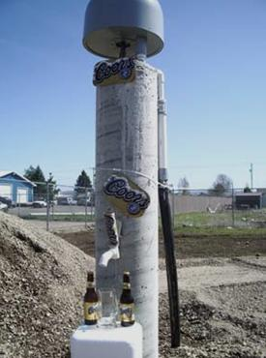
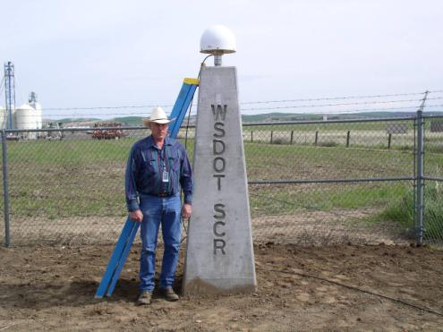
WSRN Regional Integration
WsDOT Mount – Walla Walla
This mount will be there for a few years
KOOT - Kootenai County Airport

Slide 13
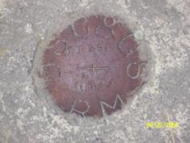
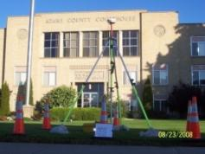
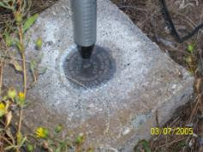
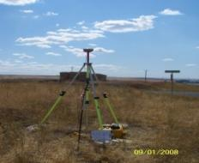
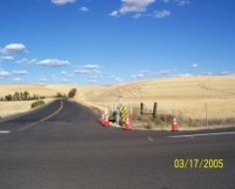
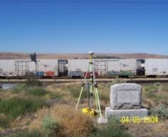
Inventory Monuments
Notes:
Washington has a wide variety of terrain and vegetation types from coastal forests, inaccessible mountain terrain, and arid prairie. Many of the monuments have been destroyed by development and a lack of continued maintenance.

Slide 14
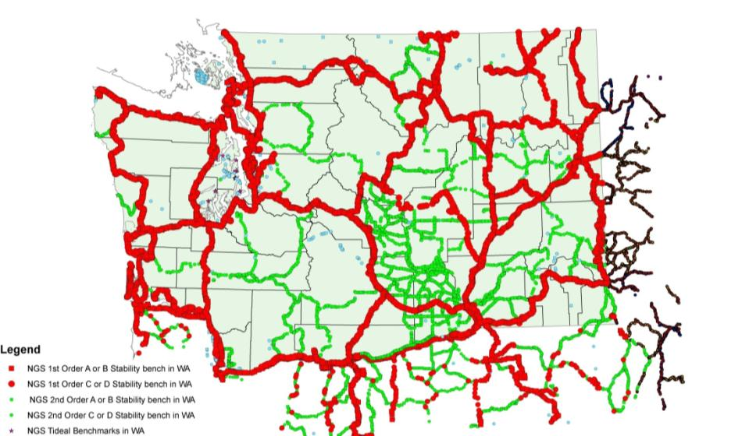
NGS Leveling Network
Notes:
The original NGS network, which is approximately 30% missing or out-of-position

Slide 15
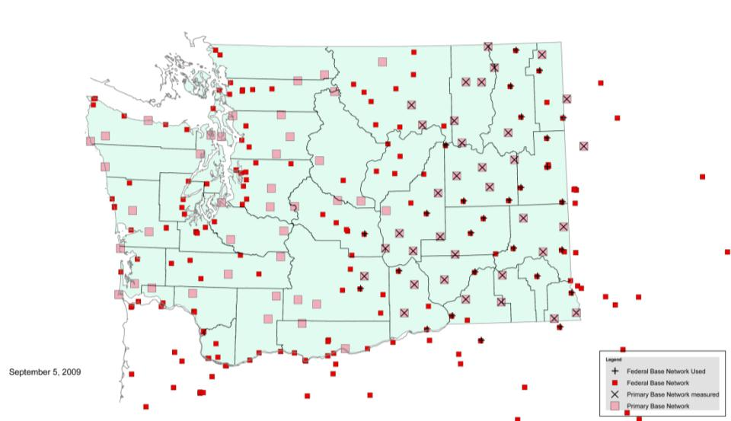
Primary Base Station Network
DNR - SRCW
Notes:
This is an ‘A’ Order horizontal, 4-dimensional, High Accuracy Reference Network
Future intent is to have the WSRN stations included in the NSRS

Slide 16
Primary Base Station Network
The existing High Accuracy Reference Network (HARN) did not routinely include precise ground (orthometric) elevations.
This degrades the geoid model quality, especially in areas of significant crustal motion.
‘A’ Order horizontal and precise ellipsoid height measurement will include 1st order orthometric elevations with optimal spacing of 30 km across the entire state.

Slide 17
Primary Base Station Network
Horizontal positions and ellipsoid heights will be measured on 60 existing 1st and 2nd order benchmarks and tied into 45 existing HARN stations, in addition to Federal CORS, WSRN, and PBO stations. Cost is approximately $8,000 per mark.
Great care is being taken to fine tune the WSRN and all of the ground monuments on their separate datum and all will be included in the National Spatial Reference System.

Slide 18
Primary Base Station Network
An improved geoid model from this data will allow GPS measurements to be made with relative accuracies less than 20 mm vertically and 5 mm horizontally.

Slide 21
Measurement Comparison published vertical to adjusted orthometric heights
Station BM Quality Δ Pub to Measured
N69 2nd Order 0.071 m
F509 1st Order 0.049 m
Z271 2nd Order 0.163 m
B143 1st Order 0.111 m
F30 1st Order -0.081 m
N283 1st Order -0.090 m

Slide 23
Differential Leveling
Contract Leveling
Olympia tidal gauge leveling project
Skamania WSRN station
Spokane WSRN station
Latah WSRN station
Sprague WSRN station

Slide 24
Differential Leveling
Cooperative Leveling
Regional leveling in Tacoma (Pierce County)
Grand Mound WSRN station (WsDOT)
Raymond PBO station (WsDOT)
Chimacum WSRN station (WsDOT)
Darrington WSRN station (WsDOT)
Tumwater Hill PBO station (WsDOT)
North Seattle WSRN station (WsDOT)
Lake Cushman WSRN station (WsDOT)

Slide 25
Support of GRAV-D
NGS has pointed a way to the future elevation datum; a gravity based elevation datum.
The GRAV-D program can be aided by local cooperation and Washington has requested permission to measure a network of absolute gravity stations that are spaced approximately 100 km.
Notes:
Gravity stations will be located near airports to support the aerial GRAV-D survey and are evenly spaced to allow future monitoring of the moving crustal plates

Slide 26
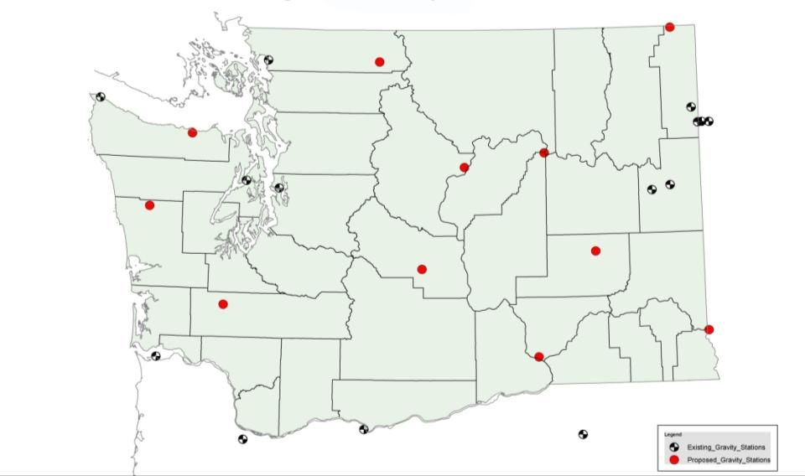
Support of GRAV-D
Absolute Gravity Station Network

Slide 27
Contacts
Washington State Dept. of Natural Resources
Geodetic Survey
David Steele, Director
PO Box 47030
Olympia, WA 98504-7030
360-902-1171
David.Steele@dnr.wa.gov
The Spatial Reference Center of Washington
http://www.washington3d.org/
Washington State Reference Network
http://www.wsrn.org/

