Slide 1
Federal Advisory Committee
NOAA’s Hydrographic Services Review Panel
Northwest Regional Stakeholder Panel
Offshore Renewable Energy
October 13, 2010
Meleah Ashford, Program Manager
Northwest National Marine Renewable Energy Center
Oregon State University

Slide 2








The Northwest National
Marine Renewable Energy Center
US Department of Energy sponsored research center
A partnership between Oregon State University (wave) and the University of Washington (tidal)
Develop a full range of capabilities to support wave and tidal energy development
Center activities are structured to:
  facilitate device commercialization
  inform regulatory and policy decisions
  close key gaps in understanding
Other USDOE Centers include Hawaii (wave and OTEC) and Florida Atlantic University (current energy)
Funding for NNMREC is provided by DOE, OSU, UW and multiple partners

Slide 3
NNMREC is a virtual center focused on research and testing of marine renewable energy
Environmental
Sediment Transport
Electromagnetic Fields
Benthic Ecosystems
Acoustics
Technical
Testing/Demonstration
Wave Forecasting
Survivability/Reliability
Anti-fouling / Corrosion
Device/Array Optimization
Social
Fisheries/Crabbing
Outreach/Engagement
Existing Ocean Users
Local/Oregon Economy

Slide 4
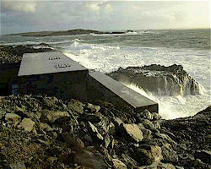
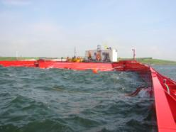
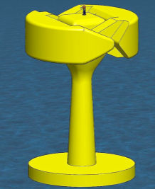
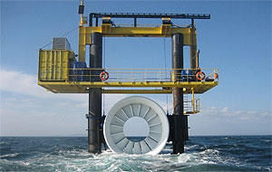
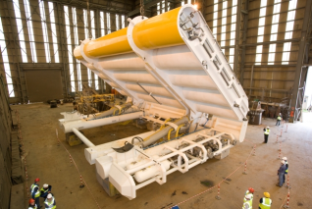
Challenges for Marine Renewable Energy Development
WaveGen
Lack of standardized U.S. testing facilities
Regulatory hurdles
Lack of knowledge about effects/impacts which won’t be understood until we deploy them
Infrastructure to manufacture, service & deploy devices
Funding/financing
Wave Dragon
Open Hydro - tide
Oyster
[Image courtesy Columbia Power, www.columbiapwr.com]

Slide 5
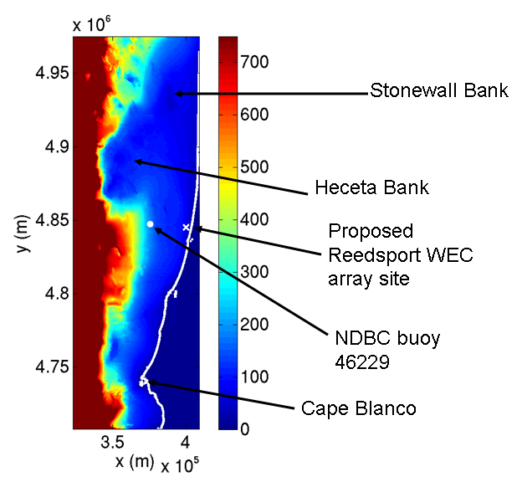
How do we utilize NOAA Hydrographic Data?
Marine renewable energy siting
Marine energy permitting
Marine spatial planning - ocean space-use conflicts
Survivability, reliability and optimal device performance
Environmental effects analysis
Wave forecasting for energy production
Future: adding sites to navigational charts and AIS

Slide 6
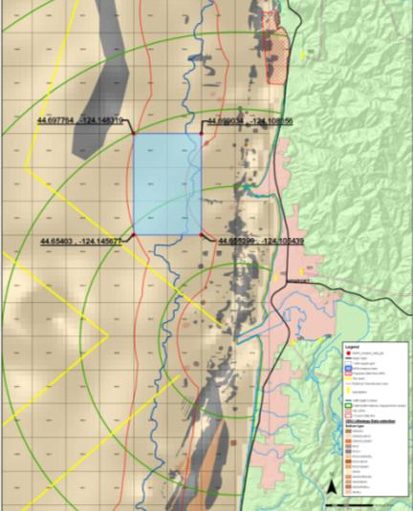
Marine Renewable Energy Siting
Rocky Surface
140ft depth
3NM Line
Marine Reserve
Conditions developers look for:
  Depth
  Bottom Type (rock, soft sandy, etc)
  Bottom Conditions (gently sloped)
  Proximity to the electrical grid
  Proximity to Ports for deployment and O&M
  Marine traffic
  Avoidance of high-value areas (reefs)
OSU Mobile Ocean Test Berth Siting Example
Future need for sites to be on navigational charts and Automatic Identification Systems (AIS) (Likely to be “areas to be avoided”)
Test site study area
Tow lane
Distance from Port

Slide 7
Marine Energy Permitting
Development of Environmental Impact Statements or Environmental Assessments for projects, these utilize:
  Navigational charts (navigational hazards and restrictions)
  Danger to Mariners
  Wreck and Obstruction Information System (AWOIS)
  Dredge Disposal Sites
  Essential Fish Habitat
  Downloadable GIS layers for presentation purposes
  NEPA, SHPO, EFH, Navigational Permits, 404, Section 10, ESA, ACHP
  DSL, USACE, NMFS, DWR, FERC, BOEM, DEQ, ODFW, CWA, CZMA, USCG, USFWS
  Fishermen, Recreational Users, Surfers, Ports, Economic Development, Conservationists, Marine Reserves, Utilities

Slide 8
Marine Spatial Planning/Ocean Space-use Conflicts
Identifying both the potential for conflict between ocean uses and ways of mitigating conflicts is key to meeting the needs of our economy and society while safeguarding environment and coastal communities.
Type I Conflicts: Areas with existing regulated, restricted, or prohibited access such as:
      Major shipping routes.
      Military exercise grounds.
      Major coastal or offshore structures (bridges, harbors, oilrigs).
      Sub-sea cables or pipelines.
      Marine protected areas for fisheries management or marine conservation.
Type II Conflicts: Areas with conflicting uses such as
      Commercial and recreational fishing grounds.
      Resource extraction areas.
      Tourism and non-consumptive recreational areas.
      Archaeological sites such as shipwrecks.
      Cultural significance, for example, customary use or tribal history.
A lack of information and accessible geovisualization tools and spatial decision support tools to assess tradeoffs hinders planning efforts.

Slide 9
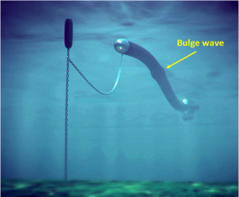
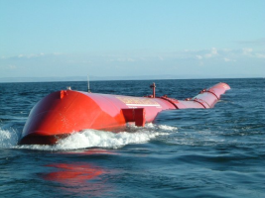
Survivability, Reliability and Optimal Performance
What are the conditions that devices must survive?
  Wave spectral (height and period) data from NOAA buoys was used to characterize storm conditions and establish design parameters
  Predicting when waves break in the open ocean is important for survivability design
  Shoreline and bathymetry data for visualization/presentation
Data can be used to optimize device performance
  Directional wave data was useful for optimizing device design
  Not all NOAA buoys have directional data
Anaconda device must face into the waves
Pelamis device must face into the waves

Slide 10
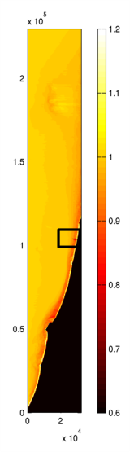
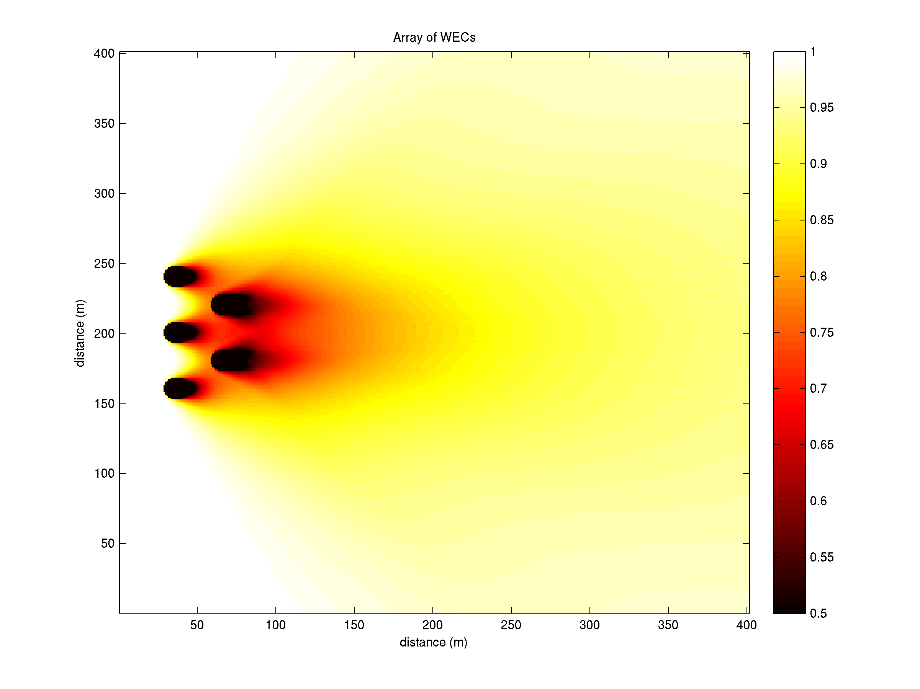
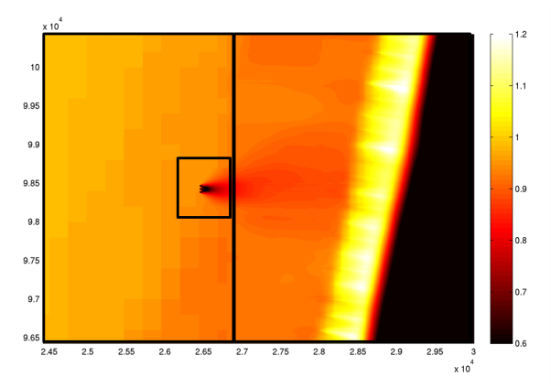
Environmental Effects
Wave energy devices will extract energy from waves, which can change shoreline features and energy that might affect nearshore life
Work by Dr. Tuba Ozkan-
Haller & graduate student
Jeff Oskamp/OSU at OPT’s
Reedsport project site
(funded by OWET/DOE)

Slide 11
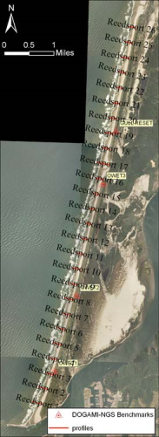
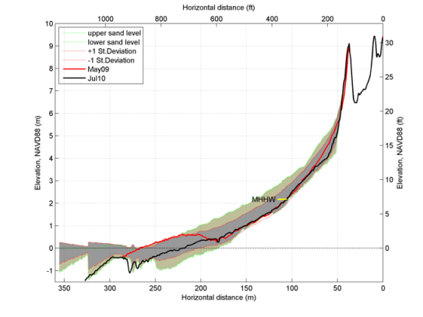
Environmental Effects
Wave energy devices will extract energy from waves, which can change shoreline features
OSU and partners are collecting baseline sediment data at candidate sites.
Monitoring Beach and Shoreline Morphodynamic, by Jonathan Allan, Oregon Department of Geology and Mineral Industries (work funded by OWET)

Slide 12
Advanced Wave Forecasting
Winter Storm Summer Sea
SWAN model is used to predict nearshore waves
  NOAA bathymetry used to refine model
  NOAA NDBC Buoy and nearshore wave measurements used to validate model
  Correlation of model and measured data is within 10%
  Analysis allows us to understand refraction and diffraction around bathymetric features and how that will affect power generation
  For nearshore (<200m depth), disparate data is pieced together for more accurate bathymetry (Corps, NOAA & others). The Tsunami Inundation Mapping Project for the Pacific Northwest has integrated data
  Nearshore bathymetric data is not accurate because of year-to-year changes in bathymetry and often is in need of updating
AWAC
NDBC buoy 46229
Wave Height (m)
Reedsport, OR - Site of OPT’s planned Powerbuoy array deployment

Slide 13
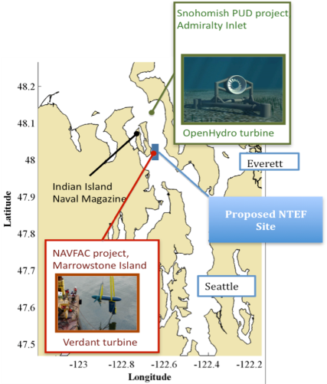
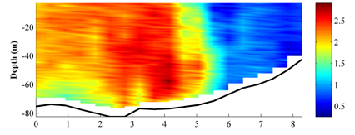
Tidal Energy – Puget Sound
Siting of Tidal Testing Facilities
NOAA bathymetric data is used for coarse site assessment:
Recent modifications to the NOAA GIS web interface have made it easier to navigate the site or download products.
NOAA data is used to predict tidal currents for site operations:
Data generally underpredicts peak currents at our site, as well as misrepresenting the timing of slack water and peak currents by up to an hour. NOAA is aware of this and planning a resurvey effort in Puget Sound in FY11.
m/s
Current Velocity Profile

Slide 14
Conclusions & Recommendations
Conclusions:
  Marine Renewable Energy appears to be moving forward as seen by high interest from developers nationally and internationally
  The current focus of developers is the technology so interactions with hydrographic data will likely be expanded with more maturity as developers move to site projects
  Hydrographic data will be used extensively for
    Marine renewable energy siting
    Marine energy permitting
    Marine spatial planning - ocean space-use conflicts
    Survivability, reliability and optimal device performance
    Environmental effects analysis
    Wave forecasting for energy production
Recommendations:
    Outreach/education to developers and agencies about available data
    Continue improvement of access and interface tools
    Continue to develop more accurate and recent bathymetry data, particularly in the <200m nearshore area
    Incorporate data from others (Corps) more frequently into a single data set
    Consider sponsoring a navigational impacts study (How will Marine Renewable Energy project impact navigation?)
    Requirie notification of project siting for navigational charts and Automated Identification Systems (AIS)

