Slide 1
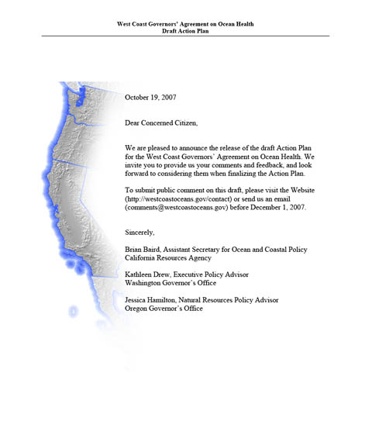
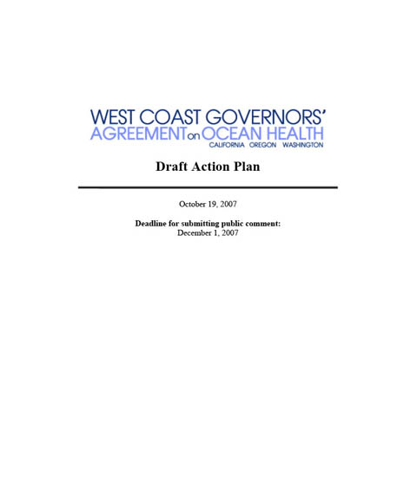
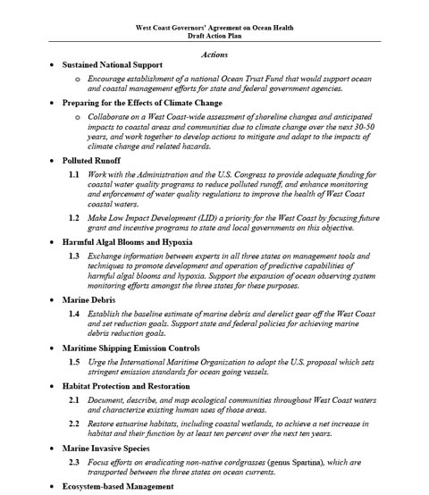
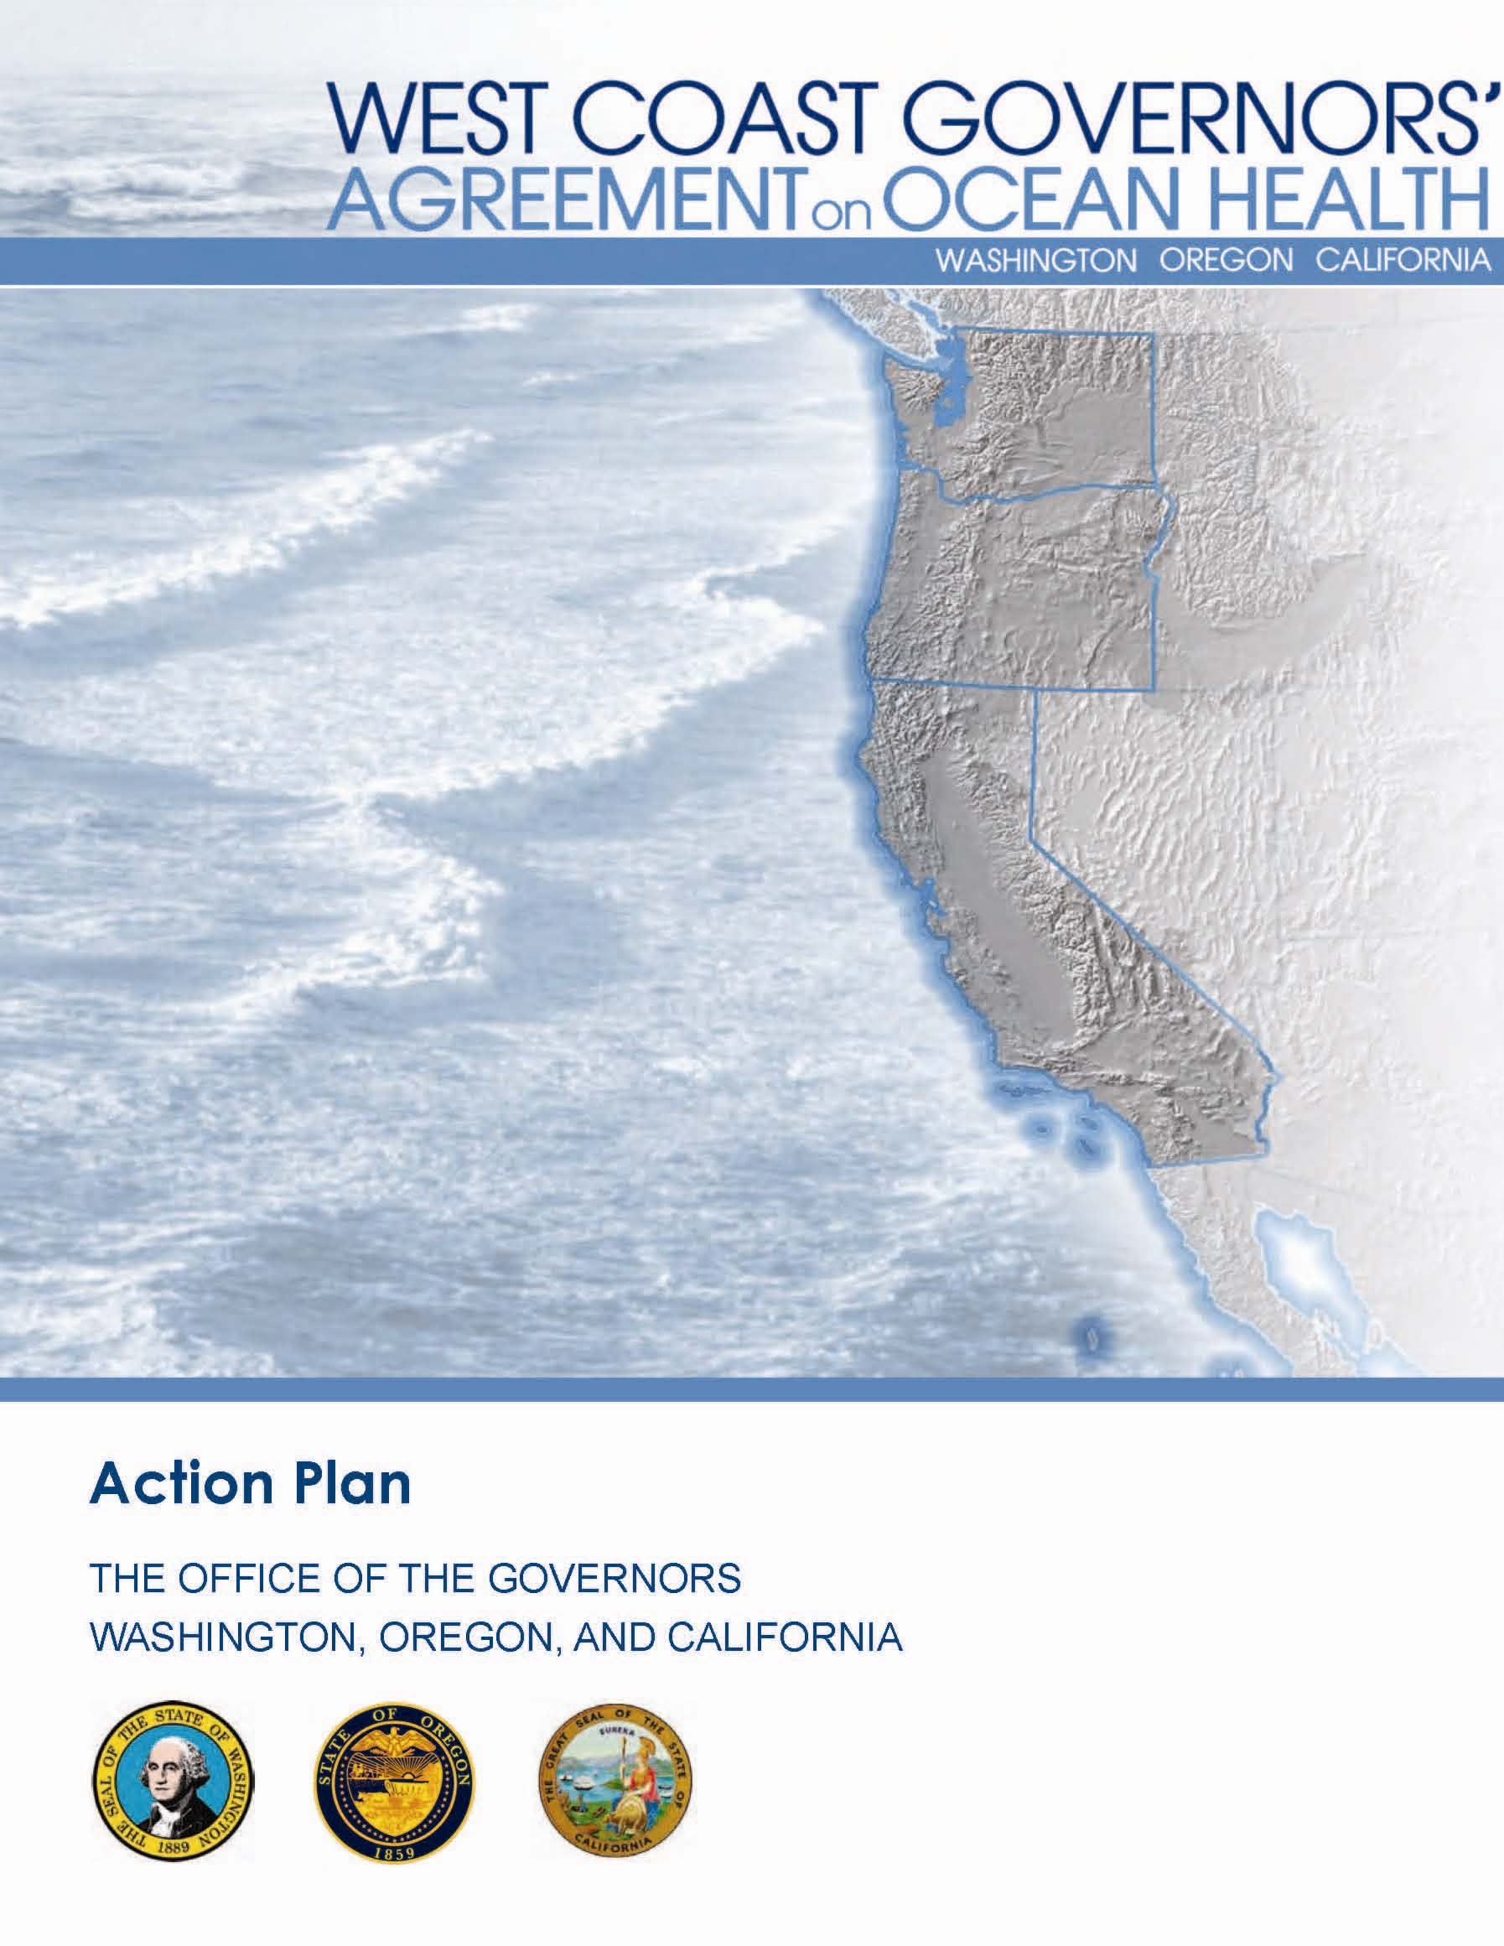
Climate Change
Notes:
1

Slide 2
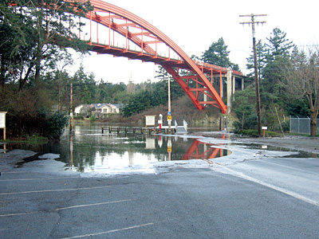
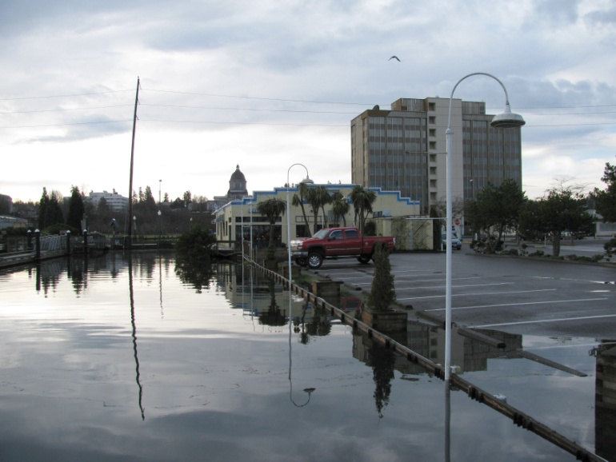
Overview
Climate Change
Impacts
State and Federal partnership
Notes:
2
Talk is broken into two general categories. The first part covers how the ACT is addressing climate change impacts and the second part describes the State-Fed partnership.
The primary objective of the Climate Change ACT is to create a framework and access to information that helps local governments wisely plan for the shoreline impacts resulting from climate change over the next several decades. The products from this ACT should assist state agencies in their various roles managing coastal lands, with an emphasis on those activities involving local land use and infrastructure planners as well as resource managers. In addition, this group will provide recommendations to facilitate continuing coordination among the states and federal agencies by identifying the common regional issues and solutions. Specifically, the Climate Change ACT seeks to provide access to tools and information that will allow the states to develop strategies necessary to address shoreline change, and for local governments to develop detailed vulnerability assessments.

Slide 3
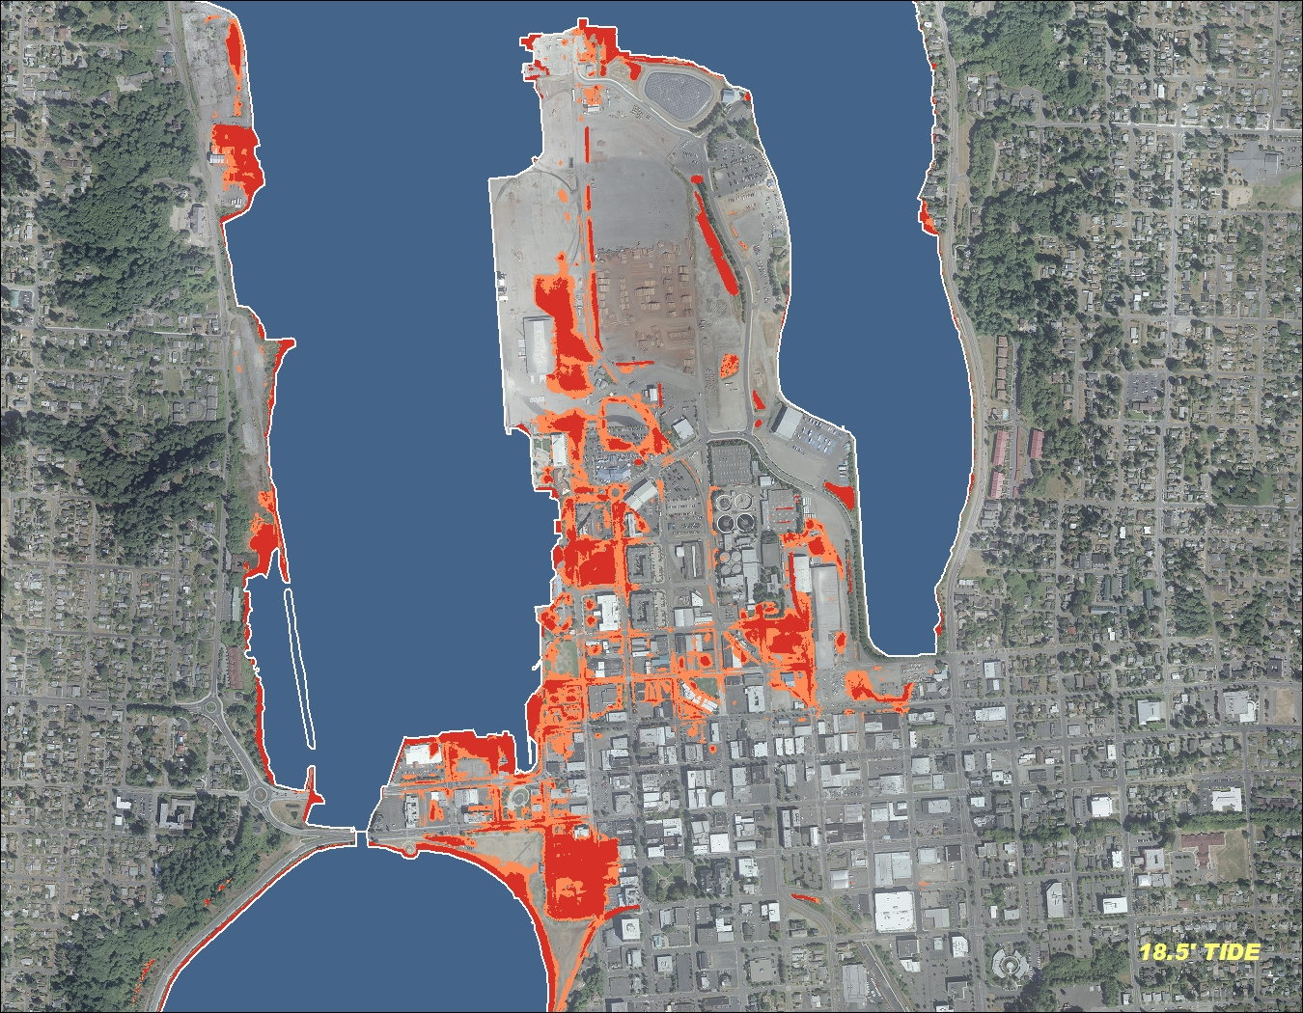
1. Impacts from Climate Change
Shoreline changes
Coastal areas
Communities
Coastal hazards
18 ft. tide
18.5 ft. tide
Notes:
3
These are the four areas that will be covered for climate change impacts.

Slide 4
Scope of Work
A west coast-wide assessment
Recommendations to mitigate and adapt
Engage with stakeholders
Promote a consistent frame of reference
Liaison with the Sediment Management ACT
Align methods and tools to improve info exchanges
Notes:
4
So, to begin with the climate change impacts, the scope of work develops a west coast-wide assessment of shoreline changes and anticipated impacts to coastal areas and communities due to climate change over the next several decades and work to develop recommended actions to mitigate and adapt to the impacts of climate change and related coastal hazards. Specifically, the Climate Change ACT will seek to:
• Engage with academia, nongovernmental entities, local, state and federal government agencies, tribal governments, and the private sector to ensure that impacts to the West Coast under various likely climate change scenarios are modeled.
• Promote the use a consistent frame of reference for predicting and responding to shorelines changes from storm surge events and sea level rise (SLR). Liaison with the Sediment Management ACT to ensure climate change impacts, manifested in sediment dynamics, are addressed properly.
• Promote and facilitate the alignment of methodologies and tools to improve information exchanges across the region.

Slide 5
Shoreline Changes
Sea level rise and storminess estimates
Develop a consensus of estimates and uncertainties
For 2030, 2050, and 2100
Bring together west coast scientists
Assess climate/weather models of extreme events
Notes:
5
Develop a consensus of estimates and uncertainties of SLR and changes in storminess (including overall atmospheric and oceanic processes) along the west coast of the United States for the years 2030, 2050, and 2100. Through the relationships and partnerships fostered by the WCGA, the three states, with some support from NOAA, USGS and the Army Corps of Engineers, have funded the NAS to conduct this Sea Level Rise Assessment Report that will begin in early 2010. The study will establish regional estimates with ranges and uncertainties covering:
a. Global inputs to SLR
b. El Niño/Southern Oscillation, Pacific Decadal Oscillation, other oceanic conditions
c. Storm frequency and intensity/storm surge
d. Local factors effecting relative SLR such as seasonal tidal changes, winds and currents, vertical land movement (VLM) and other local atmospheric effects or extreme weather events.
2.1.2 Bring together west coast scientists in a workshop, or series of sub-regional workshops, to develop a consensus process to share current knowledge and to promote idea sharing related to generating estimates listed in 2.1.1. Although such workshops will be part of the NAS study, the Climate Change ACT may recommend additional workshops to achieve these objectives.
2.1.3 Assess climate/weather models that capture extreme events and what these models can reveal about impacts to shoreline from SLR and storminess. In this assessment of models, consider whether the further development of regional climate models, or other strategies, would be the most efficient in terms of both cost and resources well still addressing the needs of regional, state and local coastal resource managers.

Slide 6
Coastal Areas and Hazards
Natural Shorelines
ID the physical forcing mechanisms
Develop a common classification system
ID and catalogue potential impacts
ID possible assessment methods and predictive models
Modified Shorelines
Develop a common classification system
Identify and catalogue impacts
Notes:
6
Outline a strategy for developing an improved understanding of the physical impacts on coastal environments.
Natural Shorelines
a. Identify the physical forcing mechanisms associated with climate change (e.g., SLR, increased storm activity, increased wave height, sediment budget and composition changes) that will impact coastal environments.
b. Develop a shoreline classification system for a west coast-wide physical impacts assessment of shoreline change.
c. Identify and catalogue potential impacts of the different physical forcing mechanisms (2.2.1.a) to different shoreline types identified in the classification system (2.2.1.b).
d. Identify possible assessment methods and predictive models that could forecast the impact of the physical forcing mechanisms associated with climate change on specific coastal regions.
Modified Shorelines
a. Develop a classification system for modified shorelines.
b. Identify and catalogue how various modified shorelines might be impacted by the physical forcing mechanisms identified in 2.2.1.a.

Slide 7
Coastal Geomorphic Systems
Rocky Coasts and Headlands
e.g., plunging sea cliffs
Deposition Coasts
e.g., barrier beaches, spits, beaches, dunes
Erosion Coasts
e.g., bluffs, marine terraces, sea cliffs
Estuaries and Lagoons
e.g., barrier estuaries, closed lagoons and marshes
Notes:
7

Slide 8
Physical Forcing Mechanisms
• Sea Level Rise
Increased Storm Activity
Increased Wave Height
• Changes in:
Seasonal stream flows
Seasonal precipitation patterns
Long-term precipitation patterns
Dominant wind pattern
Sediment composition and budget
Notes:
8

Slide 9
Communities
Coastal ecosystems as adaptation tools for community and resource managers planning
ID habitat types for protection, restoration and/or enhancement
Highlight priorities and “Best Management Practices” for managers
Use coast-wide habitat map to identify “hotspots” of threatened habitats
Provide guidance for adding resilience to “buffering” habitats
Notes:
9

Slide 10
2. State and Federal interests
Progress and coordination
Challenges
Uses of data in decision-making
State and Federal partnership
Notes:
10

Slide 11
Progress and Coordination
Progress
NAS study on West Coast SLR and Storminess Estimates was funded
Physical impacts assessment: natural shorelines
Summary of potential ecosystem impacts - $20,000 to support intern
Adaptation strategies database
Notes:
11

Slide 12
Challenges
Funding
Continuing to look for additional funding sources
Staffing , we now have…
NOAA Coastal Fellows in 3 states working on coastal climate impacts
WCGA funding for an intern to characterize observed and anticipated ecosystem effects of SLR, storminess, and extreme events on coastal habitats (section 2.3 of work plan)
Notes:
12

Slide 13
Uses of data in decision-making
Coastal Climate Change Adaptation ‘Guidebook’
To provide tools and resource to coastal resource managers
Information Needs to plan for coast impacts/ inundation
Identify key baseline data needed– such as:
shoreline maps and collection of topographic and bathymetric merged data (e.g., LIDAR);
coastal vertical uplift and subsidence
Work with the Seafloor Mapping ACT to identify potential sources for the bathymetric and topographic data and the resources needed to create accurate shoreline maps.
Notes:
13

Slide 14
The Fed-State partnership
Ecosystem Impact Assessment: Co-sponsored a conference for coastal natural resource managers, highlighting the “state of the science” presentations from ecological, climate, and policy experts. [Completed January 2009].
NAS study supported by 3 states, NOAA, USGS, and the Army Corps of Engineers
Develop database of adaptation methods with the Climate Impacts Group (CIG)
Co-chairs for Climate Change ACT
Notes:
14

