Slide 1
The West Coast Governors’ Agreement on Ocean Health
Jessica Hamilton Keys
Natural Resources Policy Advisor
Oregon Governor Ted Kulongoski
Hydrographic Services Review Panel
October 12, 2010

Slide 2
The Call for Regional Ocean Management
Two national ocean commissions identified the need for a regional, ecosystem-based approach to ocean management
We have limited state jurisdiction and capacity to address the size and complexity of the marine ecosystem and diversity of its uses in federal waters
New state-federal partnerships and ecosystem-based management are needed to achieve long-term ocean stewardship

Slide 3
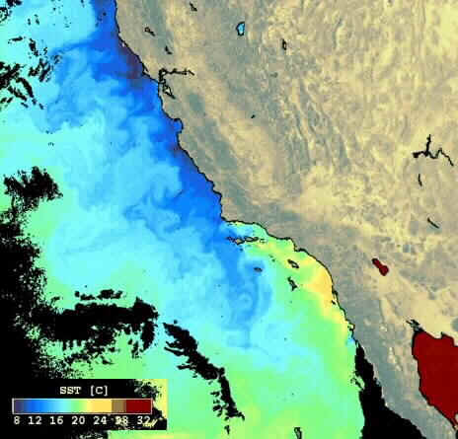
The California Current: Transcending Political Boundaries
Water pollution
Education needs
Declining fish populations
Degraded marine habitats
Climate change impacts
Marine research needs

Slide 4
Strategic Alliances Create Collaboration Opportunities
Create mechanisms to share lessons learned from all stakeholders
Expand scientific and educational efforts
Coordinate management strategies for shared coastal and marine resources
Engage federal government on issues that warrant national level support and attention

Slide 5
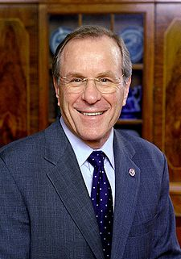
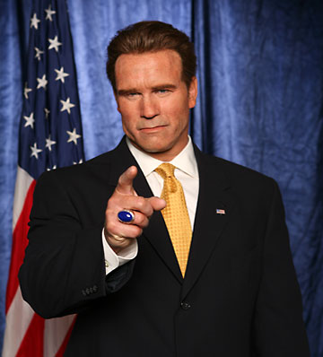
Theodore R. Kulongoski
Governor of Oregon
Christine O. Gregoire Governor of Washington
Arnold Schwarzenegger
Governor of California
Notes:
2006

Slide 6
Shared Priorities for the West Coast
Ensure clean coastal waters and beaches
Reduce adverse impacts of offshore development
Protect and restore healthy ocean & coastal habitats
Implement ecosystem-based management
Foster sustainable economic development in coastal communities
Increase ocean awareness and literacy
Expand ocean and coastal scientific research
Notes:
They established the following 7 broad priority areas:

Slide 7
Executive Committee
California | Oregon | Washington
Brian Baird Assistant Secretary for Oceans Natural Resources Agency | Jessica Keys Natural Resource Policy Advisor Governor Kulongoski’s Office | Bob Nichols Policy Advisor Governor Gregoire’s Office
Federal Partners
Usha Varanasi, Dept. of Commerce (NOAA)
Alexis Strauss, Environmental Protection Agency
Joan Barminski, Dept. of Interior (Ocean Energy Mgmt.)
Notes:
EMPHASIZE working relationship
Comfortable speaking for each of us

Slide 8
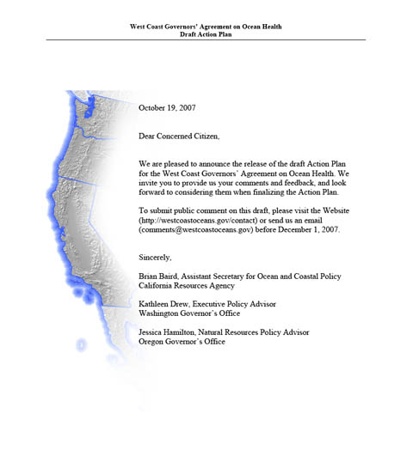
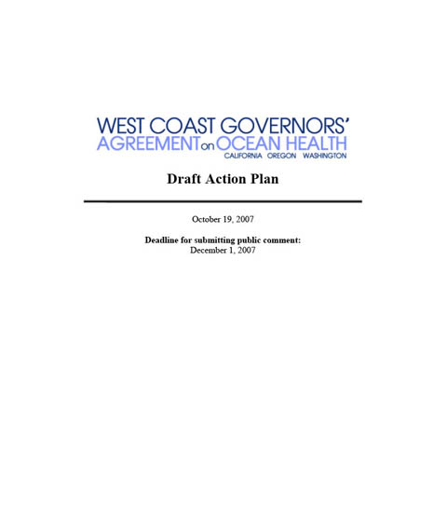
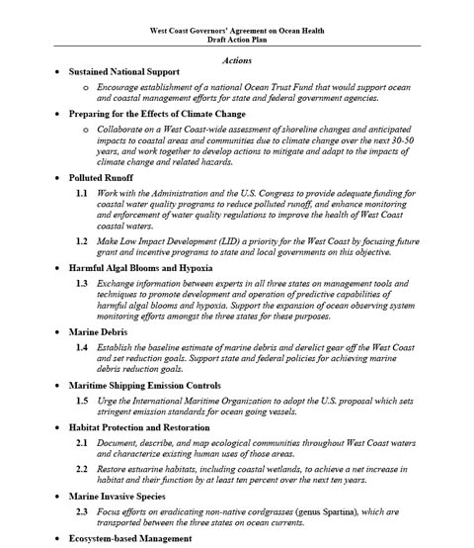
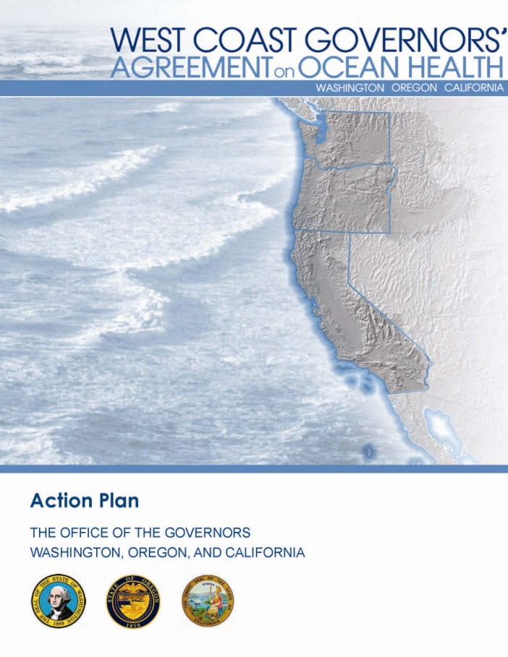
Notes:
8
26 actions – 2008
Public comment
The action plan covers a diverse range of activities such as:

Slide 9
Examples of the 26 Actions of WCGA
Evaluate the potential impacts of offshore alternative energy development
Complete a seafloor map for West Coast territorial seas
Reduce marine debris
Support local planning efforts for working waterfronts
Promote “clean ports” and the Clean Marinas Program
Notes:
9
Create a framework and access to information that helps local governments wisely plan for the shoreline impacts over the next several decades

Slide 10
Action Coordination Teams (ACTs)
Seafloor mapping
Polluted runoff
Marine debris
Spartina eradication
Renewable ocean energy
Ocean education
Sediment management
Climate change
Integrated ecosystem assessments
Sustainable coastal communities
Notes:
10

Slide 11
Future Step: Identify West Coast Research Priorities
WCGA Goal: Create a regional research priority plan to strategically focus investments in improved scientific understanding of ocean resources and processes.
Based on advice from Sea Grant and other marine experts, the WCGA will identify the top 3 to 5 research priorities for the California Current Large Marine Ecosystem.
Notes:
11
In Winter 2009-2010, marine scientists and experts will identify the top 3 to 5 priority research areas for the California Current Large Marine Ecosystem to be addressed via the WCGA. The 46 priorities listed in the Sea Grant Regional Research and Information Needs report will be reviewed by these experts in coming up with the top regional priorities.
Following this selection process, a new Research ACT will track the efforts of the region to address the research priorities identified. The Research ACT will also ensure that the other ACTs use the best available science in the implementation of their issue specific work plans.

Slide 12
WCGA Federal Funding
Fiscal Year 2010: $500,000 for WCGA
Congressional leadership on Governors’ request
Pacific States Marine Fisheries Commission will manage the grants for the region
Eight ACT work plans will be advanced
Fiscal Year 2011:
$1 million for WCGA
Compete with 8 regions for part of $20 million
NOAA prioritizing marine spatial planning
Notes:
12
Further the goals of the ACT work plans
Include diverse stakeholders and a coast-wide perspective
Result in concrete outcomes or products that benefit coastal communities
Result in positive effects on coastal and ocean ecosystems
Address a time-sensitive or urgent issue
Be technically feasible
Have demonstrated support
Identify areas of synergy across ACTs

Slide 13
National Ocean Policy Framework
Common Principles
Ecosystem-based management
Adaptive management
Precautionary approach
Minimize cumulative impacts
Common Priorities
Climate change resilience and adaptation
Water quality and sustainable practices
Strengthen observation systems

Slide 14
National Framework for Coastal and Marine Spatial Planning
Common Goals
Support sustainable uses
Provide for public access
Enhance intergovernmental collaboration
Common Principles
Reduce conflicts of existing and emerging uses
Involve partners, the public, and stakeholders through a transparent process
Use best available science-based information
Notes:
In addition to principles recognized in the Interim Framework (such as EBM and adaptive management), the CMSP Framework highlights some additional goals and principles. The ones listed here are ones that align with those of the WCGA.
Geographic Scope
Regional scale planning based on eleven recognized Large Marine Ecosystems (LME)
Regional Partnerships
WCGA is the existing regional partnership for the California Current LME

Slide 15
Challenges for Regional CMSP
Adequate and sustained funding
National consistency vs. regional flexibility
Timeline
Planning and engagement fatigue
Scale
Lack of capacity
Changes in CA and OR Governors
Notes:
15
Challenges for state and federal reps thus far have been capacity to engage in ACTs and develop plans
Challenges will increase with implem NOP and CMSP
Additional and sustained resources for the regions and states are critical to tackle CMSP. This includes both direct support for states and regions to conduct CMSP activities prioritized by the regions as well as indirect support for federal agencies to engage and provide technical assistance. This effort cannot and should not take away from existing coastal and ocean management programs, but rather be focused on where opportunities present themselves.
Priorities and drivers for CMSP vary across states and regions. Reflecting bottoms-up needs and processes but providing region-wide focus.
National consistency versus regional flexibility. National guidance and activities should continue to reflect flexibility needed by states and regions and acknowledge their authorities in approaching CMSP – unique issues that states and regions need to focus on and thus, plan different plan outcomes and implementation mechanisms. National guidance should also acknowledge, reflect, and involve regional/state/local expertise in developing any national criteria or launching CMSP-related activities.

Slide 16
WCGA Actions in Response to Frameworks
Connections to existing regional priorities
Integration and alignment with state efforts
Structure & organizational adjustments
Supporting FY11 mark for $20 million for Regional Ocean Partnerships
Responding to NOAA’s Federal Funding Opportunity
Governance Coordinating Committee names
Notes:
16
WCGA is exploring options for addressing national CMSP framework in the following ways:
Connection to existing regional priorities, particular existing ACTs like Seafloor Mapping, Renewable Ocean Energy and Integrated Ecosystem Assessments.
Structure/organization – tribes and Pacific Fisheries Management Council conversations ongoing among governors offices and initiating conversations with the other entities that need to be involved.
Next Steps: determining what tasks are needed over the next year to prepare for developing a plan (what’s the plan for a plan) (e.g. resources, processes, and data). This includes developing a process and priorities for federal funding for CMSP – should it become a reality…

Slide 17
www.westcoastoceans.gov
Thank you!

Slide 18
ADDITIONAL SLIDES
Notes:
You can find more information including the WCGA Action Plan and the ACT Work Plans at our website.

Slide 19
Definitions
A healthy ocean and coast means that…
marine, coastal, and estuarine ecosystems, the watersheds that drain into these waters, the plant and animal communities therein, and the physical, chemical, and biological processes involved are diverse and functioning, and the economies and people depending on them are thriving.
Notes:
19

Slide 20
Definitions
Ecosystem-based management (EBM) is…
a process that integrates ecological, social, and economic goals, recognizes humans as key components of the ecosystem, and considers ecological boundaries while acknowledging political borders. An EBM approach assesses cumulative impacts from various sources and strives to balance conflicting uses.
Notes:
20

Slide 21
Benefits of CMSP on Regional Level
Leverage resources
Integrate with and advance current state & regional priorities
Coordinated regionally but implementation will occur at state level
Create common information & roadmap
Provide opportunities for increased collaboration with tribes, scientists, stakeholders, and communities
Notes:
21

