Slide 1
HSRP Spring Meeting
May 4, 2011
David M. Kennedy

Slide 2
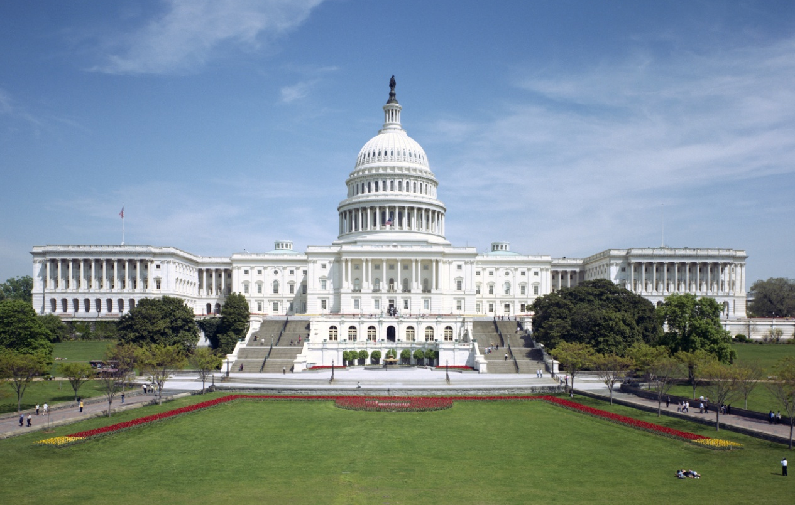
Challenges – Appropriations
FY 2011 Continuing Resolution Process
Expectations for FY 2012

Slide 3
Opportunities – National Ocean Policy
NOAA’s Coastal Goal Objectives | National Ocean Policy Priority Objectives
Resilient coastal communities that can adapt to the impacts of hazards and climate change | Resiliency and adaptation to climate change and ocean acidification
Comprehensive ocean and coastal planning and management | Coastal and marine spatial planning
Safe, efficient environmentally sound marine transportation | Ocean, Coastal, and Great Lakes observations, mapping, and infrastructure
Improved coastal water quality supporting human health and coastal ecosystem services | Water quality and sustainable practices on land
Safe, environmentally sound Arctic access and resource management | Changing conditions in the Arctic: address environmental stewardship needs

Slide 4
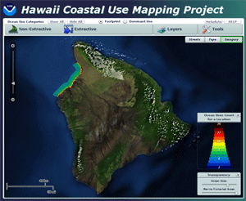
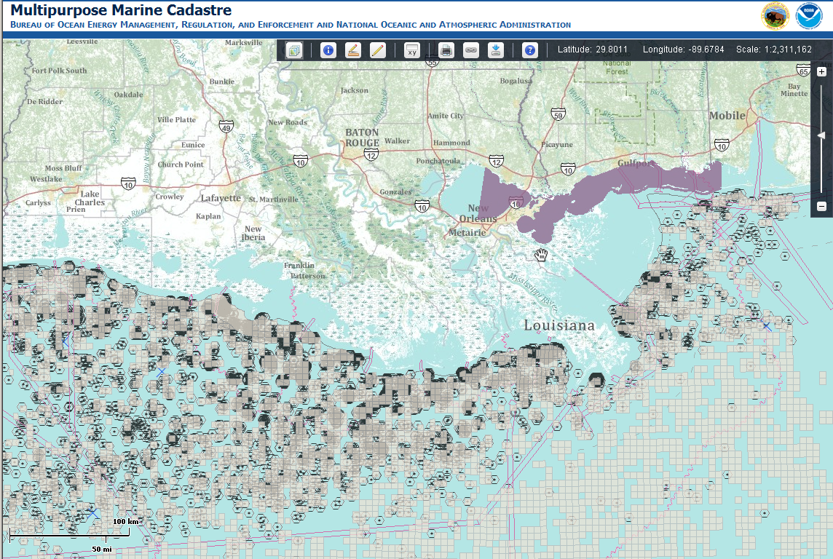
Coastal and Marine Spatial Planning
Decision-support tools, data integration, and mapping
Effective, ecosystem-based planning through regional governance

Slide 5
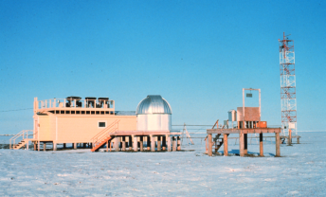
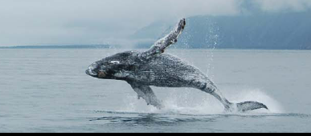
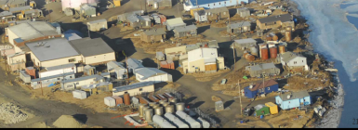
NOAA’s Arctic Vision and Strategy
Arctic V&S Goal
Purpose
Forecast Sea Ice
Strengthen Foundational Science to Understand and Detect Arctic Climate and Ecosystem Changes
Improve Weather and Water Forecasts and Warnings
Enhance International and National Partnerships
Improve Stewardship and Management of Ocean and Coastal Resources in the Arctic
Advance Resilient and Healthy Arctic Communities and Economies
Accurate daily to decadal predictions of sea ice for safe Arctic operations and ecosystem stewardship.
Improved baseline obs and understanding of Arctic climate ecosystems to reduce uncertainty of changing Arctic impacts.
Ensures society can prepare for and respond appropriately to weather-related routine and extreme events.
For cooperation and sharing of data, obs platforms, and intellectual resources to achieve Arctic science/EBM goals.
Using sound science to support healthy, productive, and resilient ecosystems.
Support with improved geospatial infrastructure, safe navigation, oil spill response readiness, and climate change adaption strategies.

Slide 6
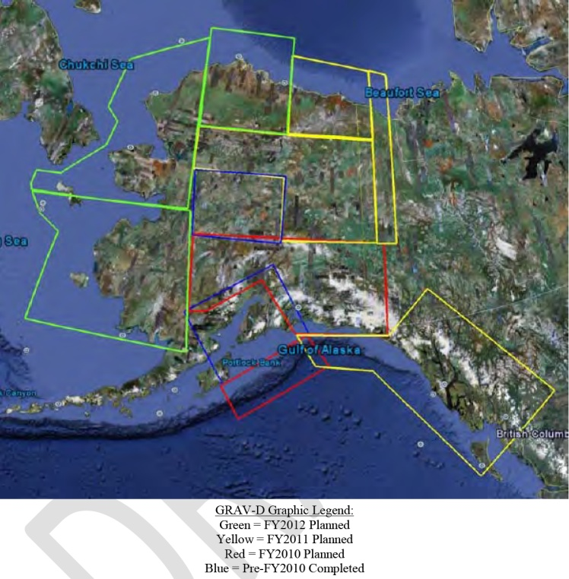
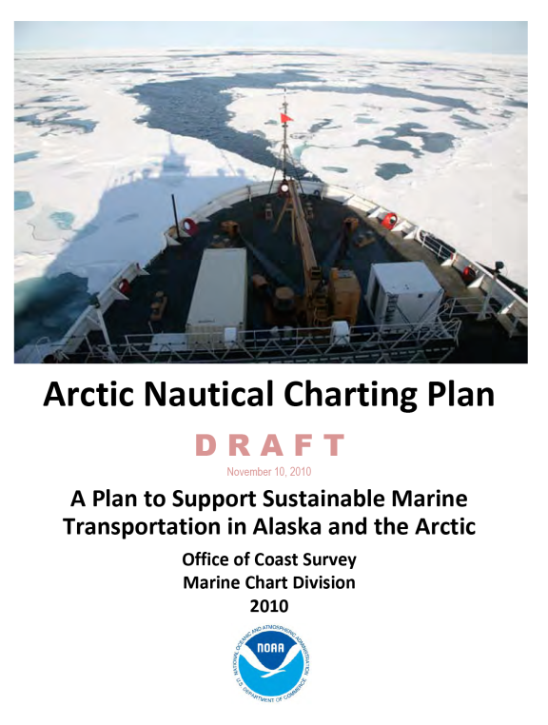
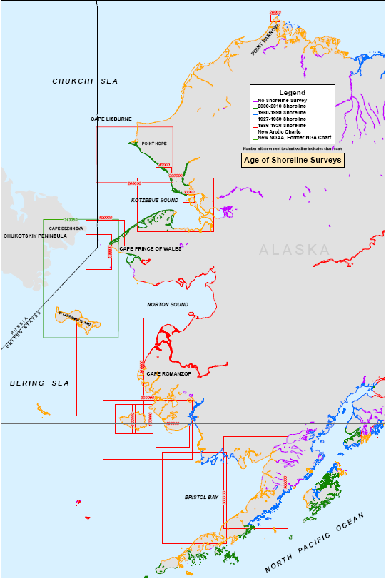
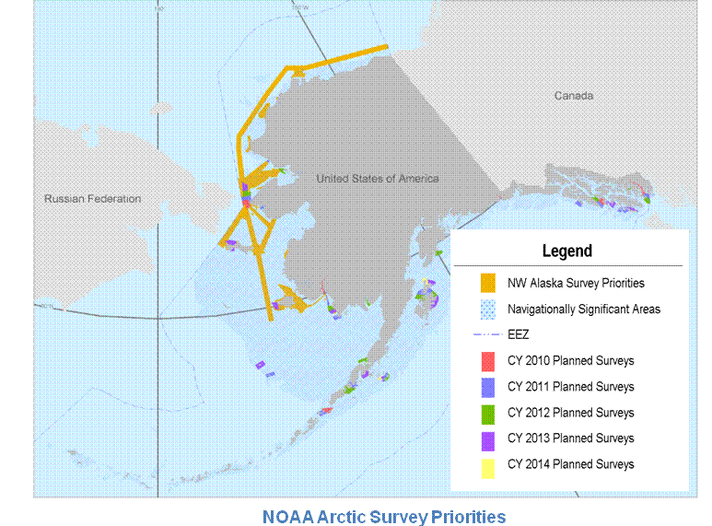
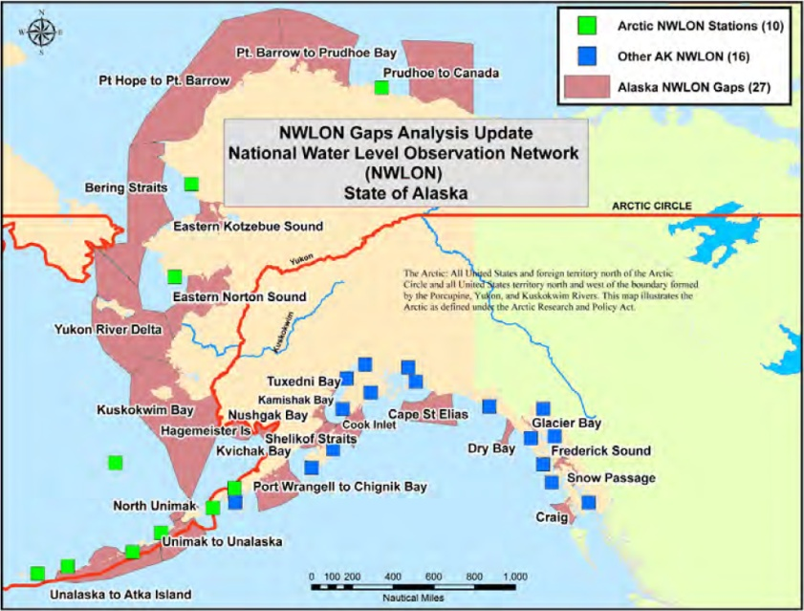
Addressing Arctic Needs
Updating Shoreline Data
GRAV-D Data Collection
NWLON Gap Analysis
Hydro Survey Plans

Slide 7
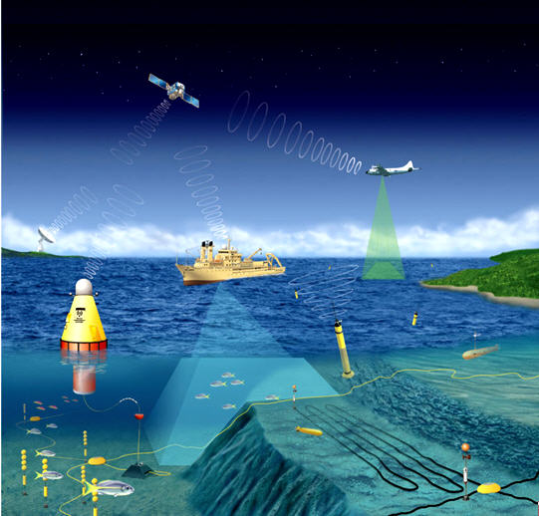
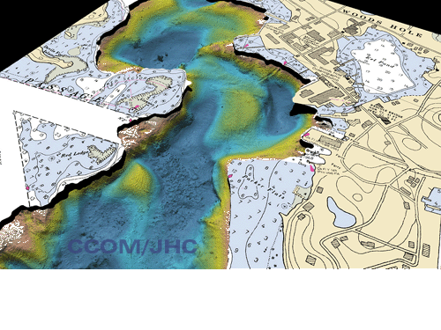
Obs, Mapping, and Infrastructure
Strengthen and integrate:
Ocean observing systems
Sensors
Data collection platforms
Data management
Mapping capabilities

Slide 8
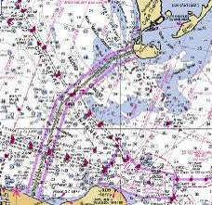
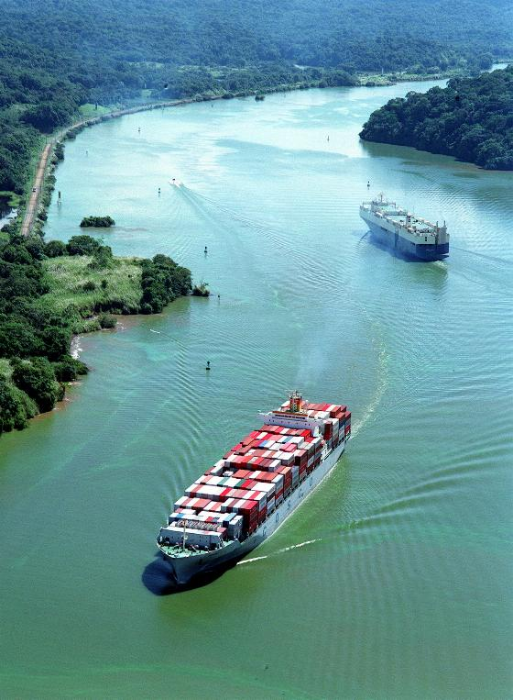
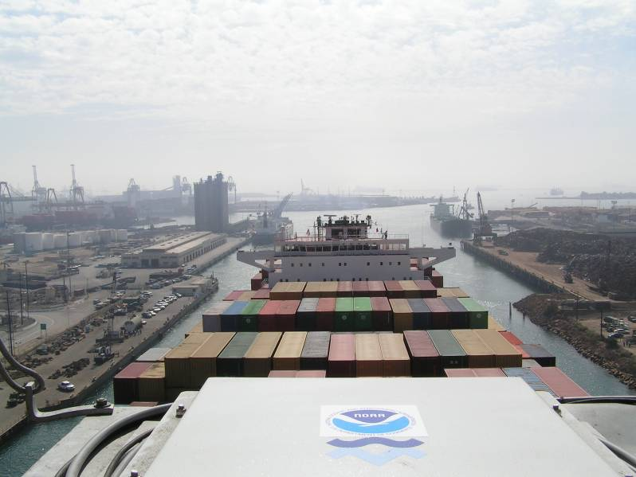
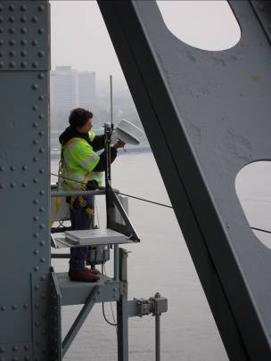
Other Opportunities
National Export Initiative
Panama Canal Expansion and PORTS
Harbor Maintenance Trust Fund
Economy, Government Efficiency

Slide 9
HSRP Strategy
Ensure programs align with and support NOAA and Administration priorities (e.g. NOP, NEI)
Recommend approaches to quantify economic, societal benefits
Ensure programs are meeting user needs and providing maximum value
Help identify outreach opportunities to strengthen stakeholder support

