Slide 1
National Geodetic Survey Update
Hydrographic Services Review Panel
Honolulu, HI
May 4, 2011
Juliana Blackwell
Director
National Geodetic Survey

Slide 2
Performance Measures
Support many of HSRP’s most wanted improvements
Disseminate NOAA’s hydrographic services data and products to achieve greatest public benefit
Current GPRA: Percentage of U.S. counties enabled with accurate positioning capacity
Modernize heights
New GPRA 2013: Percent of U.S. enabled to benefit from a new national vertical reference system (GRAV-D)
Aggressively map the Nation’s shorelines
Update the U.S. shoreline
Update the shoreline in priority ports
Analyze priority ports for changes

Slide 3
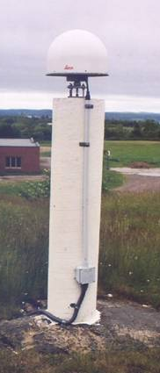
Joint Milestones
Expansion of National VDatum
Two new VDatum models Texas, New England
New guidelines for geospatial infrastructure for monitoring coastal and environmental change at sentinel sites and other coastal reserves
Establish and co-locate 3 Continuously Operating Reference Stations (CORS) at tide and water level stations:
Oregon coast, San Francisco Harbor, Midway Island

Slide 4
Recent Accomplishments
GPS data sharing solution through online service (OPUS-DB) milestone -- 3,000 marks submitted for database inclusion
Collected emergency response imagery in Red River (Minnesota – North Dakota)

Slide 5
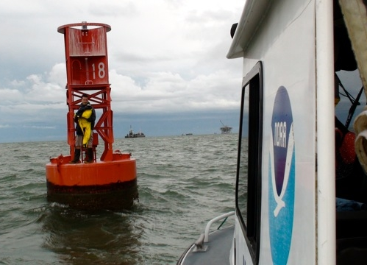
Recent Accomplishments
Mobile Bay project -- CO-OPS, OCS and NGS are working in Mobile Bay, surrounding area and nearby National Estuarine Research Reserve Systems (NERRS), to establish foundational data and validate coastal circulation model.
Cooperative effort with USGS and Harris-Galveston Subsidence District -- collecting data at a new Continuously Operating Reference Station (CORS) in Houston, TX for consideration as a National CORS

Slide 6
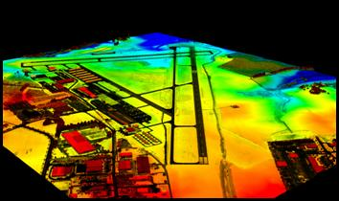
Recent Accomplishments
Initiate socio-economic benefit study of NGS remote sensing products and services
New remote sensing capability – airborne Lidar
Research and development of new procedures

Slide 7
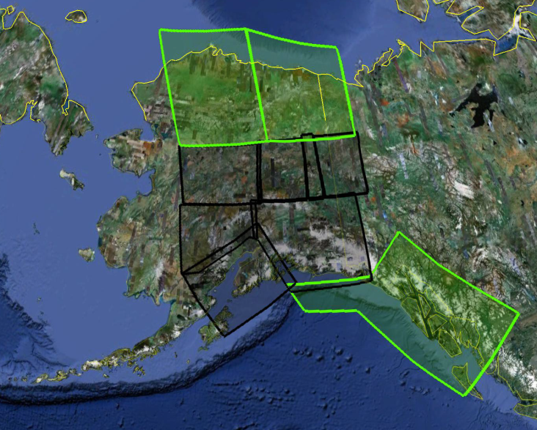
Recent Accomplishments
GRAV-D airborne survey
Focus on Alaska
Ground based - new absolute gravity meter
Expected to save one to two days per measurement in support of airborne surveys
Reduce survey cost
New Horizontal Time Dependent Positioning (HTDP) model

Slide 8
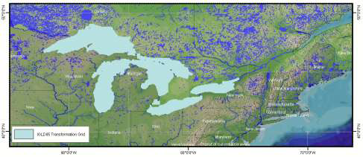
Upcoming Activities (FY11/12)
Install one NOAA foundation CORS site
Complete GPS positions for International Great Lakes Datum 2015 update

Slide 9
Upcoming Activities (FY11/12)
Develop operational GPS-interference detection service in cooperation with Department of Homeland Security
Complete socio-economic benefit study on remote sensing products and services
Complete gravity data collection in most of Alaska with the exception of the Aleutians
Complete VDatum model - PR/VI
Provide NOAA Composite Shoreline as a framework data set for the CMSP Data Portal

Slide 10
Performance Metrics
Performance Measure | FY10 | FY11 | FY12
Percentage of U.S. counties enabled with accurate positioning capacity (Current GPRA) | 78.89% | 83% | 86%
Percent of U.S. enabled to benefit from a new national vertical reference system GRAV-D (New GPRA - coming soon!) | 7.83% | 13% | 20%
Update the U.S. shoreline | 3.6% | 3.5% | 3.2%
Update the shoreline in priority ports | 12% (21) | 11% (20) | 12% (21)
Analyze priority ports for changes | 16% (28) | 16.5% (29) | 15.4% (27)

Slide 11
NGS Budget
 | FY10 | FY11 | FY12
Geodesy Base | $26.417 M | $26.138 M | $27.001 M
National Height Modernization | $2.541 M | $2.541 M | $2.541 M
Mapping and Charting Base (~8% of total) | $3.950 M | $3.917 M | $4.135 M
Shoreline Mapping | $2.424 M | $2.398 M | $2.424 M
Total | $35.332 M | $34.994 M * | $36.101 M **
*Subject to change until the NOAA budget is finalized.
**All of these figures can change until Congress enacts a budget.

