Slide 1
NOAA Navigation Services
CO-OPS Update
Richard Edwing
National Ocean Service
Center for Operational Oceanographic Products and Services
Hydrographic Services Review Panel
May 4, 2011
Notes:
20 minute time limit

Slide 2
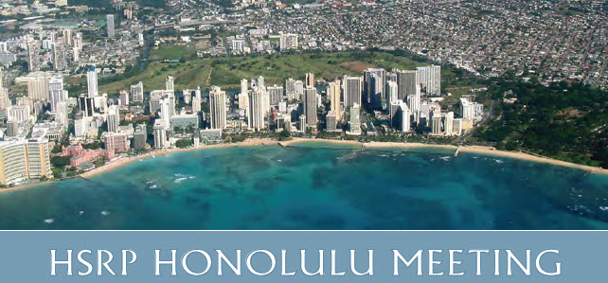
Outline
Mapping and Charting Support Services Program
Maritime Services Program
COASTAL Program
Budget and Performance Metrics
Notes:
CO-OPS turns operational oceanographic data into meaningful information for the Nation and supports multiple NOAA strategic mission goals. CO-OPS accomplishes this through 3 thematic program areas; Maritime Services, Mapping and Charting Support, and COASTAL (non-navigation applications).
I will go through each of the major programs and highlight a few recent accomplishments, as well as a few projects slated for FY11.

Slide 3
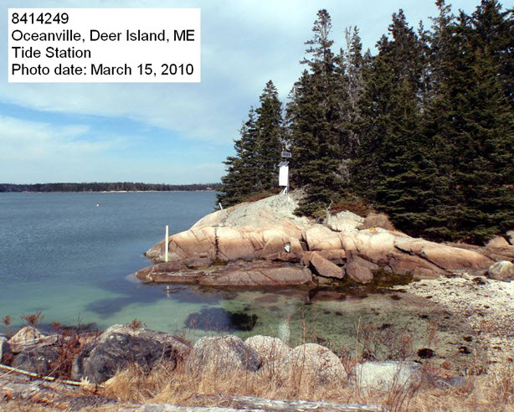
Mapping and Charting Support Services
Recent Accomplishments
Future Outlook
Support for 46 hydro/shoreline surveys
  CO-OPS provides tidal information and marine boundaries
NOS VDatum Program surveys completed (Maine, Massachusetts, Alaska)
  NOAA, USACE, USGS Data Interoperability
  Trilateral Agency pilot project
Approx. 35 hydro/shoreline projects planned
VDatum surveys planned (Alaska, Puerto Rico)
Notes:
Mapping and Charting Support Services
Enabled Office of Coast Survey and National Geodetic Survey to accomplish hydrographic and shoreline surveys by providing tidal information (e.g. zoning, constituents, correctors) and marine boundaries
- OCS acquired 4,500 square nautical miles of hydrographic data in FY2010
NGS surveyed 6,001miles of shoreline in FY2010
CO-OPS installed temporary tide stations to collect bathymetric and topographic data in support of the NOS Vertical Datum Transformation Tool (VDatum) program in Alaska, Maine, and Massachusetts in FY2010.
Enabled delivery of two new VDatum models in FY2010, consisting of new coverage of the Southeastern U.S. (NC southward) and West Coast of Florida. The data collected in FY10 will be used in the model development.
-------------------------------------
- Trilateral Datums effort w/ USACE and USGS: We have selected a pilot region, Houston/Galveston, to upgrade 7 USGS gages to NOAA standards.
Background for 46 hydro/shoreline surveys supported:
Coast Survey
- CO-OPS provides tidal zoning and final tide reducers for bathymetric surveys
- Time and height offsets relative to MLLW
Water level gauges are installed just prior to survey and data are used during time of survey
NGS
- Install gauges well in advance
- CO-OPS provides tidal zoning
- NGS flies photogrammetry at MLLW and MHW
Gauges operate during flights
-------------------------------------
FY11 Outlook
- Don't know numbers yet for FY12 Hydro/shoreline projects, but will be around 30 for hydro and probably 5 or so for shoreline.
VDatum
Installs for FY11 are only AK and PR
Hoping to install GA and NC in FY12

Slide 4
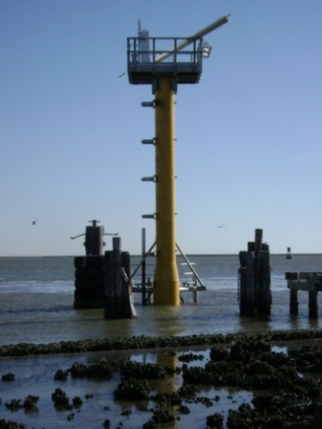
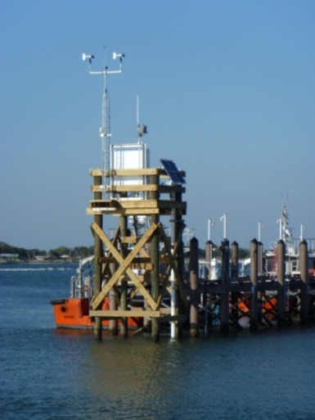
Mapping and Charting Support Services
National Water Level Observation Network
Recent Accomplishments
Future Outlook
Six stations hardened
181 of 207 water level stations have meteorological sensors
Completed microwave water level sensor test and evaluation report
Constructing two new Sentinel stations in Texas
Five stations planned to be hardened
Construction of the new Texas Point Sentinel station
Hardened station at Mayport Bar Pilot’s Dock, Florida
Notes:
Recent Accomplishments
6 stations:
USGS Station Hatteras, SC
Lake Worth Pier, FL
Apalachicola, FL
Holland, MI
Berwick, LA
Mayport, FL
FY11
Sentinel info: 2 Sentinel stations – CO-OPS collaborating with USACE; other sentinel stations have 1 inch thick single piles, but the sentinels planned in FY11 may be designed at 2 inches thick because the sites are more exposed and in deeper water.
Texas Point, TX
Galveston Entrance Channel North Jetty, TX
5 Planned Stations:
Port Isabel, TX
Galveston Pier, TX
Colonial Beach/Dahlgren, VA relocation
Panama City Beach, FL
Pascagoula, MS
--------------------------------------------
Other Accomplishments:
Support for DWH response efforts

Slide 5
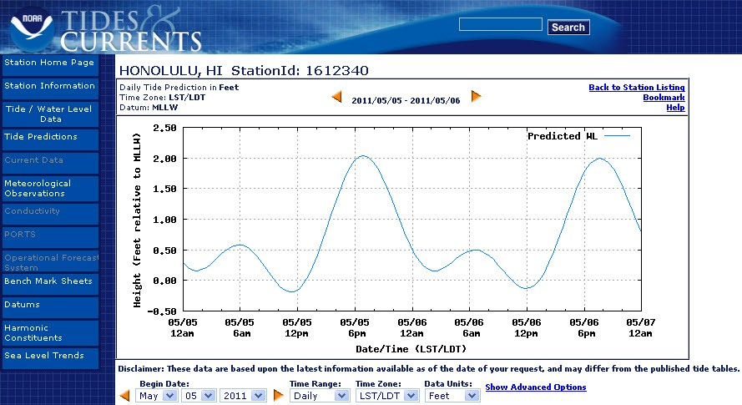
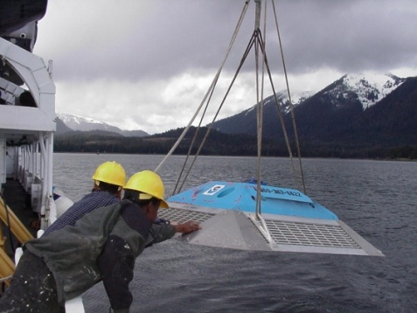
Maritime Services
Tide and Currents Predictions
Recent Accomplishments
Future Outlook
Conducted tidal currents surveys in Hawaii, Alaska, Connecticut, and New York
Released NOAA Tide Predictions
Published special tidal currents predictions
  Miami, Kodiak, Prince William Sound, Cook Inlet, Hudson River
Currents surveys planned
  Boston, San Francisco Bay, Florida Keys, Fernandina Beach, FL, Johns Pass, FL, Kachemak Bay
Notes:
Predictions
Released NOAA Tide Predictions, a web based product that generates on-line, customizable, and easily accessible tide tables, which will soon replace the need for paper publications. Due to limitations on the amount of information that can be put into a paper volume, mariners often must do manual calculations to get tide predictions at most locations. The NOAA Tides product does all those calculations on the fly and generates all the predictions for the mariner, eliminating the potential for mistakes and saving time.
- Special predictions (Advanced Copy of Tidal Current Tables) have been published recently for Miami, FL and Kodiak, AK. We have also Prince William Sound, Cook Inlet and Hudson River.

Slide 6
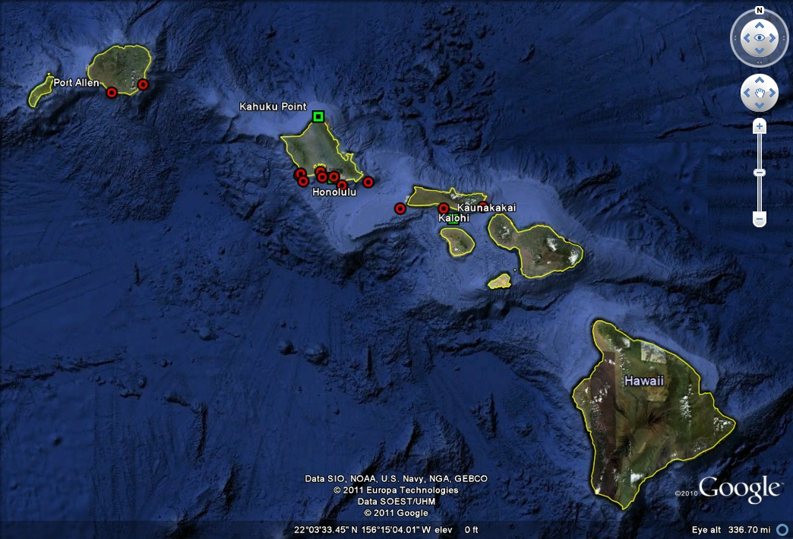
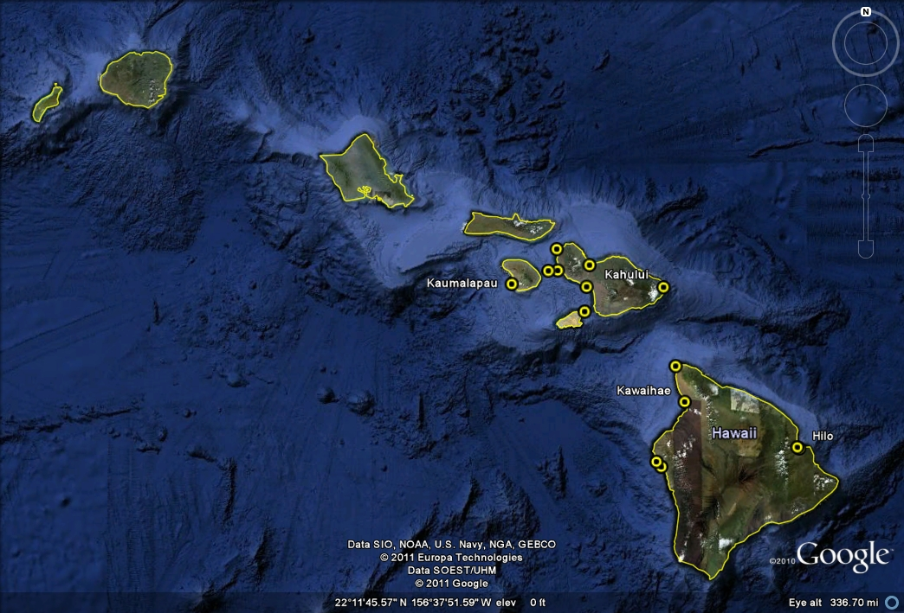
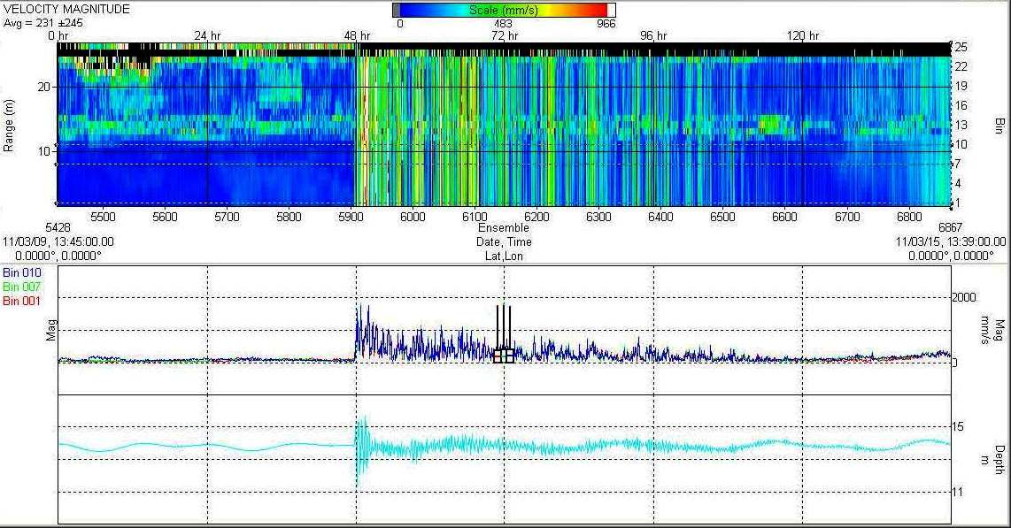
Notes:
The first map shows the first deployment of current meters in the northern islands. These stations were deployed in January and recovered in February.
Green squares in the first deployment are stations that were deployed for at least 70 days. All other stations were deployed for 35 days (with the exception of Port Allen (Station #2) since it was not recovered until after the tsunami).
30 total stations were deployed and recovered during the survey.
Click to the second map, which shows the 2nd deployment of current meters.
Preliminary results show a clear tsunami signal at Kahalui Harbor, Maui, which had the highest recorded wave amplitude in Hawaii during the March 11 tsunami.
Click the arrow to return to the previous slide.

Slide 7
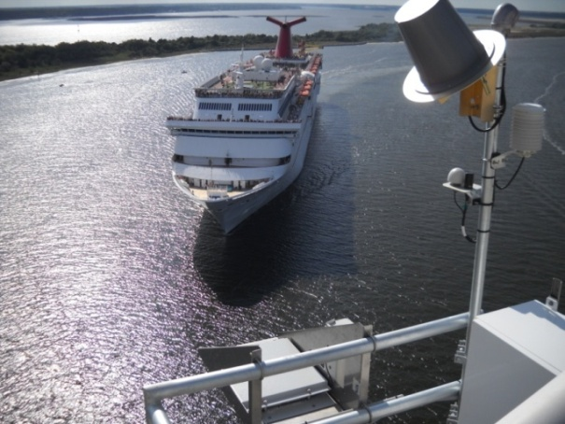
Maritime Services
Real-Time Data
Recent Accomplishments
Future Outlook
Added visibility and waves to PORTS®
Published Columbia River PORTS® Economic Study
Installed air gap sensor in Jacksonville, Florida
Installing a PORTS® in New London, Connecticut
Future PORTS ®
  Jacksonville ?
  Humboldt Bay ?
A cruise ship navigates below the air gap sensor at the Dames Point Bridge
Notes:
Real-time
Added visibility and waves to the suite of real time environmental parameters provided by PORTS, responding to the two highest needs identified by PORTS partners.
The lower Columbia River area, for example, receives an estimated economic benefit of $7.4 million annually in savings and direct income from PORTS® according to a study released in June 2010.
Air gap sensor installed at Dames Point Bridge:
Economic Impact: The response to this request will support the cruise ship business which generates $3.4M in revenue for the Port of Jacksonville, not to mention the economic impact to the local community:
Last year, Carnival generated $3,403,222 in gross operating revenues to the port or $47,267 per ship call. If Carnival were displaced to Blount Island for example, JPA would have been liable for all costs associated with transferring passengers between Blount Island and Dames Point for processing by CBP and to access the parking facilities. Current estimates for running shuttle system to a remote terminal facility are on the order of $7,000-7,500 per ship call.
Due to a bridge maintenance project by the Florida Department of Transportation (FDOT) on the Dames Point Bridge, the air gap, or bridge clearance, was reduced. Carnival Cruise Lines expressed concerns about this reduction because of the small clearance already experienced by cruise vessels, and considered moving their business unless there was an accurate measurement of the clearance. Ship captains need updated, accurate clearance data to safely navigate vessels under this bridge.
In response to the request, NOAA and FDOT installed an air gap system on April 8, and are now providing bridge clearance information to Carnival and other large vessels transiting under the Dames Point Bridge.

Slide 8
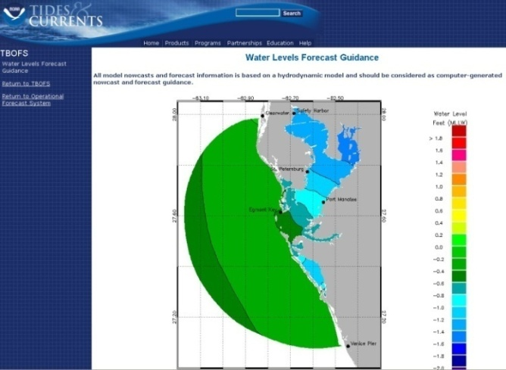
Maritime Services
Operational Forecast Systems
Recent Accomplishments
Future Outlook
Transitioning Operational Forecast Systems to high-performance computers
  Models run faster, with products available earlier
  Standardized web page design
Expanded the suite of hydrodynamic models
  Released Tampa Bay and Delaware Bay
  Upgraded Chesapeake Bay
New Operational Forecast Systems
  Columbia River
  Northern Gulf of Mexico
Snapshot of water level Nowcast at Tampa Bay
Notes:
Expanded suite of operational nowcast/forecast hydrodynamic models from 9 to 11 by rolling out new models in Delaware Bay, and Tampa Bay, as well as an updated model for the Chesapeake Bay. These forecasts support mariners, port managers, and emergency response teams with present and future conditions of water levels, currents, temperature and salinity

Slide 9
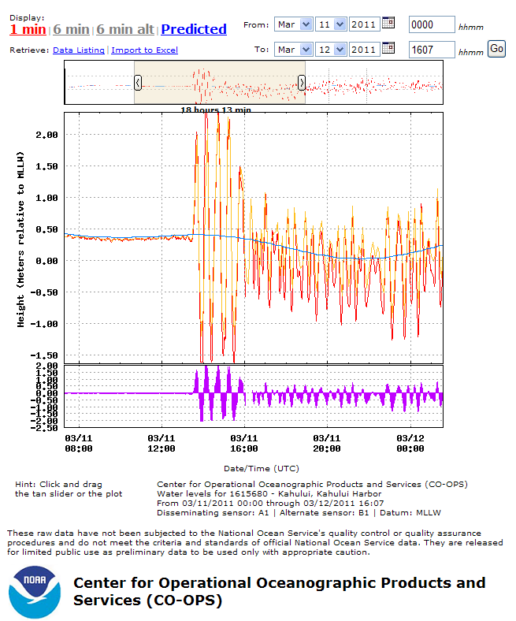
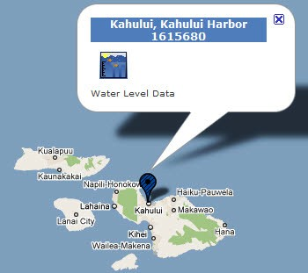
COASTAL
Coastal Oceanographic Applications and Services of Tides And Lakes
Coastal Hazards
Recent Accomplishments
Future Outlook
Supported national tsunami warning and mitigation efforts
Supported National Weather Service storm surge warning forecasts
  Storm Quicklook
  SLOSH Model Input
Mobile Bay Storm Surge project
Notes:
- Continued and improved support for NWS tsunami and storm surge warning forecasts through provision of real-time data from NWLON
Tsunami warning issued following the magnitude 8.8 earthquake off the coast of Chile on February 27, 2010 is one example.
NWLON station strengthening and meteorological upgrades discussed above support this mission area as well
Provide maximum water level heights to National Hurricane Center and Weather Forecast Offices immediately following coastal storm events to support NWS operations

Slide 10
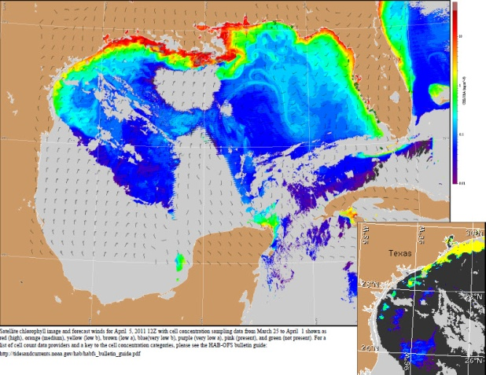
COASTAL
Coastal Oceanographic Applications and Services of Tides And Lakes
Ecosystem Management
Recent Accomplishments
Future Outlook
Expanded Harmful Algal Bloom (HAB) forecast system to the Gulf coast of Texas
Developing a HAB forecast system for the Great Lakes
Water level support for NERRS Sentinel Site Network
Image from Gulf of Mexico HAB Bulletin for the Texas region
Notes:
- Expanded Harmful Algal Bloom (HAB) forecast system to 2 by transitioning to operations the Gulf coast of Texas. HAB bulletins are issued to Texas coastal managers twice weekly during HAB events and once weekly during inactive periods. Bulletins enable better safety and economic decisions to be made about beach and shellfish bed closings.
- Continued support for habitat restoration by providing tidal datums, frequency and duration of inundation statistics, sea level trends, and other geospatial data needed for sustainable restoration design and implementation in locations including the Chesapeake Bay, South San Francisco Bay, and Mobile Bay.

Slide 11
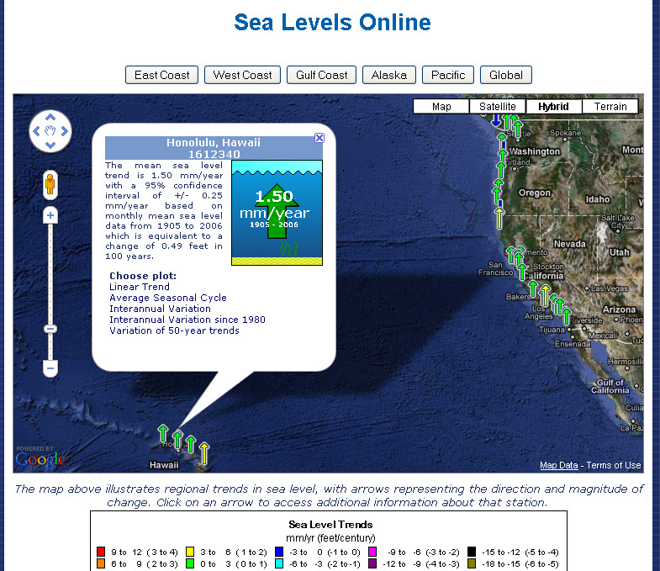
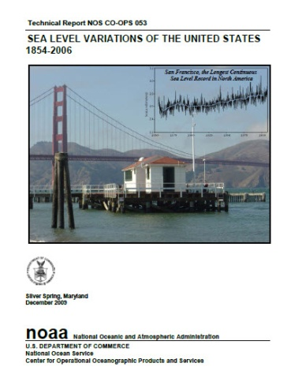
COASTAL
Coastal Oceanographic Applications and Services of Tides And Lakes
Climate Change
Recent Accomplishments
Future Outlook
Provided long-term sea level trends
Issued a new publication, “Sea Level Variations of the United States, 1854-2006” with updated local sea level trends for 128 locations in the United States
Worked with USACE to incorporate sea level trend guidance into coastal project planning
Caribbean sea level project in Barbuda
Notes:
- Continued providing long term local sea level trends for both domestic and international locations.
Issued a new sea level publication, “Sea Level Variations of the United States, 1854-2006” with updated local sea level trends for 128 locations in the United States.
Worked with US Army of Corps of Engineers to incorporate sea level trend guidance into coastal project planning policy documents.
Worked with state coastal managers to utilize CO-OPS local sea level trends to inform sea level planning and policy at a state level
Barbuda: CO-OPS has received funding from the U.S. Department of State to install one hardened tide station on the island of Barbuda and provide capacity building and training in sea level station operation.
Other future projects are an Exceedence Probably Statistics Tool and a Sea Level Anamolies Tool

Slide 12
Budget
FY 2012 Proposed Operating Plan | FY 2010 Enacted | FY 2011 Annualized Continuing Resolution | FY 2012 Estimate
Tide & Current Data
Tide & Current Data Base | 33,078 | 32,729 | 28,979
PORTS® Operation and Maintenance | [3,800] | 0 | 0
Coastal Tidal Gauges | 600 | 0 | 0
Total, Tide & Current Data | 33,678 | 32,729 | 28,979
Notes:
FY 2010 Conference Mark $33,078K (including $3,800K earmark for PORTS O&M)
- There was also separate $600K earmark for Coastal Tide Gauges, but you may not want to include that.
FY 2011 President's Request $29,715K (that's about the only number we can give at this point)
FY 2012 President's Request $28,979K

Slide 13
Performance Metrics
Corporate Performance Measure | FY2010 | FY2011 | FY2012
Percent of top 175 US Seaports with access to full suite of NOAA Navigation Products and Services* | 65% | 67% | 70%
* Tracks access to updated ENCs, shoreline, tidal current predictions, Vdatum models, real-time data
CO-OPS FY2011 Milestones
Establish new PORTS (New London)
Conduct tidal current surveys (Al, HI, MA)
Publish Annual Tide and Tidal Current Prediction Tables
New Operational Forecast Models (Tampa)
Publish local sea level trends for 159 global sea level stations
Collect water level data at 5 Arctic locations
Complete technical report on Barrow, AK water level project
Notes:
Rich will send

Slide 14
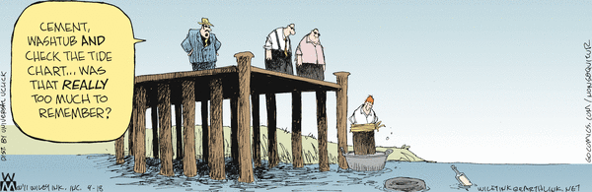
Questions

Slide 15
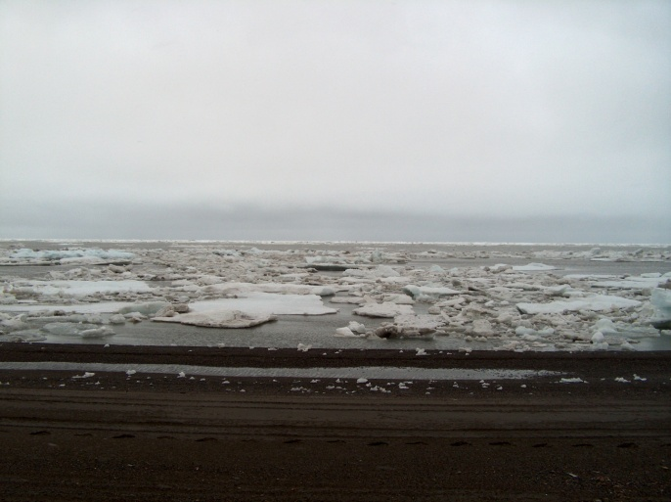
Issues
Challenging budget climate
Federal funding for PORTS®
The Arctic
Barrow, Alaska in July

