Slide 1
How Can NOAA Navigation Services Support Coastal Science (and Management) in the Pacific
Hydrographic Services Review Panel
Honolulu, HI, May 5, 2011
Joyce E. Miller, Certified Hydrographer & HSRP Member

Slide 2
Pacific Islands Region Primary National Mapping Drivers
Coral Reef Conservation Act: National Action Plan to Conserve Coral Reefs (2000) – “produce comprehensive digital maps of all coral reefs in the U.S. States and Trust Territories within 5 to 7 years.”
Magnuson Stevens Reauthorization Act of 2006 – define Essential Fish Habitat (EFH), Habitat Areas of Particular Concern (HAPC) and Annual Catch Limits (ACLs)
Endangered Species Act (ESA) – if species is endangered or threatened, must define Critical Habitat

Slide 3
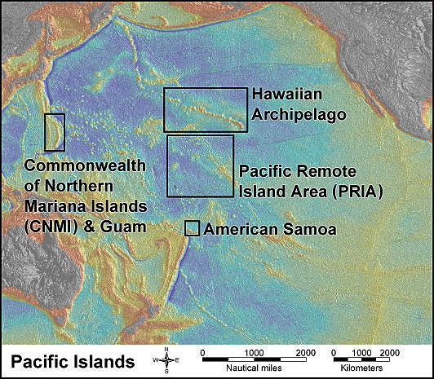
U.S. Pacific Islands – Vast & Remote
50+ islands and atolls
-Hawaii
-NWHI
-CNMI
-Terr. of Guam
-Terr. of Am. Samoa
-PRIA
4 Monuments
-Papahānaumokuākea
-Mariana Trench
-Rose Atoll
-PRI
World Heritage Site

Slide 4
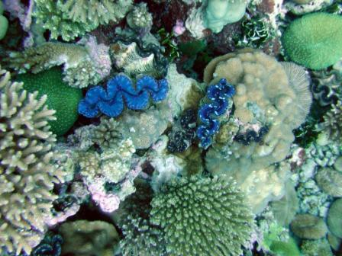
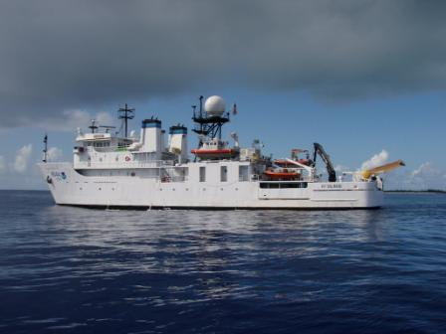
Corals & Giant Clams
Kingman Reef
NOAA Ship Hi’ialakai
& R/V AHI
Pacific Mapping
has been
Coral Centric (0-150 m)
Few lagoons or estuaries
Remote -- dedicated
ships and launches needed
R/V AHI at Uracus, CNMI
Volcanic islands and coral atolls – usually very steep

Slide 5
Diagram from OzCoasts: http://www.ozcoasts.org.au/

Slide 6
Benthic Habitat Maps
*Identify coral resources
*Design statistically valid “random stratified sampling” biological monitoring protocols, based upon depth and bottom type
*Site locations for biological and climate change monitoring
*Design/evaluate Marine Protected Areas (MPAs)
Evaluate & monitor fish populations
Define Annual Catch Limits (ACLs)
Correlate fish populations with Essential Fish Habitat
Identify critical habitat for Endangered Species
Life history and preferences for overfished and/or invasive species
Also specific management needs (energy routes and sites; groundings, storm/tsunami models and damage, harbors …)

Slide 7
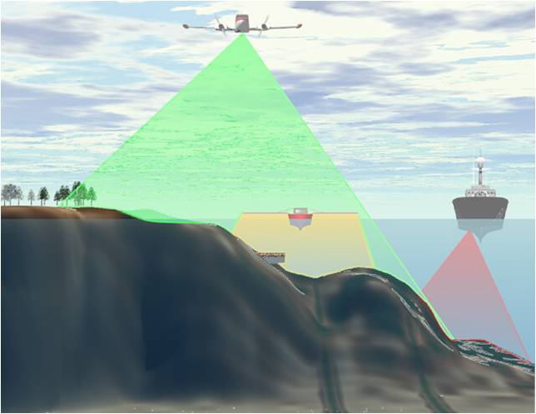
Data for Benthic Habitat Mapping
Multispectral Satellite
Imagery (0-30 m)
Estimated Depths (0-12 m)
LiDAR Bathymetry
& “Backscatter”
(0-30+ m)
Ship-based
Multibeam Sonar
Bathymetry
& Backscatter
(30-1000+ m)
Launch-based
Multibeam Sonar
Bathymetry
& Backscatter
(10-250 m)
Optical Validation
Divers (0-30 m)
Towed Camera,
ROV, AUV
(20-250+ m)

Slide 8
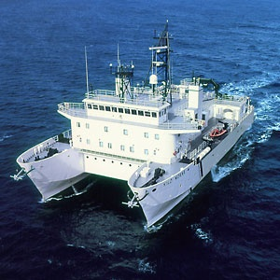
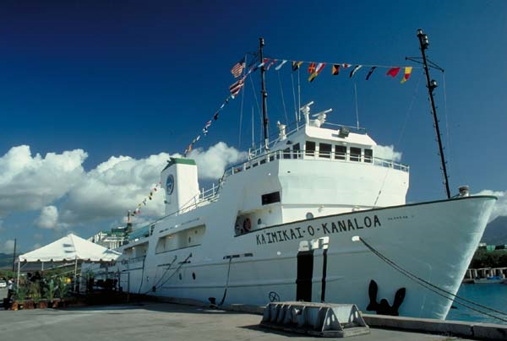
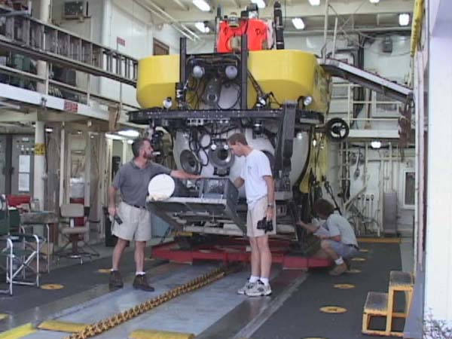
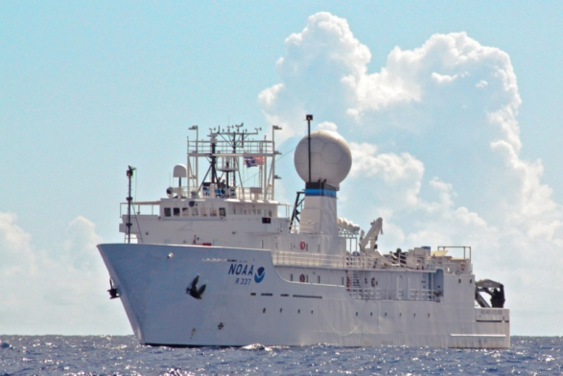
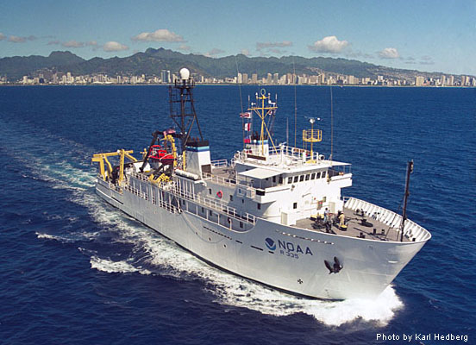
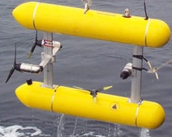
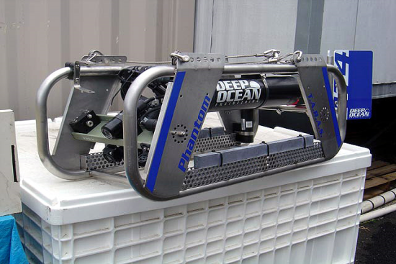
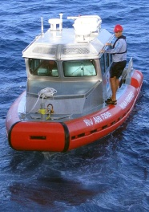
Resources
UH R/V Kilo Moana
UH/NOAA R/V Ka`imikai-o-Kanaloa
SeaBeam 210 & Pices Submersibles
Kongsberg EM122 and EM1002
NOAA Ship
Okeanos Explorer
NOAA Ship
Oscar Elton Sette
NOAA Ship Hi’ialakai
& R/V AHI
Ship has Kongsberg
EM300 and EM3002
R/V AHI has Reson 8101ER
Towed Cameras/ROV
SeaBed AUV

Slide 9
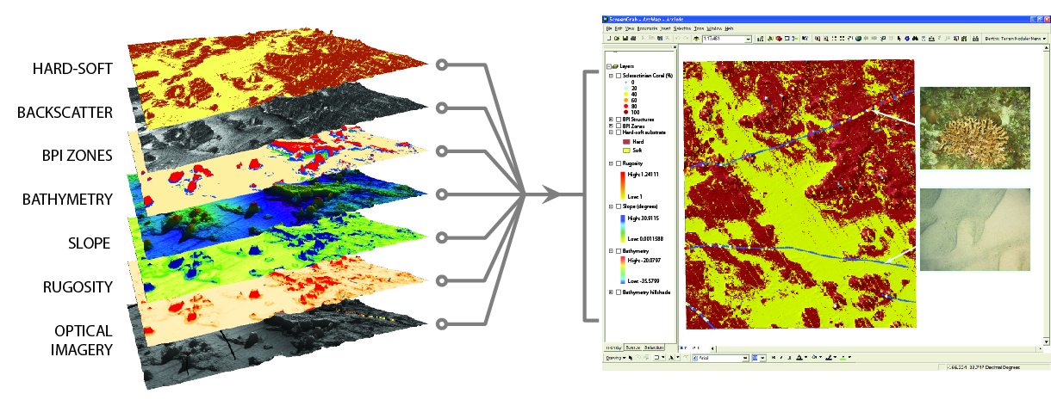
Mapping Products
Some Derivative Products can be created from bathymetry and backscatter
data with a limited amount of optical ground-truth data.

Slide 10
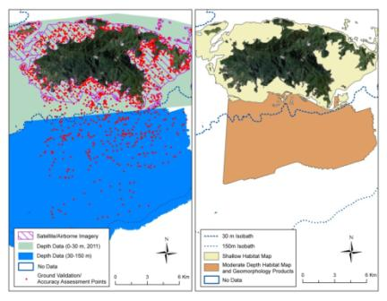
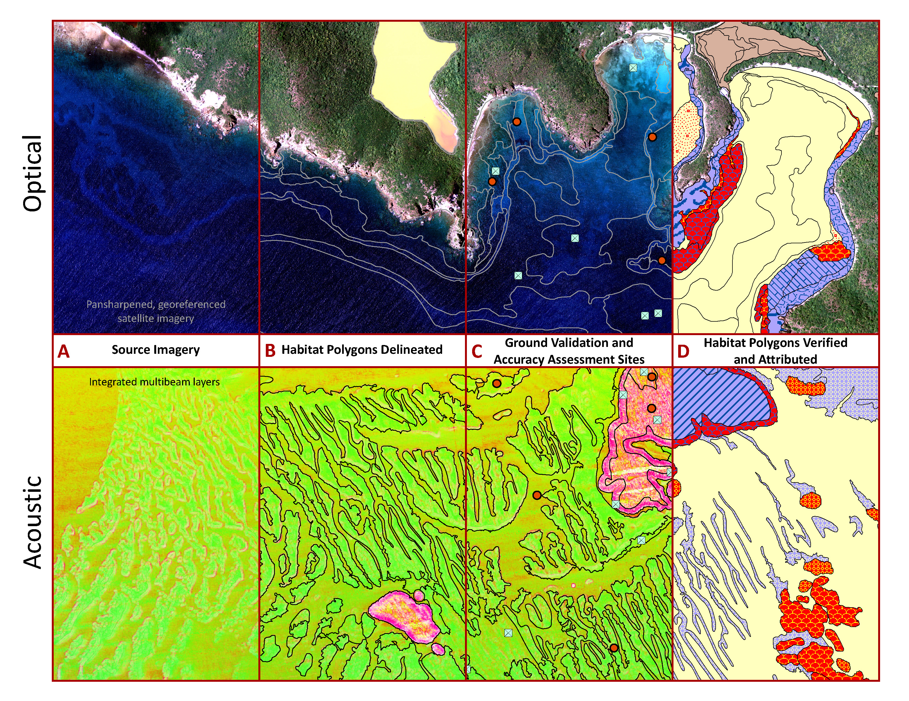
Mapping Products
Satellite data, bathymetry and
dense optical ground-truth
data needed to create a…
Seamless Benthic
Habitat Map

Slide 11
Coral Mapping Status 0-150 m
 | CNMI /Guam | Main HI | NWHI | Am. Samoa | PRIA | Totals Pacific | Atlantic/ Caribbean
0-150 m Seafloor (sq. km.) | 1,149 | 5,921 | 12,722 | 470 | 430 | 20,692 | 22,480
% MPA | 6.9% | 65.9% | 100% | 10.6% | 100% | 83% | 74%
0-150 m Bathymetry | 81.8% | ~90% | 25.5% | 86.8% | 70% | 38% | 14%
Bathy (> 150 m) (sq. km.) | 12,608 | ~90%* | 42,225 | 1,302 | 4,159 | 61,205+ | 344
0-30 m Benthic Habitat Map | 80.6% | 70.8% | 15.5% | 100% | 15% | 26% | 65%
20-150 m Optical Data (linear km.) | 1435 | 562 | 538 | 347 | 300 | 3185 ~2% | 17%
0-150 m Derived Products | 71.2% | 16.9% | 15.4% | 100% | 68% | 22% | 8%
30-150 m Benthic Habitat Maps | 0% | 0% | 0% | 100% | 0% | 3% | 17%
Statistics from “NOAA CRCP Mapping Accomplishments and Unmet Needs, 3/2011

Slide 12
Mapping Collaboration & Integration
CRCP has spent ~$26M since 2001 on coral reef mapping and other NOAA groups and external partners have spent ~$37M in collaborative efforts
Primary State and Federal Partners
University of Hawaii, School of Ocean and Earth Sciences
Pacific Islands Benthic Habitat Mapping Center
Joint Institute for Marine and Atmospheric Research (JIMAR)
Hawaii Mapping Research Group
State of Hawaii, DLNR and DBEDT
US Naval Oceanographic Office
Naval Facilities Engineering Command
Military Sealift Command
US Geological Survey
US Army Corps of Engineers
US Fish and Wildlife Service
Numerous state and local agencies in Caribbean & Florida

Slide 13
NOAA Collaborations
Coral Reef Conservation Program
Pacific Islands Benthic Habitat Mapping Center (NOAA-UH)
JIMAR (NOAA-UH)
Pacific Islands Fisheries Science Center, NMFS
Office of Coast Survey – Honolulu, Saipan, Tinian, Rota and
Apra Harbors
Office of National Marine Sanctuaries
4 Pacific Marine National Monuments
National Center for Coastal and Ocean Science
Office of Marine and Aviation Operations
Biogeography Branch
Hawaii Undersea Research Laboratory, NOAA-UH
Joint Hydrographic Center, Univ. of NH
Office of Ocean Exploration
VENTS Program (Mariana Area)
National Geophysical Data Center

Slide 14
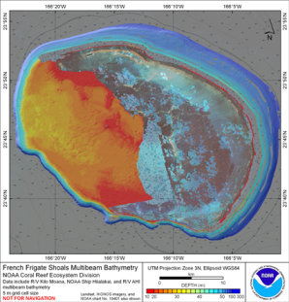
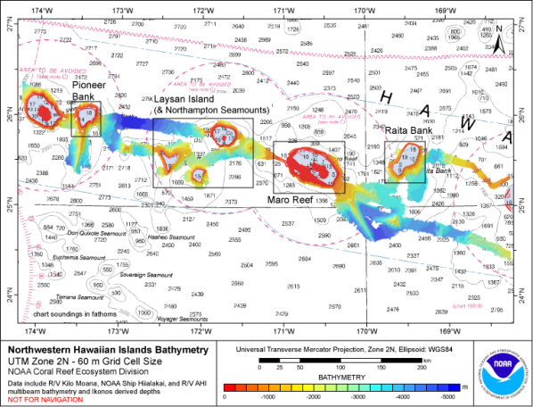
What’s Missing?
Data Needed
Satellite imagery
Lidar 0-20 m
Multibeam > 20 m
Optical validation
Integrated maps
NWHI Bathymetry Coverage

Slide 15
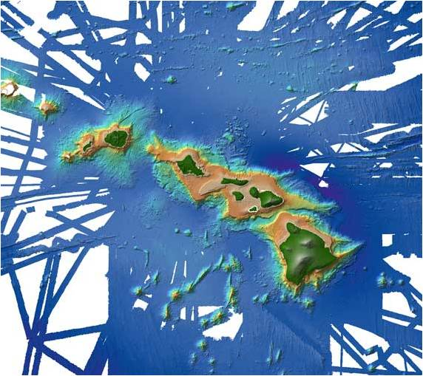
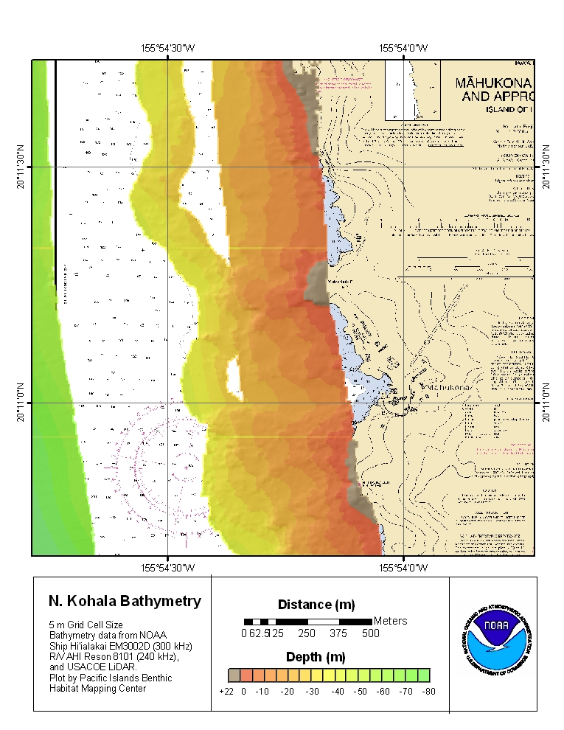
What’s Missing? MHI/Overall
Launch
Multibeam
Data
LiDAR
Very shallow – important
for piers, construction, coastal
management
Gaps between LiDAR (if
available ) and multibeam
data 15-100 m --Important for
fisheries and coral science
and coastal management
Ship
Multibeam
Data

Slide 16
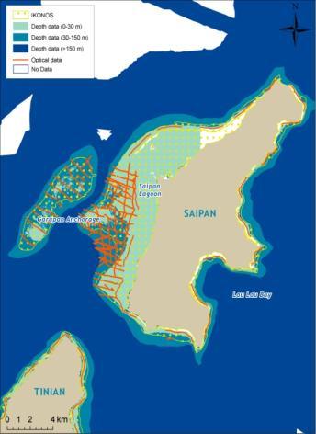
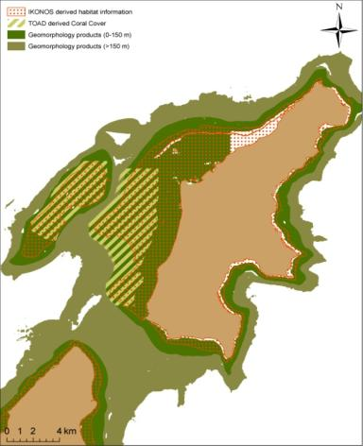
What’s Missing?
Primary Data
Bathymetry 0-20 m, “Bathtub Ring”
Sufficient groundtruth data 20-150 m
Products
Integrated Benthic Habitat Maps

Slide 17
Challenges – How can NOAA Navigation Services support Pacfic Coastal Science?
Ship time is steadily shrinking, cannot access remote areas without a ship and a launch. “Buy-back days” are now expected and costs are increasing rapidly (e.g., fuel)
Uncertainties in NOAA process for assignment of ship time, cruise schedules uncertain until well into the FY
Overall funding uncertainties make maintenance and retention of mapping assets difficult (boats, equipment and personnel). Sharing of maintenance costs and equipment.
Ability to do collaborative mapping is restricted due to difficulties in transferring funds between line offices or between NOAA and other federal/state groups. Need effective and rapid funds transfer methods.

Slide 18
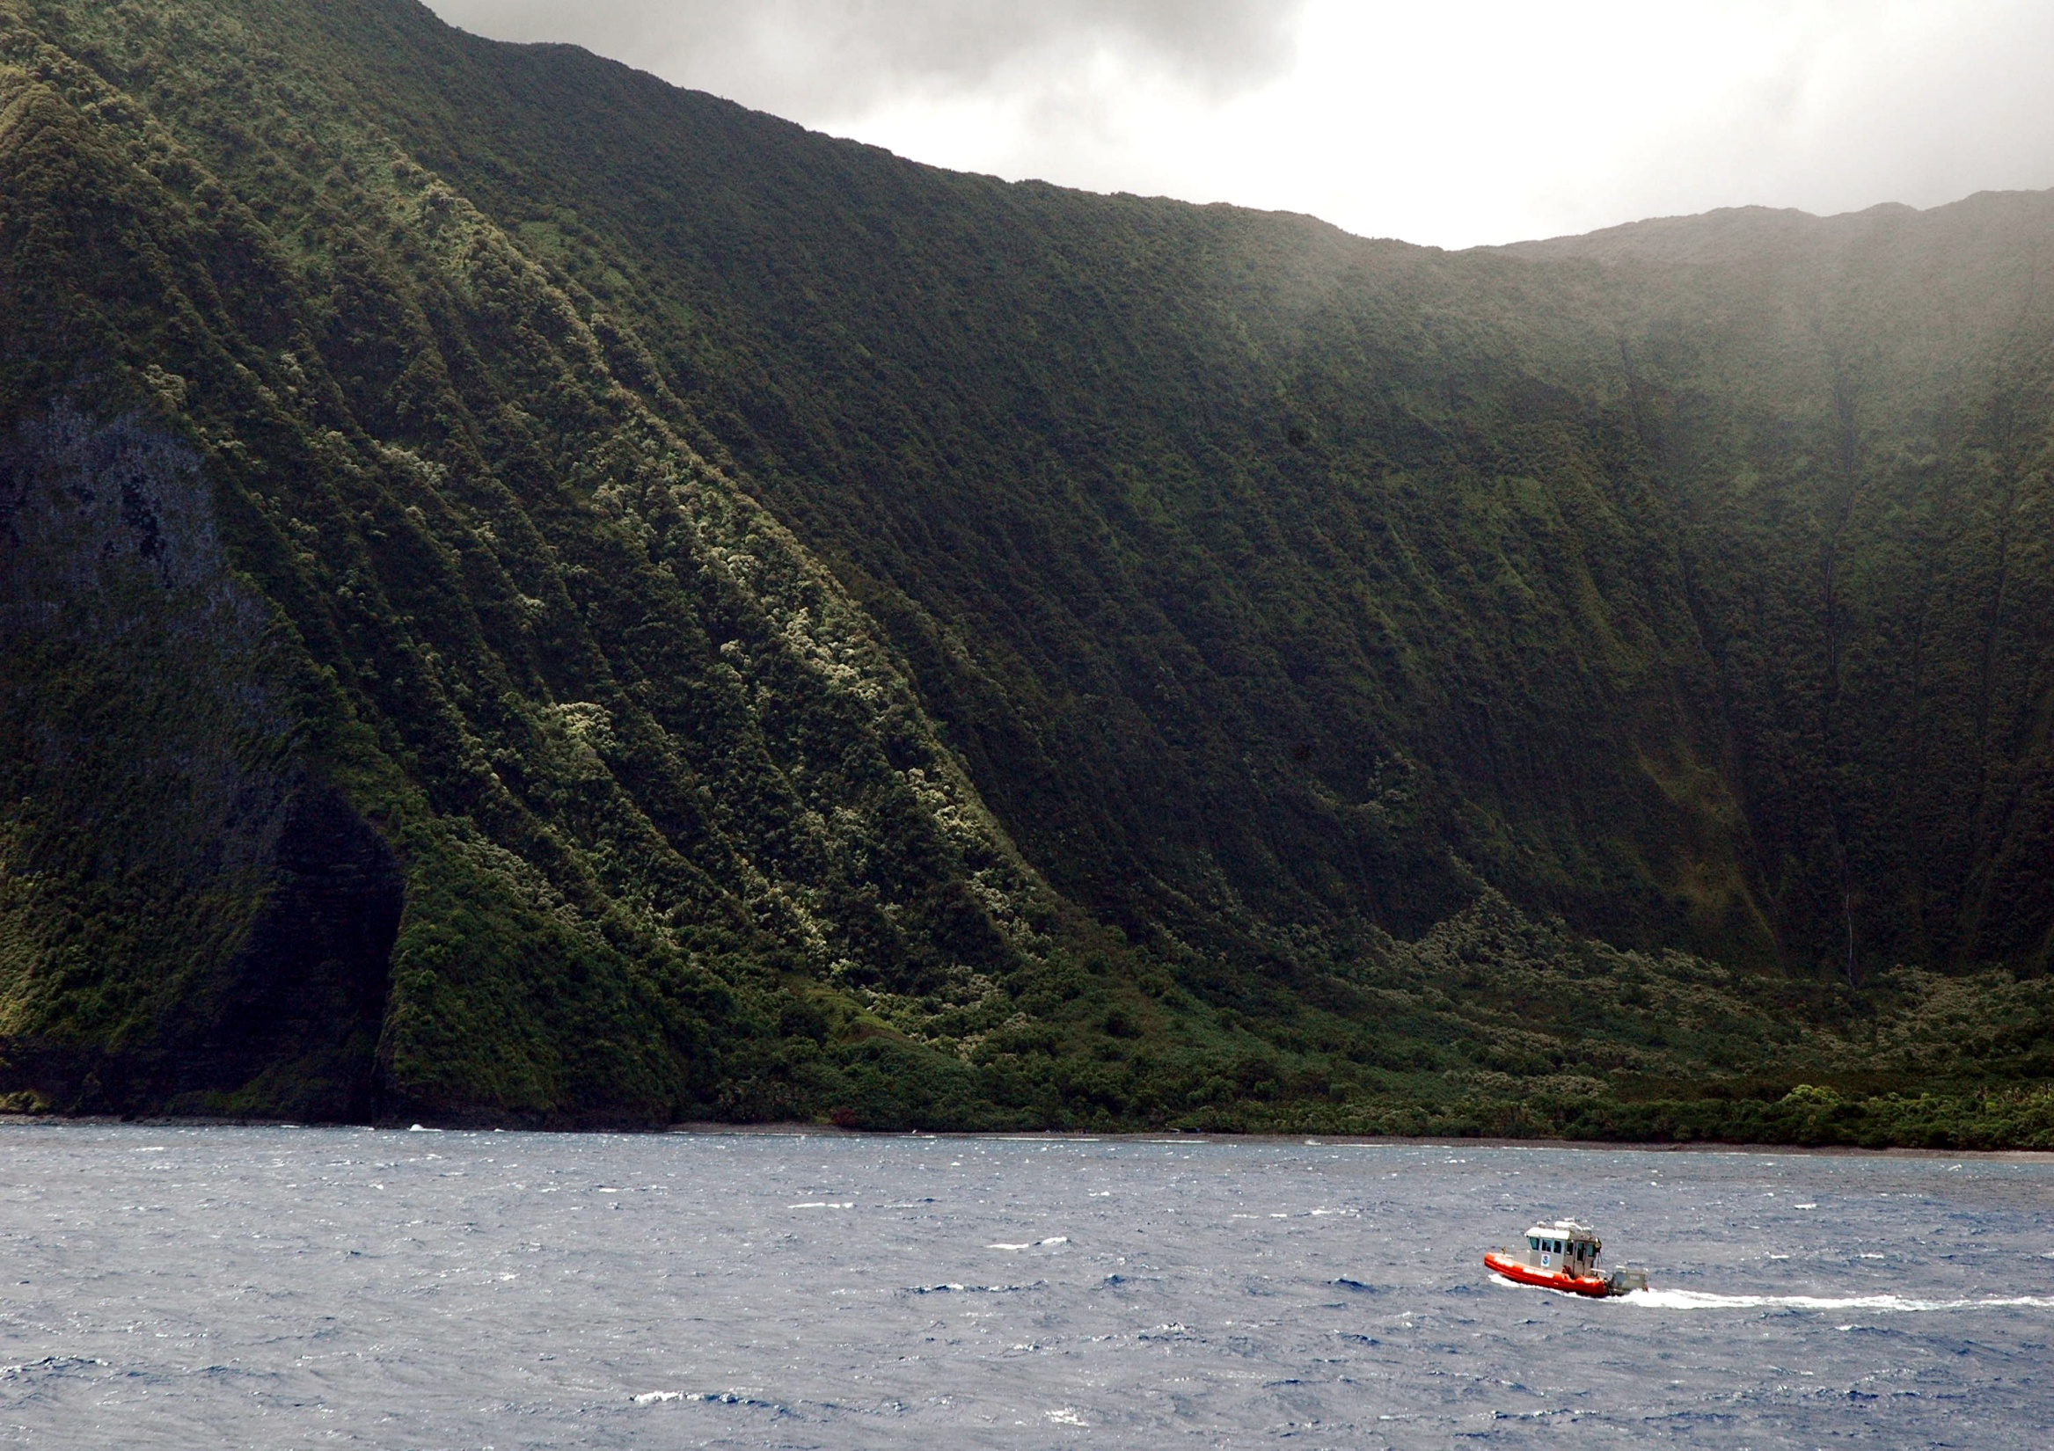
Questions?
North Coast of Moloka’i

