Slide 1
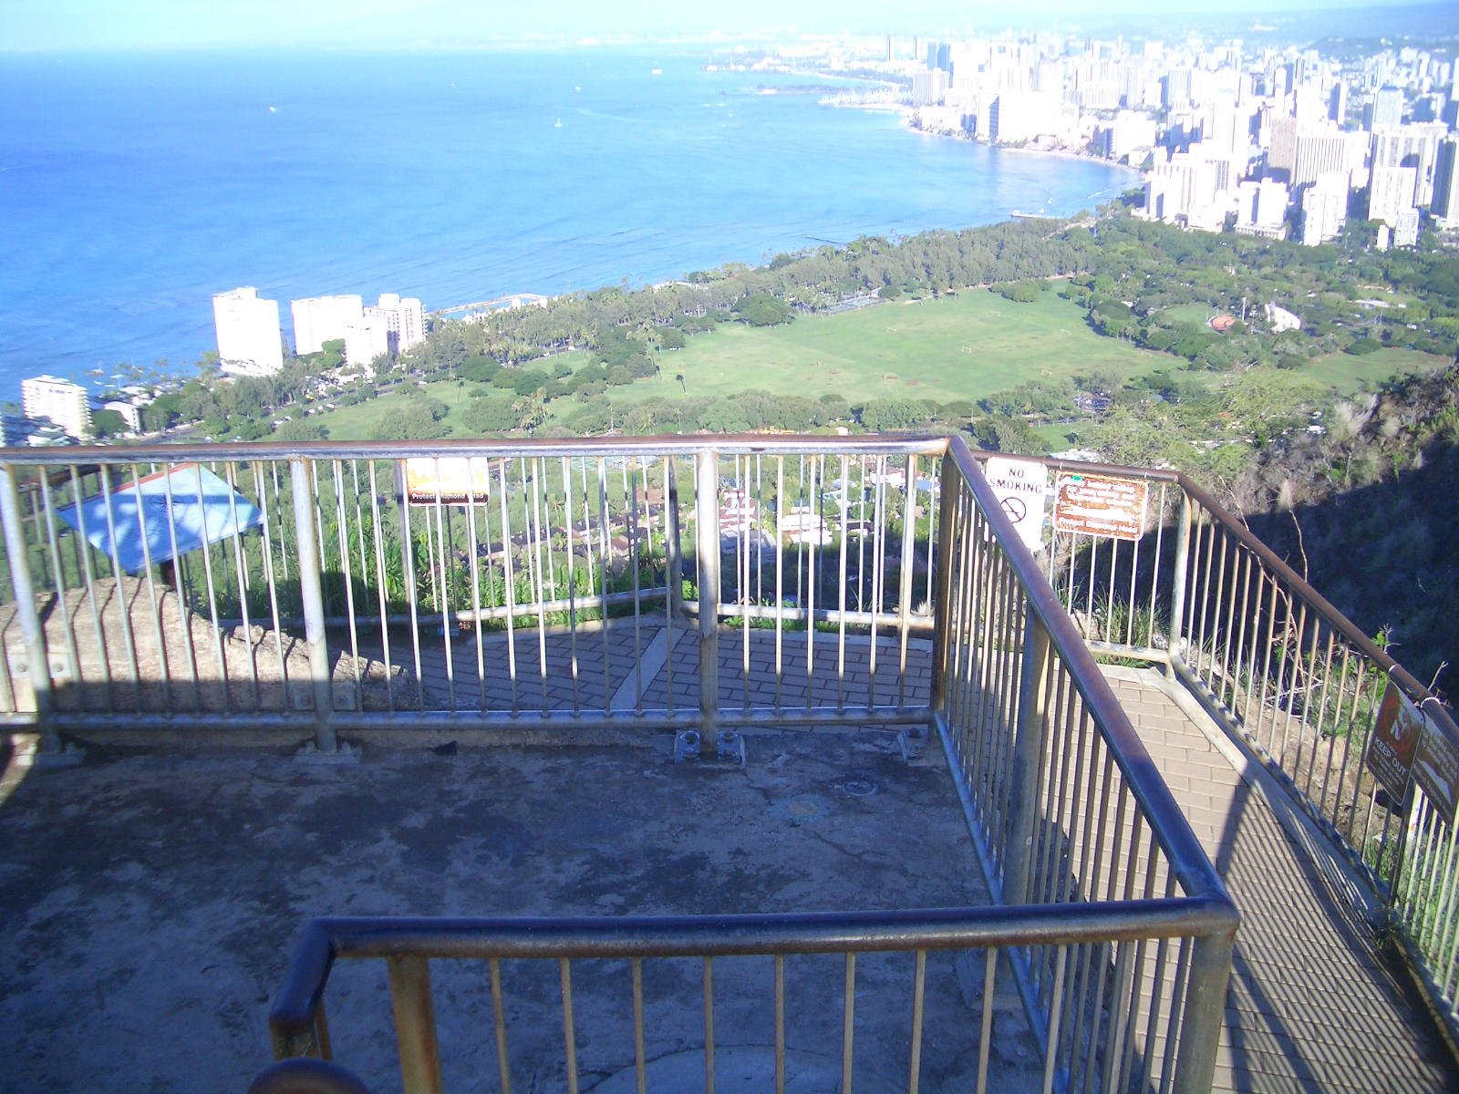
Hawaii DOT Leveling and RTN Plan
May 5, 2011
HSRP Public Meeting
DK4164

Slide 2
Purpose of the Height Modernization in Hawaii
The purpose of the Height Modernization in Hawaii came about because We (State of Hawaii, State of Hawaii DOT or NGS) have not updated the benchmarks since the 70’s (Oahu only). A good portion of the benchmarks were lost due to construction, vandalism and highway widening, new subdivision etc…
After looking at vertical issues, we proceeded to look at the horizontal controls and decided there is also a need to be updated.
Comparing with what the other states are doing to address this same issues, we decided to do a Height Modernization project with some additional activities to make the most of it.
We decide to take it one step further and create a new Geoid model.

Slide 3
Plans for Hawaii DOT Height Modernization
Phase 1 – Digital Leveling (Currently at Con office)
Order of Survey
  First order, class II (Following NGS Guidelines)
  Tied at a NOAA tidal station
Digital Level ONLY
  ONLY digital level will be accepted
  First order instruments will be used
  Thermister – Upper and Lower will be used
  Collimation Check must be completed daily
Invar Rods
  Single piece, barcode, calibrated rod with brace poles

Slide 4
Oahu Benchmark Recovery
Cadastral Engineering Section has completed the benchmark recovery for Oahu. Field work only.
A total of 341 benchmarks was searched for
ONLY 197 benchmarks recovered
144 benchmarks destroyed, damaged or could not be found.

Slide 5
Benchmark Recovery other Islands
Currently the DOT has not started searching for existing beachmarks on the outer islands due to time and cost issues.
  Big Island, Maui, Lanai, Molokai and Kauai
We (State of Hawaii and NGS) have to depend on the surveying, Engineering and the GIS community to help in the search until the digital leveling contracts can be executed in the near future.

Slide 6
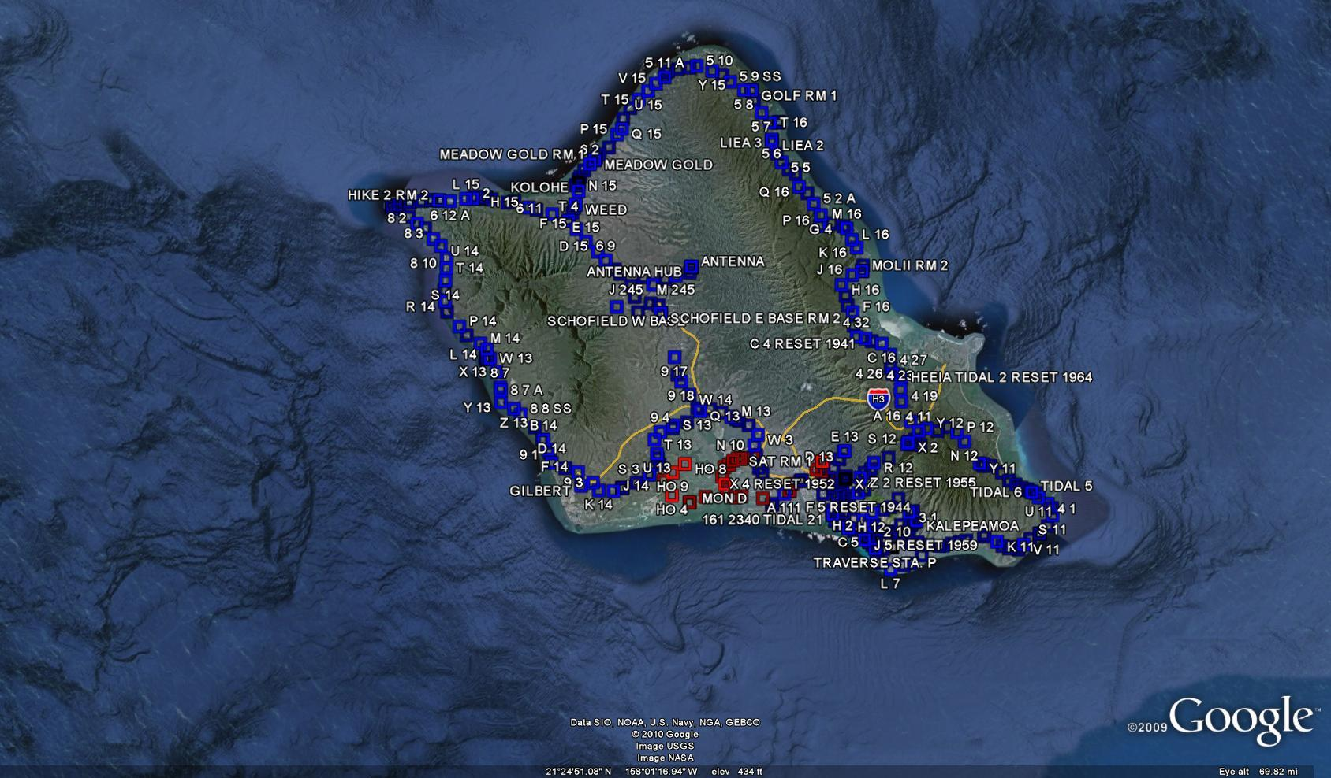
Existing Benchmarks Oahu

Slide 7
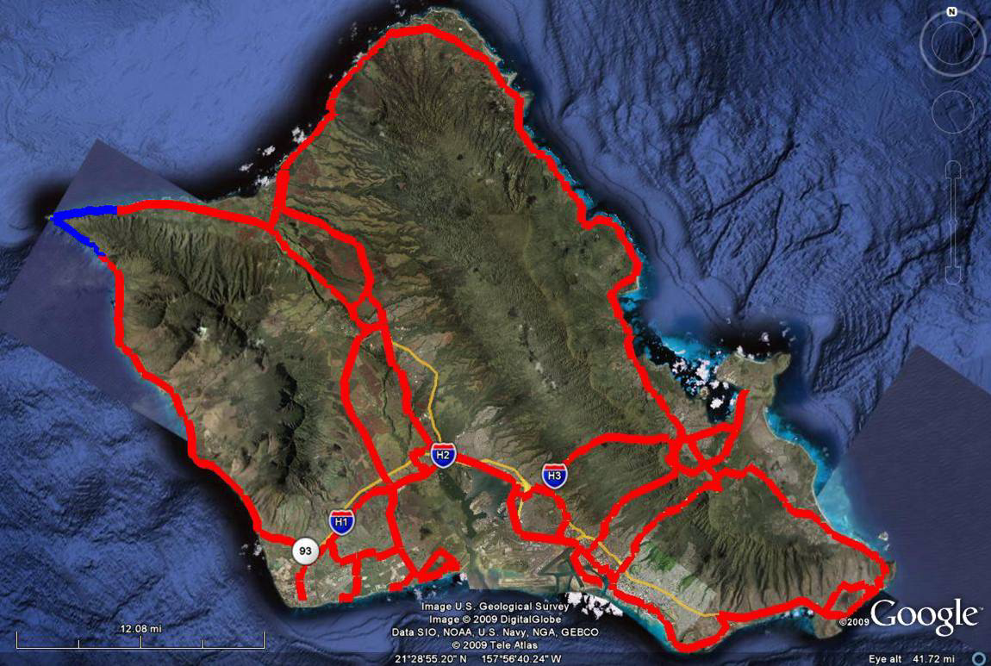
Proposed Benchmark Oahu

Slide 8
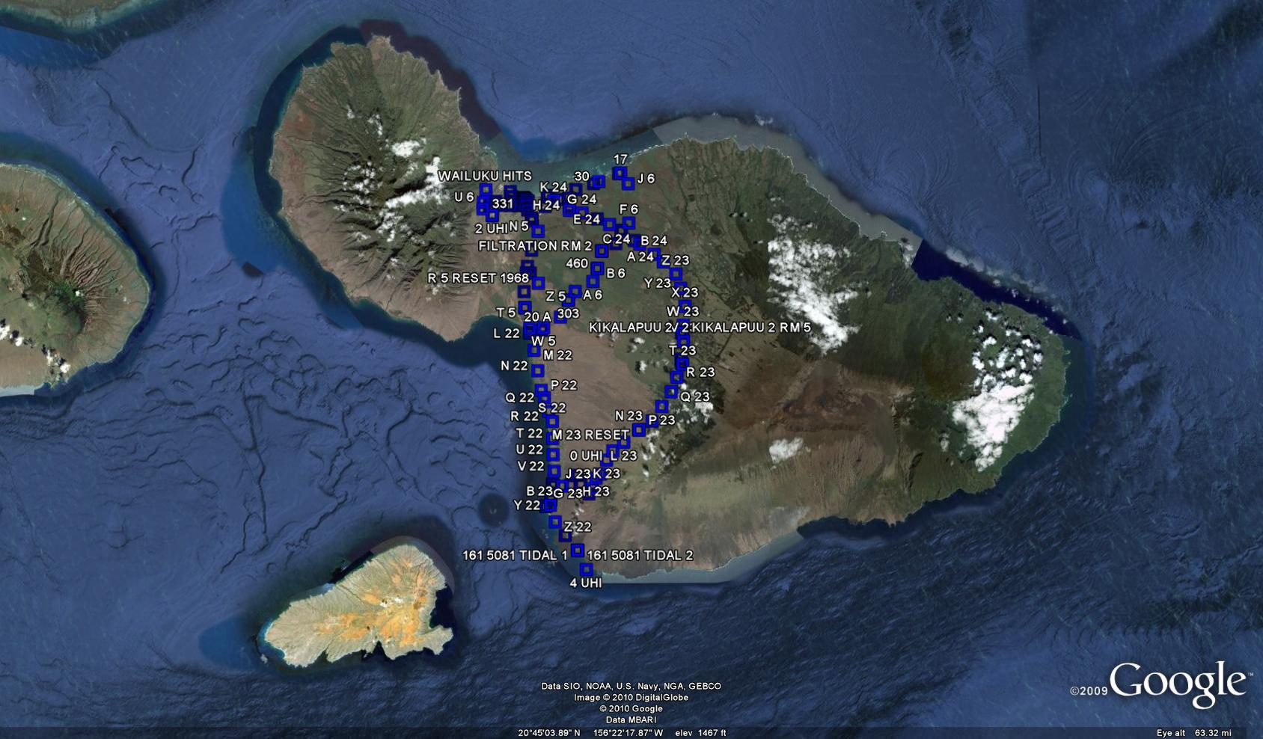
Existing Benchmark Maui

Slide 9
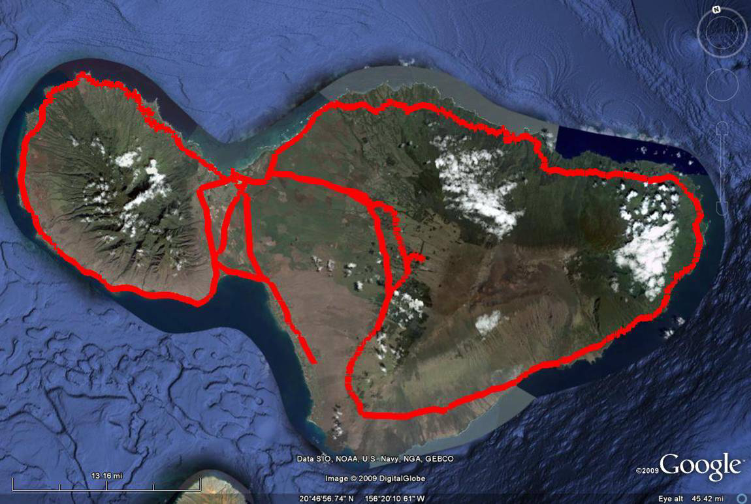
Proposed Benchmark Maui

Slide 10
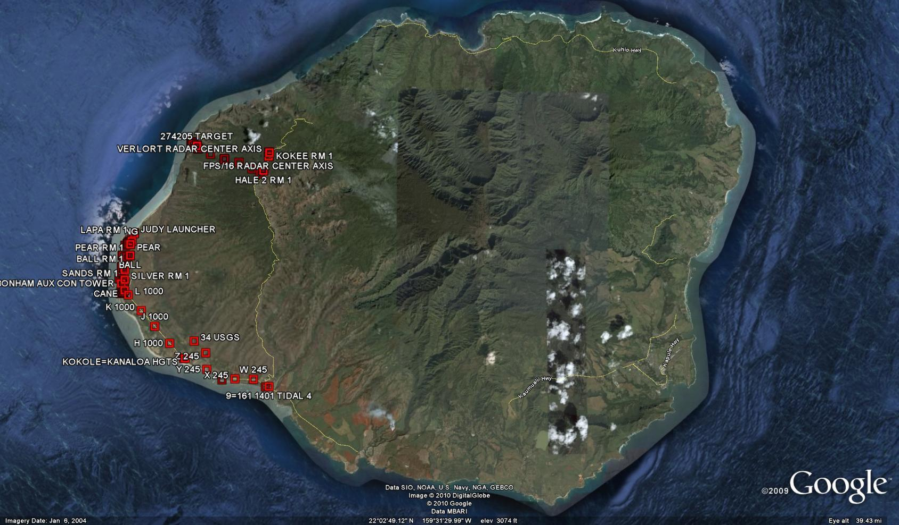
Existing Benchmark Kauai

Slide 11
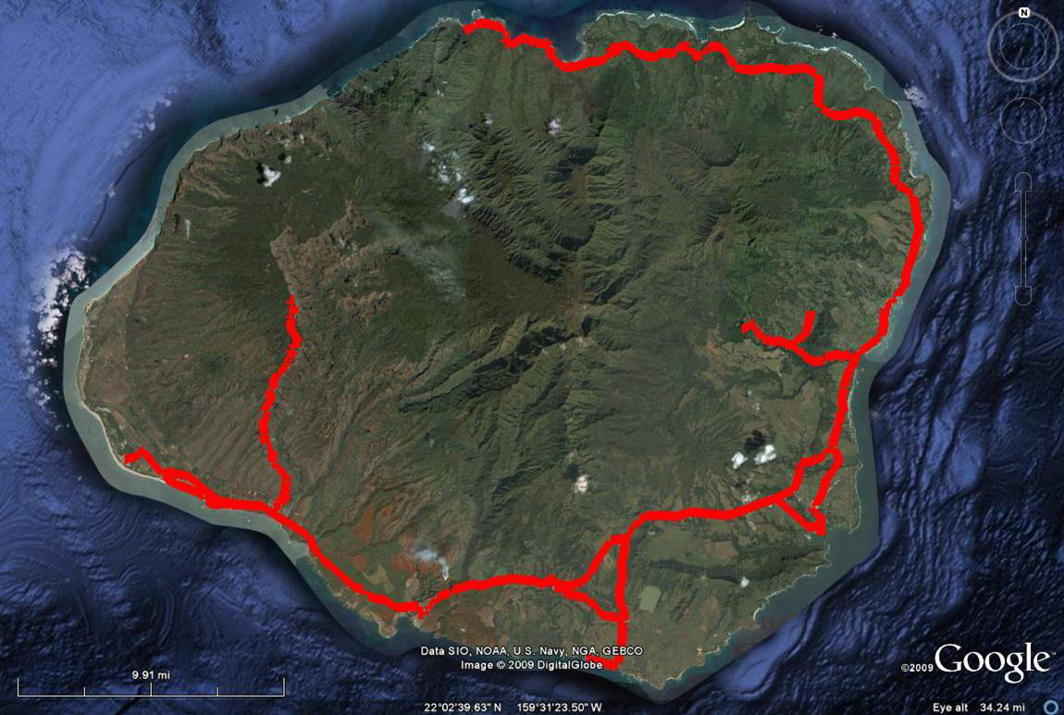
Proposed Benchmark Kauai

Slide 12
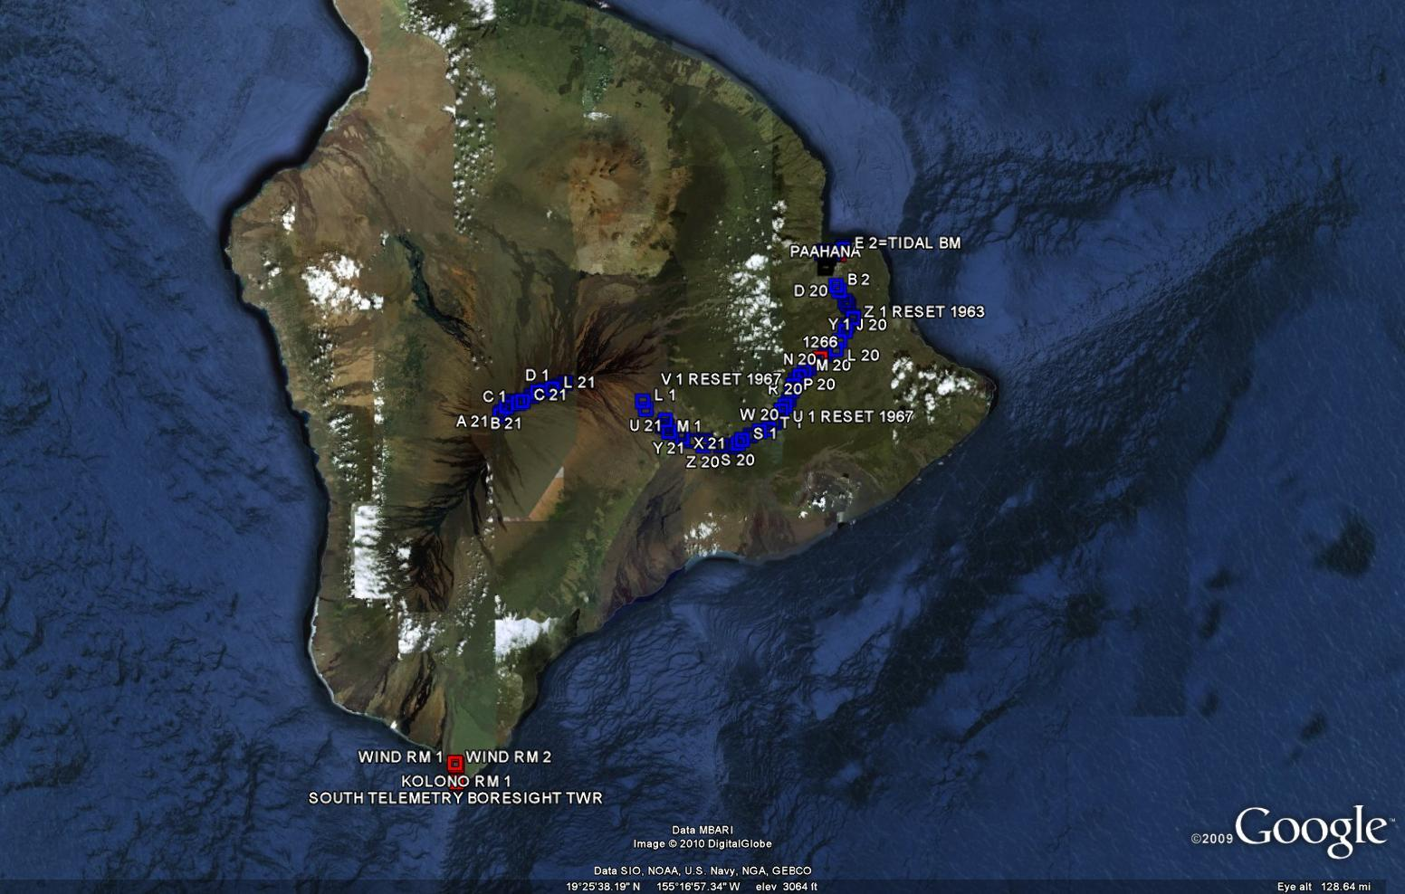
Existing Benchmark Big Island

Slide 13
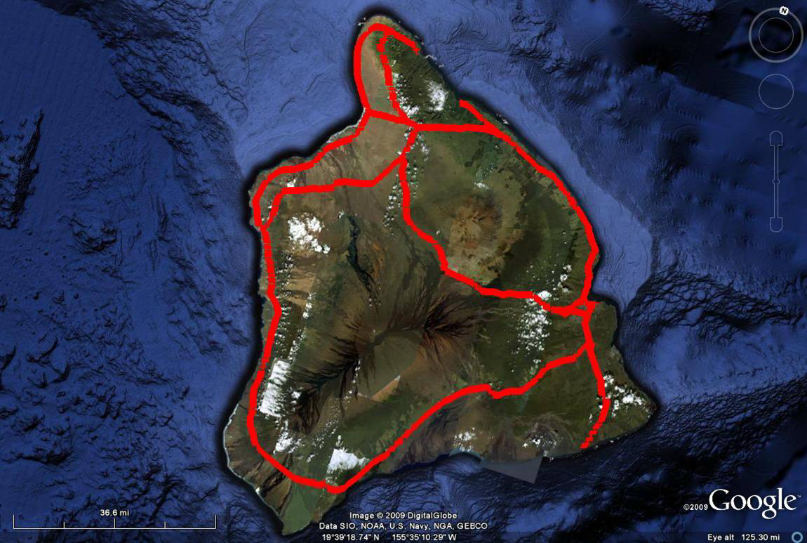
Proposed Benchmark Big Island

Slide 14
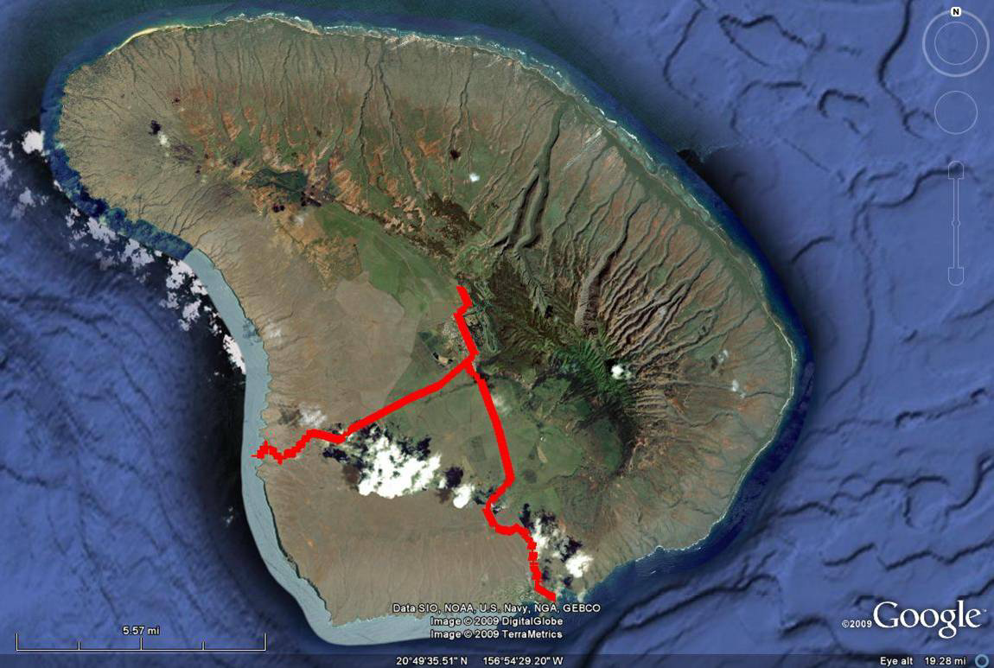
Proposed Benchmark Lanai

Slide 15
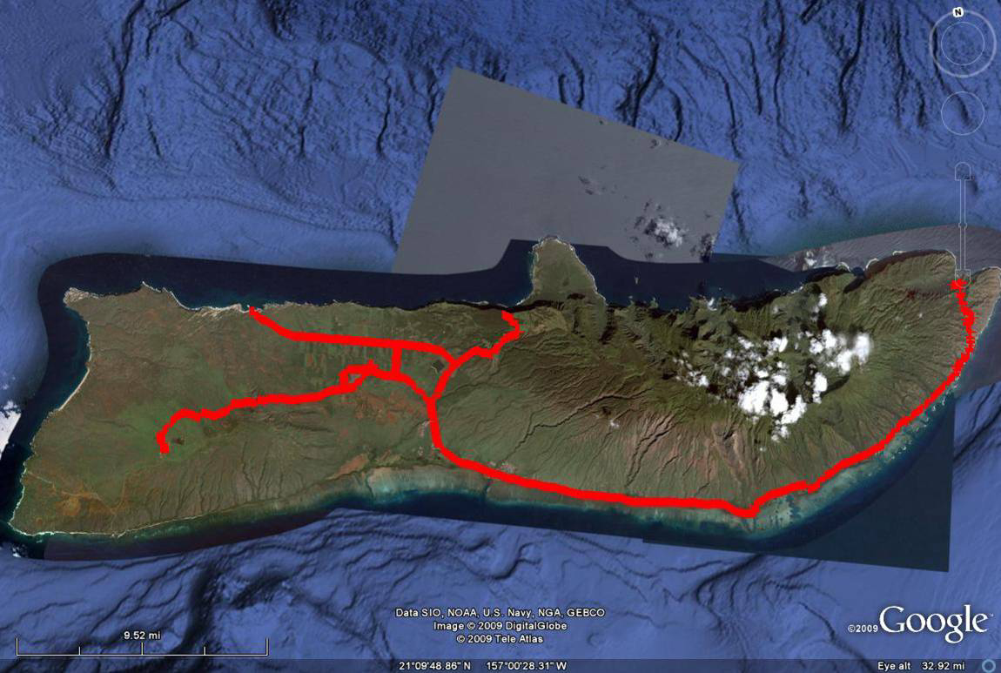
Proposed Benchmark Molokai

Slide 16
Estimated miles of leveling
Oahu
  Estimate of 211 miles
Maui
  Estimate of 251 miles
Kauai
  Estimate of 128 miles
Big Island
  Estimate of 410 miles
  Data to be submitted to NGS to be included in NSRS.

Slide 17
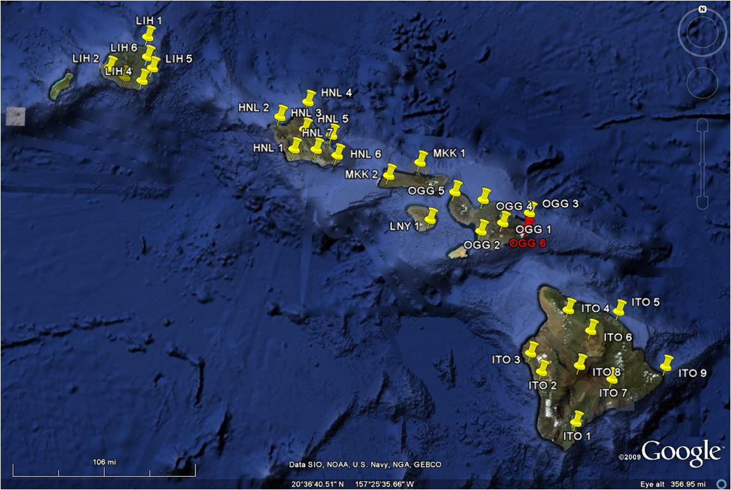
Phase 2 – CORS / VRS

Slide 18
GPS Receivers:
  Current GNSS Receivers and Geodetic Antennas
Equipment:
  Solar panels, backup batteries, battery enclosure box
  Modem radio where no internet exist to provide a single base solution
Construction:
  In Federal, State or County property where possible
  Sites may change depending on site issues (high buildings, trees, transmission towers, mountains, etc.)
Servers
  Central server with redundant server located in each county.

Slide 19
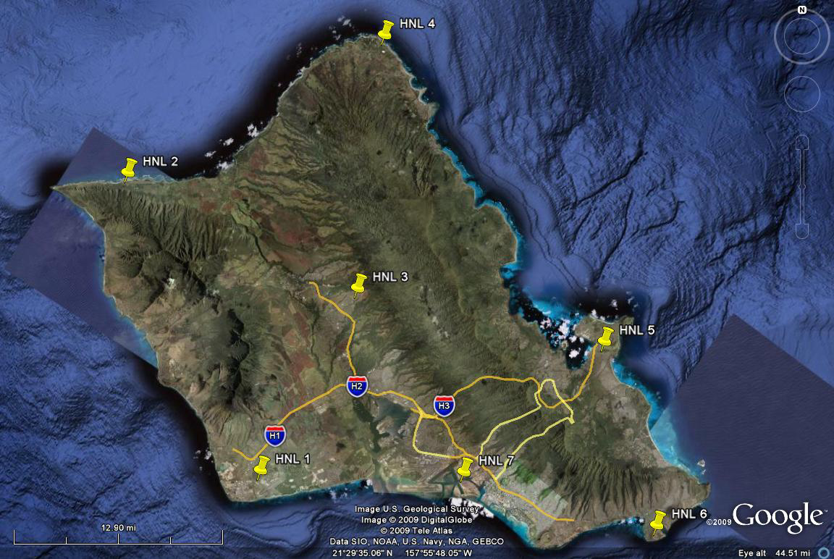

Slide 20
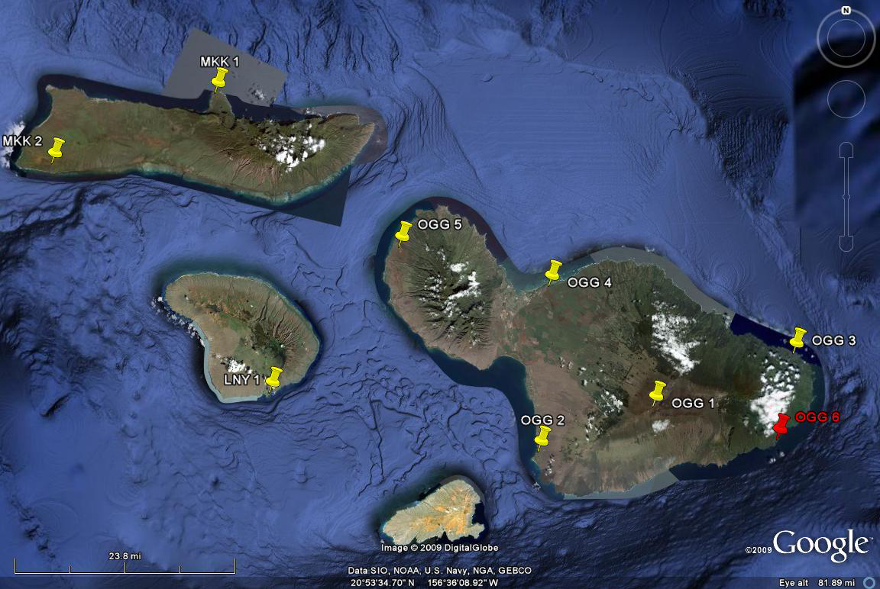

Slide 21
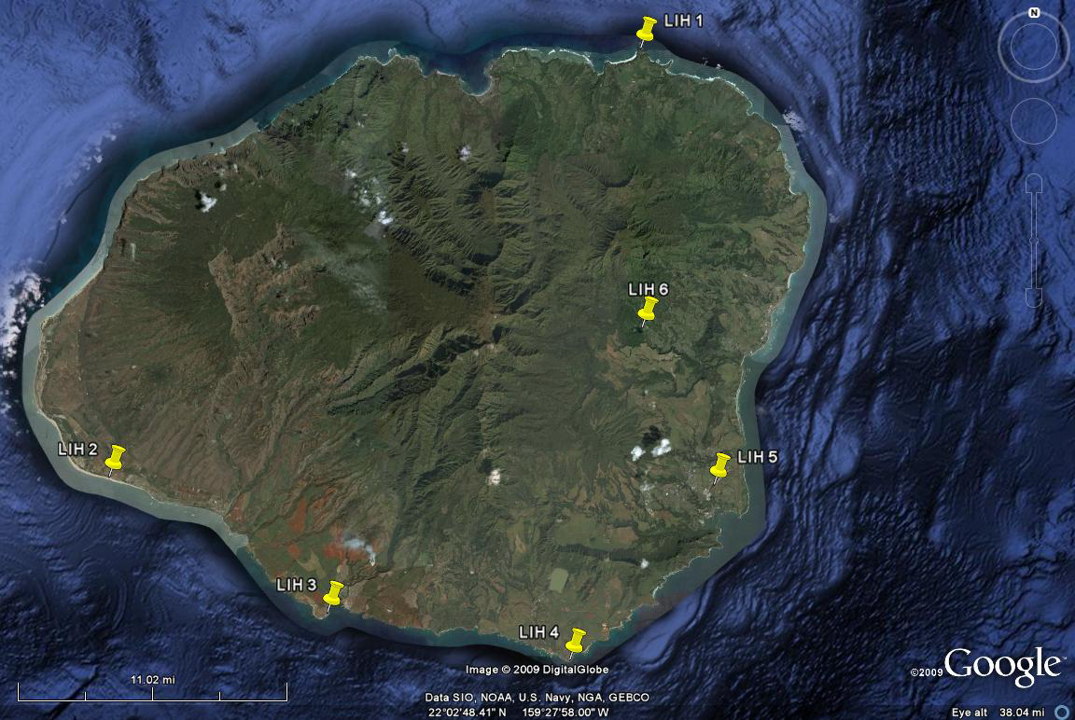

Slide 22
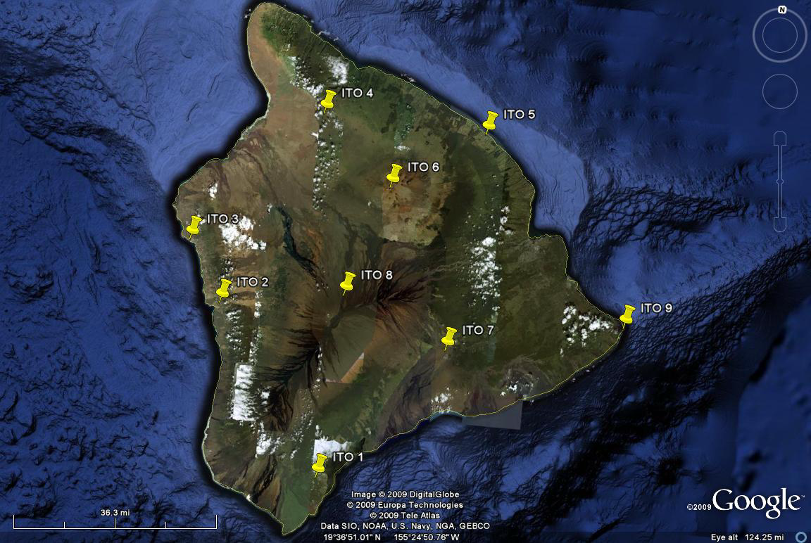

Slide 23
VRS Network
Oahu - 7 Stations
Maui - 8 Stations with a possible 9th station
Kauai – 6 Stations
Big Island – 9 Stations
NOTE 1: Will level to as many VRS stations
NOTE 2: Include at least 20% in the National CORS network system

Slide 24

A Good Money Saver
There is no need for buying a base station
There is no need to leave a person to watch the base station
The VRS System will allow user to complete lager project faster with less cost

Slide 25
HARN Projects Completed
3 HARN projects completed
  2004 HARN (Demonstration Project)
    4 “A” Order station installed
    7 Station upgraded from 1st Order to “A”
    2 existing benchmarks have now 1st order horizontal positions
      Area Covered Kahe to Kaimuki
  2006 HARN (User Densification Project)
    23 Station added in this project
      Areas covered Ewa Beach and Waipahu
  2008 HARN
    10 New “B” order station added
    3 existing benchmarks have now “B” order
      Areas covered Downtown to Diamond Head

Slide 26
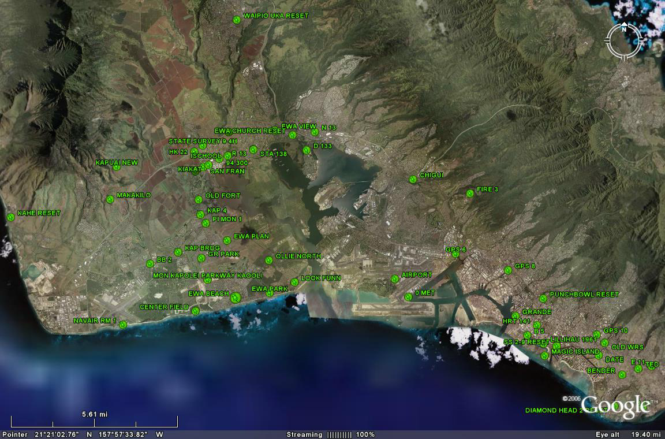

Slide 27
Future Funding Phase 3 to 5
Future Funding will go through CIP same as Phase 1 and 2
Phase 3 – LIDAR and Airborne Gravity
Phase 4 - Research and Development
  Calculating of a new Geoid Model for the State of Hawaii
  NGS to advise as needed
Phase 5 - Reference Center

Slide 28




Who will Benefit MOST
Private Sector (Engineers, Surveyors, Planners, Contractors, and Construction company’s, etc.)
Government Sector (Federal, State, County)
Military
GIS Community
And the Tax Payers in general (lower cost for surveying, engineering, etc.)

Slide 29
Contact Information
Christopher Guerin
601 Kamokila Blvd. Room 600
Kapolei, Hawaii. 96707
808-692-7602 Phone
808-692-7608 Fax
christopher.guerin@hawaii.gov

Slide 30
Question
Thank you for allowing me to present our current and future plans for The Height Modernization for the State of Hawaii
Any Questions?

