Slide 1
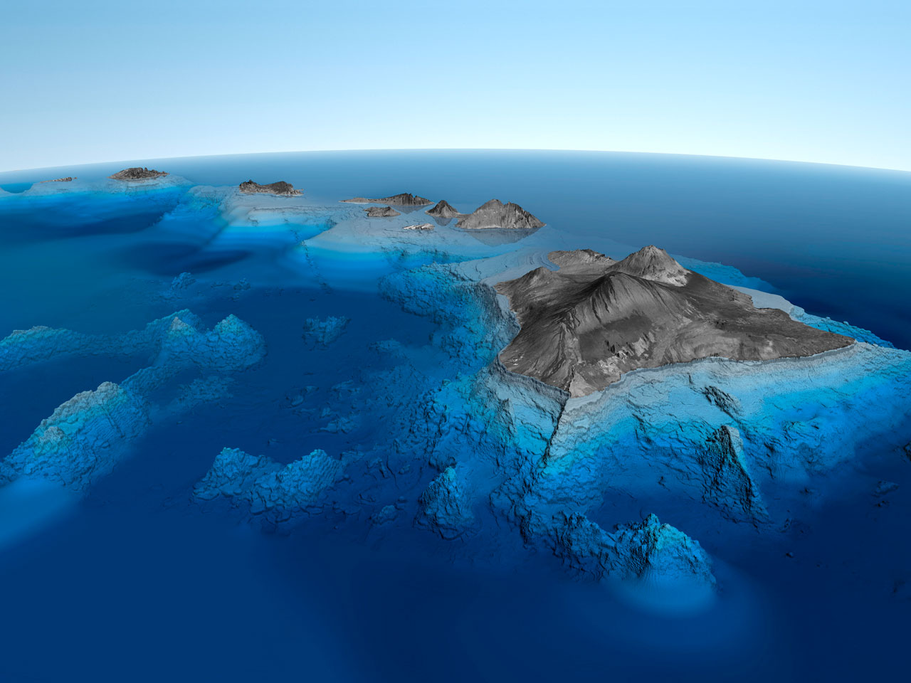
Hawaii State Civil Defense
Presentation to:
Hydrographic Services Review Panel
Honolulu, Hawaii
May 6, 2011

Slide 2
MISSION
Prepare for and respond to disasters and emergencies.
Prevent or minimize loss of life and reduce damage or destruction to property and the environment.
Provide for public safety, health and welfare of citizens.
Restore vital services and lifeline utilities.
Ensure there is continuity of government or preservation of the structure of government.
Manage resources for response and recovery.

Slide 3
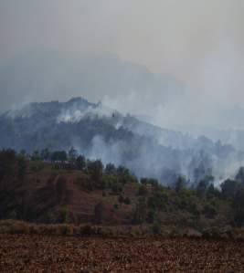
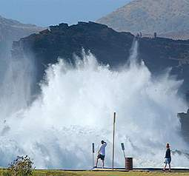
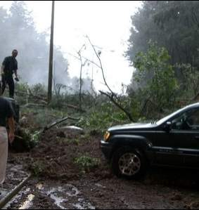
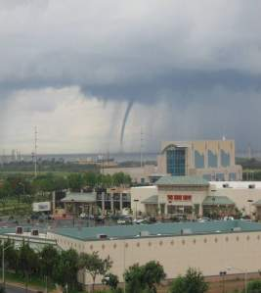
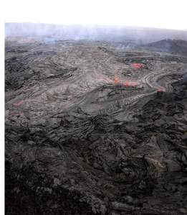
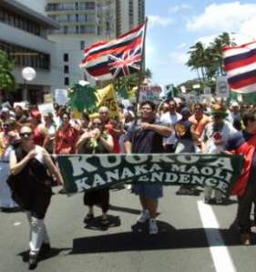
WILDFIRES
HIGH SURF
LANDSLIDES
FUNNEL
CLOUDS
VOLCANIC
ACTIVITY
CIVIL
DISORDER
Notes:
We face a number of hazards and threats and run the full spectrum from wildfires to civil disorder

Slide 4
HAWAII HAZARD PROFILE
0
2
4
6
8
10
Hurricane
Flash Flood
Tsunami
Earthquake
Volcano
Landslide
Urban Fire
Power Failure
Wild Fire
HAZMAT (trans/oil spill)
Drought
Aircraft Incident
HAZMAT (fixed)
Tornado/Water Spout
Dam Failure
Radiological
Terrorism
Civil Disorder
September 2006
Threat ranking includes likelihood and effect on population and property
Notes:
Hawaii’s hazard profile displays a wide range of natural and technological hazards. Not surprising, water related hazards top the list, with Hurricanes, Flooding and Tsunamis posing the highest risk. Earthquake and Volcanic activity also pose notable risks.
Hazard ranking is determined by likelihood of occurrence and effects on population and property.

Slide 5
VISION
Leading the State in prevention, protection, and rapid assistance during disasters with a full range of resources and effective partnerships.
Strategic Areas of Emphasis:
Homeland Security
Prevention and Protection
Partnerships
Information Superiority
Emergency Communications, Coordination, and Control

Slide 6
PREVENTION AND PROTECTION
Mitigate to reduce or eliminate risk to people and property in the State of Hawaii.
Early Warning Systems
Stream and River Flood Gage Network
DART Network
Coastal Inundation Analyses
Tsunami Wave Modeling
Catastrophic Hurricane Planning
Public Awareness and Education

Slide 7
MITIGATION
State required to maintain a Multi-Hazard Mitigation Plan (per Stafford Act), to include:
Hazard Identification and Assessment
Risk & Vulnerability Analysis
Mitigation Strategy,
Local Planning Coordination
Updated Plan ensures the State qualifies to receive:
Non-emergency Stafford Act funding
Public Assistance Categories C - G

Slide 8
EMERGENCY CATEGORIES
 | TYPE | CATEGORY
EMERGENCY WORK | Debris Removal | A
 | Emergency Protective Measures | B
PERMANENT WORK | Road Systems | C
 | Water Control Facilities | D
 | Buildings and Equipment | E
 | Utilities | F
 | Parks, Recreational , and Other | G

Slide 9
Plan organization
Governor’s Order to Adopt
Executive Summary
Table of Contents
Chapter 1: 2007 Evaluation and Introduction to the 2010 Plan
Chapter 2: Planning Process
Chapter 3: Identifying and Profiling Hazards
Chapter 4: Characterization of Assets, Resources, Socioeconomic Factors
Chapter 5: Risk and Vulnerability Assessment
Chapter 6: Current Mitigation Actions and Capability Assessment
Chapter 7: Mitigation Strategy
Chapter 8: Plan Maintenance Procedures

Slide 10
Plan ELEMENTS
Identify and Profile Hazards
Characterize and analyze natural hazard risks for the State of Hawaii
Risk and Vulnerability
Describe vulnerability (examples: identify jurisdictions most threatened by specific hazards; HAZUS modeling)
Mitigation Strategy
Description of State goals and objectives to mitigate and reduce potential losses
Identification, evaluation, and prioritization of cost-effective, environmentally sound, and technically feasible mitigation actions and activities to reduce loss
Notes:
Forum meetings are meetings of the experts to provide input, provide a mechanism for public participation and state adoption of updated plans

Slide 11
PARTNERSHIPS
USGS
NOAA
NTHMP
ITIC
NWS
PTWC
UH Sea Grant
FEMA
Disaster Assistance
Grant Assistance
State Agencies
County Agencies

Slide 12
PARTNERSHIPS
USGS
NOAA
NTHMP
ITIC
NWS
PTWC
UH Sea Grant
FEMA
Disaster Assistance
Grant Assistance
State Agencies
County Agencies

Slide 13
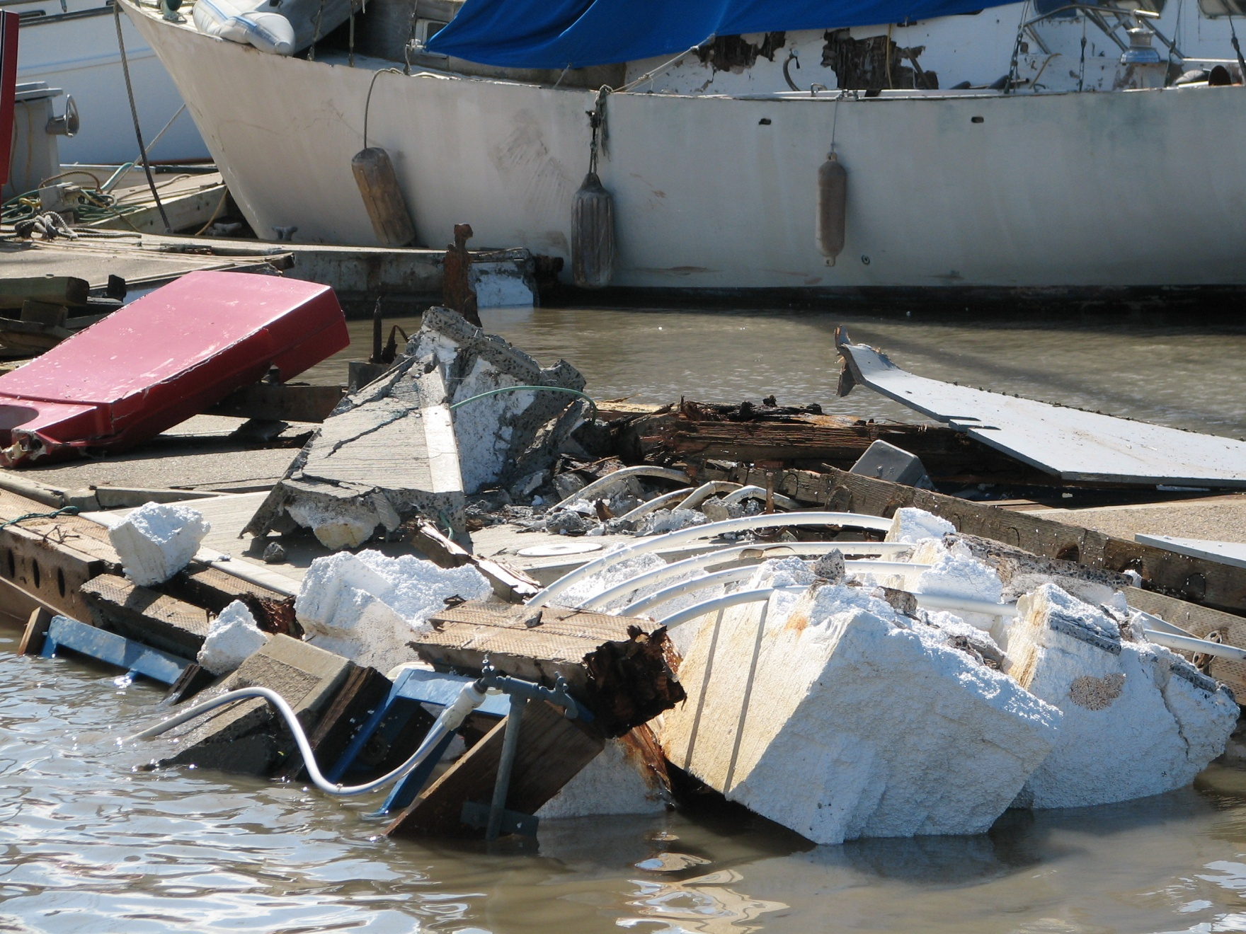

Slide 14
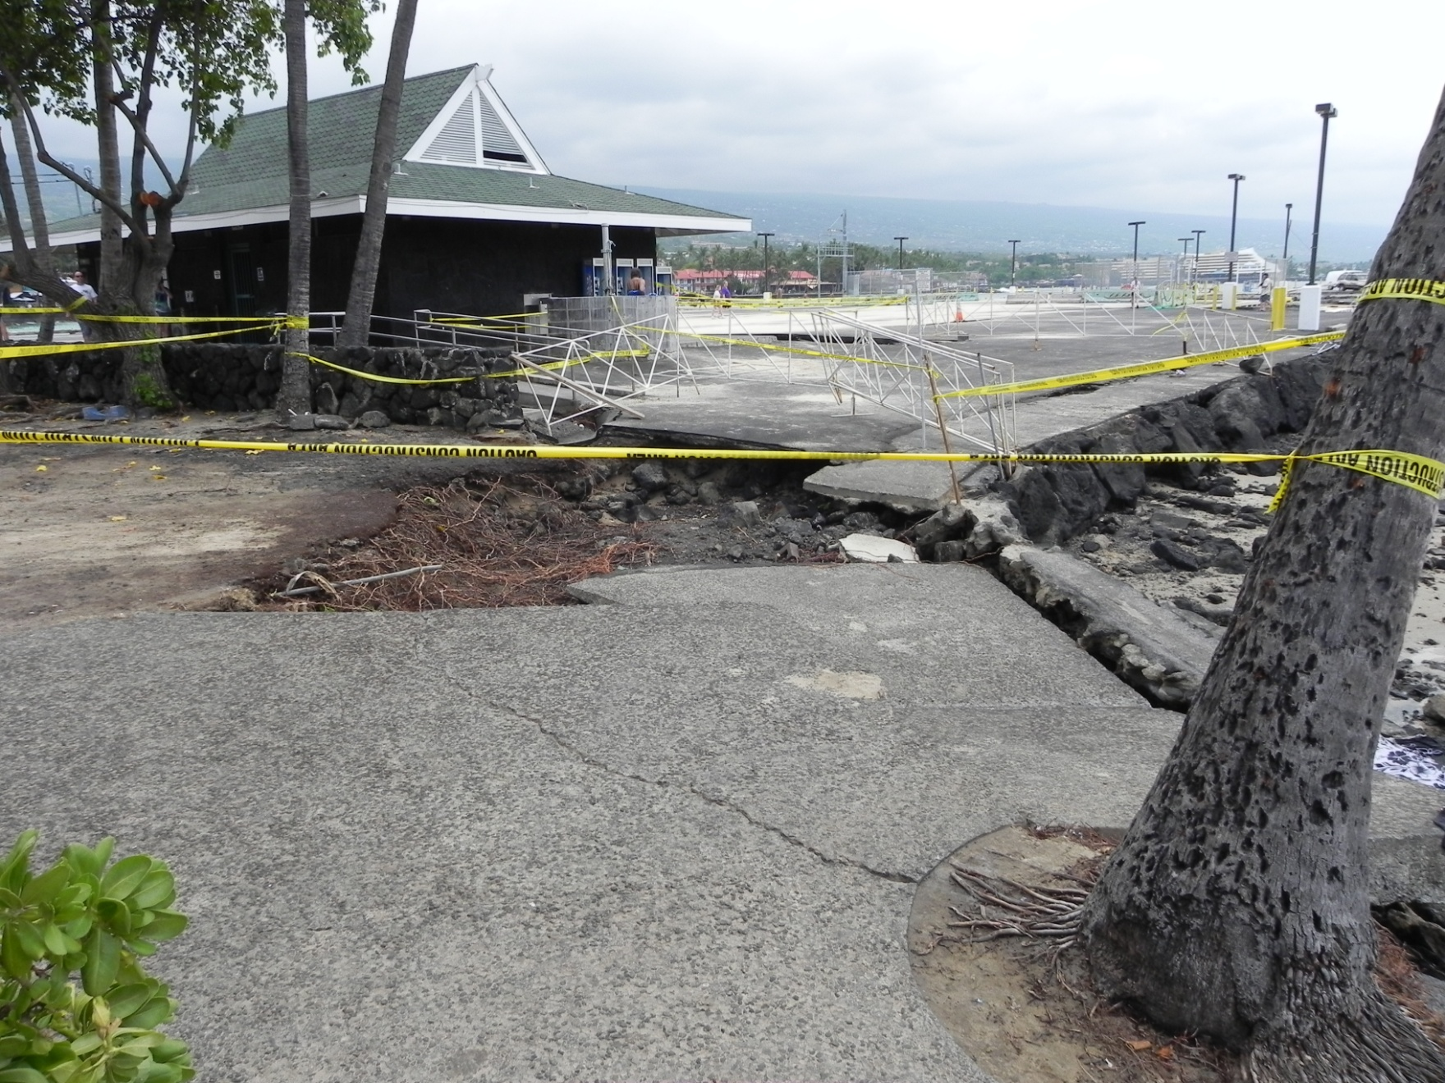

Slide 15
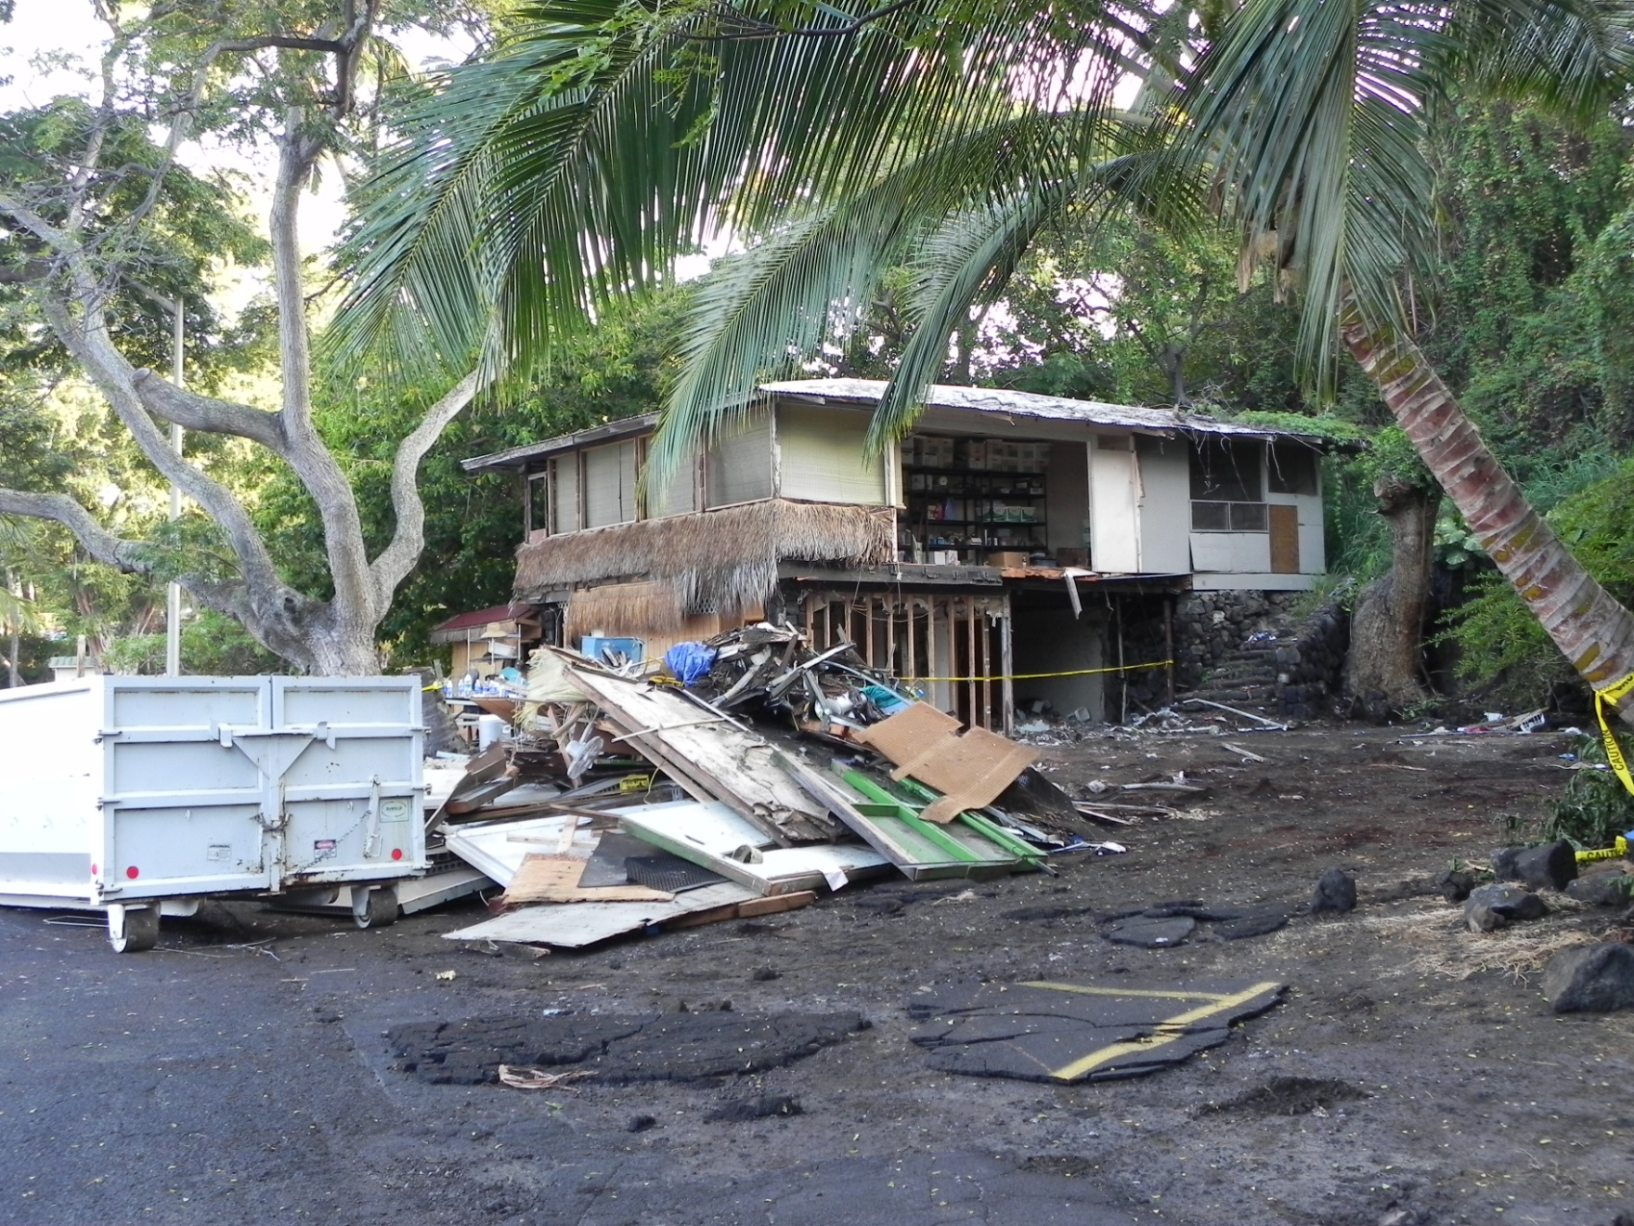

Slide 16
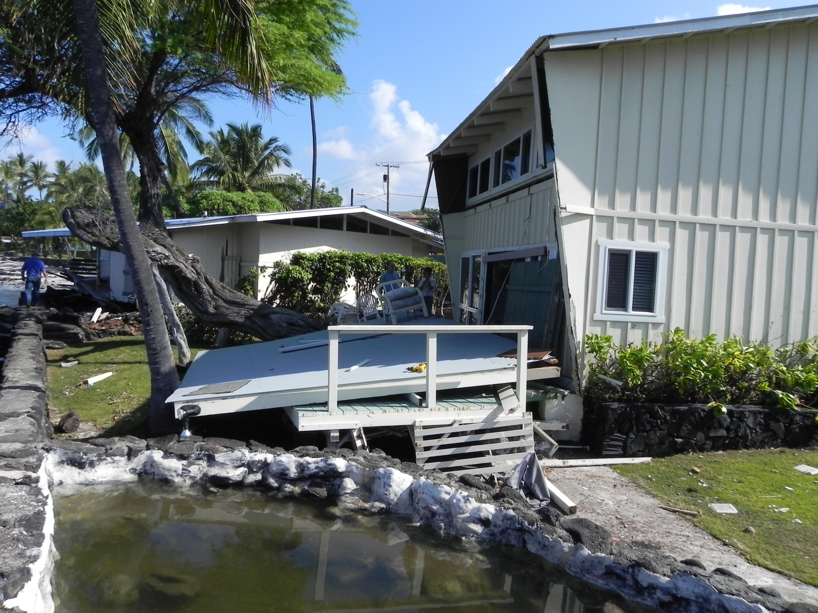

Slide 17
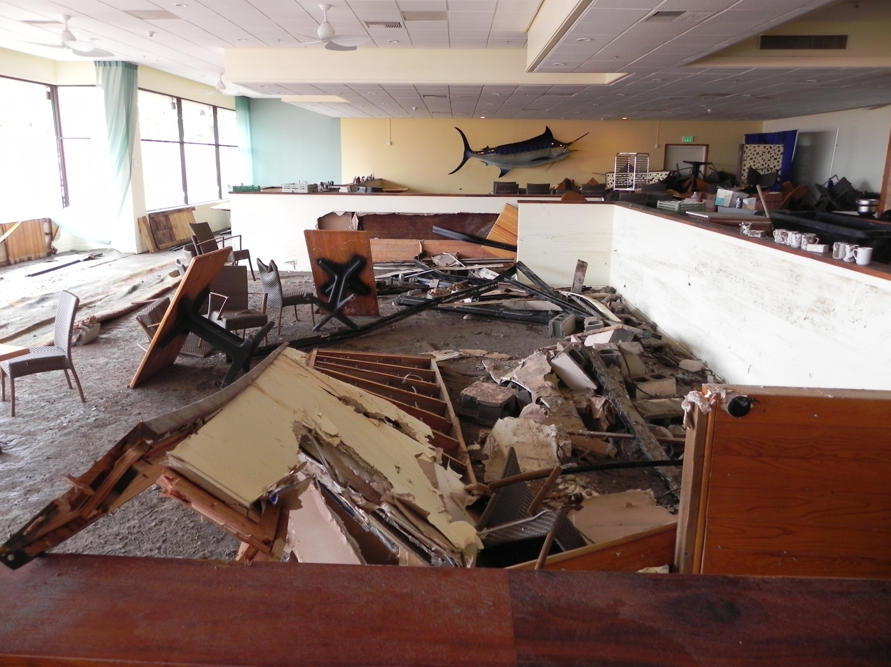

Slide 18
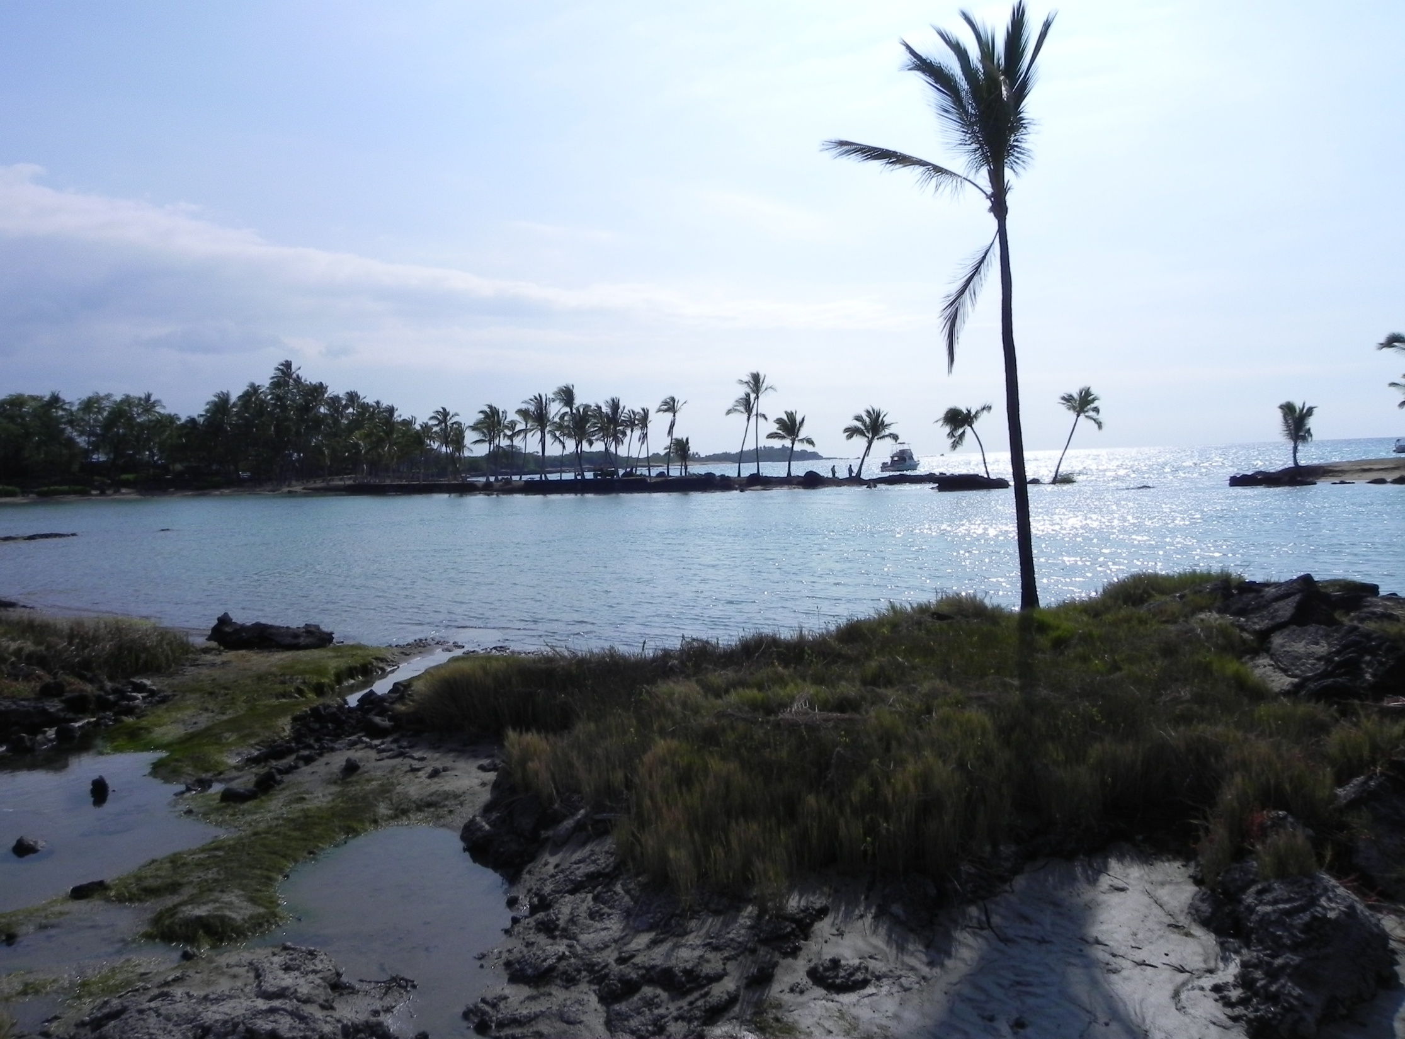
Mahalo

Slide 19
Mahalo

Slide 20
PRIVATE SECTOR SUPPORT
Build towards disaster resiliency
Participate on planning teams
Develop and implement Continuity of Operations Plans
Support pre-disaster response agreements
Provide damage assessments to the State Emergency Operating Center
Recover quickly to provide services
Support community disaster recovery operations
Building Code Enhancements

Slide 21
PILLARS OF EMERGENCY MANAGEMENT
Recovery
Prevention
Protection
Mitigation

Slide 22
STRATEGIC AREAS OF EMPHASIS
Homeland Security
Prevention and Protection
Partnerships
Information Superiority
Emergency Communications, Coordination, and Control

Slide 23
MITIGATION: RISK REDUCTION
Climate Change
Sea Level Rise
Severe Weather Events
Catastrophic Seismic Events
EXAMPLES:
January 2011 Flood Event
March 11, 2011 Honshu Earthquake

