Slide 1
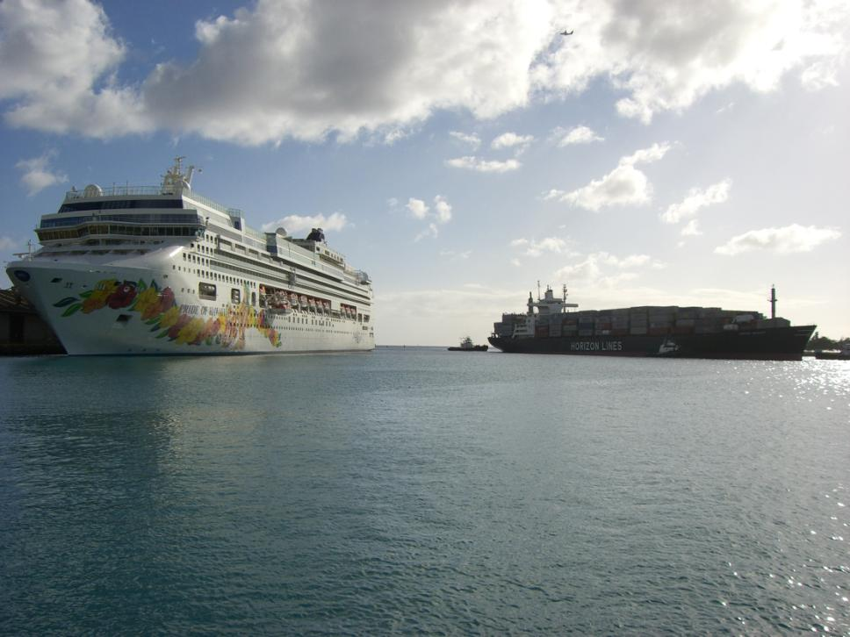
NOAA Hazards & Coastal Management Stakeholder Panel Waikiki, Hawaii – May 6, 2011
U.S. COAST GUARD
Presented by LCDR Marcella Granquist
Waterways Management Division, Sector Honolulu

Slide 2
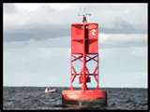
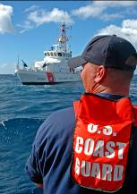
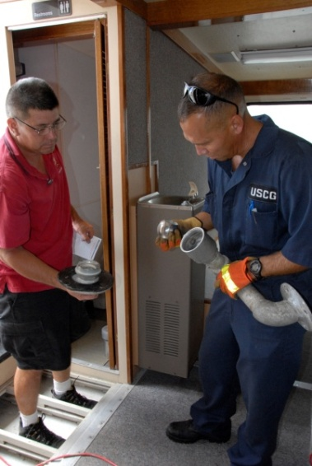
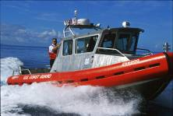
U.S. Coast Guard Roles
Safety
Security
Ports, Waterways
& Coastal Security
Search & Rescue
Defense Readiness
Marine Safety
Escorts
Multi-Mission
Service
Aids to
Navigation
Other Law
Enforcement
Marine Environmental Protection
Living Marine Resources
Stewardship
Notes:
This Venn Diagram displays how Maritime Safety, Maritime Security and Maritime Stewardship are interwoven into tactical operations. As a few examples, on any given day, my personnel may be required to work with a variety of interagency partners:
For Marine Environmental Protection and oil spills, we work closely with the maritime industry and the State Department of Health and Environmental Response
For Maritime Search and Rescue, our natural partners are the County Fire Departments and Departments of Ocean Safety, we’ve responded to over 200 cases this year
Our Ports Waterways and Coastal Security missions are coordinated in conjunction with our federal law enforcement partners, the State Department of Transportation Harbors Division, and over 64 private sector facility owners who are responsible for developing plans to address MTSA and SAFEPORT security requirements.
And we provide direct support to the US Navy to protect High Value Units as they transit into and out of Pearl Harbor
All of these myriad activities are coordinated through the Multi-Mission Command Center that we toured earlier.

Slide 3
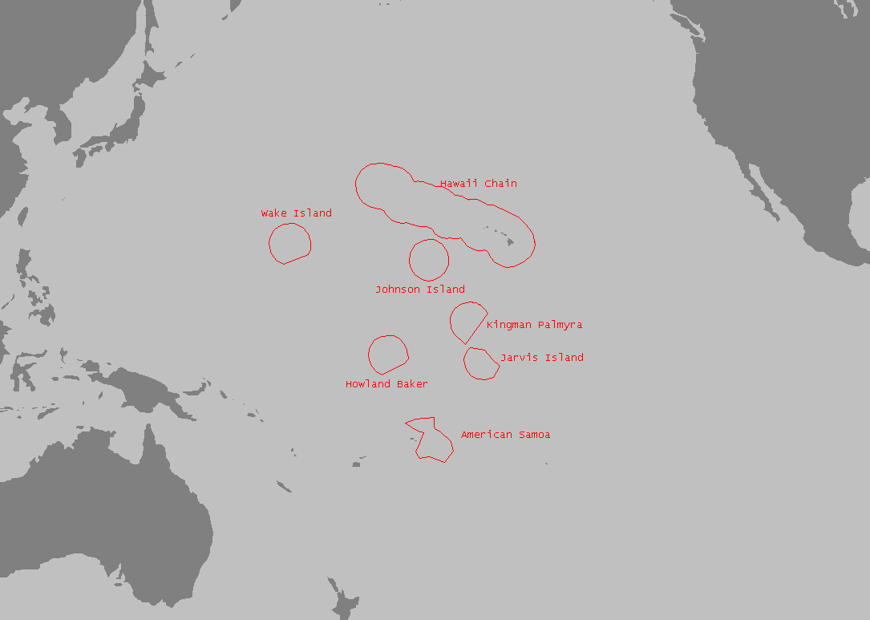
Captain of the Port (COTP) Area of Responsibility
COTP Search & Rescue Responsibility span 200NM
All Other Responsibilities span 2,500NM
Notes:
Sector Honolulu AOR for:
COTP – Captain of the Port
FOSC – Federal On Scene Coordinator
FMSC – Federal Maritime Security Coordinator OCMI
Officer in Charge, Marine Inspection – covers all areas within D14 except those covered by Sector Guam.

Slide 4
Fiscal Year 2010 Operations Summary for Hawaii
264 Search & Rescue Cases
45 Lives Saved
361 People Assisted
$1.52M Property Saved
725 Vessel Boardings
784 Pollution Incident Cases
2,396 Mariner Docs Issued
449 Federal Aids to Navigation
Maintained
779 Vessel Inspections
279 Marine Casualty Investigations
102 Marine Events Permitted for
707 Hawaii Events Reviewed
352 Container Inspections
209 Maritime Facility Inspections
18 Explosive Load Monitors
22 Waterway Construction Projects
Reviewed
Notes:
Top 6 case types:
119 Disabled
50 PIW
31 Aground
23 red /orange flare
20 MEDEVAC
16 Taking on water

Slide 5
Our Partners…
All Waterways Users
Commercial
Recreational
State of Hawaii
DOT
DLNR/DOBOR
Civil Defense
Police/Fire Depts
Health Dept
County Agencies
Other Federal Agencies
DOD/Military
DOT
FEMA
NOAA
U.S. State Department
Community Groups
Industry Advisory Board
H.O.S.T.
Neighborhood Boards
Many, many others…

Slide 6
NOAA Products & Services Used
Hardcopy & On-line Charts http://www.nauticalcharts.noaa.gov/mcd/OnLineViewer.html
Coast Pilot http://www.nauticalcharts.noaa.gov/nsd/coastpilot_w.php?book=7
On-line Weather - Forecasted, Current & Historical Data
(Search & Rescue, Pollution Responses, and Maritime Incident Investigations)
NOAA Buoys, Tide Gauges & Survey Teams
(Pre/Post Tsunami, Heavy Weather Conditions, and Recovery Operations)
Hydrographic Surveys
(Maritime Incident Investigations & Waterway Construction/Project Reviews)
Forthcoming 2011 Tidal Current Information
(Search & Rescue, Positioning Aids to Navigation, and Facilitating Commerce)

Slide 7
Foreseeable Challenges
As vessels continue to be built larger and carry more cargo per voyage, a need to modify harbors to best accommodate them in a safe and efficient manner will necessitate the need for current survey data
As extreme weather and natural disasters continue to be unpredictable, the availability of real-time, accurate, and easily accessible data could better inform the growing maritime industry as well as the increasing number of public waterway users

Slide 8
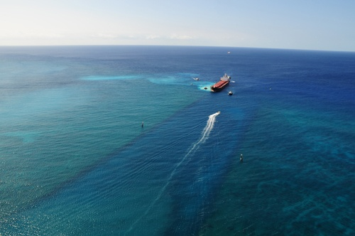
Recommendation
Implement PORTS® in Kalaeloa Barbers Point Harbor, Oahu, Hawaii
2010 Vessel Grounding outside Barbers Pt. Channel Entrance
This harbor, which contains specialized cargo handling facilities not found in Honolulu Harbor, is subject to unpredictable cross currents outside the entrance channel, and is visited by increasingly larger vessels, at a greater frequency, carrying more bulk quantities of materials per voyage.

Slide 9
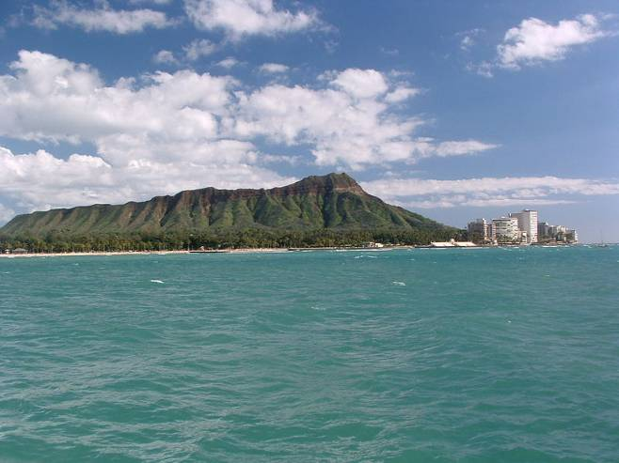
Mahalo

