Slide 1
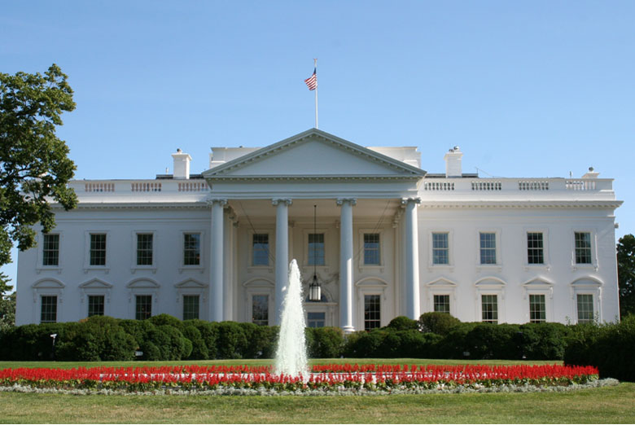
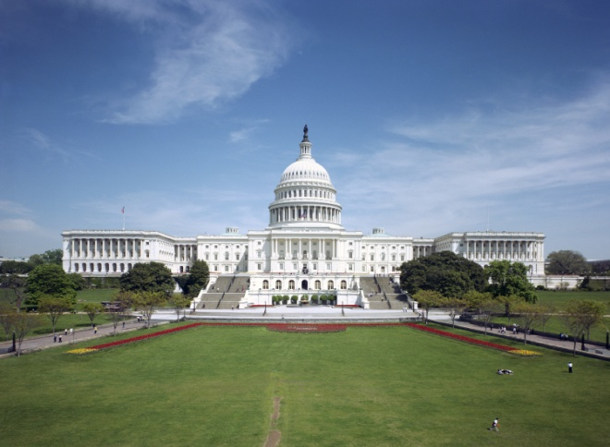
NOAA National Ocean Service Management and Budget Office Policy, Planning & Analysis Division
Paul Bradley
May 6, 2011

Slide 2
Outline
NOAA Budget Process
Congressional Appropriations Process
Legislative Issues
Administration Policy Issues
Outreach
Congressional
Constituent
Administration/NOAA

Slide 3
Budget: The Players
NOAA:
Line Offices
NOAA Budget Office
Dept of Commerce Budget Office
Office of Management and Budget (OMB)
Congressional Budget Committees
Congressional Appropriations Committees

Slide 4
Budget
NMFS
NOS
NESDIS
OAR
NWS
PPI

Slide 5
NOAA Budget Process
Begins 18 months to 2 years before start of fiscal year
Draws upon agency’s strategic documents
Includes three iterations: DOC, OMB, and Congressional (President’s Budget)
Each iteration is presented and defended in turn by NOAA

Slide 6
DOC Budget Submission
Jan – Feb:
Line Offices finalize budgets for submission to NOAA Budget Office
March – April:
NOAA Budget reviews and analyzes budget proposals for DOC Submission
NOAA CFO makes recommendations to Undersecretary for NOAA
Undersecretary finalizes budget decisions
LOs & NOAA budget prepare DOC Submission
May – June:
NOAA Submits budget to DOC for review and analysis
Line Offices & NOAA brief DOC and respond to questions

Slide 7
OMB Budget Submission
July:
NOAA receives DOC initial passback (with Secretary’s decisions)
LOs and NOAA budget develop appeal requests
August – September:
NOAA receives DOC final passback
LOs and NOAA budget prepare OMB Submission
DOC submits budget to OMB mid-September
November:
DOC/NOAA receives initial OMB passback
NOAA budget reviews and coordinates appeal requests

Slide 8
President’s Budget
December – January:
OMB final passback
LOs and NOAA budget prepare President’s Budget
February – March:
Submit President’s budget to Congress first Monday in February
President’s Budget rollout (meetings, briefings, responses to questions)
April – September (and beyond):
Congressional Action on Appropriations
Hearings
Mark Up and Floor Action
Continuing Resolutions (if needed)

Slide 9
Budget Timeline
2010 |  |  | 2011 |  |  |  |  |  |  |  |  |  |  |  | 2012
Oct | Nov | Dec | Jan | Feb | Mar | Apr | May | Jun | Jul | Aug | Sep | Oct | Nov | Dec | Jan | Feb
FY 2011
Appropriations/Execution
Budget Execution
FY 2012
OMB Passback
Prepare Pres. Bud.
Rollout Pres. Bud.
Congress: Budget & Appropriations
Budget Execution
FY 2013
LOs Develop Budgets
NOS Review; Prepare DOC
DOC Passback; Prepare OMB
OMB Pass-back
Prepare Pres. Bud.
Roll Pres. Bud.

Slide 10
Congressional Appropriations
Feb: Receive President’s Budget Request
Mar-Apr:
Budget Committees set “top-line” limit on discretionary spending
Members submit priority requests to Appropriation Committees
May: “Top-line” spending number is allocated across 12 Appropriations Subcommittees, in both houses
Feb-Jun: Committees hold budget oversight hearings
May-Jul: Subcommittees start the “mark-up” process
Sept: Theoretically, individual appropriations bills are passed
Oct-Dec (and beyond): appropriations bills (or Omnibus, or Continuing Resolution) are actually passed

Slide 11
Congressional Committees
Authorization bills:
establish, continue, or modify federal programs; authorize spending and provide guidance on appropriate funding levels
1 Committee in the Senate
3 Committees in the House
Appropriation bills:
Direct spending and allocate funds to Federal gov’t
1 Committee in each Senate and House
1 Subcommittee with jurisdiction over NOAA

Slide 12
Senate Appropriations Committee
Commerce, Justice, Science (CJS) Subcommittee
Barbara Mikulski (MD)
Daniel Inouye (HI)
Patrick Leahy (VT)
Herb Kohl (WI)
Dianne Feinstein (CA)
Jack Reed (RI)
Frank Lautenberg (NJ)
Bill Nelson (FL)
Mark Pryor (AR)
Sherrod Brown (OH)
Kay Bailey Hutchison (TX)
Richard Shelby (AL)
Mitch McConnell (KY)
Lamar Alexander (TN)
Lisa Murkowski (AK)
Ron Johnson (WI)
Susan Collins (ME)
Lindsey Graham (SC)

Slide 13
House Appropriations Committee
Commerce, Justice, Science (CJS) Subcommittee
Frank Wolf (VA)
John Culberson (TX)
Robert Aderholt (AL)
Jo Bonner (AL)
Steve Austria (OH)
Tom Graves (GA)
Kevin Yoder (KS)
Chaka Fattah (PA)
Adam Schiff (CA)
Michael Honda (CA)
José Serrano (NY)

Slide 14
Authorizing Committees
Senate Committee on Commerce, Science, and Transportation
Subcommittee on Oceans, Atmosphere, Fisheries and Coast Guard
House Committee on Natural Resources
Subcommittee on Fisheries, Wildlife, Oceans, and Insular Affairs
House Committee on Science, Space, and Technology
House Committee on Transportation and Infrastructure

Slide 15
Governing Statutes
Coast and Geodetic Survey Act of 1947
NOAA to provide nautical charts and products for safe maritime commerce and navigation
Hydrographic Service Improvement Act of 1998
Amended in 2002 and 2008
Reiterate purpose and authorize increased funding for NOAA's navigation services
Establishment of HSRP mandated in 2002 Amendment
Title 33 of Code of Federal Regulations
NOAA nautical charts, U.S. Coast Pilots, tidal and current information must be carried on all self-propelled vessels, including passenger vessels, > than 1600 gross tons

Slide 16
Legislative Issues
HSIA Reauthorization
Authorizes NOAA Navigation Services through FY 2012
H.R. 295
To amend HSIA to authorize funds to acquire hydrographic data and provide hydrographic services specific to the Arctic for safe navigation, delineating the U.S. extended continental shelf, and the monitoring and description of coastal changes.
Authorizes $5M for hydrographic data acquisition, coastal change analysis
Authorizes $2M for hydrographic services needed to delineate the U.S. Extended Continental Shelf
Hearing May 12
No Senate counterpart

Slide 17
Administration/Policy Issues, Opportunities
National Ocean Policy
Development of 9 SAPs
CMSP: needs robust geospatial foundation
National Export Initiative
Announced March 2010; Double U.S. exports by 2015
Information infrastructure support
Committee on the Marine Transportation System
Cabinet-level Committee (18 Depts., agencies, etc.)
Coordinating Board (25+ Federal agencies); NOAA Chair
Harbor Maintenance Trust Fund
NOAA’s Next Generation Strategic Plan

Slide 18
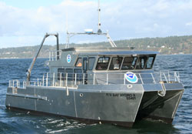
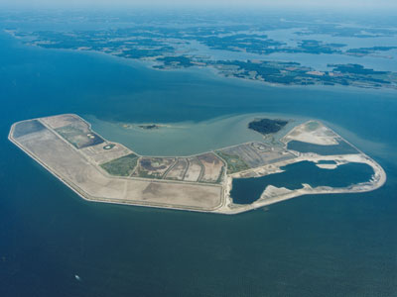
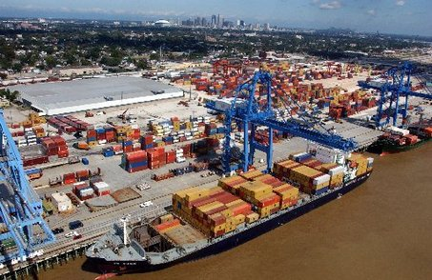
Congressional Outreach
Strengthen existing relationships
Identify new Nav Services champions
Pursue Congressional briefings
Site visits, tours, etc.
Bay Hydro II
Poplar Island
New Orleans/LMR

Slide 19
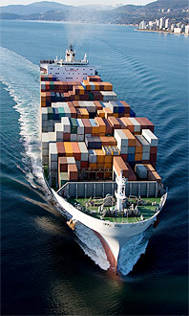
Constituent Affairs
Constituents:
326 public/private ports
3700 marine terminals
12 million cruise passengers
78 million recreational boaters
110,000 fishing vessels
Significance of the MTS:
13 million jobs, $1 trillion+ annually to U.S. GDP
95% of U.S. foreign trade in/out by ship

Slide 20
Constituent Affairs
Budget support
Strengthen relationships with traditional and non-traditional stakeholders
Explore new partnerships
Outreach opportunities
OpSail 2012
America’s Cup 2013

Slide 21
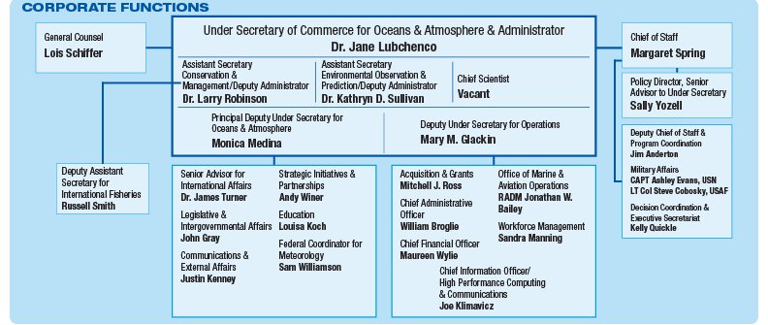
Administration Outreach (Inreach?)
Strengthen messages
Identify opportunities to “tell the story”
Site visits, meetings beyond the Beltway, etc.
Constituent meetings

Slide 22
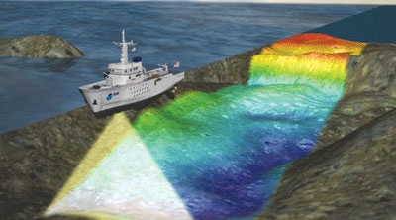
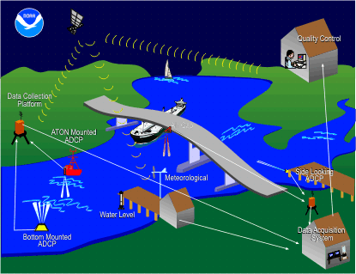
Summary
Budget process is long, complex, and starts up to 2 years before start of fiscal year
Timeline for Congressional appropriations is uncertain and politically-charged
Constituent support is critical during the budget formulation and Congressional appropriations process
No major legislative issues or needs
Awareness and outreach are the biggest challenges

Slide 23
 | 2010 |  | 2011 |  |  |  |  |  |  |  |  |  |  |  |  | 2012
 | Nov | Dec | Jan | Feb | Mar | Apr | May | Jun | Jul | Aug | Sep | Oct |  | Nov | Dec | Jan | Feb
FY 2011 | Execution Phase: Currently operating under a CR
FY 2012 | OMB pass-back & appeals | Prepare President’s Budget |  | President’s Budget Rollout |  | Congressional Action: Appropriations |  |  |  |  |  | Execution Phase begins
FY 2013 |  |  | LOs develop LO budget submissions |  | Review line office proposals and prepare DOC Submission |  |  |  | DOC passback & appeals; prepare OMB Submission |  |  |  | OMB pass-back & appeals |  | Prepare President's Budget |  | PB Roll-out

Slide 24
HSIA Authorization Amounts
Purpose | FY 2012 Authorization Amount | FY 2012 President’s Request
Carry out nautical mapping and charting | $58.0 million | $67.7 million
Contract for hydrographic surveys | $34.0 million | $31.2 million
Operate hydrographic survey vessels | $27.4 million
Carry out geodetic functions | $34.6 million | $29.5 million
Tide and current measurements | $28.5 million | $29.0 million

