Slide 1
“…how NOAA might improve its navigation and science-related products and services.”
John Rooney, Ph.D.
Pacific Islands Benthic Habitat Mapping Center (PIBHMC)
Coral Reef Ecosystem Division
NOAA Pacific Islands Fisheries Science Center

Slide 2
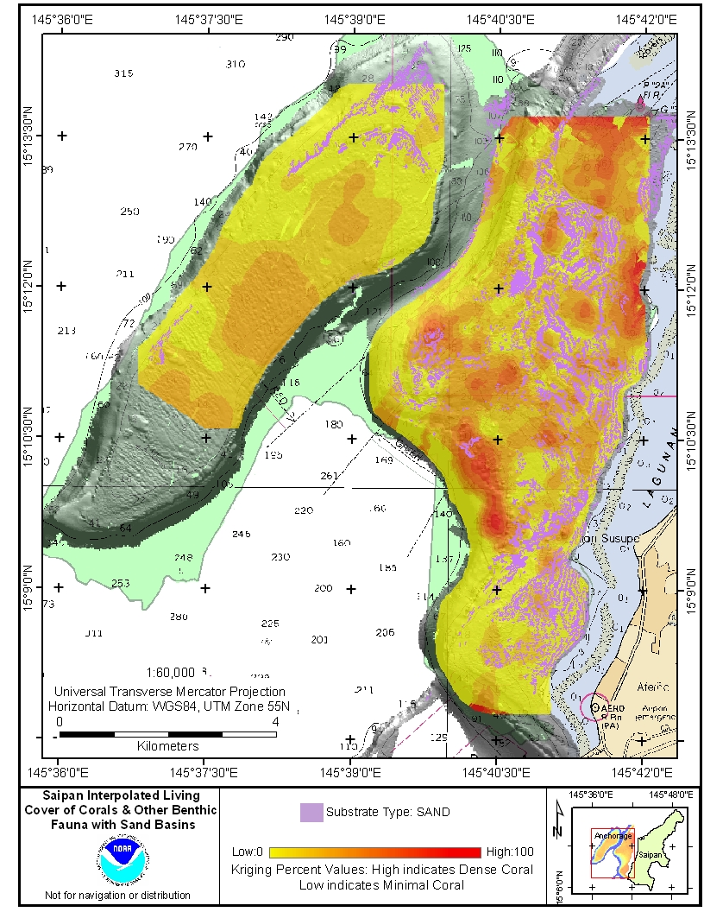
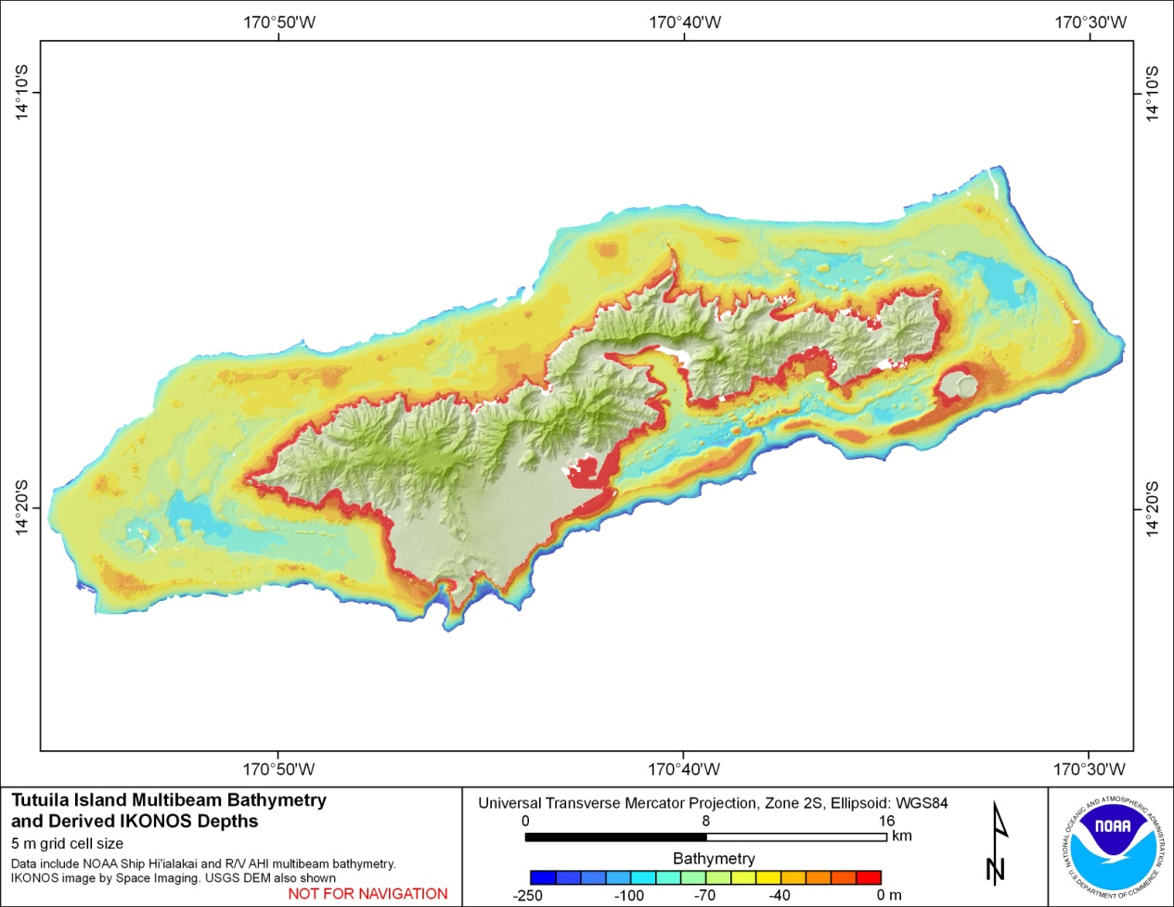
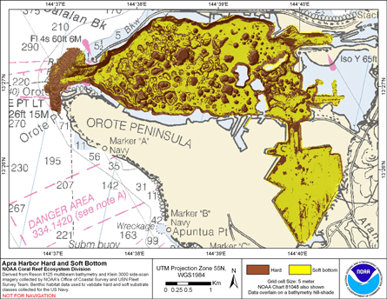
PIBHMC:
• Pacific Islands Region - coral reef ecosystems
• Funded by NOAA CRCP & partners
• depth, substrate, biological communities
• Provide data ⇨ CMSP & management
• Stats
Coral Cover
Bathymetry
Hard/Soft Substrate

Slide 3
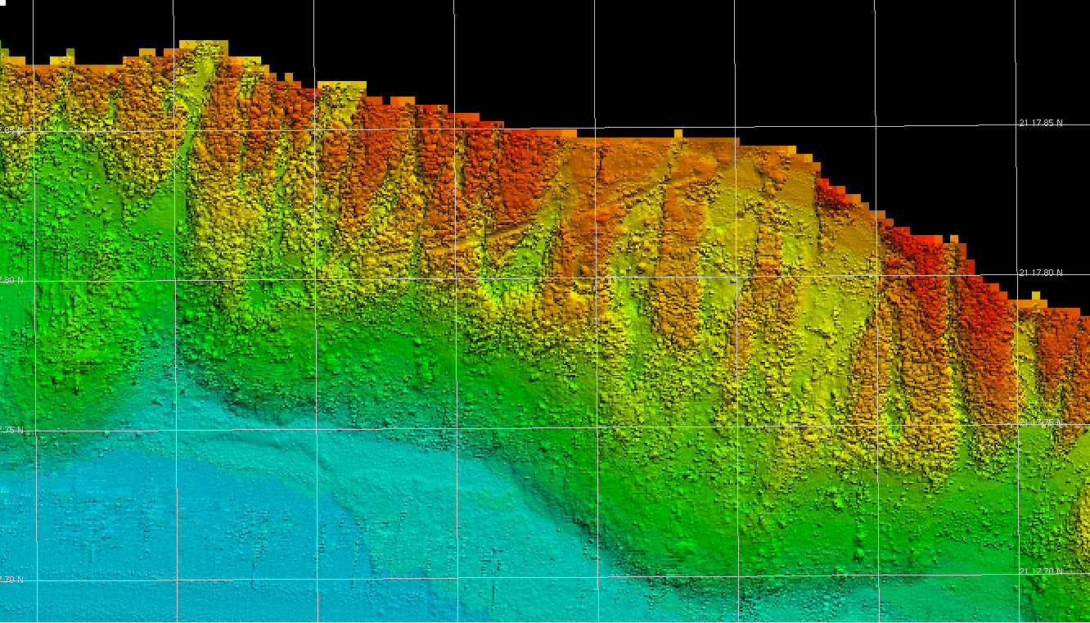
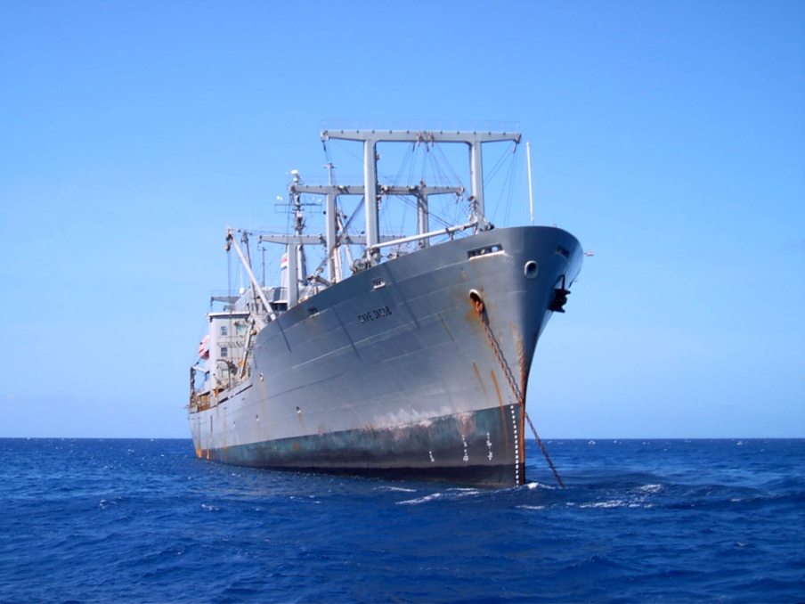
Uses of map products:
• delineate MPAs
• plan sub-sea pipeline and cable routes
• designate anchorage areas
• delineate EFH & HAPC
• environmental impact assessment
• characterize fish communities and fish/habitat associations
• stratification of biological surveying
• site selection for research
• tsunami inundation maps
• safe navigation

Slide 4
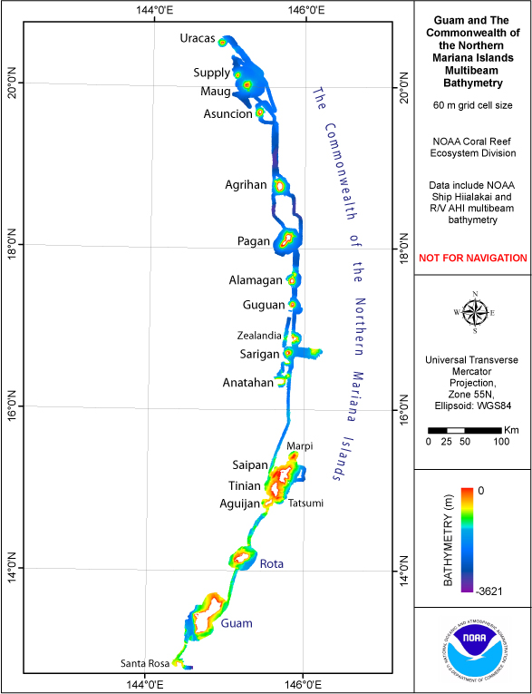
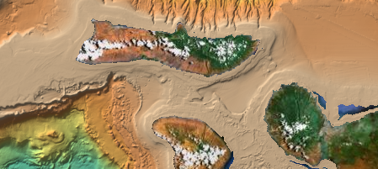
Bathymetry Syntheses:
Northwestern Hawaiian Islands
American Samoa
CNMI and Guam
Pacific Remote Islands Area
Main Hawaiian Islands - SOEST
Data Exchange: NGDC, NAVOCEANO, OCS, PMEL,
HMRG, HURL, etc.
PIBHMC website
http://www.soest.hawaii.edu/pibhmc/

Slide 5
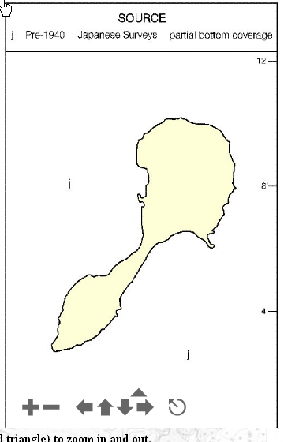
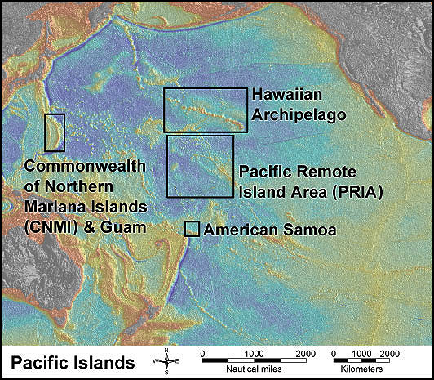
Shared Challenges:
- Long distances between island groups
- 50+ islands, atolls & banks
- Many other banks
- Existing chart data old & incomplete
- Funding reductions
- requests: critical needs/ improved efficiency
NOAA Chart No. 81092, Dec. 2007

Slide 6
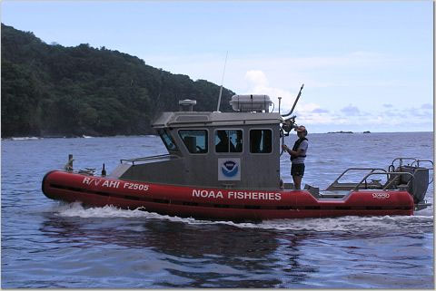
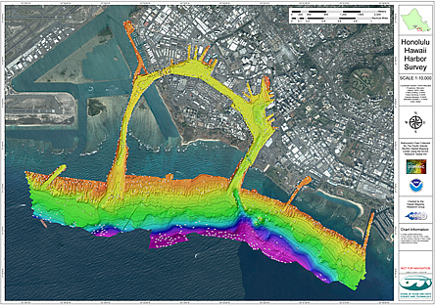
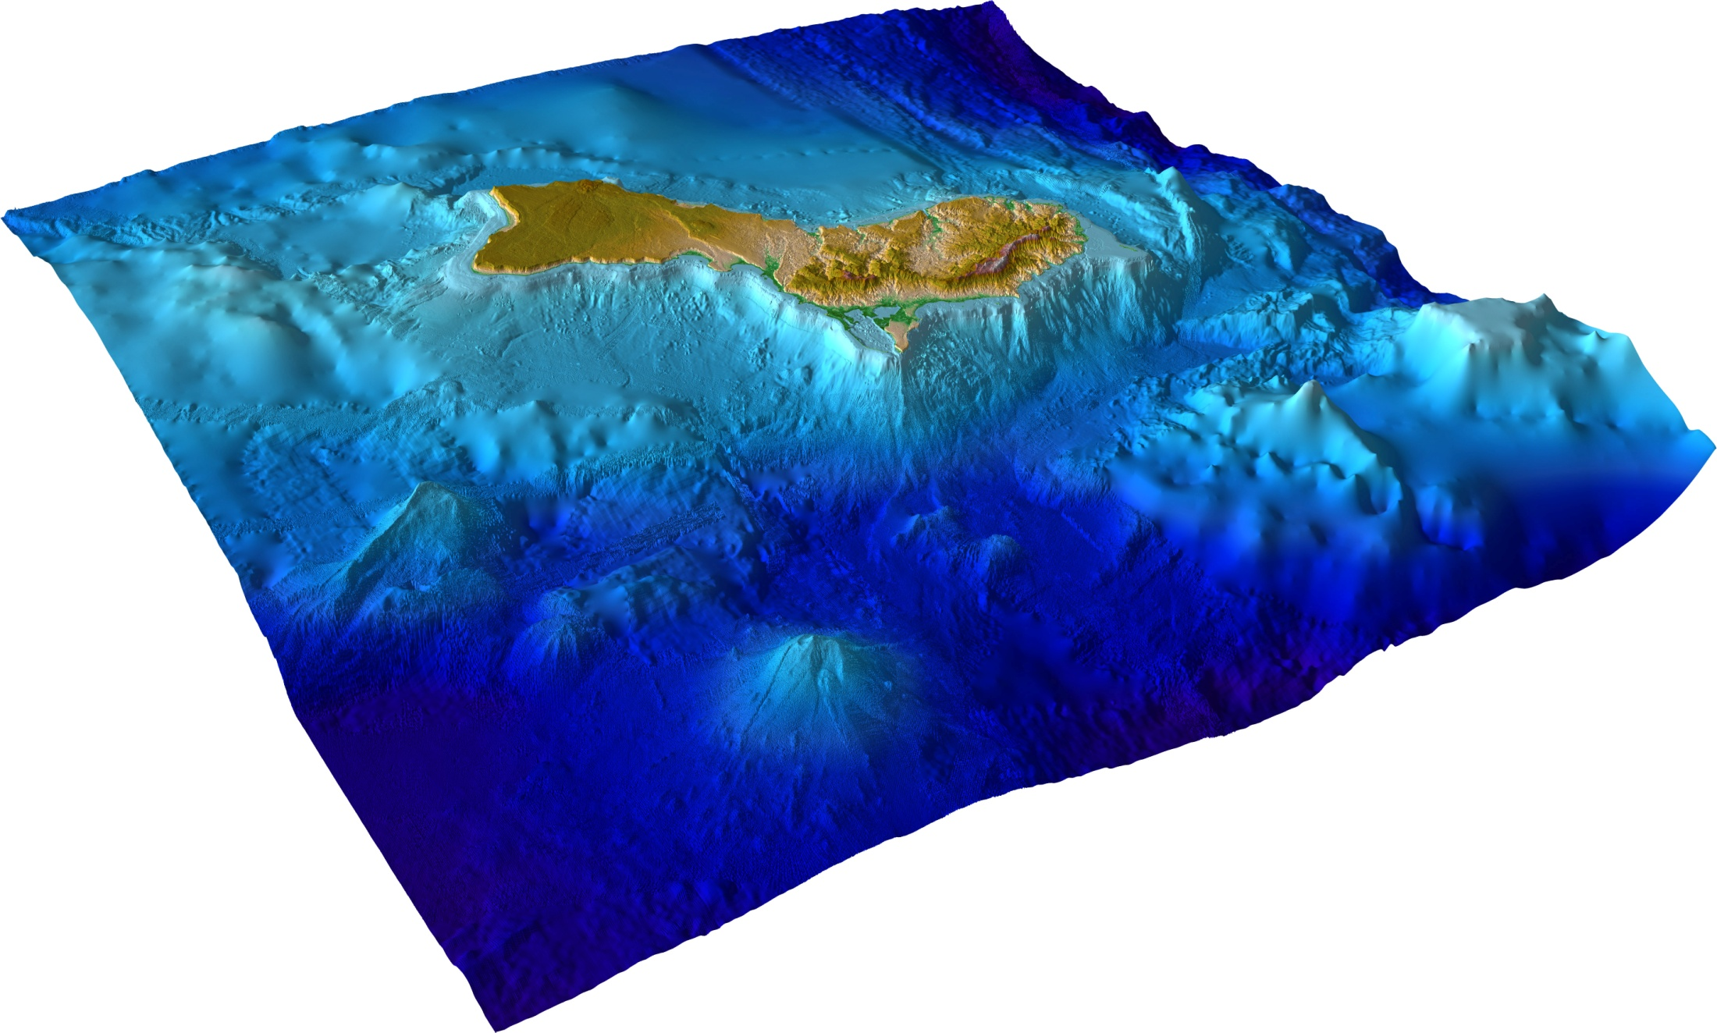
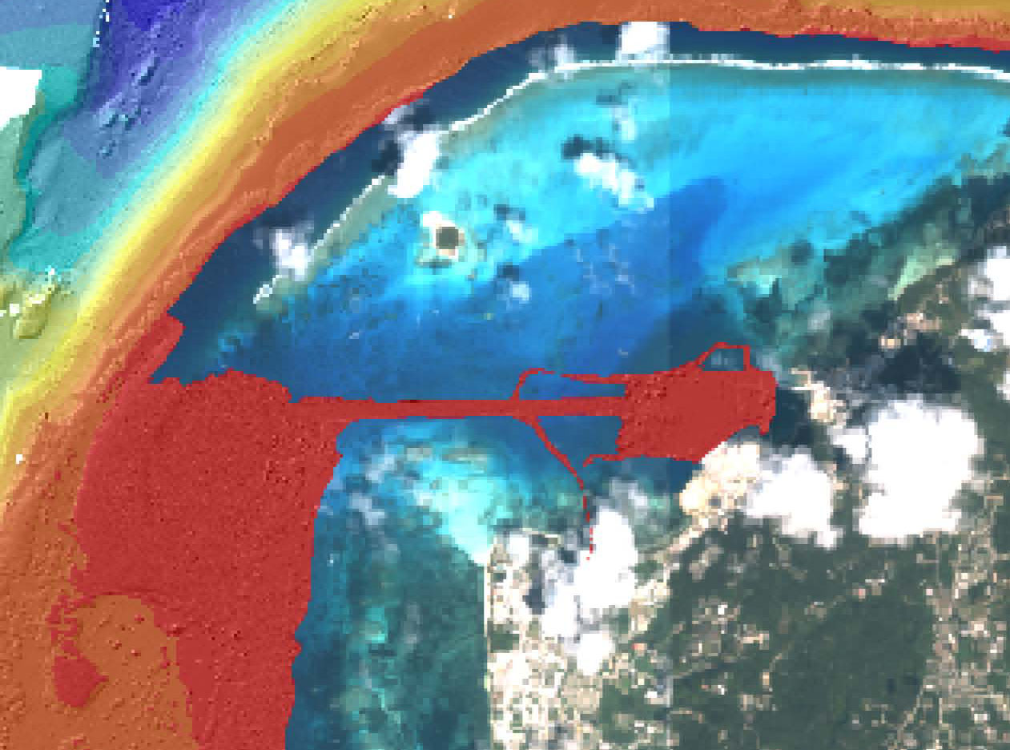
Regional Asset - Survey launch R/V AHI & Reson 8101ER
harbor surveys
tsunami inundation
damage assessment

Slide 7
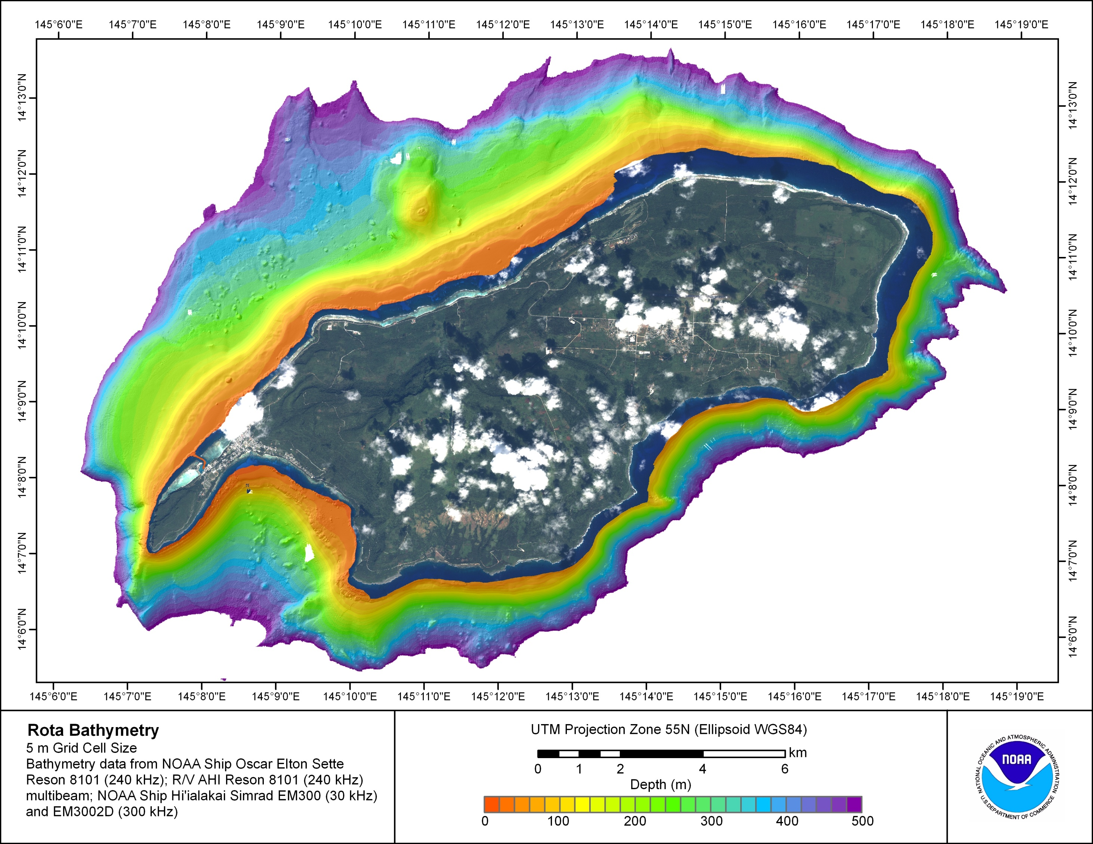
nearshore bathymetry gap

Slide 8
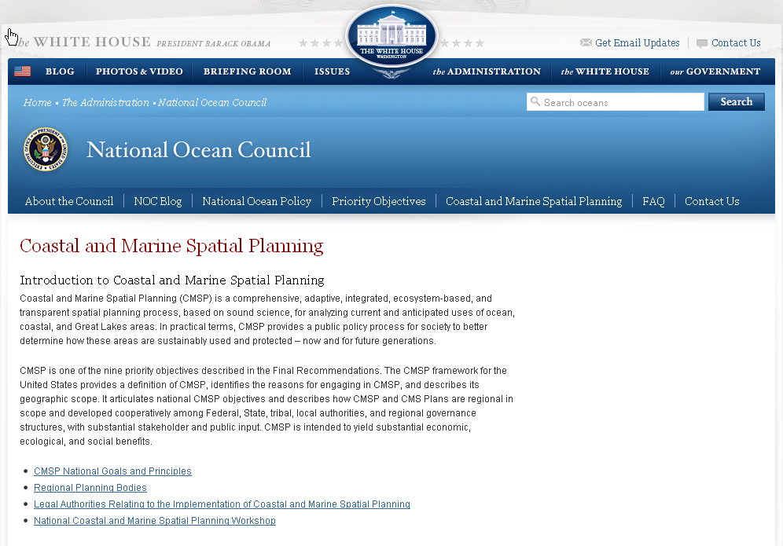
#2. Coastal and Marine Spatial Planning: Implement comprehensive, integrated, ecosystem-based coastal and marine spatial planning and management in the United States.

Slide 9
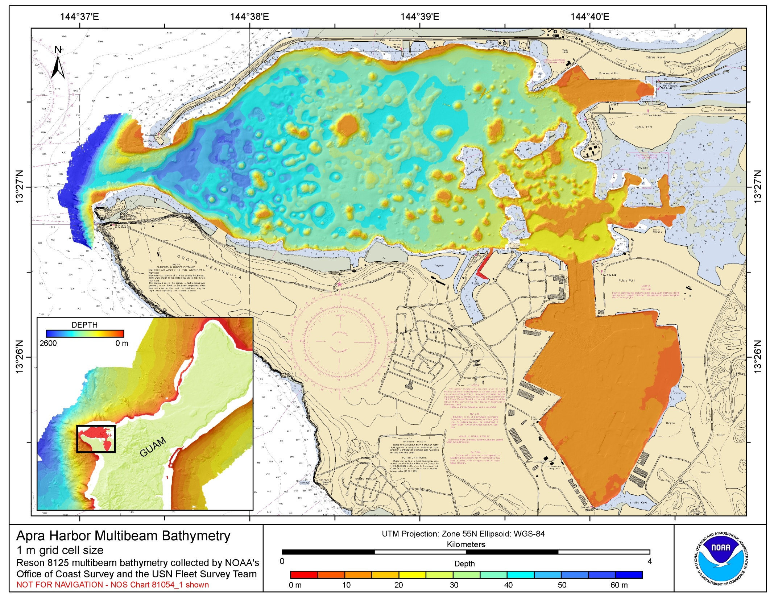

Slide 10
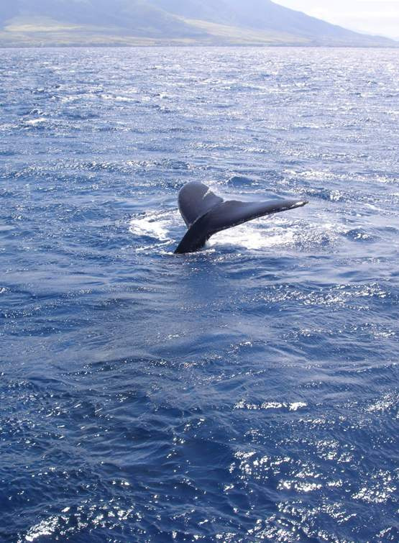
Requests for recommendations:
Help maintain availability of R/V AHI.
Collect bathymetric LIDAR to fill nearshore gap.
Support collection of mapping data for CMSP.
Initiate long-term agreement to share data with DOD.
…the End

