Slide 1
Water Level & Tides in Western Alaska
Bering Sea Storm, November 2011
Aimee Fish, NOAA National Weather Service Alaska Region
Alaska HSRP: May 2012

Slide 2
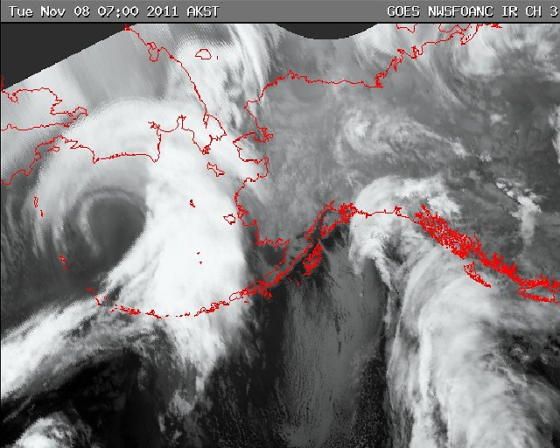
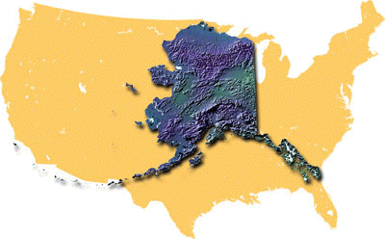
November 2011
>35 communities with damage
~1,000 miles of coastline
Presidential Disaster Declaration
Damage estimates are still coming in due to ice
.
.
.
40-foot seas
Wind gusts to 93 mph
Blizzard conditions
Storm Surge
.
.
.
.
.
.
.

Slide 3
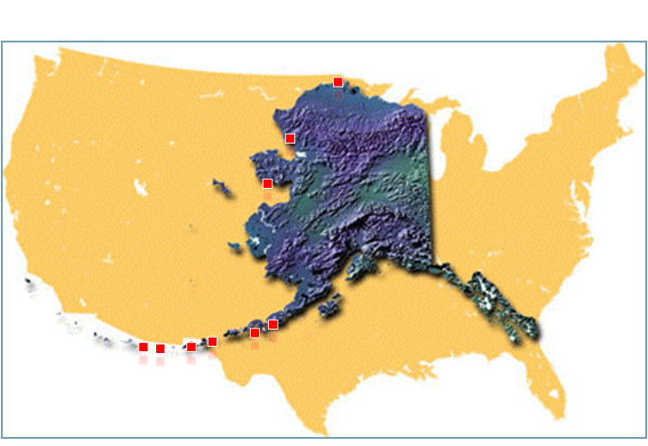
November 2011

Slide 4
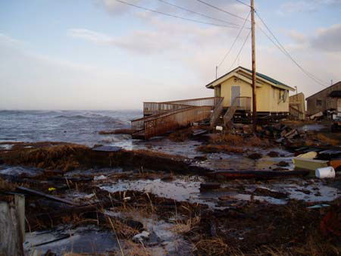
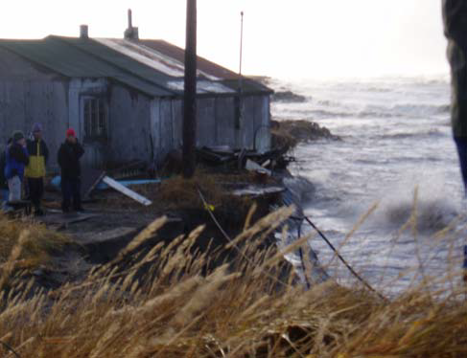
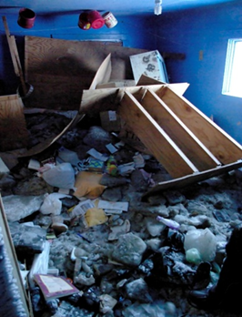
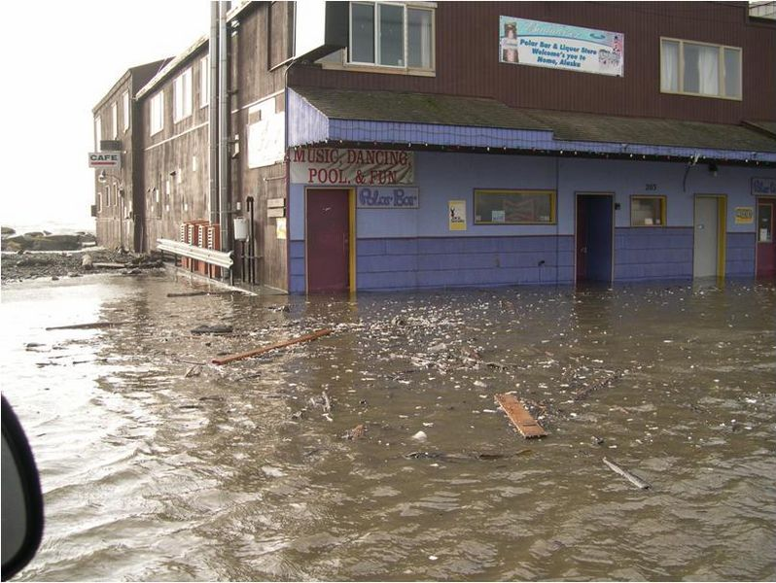
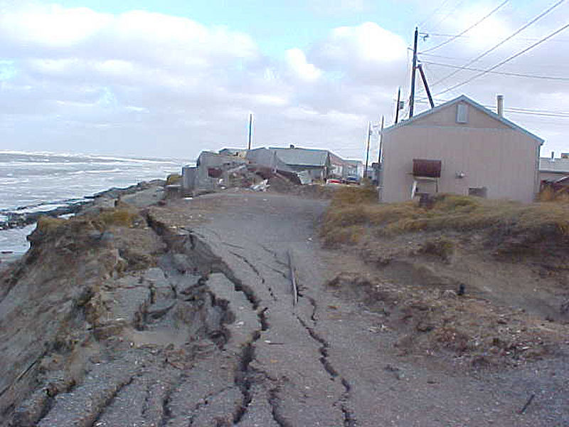
Vulnerable to Storm Surge

Slide 5
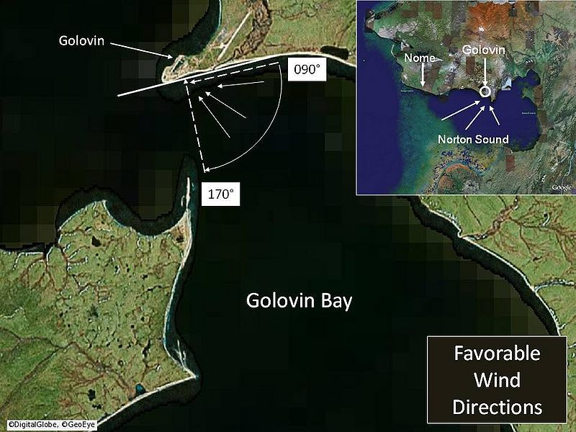
Golovin, AK

Slide 6
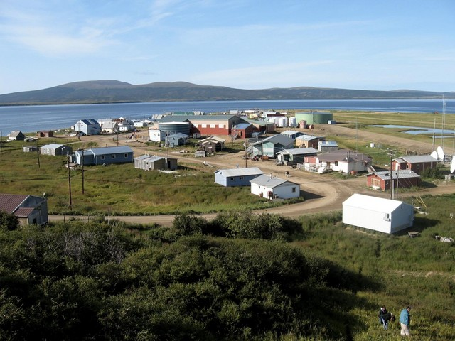
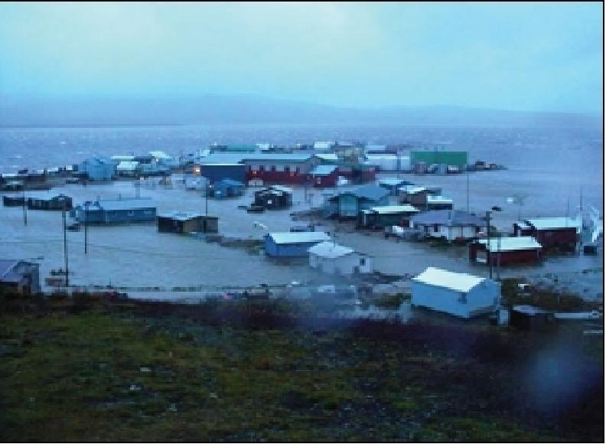
Golovin, AK
MLLW
September 2005

Slide 7
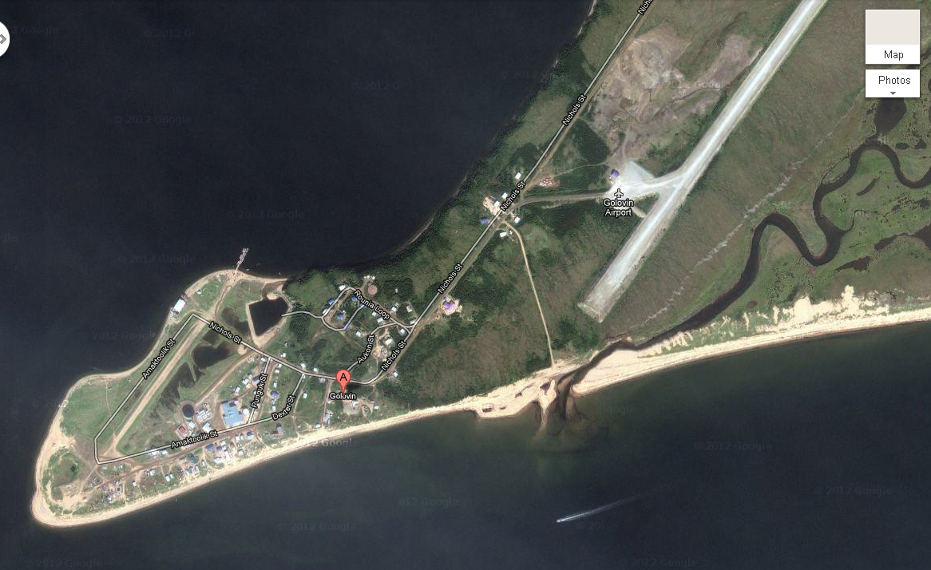
Golovin, AK

Slide 8
Community Decisions
November 2011
Evacuate due to surge? If so, when?
  Blizzard
  Cold and very windy
  One private generator for evacuation area, little fuel
Water and Power station threatened?
  Will the plants be inundated?
  Should we shut down power and water?
  When?
How bad will it be? 2004 or 2005?

Slide 9
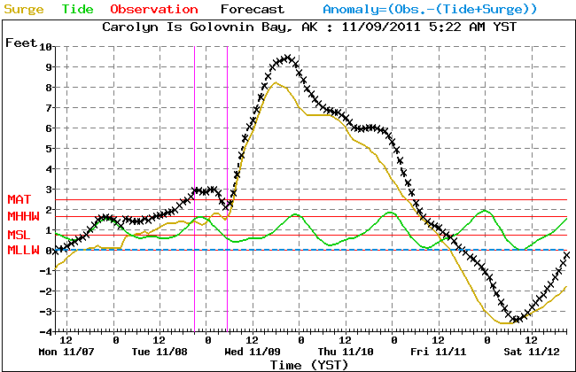
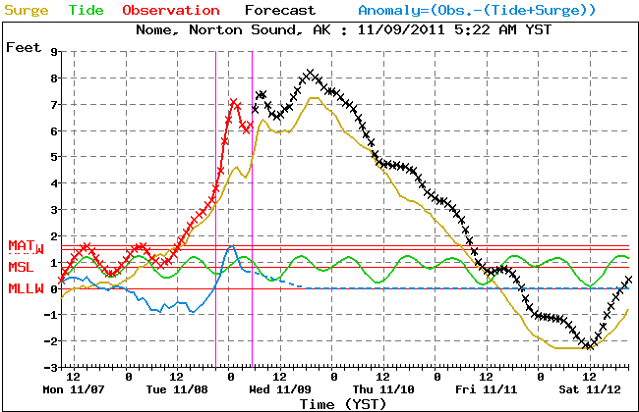
Extra Tropical Storm Surge
Water Level forecast
Golovin Bay
Golovin was lucky, they had tide predictions;
most villages do not
Nome

Slide 10
Questions from Villages:
How bad will it be?
How high will the water get?
  Impossible to answer without tidal prediction
“When is high tide?”
  Silence on the phone

Slide 11
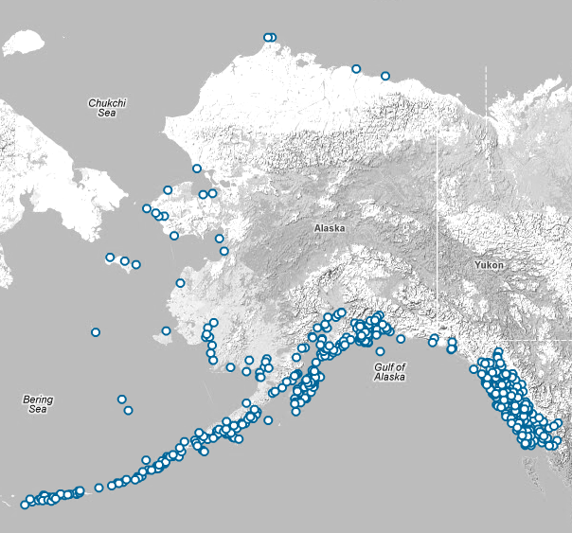
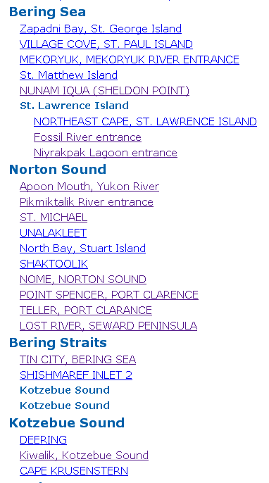

Slide 12
What can we do?
Not feasible to install NWLONs in all villages
  Grassroots water level observation program
  Less expensive platforms
More Tidal Predictions
  Lots of historic data, few predictions (e.g., Golovin: 9/16/1899 – 9/23/1899)
Relax criteria for Alaska!

Slide 13
Bad data worse than no data?
Are predictions based on short observations better than no predictions at all?
Data is “nourishment” for a forecast

Slide 14


Bad food worse than no food?
Yes!!

Slide 15

Bad food worse than no food?
No!!

Slide 16
Thank you!

Slide 17
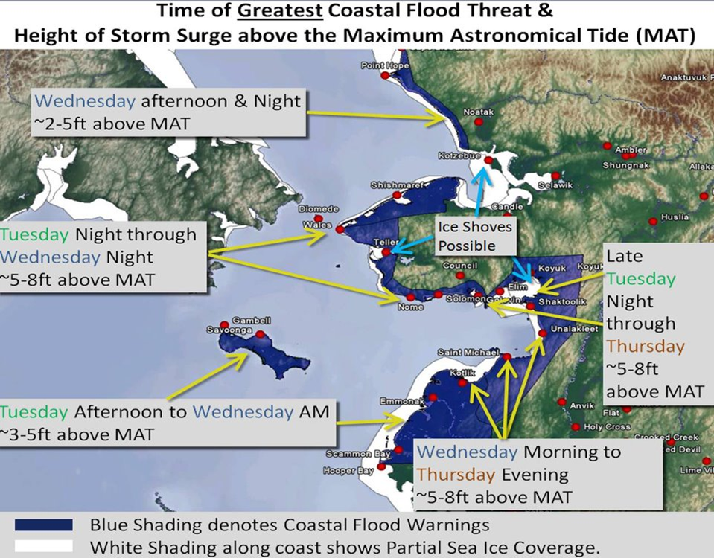
Complex Coastline = Complex Forecast

