Slide 1
Great Lakes Navigation Challenges: A USACE Perspective
Josh Feldmann
U.S. Army Corps of Engineers Chief, Operations, Buffalo District
August 30, 2016

Slide 2
Great Lakes Navigation System Economic Data
A non-linear interdependent system of 140 deep and shallow draft projects; commercial ports are dependent on each other for the efficiency and health of the system.
145M tons (5-year average) – (USACE Waterborne Commerce Statistics)
20% of tonnage is exported – to Canada or overseas (USACE Waterborne Commerce Statistics)
GLNS saves the country $3.6 billion per year compared to the next least costly mode of transportation (USACE Inland Nav Center of Expertise)
Notes:
140 projects – next slide will show details on geographic extent of system
Most tonnage is internal to the GL. US-US or US-Canada. A majority of the cargo consists of bulk commodities being transported from source generally on Lake Superior (mines, etc) to destination manufacturing center (mills, power plants, etc) on the lower lakes
$3.6B a year over next least costly mode of transportation; According to Marad’s recent report (Feb 2013), studies have demonstrated that, on average, transportation cost savings from $10 to more than $20 per ton of bulk cargo are associated with the use of Lakers compared to the next most competitive transportation mode (rail or truck).
The GLNS is extremely important to the nation and especially to the manufacturing industry in this country

Slide 3
Federal Projects on the Great Lakes
A non-linear navigation system with 60 federal commercial projects and 80 federal shallow draft/recreational projects
Grand Marais
Chippewa Harbor
Taconite
Lake Superior
Silver Bay
Two Harbors
Cornucopia
Eagle Harbor
Lac La Belle
Knife River
Keweenaw Waterway
Grand Traverse Bay
Duluth-Superior
La Pointe
Port Wing
Bayfield
Big Bay
Little Lake
Whitefish Point Harbor
Black River
Ontonagon
Presque Isle
Grand Marais
Soo Locks
Ashland
Saxon
MI
Marquette
St. Marys River
Manistique
Channels in Straits of Mackinac
Detour
Grays Reef
Les Cheneaux Island
CANADA
Little Bay de noc
Mackinac Island
St. James
Mackinac City
Cheboygan
Hammond Bay
Washington Island
Inland Route
Cedar River
Petoskey
WI
Menominee
Charlevoix
Lake Huron
Ogdensburg
Oconto
Sturgeon Bay
Leland
Alpena
Morristown
Pensaukee
Algoma
Greilickville
Big Suamico
Kewaunee
Frankfort
Harrisville
Green Bay
Arcadia
Au Sable Harbor
Cape Vincent
Two Rivers
Portage Lake
Tawas Bay
Ontario
Sackets Harbor
Manitowoc
Manistee
Point Lookout
Port Austin
Lake
Ludington
Harbor Beach
Port Ontario
Sheboygan
Pentwater
Caseville
Oswego
White Lake
Saginaw
Bay Port
Port Sanilac
Port Washington
MI
Sebewaing
Lexington
Little Sodus Bay
Lake Michigan
Muskegon
Niagara River
Oak Orchard
Great Sodus Bay
Little River
Irondequoit Bay
Olcott
Grand River
Black River
Wilson
Rochester
Milwaukee
Grand Haven
Pine River
St. Clair River
Buffalo
Holland
Belle River
Black Rock Lock/Tonawanda
Kenosha
Saugatuck
Clinton River
Sturgeon Point
NY
IL
Waukegan
South Haven
Lake St. Clair
Lake Erie
Cattaraugus
St. Joseph
Rouge River
Dunkirk
Commercial
St. Joseph River
Detroit River
Barcelona
Chicago Harbor
New Buffalo
Monroe
Erie
Bolles Harbor
Put-In-Bay
Conneaut
Recreational
Michigan City
Fairport
PA
Chicago River
Toledo
Ashtabula
Calumet
Burns Small Boat Harbor
OH
Cooley Canal
Rocky River
Toussaint River
Cleveland
West Harbor
Indiana Harbor
Port Clinton
Burns Waterway Harbor
Vermilion
IN
Lorain
Huron
Sandusky
3
Notes:
Great Lakes system is comprised of:
140 federal harbors on the great lakes: 60 commercial and 80 recreational
Connecting channels: St. Marys, Detroit River, St. Clair River, and Channels of Lake St. Clair
3 locks: Soo, Chicago, Black Rock (Buffalo)
We maintain the channels (dredging) and also maintain the navigation structures at each harbor.

Slide 4
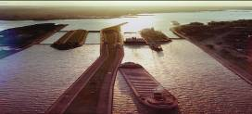
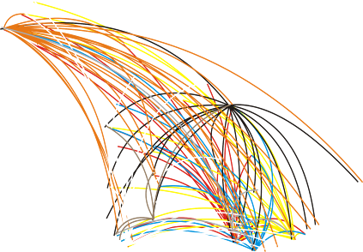
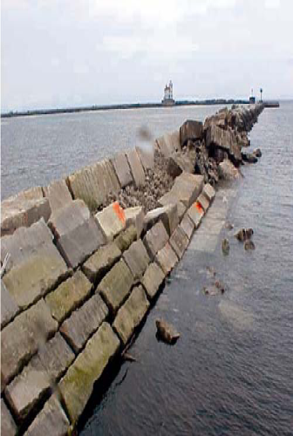
Great Lakes Navigation
Interdependent Ports
Silver Bay
Lake Superior
Key Challenges
Balancing System Requirements
Dredging
Dredged Material Management
Navigation structures
Soo Locks
Interdependency requires using a system approach in prioritizing investments
Two Harbors
Duluth-Superior
Ontonagon
Presque Isle
Ashland
MI
Marquette
>10M Ton Harbor 1-10M Ton Harbor <1M Ton Harbor
Gladstone
WI
Menominee
Cheboygan
Lake Huron
CANADA
Charlevoix
Alpena
Green Bay
Manitowoc
Manistee
Harbor Beach
Ontario
Ludington
Saginaw
Lake
Muskegon
Marysville
Milwaukee
Lake Michigan
Grand Haven
St. Clair
Put In Bay
Buffalo
Holland
MI
NY
Waukegan
Rouge River
Lake Erie
St. Joseph
Detroit River
Chicago Harbor
Monroe
PA
Calumet
Toledo
Conneaut
Ashtabula
Fairport
IL
Indiana Harbor
Cleveland
Burns Waterway Harbor
Lorain
Sandusky
IN
Huron
OH
Notes:
- GL is a system of interdependent ports
High tonnage harbors are dependent on low and moderate tonnage harbors
There are four main categories to our Nav mission on the GL: dredging, dredged material management, navigation structures, locks
Must consider interrelationship of harbors in prioritizing projects – Managing the GL as a system is key to our approach

Slide 5
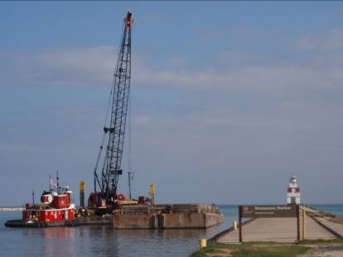
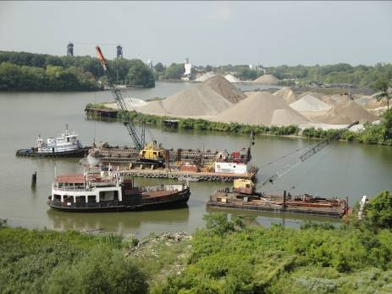
Dredging
Notes:
Pictures of 2009 dredging at Lorain Harbor (left) and Kewaunee Harbor (right)

Slide 6
FY16 Dredging Funding and Dredging Requirements
Grand Marais
Chippewa Harbor
Taconite
Lake Superior
Silver Bay
Two Harbors
Eagle Harbor
Lac La Belle
Knife River
Cornucopia
Keweenaw Waterway
Grand Traverse Bay
Duluth-Superior
La Pointe
Port Wing
Bayfield
Ontonagon
Big Bay
Little Lake
Whitefish Point Harbor
Ashland
Black River
Presque Isle
Grand Marais
Soo Locks
Saxon
MI
Marquette
St. Marys River
Manistique
Channels in Straits of Mackinac
Detour
Grays Reef
Les Cheneaux Island
Little Bay de noc
Mackinac Island
St. James
Mackinac City
Cheboygan
Washington Island
Petoskey
Hammond Bay
Cedar River
Inland Route
WI
Menominee
Leland
Charlevoix
Lake Huron
CANADA
Ogdensburg
Oconto
Sturgeon Bay
Alpena
Morristown
Pensaukee
Algoma
Greilickville
Black River Harbor
Big Suamico
Kewaunee
Frankfort
Harrisville
Green Bay
Arcadia
Au Sable Harbor
Cape Vincent
Two Rivers
Portage Lake
Tawas Bay
Ontario
Sackets Harbor
Manitowoc
Manistee
Point Lookout
Port Austin
Lake
Port Ontario
Sheboygan
Ludington
Saginaw
Harbor Beach
Oswego
Pentwater
Caseville
White Lake
Bay Port
Port Sanilac
Port Washington
MI
Sebewaing
Lexington
Little Sodus Bay
Lake Michigan
Muskegon
Oak Orchard
Great Sodus Bay
Irondequoit Bay
Rochester
Olcott
Grand River
Black River
Wilson
Milwaukee
Grand Haven
St. Clair River
Little River
Pine River
Buffalo
Commercial
Holland
Belle River
Black Rock Lock/Tonawanda
Kenosha
Saugatuck
Clinton River
Sturgeon Point
NY
Recreational
IL
Waukegan
South Haven
Chnls Lake St. Clair
Lake Erie
Cattaraugus
St. Joseph
Rouge River
Dunkirk
St. Joseph River
Detroit River
Barcelona
FY16 Funded Dredging
New Buffalo
Monroe
Erie
Chicago Harbor
Bolles Harbor
Put-In-Bay
Conneaut
FY16 Unbudgeted Dredging Need
Michigan City
PA
Chicago River
Ashtabula
Calumet
Toledo
Fairport
Burns Small Boat Harbor
OH
Cooley Canal
Rocky River
Port Clinton
Cleveland
Toussaint River
Burns Waterway Harbor
West Harbor
Vermilion
Indiana Harbor
Lorain
IN
Huron
Sandusky
Notes:
Green dots show harbors that are funded in FY15 in PB. Note that many (probably all) harbors are not funded to their full need due to highly constrained budgets. There are 23 projects funded in FY15.

Slide 7
FY16 PBUD + Work Plan Dredging ($59.2M)
Duluth-Superior +
Green Bay +
Erie
Indiana Harbor
Holland
Grand Haven
Saginaw River +
Ludington
Toledo
Presque Isle
Rouge River
Manistee
Conneaut
Sandusky
Cleveland
Alpena
Fairport
Huron
Waukegan
Burns Harbor
Monroe
Rochester
St. Joseph
Muskegon
Calumet +
Ontonagon
Lorain
Manistique
Manitowoc
Oswego

Slide 8
FY 17 Great Lakes Navigation
$103.3M Great Lakes Navigation Operations & Maintenance
Key Items
$39M in Dredging (19 projects – 3.2M cubic yards)
$8.2M in Dredged Material Management
$5.9M in Soo Asset Renewal

Slide 9
FY17 President’s Budget Dredging Projects
Grand Marais
Chippewa Harbor
Lake Superior
Beaver Bay
Eagle Harbor
Two Harbors
Lac La Belle
Knife River
Cornucopia
Keweenaw Waterway
Grand Traverse Bay
Duluth-Superior
La Pointe
Port Wing
Bayfield
Ontonagon
Big Bay
Little Lake
Whitefish Point Harbor
Ashland
Black River
Presque Isle
Grand Marais
Soo Locks
Saxon
MI
Marquette
St. Marys River
Manistique
Channels in Straits of Mackinac
Detour
Gladstone
Grays Reef
Les Cheneaux Island
Little Bay de noc
Mackinac Island
St. James
Mackinac City
Cross Village
Cheboygan
Washington Island
Petoskey
Hammond Bay
Cedar River
Inland Route
WI
Menominee
Leland
Charlevoix
Lake Huron
CANADA
Ogdensburg
Oconto
Sturgeon Bay
Alpena
Morristown
Pensaukee
Algoma
Greilickville
Black River Harbor
Big Suamico
Kewaunee
Frankfort
Harrisville
Green Bay
Arcadia
Au Sable Harbor
Cape Vincent
Two Rivers
Portage Lake
Tawas Bay
Ontario
Sackets Harbor
Manitowoc
Manistee
Point Lookout
Port Austin
Lake
Port Ontario
Sheboygan
Ludington
Saginaw
Harbor Beach
Oswego
Pentwater
Caseville
White Lake
Bay Port
Port Sanilac
Port Washington
MI
Sebewaing
Lexington
Little Sodus Bay
Lake Michigan
Muskegon
Oak Orchard
Rochester
Great Sodus Bay
Olcott
Irondequoit Bay
Grand River
Black River
Wilson
Commercial
Milwaukee
Grand Haven
St. Clair River
Little River
Holland
Pine River
Buffalo
Belle River
Black Rock Lock/Tonawanda
Recreational
Kenosha
Saugatuck
Clinton River
Sturgeon Point
NY
President’s Budget
Waukegan
South Haven
Chnls Lake St. Clair
Lake Erie
Cattaraugus
IL
St. Joseph
Rouge River
Dunkirk
St. Joseph River
Detroit River
Barcelona
Chicago Harbor
New Buffalo
Monroe
Erie
Bolles Harbor
Put-In-Bay
Conneaut
Chicago River
Michigan City
Ashtabula
PA
Calumet
Toledo
Fairport
Burns Small Boat Harbor
OH
Cooley Canal
Rocky River
Port Clinton
Cleveland
Toussaint River
Burns Waterway Harbor
West Harbor
Vermilion
Indiana Harbor
Lorain
IN
Huron
Sandusky

Slide 10
Historical Shallow Draft/Recreational Harbor Funding
Notes:
Many members ask about funding for recreational harbors.
Although 2014 and 15 are good funding years for GL, the news is not so positive for the recreational harbor stakeholders. With funds so limited and the many needs throughout the country, the Corps prioritizes projects that support commercial shipping.
Number of projects includes dredging and structural repair – only regular Corps funding – no contributed funds, no Sandy funds
Shallow Draft/Recreational: harbors that are authorized as deep draft but with no commercial traffic are included in the Rec count.
Background
Last time rec harbors were in PB was 2006 (Lac La Belle)
2007 and 2011 year long CR – only PB projects
2008, 2009, 2010 Adds , regional provisions and ARRA
2012 – had appropriation with additional funds for ongoing work but no funds were allocated to rec harbors
- no funding other than Sandy and state of MI contributed funds so 0 in this table.
2014 funding for rec harbors 5 dredging and 1 structure repair (including authorized deep draft with no comm traffic) funded in “additional funds for ongoing work”

Slide 11
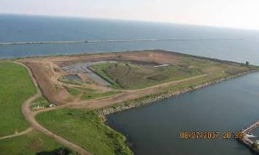
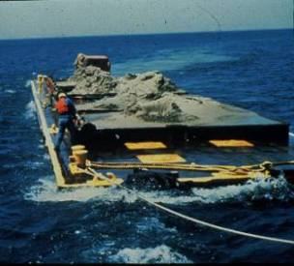
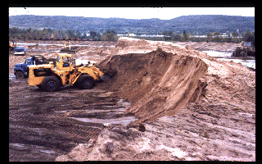
Dredged Material Management

Slide 12
Historical Perspective
Dredged material nearly exclusively disposed via open water placement
Execute sustainable DMM solutions
45 Great Lakes CDFs constructed and/or operated by USACE at a cost of $900M (2009 dollars)
1960
1970
1980
1990
2000
Current CRITICAL situation. DMM strategies must be developed.
1988 - Federal Standard defined
1970 - River and Harbor Act and Flood Control Act of 1970 (PL 91-611) passed
1996 - Section 201 of the 1996 WRDA requires cost-sharing
Notes:
December 1970: In December of 1970, Congress passed the River and Harbor and Flood Control Act of 1970 (P.L. 91-611). Section 123 of that Act specifically authorized the USACE to construct, operate and maintain “spoil disposal” facilities on the Great Lakes for the confinement of dredged materials. Costs of facilities were to be borne by the federal government and a non-federal sponsor. The need for a particular CDF was to be established in conjunction with the USEPA and the affected states and local entities. Further, Section 123 stated that spoil facilities were to be established for a period not to exceed 10 years. The assumption at the time was that after 10 years, the nation’s waters would be sufficiently restored such that dredged material would no longer require confined disposal. Amendments to that authority extended the timeframe in which CDFs could continue to be operated by the Corps.
1970 to Present: Most of this construction occurred between 1974 and 1980. There are currently 20 active CDFs on the Great Lakes, which are more than 80 percent full.
1988: The Federal Standard (33 CFR 209, 335-338) is the least costly management alternative that is technically sound and complies with federal environmental laws and regulations. If a state or local government imposes restrictions that are more costly than the Federal Standard, the additional costs must be borne by non-federal interests. The Federal Standard levels the playing field for dredging and related costs among states having disparate policies and requirements on dredged material management. A state that may wish to have a policy prohibiting open water disposal regardless of testing and evaluation of its suitability will have to pay all costs beyond those associated with the Federal Standard. The USEPA/USACE testing protocol that defines the “Federal Standard” is currently under revision, with the updated dredged material testing standards for open water disposal to take effect in 2011. Those standards are expected to be even more stringent than those that exist today, further limiting disposal options.
1996: Section 201 of the Water Resources Development Act of 1996 created a national program for the construction of CDFs. This authority specified uniform cost-sharing requirements for all future CDFs. The non-federal cost share is based on the depth of the navigation channel. For deep draft channels on the Great Lakes (greater than 18 feet and less than 45 feet), the non-federal sponsor must provide 25 percent of CDF construction costs, plus an additional 10 percent (paid over as long as 30 years) against which all lands, easements, rights-of-way and relocations may be credited.

Slide 13
Navigation Structures

Slide 14
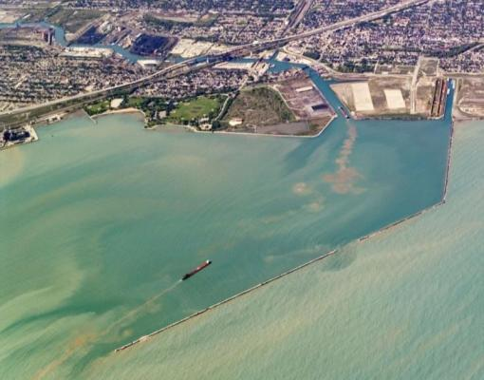
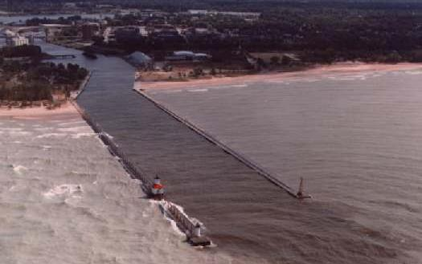
Great Lakes Navigation Structures - Purposes
Navigation structures intended purposes:
Safeguard navigation from wave and ice damage (GL experience waves over 25 ft)
Protect navigation channel from sediment shoaling
Protect navigation channel from wave action (preserve the design wave climate to allow pilots to navigate the channel)
Additional benefits provided:
Protect other navigation structures within harbor such as CDFs
Protect critical city infrastructure (buildings, roads, power plants, water/wastewater plants)
Provide essential flood and storm protection
Control and reduce shoaling in navigation channel
Control wave climate within navigation channel and harbor
Notes:
Breakwater maintenance preserves the design wave climate and provides a predictable and reliable and water column for marine pilots to navigate. The loss of a predictable water column has the same economic consequences as shoaling. The harbors will not function indefinitely without regular breakwater maintenance, and a "fix as fails" approach is extremely expensive.
Increased wave climate in a harbor is unsafe for ships. Example of Burns harbor with 9 barges and 1 tug sinking in the harbor in March 1998 and three vessels sinking within the harbor in the 1970s due to deficiencies in the breakwater (sections that had lost 2 to 3 feet of design height caused waves climate in the harbor to increase to a point that barges became unstable and sank); ERDC report documented the unusual amount of stone replacement maintenance needed at Burns due to the strength of the wave s and ice that routinely pound the structure.
Higher waves in a harbor will also force vessels to lighten their load even more. Thus, increased waves in a harbor have the same effect as increased shoaling in terms of economic consequences resulting from light loading.
Dredging is how the Corps controls available water depth in a channel; Coastal structures are how the Corps controls the wave climate in a harbor – both affect the safe navigability of the vessel and the amount of light loading required.

Slide 15
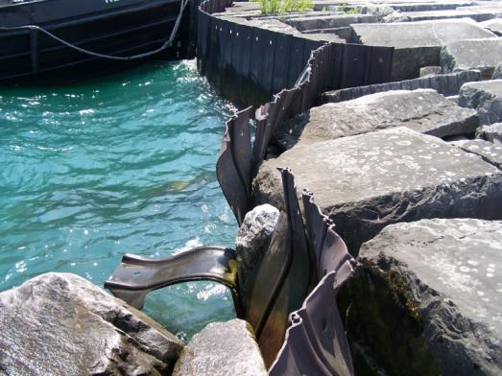
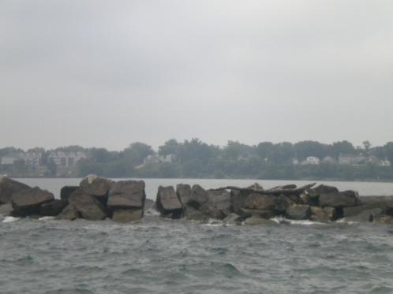
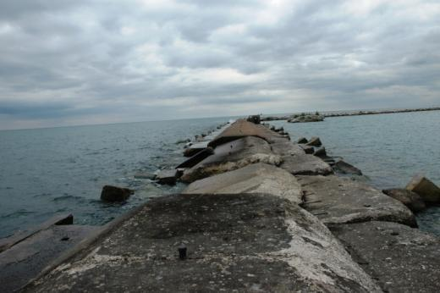
Great Lakes Navigation Structure Conditions
50% of GL coastal structures were built before WWI
Over 80% of all coastal structures exceed 50 years of age
45% have never undergone any significant repair effort due to funding constraints
Over 30% of structures have timber crib core sections; recent low water levels have accelerated deterioration of the wood
Notes:
Left : Calumet steel sheet pile crumpled and twisted due to wave action
Middle: Fairport – significant loss of stone – ability to restrain waves is significantly compromised
Right: Chicago harbor – loss of height and shifting stone and cap

Slide 16
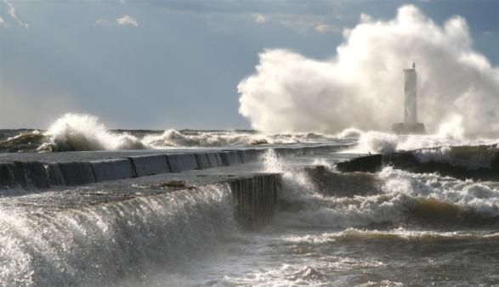
Harbor Structure Condition Assessments
Grand Marais
Lake Superior
Two Harbors
La Pointe
Eagle Harbor
Knife River
Cornucopia
Keweenaw
Waterway
Lac La Belle
Duluth-Superior
Bayfield
Grand Traverse
Port Wing
Big Bay
Little Lake
Whitefish Point
Presque Isle
Ontonagon
Saxon
Black River
Marquette
Ashland
MI
Grand Marais
Manistique
Detour
Cost to Restore Most Critical Harbors to Acceptable Level of Risk:
Ashtabula Harbor
$39.0M
Chicago Harbor
$19.6M
Cleveland Harbor
$10.0M
Fairport Harbor
$28.0M
Lorain Harbor
$14.0M
Milwaukee Harbor
$33.0M
________________
Total: $143.6M
Mackinac Island
WI
Mackinaw City
Inland Route
Cheboygan
Cedar River
Petoskey
Hammond Bay
Menominee
Leland
Charlevoix
Alpena
CANADA
Oconto
Sturgeon Bay
Greilickville
Lake Huron
Algoma
Frankfort
Harrisville
Kewaunee
Arcadia
Au Sable
Cape Vincent
Two Rivers
Portage Lake
Tawas Bay
Ontario
Manitowoc
Manistee
Point Lookout
Port Austin
Lake
Port Ontario
Ludington
Harbor Beach
Sheboygan
Pentwater
Caseville
Port Sanilac
Oswego
Port Washington
White Lake
MI
Olcott
Little Sodus Bay
Lake Michigan
Lexington
Oak Orchard
Rochester
Irondequoit Bay
Muskegon
Wilson
Great Sodus Bay
Milwaukee
Grand Haven
Buffalo
Holland
Clinton River
Black Rock Lock/Tonawanda
Kenosha
Saugatuck
Cattaraugus
NY
IL
Waukegan
South Haven
Lake Erie
Dunkirk
Barcelona
Erie
St. Joseph
Detroit River
A – Failure Unlikely
B – Low Risk of Failure C – Medium Risk of Failure
D – High Risk of Failure
F – Failed
Conneaut
Chicago Harbor
New Buffalo
Bolles Harbor
Ashtabula
Chicago River
Michigan City
Fairport
PA
Indiana Harbor
OH
Cleveland
Cooley Canal
Port Clinton
Lorain
Calumet
Rocky River
Burns Small Boat Harbor
West Harbor
Vermilion
Burns Waterway Harbor
Huron
IN
Sandusky
Commercial
Recreational
Notes:
There are over 130 coastal cities and towns on the Great Lakes with federal navigation projects that include breakwaters; 63 of these projects currently support commercial navigation. Originally built to safeguard navigation in the federal harbors from waves and ice, these structures also provide critical flood and storm damage protection for buildings, roads, facilities and municipal infrastructure. In many cases, cities and downtowns have ‘grown up’ behind and are now safeguarded by federal breakwaters.
Over 50 percent of the coastal structures on the Great Lakes were built prior to World War I (1918) and 80 percent are older than their typical 50-year design life. Federal funding for maintenance of projects is prioritized based on economic benefits related to commercial navigation. Federal breakwaters at harbors with small amounts of commercial navigation are a low priority for funding. Funding for structure repairs at harbors with significant levels of commercial navigation has also been under funded for the last decade. The Corps’ floating plant performs some preventive maintenance and minor repairs but does not have the capacity to perform major repairs or reconstruction.
The GLNS has approximately $50 million in annual needs for structure repairs. The majority of these needs represent significant repairs or reconstruction of navigation structures. In 2007 the three Great Lakes Districts formed a regional, multi-disciplined breakwater assessment team that developed technical assessment criteria and began inspecting and rating breakwaters around the Great Lakes. The breakwater assessment team’s work will allow the Corps to prioritize these needs on a regional level so that the most urgent structures are given priority in the budget process each year.
This slide demonstrates the different ratings that each of the harbor infrastructures received from the Condition Assessments. As you can see, three harbors have structures that have failed and 10 others are considered to be in high risk of failure. Out of the 13 harbors that were rated as already failed or in high risk of failure, 8 are commercial harbors. The cost to restore a few of the major harbors into an acceptable state has also been provided on this slide.

Slide 17
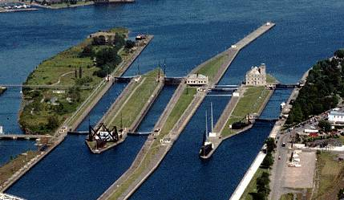
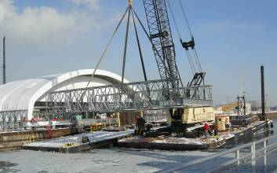
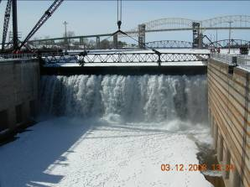
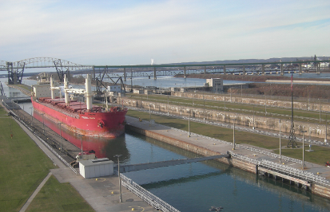
Lock Reliability

Slide 18
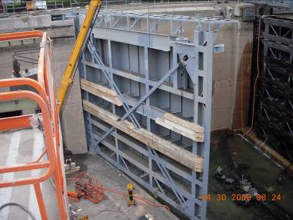
The Soo Locks Lynch Pin of the Great Lakes Navigation System
70% of the commercial commodities transiting the Soo Locks are limited by size to the Poe Lock
Aging and deteriorating infrastructure; unscheduled outages increasing
There is currently no redundancy for the Poe Lock
The economic impact of a 30-day
unscheduled closure of the Soo Locks = $160M
Two major efforts are underway to improve reliability of the Soo Locks
Maintain existing infrastructure through Asset Renewal Plan
New lock with the same dimensions as the Poe Lock - BCR sensitivity analysis underway

Slide 19
GL Navigation Funding History
Sustainable Funding Range
Notes:
Good news story – 2014 and 2015 healthy funding, recovering from low budget years 2010 – 2013 that coincided with low water levels.

Slide 20
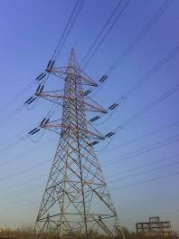
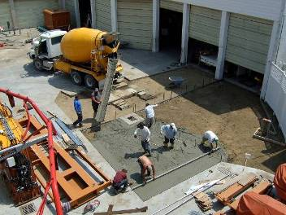
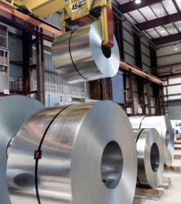
Great Lakes Navigation System – A Great Investment
Great Lakes Navigation System’s Transporting Rates Savings
$3.6 BILLION/year for a $90 Million/yr total investment!
More competitive American steel
Lower cost energy
Lower cost concrete (construction)
More competitive Grain for Export
Less fuel consumption and greenhouse gas emissions
Less congested highways/rails
20
Notes:
20

Slide 21
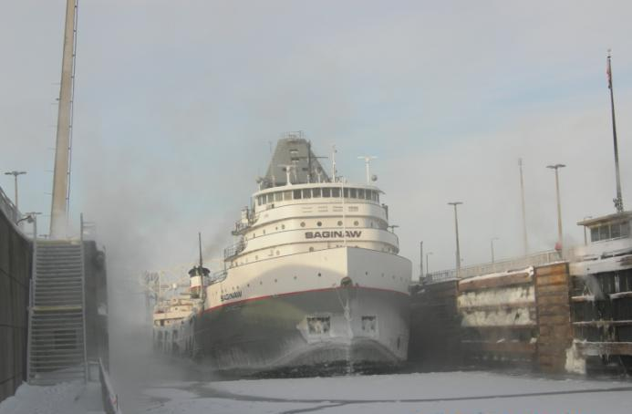
Questions

