Slide 1

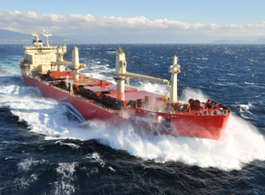
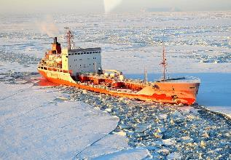
Briefing to HSRP re Arctic Issues
Paul Fuhs
President of the Board
A non-profit maritime organization established to provide the Alaska maritime community information, communications and services to ensure safe, secure, efficient and environmentally responsible maritime operations.

Slide 2
Board of Directors

Slide 5
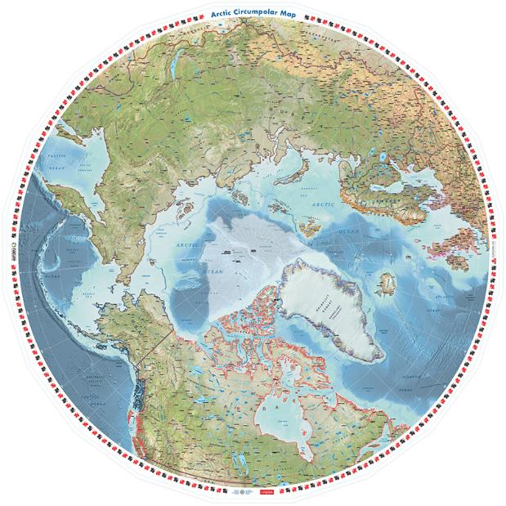

Slide 6
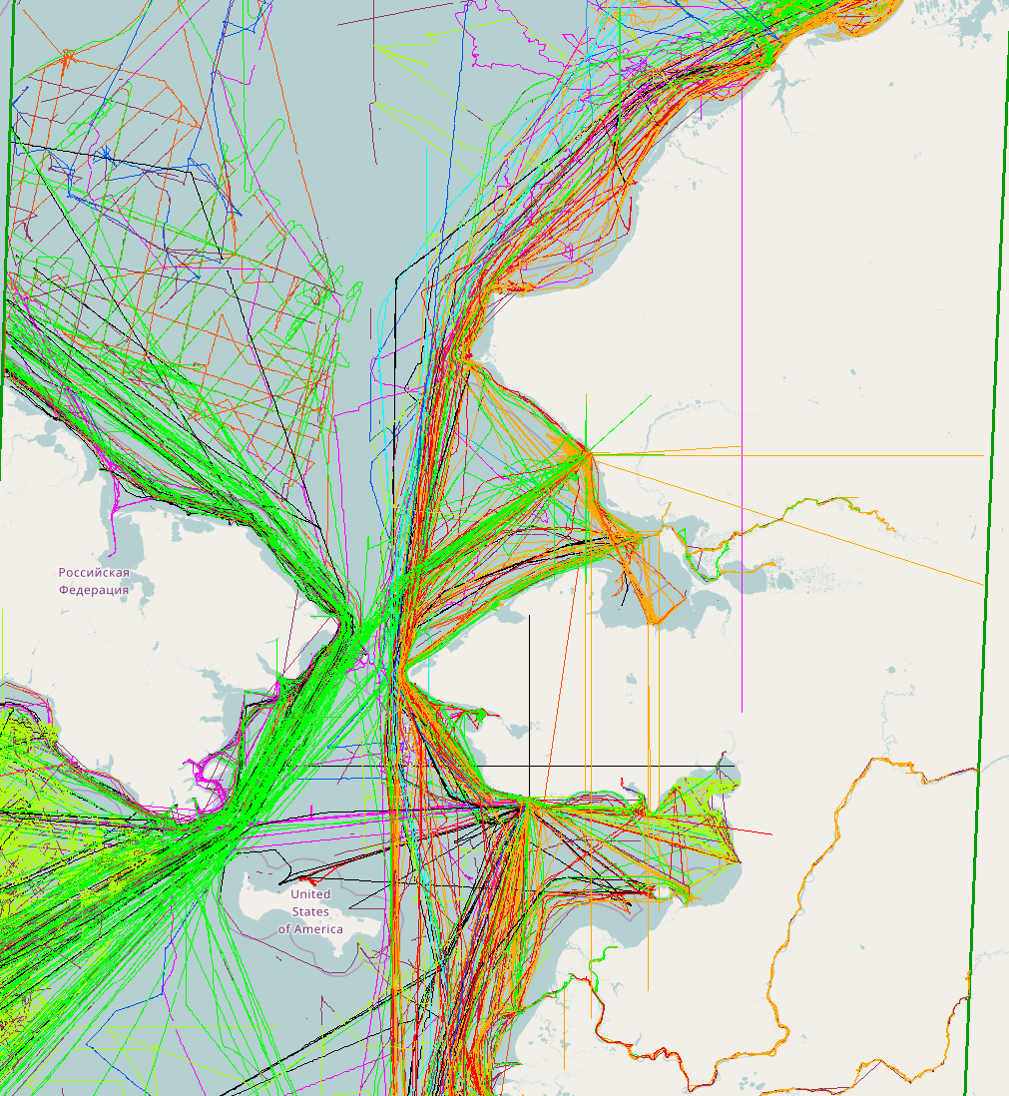
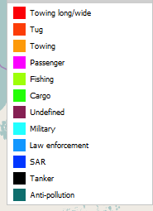
Bering Strait Traffic
2016

Slide 7
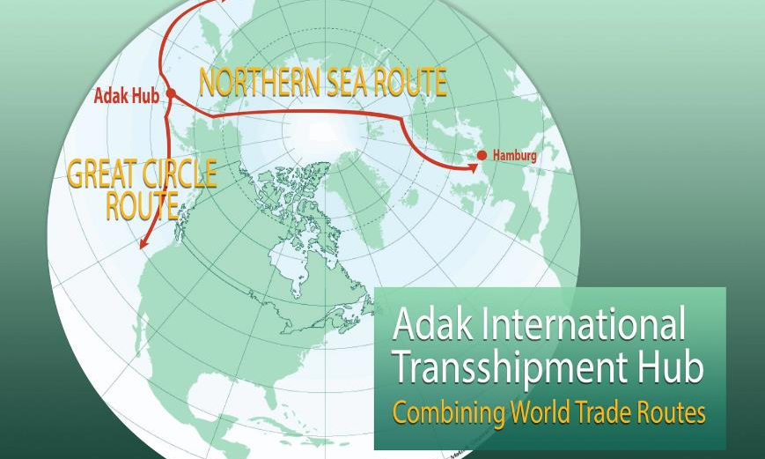

Slide 8
Arctic Ocean Presents Blue Economy Opportunities

Slide 9
UBER for Icebreakers

Slide 10
PREVENTION IS CRITICAL
Oil spill response is limited.
Arctic response infrastructure is lacking.
Hydrographic mapping is limited.
Marine mammals are the index species in the Arctic and must live at the surface of the water making them especially vulnerable.
These species are the basis of food security for many Arctic residents.
The financial and environmental cost of an oil spill in the Arctic would be catastrophic.

Slide 11
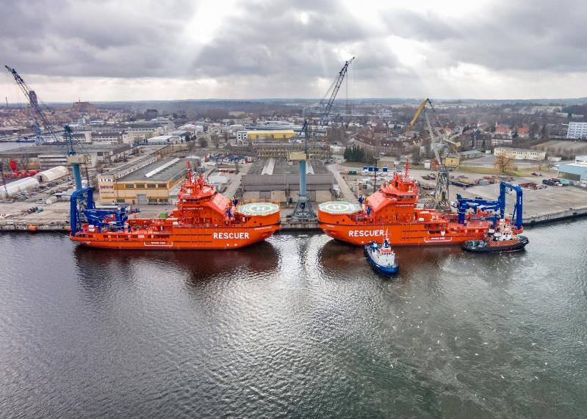
Russian Icebreaking Rescue Vessels

Slide 12
Pollution Control Alaska Style

Slide 14
ESSENTIAL PREVENTION MEASURES
Routing measures, active vessel tracking and monitoring, early response, Vessel of opportunity.
Improved Hydrologic and meteorological Data.
Effective provision of data to vessels, weather, ice, currents, marine mammal concentrations, virtual buoys, hazards to navigation.
International agreements for prevention measures and emergency response.

Slide 15
Dynamic Resource Protection

Slide 16
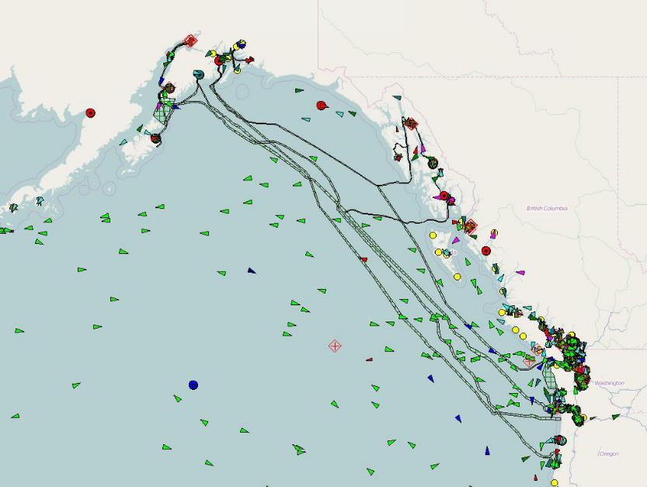
Protect Fiber Optic Cables

Slide 17

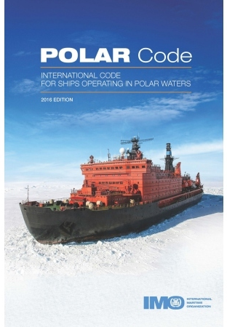


Arctic Communities, Business & Government Engagement

Slide 19
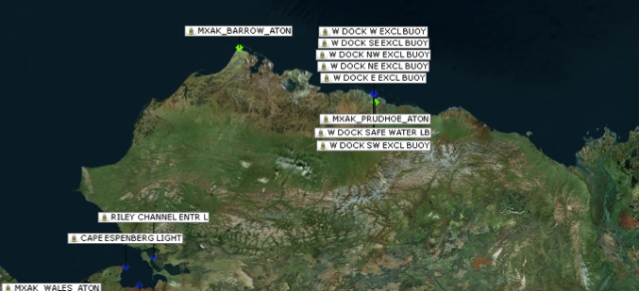
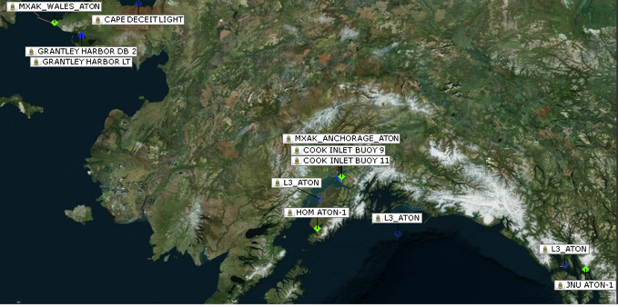
AIS Atons in Alaska

Slide 20
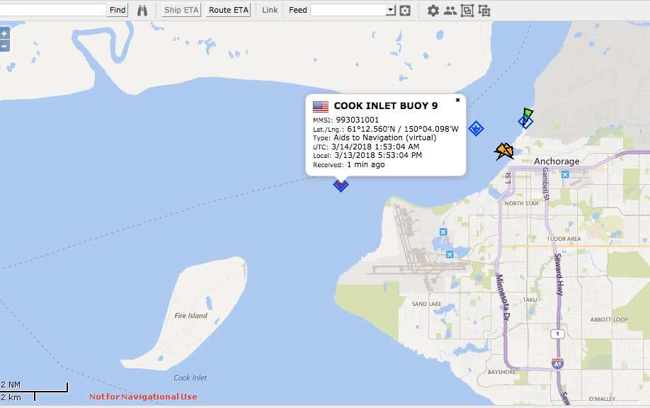
Virtual AIS Buoys

Slide 21
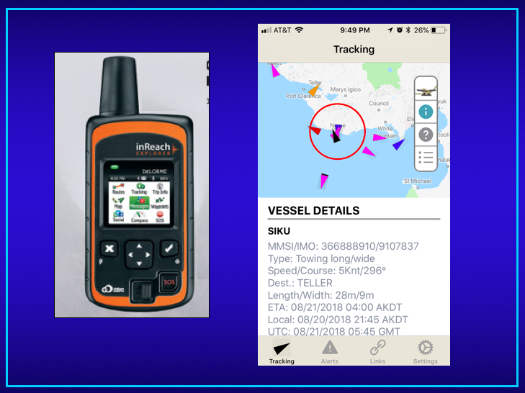

Slide 22
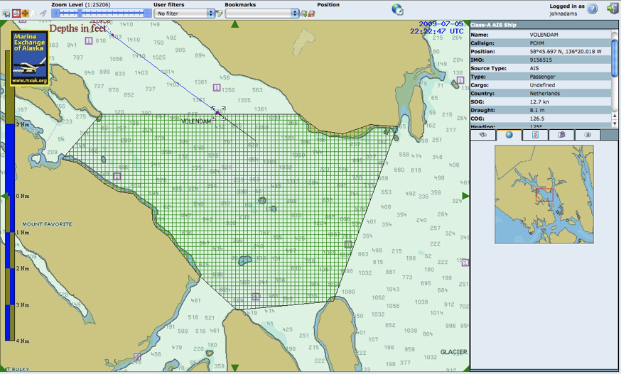
Cruise ships Transiting Whale Waters
Applying Technology
Automatic generation of e-mail and text msg alerts

Slide 23
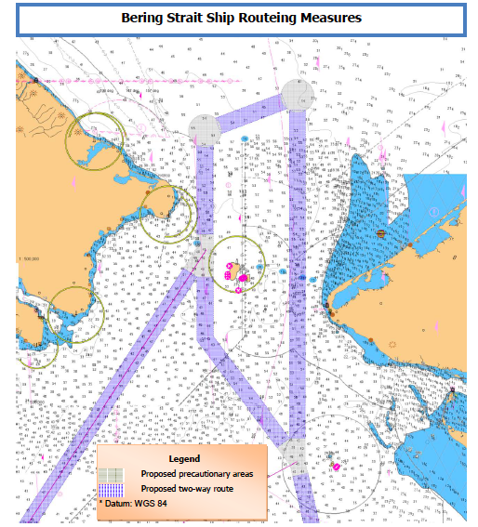

Reducing Risk of Maritime Operations in the Bering Strait

Slide 24
Barriers and Solutions
Permissions for AIS data transmissions.
Verification of marine mammal data
Installation of transmission equipment.
AIS software and hardware requirements, IMO regulations.
International agreements for implementation in the Arctic.

Slide 25
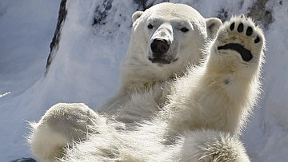
For More Information Contact:
Paul Fuhs, President MXAK paulfuhs@earthlink.net

