Slide 1
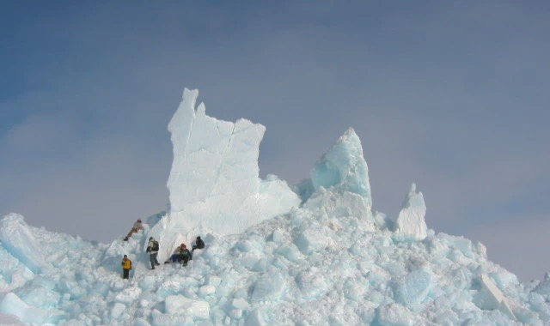
The Arctic Experience Willie Goodwin – Chairman, Arctic Waterways Safety Committee

Slide 2
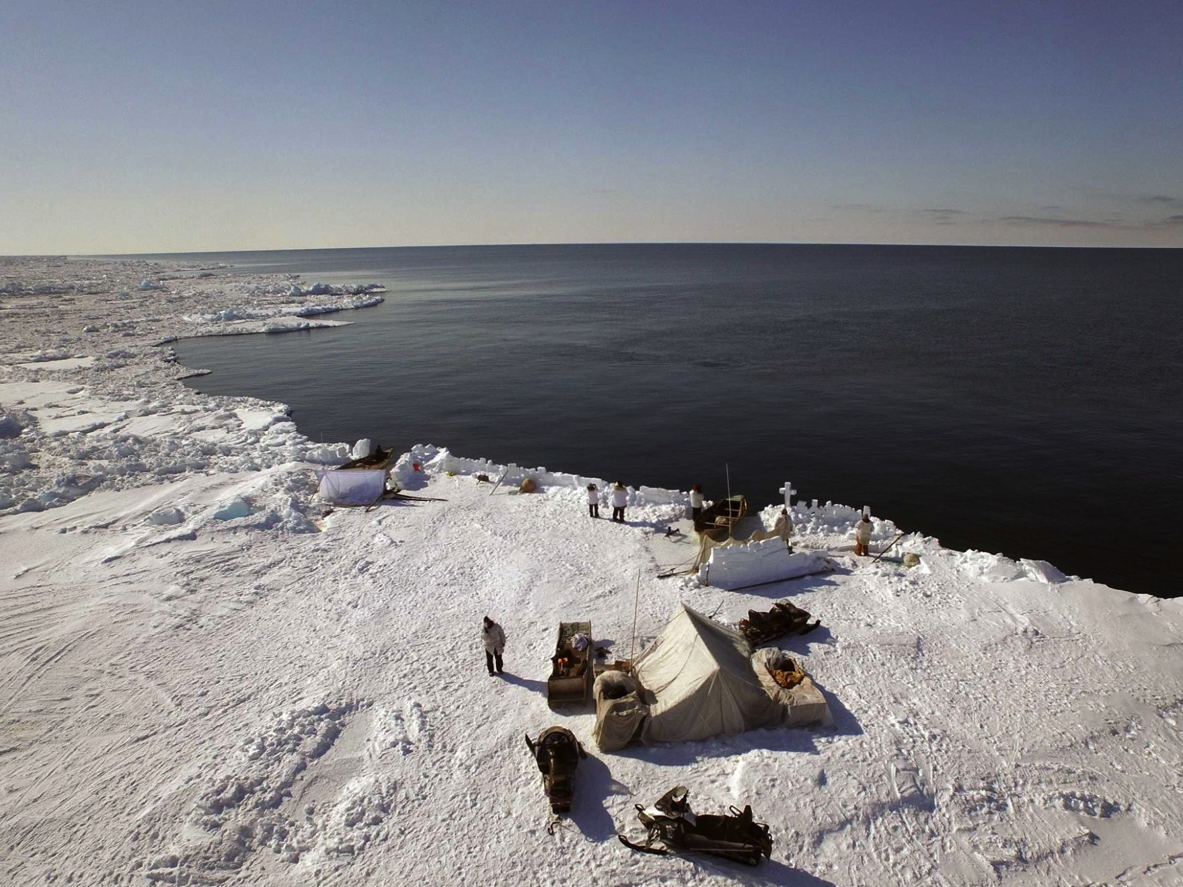
THE CONTEXT FOR DEVELOPING SAFE PRACTICES IN ARCTIC WATERS
Understanding who utilizes Arctic waters and why:
Local Communities
Industrial and Economic Development
Research
Note Sea ice elsewhere
Subsistence
Photo: Peak 3/AEWC

Slide 3
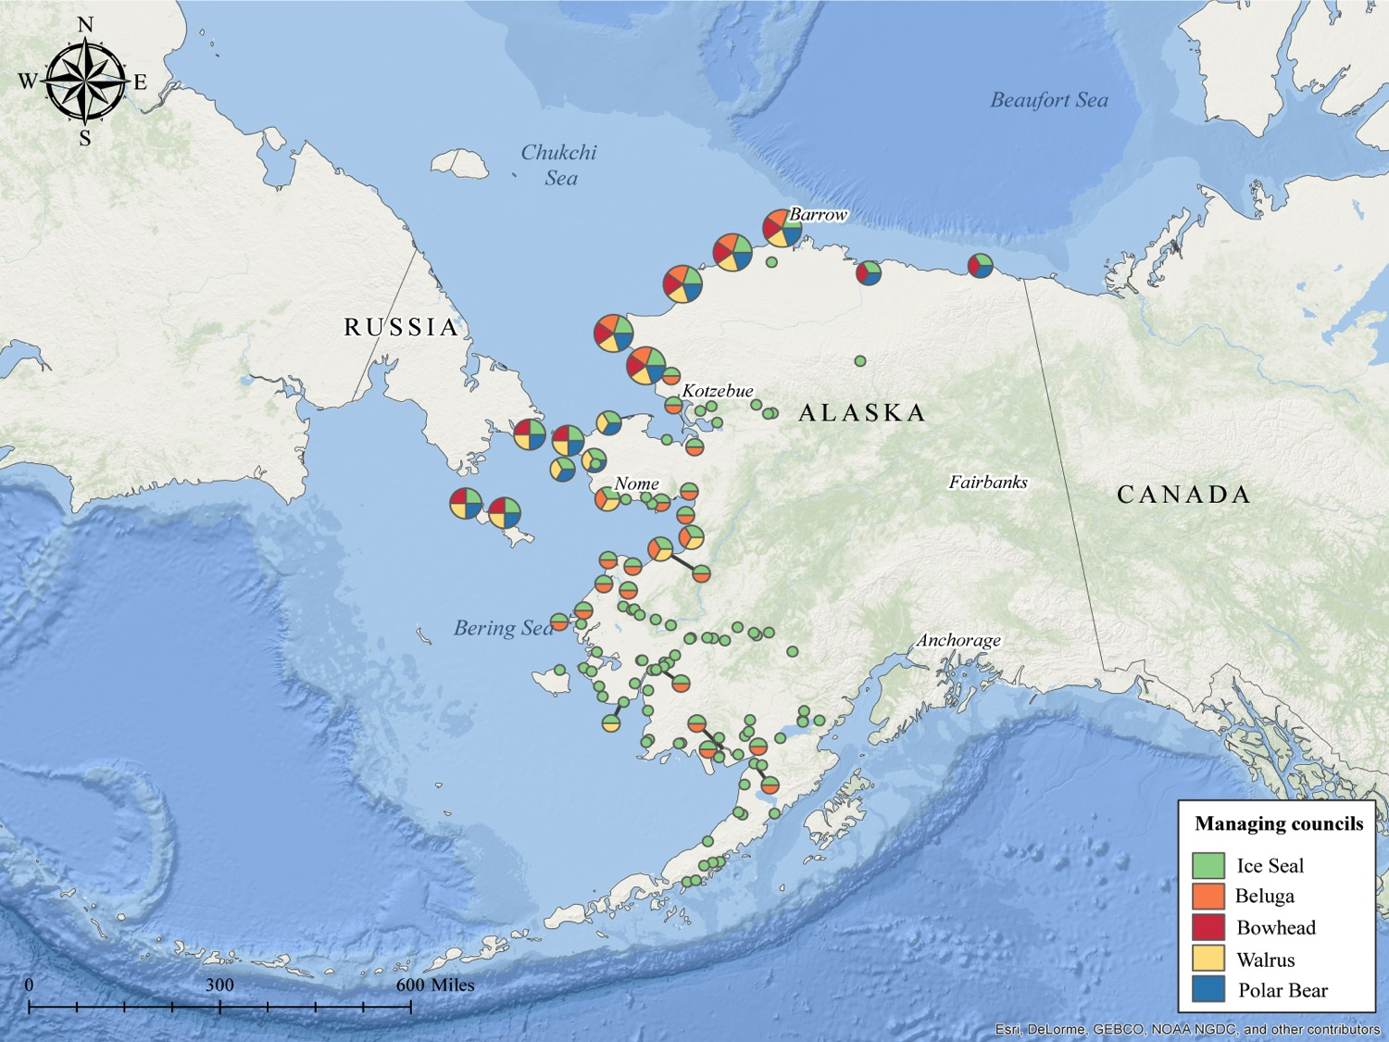
LOCAL COMMUNITIES
Social Systems Built Around Environmental Systems
Subsistence Hunting Culture
Food Security
Survival Through Adaptation

Slide 5
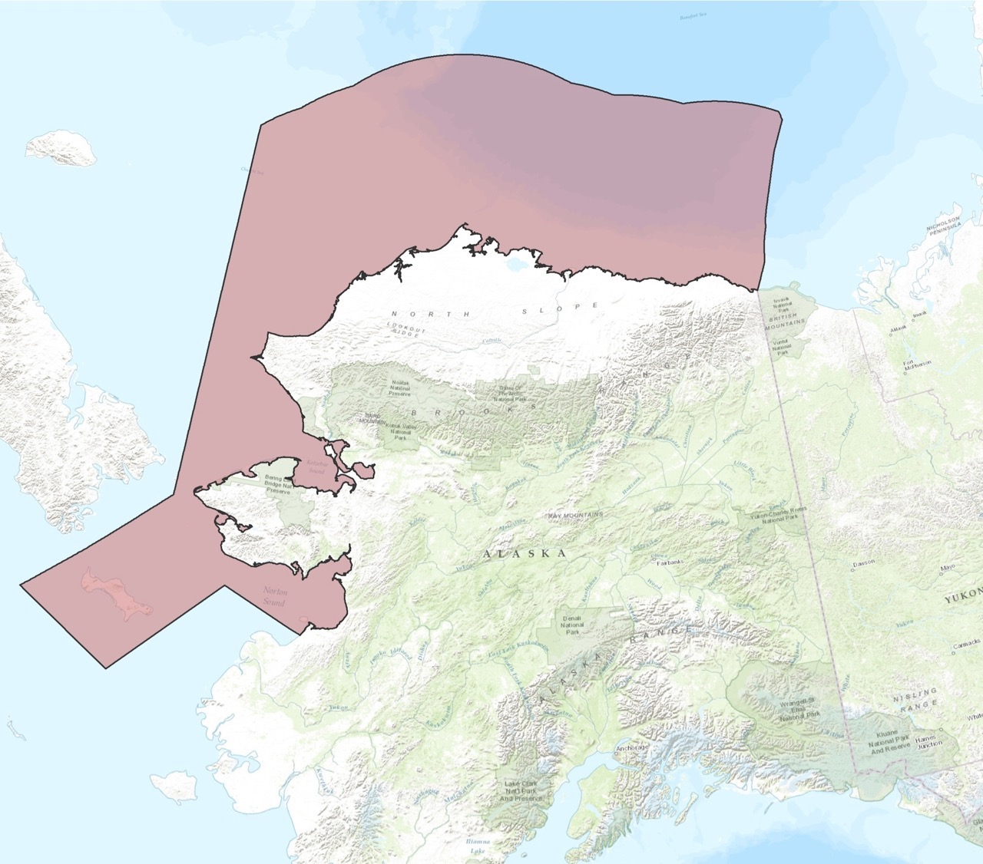
About [Company/Group Name]
AWSC AREA OF INTEREST

Slide 6
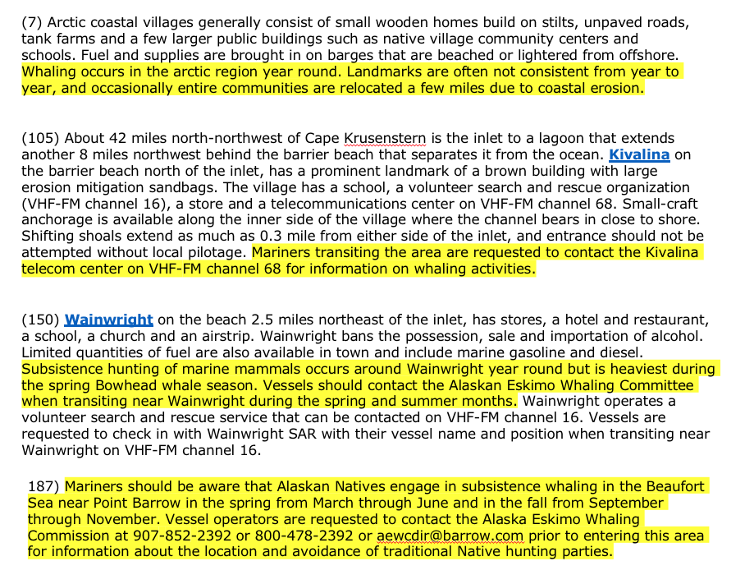
Usage of NOAA Navigation Services – Coast Pilot

Slide 7
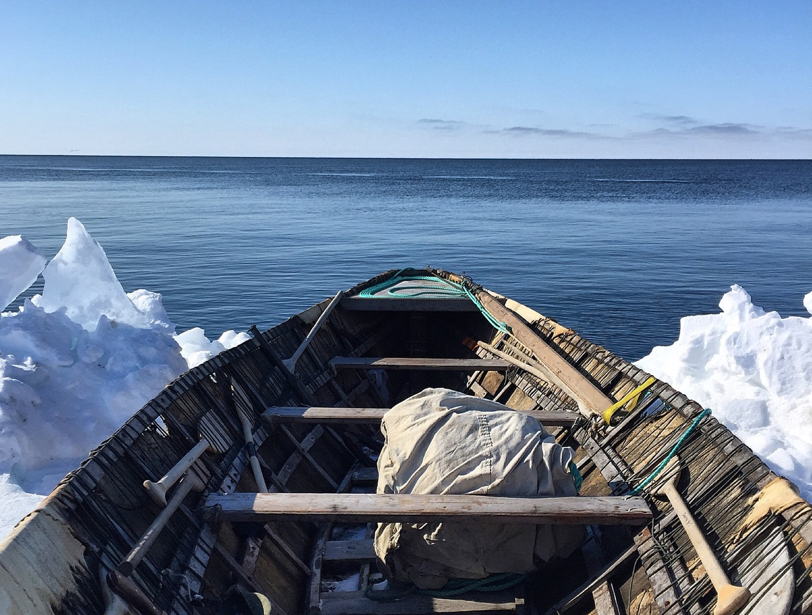
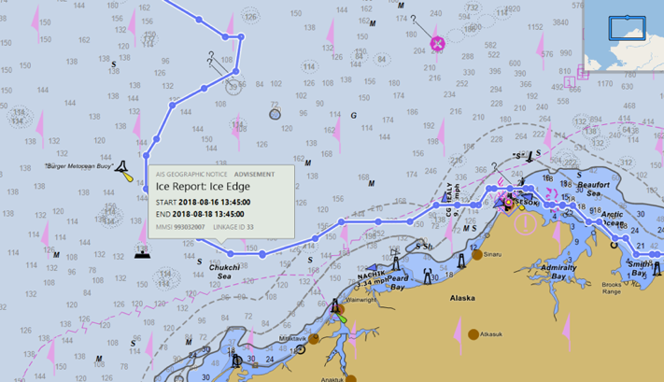
Requests for NOAA Navigation Services & AOOS Data
Requests for NOAA Navigation Services & AOOS Data
Provide real-time information to vessels operating in the Arctic that can help prevent marine casualties and environmental harm;
Environmentally sensitive areas (subsistence)
Location of native subsistence activities (e.g. whaling)
Information is currently difficult to access and relies on vessels operators’ knowledge and adherence to Coast Pilot guidelines.
Ice Edge Information Disseminated via AIS Transmitter in Barrow

Slide 8
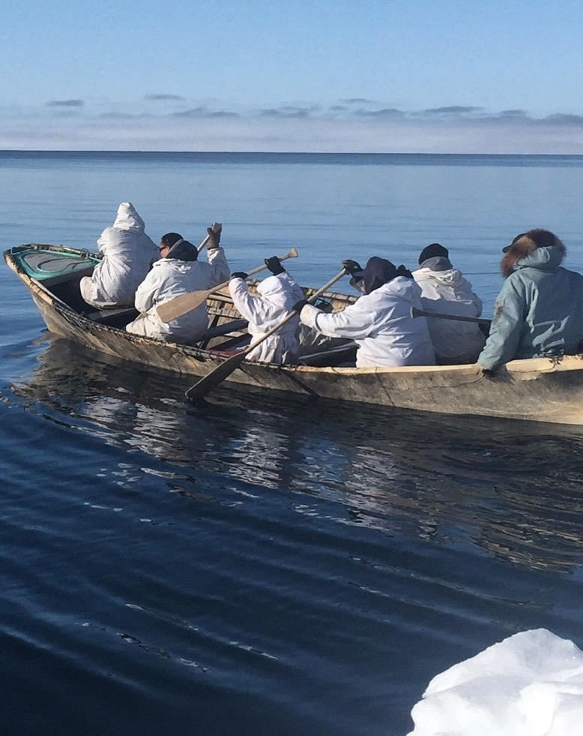
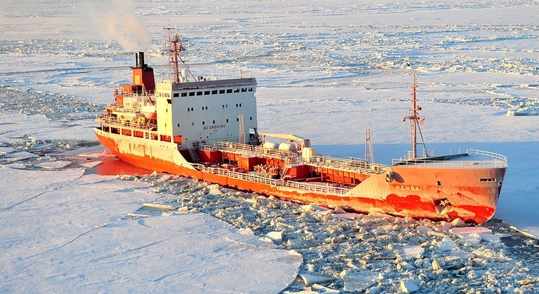
Real Impacts

Slide 9
Contact Information:
Willie Goodwin
Chair, Arctic Waterways Safety Committee
argagiaq@gmail.com
Cell: (907) 412-1248
www.arcticwaterways.org

