Slide 1
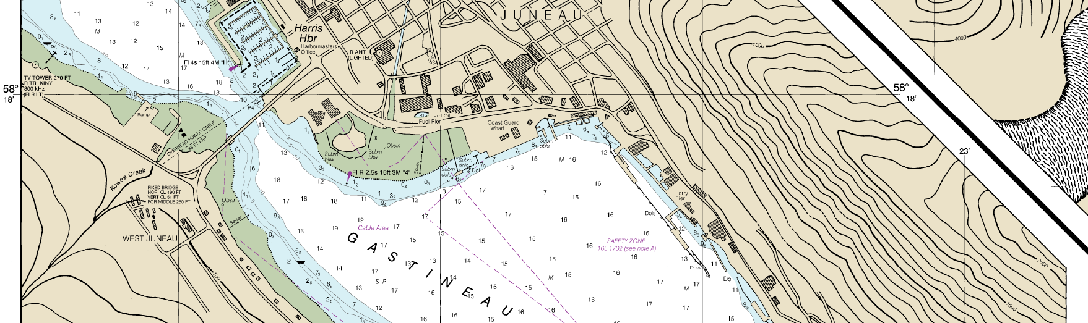
Southeast Alaska Pilots’ Association
Captain Hans H Antonsen
Hydrographic Services Review Panel
Stakeholder Perspectives
August 28, 2018

Slide 2
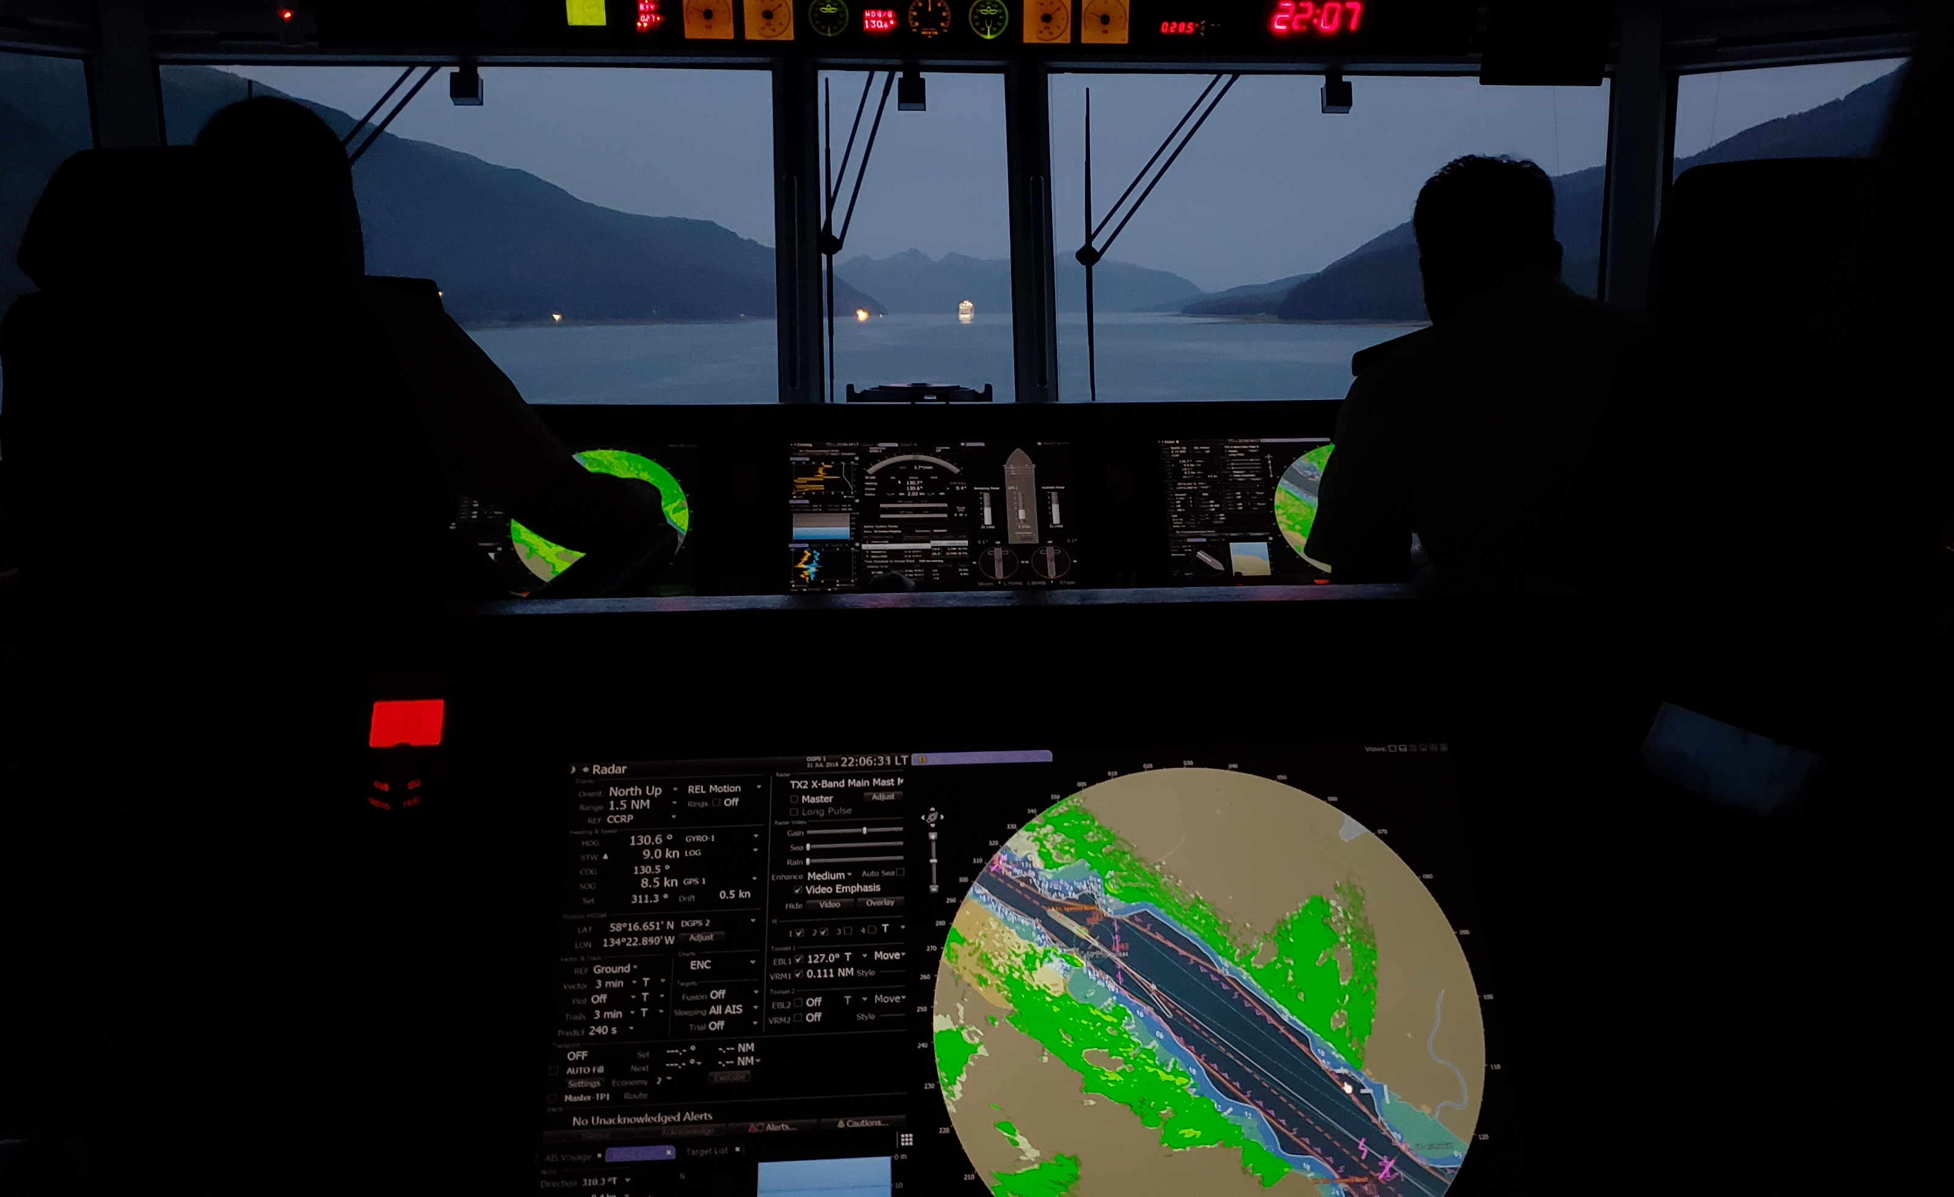
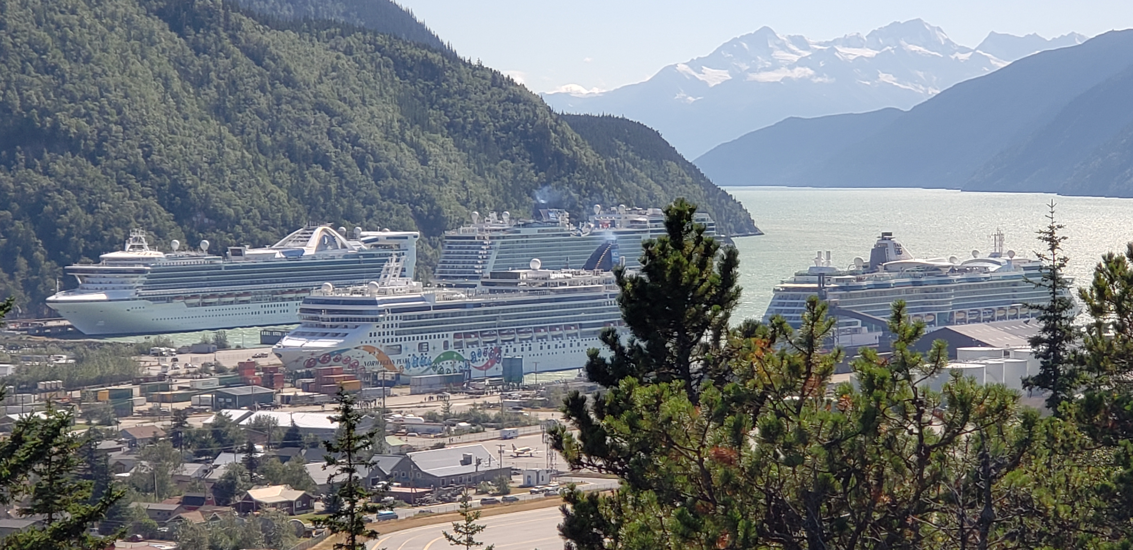
About SEAPA
Safe navigation of vessels since 1971 when the Pilot Act was first adopted
Two thirds of all Alaskan pilots serve the Southeast region
Over 2,500 ship movements per year- cruise ships, yachts, cargo ships
Average of 34 cruise ships per year bringing over 1 million passengers to the region
Tourism is the #1 industry in Southeast Alaska
Norwegian Pearl
Skagway, AK

Slide 3
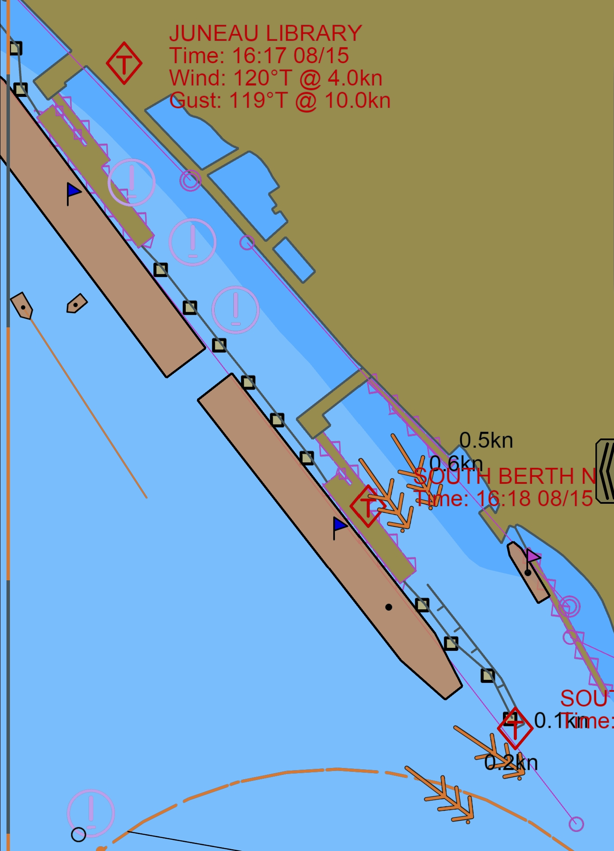
Usage of NOAA Navigation Services & AOOS Data
Charts
Scenic cruising depends on accurate and frequent updates
Accurate tide and current data
Bigger ships have lower tolerances
More ships requires tighter sequencing of traffic
Weather
Predictions
Real-time
Juneau Harbor

Slide 4
Requests for NOAA Navigation Services & AOOS Data
Real-time weather/tides/currents data
Expansion of real-time current sensors
Improve ease of access to frequently used wx tools
i.e. Basic surface map
Updated surveys of rapidly retreating glaciers
Tracy Arm/Endicott Arm
Margerie Glacier, Glacier Bay
Gulf of Alaska

Slide 5
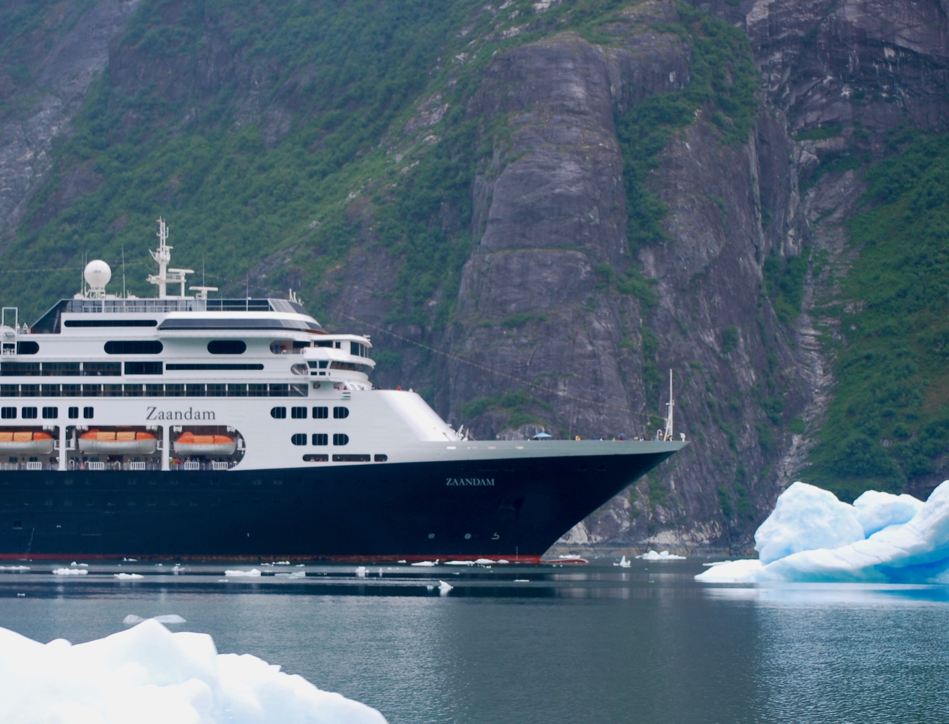
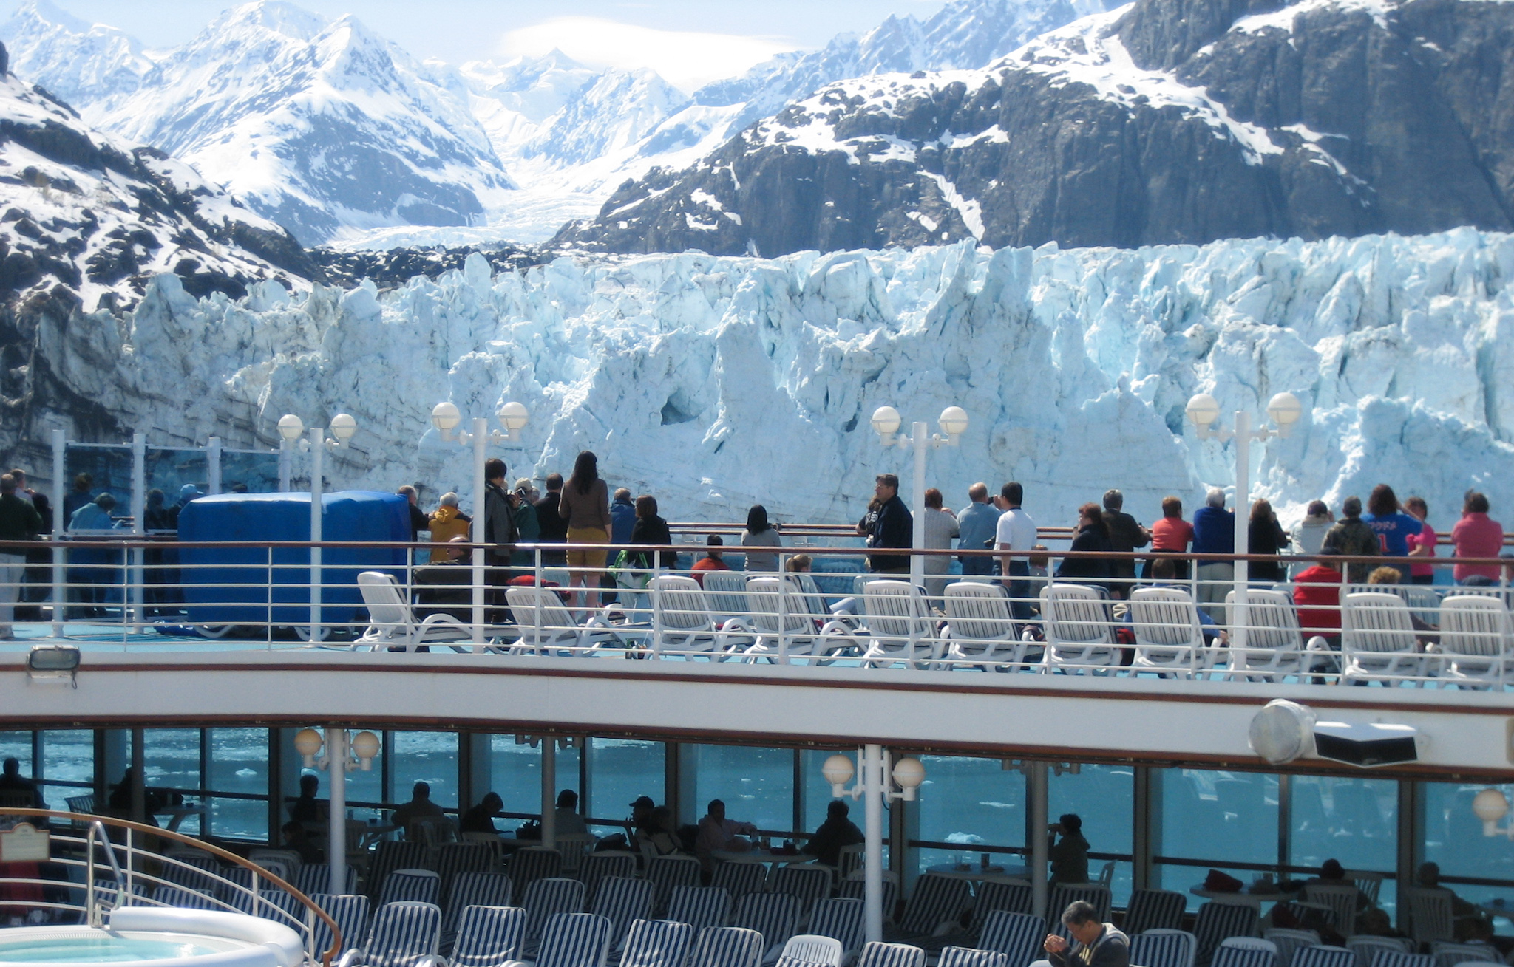
Real impacts of NOAA Navigation Services / AOOS Data
Objects in this fjord may be further than they appear
Margerie Glacier, Glacier Bay
Tracy Arm
Even small bergs can make a big dent

Slide 6
Contact Information:
Captain Hans H Antonsen
Southeast Alaska Pilots’ Association
seapilot@att.net

