Slide 1
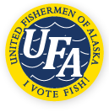
United Fishermen of Alaska
Frances Leach, Executive Director
Hydrographic Services Review Panel
Stakeholder Perspectives
August 28, 2018

Slide 2
The Alaska Seafood Industry by the Numbers
$4.2 Billion in first Wholesale Value
Over 9,000 vessels in Alaska’s commercial fishing fleet
Alaska fisheries account for over half of total U.S. harvest volume
60,000 direct jobs in Alaska
6.1 Billion pounds total harvest
Sources: Alaska Department of Labor and Workforce Development Research & Analysis Section, “Alaska Economic Trends November 2017” and “The Economic Value of Alaska’s Seafood Industry” prepared for The Alaska Seafood Marketing Institute by McDowell Group. Numbers reflect 2015/2016 season.

Slide 3
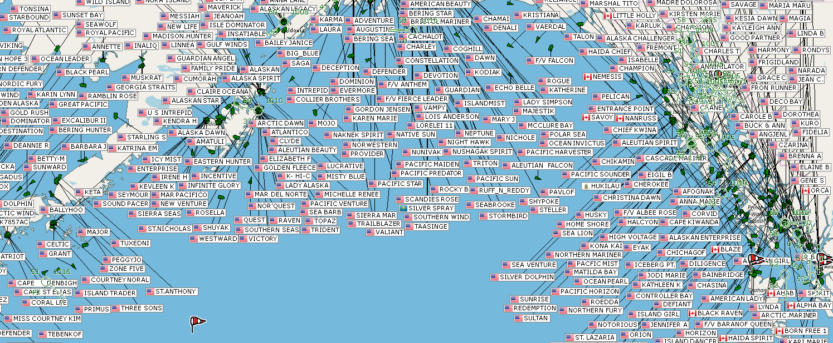
Usage of NOAA Navigation Services & AOOS Data
Fishing Vessels in Alaska and AIS

Slide 4
Usage of NOAA Navigation Services & AOOS Data
Fishermen rely heavily on NOAA for;
Accurate real time weather info
Weather forecasts
Accurate Charts
Tidal and current information
The safety of fishermen and their vessels is heavily dependent on constantly making risk assessment an decisions based on the weather.

Slide 5
Requests for NOAA Navigation Services & AOOS Data
NOAA Navigation Services and AOOS addition of more real time weather sensors and dissemination of forecasts and weather observations via smartphones and AIS will enhance efficiency and safety of fisheries.
The recent expansion of weather sensors by AOOS and the Marine Exchange has been an asset and is heavily used by fishermen.
Example
Listening to the VHF radio broadcasts and waiting to hear relevant weather observations is frustrating and hard to do on a noisy fishing boat.

Slide 6
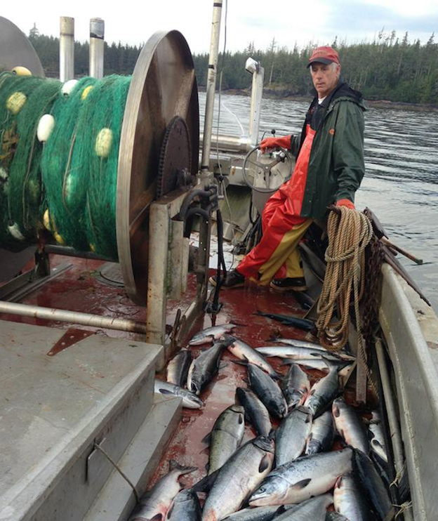
Real impacts of NOAA Navigation Services / AOOS Data

Slide 7
Contact Information:
Frances Leach, Executive Director
United Fishermen of Alaska
director@ufa-fish.org

