Slide 1
VITUS ENERGY LLC
Mark Smith
Hydrographic Services Review Panel
Stakeholder Perspectives
August 28, 2018

Slide 2
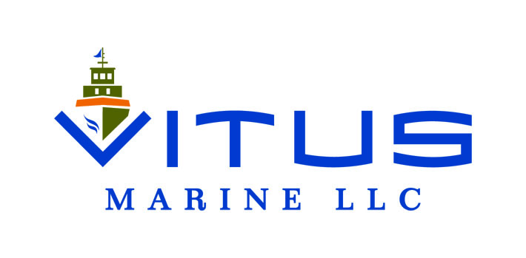
About Vitus Energy
Western Alaska Marine Fuel Distributor
Alaskan owners and operators committed to customer service
Introduced new equipment and supply chain paradigm
Western Alaska consumers saved millions since Vitus introduction
Vitus is one of four marine distributors
Two are both coastal and inland
One is inland, another coast exclusively

Slide 3
Lack of NOAA Navigation Services & AOOS Data
90 % of Vitus coastal operations rely heavily on NOAA charts and tide tables for basic day to day navigation
For critical “last mile” and inland navigation Vitus uses:
Known “track lines” from internal and external sources
Sounding skiff with both simple depth sounder and a stick (!)
For administrative voyage planning
Google Earth, windy.com, Rose Point
Bridge Resource Management
Use every tool available to safely execute on the mission
Utilize crowd source data when “official” data doesn’t exist

Slide 4
Requests for NOAA Navigation Services & AOOS Data
FILLING IN THE BLANKS
The most dangerous part of the ocean is hard parts around the edges
Coastal Interface is where VITUS is most challenged
Any data is better than no data
Crowd sourcing does work
Can NOAA / AOOS help?

Slide 5
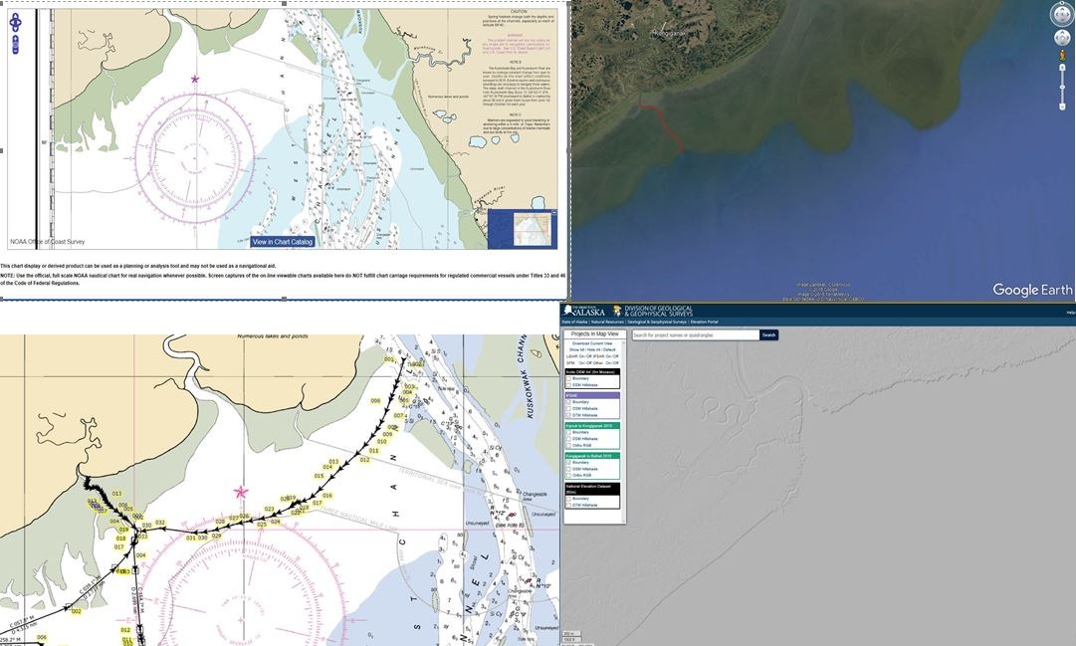
KONGIGANAK - NOAA Navigation Services / AOOS Data

Slide 6
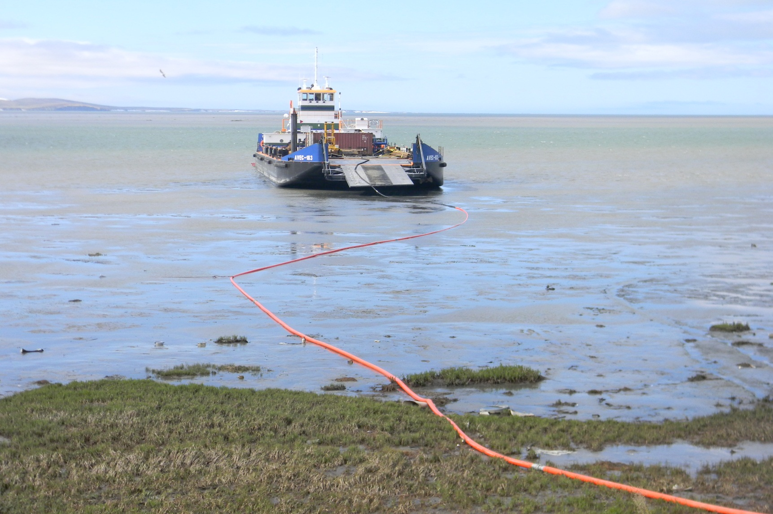
Contact Information:
Mark Smith
VITUS ENERGY LLC
mark.smith@vitusmarine.com
(907) 793-6711
http://www.windy.com

