Slide 1
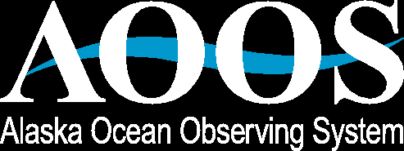
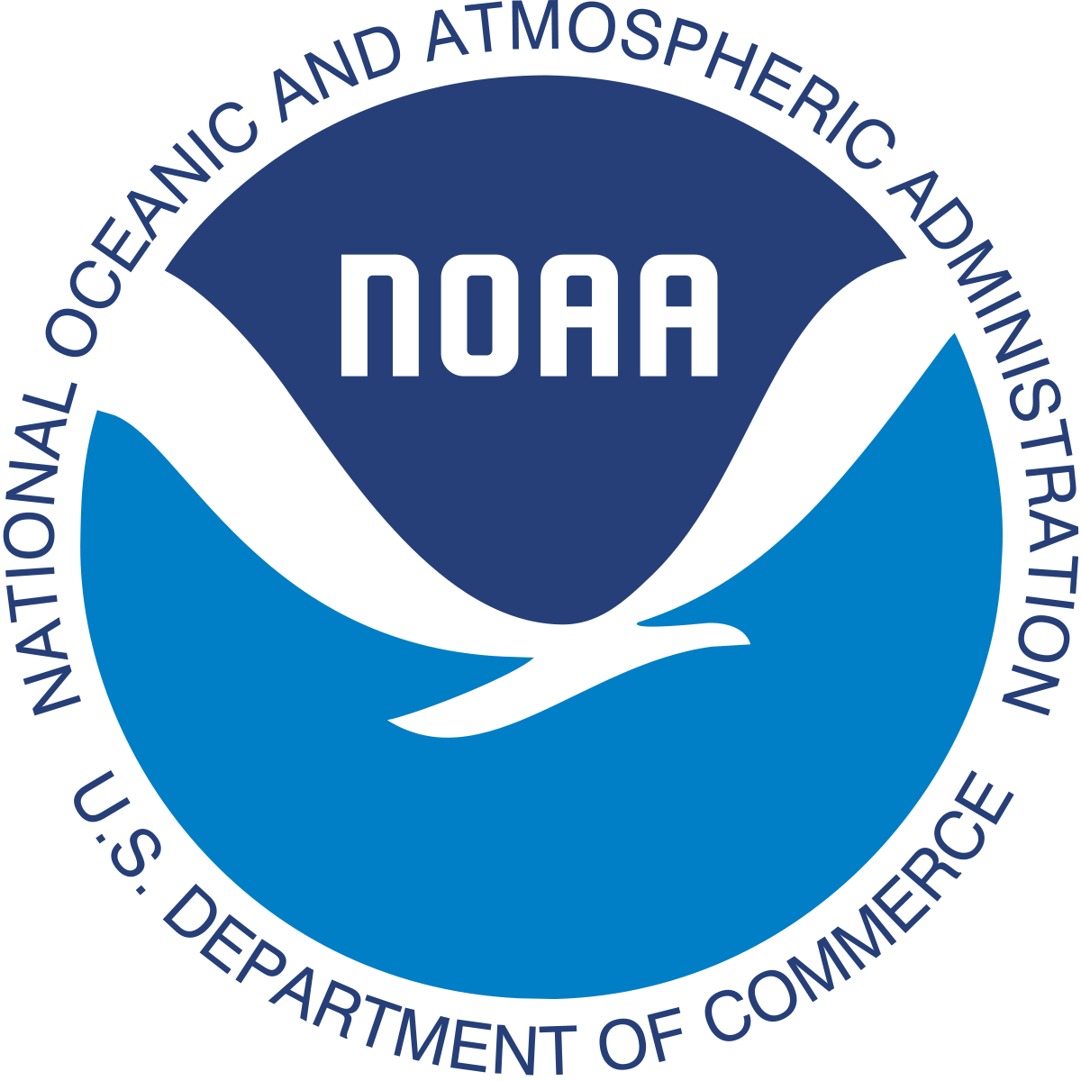
Growing an Alaska Water Level Network
Data Management, Access, Innovation & Partnerships
Joint Meeting of
Hydrographic Services Review Panel and IOOS Federal Advisory Committee
Juneau, Alaska
August 28, 2018
Molly McCammon
Executive Director
Alaska Ocean Observing System
Notes:
https://docs.google.com/presentation/d/1PxaQtJeq5CCcXpdexb_22xQ88XvJbJKKm83DZGJrCFw/edit#slide=id.p23

Slide 2
Our future: where we would like to be
Notes:
Serving mechanisms are the same as co-ops

Slide 3
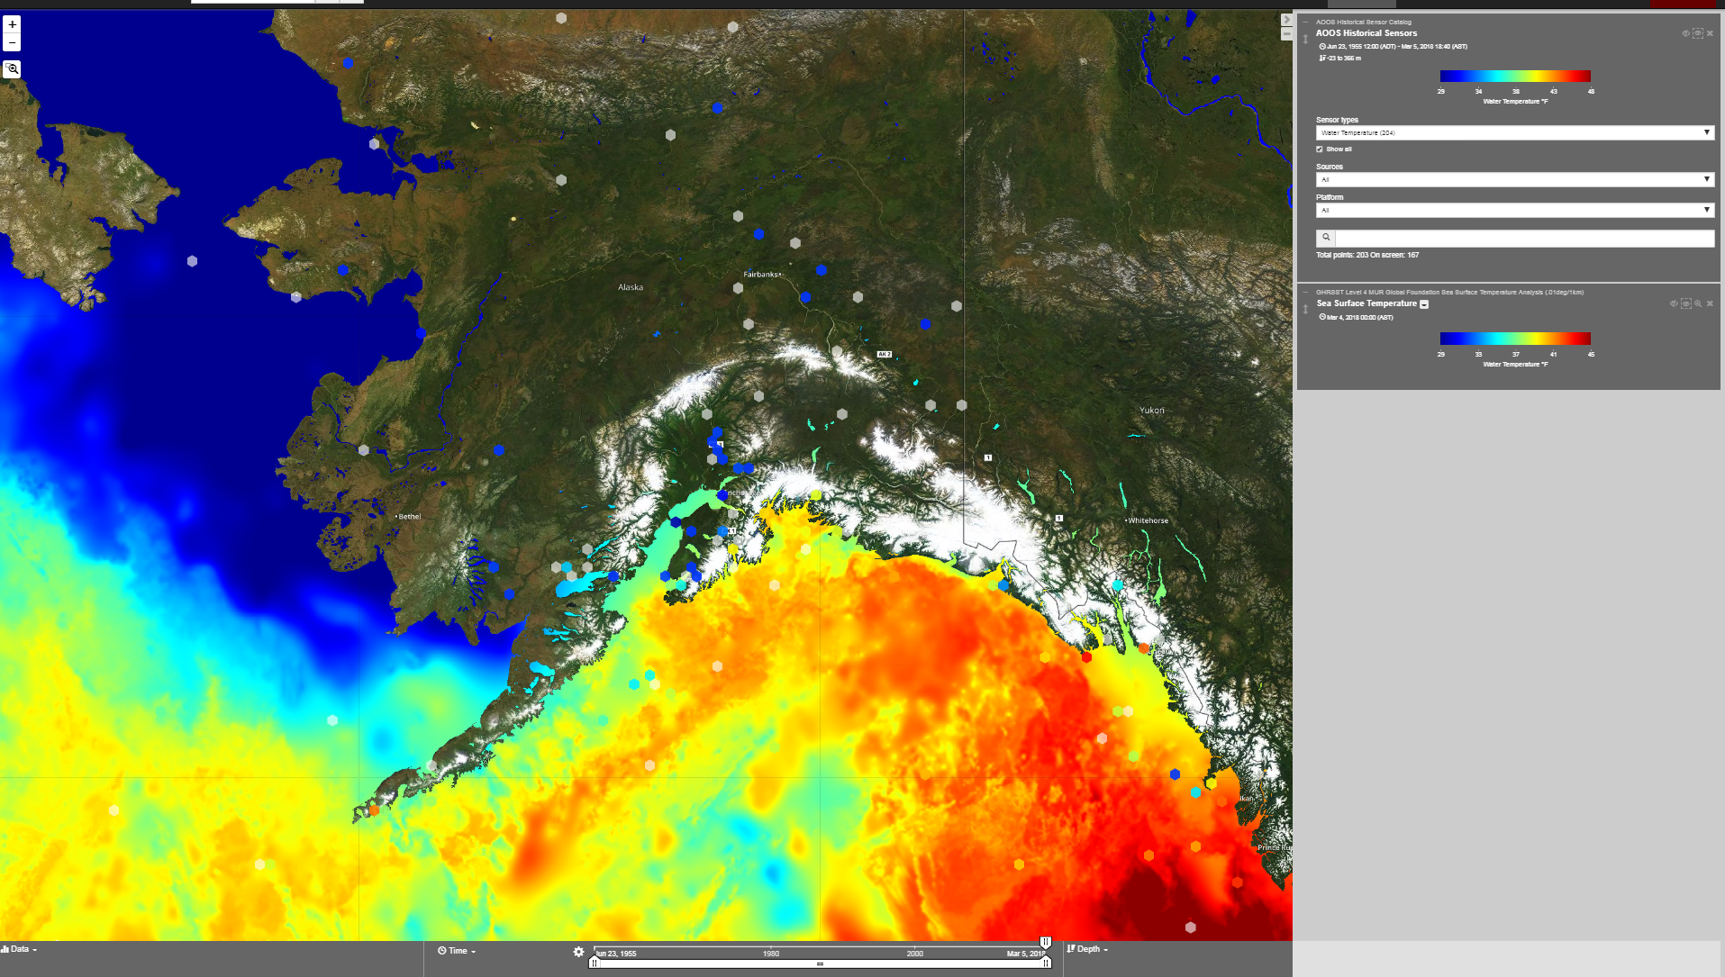
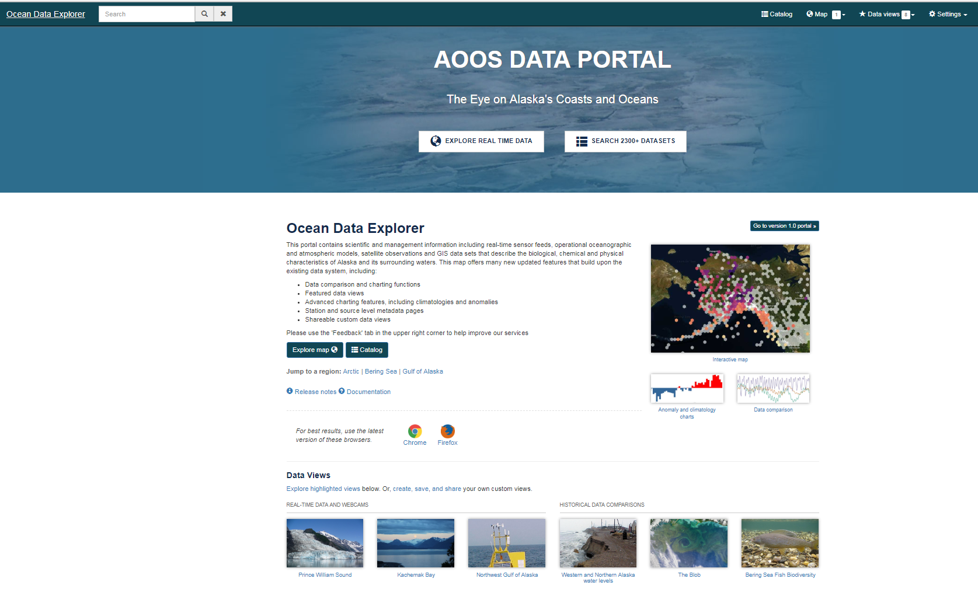
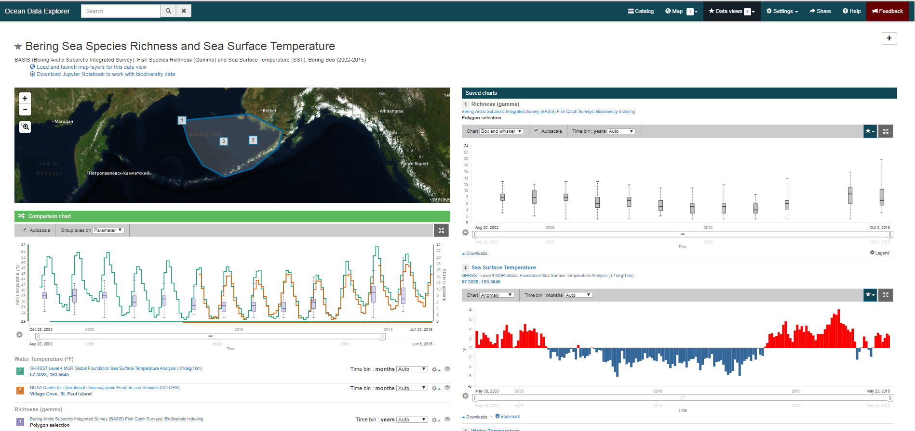


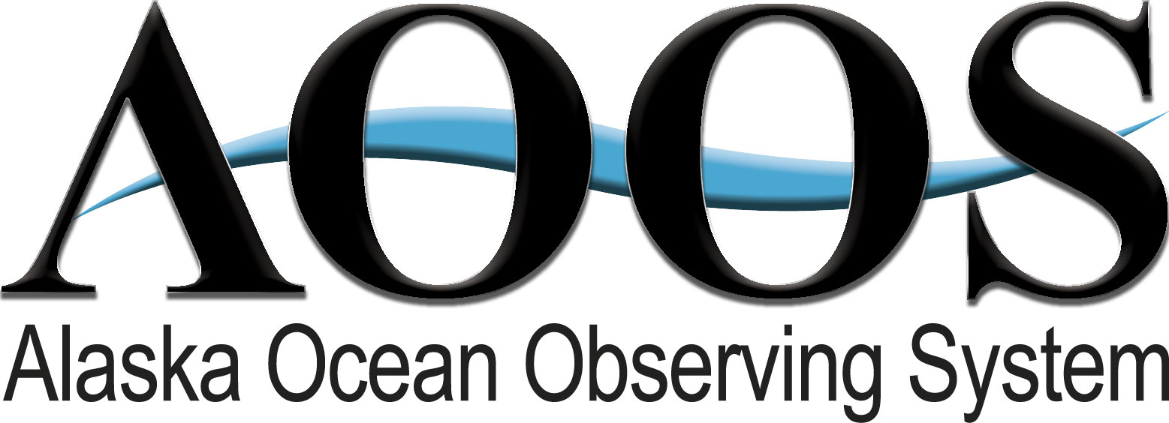
Using AOOS Capabilities, Building on:
Data Assembly Center & Ocean Data Explorer
Notes:
The portal is likened to data environment (rather than standalone system) as it is intended to grow and adapt to new data, and new data discover and visualization capabilities.
We are trying to solve three main things with the portal:
Discoverability
Accessibility
Interactive Visualization of data

Slide 4
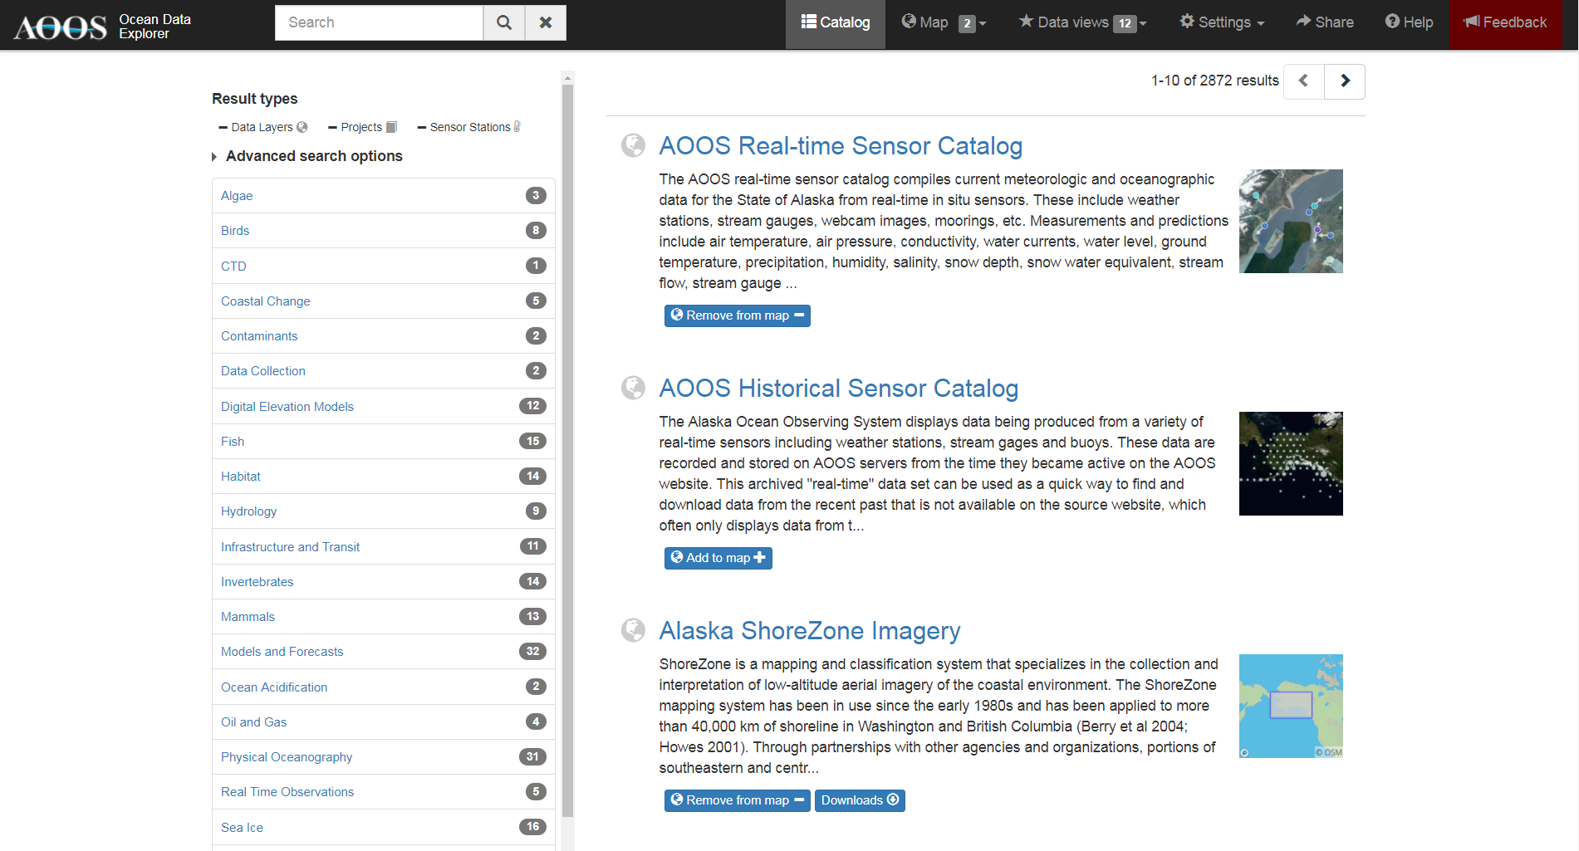
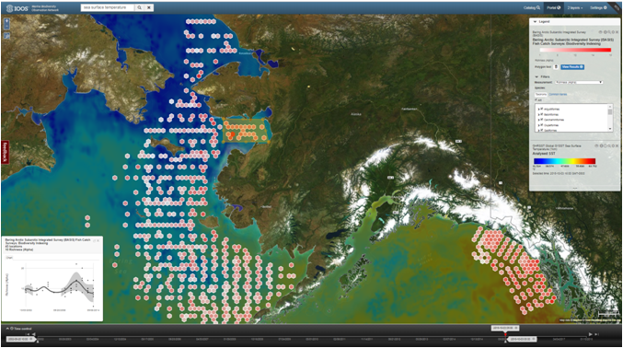
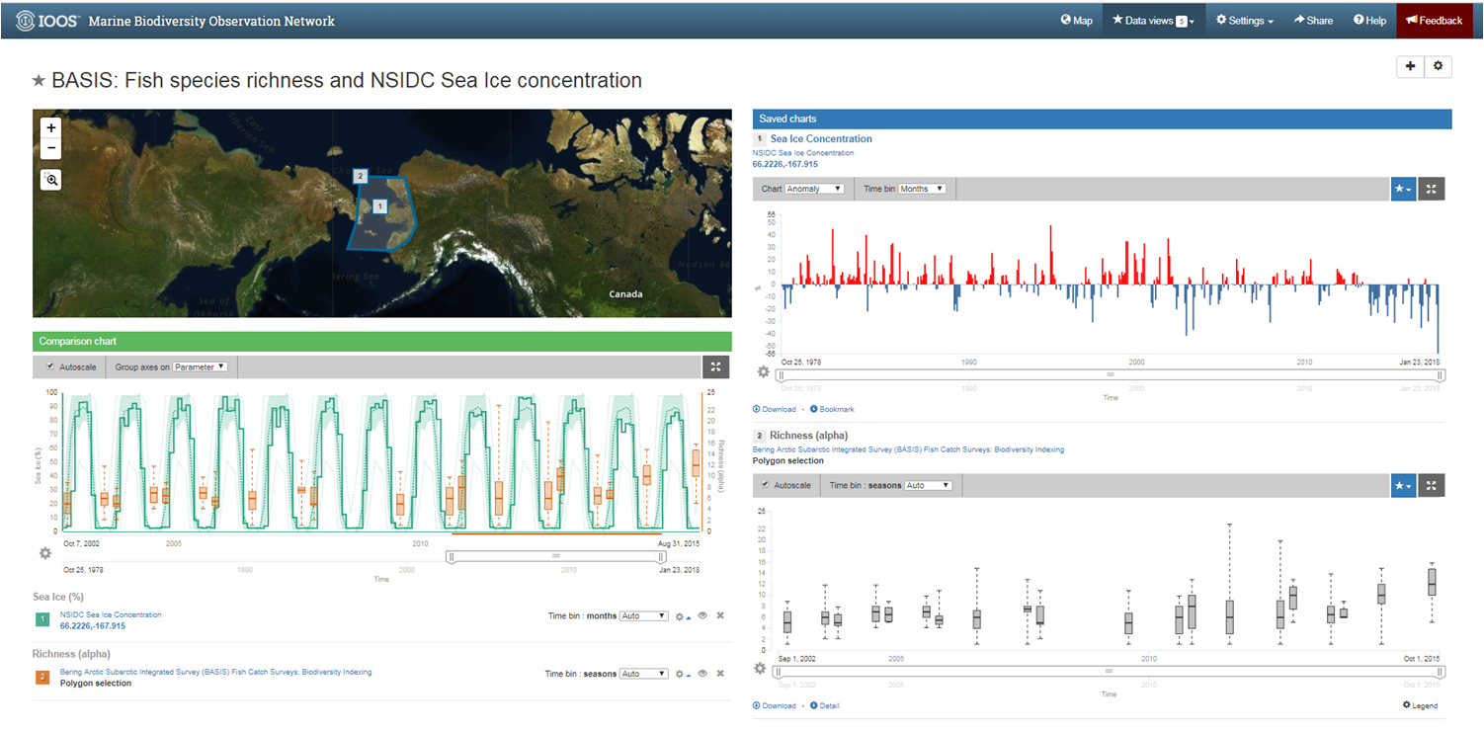
What AOOS Has: Portal Components
Map
Catalog
Integrate & visualize data from many sources:
Grids, GIS, mobile sensors, platforms, products
Search , metadata, & data download
Data Views
Rapidly assimilate & compare
different data streams
Data Amount
2,300 data layers
1,500 sensors
35 parameters
20+ data sources
5 million obs/week
Notes:
Within the portal itself there are 3 main capabilities
Catalog: query, discover, and download data types
Map: automatically analyze and visualize the raw data streams
Data views (new): rapidly assimilate data and integrate these into comparison charts with on the fly data summaries and charting

Slide 5
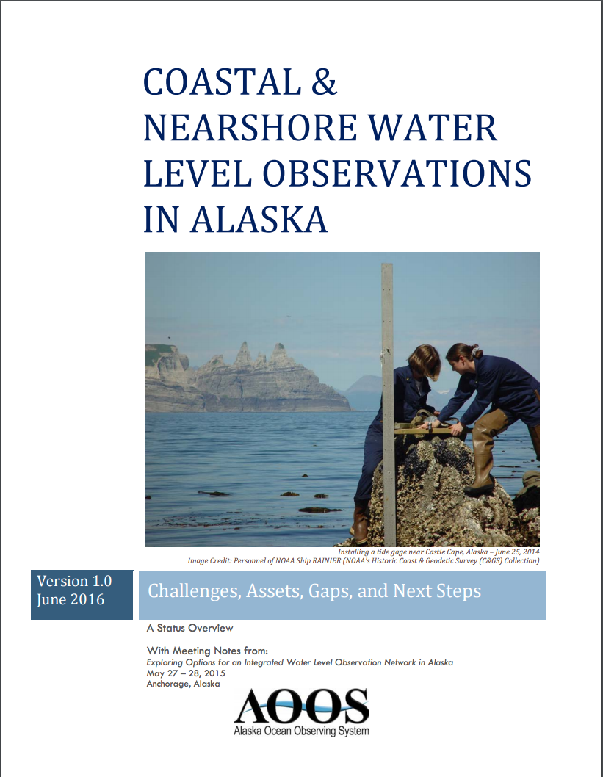
Making Elevation and Water Level Observations Where Conventional Methods Don’t Work
NOAA NWS iGage acoustic sensors: low cost, downward looking on bridges & docks; oblique over tidal rivers
Rapid deploy water level sensors ahead of storms – not real time
Bottom mounted pressure sensors – not real time, but help validate models
Community flooding maps
Water level observing trials using GPS Reflectometry
LiDAR imagery of Yukon Delta: spatially expansive, high resolution elevation data
Available on @ www.aoos.org
Notes:
AOOS is working towards finding solutions to the gaps in water level observations in western and northern Alaska, where conventional NWLON technologies are difficult to install and then maintain.

Slide 6
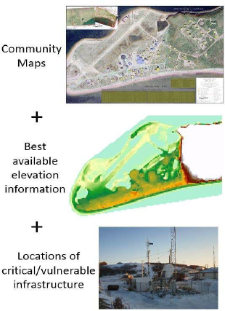
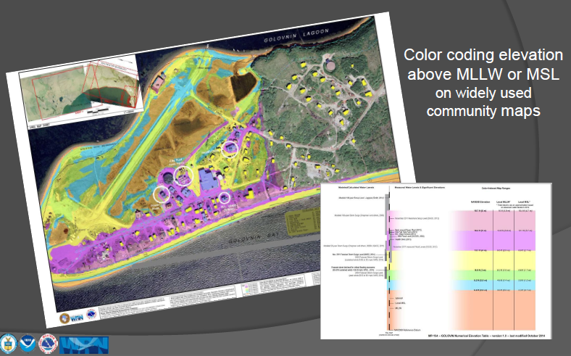
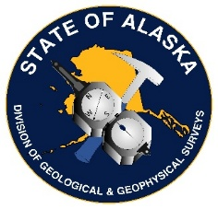
Simple: Color Indexed Map Series
for Flood Communication
Notes:
Instead of giving out a forecast: flooding expected to mean lower low water, which most people don’t understand, the weather service can now forecast that it is expected to flood a community up the pink zone, which might include the school or the washeteria.

Slide 7
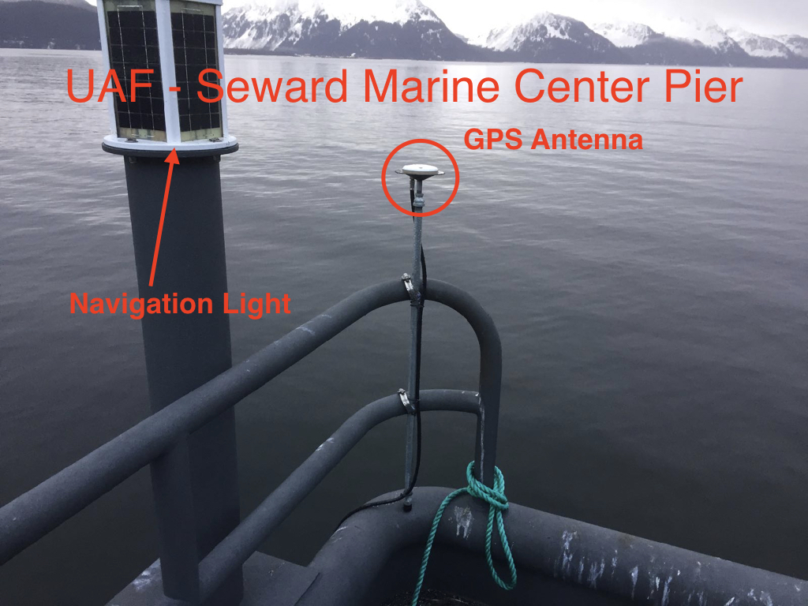
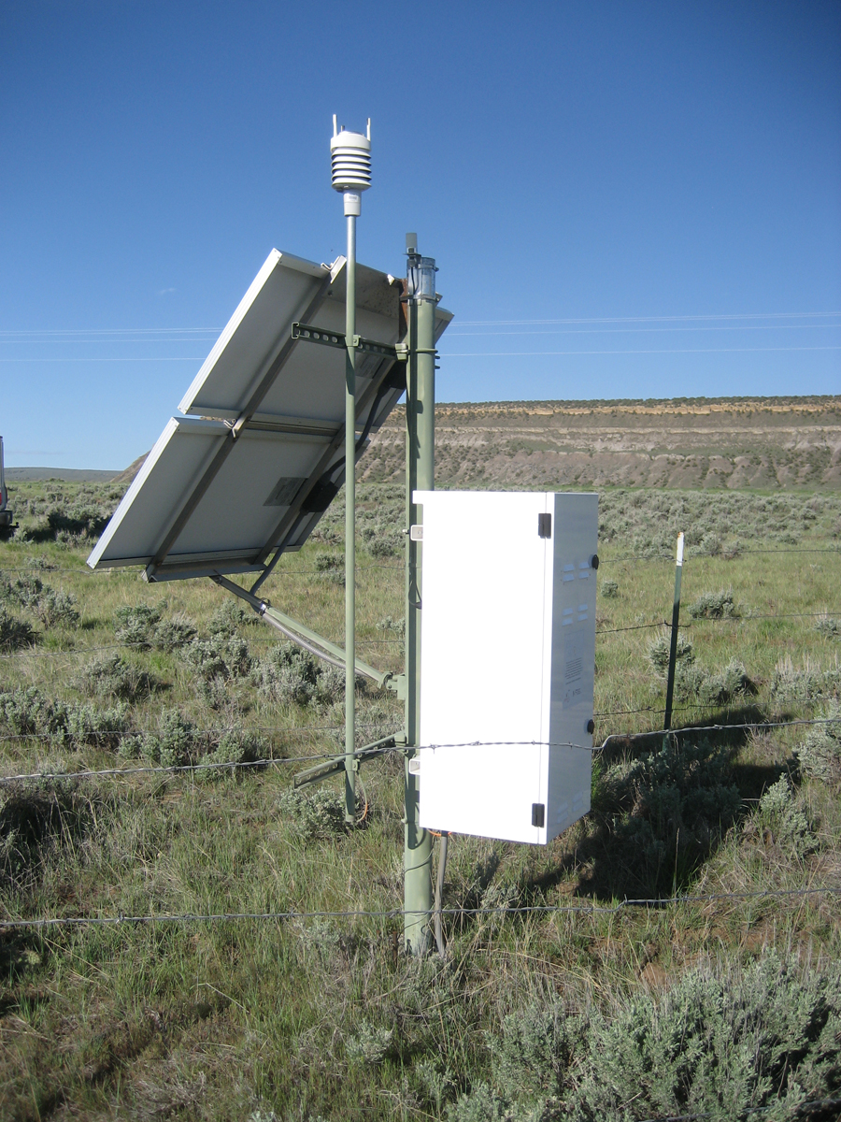
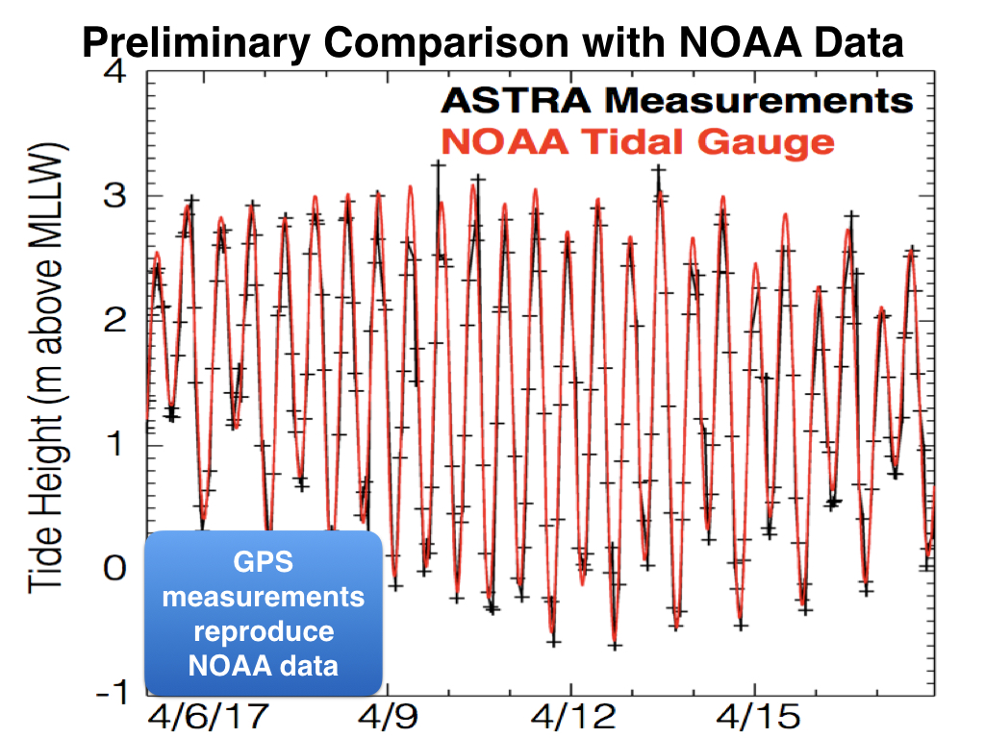
Land-Based, GPS Reflectometry
for Measuring Water Level
Private Sector Partners:
UNAVCO - NSF funded Plate Boundary Observatory
ASTRA, LLC
Notes:
This technique uses a GPS receiver to measure the incoming satellite GPS and reflected satellite GPS signals off the surface of the water to determine the water level.
AOOS has two efforts underway to test GPS reflectometry technologies for providing low cost/high accuracy water level measurements
Goal
to demonstrate the method can produce Tier B (< or == +/- 11-30 cm) quality observations:
Demonstrate portable installations can work in remote Alaska
Make these systems operational for larger spatially distributed installations
Work out the data processing and handling so the output can be delivered real-time via the AOOS data portals.
ASTRA GPS receivers measured Tier B quality level water level observations
11-30 cm
ASTRA GPS data produced major tidal constituents to within 5-6 cm of the NWLON at both locations
The GPS reflectometry technology is quality alternative for water level observing
Suitable for remote
Various technologies can be used in the same way (ASTRA, UNAVCO)
Installation and operation costs low compared to NWLON installations and can go where NWLONs cannot
Other studies support the use of GPS reflectometry for making high quality water level observations
The GPS signal follows 2 paths from a satellite to the antenna
First is the direct path
2nd path is reflected from the antenna off the water surface
GPS cannot tell difference between two paths
Water level is estimated using the interference between the 2 paths based on the reflecting surface height relative to the antenna height

Slide 8
NOAA CO-OPS: the Gold Standard
(but need for less robust data)
- Focus is on stringent NWLON WL data products
- Mission to maintain authoritative WL observations
→ Accurate and reliable WL observations = backbone network
→ Legal requirements to support navigation and engineering
→ Official Datums (land ownership & maritime boundaries)
→ Long-term relative sea level trends
- Dedicated to enabling supplemental instrument operation where NWLON operation is not needed or not possible
→ Policy for Management and Dissemination of External Source Water Level Data – December 2015 (AKA “Tiered Data Policy”

Slide 9
AOOS/CO-OPS Data Partnership
- Leverage partners and external data providers to formally supplement NWLON in Alaska
- Regionally implement CO-OPS’ Tiered Data Policy
→ 3 Tiers based on accuracy, vertical control, and application
PRODUCTS | A: NWLON | B: ~IHO Standard | C: Other Partner
Real-Time Water Levels | ✓ verified | ✓ as possible | ✓ >24 hr. latency
Harmonic Constants & Predictions | ✓ official | ✓ unofficial | ✗
Bench Mark Sheets | ✓ official | ✓ unofficial | ✗
Datums | ✓ official | ✓ unofficial | ✗
Sea Level Trends | ✓ official | ✗ | ✗
 | CO-OPS Data | iGages, GNSS reflectometry, seasonal pressure sensors, WL buoys, etc. | rapid response tools, high water marks, tide staffs, etc.

Slide 10
Result: Win-Win for all!
CO-OPS Upside
Expands IOOS/CO-OPS relationship
Enhances IOOS contributions to Blue Economy by densifying WL observations beyond NWLON backbone
Pilots regional implementation of CO-OPS Tiered Data Policy vision
Encourages use/development of new products and services that put WL evaluation in hands of users (e.g. Tidal datum calculators)
Alaska WL Stakeholder Upside
Public access to additional WL stations in Alaska
Increased consistency in format and delivery of WL records from a mix of sensors
Enhanced data discoverability with centralized metadata
Calculation of unofficial tidal datums
Notes:
IOOS/CO-OPS: existing modeling, HF radar, total water (also modeling), flexible equipment options

Slide 11
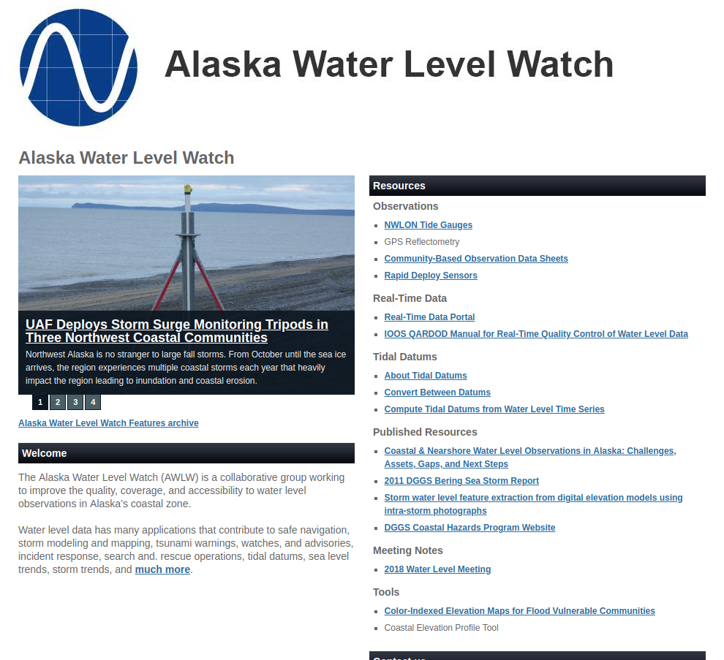
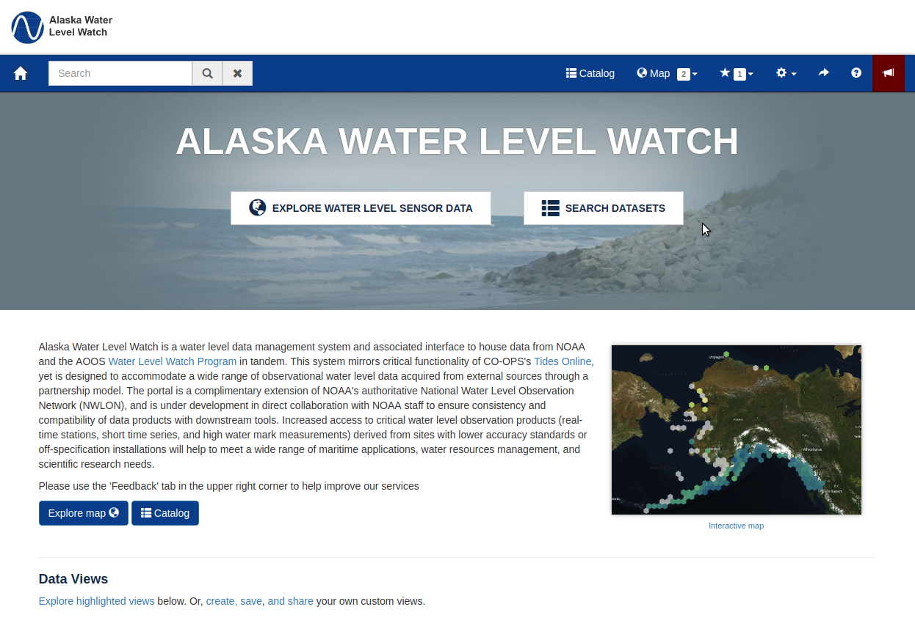
Alaska Water Level Watch Website & Portal
Templates
Notes:
https://www.aoos.org/alaska-water-level-watch/

Slide 12
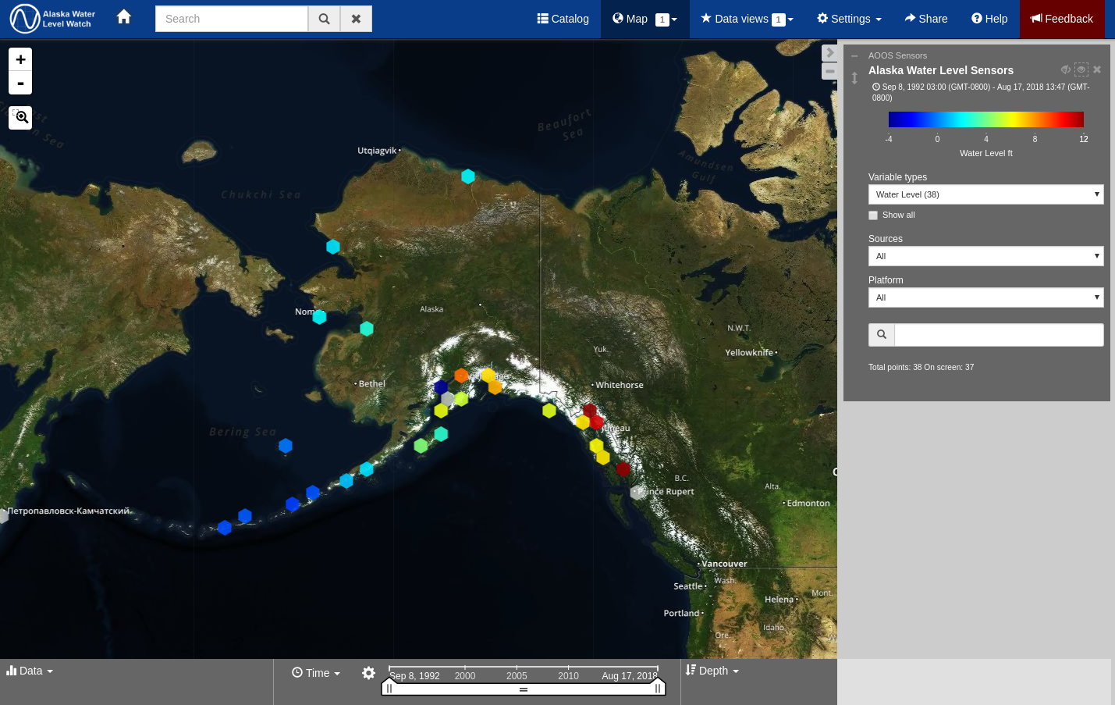
AOOS Water Level Watch Map:
Uses AOOS interactive map, so additional layers can be added
Notes:
Spatial representation of water level observation stations in Alaska

Slide 13
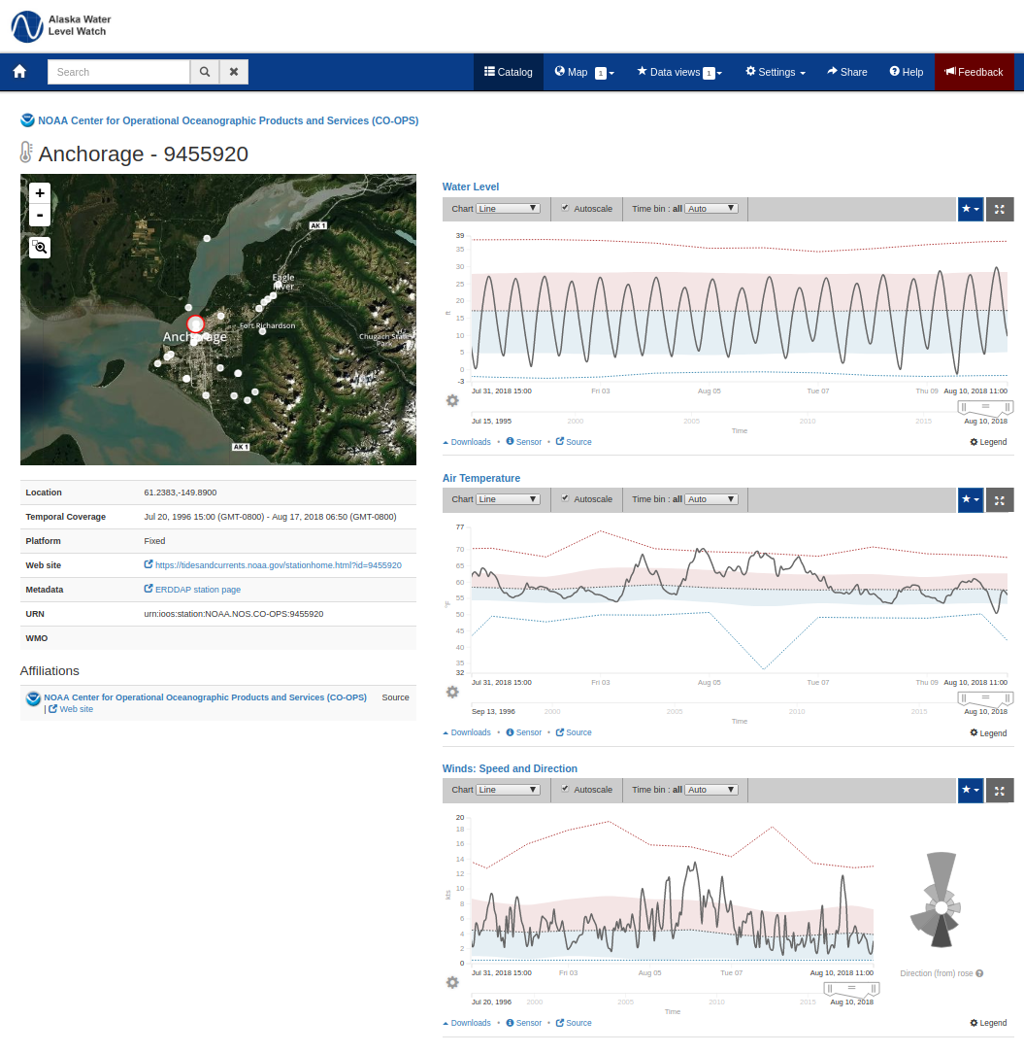
Sample Water Level Watch Station Pages
Interactive graphs
Interannual statistics
Anomaly plots
Each station has own page: shows individual parameters over time, metadata, link to original source, download links, contact information
Notes:
Each dataset has its own content page
Summary
Data availability
License / usage information
Variable / layer preview
Contact information
Original-source link
Download links

Slide 14
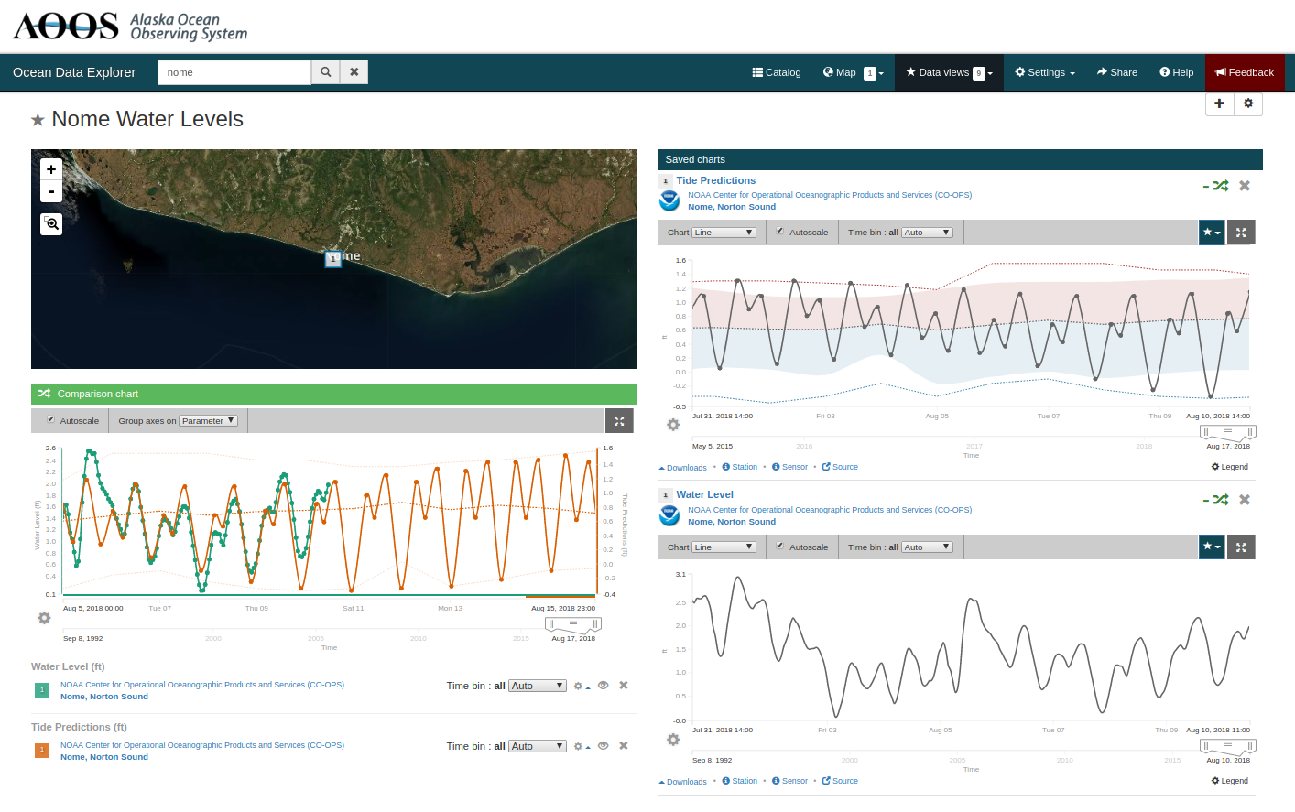
Water Level Watch Data Views (Comparisons)
Sample of customized data views that can be developed on the fly, as in these
comparison of CO-OPS water level observations to tide predictions
Notes:
Customized comparison of CO-OPS water level observations to tide predictions.
(Note: water level observations are displayed in hourly increments by default, full 6-minute data is available via download).

Slide 15
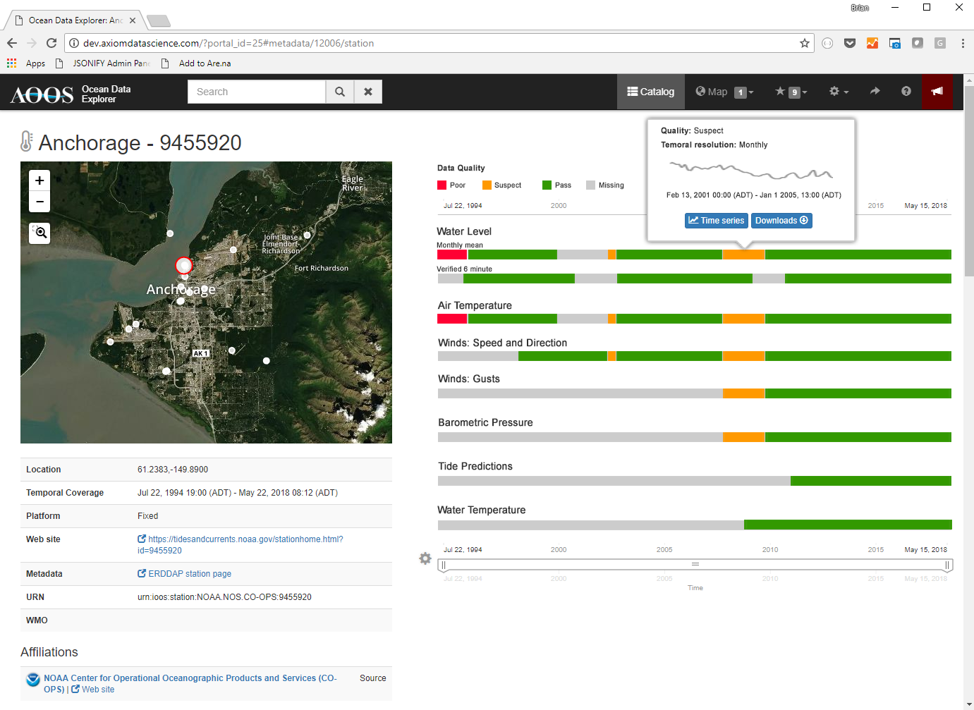
Water Level Watch Data Inventory Pages
Example of data inventory page, showing QARTOD quality data over a sensor’s lifespan
Notes:
Draft example of what data inventory pages may look like, showing QARTOD quality data over a sensors lifespan.

Slide 16
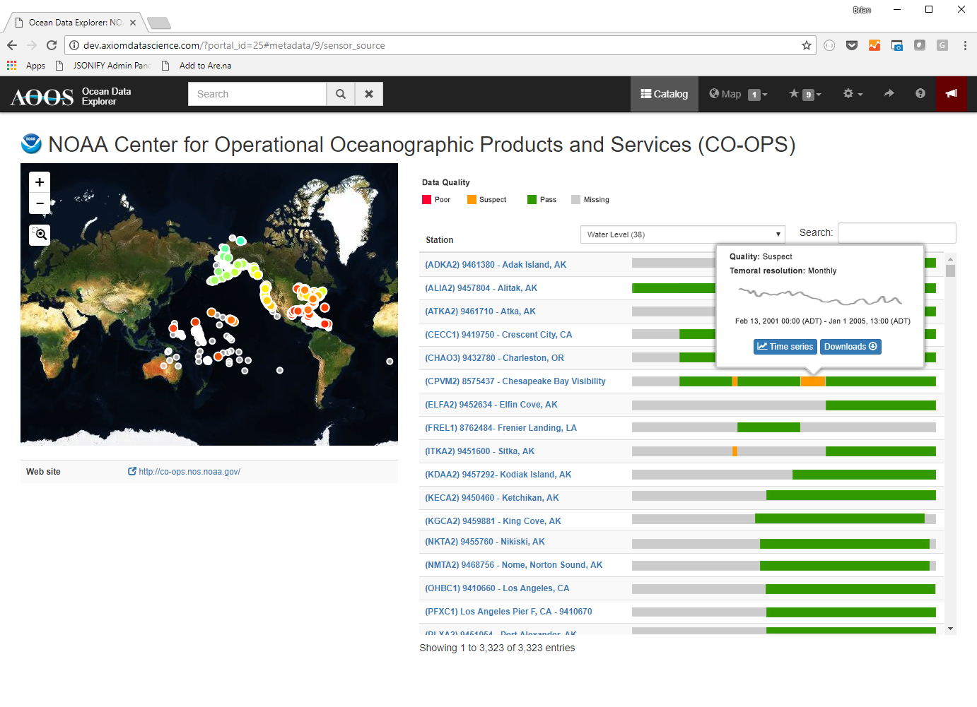
Data Source Inventory Page
Example of source inventory page, showing water level inventories (& qualities) for all stations from
1 source. This example uses CO-OPS source, but for Tier B&C data – will be very similar.
Notes:
Draft example of what a source inventory page will look like, showing water level inventories (and qualities) for all stations from one source. In this case, we're showing CO-OPS, but for Tier B and C data these inventory pages will be very useful to see data coverage and quality.

Slide 17
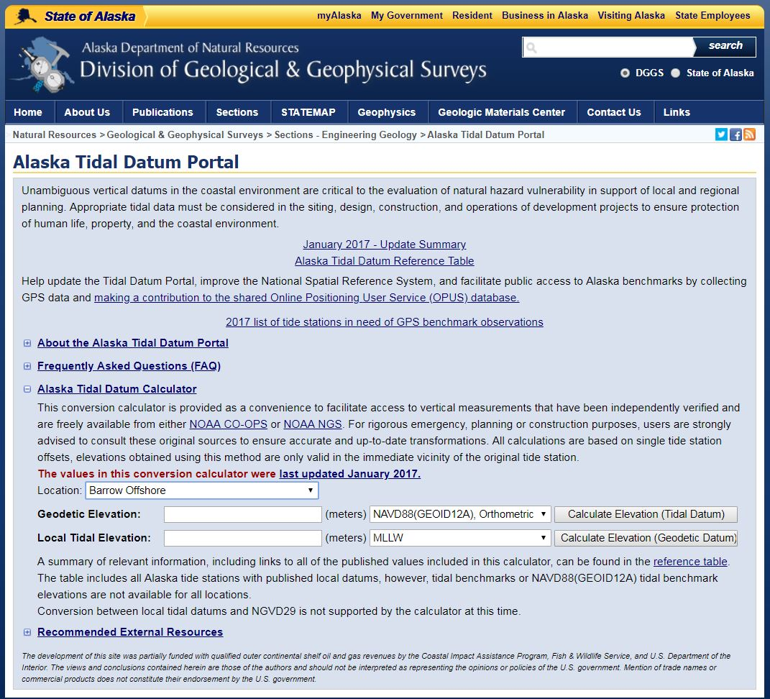
Tidal Datum Tools
Data portal would include
on-line products to fill gaps
in tidal data computations
& transformations
Notes:
Current tools that supplement NOAA CO-OPS functionalities to fit Alaska’s needs for water level products fill gaps in tidal datum computations and transformations, including the Alaska Tidal Datum Portal, which functions similar to VDATUM for single location conversions and the Online Tidal Datum Computation tool which allows users to compute tidal datums from water level time series. Links to these tools are listed on the Alaska water level watch page.

Slide 18
What we have so far
AOOS cyberinfrastructure
Lots of data
Serving mechanisms through ERDDAP, THREDDS, OPeNDAP, etc.
QARTOD for quality checks including gap tests
AOOS API calls already include Time Strata fields
Notes:
Serving mechanisms are the same as co-ops

Slide 19
Future actions to make this happen
Fund pilot implementation of both obs & data portal
Integrate & serve up data, especially historical data
Use for water level buildout planning & prioritization
Explore options for an Alaskan “PORTS-lite system”
Serve as model for other IOOS regions
Grow the partnership
Couple with mapping initiative
Notes:
Serving mechanisms are the same as co-ops

