Slide 1
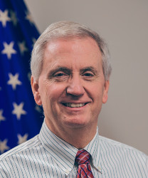
Rivers to Oceans: NWS Reliance on Alaska Water Level Observations
Carven Scott
Regional Director
National Weather Service (NWS) Alaska Region
Notes:
Introduction
This presentation will focus on highlights of NWS Alaska investment in and use of water level observations, with a discussion of coastal observation gaps and areas for model improvements.

Slide 2
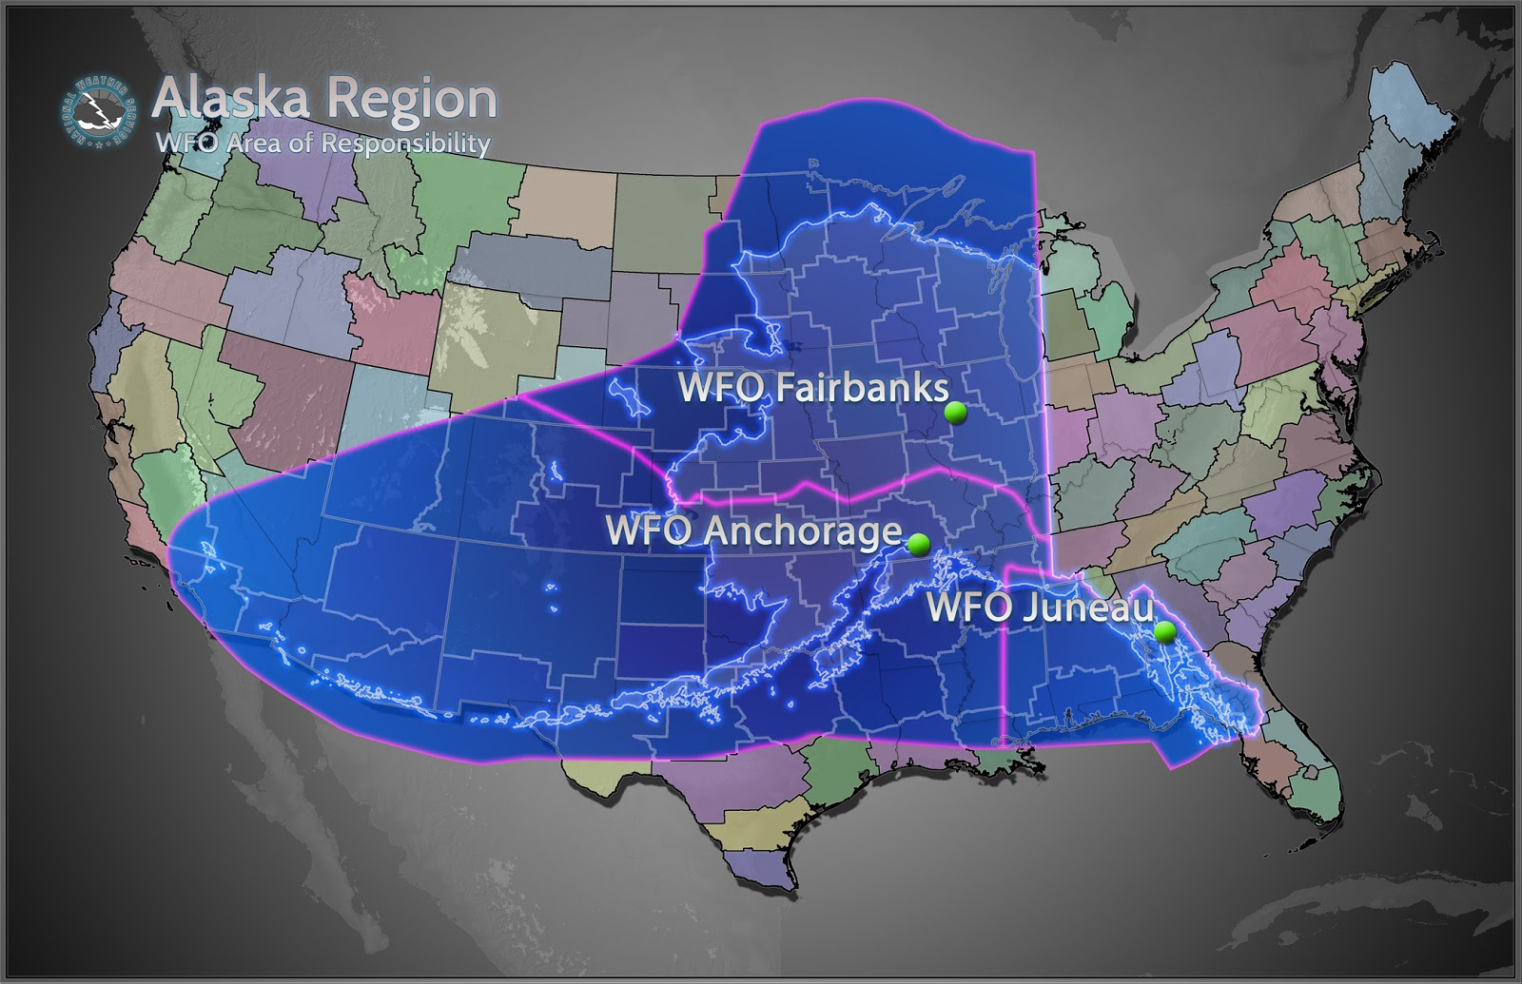
NWS Alaska Water Level Challenges
Alaska has over 35% of the nation’s coastline (33,904 statute miles)
Federal, state, and village officials have identified 31 villages that face imminent coastal flooding and erosion threats
Water level observations are extremely limited
Notes:
According to the NOAA Office for Coastal Management, Alaska has 33,904 statute miles of shoreline.
That compares with 95,439 statute miles of shoreline for the entire United States.
So Alaska makes up over 35% of the nation’s coastline.
At the same time Alaska has 31 villages that have been identified as facing imminent coastal flooding and erosion threats.
We have a mission at the NWS Alaska, to protect life, property for all of Alaska, including these most vulnerable communities.
Fall coastal storms, coastal flooding, and erosion have serious impacts to Alaskan communities.
The longer open water season in the fall is resulting in a longer storm season.
We have a vision to ensure Alaska Region communities and stakeholders are ready, responsive, and resilient to environmental impacts: protecting lives and property, enhancing commerce, and safeguarding the “Last Frontier”.

Slide 3
NWS Alaska Water Level Needs
NWS Alaska’s #1 Water Level Need: Good Tidal Datum along Alaska’s West Coast
Tidal Datum feed into NOAA coastal storm models
Image Source: Jaci Overbeck
Enhance NWS ability to provide coastal hazard warnings to vulnerable AK communities
Notes:
The Bering, Chukchi, and Beaufort Sea coasts severely lack tidal or buoy data.
We are incredibly grateful for the data available in Alaska, however it is very limited when compared with other coastlines of the US.
There are limited NOS tidal stations, and we are working with partners such as DGGS and AOOS to enhance our tidal and buoy data network where possible.
Our #1 Water Level need at NWS Alaska is good tidal datum along Alaska’s west coast.
This data feeds into NOAA coastal storm models and enhances NWS Alaska’s ability to provide coastal hazard support to vulnerable Alaska communities.

Slide 4
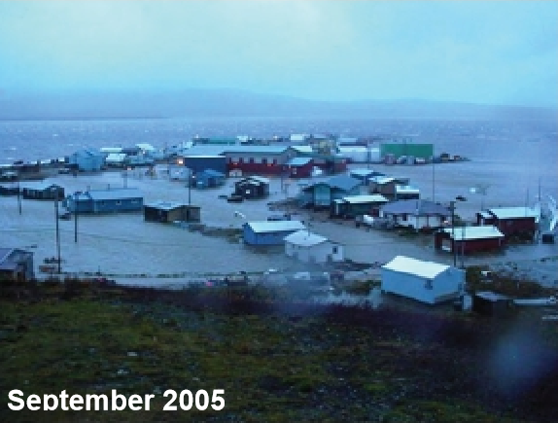
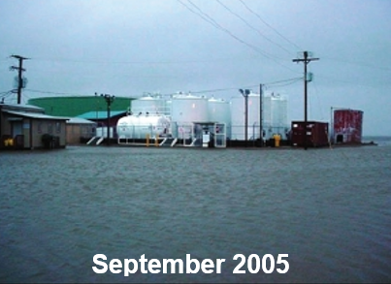
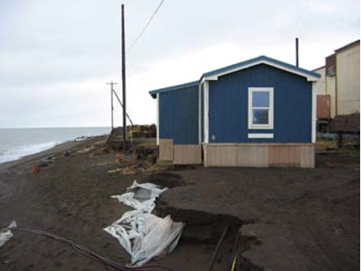
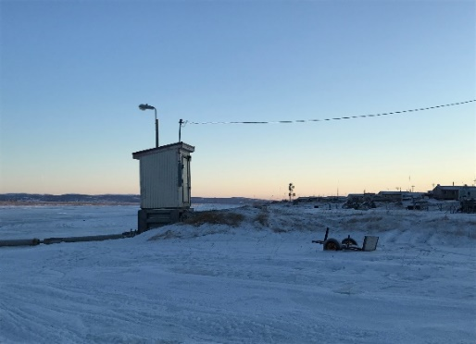
NWS Alaska Water Level Needs
Additional Needs:
Any additional tidal stations near vulnerable communities
Accuracy of tidal stations within a few inches
Community observations and impacts to be documented for future storms
Hazards
Impacts
Fuel tanks flooded or at risk from erosion
Coastal Flooding
Erosion
Fresh H2O supply compromised
Notes:
Additional needs for the NWS include additional tidal stations near vulnerable communities, noting that we realize it is not feasible to install NWLON stations everywhere we would like.
We can explore installation of iGauges or other 2nd tier level stations.
Even a simple calibrated tide staff in communities with trained observers to report can be of tremendous use to operational NWS staff when evaluating and warning for coastal flooding and erosion community threats.
The accuracy of these lower tier tidal observations can be within several inches to be of use to the NWS.
The more data we have the better guidance and forecasts we can produce to support our most vulnerable communities.

Slide 5
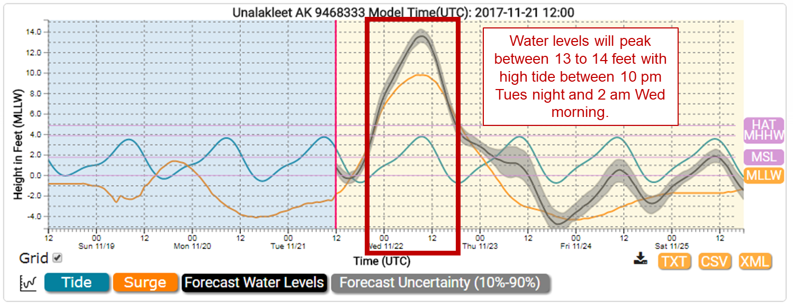
Example from Unalakleet, AK – Nov 2017
Notes:
This is an example of how NWS Alaska offices utilize NOAA water level models during an actual storm event.
Here we are looking at NOAA ETSS model output data for a storm near Unalakleet, AK during November of 2017.
Water levels were forecast to peak between 13 and 14 feet during this event, and the NWS office issued a coastal flood warning.

Slide 6
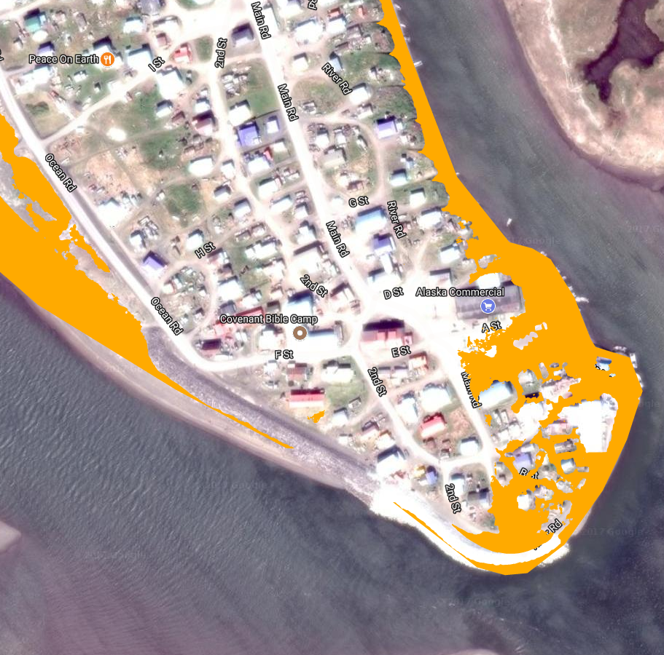
Example from Unalakleet, AK – Nov 2017
Orange is the possible area of inundation with water levels 13-14 feet.
Notes:
NWS Weather Forecast Offices utilize color-indexed elevation maps for flood-vulnerable coastal communities in Alaska produced by the State of Alaska DGGS in cooperation with AOOS and NWS Alaska to interpret what areas of vulnerable communities may see inundation based on NOAA water level models.
In addition, the offices rely on monitoring coastal tide gauge data in real time during events and post events to monitor whether the forecast is on track or over/under forecast to make adjustments. The data also provide model verification post-event.

Slide 7
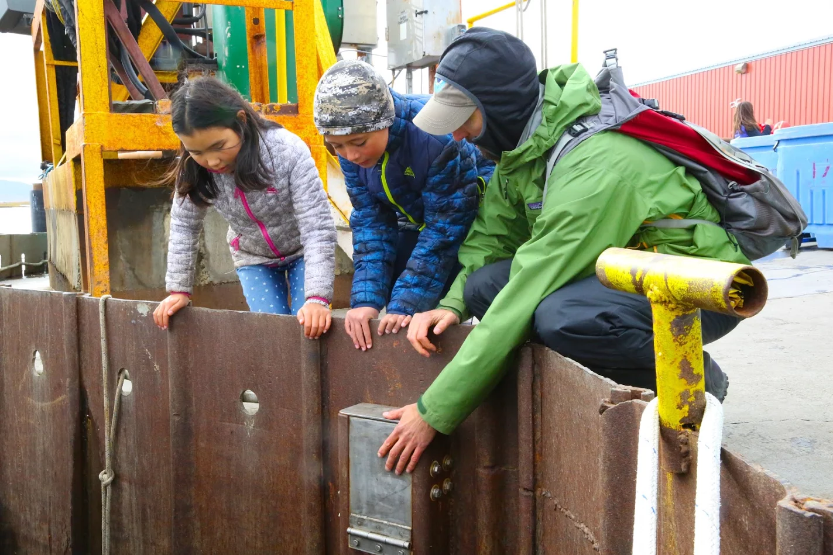
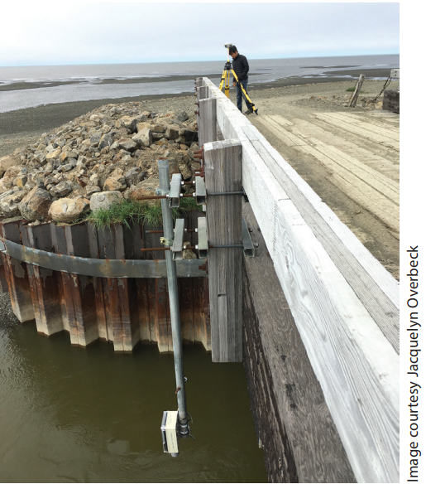
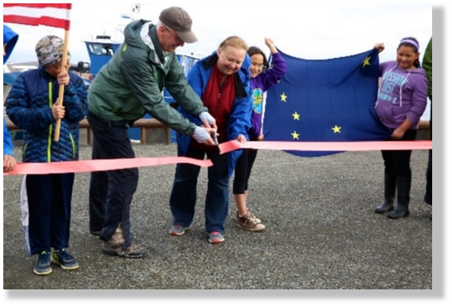
NWS Alaska Investment in Water Level Observations
Ed Plumb (Fairbanks WCM) showing the new NWLON gage to children in Unalakleet
NWS Regional Director at the Unalakleet tide gauge ribbon cutting ceremony
iGage re-installation at Tununak by NWS forecaster Jason Ahsenmacher
Notes:
To help us address these challenges and close the observational gaps, we are partnering with AOOS, IRIS, UAF, and others to expand observations across the state.
As an example, we are working with AOOS and NOS and have deployed a new National Water Level Observation Network (NWLON) sensor in Unalakleet, which you will see on the map in the top left. As part of a ribbon-cutting ceremony I attended in September for the NWLON, our Fairbanks Warning Coordination Meteorologist, Ed Plumb, is showing the gage to some of the children in the community.
With support from AOOS, the Alaska Department of Natural Resources (AKDNR) and our NWS River Forecast Center, we are deploying cost-effective gages as an alternative to the NWLONs. These are battery and solar powered, making them suitable for remote locations, easy to deploy, and produce real-time data useful for timely and accurate forecasts and warnings. The picture in the top right is a re-installation at Tununak.
Other emerging technologies we are exploring include real-time water level observing using GPS reflectrometry in collaboration with ASTRA and UNAVCO, moored Beaufort sea-wave and bottom-pressure observations, ice freeze-up detection buoys, rapid-deployment inundation platforms and storm-surge gages, tide staffs, tsunami gages, and others.
One new observational opportunity that has occurred within Alaska in the NSF-funded USArray network. While primarily a network of seismic sensors, these stations are being outfitted with meteorological sensors, supported in part by not only NWS but also NASA and other organizations. The network is fully deployed now until summer 2019, at which time NSF will begin to decommission the network. This would be an opportunity lost, in my opinion, and I continue to work with Sandy Starkweather, Executive Director, US AON, and Martin Jeffries, White House Arctic Executive Steering Committee, to identify an interagency process that will enable many of these stations to remain for the long term.

