Slide 1
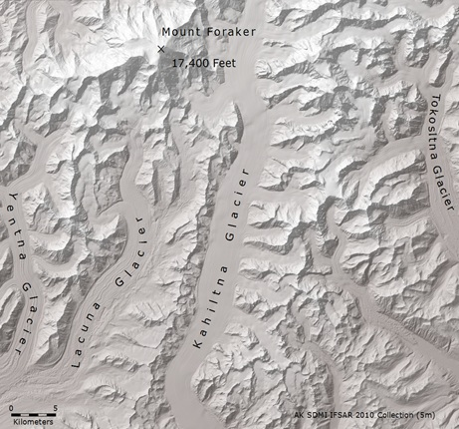
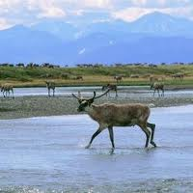
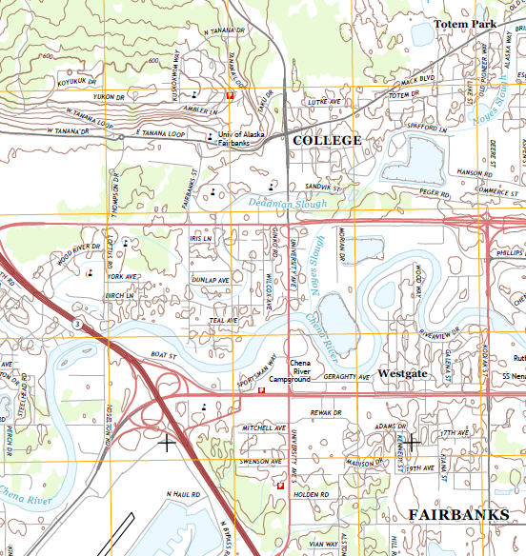
Summary of Alaska Mapping Executive Committee (AMEC) to HSRP – Juneau, AK
August 29, 2018

Slide 2
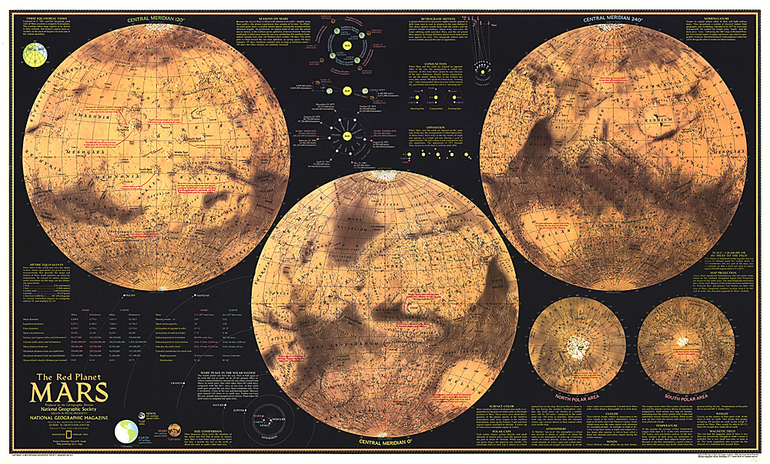
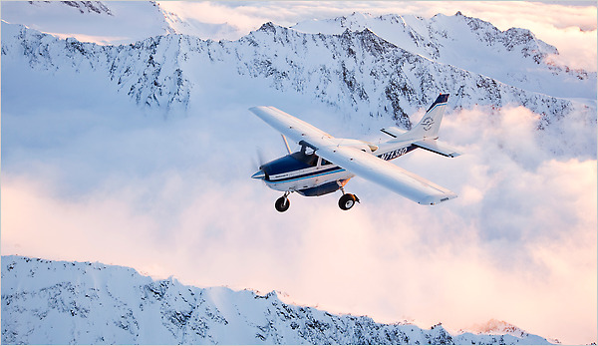
Alaska Mapping Background
What was Alaska Mapping Status in 2008?
60m elevation grid created primarily in 1960’s.
1:63,360-scale statewide topographic map coverage (one inch to the mile); created primarily1950s to 1980s.
Proponents for updated Alaska mapping were announcing “Mars is better mapped than Alaska”.
State suggested that Alaska aviators were at risk due to inaccurate elevation data used in flight systems.

Slide 3
Alaska Statewide Digital Mapping Initiative
Alaska SDMI sponsored the 2008/2009 Alaska elevation study, which identified requirements for a statewide dataset.
Radar technology was recommended as the solution that would meet the broadest set of needs at the optimal cost.
SDMI also sponsored a Statewide orthoimagery acquisition for Alaska still in use today.
The State of Alaska continues to guide the State’s geospatial efforts through the Alaska Geospatial Council (AGC).

Slide 4
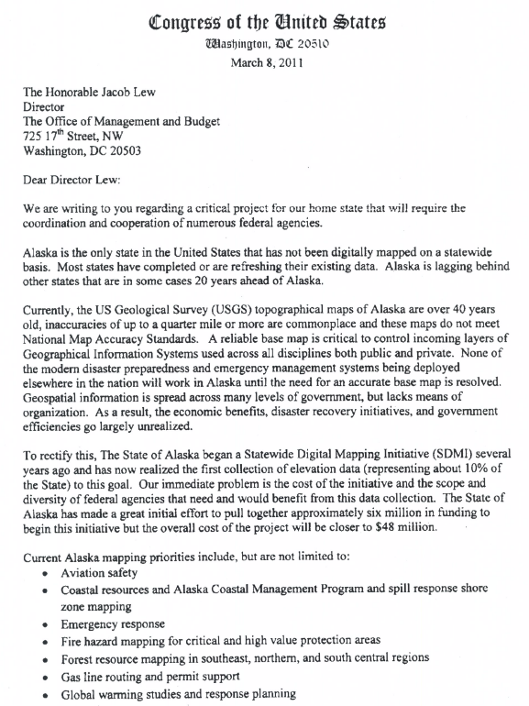
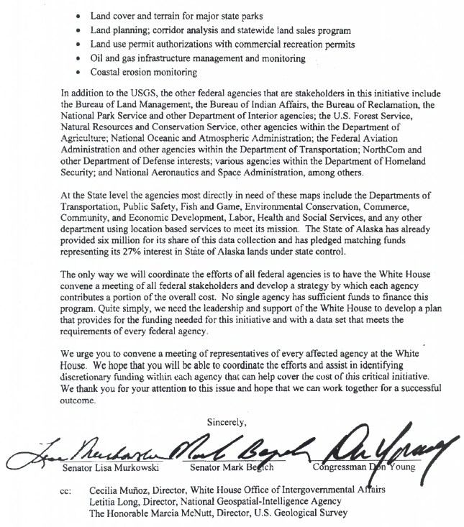
Alaska Delegation Mapping Support Request
The Alaska Congressional Delegation sent a letter to OMB on March 8, 2011, requesting federal support to improve Alaska mapping to standards enjoyed by the conterminous US.
An Alaska Mapping Roundtable was convened by DOI in June, 2012, to review priority mapping requirements.
21 Federal agencies, multiple Departments, and the State of Alaska were represented.
The need to coordinate and accelerate Federal and State mapping efforts in Alaska was acknowledged.

Slide 5
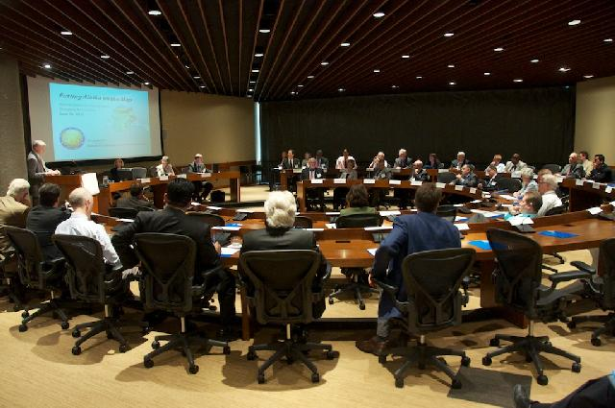
AMEC History and Purpose
The Alaska Mapping Executive Committee (AMEC) was formed as an outcome of the Roundtable.
AMEC held its first meeting in November, 2012.
AMEC meets twice annually to coordinate mapping priorities.
AMEC raises awareness, coordinates collaboration opportunities, and explores joint funding avenues.

Slide 6
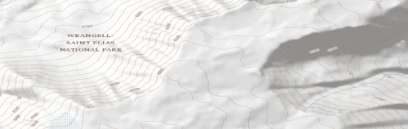
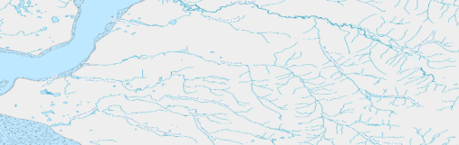
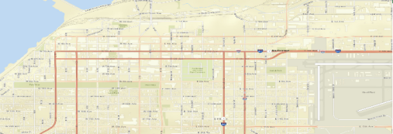
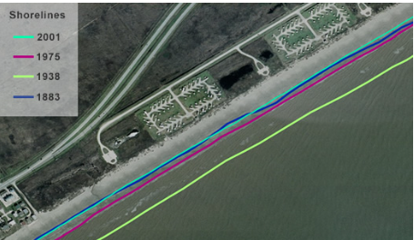
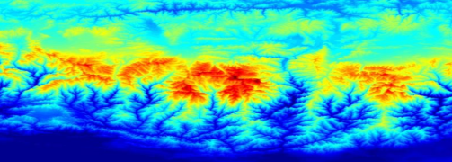
AMEC-Approved Statewide Mapping Objectives
AMEC approved five initial statewide mapping objectives.
Additional objectives can be added at the pleasure of the Committee.
AMEC monitors progress of each approved mapping objective.
No funding commitment is implied by AMEC membership.
Agencies fund only those activities that meet their own mission goals, and fund only at their own discretion.
Agencies that can’t fund specific mapping tasks add value through active AMEC participation and promoting the requirements.
5 Approved Mapping Themes
Elevation:
- USGS lead
- Topographic base
Hydrography:
- USGS lead
- Surface water
Transportation:
- State of AK DOT lead
- Roads and trails
Shoreline:
- NOAA lead
- Refined delineation
GRAV-D:
NOAA lead
Refined vertical datum

Slide 7
Data Acquisition Accomplishments
Theme | Metric | Lead Agency | August 2018 Status
Elevation | % IFSAR acquired | USGS | 98% statewide coverage achieved
Hydrography | % NHD (surface water) updated | USGS | 20% updated
Transportation | % of State completed and publicly available | AK DOT | 100% complete; ongoing maintenance
GRAV-D | % GRAV-D acquired | NOAA | 78.4%
Coastal Mapping | % AK shoreline updated | NOAA | 48.5%

Slide 8
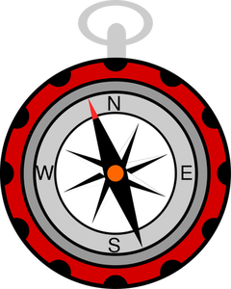
AMEC Updated Charter
Updated Charter approved March 30, 2018.
Document will guide AMEC’s five-year general direction to reach priority objectives.
Charter language expanded to explore mapping requirements and opportunities beyond the initial topographic focus:
  imagery update
  coastal zone mapping
  bathymetric mapping
  targeted lidar acquisitions
  enhanced terrestrial hydrography
  geologic mapping
  geophysical surveys
  land classification

Slide 9
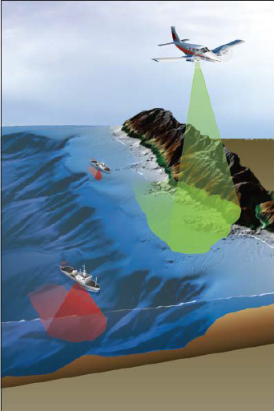
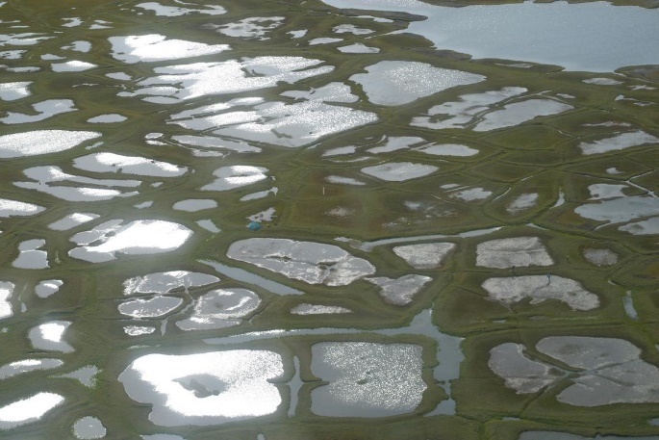
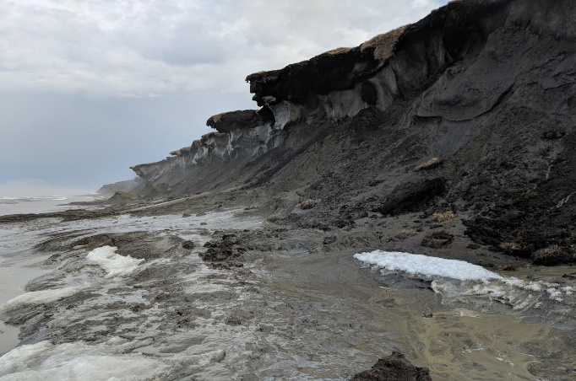
Potential AMEC and HSRP Common Interests
Ongoing 3DNation Survey – An analysis of elevation requirements that will guide future data collections.
AMEC and HSRP enhanced mapping products will support coastal understanding critical to Alaska and the Nation (adapted from various sources): Native Alaskan village relocation, shoreline erosion, hazardous storm and tsunami impacts, invasive species, toxic spill preparation, resource management, wildlife habitat modification, Arctic shipping and ports, coastal impact of sea ice change.
Ongoing topographic/bathymetric lidar acquisition research will support future inland waterway and nearshore mapping.
Current 3DEP lidar acquisition program is supporting several coastal mapping projects.
Graphic from Dewberry
Alaska Coast Seafloor - USGS
Eroding Coast Permafrost - USGS

