Slide 1
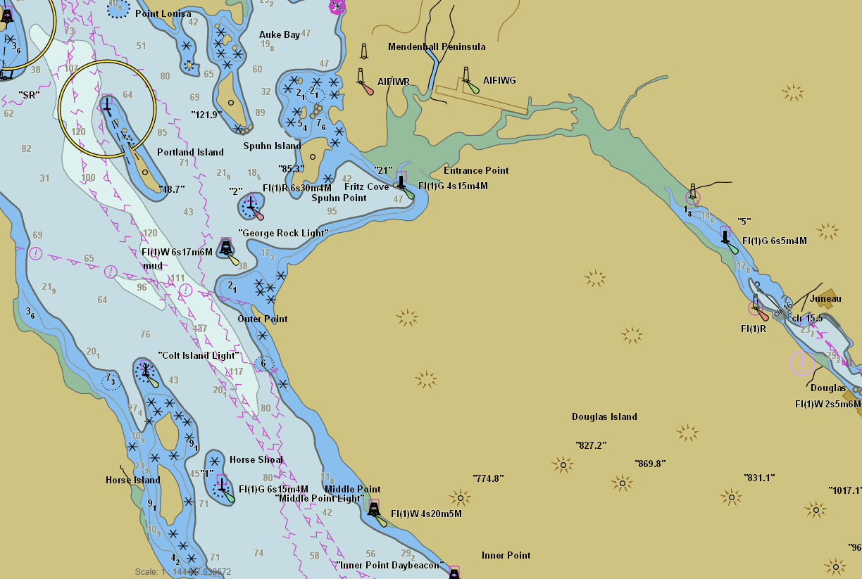
Office of Coast Survey
Rear Admiral Shepard Smith
August XX, 2018

Slide 2
Outline
Stakeholder engagement in Alaska
Data gaps
Sources of bathymetric data
Crowdsourced bathymetry
Satellite-derived bathymetry
Coast Survey updates provided this week

Slide 3
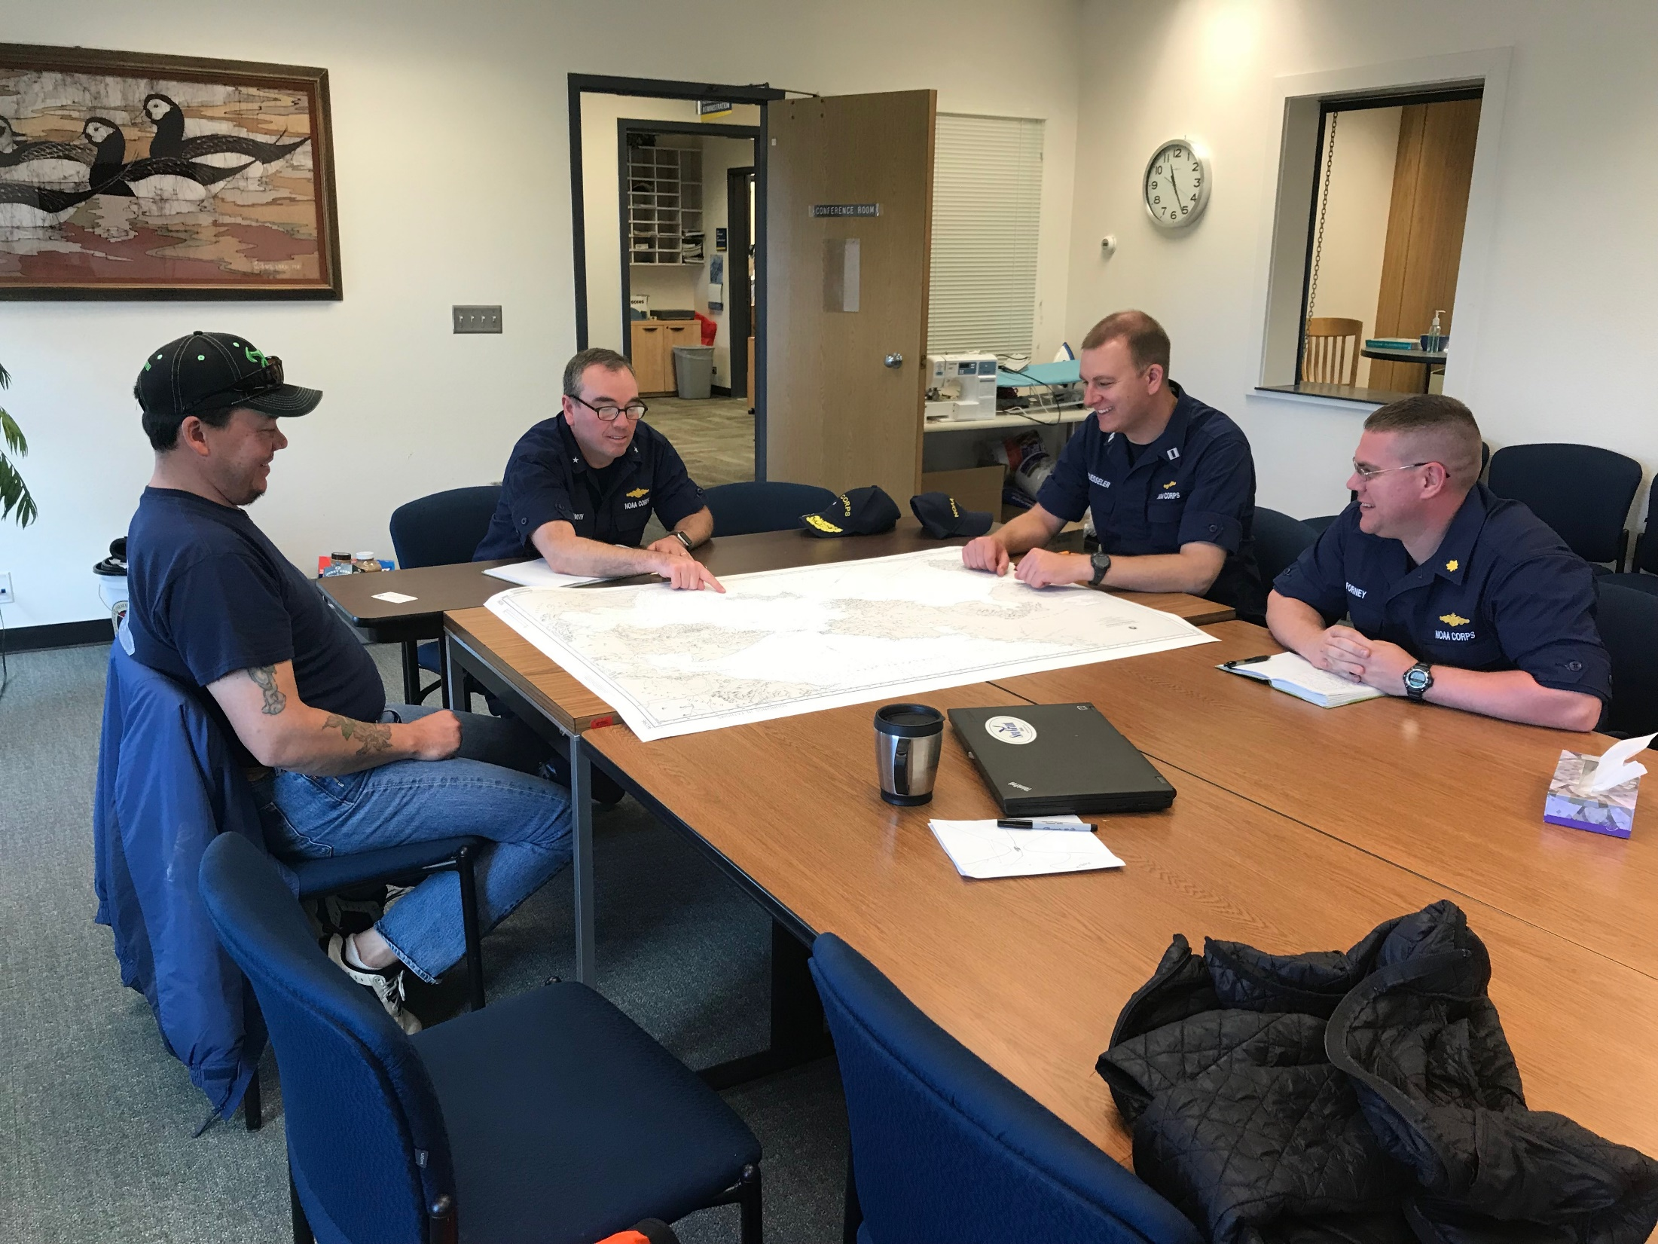
Recent Stakeholder Engagement
Kawerak Subsistence Director
Port of Nome, City of Nome
Port of Alaska
National Park Service
Brice Marine
Terrasond
Alaska Ocean Observing System
Axiom Data Science on AIS Project
Southwest Alaska Pilot Association
Fugro
BOEM
Office of Senator Lisa Murkowski Staff
Vitus Marine
Governor Walker Staff
USCG D17
Celebrity Solstice

Slide 4
Status of Surveys in Alaska
Notes:
As ice diminishment opens up new routes, maritime traffic begins to pick up, and it is evident that despite some exploration and research to date, even the most basic oceanic data are lacking. We all have to pause and imagine how the maritime community would deal with a major accident or seismic event in the U.S. Arctic.
Because the region has been relatively inaccessible, without widespread need for such information, the Arctic is deficient in many of the hydrographic services capabilities that NOAA provides to the rest of the nation.
The region currently has virtually no geospatial infrastructure for accurate positioning and elevations; it has sparse tide, current and water level prediction coverage; it has obsolete shoreline and hydrographic data in most areas; and it has poor nautical charts. We are working with current resources to fill in the blanks.

Slide 5
Status of Surveys in Alaska

Slide 6
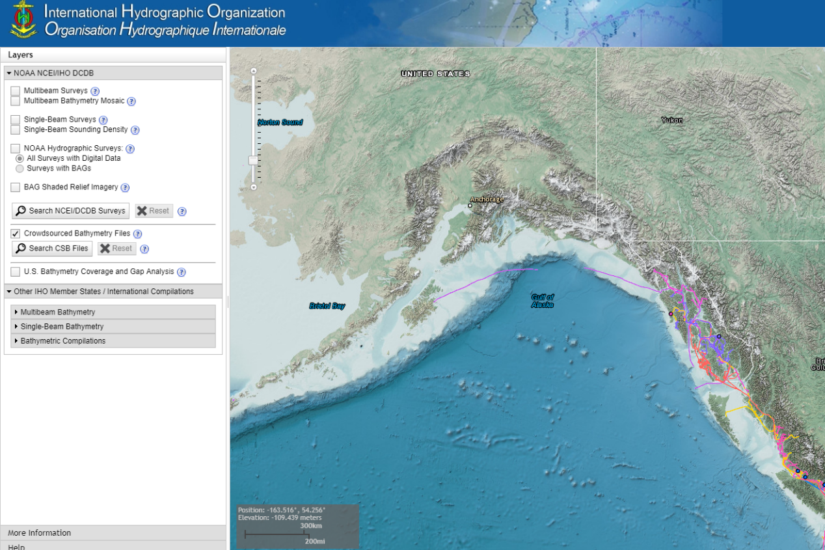
Crowdsourced Bathymetry
Notes:
Crowdsourced Bathymetry via Rose Point Coastal Explorer
As of May 2016, Rose Point’s Coastal Explorer software provides the option for users to contribute Crowdsourced Bathymetry (CSB) to NOAA. This data is shared to a public database, which can be used by NOAA to evaluate the adequacy and accuracy of nautical charts where data is available. As a public database, this data is also available to the private sector for the creation of derivative products and services to the maritime community.
Coastal Explorer comes pre-configured to easily record and submit CSB if so desired by the user. While the feature is turned off by default, it is easy for the user to enable.
In May, NOAA announced the end of a testing phase in the development of a new crowdsourced bathymetry database. Bathymetric observations and measurements from participants in citizen science and crowdsourced programs are now archived and made available to the public through the International Hydrographic Organization (IHO) Data Centre for Digital Bathymetry (DCDB) Data Viewer. The operationalized database allows free access to millions of ocean depth data points, and serves as a powerful source of information to improve navigational products.
Encourage boaters to participate

Slide 7
Using new technologies for data
Notes:
Purpose of Slide: Demonstrate the use of other data sources beyond traditional hydrographic surveys to aid in decision-making and bathymetric data collection
We are using unprecedented data sources, like AIS and satellite-derived bathymetry, for Alaska’s charts.
Image left – AIS data
Image right – Bechevin Bay, AK

Slide 8
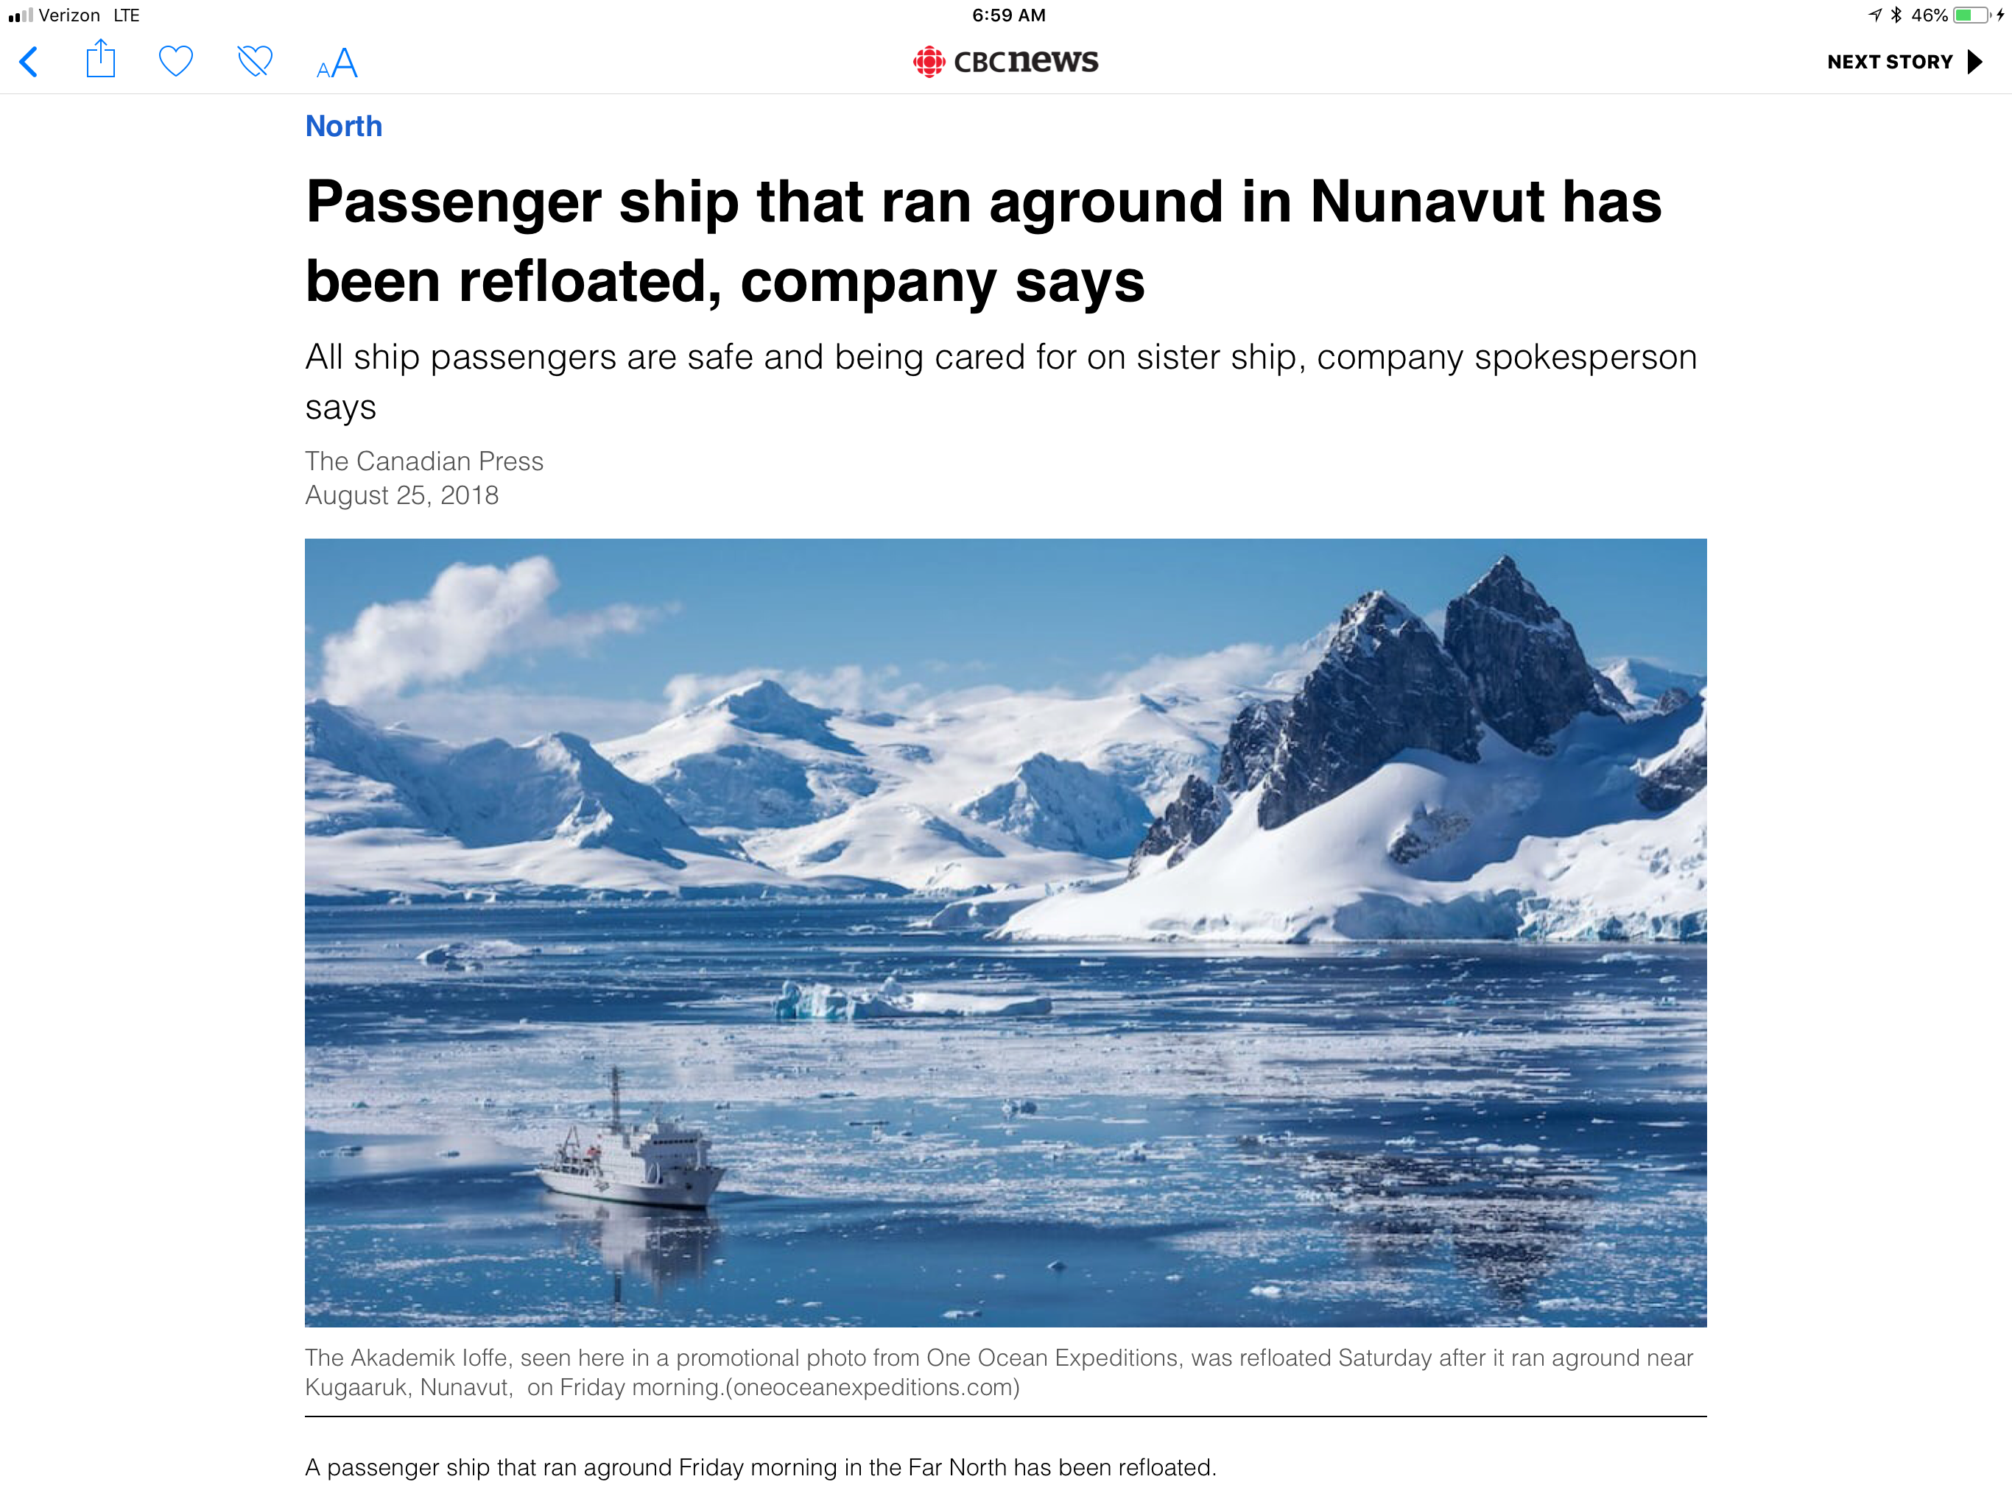
Arctic Navigation in the News
Notes:
Purpose of Slide: Demonstrate the use of other data sources beyond traditional hydrographic surveys to aid in decision-making and bathymetric data collection
We are using unprecedented data sources, like AIS and satellite-derived bathymetry, for Alaska’s charts.
Image left – AIS data
Image right – Bechevin Bay, AK

Slide 9
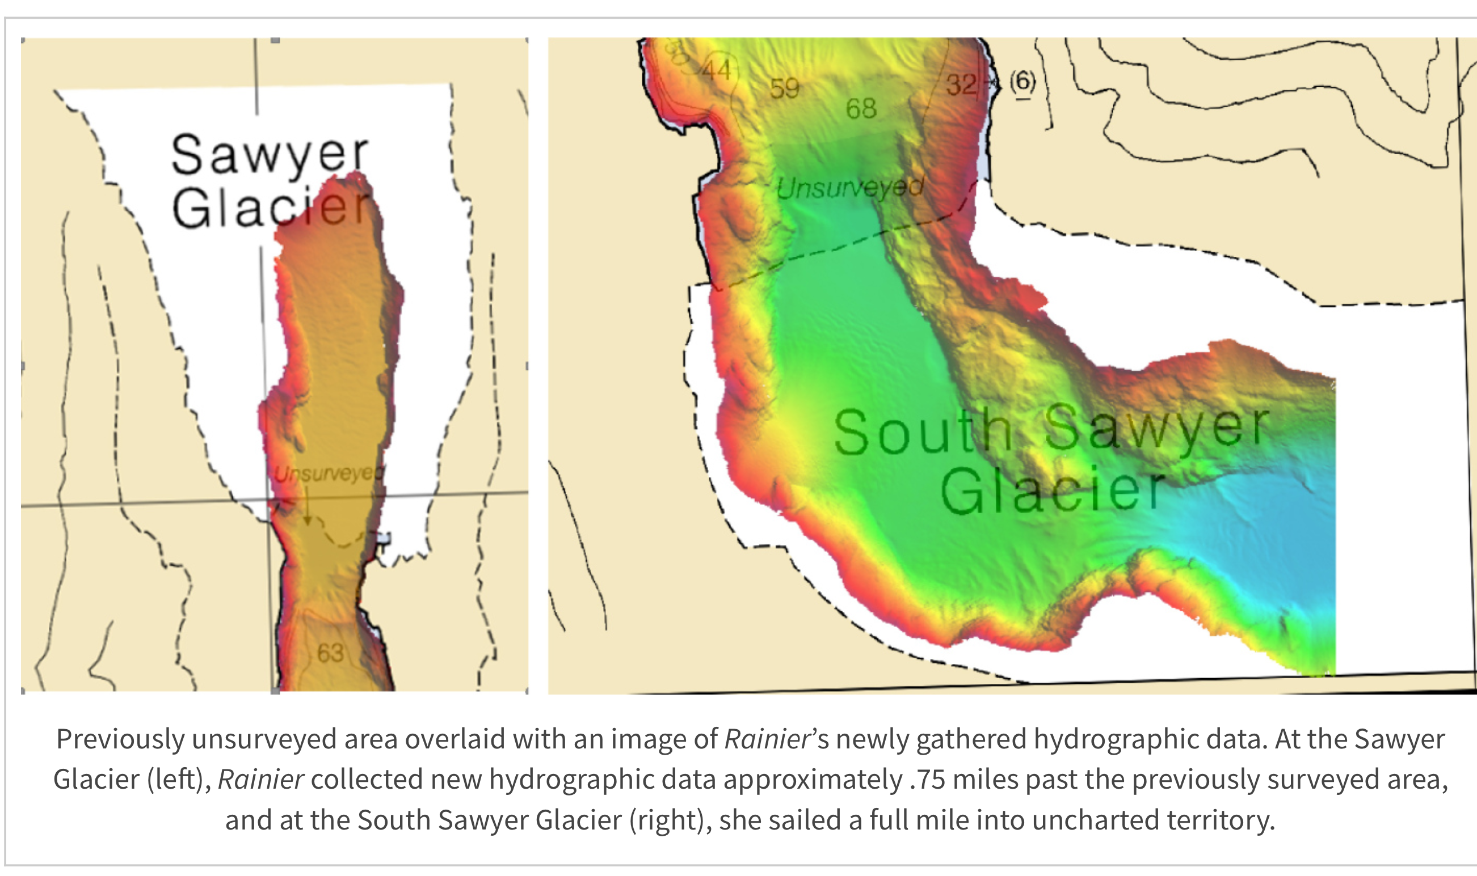
Glacier Face Surveys
Notes:
Purpose of Slide: Demonstrate the use of other data sources beyond traditional hydrographic surveys to aid in decision-making and bathymetric data collection
We are using unprecedented data sources, like AIS and satellite-derived bathymetry, for Alaska’s charts.
Image left – AIS data
Image right – Bechevin Bay, AK

Slide 10
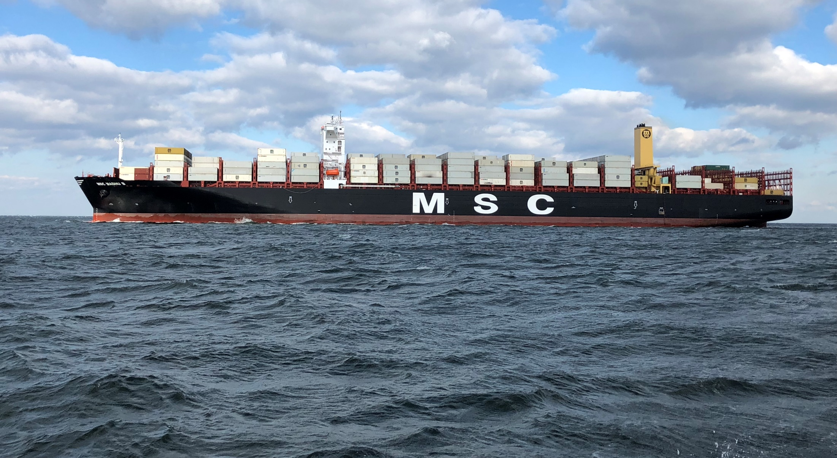
USACE Channels Update
Notes:
Purpose of Slide:

Slide 11
Coast Survey presentations this week…
Afternoon of Thursday, August 30
OCS Ocean Mapping Plan
Capt. Rick Brennan, chief Hydrographic Surveys Division
Precision Navigation
Capt. Liz Kretovic, OCS deputy hydrographer
Autonomous Systems
Neeraj Saraf, chief Coast Survey Development Lab
Alaska and National Charting Plan Rescheming
Colby Harmon, Marine Chart Division
3D National Elevation Requirements and Benefits Study
Ashley Chappell, IOCM coordinator
Notes:
Purpose of Slide:

Slide 12
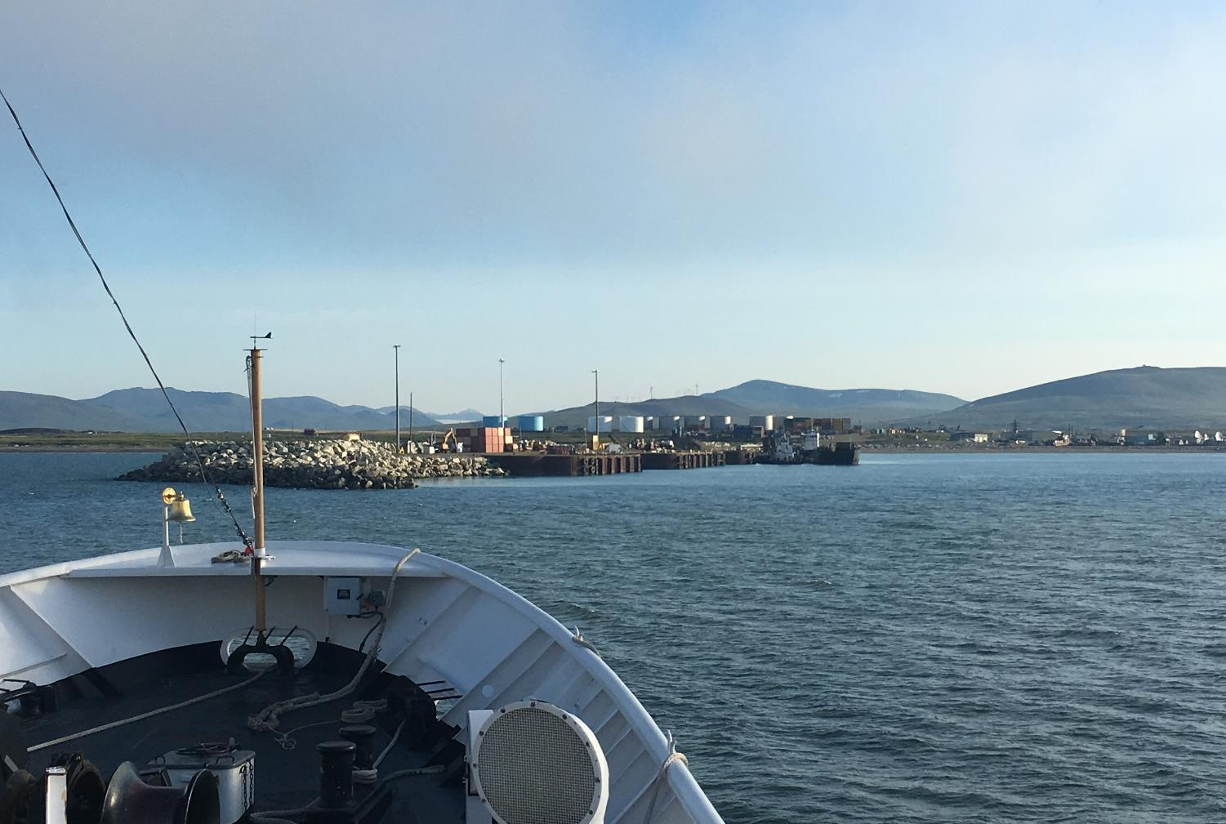
Questions?
nauticalcharts.noaa.gov
@NOAAcharts
NOAAcharts

