Slide 1
Modernizing Geodetic Control at National Water Level Observation Network (NWLON) Stations
Richard Edwing, Director
Center for Operational Oceanographic Products and Services (CO-OPS)
2018 Hydrographic Services Review Panel meeting
April 2018
Miami, FL

Slide 2
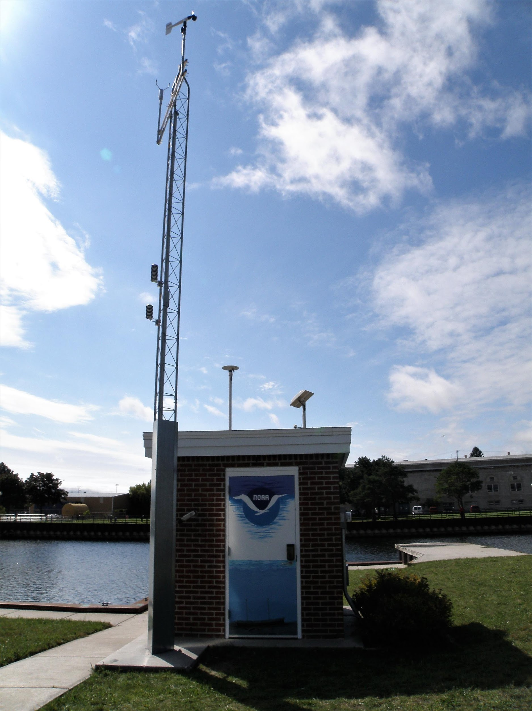
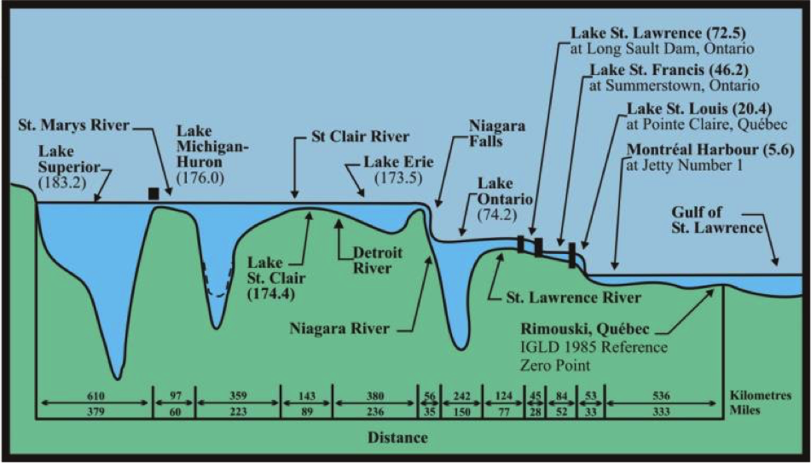
National Water Level Observation Network (NWLON)
210 Long Term Stations
National Tidal Datum Epoch (1983-2001)
International Great Lake Datum (1985)

Slide 3
Vertical Control
Vertical (geodetic) control provides the critical ability to:
Establish and maintain water level datums by:
documenting the stability of the water level sensor, and
transfering and preserving water level data/datums through a local network of bench marks.
→ Ensure consistently referenced, continous data series
Connect water level stations to the National Spatial Reference System to put station datums into a common reference frame. Water level datums are local and have a discrete span of control.
Monitor land motion to determine absolute sea level rise at a NWLON location.

Slide 4
Present capability
Leveling surveys determine relationships
between benchmarks and water level sensors
Once leveled, you can transform between tidal and geodetic datums.
Tidal Bench mark
4811 G 2004
3.550 m
Tide
Gauge
Pier
TBM
NOAA
2.736 m
Tidal Bench mark
4811 G 2004
MHW
Geodetic Benchmark
2.000 m
Bench mark with geodetic control (NAVD88,etc.)
1.350m
MLLW
1.220 m
NAVD88
Steel tape measured distance from a
”TBM” to elevation of sensor “0”
Pressure Sensor “0”
Station Datum
0.7428 m

Slide 5
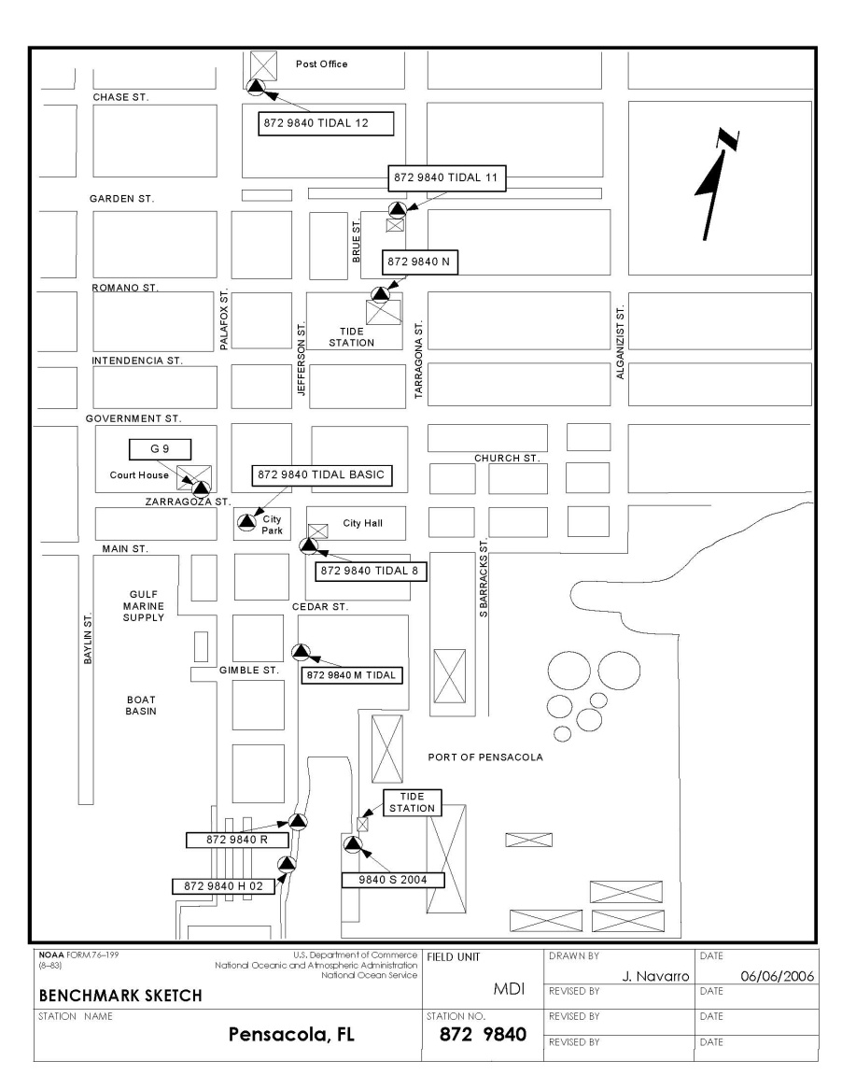
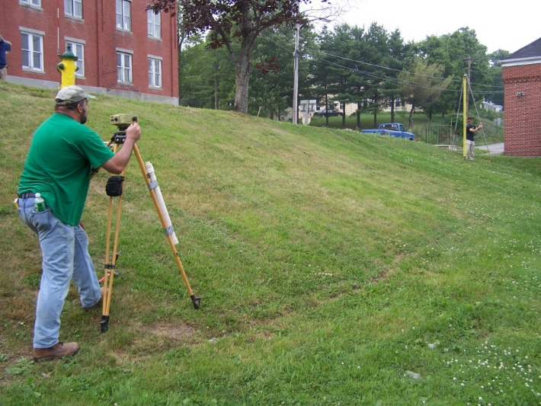
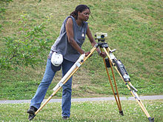
Differential Leveling Surveys
at NWLON Benchmarks for Local Vertical Control
NGS Accuracy Standards Default
2nd Order, Class I for long-term stations
3rd Order for short-term stations
Electronic Digital Barcode Leveling Equipment standard
Scheduled maintenance leveling for NWLON; installation and removal levels for short-term stations
Unplanned leveling for storm events
Primary Bench Mark
and GPS Mark
Tide Station

Slide 6
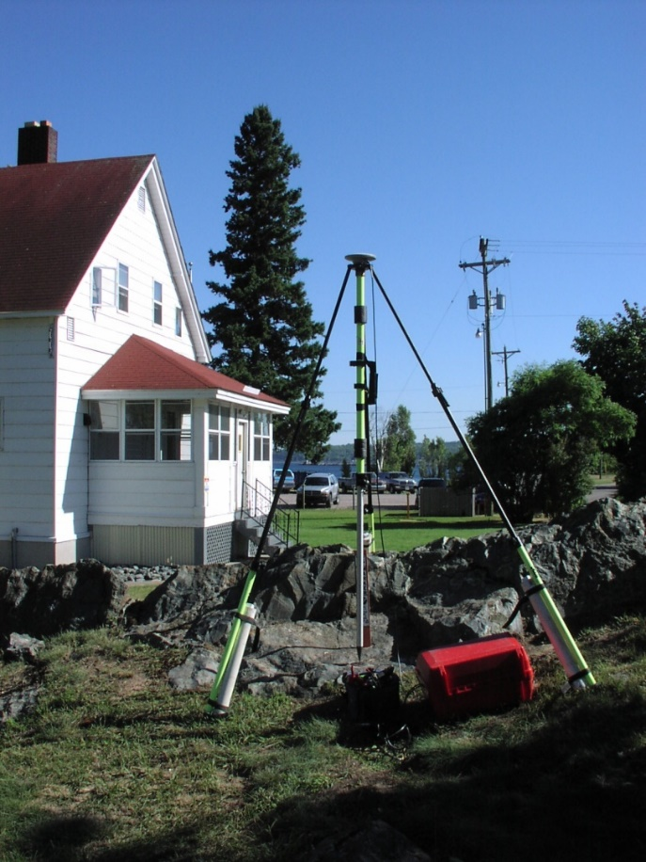
Static Global Positioning System (GPS) Observations at NWLON Benchmarks
GPS replaced line of sight connections to NGS First Order bench mark networks used to achieve NSRS connections
Each station has a designated GPS mark - observations done annually or every five years depending on sea level rate of change
Documentation and data submitted to NGS
Track and compare solutions over time

Slide 7
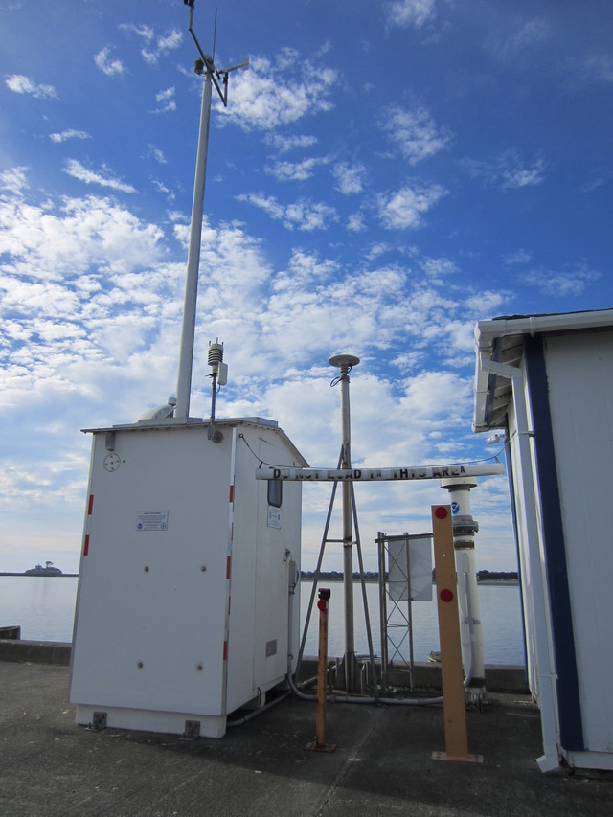
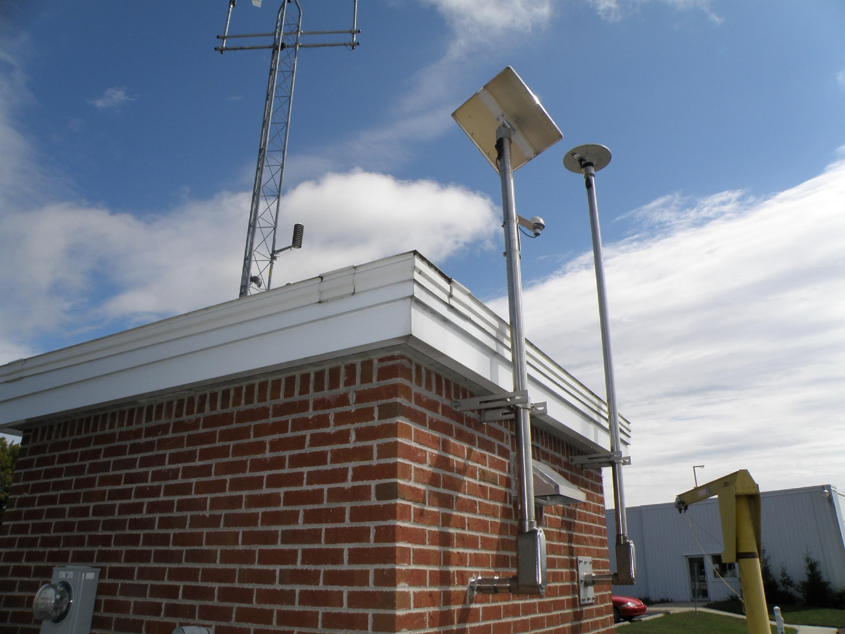
Land Motion through NWLON/CORS Collocation
Global Sea Level Observing System Group (GLOSS) requirement*
Risk reduction requirement for other NWLON stations
Crescent City, CA
Alpena, MI
*UNESCO\IOC Manual on Sea Level Measurement and Interpretation, Vol IV (2006) & Vol V (2016)

Slide 8
CO-OPS Global Navigation Satellite System (GNSS) Vision
Leverage evolving GNSS technology to:
Continuously monitor water level sensor stability and realize potential efficiencies in bench mark maintenance protocols
Strengthen station datum connections to NSRS (ellipsoid)
Improve ability to determine land motion.
Future: Use as potential water level sensor

Slide 9
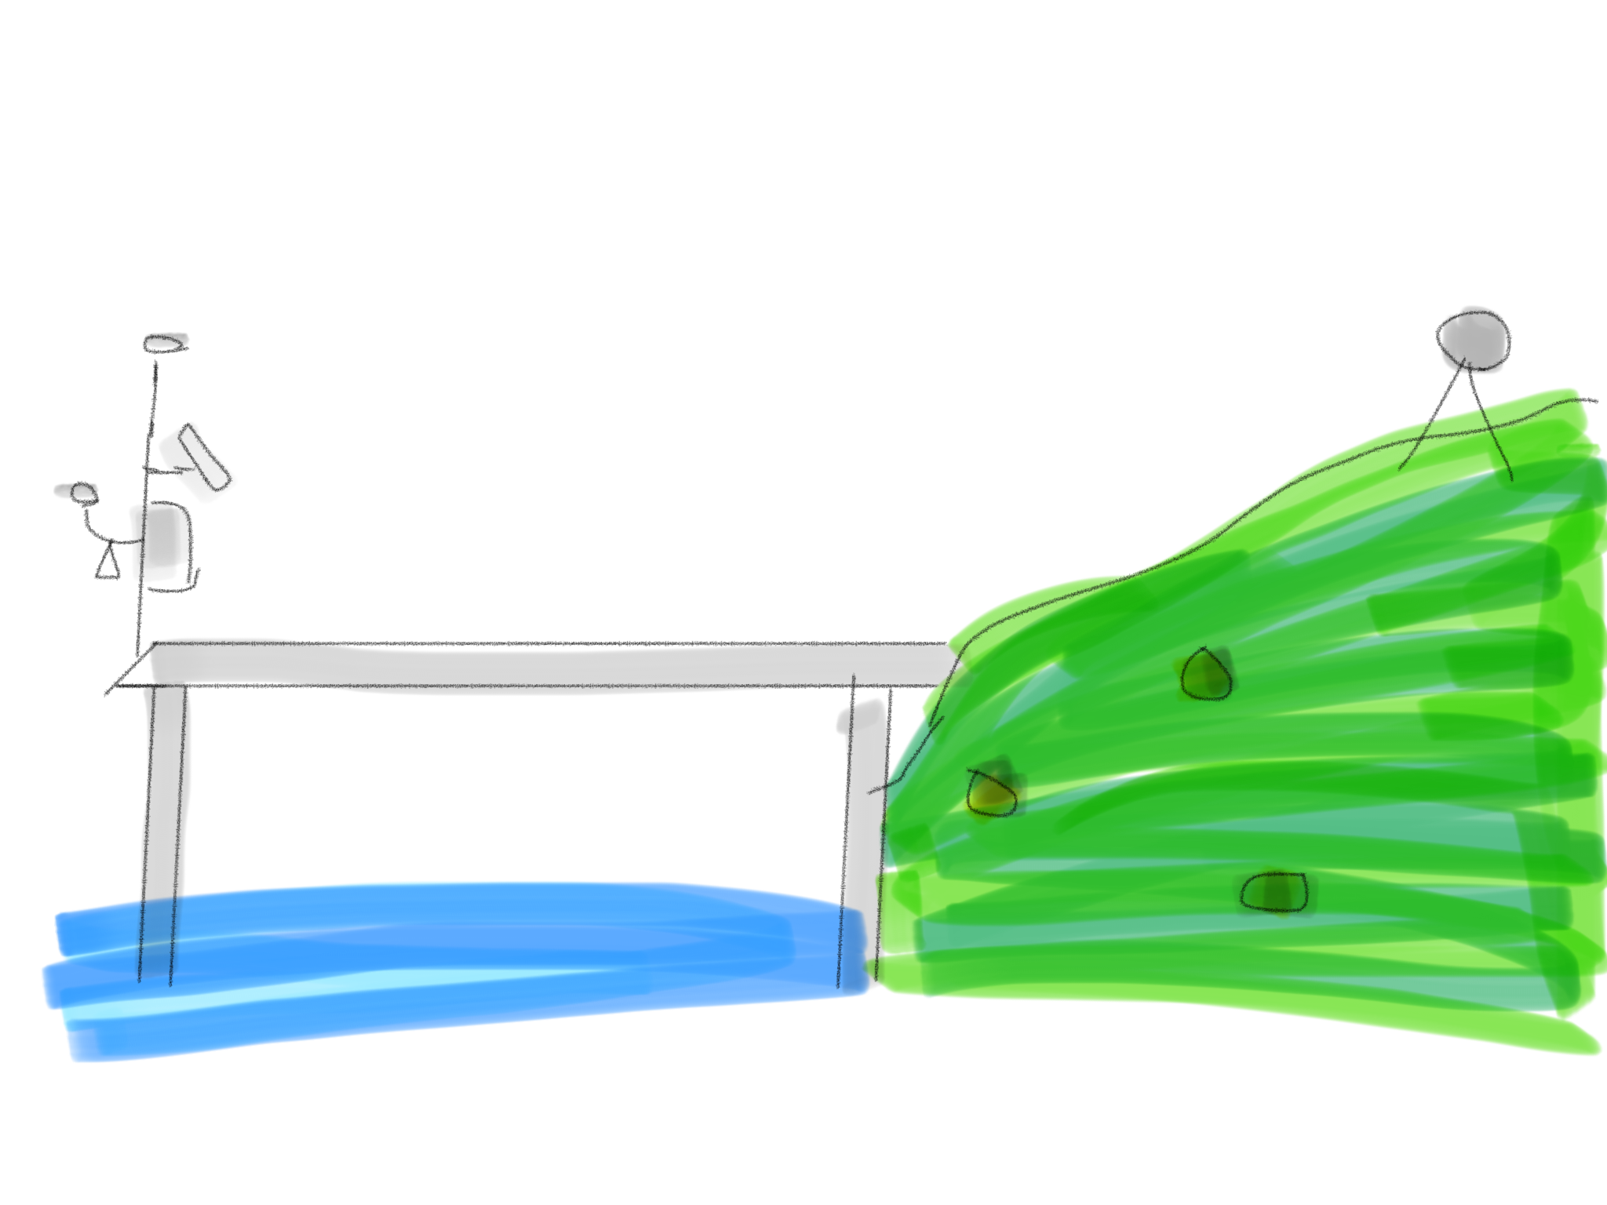
GNSS-Based Future
GNSS antenna on the sensor
or
GNSS near sensor on same platform w/ known offset
Use to continuously monitor sensor stability
NWLON station
cGNSS (CORS)
cGNSS antenna
BM
BM
BM

Slide 10
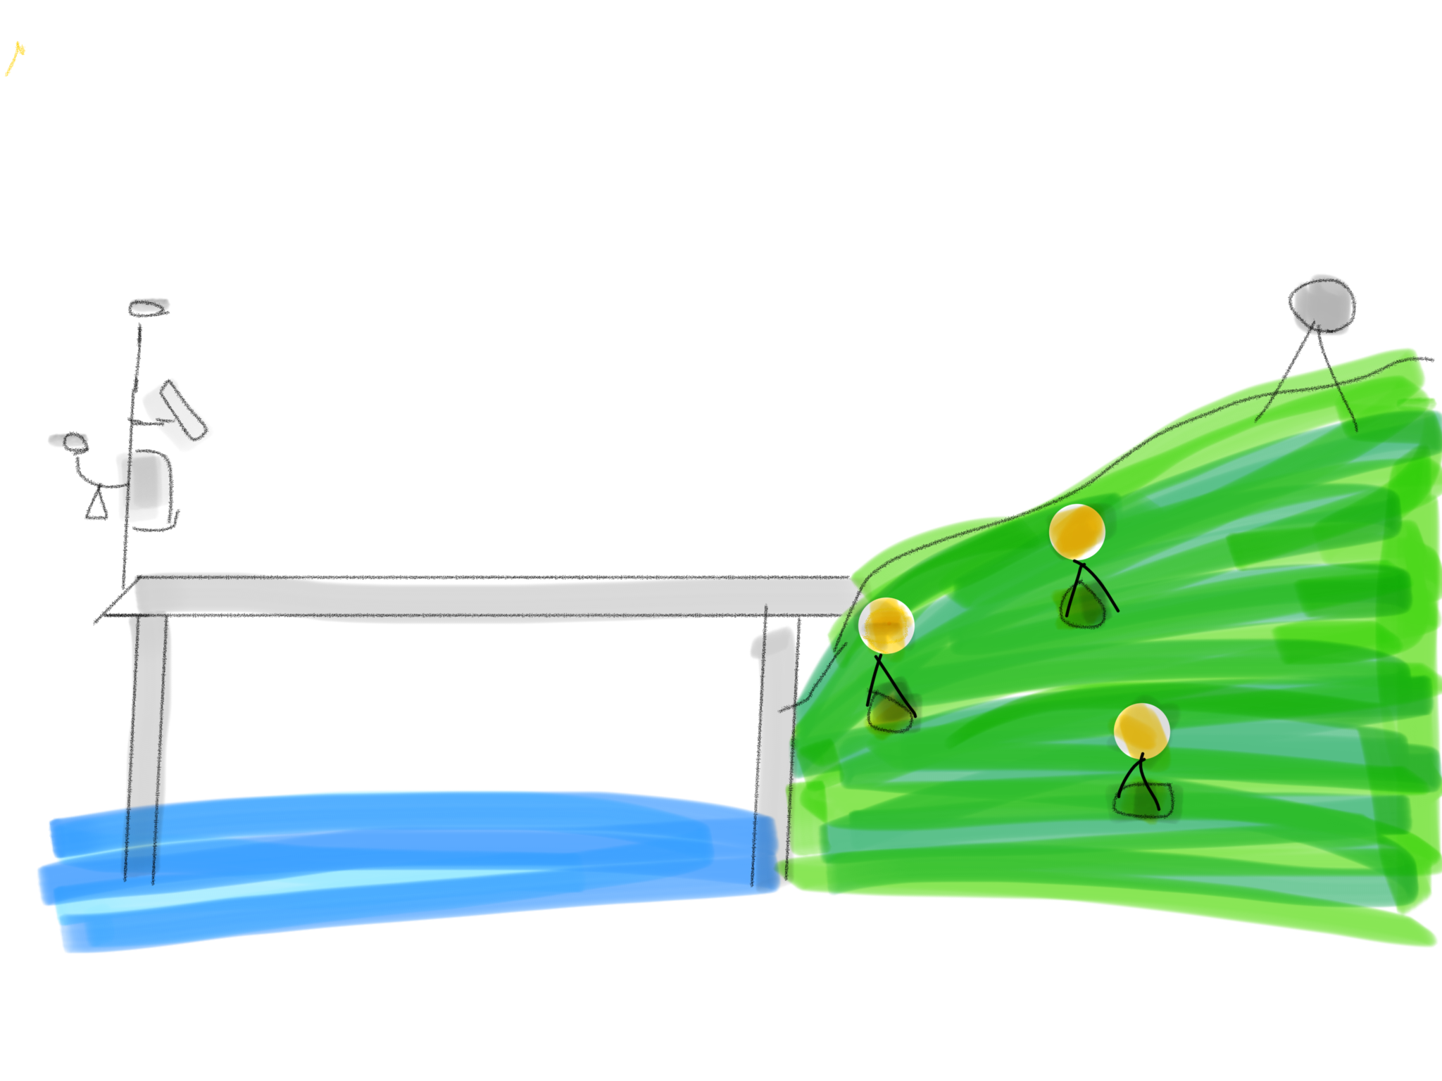
GNSS-Based Future
Use nearby CORS or CORS-like cGNSS, or
Combine static observations with continuous observations
Gain efficiencies in leveling procedures
Reduce benchmarks?
Reduce leveling frequency?
Better connection to other reference frames
NWLON station
cGNSS (CORS)
cGNSS antenna
Static GNSS
or cGNSS
BM
BM
BM

Slide 11
GNSS-Based Future
NWLON station
Differential mode to resolve components of SL Trend
Multiple cGNSS signals used to understand land component of relative sea level trends
Absolute sea level measured to the ellipsoid
cGNSS (CORS)
cGNSS antenna
BM
BM
BM

Slide 12
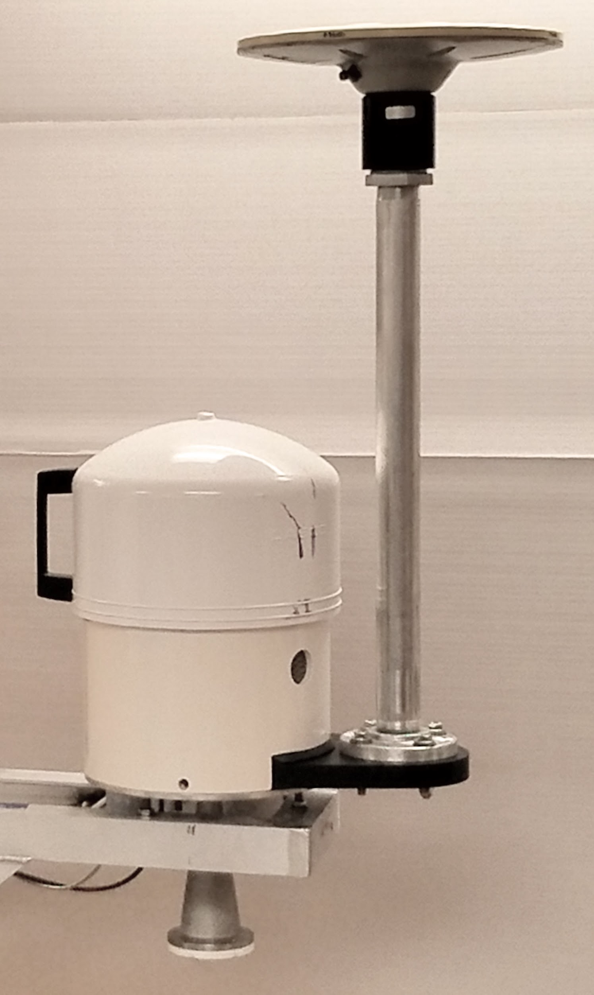
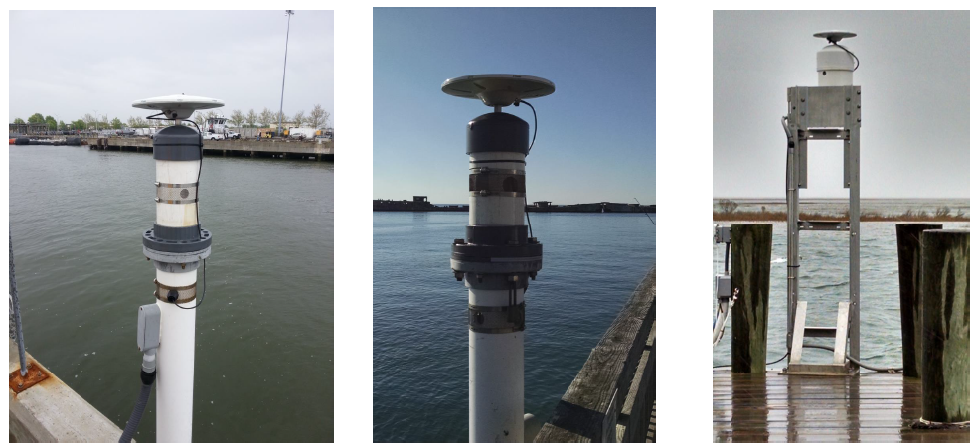
Progress to Date
PLANNING
Formed CO-OPS cGNSS working group and collaborated with NGS and other partners;
Held GNSS Workshop
Published GNSS strategy (NGS assistance)
TECHNOLOGY & DATA MANAGEMENT
Performed system, configuration, installation, operations & maintenance familiarization
Conducted data logging, processing and analysis options (with NGS assistance)
Established two long-term test platforms
FIELD OPERATIONS
Installed four long-term GNSS systems on NWLON stations in collaboration with Old Dominion Univerisity
Developed sensor GNSS antenna mounting design options

Slide 13
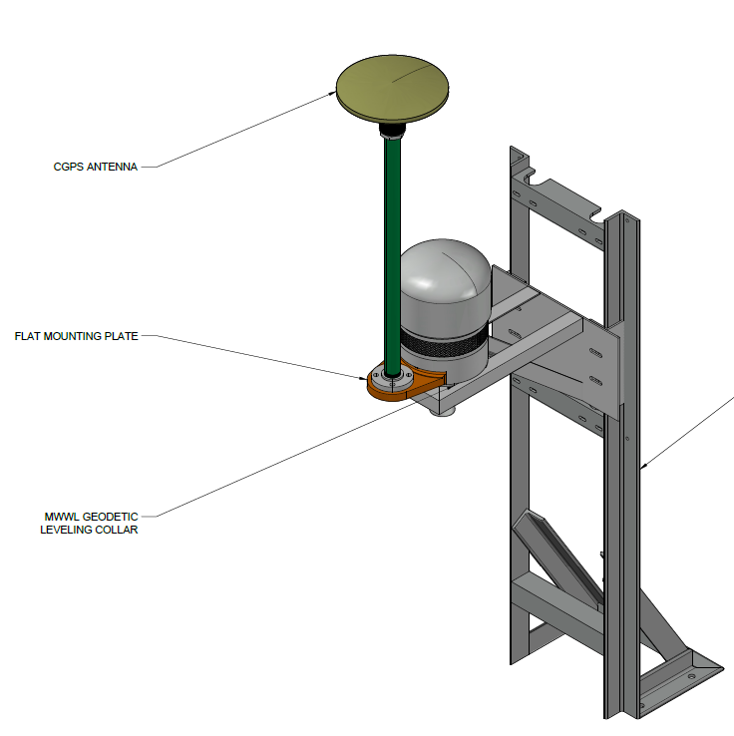
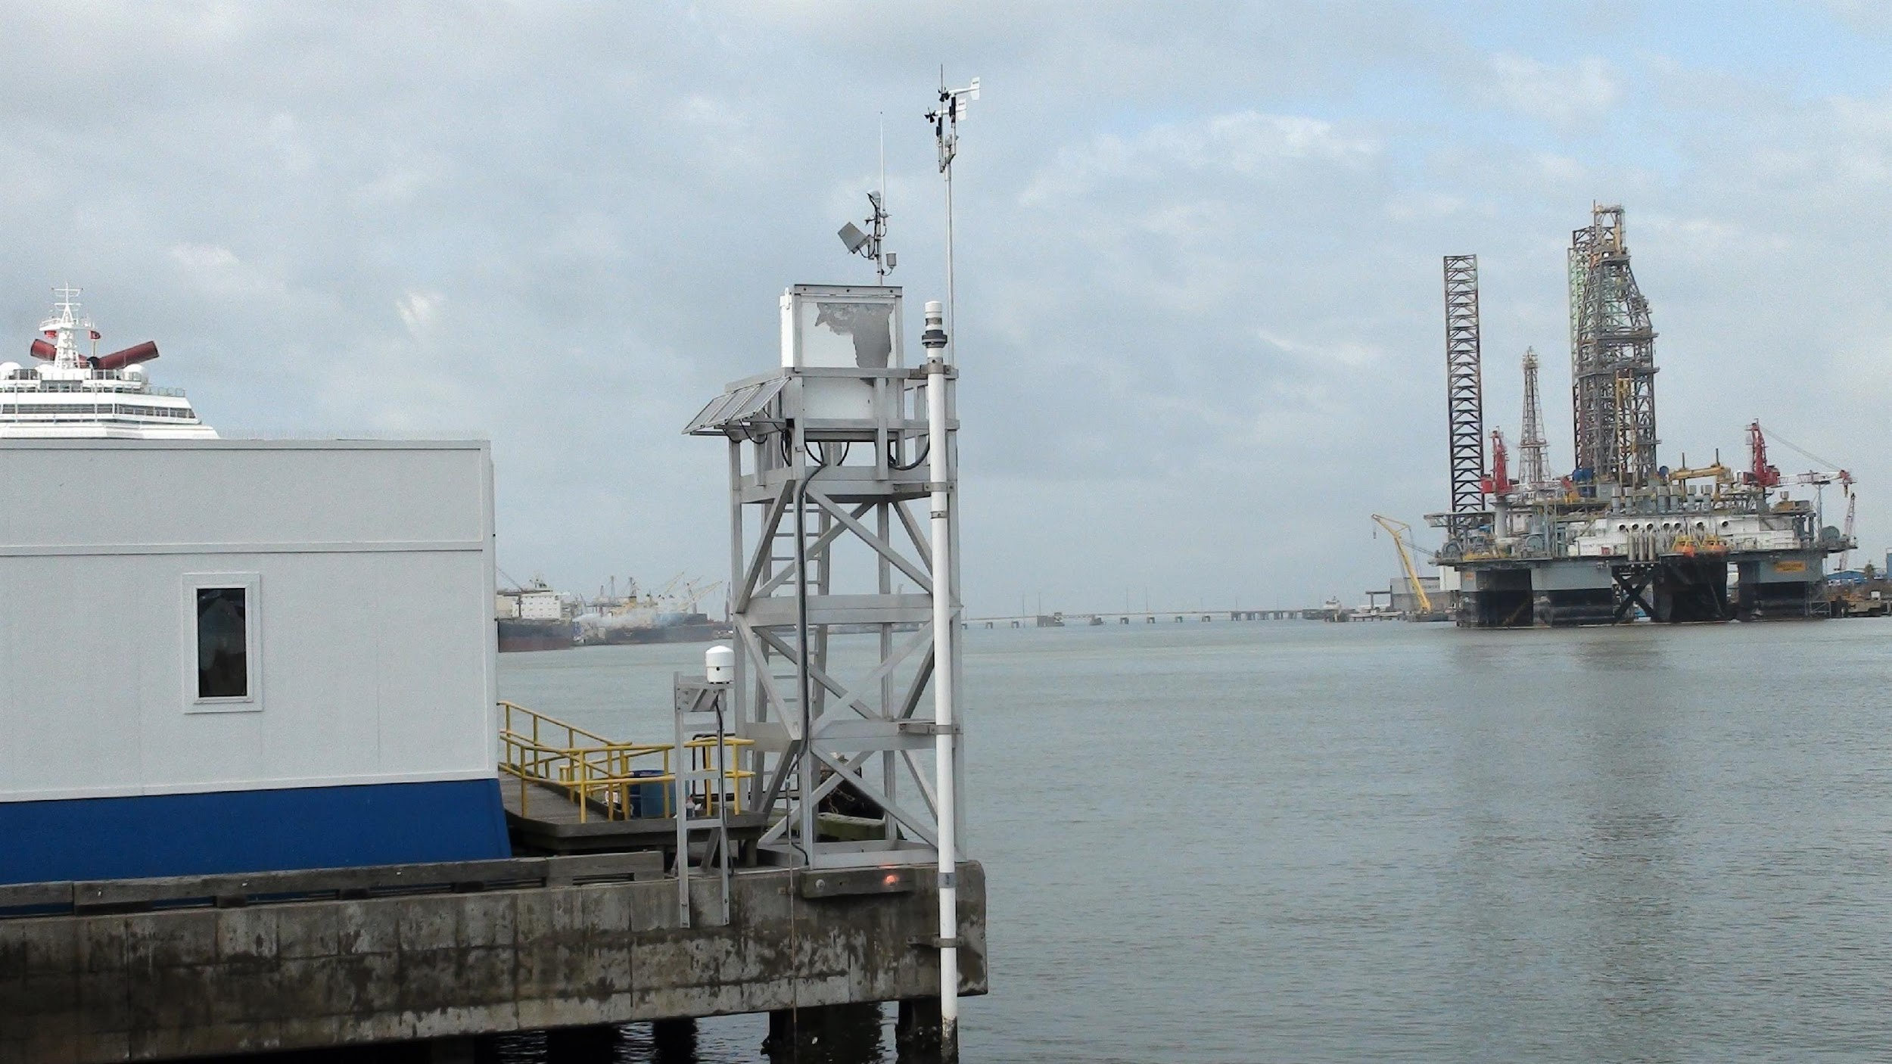
Planned Efforts in FY 18
PLANNING
Finalize CO-OPS GNSS implementation plan
TECHNOLOGY & DATA MANAGEMENT
Develop new methods for installing cGNSS systems collocated with NWLON
Explore data processing tools, methodologies and analysis for various water level applications (with NGS assistance)
FIELD OPERATIONS
Install “on sensor” cGNSS systems at four NWLON stations Virginia Key FL and Galveston Pier 21 TX (GLOSS), and Newport, RI, Dahlgren, VA
Galveston Pier 21, TX

Slide 14
FY19 and Beyond
Evaluate and implement lessons learned from FY18 cGNSS sensor installations for sensor stability
Evaluate and implement alternative surveying procedures
Explore other techniques such as rapid, short, dynamic GNSS observations for validity or quick check
Collaborate with NGS on databases and data processing
Explore the options for processing using differential cGNSS mode to resolve land and water level components

Slide 15
Future: Real-Time Water Level Observing Using GPS Reflectometry
This developing method uses reflected satellite GPS signals to determine the water level.
Research organizations and regional associations are further testing this technology.
“The Accidental Tide Gauge: A GPS Reflection Case Study From Kachemak Bay, Alaska”, Kristine M. Larson, Richard D. Ray, Felipe G. Nievinski, and Jeffrey T. Freymueller, IEEE GEOSCIENCE AND REMOTE SENSING LETTERS, VOL. 10, NO. 5, SEPTEMBER 2013

Slide 16
Summary
GNSS/GPS modernization is a CO-OPS priority ; envisioned to be the primary technology for vertical control at water level stations in the near future.
Cross office Working Group established to guide efforts, develop strategy and implementation plan.
CO-OPS has received excellent technical support from NGS (Thank You!) in all facets of its plan.
Leveraging and exploring partnerships to advance plan priorities (NGS, other NOAA and government organizations, academia, private industry, etc).

Slide 17
Back-up Slides

Slide 18
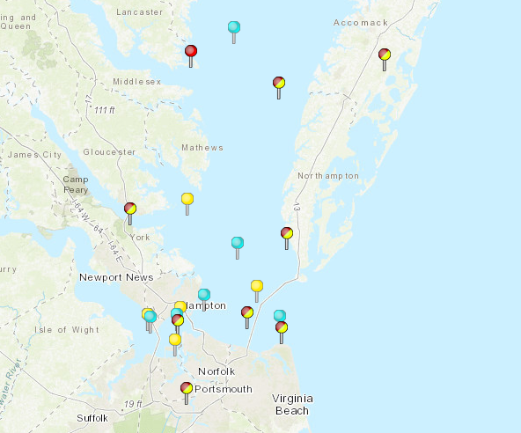
ODU cGNSS Systems at NWLON
Old Dominion University collaborated with CO-OPS to install cGNSS systems at four VA NWLON stations (ODU reps have been Dr. Hans Peter Plag and Mark Bushnell).
NWLON locations, cGNSS installation dates, & primary water level sensor type:
Sewells Point, Apr'15, acoustic
York River, Nov'15, acoustic
Kiptopeke, Dec'15, acoustic
Watchapreague, Dec'16, radar

Slide 19
ODU cGNSS Systems at NWLON
Sewells Point
Kiptopeke
Wachapreague
ED\OSTEP 2017
ED\OSTEP 2017
ED\OSTEP 2017

Slide 20
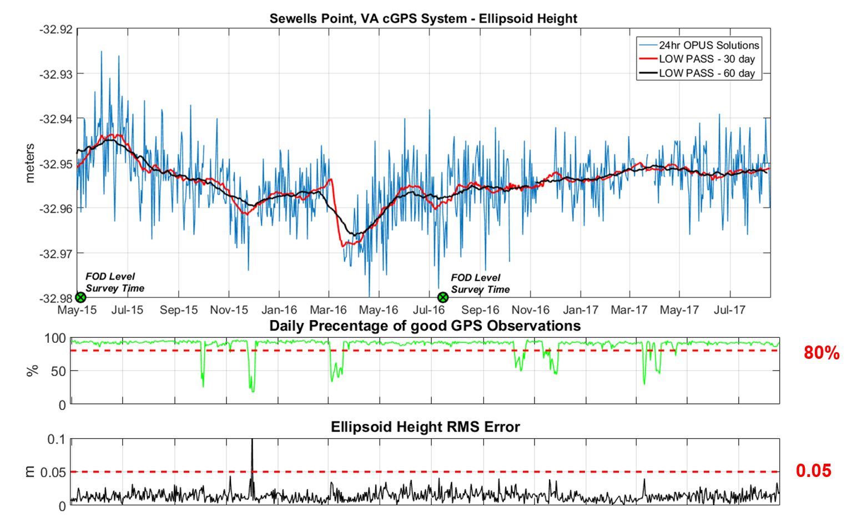
ODU cGNSS Systems at NWLON – Initial Data Processing
Using NOAA\NGS OPUS Tools

Slide 21
Challenges
Data telemetry, processing and storage (partner with NGS)
Multipath signals and location/environment selection
Accuracy requirements needed for some applications
NSRS Horizontal and Vertical datums will be finalized in 2022
NGS is improving the OPUS software by normalizing the results irrespective of the selected CORS station
The effect of Foundational CORS on data processing and accuracies in unquantified at the present
The effects of rapid, short, and dynamic GPS observations on accuracies need to be explored

