Slide 1
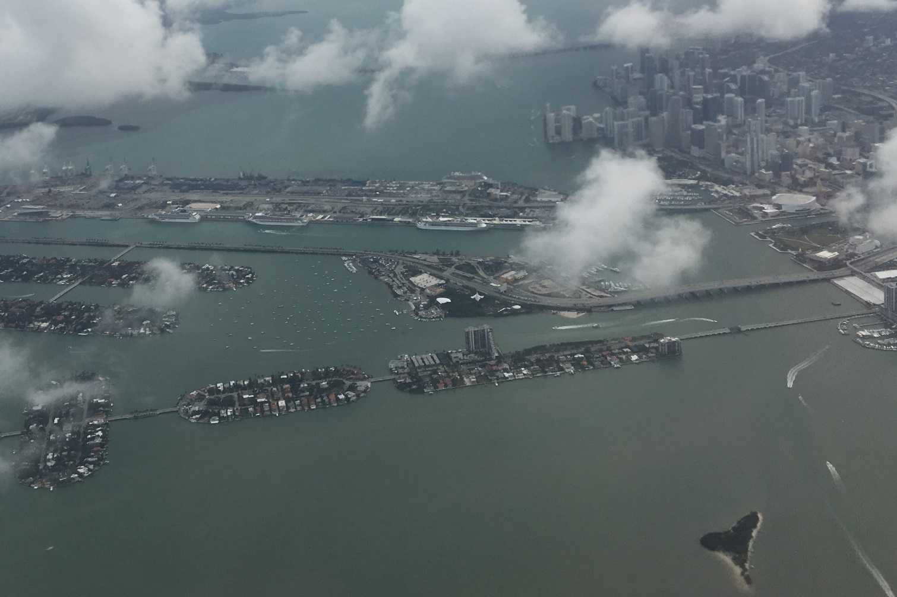
Office of Coast Survey
Rear Admiral Shepard Smith
April 4, 2018

Slide 2
Outline
Miami
  Hurricane Response
  Cruise Industry
  Boat Show
  Rising Tides
SOLAS
  Risk Management
Program Updates
  National Charting Plan
  External Source Data
  Unmanned Systems
  Precision Navigation
  Partnership with USACE
Ocean Mapping Plan
  Seabed 2030

Slide 3
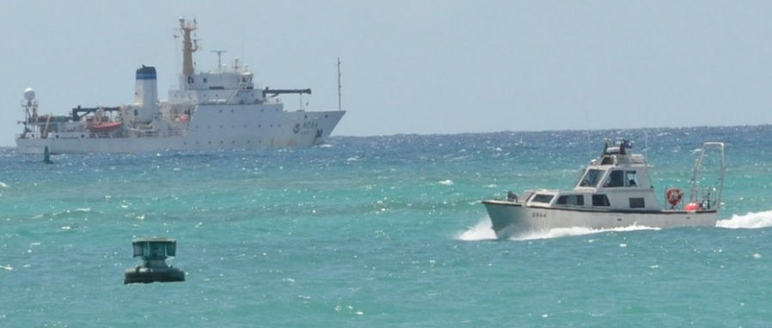
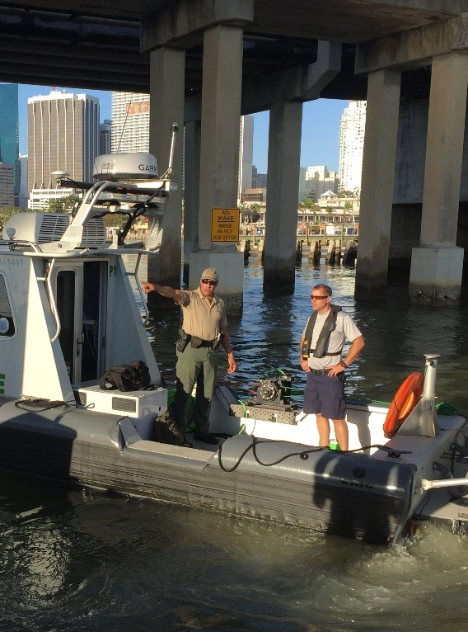
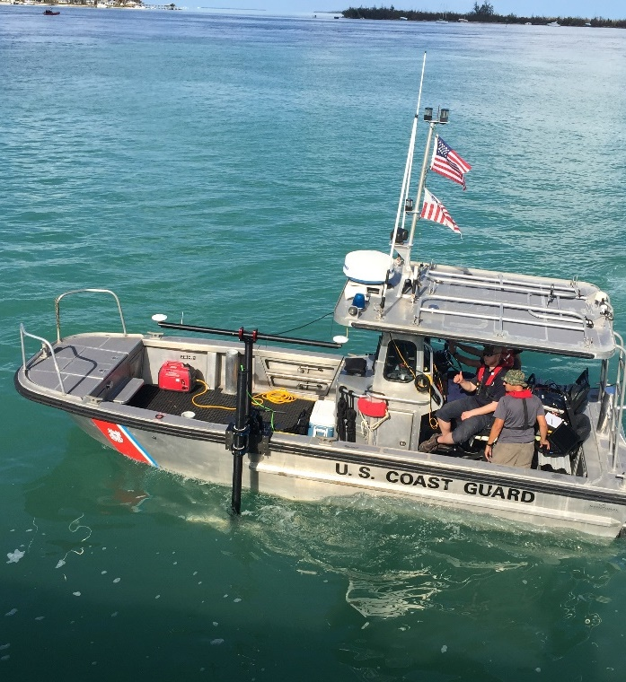
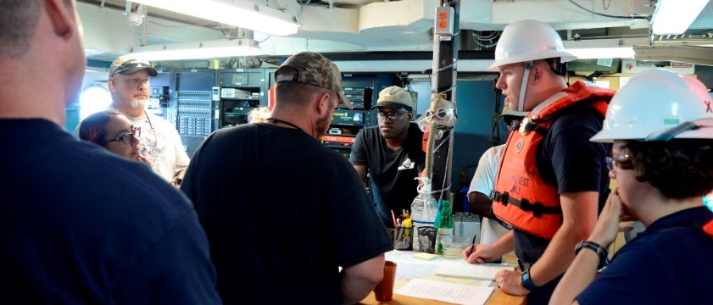
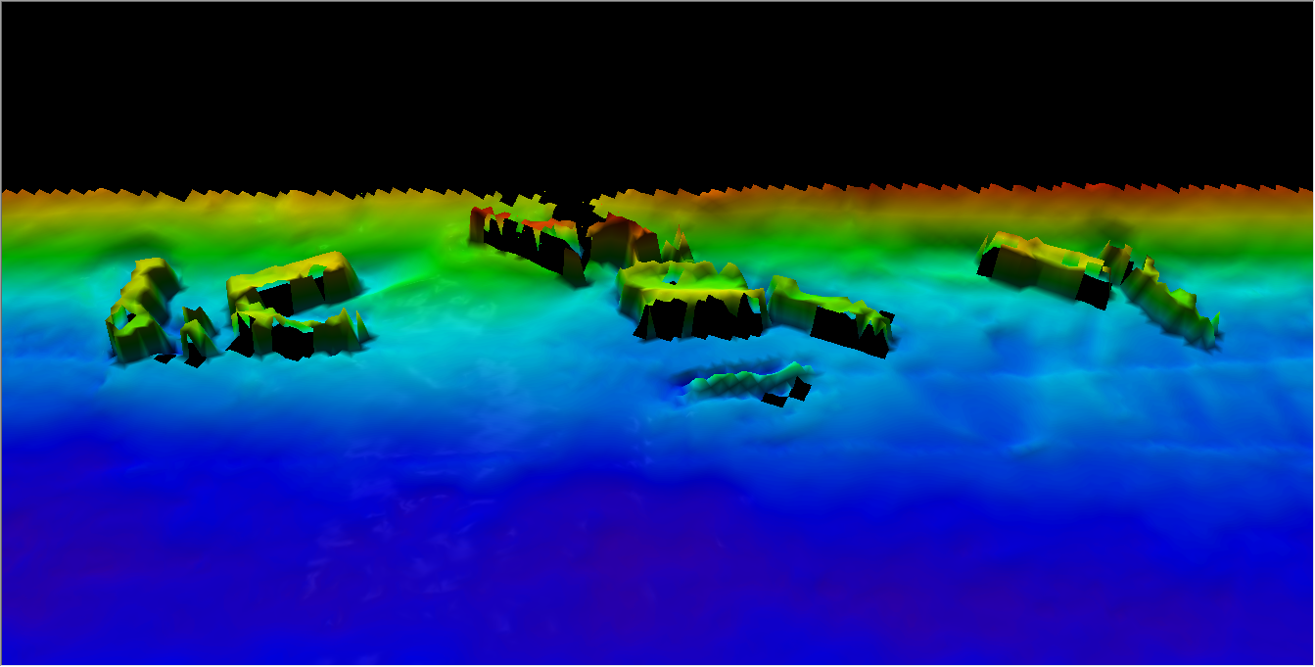
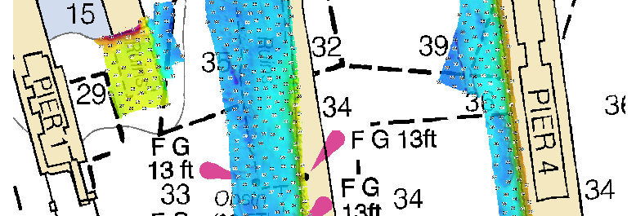
Hurricane Response
Notes:
Image (top left): NRT 2 crew at Corpus Christi incident command center with USCG Commandant
Image (top right): NOAA NRR2 at the Corpus ICC, before heading out to work on the water
around Port Aransas Pass.
Image (bottom left): NRT 4 surveying in the Galveston Ship Channel and Bolivar Anchorages.
Image (bottom right): MIST kit onboard the vessel of opportunity – FGBNMS R/V Manta

Slide 4
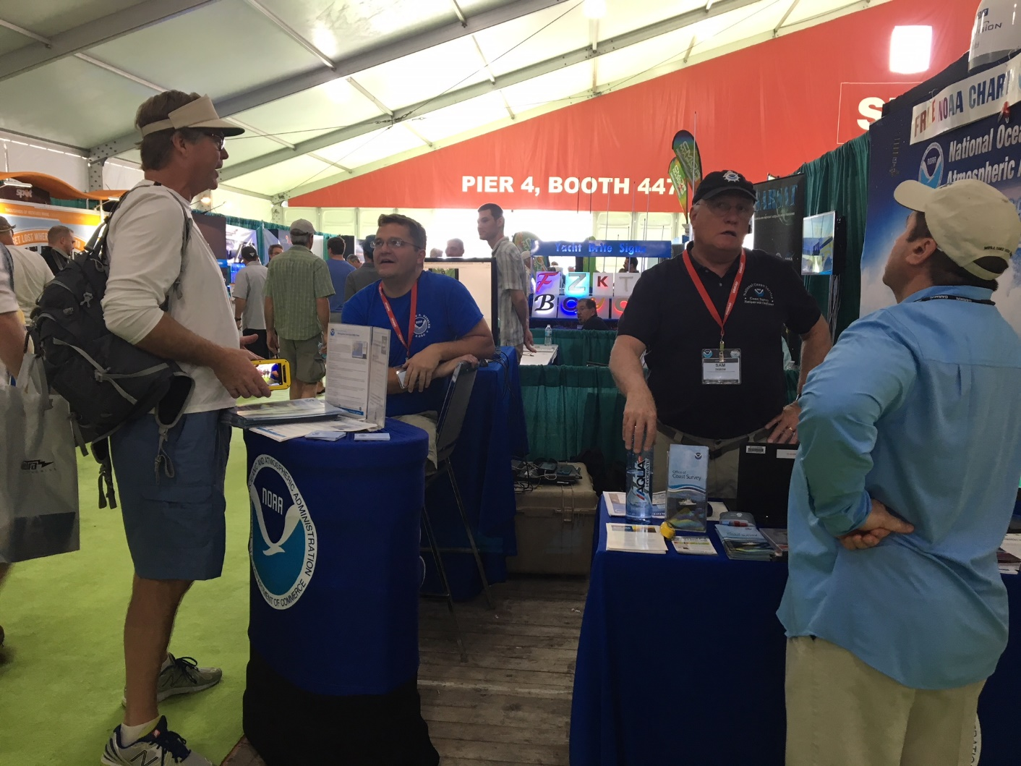
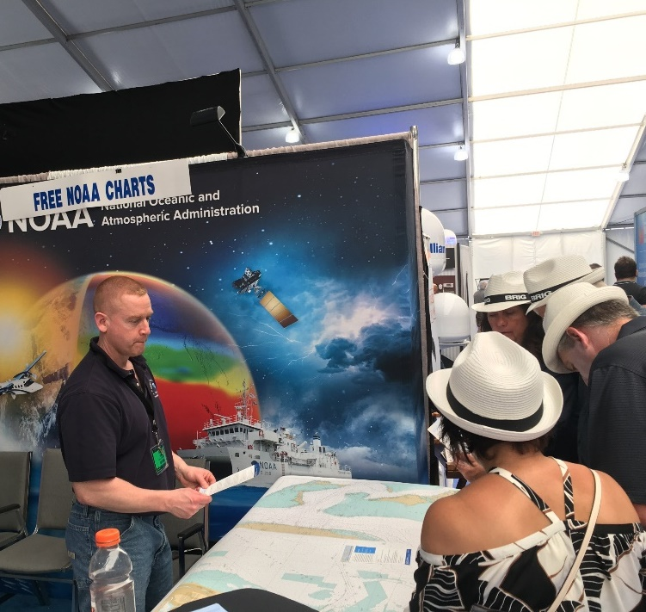
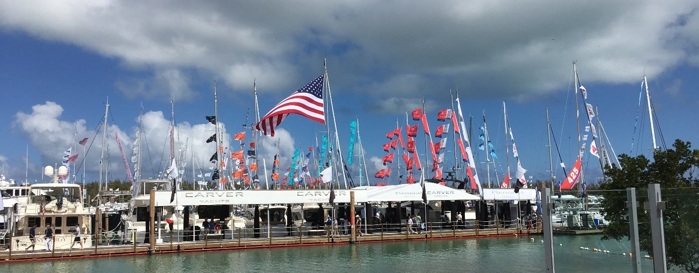
Miami Boat Show 2018
Notes:
Image (top left): NRT 2 crew at Corpus Christi incident command center with USCG Commandant
Image (top right): NOAA NRR2 at the Corpus ICC, before heading out to work on the water
around Port Aransas Pass.
Image (bottom left): NRT 4 surveying in the Galveston Ship Channel and Bolivar Anchorages.
Image (bottom right): MIST kit onboard the vessel of opportunity – FGBNMS R/V Manta

Slide 5
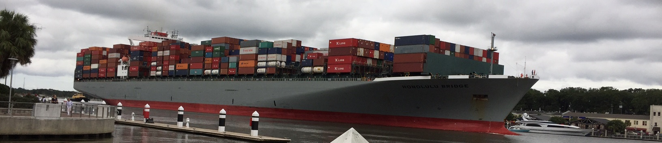
SOLAS
The International Convention for the Safety of Life at Sea (SOLAS) is an international maritime treaty which sets minimum safety standards in the construction, equipment and operation of merchant ships.
SOLAS in its successive forms is generally regarded as the most important of all international treaties concerning the safety of merchant ships.
Regulation 9 –Hydrographic Services

Slide 6
SOLAS - Regulation 9 Hydrographic Services
1. Contracting Governments undertake to arrange for the collection and compilation of hydrographic data and the publication, dissemination and keeping up to date of all nautical information necessary for safe navigation.
2. In particular, Contracting Governments undertake to co-operate in carrying out, as far as possible, the following nautical and hydrographic services, in the manner most suitable for the purpose of aiding navigation:
  2.1 to ensure that hydrographic surveying is carried out, as far as possible, adequate to the
  requirements of safe navigation;
  2.2 to prepare and issue nautical charts, sailing directions, lists of lights, tide tables and other nautical
  publications, where applicable, satisfying the needs of safe navigation;
  2.3 to promulgate notices to mariners in order that nautical charts and publications are kept, as far as
  possible, up to date; and
  2.4 to provide data management arrangements to support these services.
3.Contracting Governments undertake to ensure the greatest possible uniformity in charts and nautical publications and to take into account, whenever possible, relevant international resolutions and recommendations.*
4.Contracting Governments undertake to co-ordinate their activities to the greatest possible degree in order to ensure that hydrographic and nautical information is made available on a world-wide scale as timely, reliably, and unambiguously as possible.
Notes:
Image (top left): NRT 2 crew at Corpus Christi incident command center with USCG Commandant
Image (top right): NOAA NRR2 at the Corpus ICC, before heading out to work on the water
around Port Aransas Pass.
Image (bottom left): NRT 4 surveying in the Galveston Ship Channel and Bolivar Anchorages.
Image (bottom right): MIST kit onboard the vessel of opportunity – FGBNMS R/V Manta

Slide 7
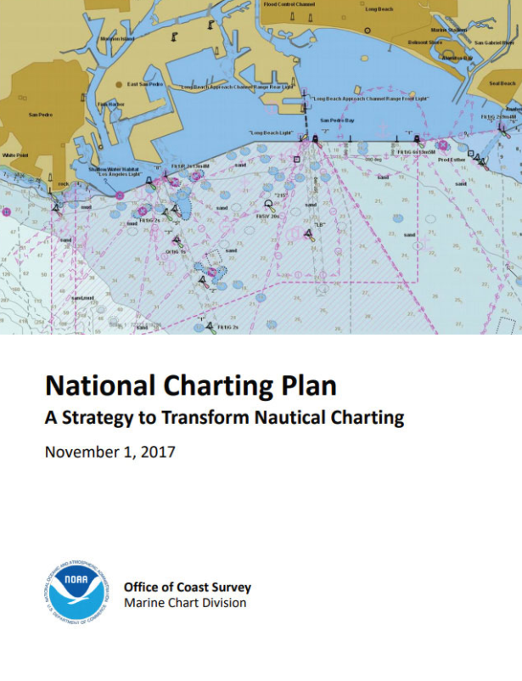
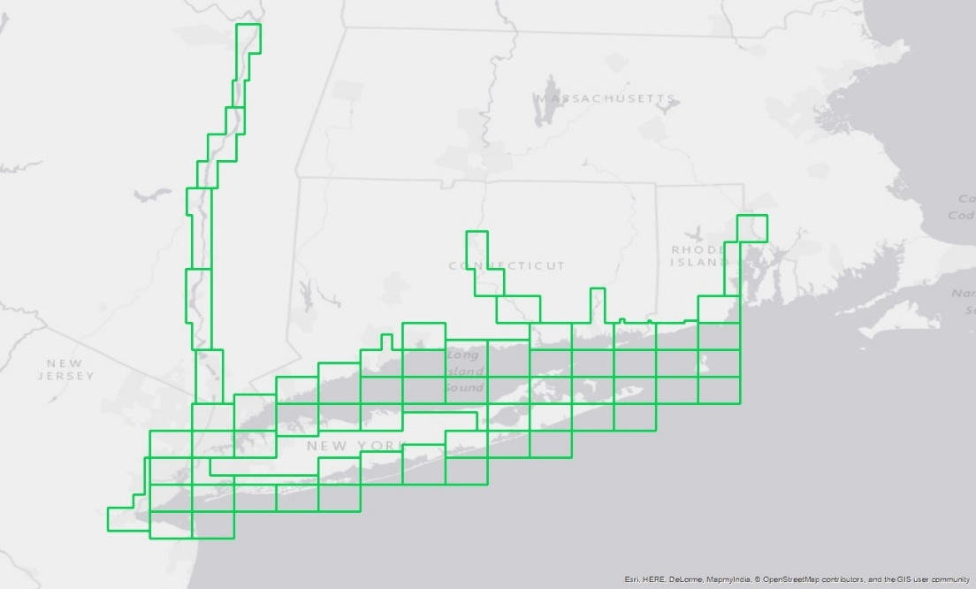
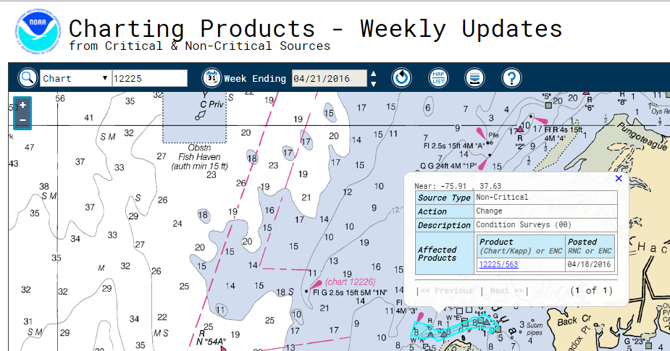
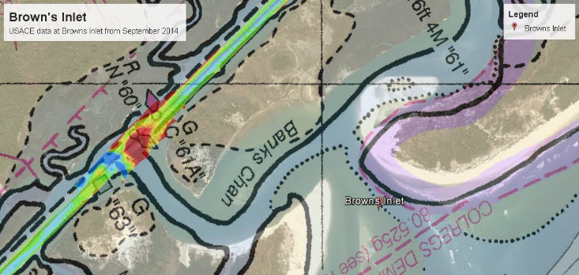
NATIONAL CHARTING PLAN
A strategy to transform nautical charting

Slide 8
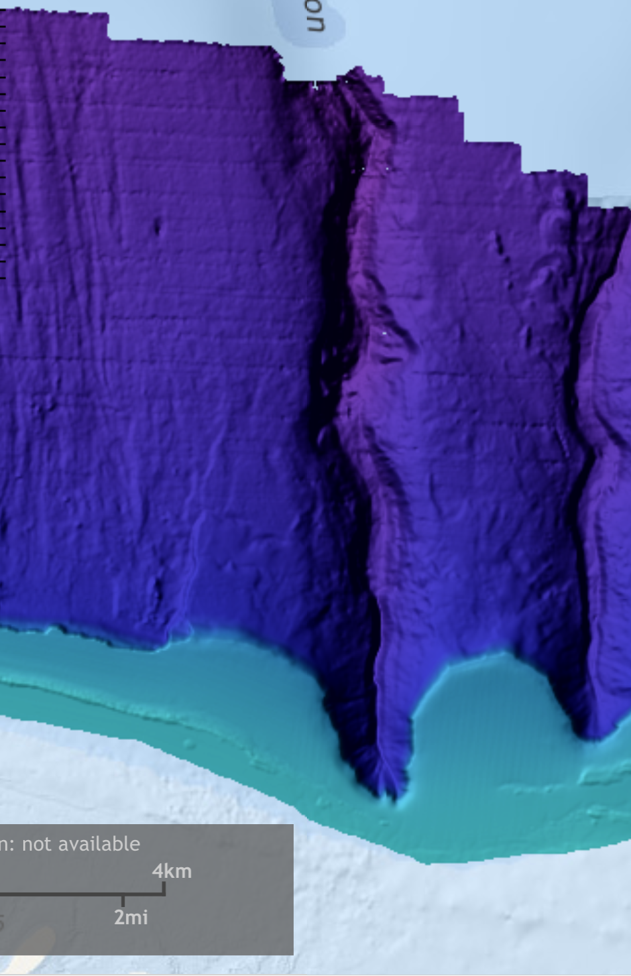
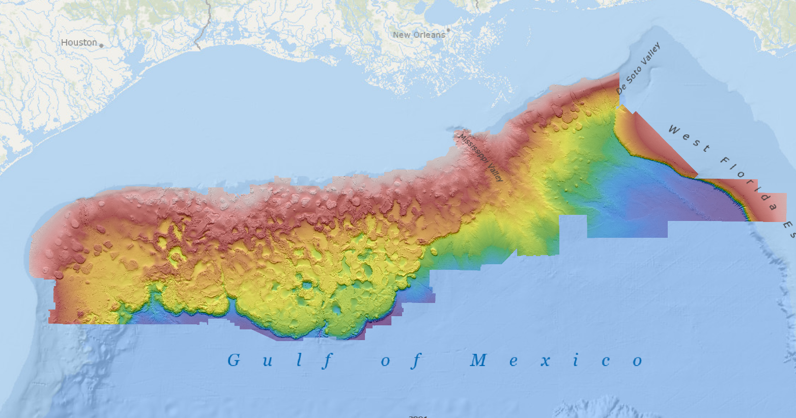
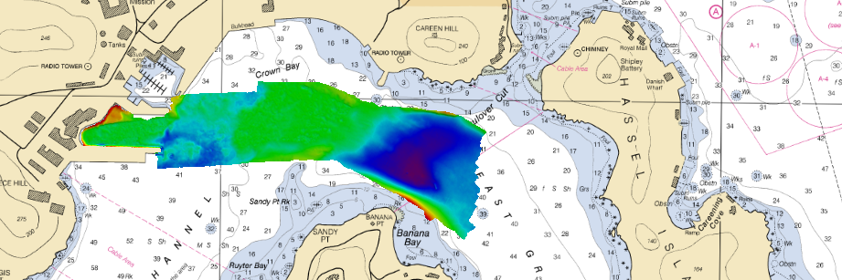
External Source Data

Slide 9
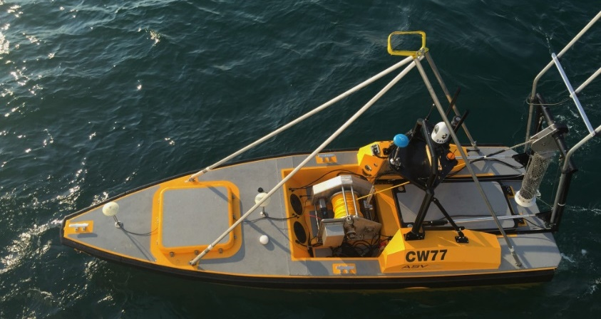
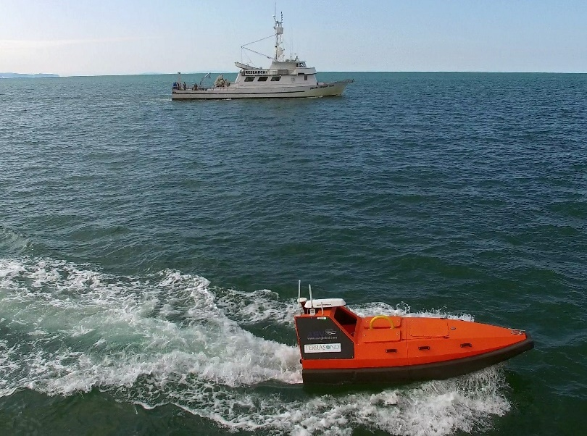
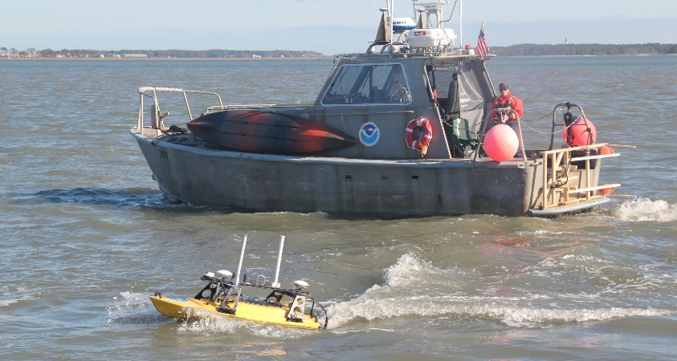
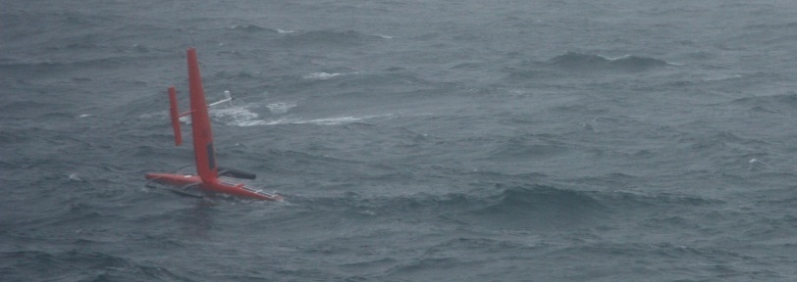
Unmanned Systems

Slide 10
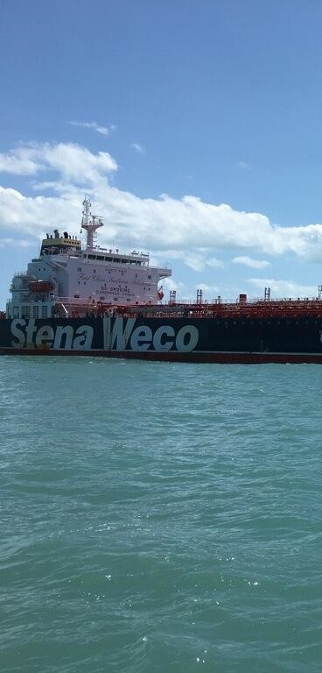
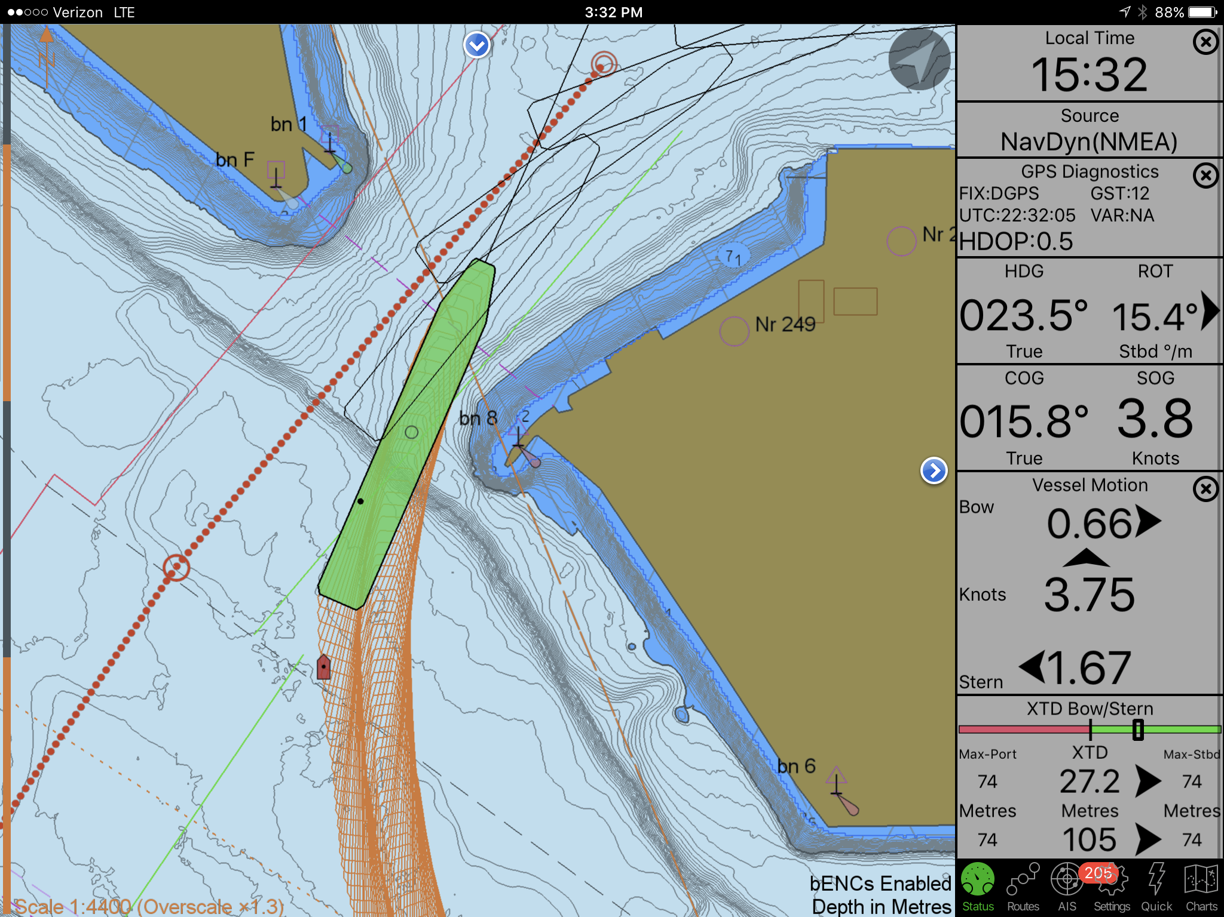
Precision Navigation
Notes:
Image (top left): NRT 2 crew at Corpus Christi incident command center with USCG Commandant
Image (top right): NOAA NRR2 at the Corpus ICC, before heading out to work on the water
around Port Aransas Pass.
Image (bottom left): NRT 4 surveying in the Galveston Ship Channel and Bolivar Anchorages.
Image (bottom right): MIST kit onboard the vessel of opportunity – FGBNMS R/V Manta

Slide 11
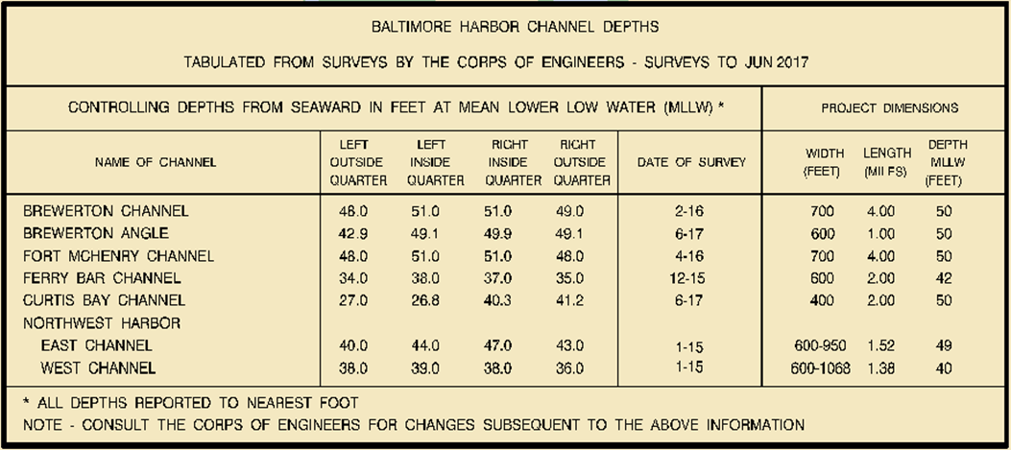
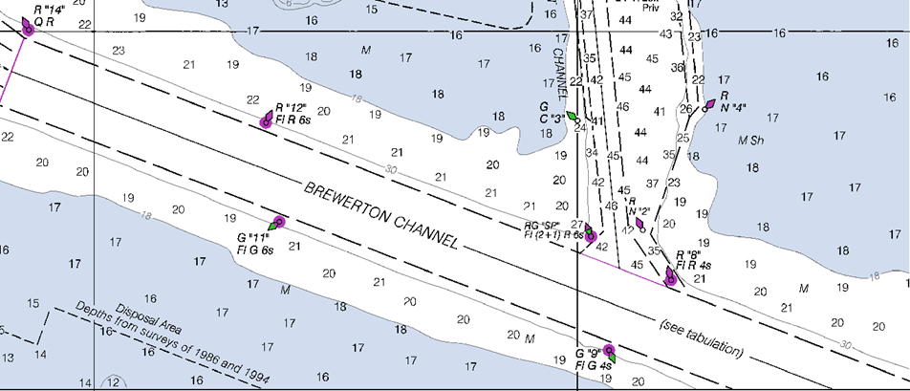
Partnership with USACE
This example below depicts the proposed revision of a channel reach in Baltimore Harbor.
Notes:
Image (top left): NRT 2 crew at Corpus Christi incident command center with USCG Commandant
Image (top right): NOAA NRR2 at the Corpus ICC, before heading out to work on the water
around Port Aransas Pass.
Image (bottom left): NRT 4 surveying in the Galveston Ship Channel and Bolivar Anchorages.
Image (bottom right): MIST kit onboard the vessel of opportunity – FGBNMS R/V Manta

Slide 12
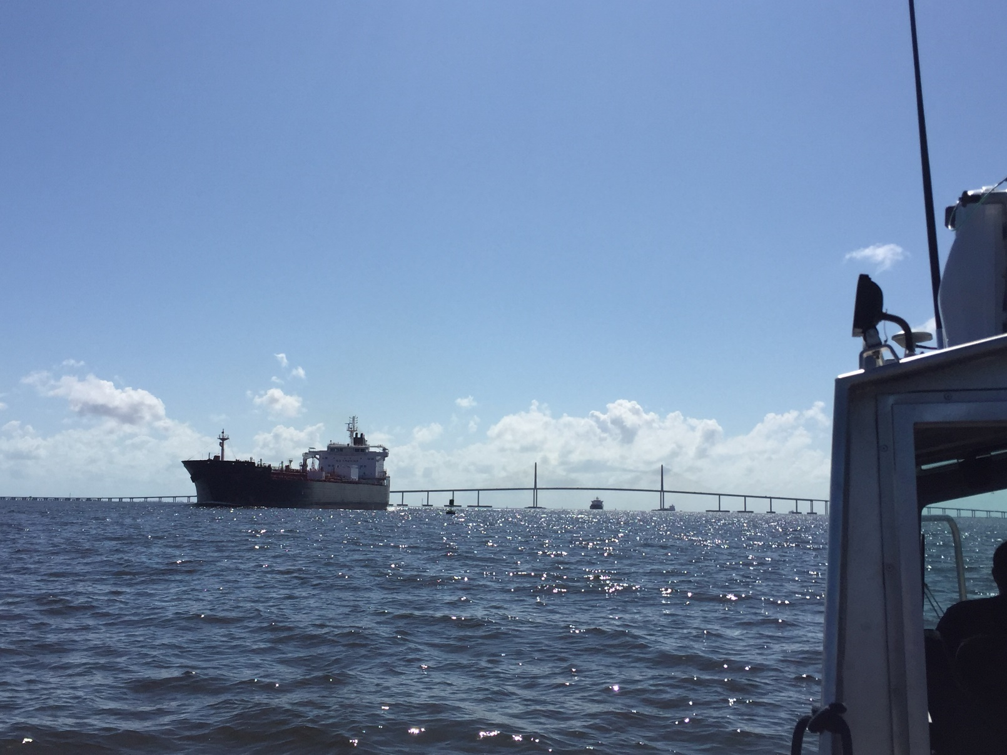
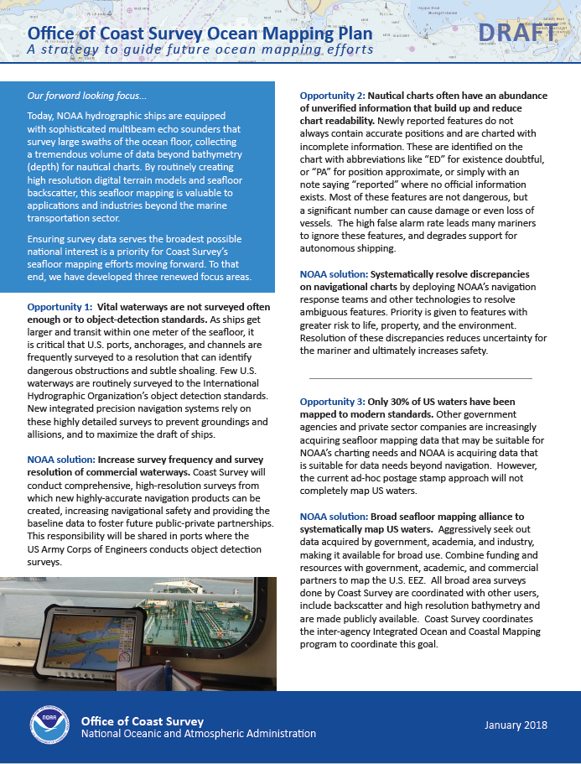
Ocean Mapping
Notes:
Images sent by Colby. He mentioned that he can't be sure that they aren't an artifact of the ENC Viewer, and not real problems, but they could still serve to illustrate the issue.

Slide 13
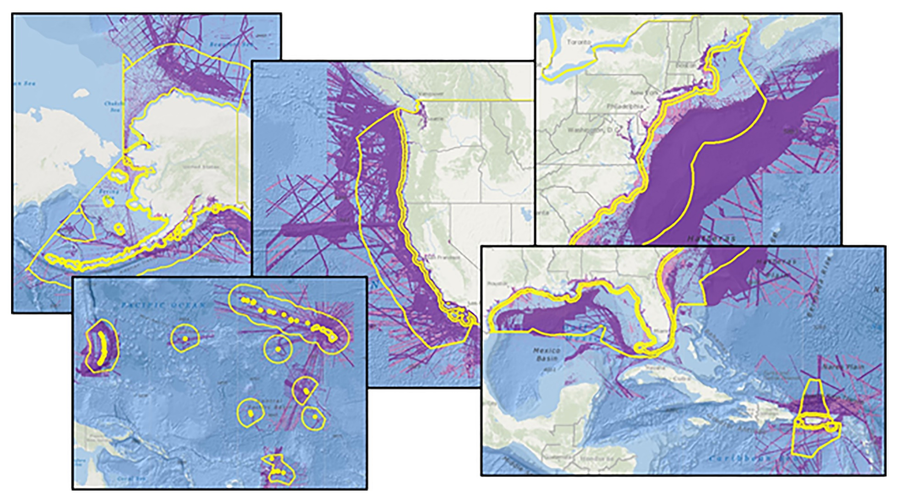
SeaBed 2030
Notes:
Image (top left): NRT 2 crew at Corpus Christi incident command center with USCG Commandant
Image (top right): NOAA NRR2 at the Corpus ICC, before heading out to work on the water
around Port Aransas Pass.
Image (bottom left): NRT 4 surveying in the Galveston Ship Channel and Bolivar Anchorages.
Image (bottom right): MIST kit onboard the vessel of opportunity – FGBNMS R/V Manta

