Slide 1
Project Depths
raster navigational charts (Rnc)

Slide 2
Project Depths vs Controlling Depths
PROJECT DEPTHS
CONTROLLING DEPTHS
Project Depths are the design dredging depth of a channel constructed by the U.S. Army Corps of Engineers. The project may or may not be the goal of maintenance dredging after completion of the channel
Project Depths are relatively stable.
Controlling Depths/Minimum Depths are the least depths within the limits of a channel. Controlling depths restrict the safe use of the channel to drafts less than the minimum depth.
Controlling depths frequently change and are challenging to maintain on RNCs.

Slide 3
Controlling Depths to Project Depths for RNC
Currently, U.S. Army Corps of Engineers (USACE)controlling depth data is applied to Raster Navigational Charts (RNC) and Electronic Navigational Charts (ENC).
Channel data published on RNCs and ENCs has often been out of sync with the data made publicly available by the USACE.
Recent prioritization of ENC updates has increased the latency of RNC publications.
In an effort to mitigate this latency, project depths will be depicted on RNCs.
ENCs will continue to be updated with the latest minimum depths provided by USACE.

Slide 4
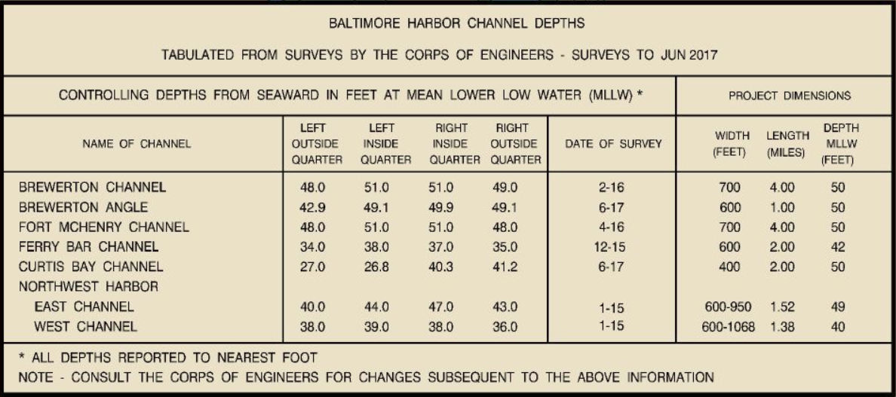
Current Depictions of Controlling Depths on RNC Products
Channel Tabulations – tables furnishing controlling depths, date of survey, and project dimensions.

Slide 5
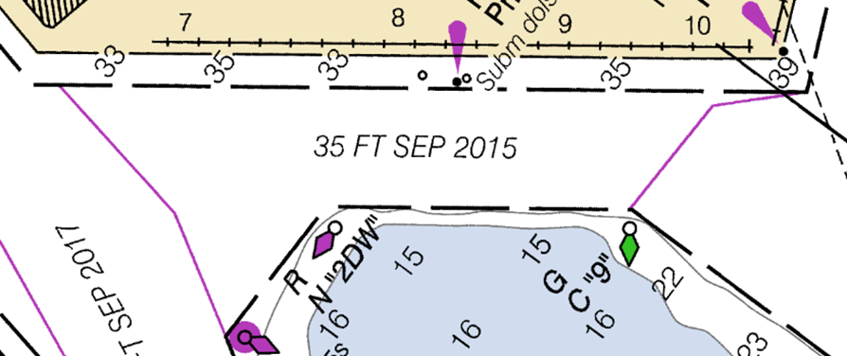
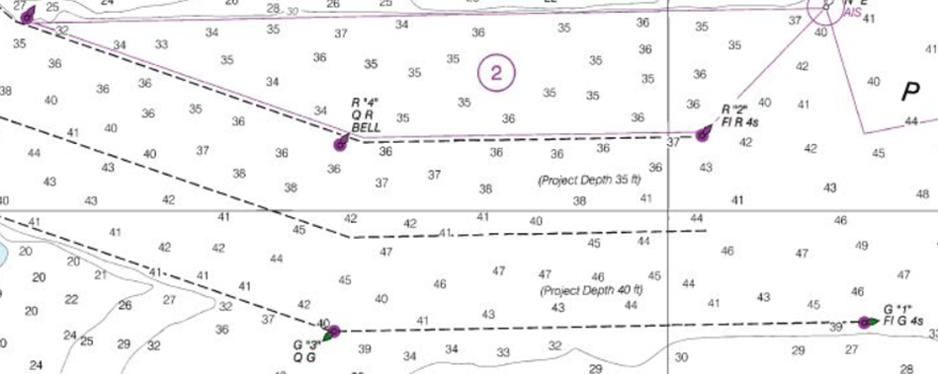
Current Depictions of Controlling Depths on RNC Products
Controlling Depth Legends
Hydrography
Depth Legends, providing controlling depth and date of survey, are used when the channel tabulation is not feasible.
Soundings and depth curves are charted within the channel limits.
Baltimore Harbor Depth Legend
Hydrography in Boston Harbor

Slide 6
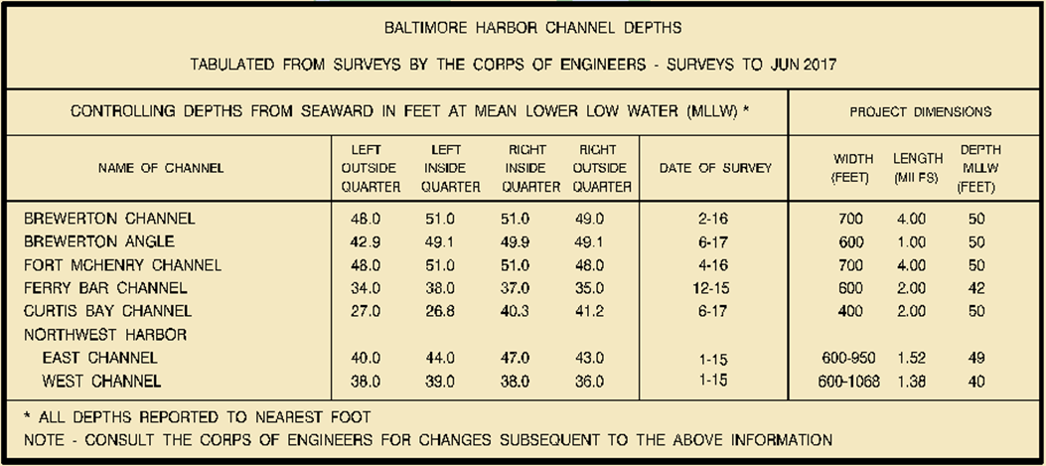
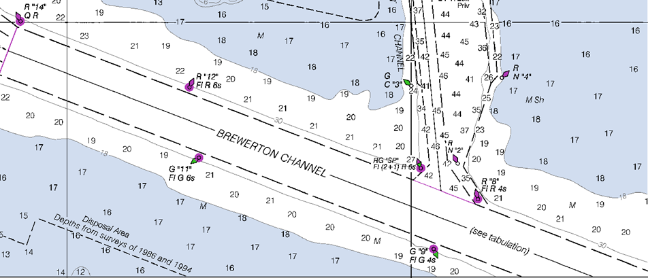
Establishing Project Depths - Example
The example below depicts the proposed revision of a channel reach in Baltimore Harbor.
This approach is applicable to all current depictions of controlling depths on RNCs.

Slide 7
Establishing Project Depths - Example
The channel tabulation is removed from the chart along with associated references.
The project depth is added to the reach with reference to the Project Depth Note.
Project Depth Note is added to the chart.

Slide 8
Establishing Project Depths – Example
There will be instances where chart scale will prevent the use of Project Legends.
In these cases, a Project Tabulation will be used to reflect controlling depths.
The Project Tabulation provides the reach names and project depth.

