Slide 1
Port Miami and the Emergency Management Program
Steve Detwiler, FPEM
Whole Community Recovery Planner
Miami-Dade County Office of Emergency Management

Slide 2
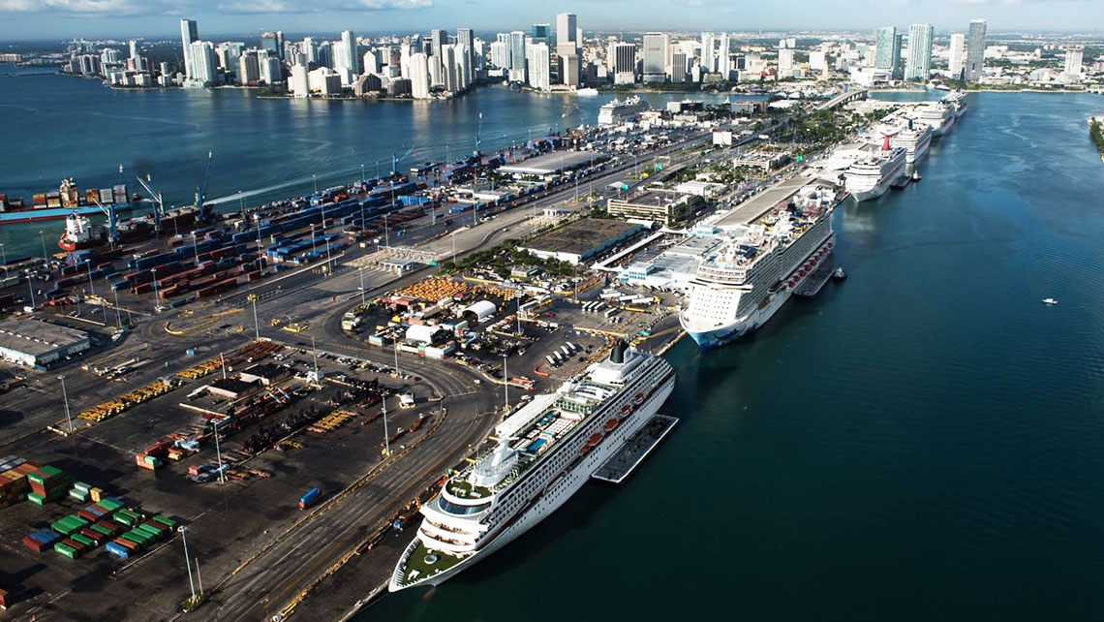
Introduction
Port Miami Overview
Miami-Dade County Emergency Operations Center Overview
Drawbridge Operations Gide
Hurricane Irma Actions and Lessons Learned
Miami-Dade County Resiliency Program

Slide 3
Port Miami Background
Port Miami is a Miami-Dade County government department. The Port Director is appointed by the County Mayor.
The port contributes $41.4 Billion to the county’s economy and supports more than 324,3652 jobs throughout South Florida.
The port is known worldwide as the “Cruise Capital of the World”. Around 5.3 million passengers pass through the port on an annual basis.
The port also receives over one million tons of cargo annually and is the #1 container port in the State.

Slide 4
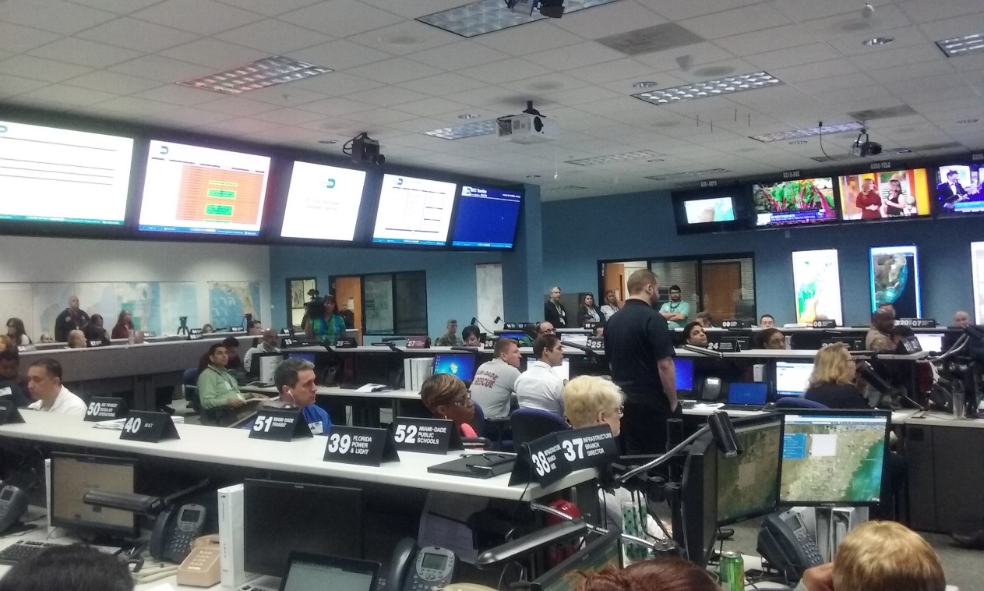
Miami-Dade County Emergency Operations Center (EOC)
The EOC is a 22,000 ft² state-of-the-art facility.
This facility is responsible for the coordination of emergency response and recovery decisions, plans, and operations.
There are three levels of EOC activation:
Level 3: Monitoring and Assessment
Level 2: Partial Activation
Level 1: Full Activation

Slide 5
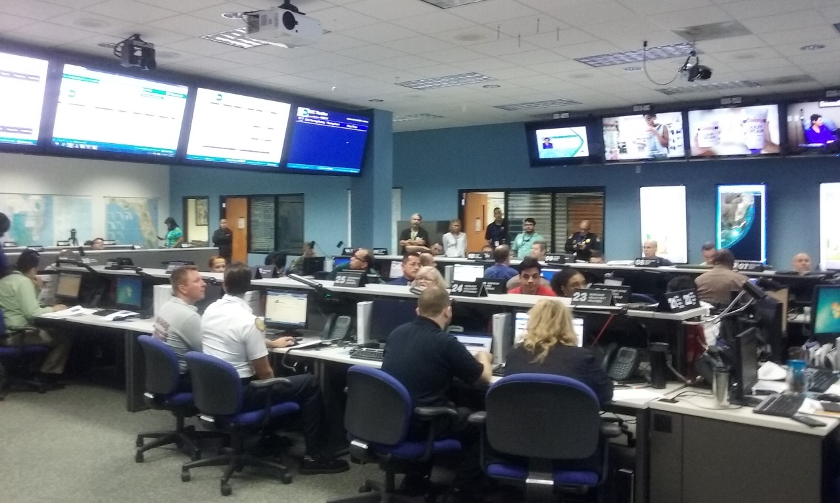
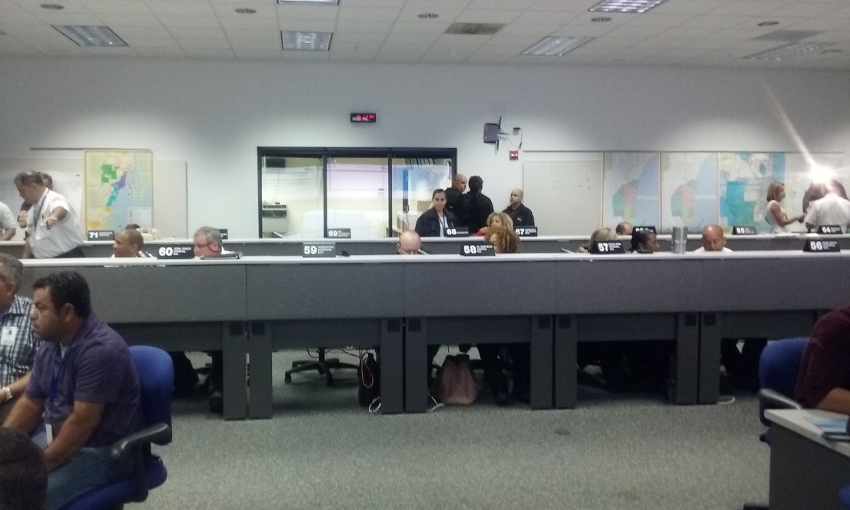
Miami-Dade County Emergency Operations Center (EOC) Cont..
The EOC has:
Over 200 networked computers and sophisticated telecommunications switch.
Advanced redundant telecommunications systems; digital, analog and satellite.
Dedicated press and media centers with direct video feed
Seven conference rooms.

Slide 6
EOC Organizational Structure

Slide 7
Port Miami’s Emergency Management Role
Port Miami is a vital partner in the Miami-Dade Emergency Management program.
The Port Director also serves on the Mayor’s Executive Group advising him on necessary actions before, during and after a disaster.

Slide 8
EOC Infrastructure Branch
Port Miami is assigned to this branch during an EOC activation.
The Infrastructure Branch agencies are responsible for monitoring and coordinating the following activities during an EOC activation:
Restoration of utility services (electric, water, sewer, natural gas)
Restoration of critical infrastructure
Supporting transportation efforts in evacuation
Conducting post-disaster impact assessments
Coordinating private sector involvement in response and immediate recovery issues
Coordinating debris clearance and removal
Coordinating the opening, closing and restoration of transportation routes (roadways and bridges)

Slide 9
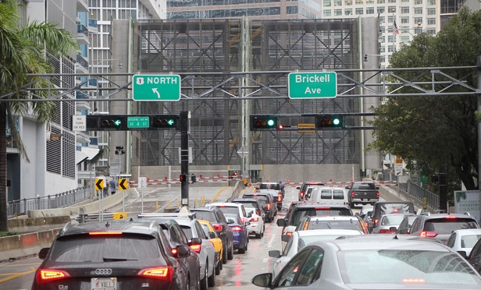
Miami-Dade Drawbridge Operations Guide
This plan’s purpose is to coordinate drawbridge operations which ultimately preserve the structural integrity of the bridges and enables, to the extent possible, the flow of vehicular and vessel traffic.
This guide identifies the relevant partners, their roles and responsibilities and establishes the coordination structure before, during and after a disaster.

Slide 10
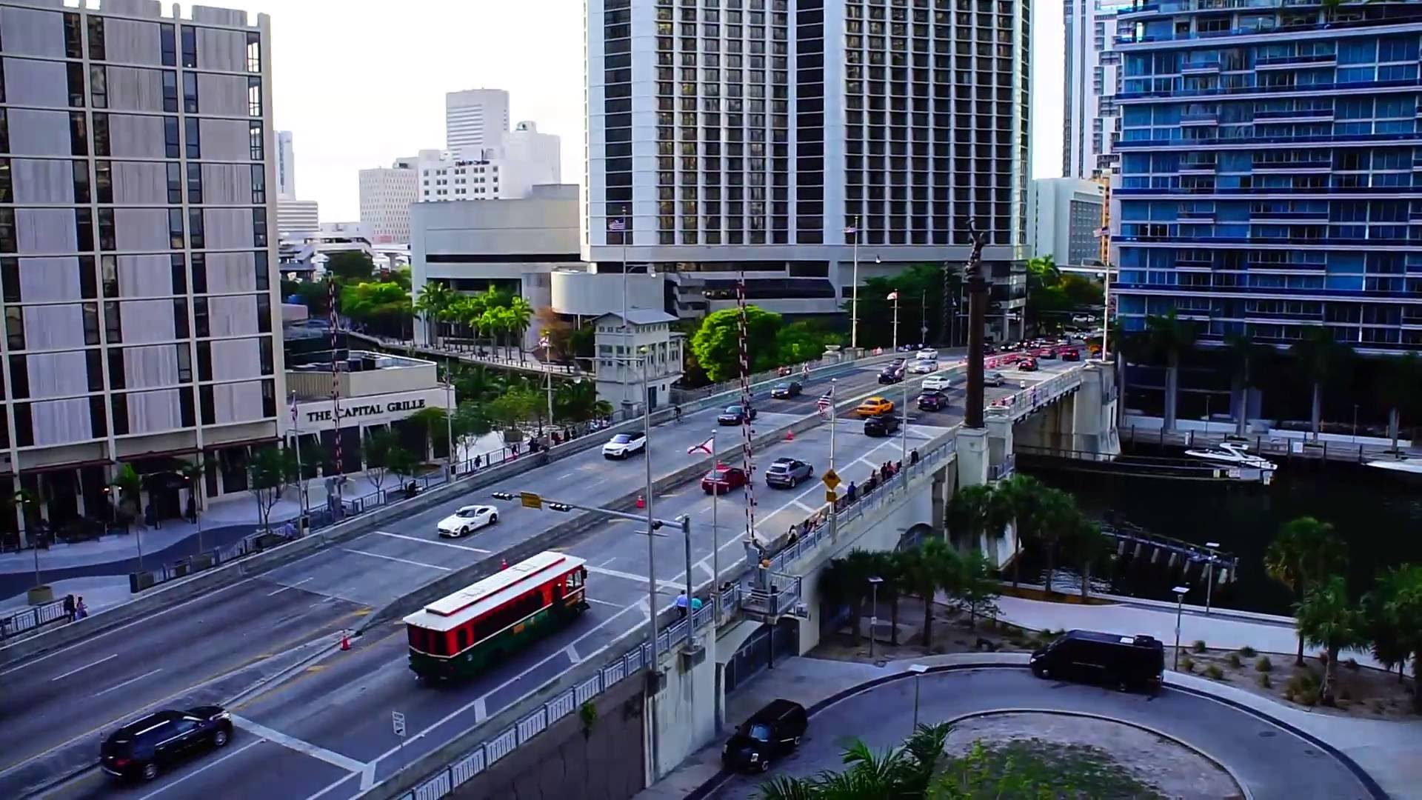
Miami-Dade Drawbridge Operations Guide Cont..
The partner agencies involved in this plan include:
United States Coast Guard– Sector Miami
Miami-Dade Department of Transportation and Public Works
Florida Department of Transportation
Town of Bay Harbor Islands
Florida East Coast Railway
Miami River Marine Group
City of Miami
City of Miami Beach
Jurisdictional Law Enforcement Agencies
South Florida Water Management District
United State Army Corps of Engineers
Florida Fish and Wildlife Commission
Port Miami
Miami Tunnel

Slide 11
Miami-Dade Drawbridge Operations Guide Cont..
The key time element in the decision-making process is the arrival, of tropical storm force winds (TSFW), which means gusts greater than 34 knots or 39 mph.
Action Item | Time (Hours)* | Notes
Notification | 72 | The EOC Infrastructure Branch Director will notify bridge owners and USCG that bridge lockdown is possible
Notification | 48 | Notify bridge owners and USCG that bridge lockdown is probable
Notification | 24 | Notify bridge owners and USCG that bridge lockdown is highly probable. Agree on a time to commence bridge lockdown (EOC, DTPW, FDOT, FEC, Bay Harbor Islands) and communicate with USCG
Bridge Lockdown | 8 | Commence Bridge Lockdown: Daylight hours to perform the lock down activities may be necessary and this may impact the time frame.

Slide 12
Miami-Dade Drawbridge Operations Guide Cont..
Drawbridges will operate under the directive from the USCG COTP:
Modified Operations – to facilitate vehicular evacuations the COTP may direct the drawbridges to modify their normal opening schedule.
Closed – drawbridges will not open to navigation unless directed by the COTP, this allows for the USCG to direct vessel movements as needed prior to the lock down. This phase will occur as TSFWs or severe weather is more imminent.
Locked – drawbridges are closed to vessel navigation. This will be during the duration of severe weather and until after the drawbridges and waterways can be assessed for damages.
There are two groups of drawbridges of concern in Miami-Dade County:
Group 1: Those over the Intracoastal Waterway (ICW) and others; the bridges on the east end of the 79th Street and Venetian Causeways and the 63rd Street Bridge over Indian Creek at Allison Island.
Group 2: Those over the Miami River (the swing bridge at the C-4 Canal will be included in the Miami River actions). NOTE: As of June 1, 2016, construction to convert the South River Drive Bridge from a swing bridge to a bascule bridge is scheduled to be completed by February 15, 2018. This will remain open for vessel traffic but no access for vehicles.

Slide 13
Miami-Dade Drawbridge Operations Guide Cont..
When a tropical storm or hurricane is threatening the South Florida Ports, the USCG Sector Miami will issue Marine Safety Information Bulletins (MSIBs) to inform the marine community on the condition of the ports. There are four port conditions.
USCG Port Condition | Time Period
Whiskey | Usually issued 72 hours prior to the arrival of TSFW
X-Ray | Usually issued 48 hours prior to the arrival of TSFW
Yankee | Usually issued 24 hours prior to the arrival of TSFW
Zulu | Usually issued 12 hours prior to the arrival of TSFW

Slide 14
Miami-Dade Drawbridge Operations Guide Cont..
Once TSFWs subside, the EOC Infrastructure Branch Director will notify the parties and consult with them regarding the decision to reverse bridge lockdown procedures. The bridge owners will, as rapidly as possible, survey the bridges to determine if there has been any damage or other condition that will prevent the return of a bridge to normal operations.
Each bridge owner will, as soon as possible, notify the EOC Infrastructure Branch Director when all their bridges will be operational, including the reason and duration of any anticipated delay, to be documented in WebEOC.

Slide 15
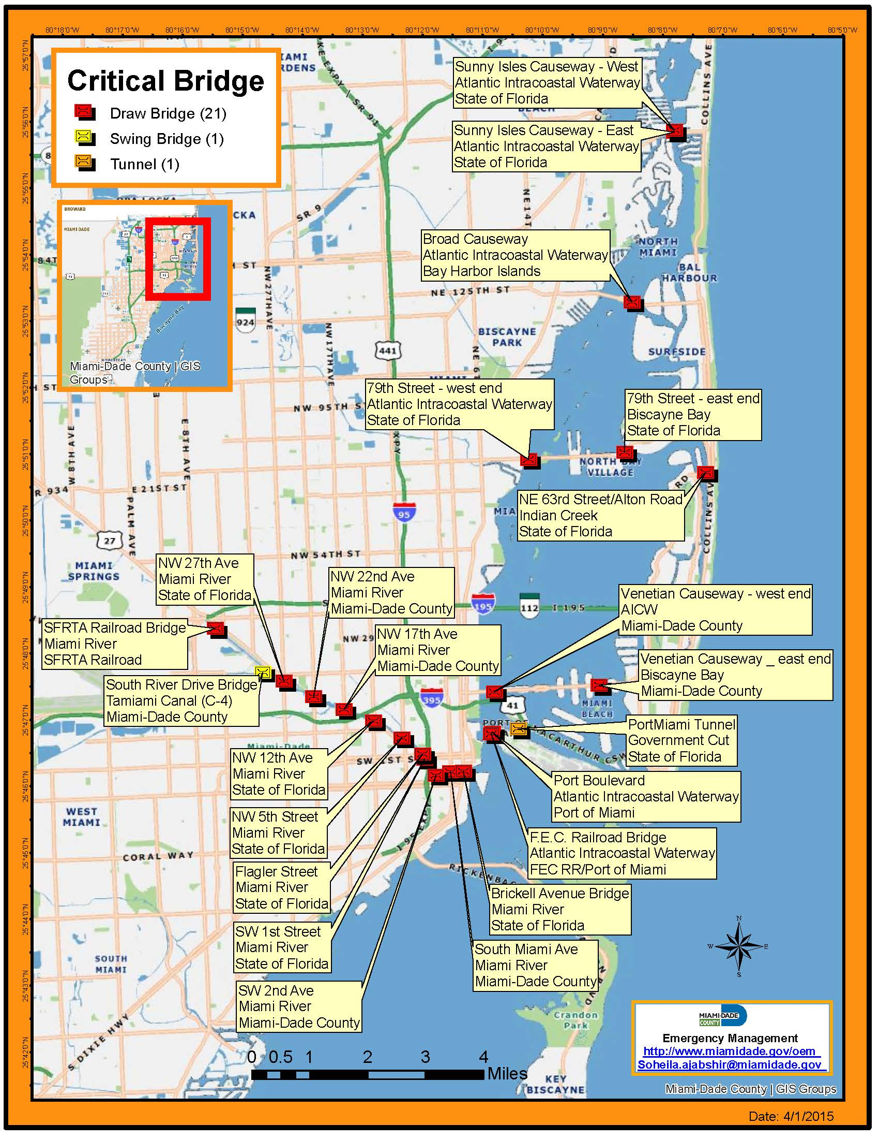

Slide 16
Hurricane Irma Port Operations
Miami-Dade Emergency Management and Port Miami participate on the daily Severe Weather Advisory Team conference calls.
Once the storm passed OEM was on the daily Statewide port call that provides updates on the various ports.
Port Miami went to Port Condition Zulu On Friday, Sept 8^{th.} The port was completely reopened by Sept 13th.
The major issues encountered in reopening the ports was vessels that sank in the channel. These boats needed to be located and their impact on navigation evaluated.
This process involved the US Army Corps of Engineers, NOAA and the Coast Guard.

Slide 17
Miami-Dade County Resilience Strategy
Miami-Dade County, the City of Miami and the City of Miami Beach are members of the 100 Resilient Cities initiative and have formed Resilient 305.
County Mayor Gimenez is a member of the City Leader Advisory Committee. This committee is a group of city chief executives that contribute their expertise to the global resilience movement.
Resilient 305 is currently beginning the 2nd phase of the project. This includes evaluating the strengths and areas of improvement for the county and developing the resiliency plan.

Slide 18
Miami-Dade County Resilience Strategy Cont..
Resilient 305 has identified the top shocks which are incidents that significant impacted the county in the past and the top stressors which are hazards and/or risks that could impact the county in the future.

Slide 19
Conclusion/Questions?
Steve Detwiler
Whole Community Recovery Planner
Miami-Dade County Office of Emergency Management
Desk #: 305-468-5423
steved@miamidade.gov

