Slide 1
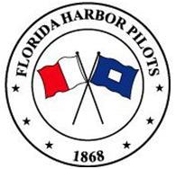
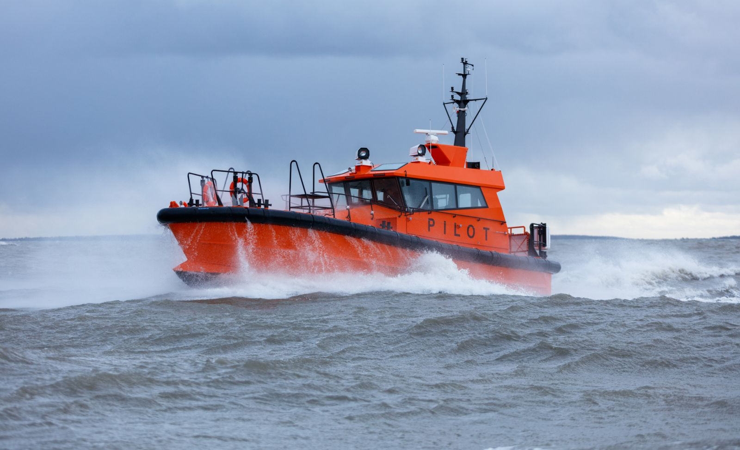
Florida Harbor Pilots

Slide 2
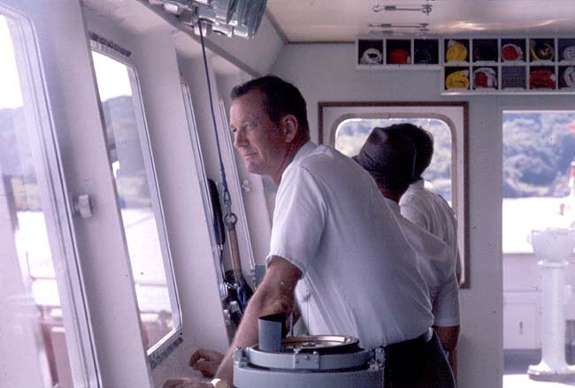
Pilots Responsibility - Safety
Florida Statute: Protect State Interest
Economy
Environment

Slide 3
Pilot’s Duties
Equipment working properly
Assess weather conditions
Order necessary number of tugs
Give helm and engine commands
Give commands to tugs
Protect State’s interest and other vessels in port.

Slide 4
Pilots Discretion
Keep ship from sailing/arriving for safety reasons
Number of Tugs Required
Draft Restrictions
Safety #1
Bottom Line: Immune from economic pressure

Slide 5
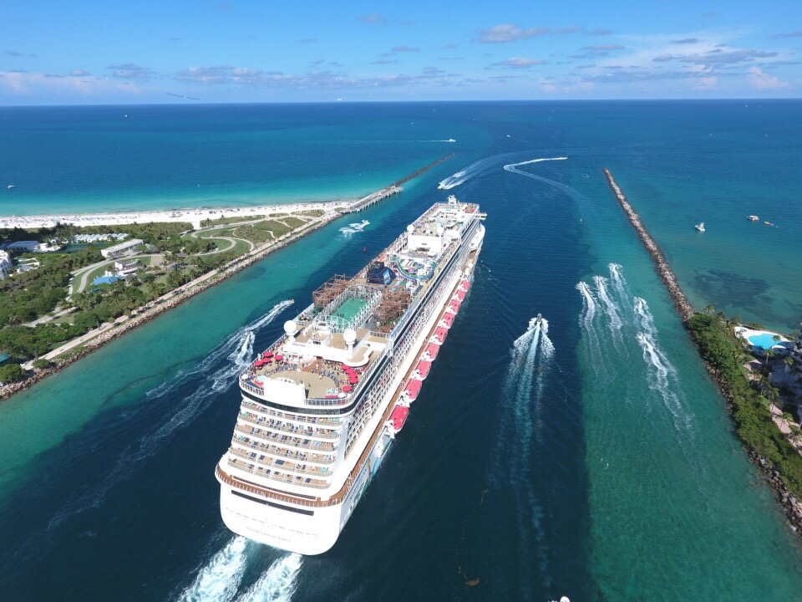
PortMiami

Slide 6
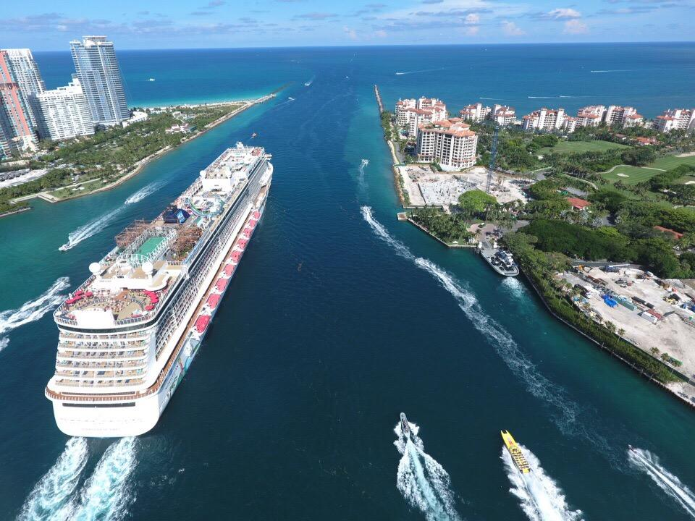
What is at Risk?
Economy
Environment
Jobs

Slide 7
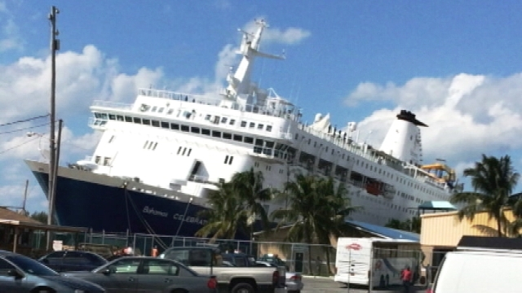
Why
Florida Channels – Single Point Failure
Ports: Economic impact for the State - 2016
Miami: $27 Billion
Port Everglades: $30 Billion
Florida Channel Widths: 450’ – 500’
In many instances one way traffic.
South Florida Channels – rock sided
Beam of ships entering Florida channels: Over 200’
Margin of error: Exponentially smaller than in past.

Slide 8
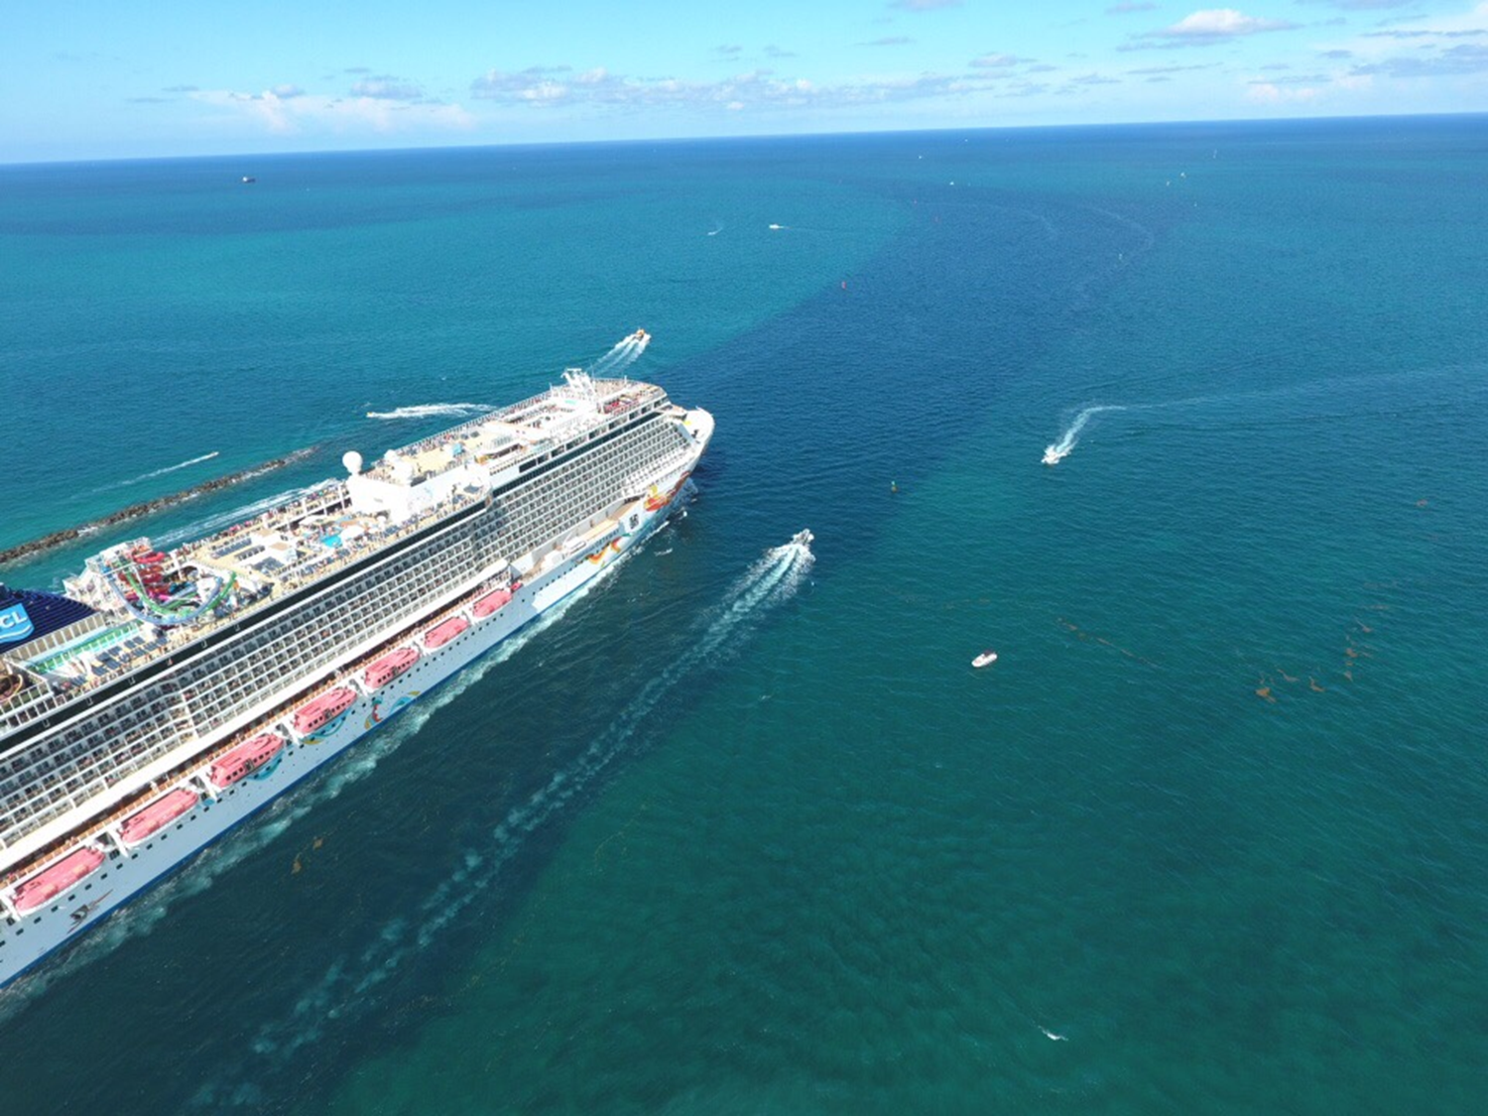
Rock sided Channels

Slide 9
PortMiami - 2016
Economic Impact more than $27 billion annually to south Florida’s economy *
Port provides direct and indirect employment for more than 207,000 jobs.*
* Florida Ports Council

Slide 10
Pilots Discretion
Keep ship from sailing/arriving for safety reasons
Number of Tugs Required
Draft Restrictions
Safety #1
Bottom Line: Immune from economic pressure
Answer to USCG and State!

Slide 11
Additional Duties
First Line of Defense – Terrorism
US Coast Guard – Port Safety
US Army Corps of Engineers - Dredging
Local & State Police – Port Protection
Report Oil Pollution - Reporting
Government Publications - Update

Slide 12
FHPA Initiatives
Hurricane Updates
Office of Emergency Management
Pilot boats used as vessels of Opportunity
FEMA Incident Command Certification - Pilots
Contingency Planning for Blocked Channel
Radiation/Nuclear Detection

Slide 13
Update as of 1500 - 9/11/2017.
Key West:
Status: Unknown - Only info is pilot's house did not flood!
Miami:
Channel surveys in progress with NOAA. The survey has identified sunken sailboats in the cruise ship turning basin. Cruise ships are expected to arrive tomorrow morning.
South channel (cargo ships) survey may not be completed until tomorrow.
USCG has asked pilots to verify positions of buoys, check ranges, etc.
Pilots are currently in the process of doing the aid to navigation survey using PPU (Portable Piloting Unit) computers which are very accurate.
Pilots have been ready to bring ships in since 1200 today and are currently working with federal & state authorities to open port as soon as possible.
.

Slide 14
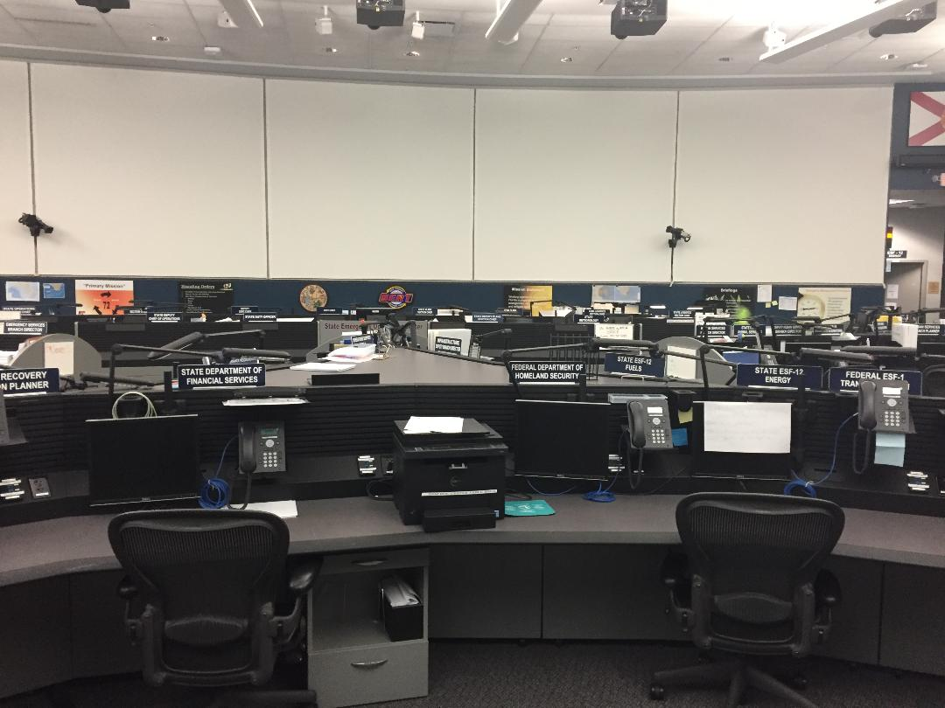
Fl. Emergency Operation Center

Slide 15
Sonar Equipment
Pilot boats used as vessels of opportunity
for sounding channels.
Why?
All weather boats
First vessels back in the port.
Large vessels and can accommodate portable sonar equipment.

Slide 16
FEMA Incident Command Courses

Slide 17
Contingency Planning for Blocked Channel
Blocked channel could have devastating consequences to economy, environment, and jobs!
Florida Division of Emergency Management.
Main Concern is keeping petroleum flowing.
Options being explored: DOD Assets, SPM’s, Rail car.

Slide 18
Port Everglades
Blocked Channel – Affect tourism and cruise industry.

Slide 19
Radiation/Nuclear Detection
Theory: Better to find out 5 miles offshore than when ship is at the dock.
Florida Pilots: First to use this technology
Proof of Concept
DARPA Technology – Discerning technology
Pilot Boat mounted
- Not only for ships but yachts/pleasure crafts.
Personal Detection Devices: Handheld

Slide 20
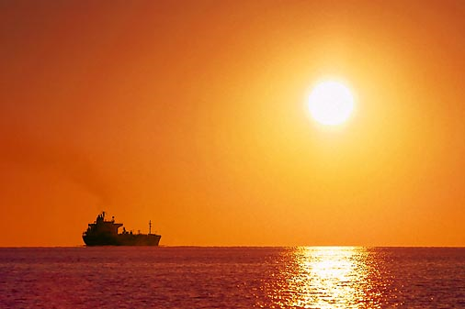
Florida Harbor Pilots
Questions

