Slide 1
National Spatial Reference System (NSRS) Modernization
Addressing Subsidence through Time-Dependent Positioning and Intra-Frame Velocity Models
Galen Scott
National Geodetic Survey
HSRP New Orleans Meeting
Thursday August 29th, 2019

Slide 2
National Spatial Reference System (NSRS) Modernization
The Earth in moving…. So where are we now?
Galen Scott
National Geodetic Survey
HSRP New Orleans Meeting
Thursday August 29th, 2019
Notes:
In 2022, the National Spatial Reference System will be modernized to take advantage of improvements in surveying and mapping technology and accuracy, with new tools and models being made available to better serve communities in regions experiencing land motion such as subsidence or uplift.

Slide 3
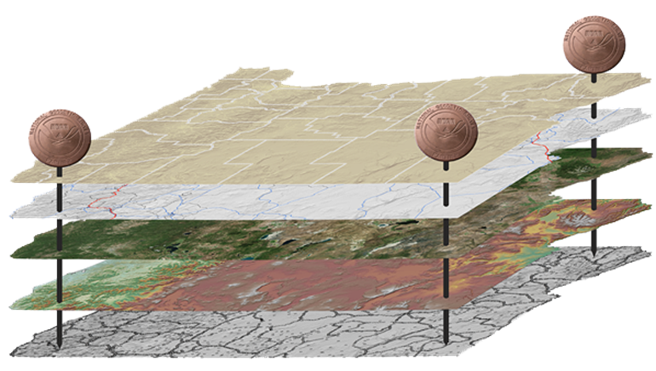
The National Spatial Reference System (NSRS)
NGS defines, maintains and provides access to the NSRS
North American Datum of 1983 (NAD 83)
North American Vertical Datum of 1988 (NAVD 88)
Latitude • Longitude • Elevation • Gravity • Shoreline Position
+ changes over time
Today’s NSRS
Notes:
The National Spatial Reference System
The system that NGS has created that meets these requirements and expectations is the National Spatial Reference System.
The National Spatial Reference System (NSRS) includes latitude, longitude and elevation in addition to the National Shoreline and geodetic control.
You can think about geodetic control is the “base map” layer at the base of GIS applications that will get everything aligned.
Two datums that make up the backbone of the NSRS today are:
North American Datum of 1983 (NAD 83)
North American Vertical Datum of 1988 (NAVD 88)

Slide 4
The National Spatial Reference System (NSRS)
NGS defines, maintains and provides access to the NSRS
Latitude • Longitude • Elevation • Gravity • Shoreline Position
+ changes over time
North American Terrestrial Reference Frame (NATREF 2022)
Caribbean Terrestrial Reference Frame (CATREF 2022)
Pacific Terrestrial Reference Frame (PATREF 2022)
Marianas Terrestrial Reference Frame (MATREF 2022)
North America and Pacific Geopotential Datum (NAPGD 2022)
Tomorrow’s NSRS
Notes:
The National Spatial Reference System
The system that NGS has created that meets these requirements and expectations is the National Spatial Reference System.
The National Spatial Reference System (NSRS) includes latitude, longitude and elevation in addition to the National Shoreline and geodetic control.
You can think about geodetic control is the “base map” layer at the base of GIS applications that will get everything aligned.
Two datums that make up the backbone of the NSRS today are:
North American Datum of 1983 (NAD 83)
North American Vertical Datum of 1988 (NAVD 88)

Slide 5
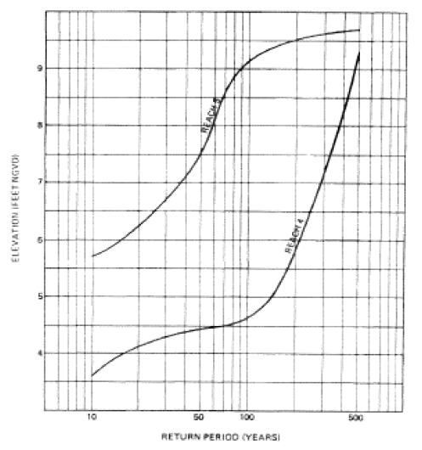
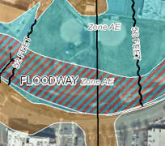
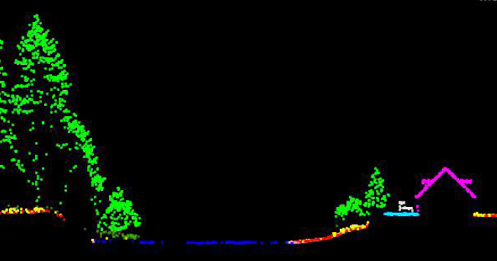
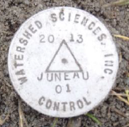
NSRS Use Case: Aligning Floodplain Mapping Data
Reliable FIRMs require data from disparate sources and dates be consistently aligned.
+
+
=
Airborne or mobile lidar data.
Stream hydrograph
Elevation certificate
Flood Insurance Rate Map
Notes:
Aligning Floodplain Mapping Data
Aligning everything sounds good, but I thought I’d spend a moment to give a floodplain mapping example to illustrate the importance. In my example,
we might collect airborne or mobile lidar data at some point in time using a particular type of technology;
next we’d generate a stream hydrograph, based on different data collected by a different group at a different point of time.
then, we have a surveyor would complete an elevation certificate using her technology at a different point of time.
Then, finally, we have our final product of a flood insurance rate map.
As you can see - just in the making of a single FIRM, data is collected a different points in time using difference methods, and must reliably be aligned and combined with historical data (in both horizontal and vertical), all to produce a final product in which all of this information is available in one place to assist the planner in appropriate flood mitigation.

Slide 6
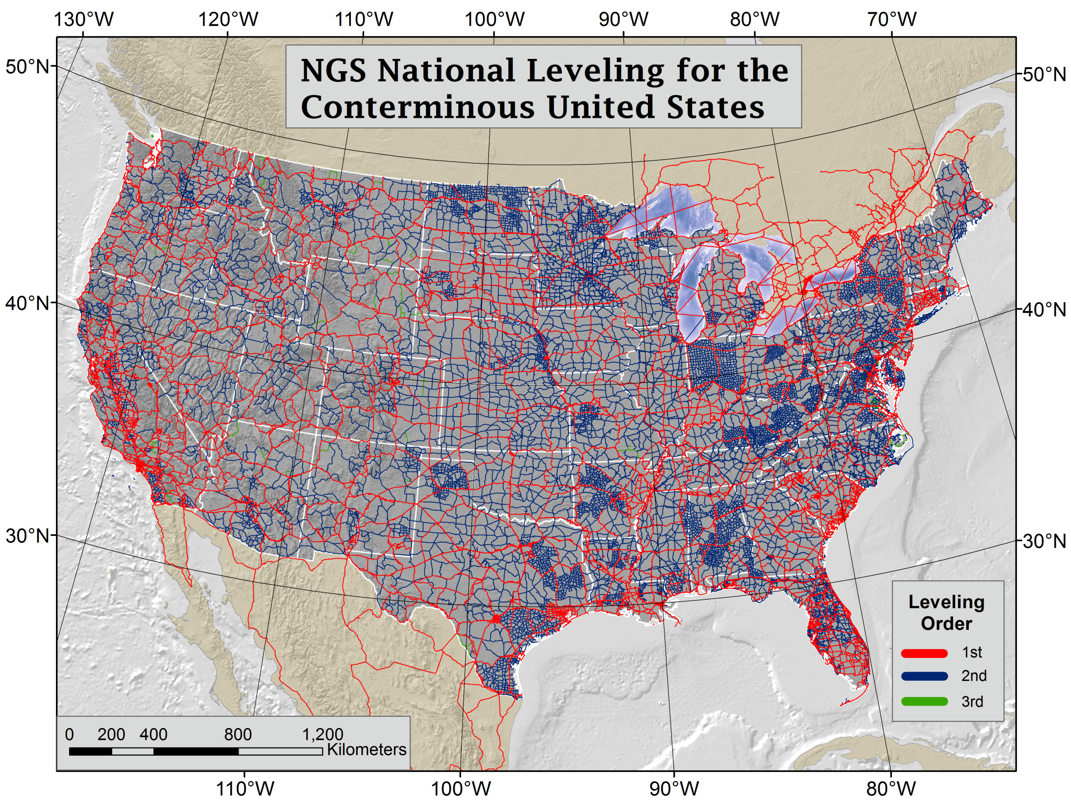
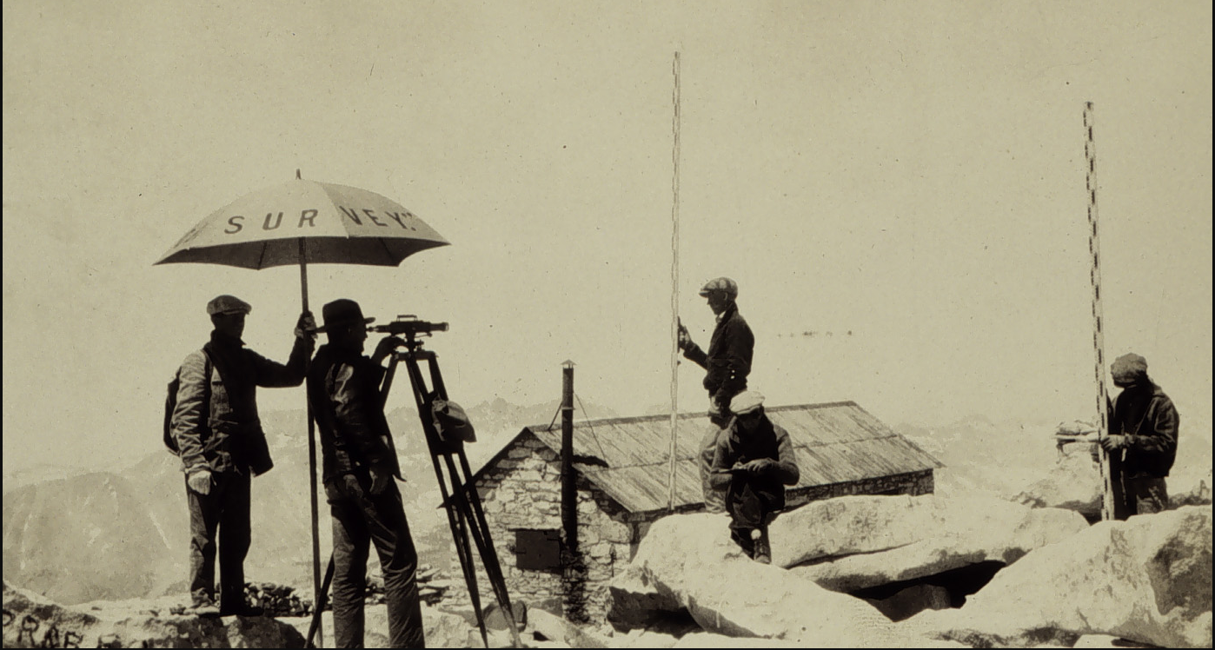
North American Vertical Datum of 1988 NAVD 88 - Geodetic Leveling Network
Notes:
NAVD 88 consists of about 800,000 benchmarks and ~2.2M km of leveling. Data was collecting over many decades by roving bands of surveyors who walked across the country multiple times over the years, east to west, north to south and back again. It is currently the official vertical datum of the US and is required for federal mapping projects.
GPS data on those leveled marks will be used to create the transformation tools that will be released with NAPGD2022.
Incredible effort – best tech at the time
But, long time period during which things were moving that we could not adequately account for
New reference frames will give coordinates at specific reference epochs and the IFVM will move coordinates through time from the survey epoch to the reference epoch.

Slide 7
Why 2022 NSRS Modernization?
NSRS Modernization will better serve communities in regions experiencing land motion such as subsidence or uplift.
Main Driver: Global Navigation Satellite Systems (GNSS)
ACCESS ACCURACY CONSISTENCY
Notes:
ACCESS!
GNSS equipment is fast, inexpensive, reliable (and improving)
Reduces reliance on finding survey control (“bench marks”)
Accuracy!
Insensitive to distance dependent errors; reliable
Immune to bench mark stability (referenced to CORS)
Consistency!
Eliminates systematic errors in current datums
Aligned with global reference frames
Integrated system for both positions and heights (“elevations”)

Slide 8
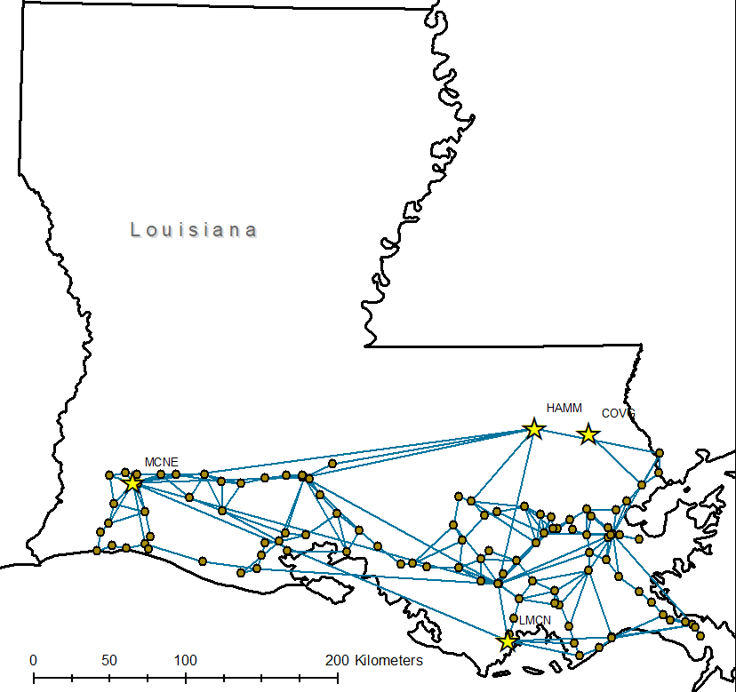
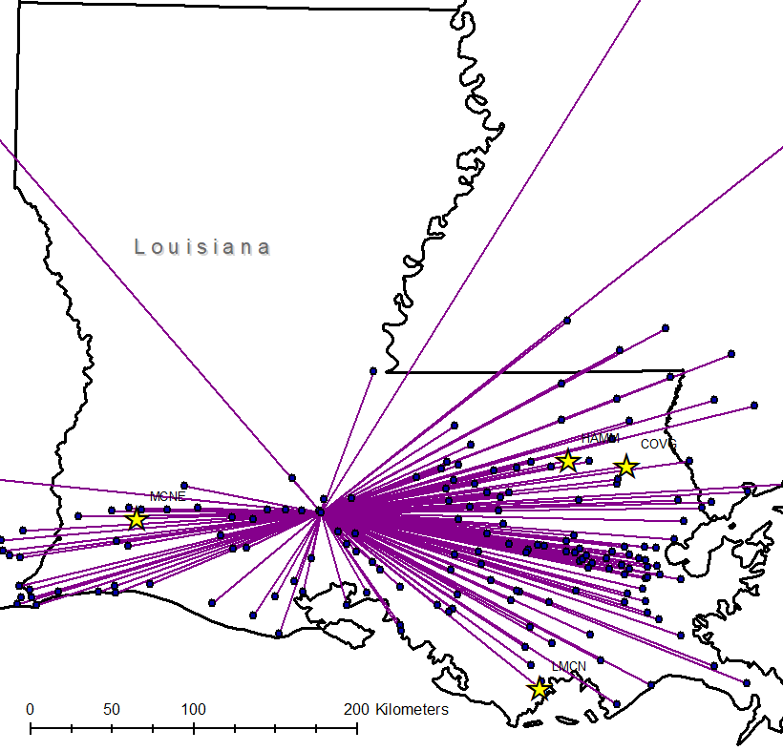
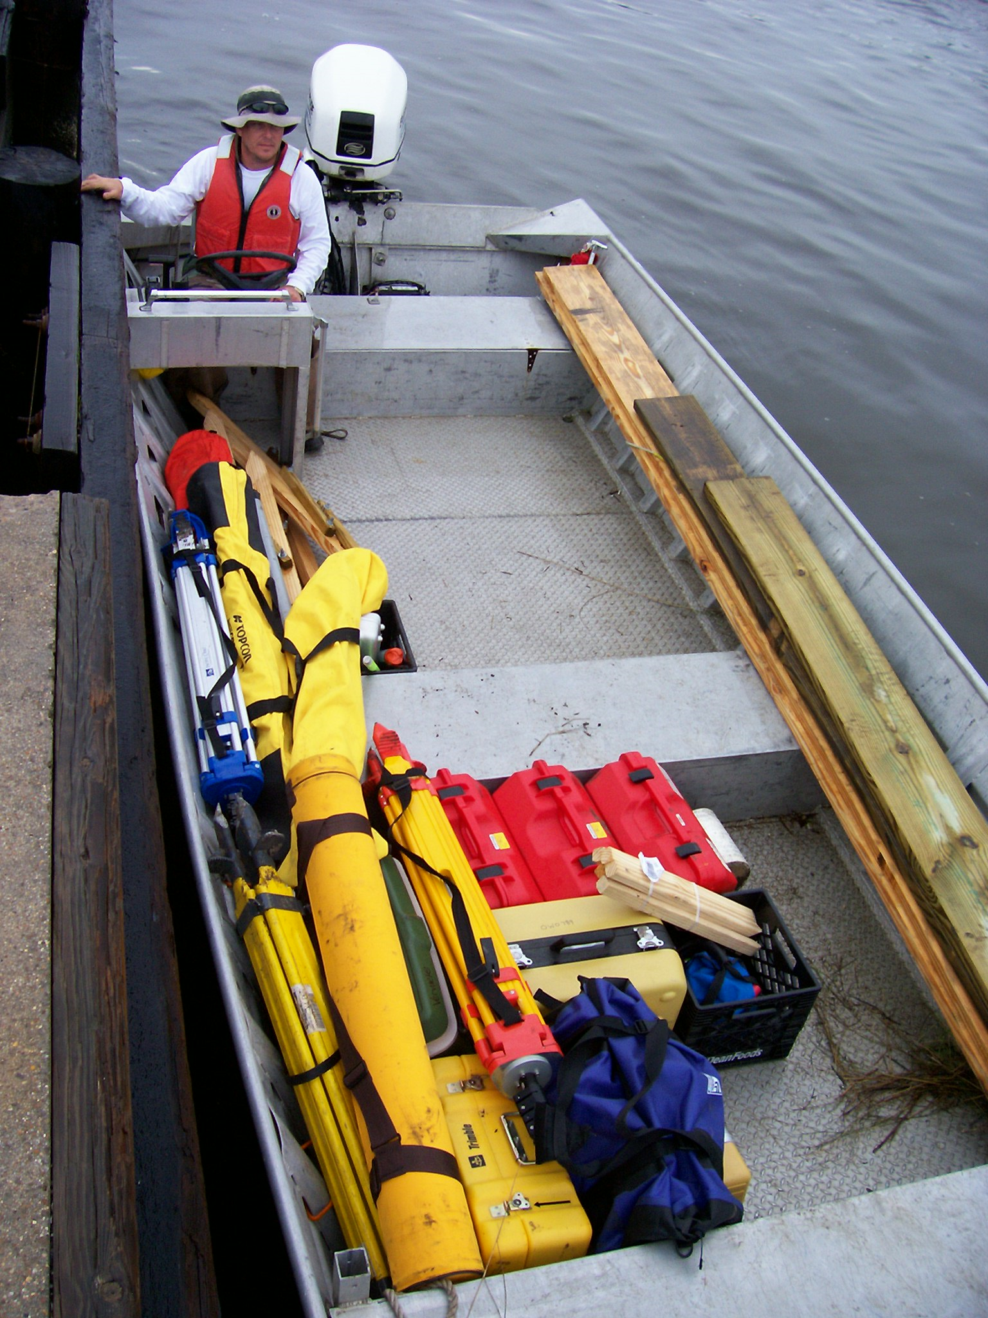
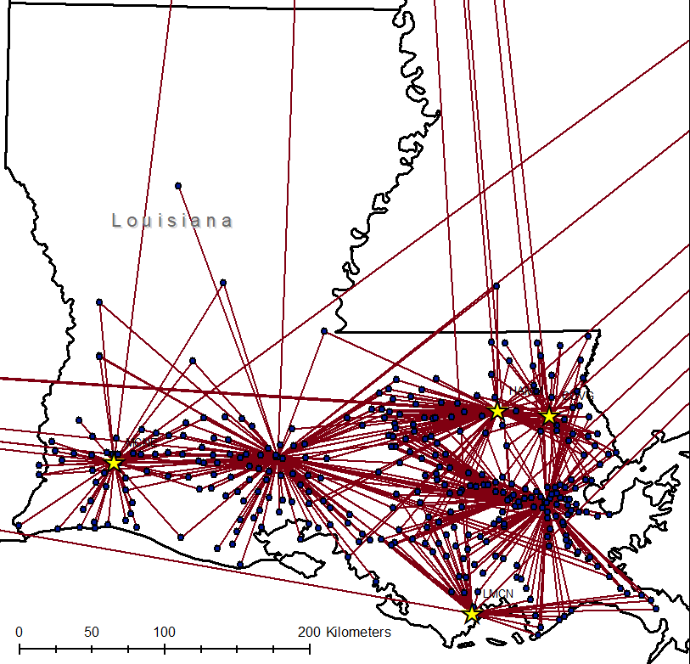
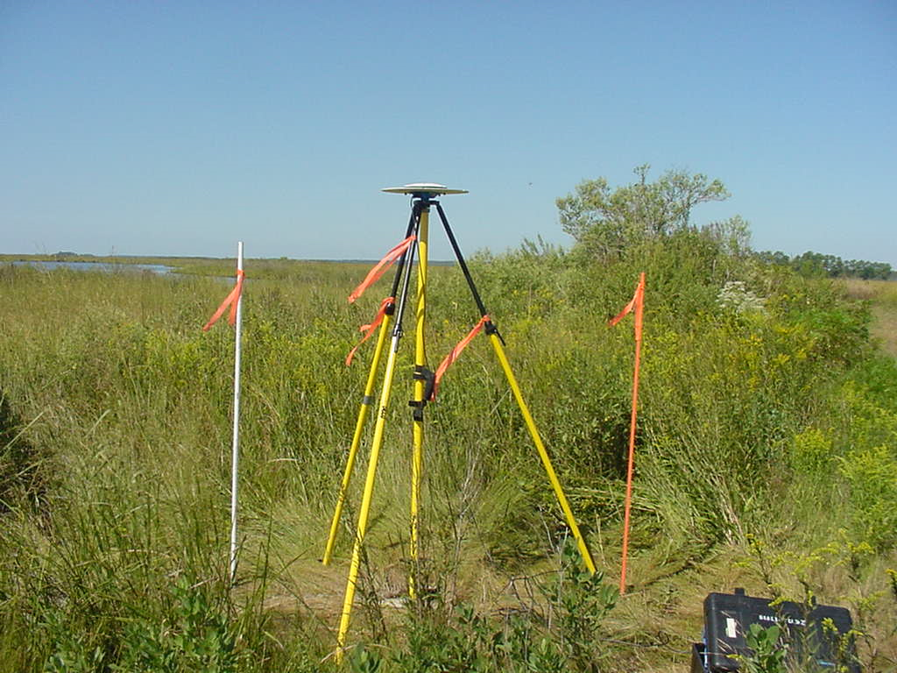
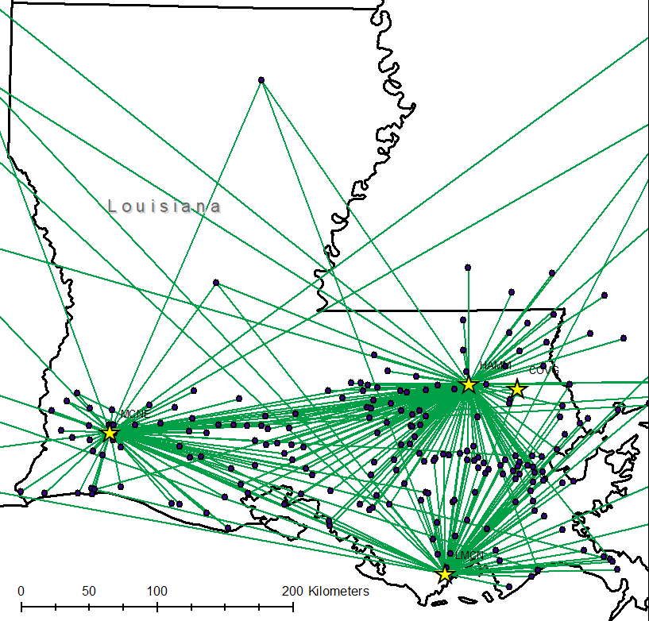
Louisiana GPS Surveys
GPS surveys to update the NSRS
97 stations were tied in 3 surveys
55 stations were tied in all 4 surveys
2004
2010
2006
2016

Slide 9
In today’s NSRS, a height is held fixed until replaced. So plotting the height over time would look like this:
2.250
2.200
h
2.150
2.100
2.050
2.000
1990
‘95
‘00
‘05
‘10
‘15
‘20
‘25
‘30
time

Slide 10
In the modernized NSRS we will also have an estimate of crustal motion from IFVM2022
2.250
In the absence of new survey data, error estimates will
grow through time.
2.200
h
2.150
2.100
Reference Epoch Coordinates
provide a consistent time frame to
compare surveys done at different times
2.050
2.000
1990
‘95
‘00
‘05
‘10
‘15
‘20
‘25
‘30
time

Slide 11
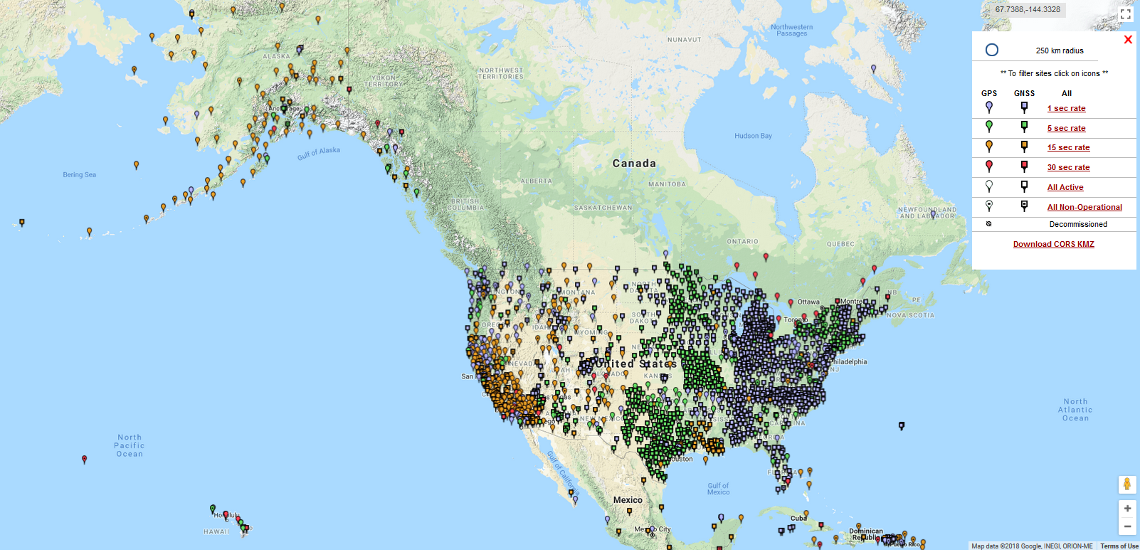
Intra-Frame Velocity Model (IFVM)
The IFVM will be used to move coordinates through time from the date of the survey to a Reference Epoch (2020, 2025, 2030 etc) so that surveys conducted at different times can be related to each other.
Approaches being considered to create the IFVM:
Gridding CORS
CORS+Geophysical Modeling
CORS+InSAR

Slide 12
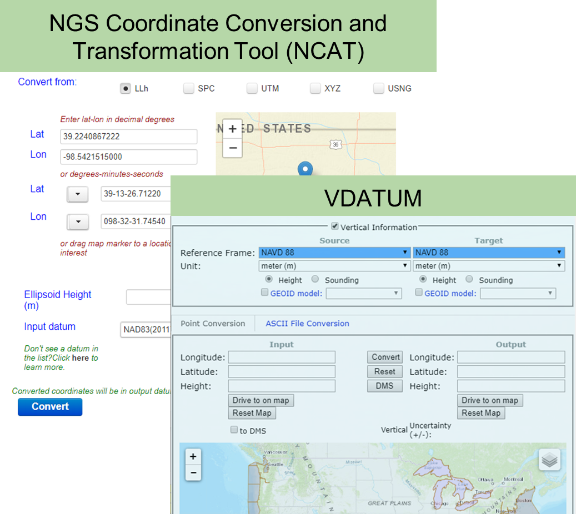
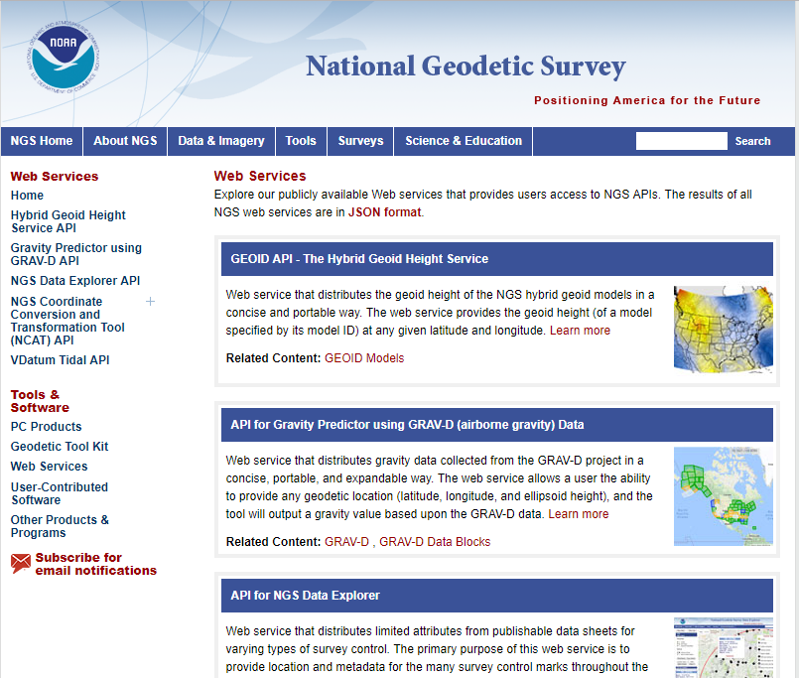
Updated Tools for the Modernized NSRS
Online Positioning User Service
Web Services

Slide 13
Questions?
Galen Scott
National Geodetic Survey
Acting Constituent Resources Manager
Galen.Scott@noaa.gov

Slide 14
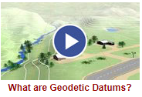
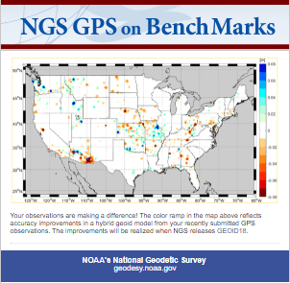
Learn more at geodesy.noaa.gov
Educational Videos
Online Lessons
NGS Testing and Training Center
Monthly Webinar Series
Notes:
Videos are 5 minutes or less
More than 185,000 views
Lessons
More than 1,200 quizzes
More than 6,200 sessions
More than 40 recorded webinars
More than 7,500 webinar attendees
Training webinars and In-person classes on OPUS Projects and Geodetic Leveling

