Slide 3
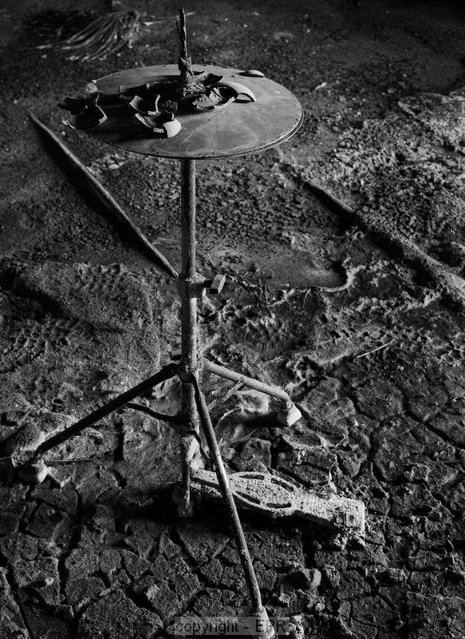

Slide 6
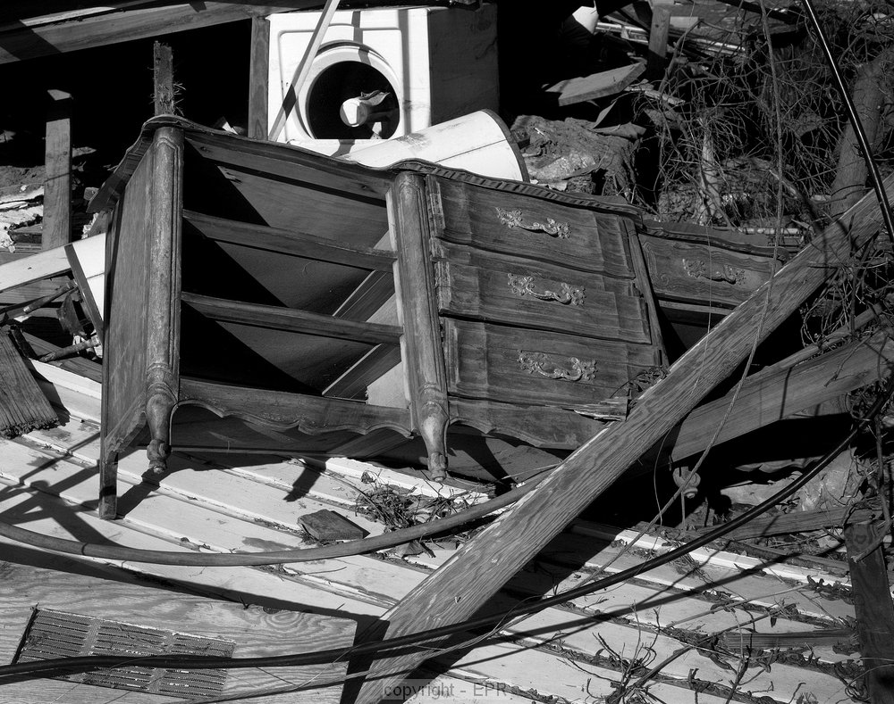

Slide 7
Photo credit: Edward P. Richards

