Slide 1
Hydrographic Services Review Panel FAC
Rick Luettich
University of North Carolina at Chapel Hill
Hydrographic Services Review Panel
Stake Holder Perspectives
August 27-29, 2019, New Orleans, LA

Slide 2
About: Coastal Modeling Community
Academics, mission agencies, private sector, NGOs needing to make water related predictions in the coastal zone
Academics – research (~2 dozen universities)
Process understanding
Model development and assessment
Model applications for complex problems – pre-transition
Mission agencies – e.g., USACE, NOAA, USGS, FEMA, USCG, EPA, LA CPRA
Hazard assessment – NFIP
Hazard mitigation design & operations – HSDRRS, LA Master Plan, SLFPAE
Navigation – tides and currents, PORTS, VDatum
Ecosystem prediction – HABS, dead zones, fisheries, ecosystem health
Event based decisions - evacuation, search & rescue, emergency response
Private sector & NGOs – e.g., consulting companies, Water Institute
Specialized expertise to support governmental sectors & businesses not having in house capability

Slide 3
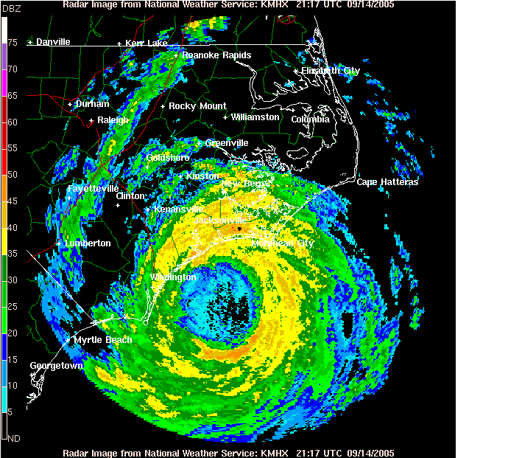
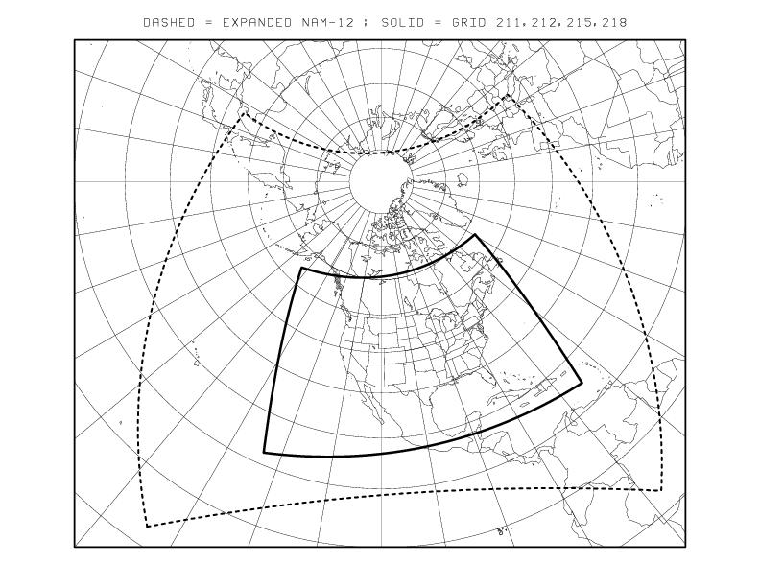
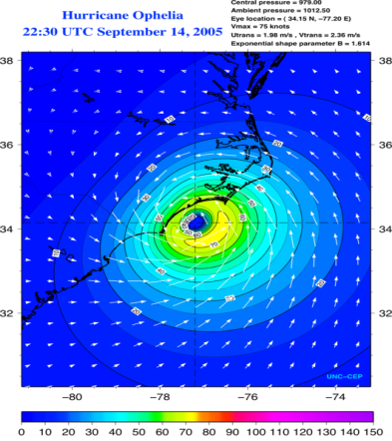
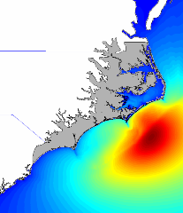
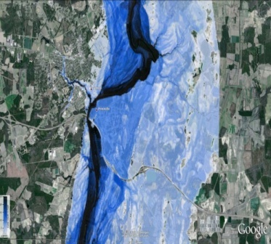
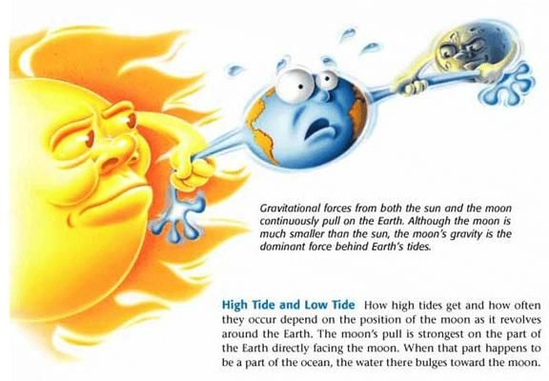
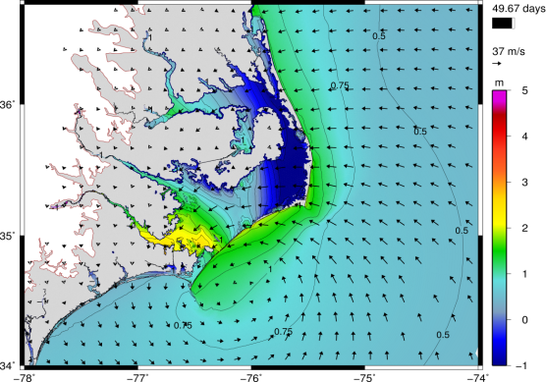
Usage of NOAA Navigation Services, products & services
Precipitation
Atmospheric Model
SWAN Wave Model
Wave Forcing
ADCIRC Coastal Hazards Modeling System
River
Forcing
Pressure and Wind Forcing
Tides
Surge/Inundation Response

Slide 4
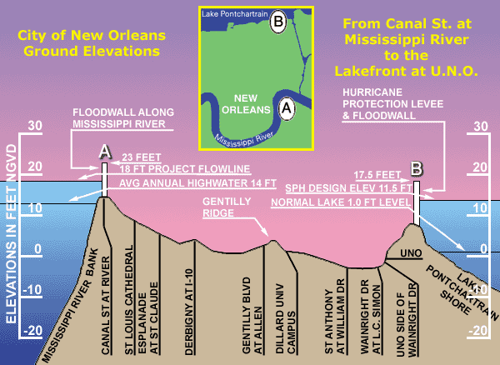
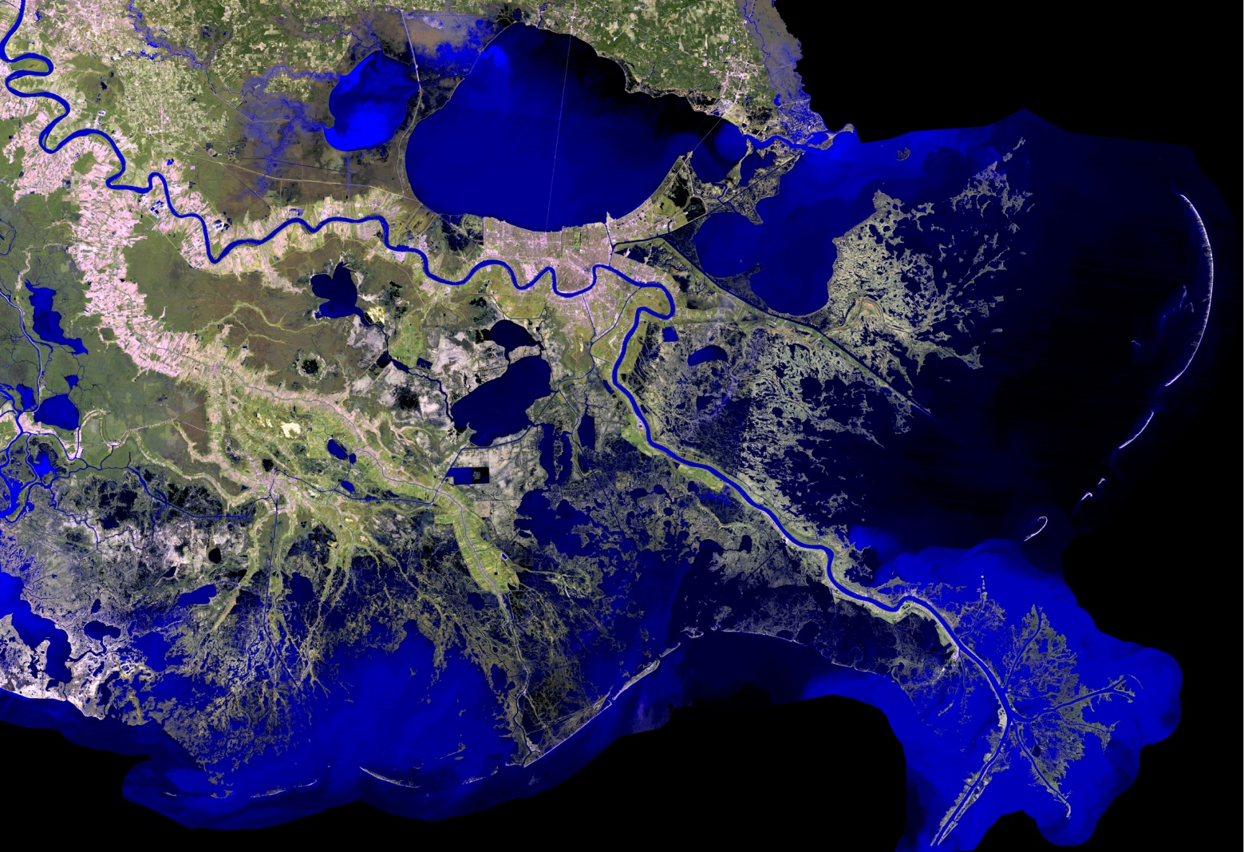
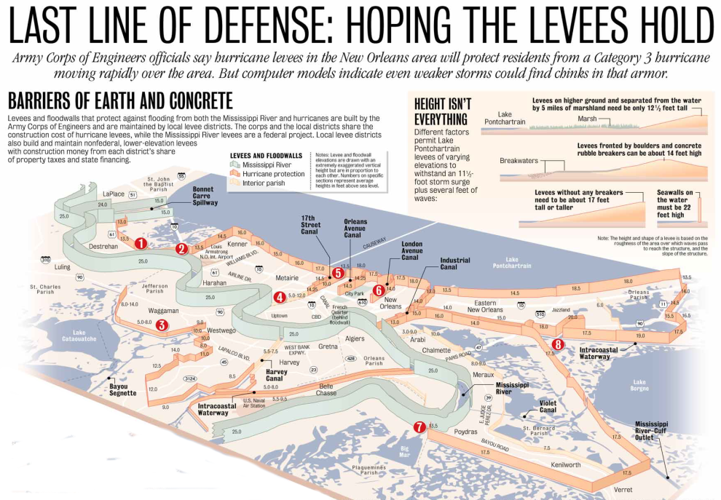
Usage of NOAA Navigation Services, products & services
Place based model implementation

Slide 5
Usage of NOAA Navigation Services, products & services
Place based model implementation

Slide 6
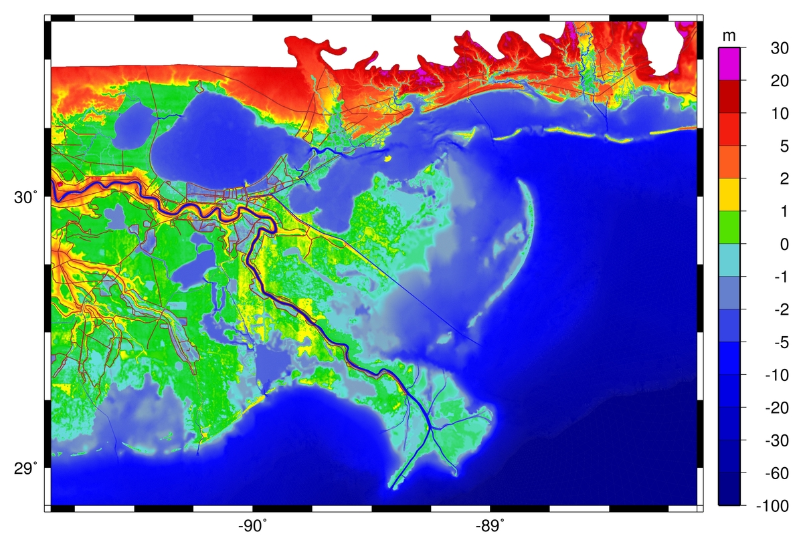
Usage of NOAA Navigation Services, products & services
Place based model implementation

Slide 7
Requests for NOAA Navigation Services data, products, and services
Key data, products and services
Up to date coastal bathymetry and topography
Well defined coastal datum tying water & terrestrial elevations – flooding models require knowledge of MSL and land surface
Robust coastal water level gauge network
Historical - model assessment and calibration
Real time availability - allows data assimilation to improve event based forecasts
Interagency collaboration on products and services in coastal waters & inland waters – assist with predicting compound flooding

Slide 8
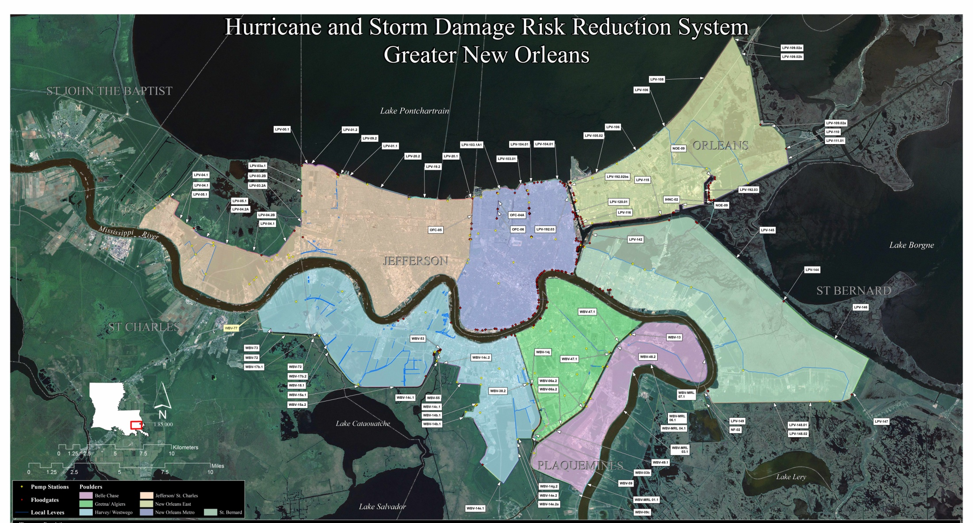
Real impacts of NOAA Navigation Services data, products & services
Living with Coastal Flood Risk in Greater New Orleans

Slide 9
Real impacts of NOAA Navigation Services data, products & services
A few statistics
270 miles of levees and floodwalls including MR River and perimeter
11 navigable flood gates
311 land based flood gates
The Forever Need
Continuously assess if risk reduction system still provides expected protection to GNO. If not, what improvements are needed given:
relative sea level rise = land subsidence + sea level rise
levee settlement
climate related change in storm statistics
Assist authorities during storm events
operate risk reduction system - considering navigation and flood protection
make evacuation and myriad emergency response decisions

Slide 10
Contact Information:
Rick Luettich
University of North Carolina at Chapel Hill
rick_luettich@unc.edu

