Slide 1
Hydrographic Services Review Panel FAC
Renee Collini
NGOM Sentinel Site Cooperative/MS-AL Sea Grant/Mississippi State University
Hydrographic Services Review Panel
'Tools: Renovate before you build' - and other bad analogies to explain what Gulf stakeholders need to address sea-level rise
August 27-29, 2019, New Orleans, LA

Slide 2
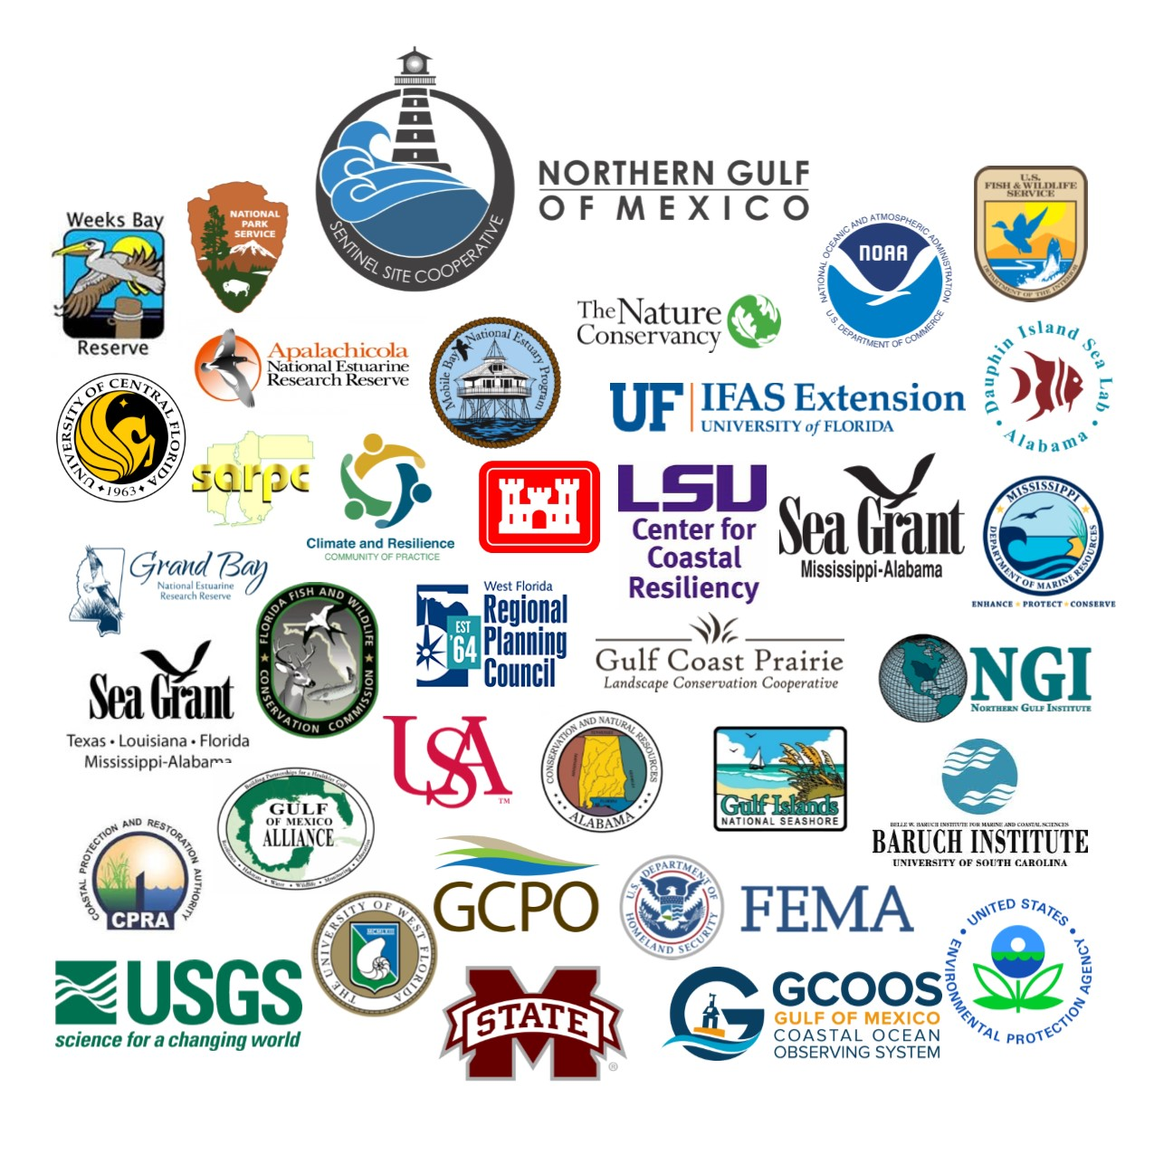
About NGOM Sentinel Site Cooperative
Partnership focused on sea-level rise
Science, Service, and Stewardship
?

Slide 3
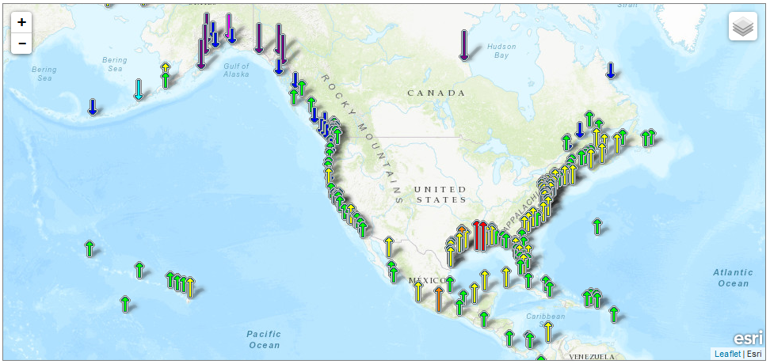
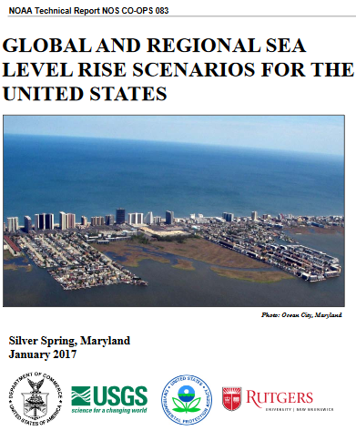
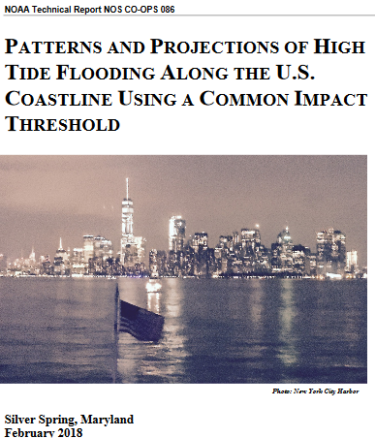
Usage of NOAA Navigation Services, products & services
Spoke with 3 groups
Extension and outreach professionals
Coastal decision-makers
Researchers
Aerial imagery
SLR projections
Historical water-level trends

Slide 4
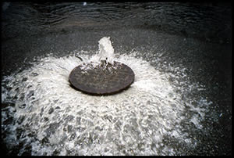
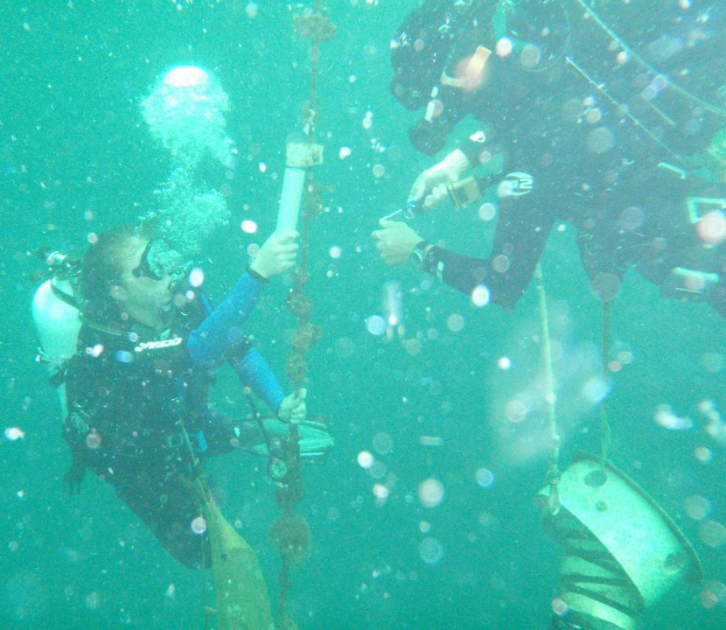
Usage of NOAA Navigation Services, products & services
Tides and currents – operational purposes
Tide gauge information
Rates of SLR
Datum info/services
NGS services
Photo credit: Wikipedia

Slide 5
Requests for NOAA Navigation Services data, products, and services
Data Needs:
SLR observation infrastructure gaps
NWLON
CORS
Contextualize/connect datasets
Subsidence data with tide gauge data
Couple aerial imagery with tide gauge observing data
Nearshore, shallow, turbid coastal aerial imagery in “non-priority” areas

Slide 6
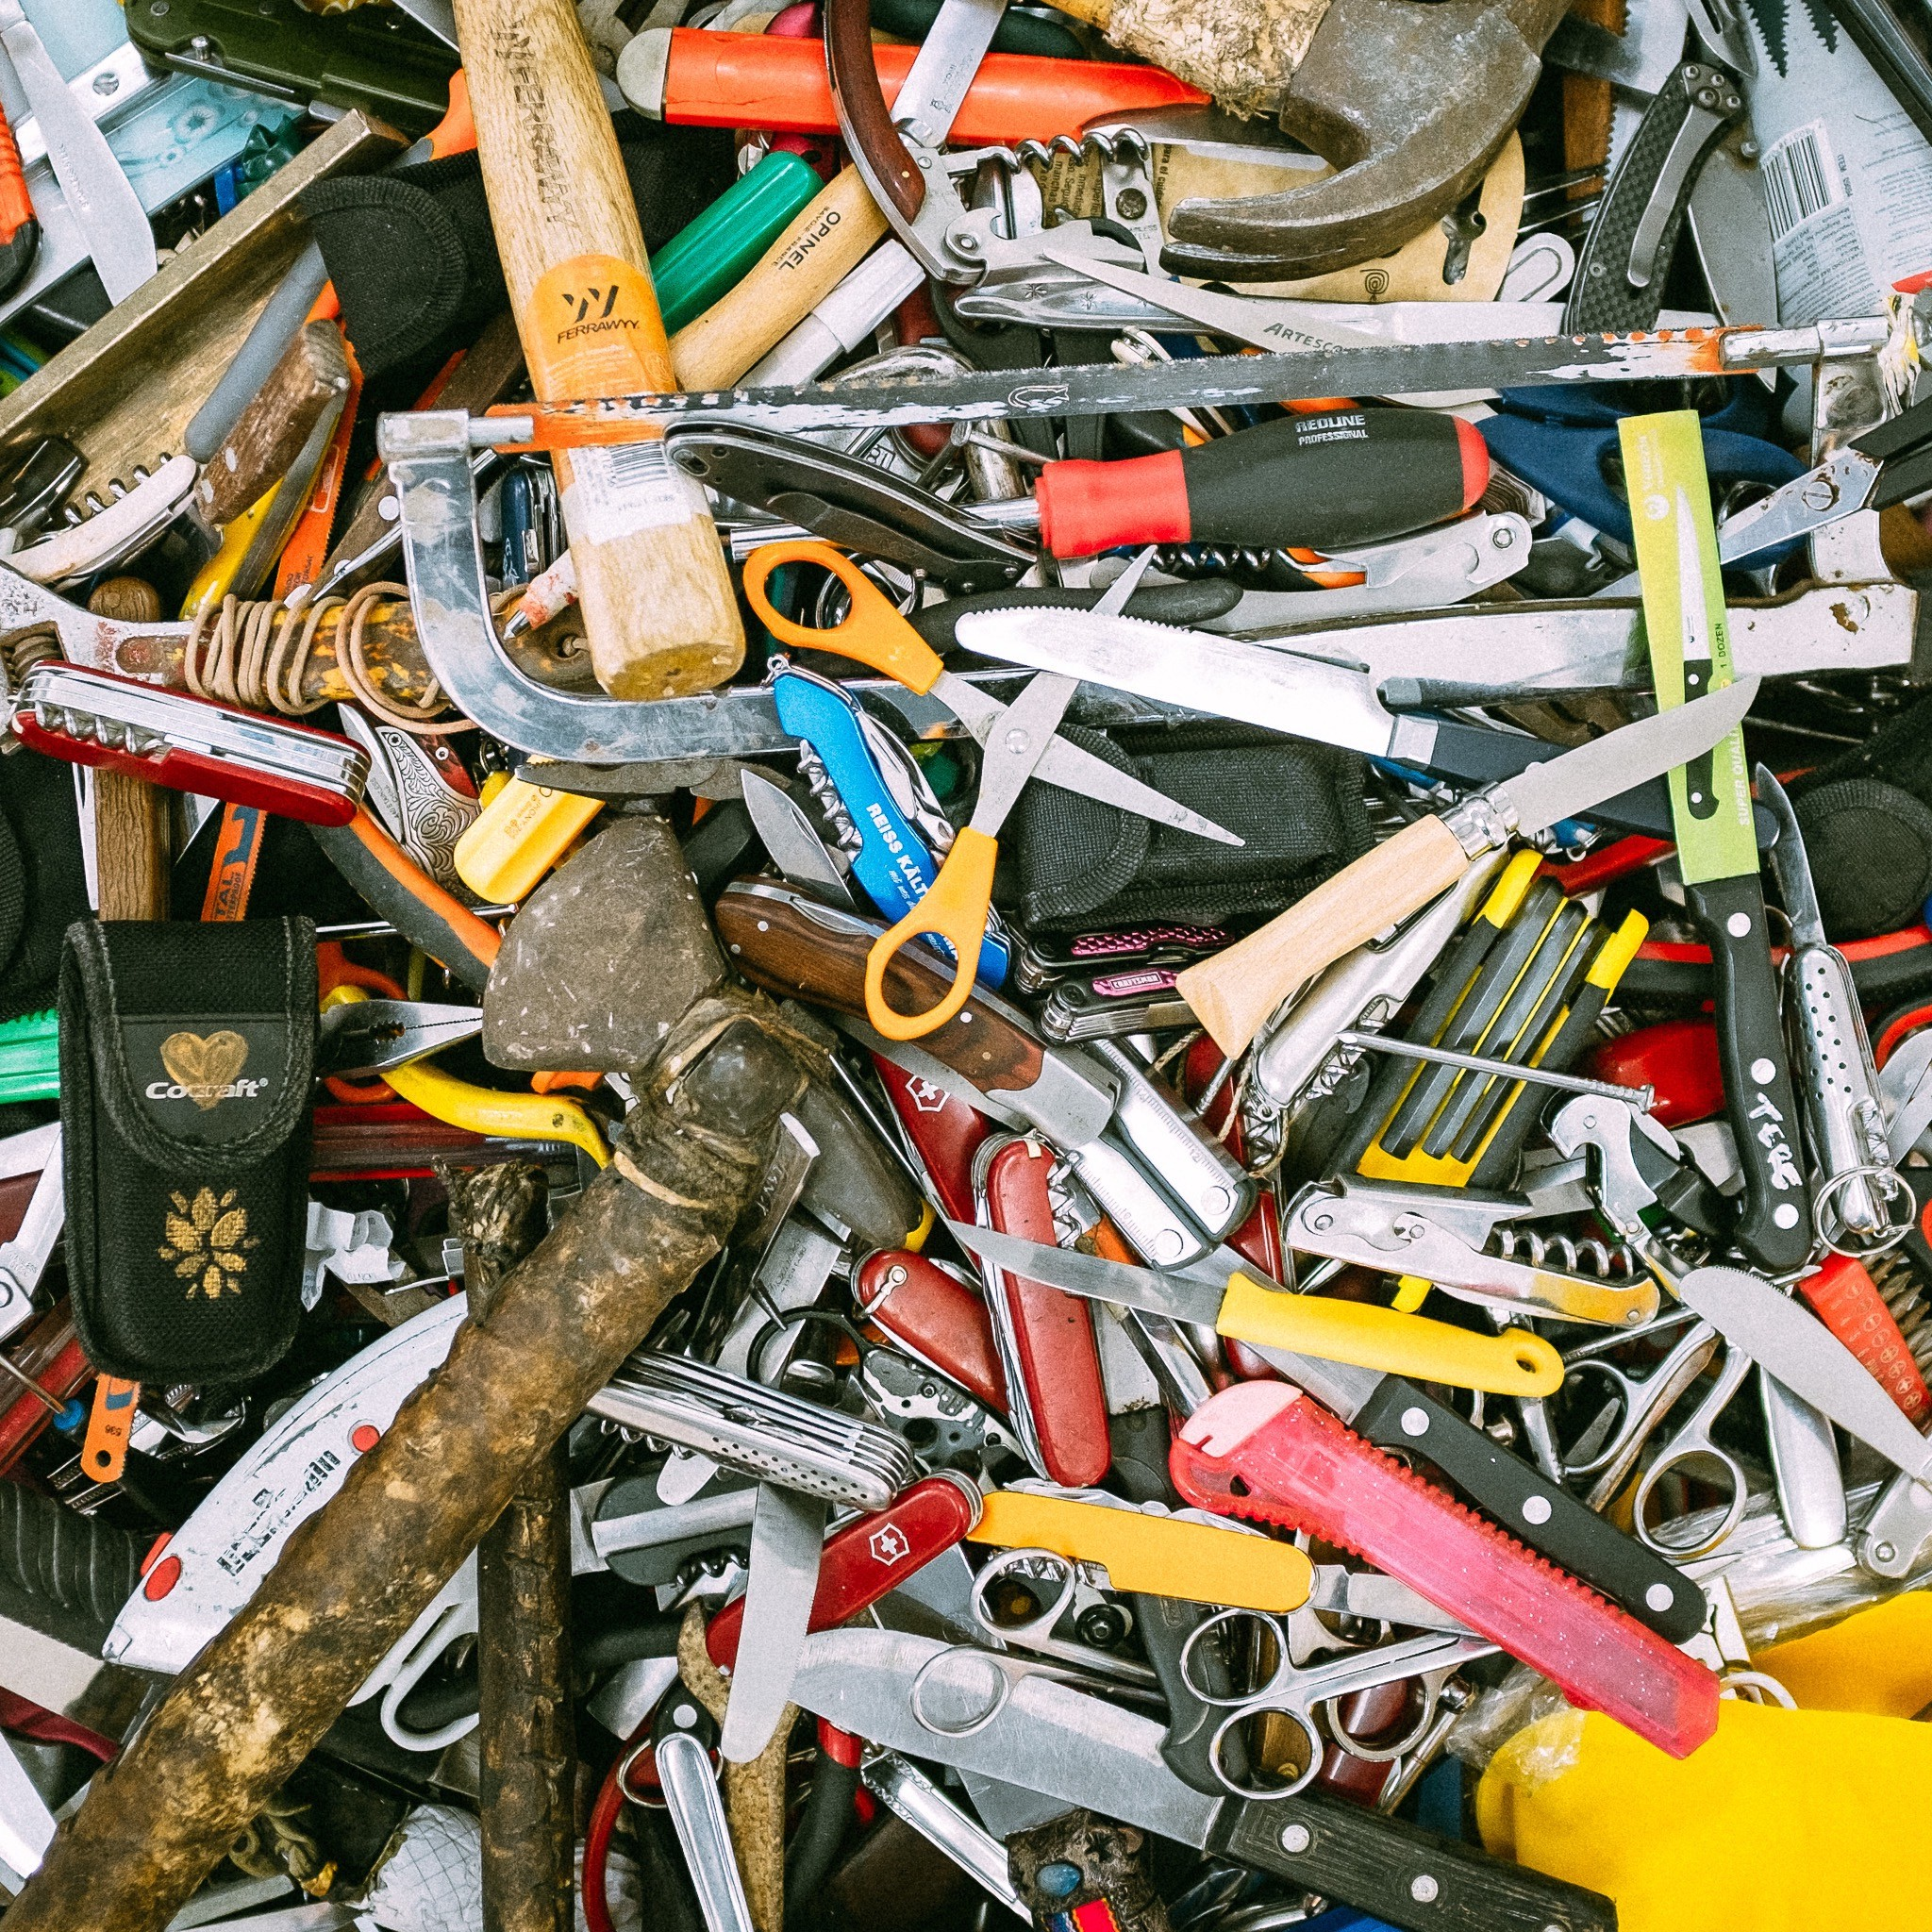
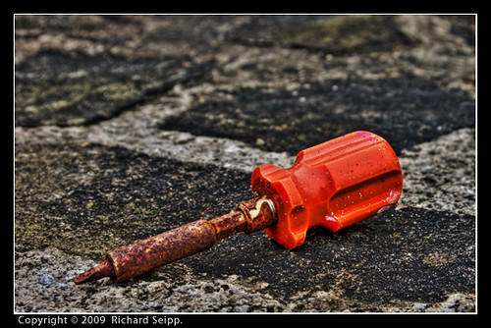
Requests for NOAA Navigation Services data, products, and services
“Happiness is a place between too little & too much” – Finnish Proverb
What additional tools & services are needed?
5% - no more tools
9% - increased capacity
13% - technical assistance
13% - weren’t sure
5% - increased awareness
*Around one third wanted case specific help, and not all of those were tools.
Happiness?

Slide 7
Requests for NOAA Navigation Services data, products, and services
“Happiness is a place between too little & too much” – Finnish Proverb
Renovate before you build
Organization of current resources
Technical support
Lean on existing outreach/ Extension services

Slide 8
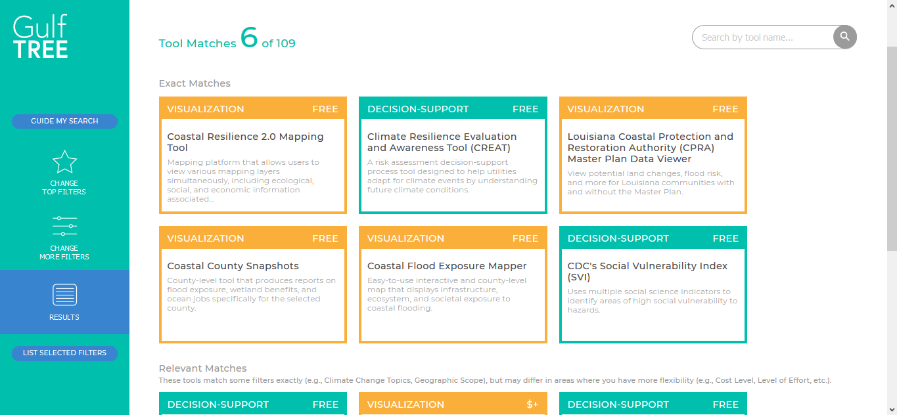
Requests for NOAA Navigation Services data, products, and services
Renovate before you build
New tool = end-user investment
Evaluate current tools
Impact & improvement
Organization
“bring existing family of tools together in a searchable database by problem or need”
“easier to find or simpler guidelines on estimate RSLR”
“clarity on available imagery data from across NOAA sources based on location”

Slide 9
Requests for NOAA Navigation Services data, products, and services
Technical support
Datum conversion calculators & guidance
On-the-ground people
“really miss our [Florida NGS] advisor. We are a big state and are currently sharing… we need help establishing key assets”
Existing outreach/Extension services
Delivery
Socialize data and information
Communicate science clearly
Help w/tool development & evaluation
ID gaps
ID existing tools to adapt/enhance

Slide 10
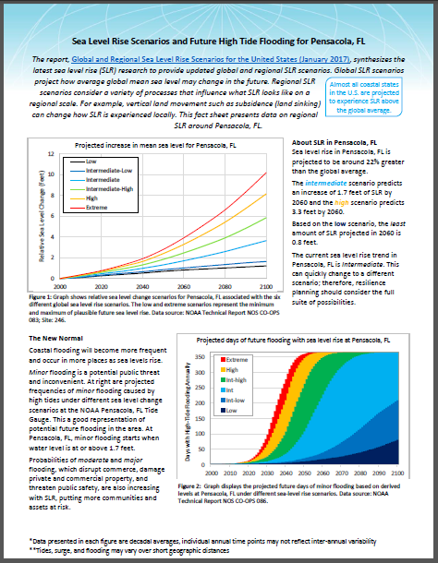
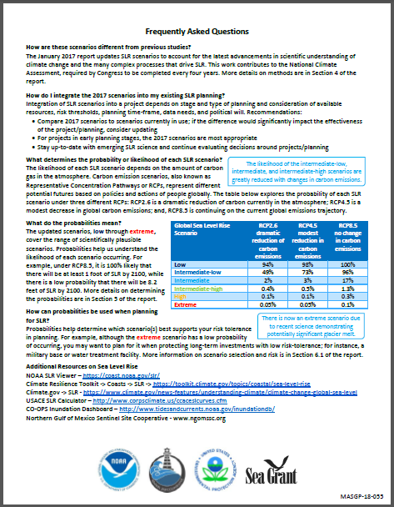
Real impacts of NOAA Navigation Services data, products & services
NOAA Technical Report CO-OPS 083
Global and Regional Sea Level Rise Scenarios for the United States
Met a clear need
Locally-relevant information
Contextualized scientific information
Worked w/Sentinel Site Cooperatives for delivery
Template and Data Analysis Helper
Standardized sharing
Easily accessible
SLR projections are being used at their full potential
Restoration projects
Planning efforts
SLR communication

Slide 11
Contact Information:
Renee Collini
NGOM Sentinel Site Cooperative/MS-AL Sea Grant/MSU
r.collini@msstate.edu • 228-546-1044

