Slide 1
Louisiana’s coastal program
Brian Lezina
Coastal Protection and Restoration Authority
Hydrographic Services Review Panel
August 27-29, 2019
committed to our coast
committed to our coast

Slide 2
CPRA
Single state entity with authority to articulate a clear statement of priorities to achieve comprehensive coastal protection and restoration for Louisiana.
Mandate is to develop, implement, and enforce a comprehensive coastal protection and restoration master plan.
committed to our coast

Slide 3
Louisiana’s Coastal Program

Slide 4
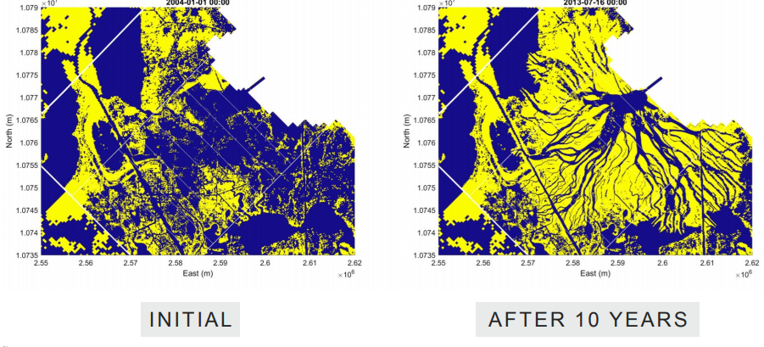
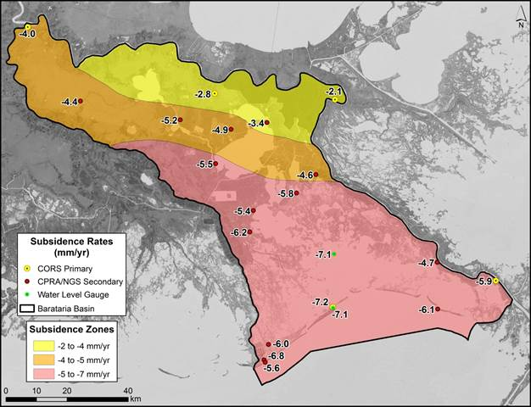
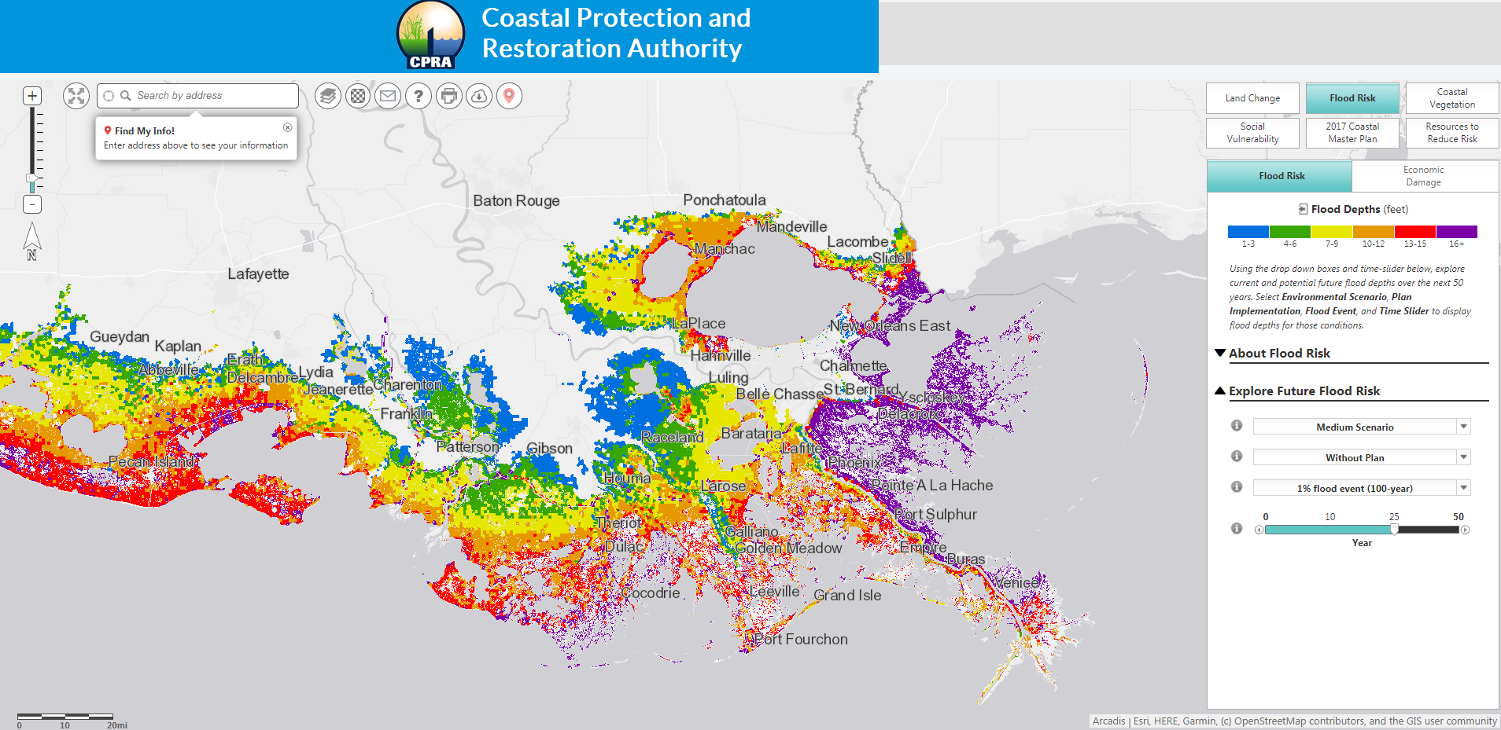
Key NOAA Products and Use
Water level information
Bathymetry
Salinity, Temperature, Altimetry
RSLR
Atmospheric
Guidance based on observations

Slide 5
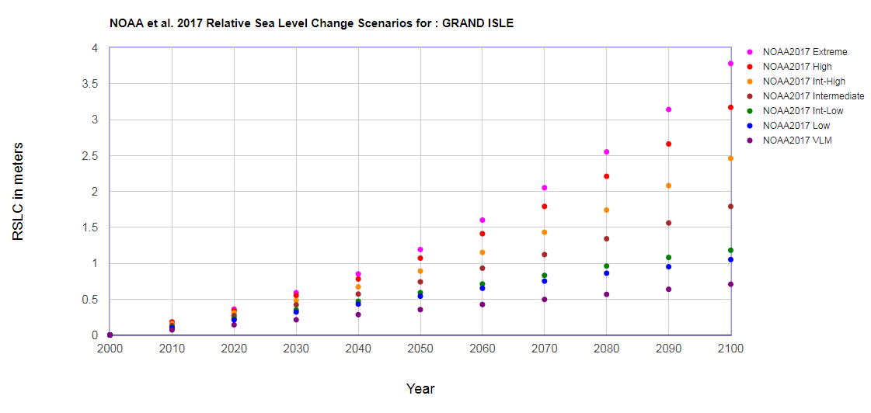
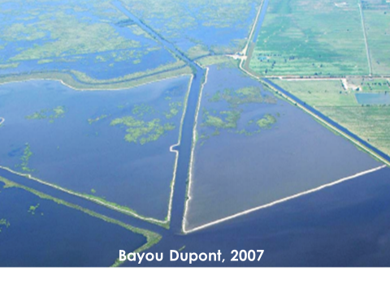
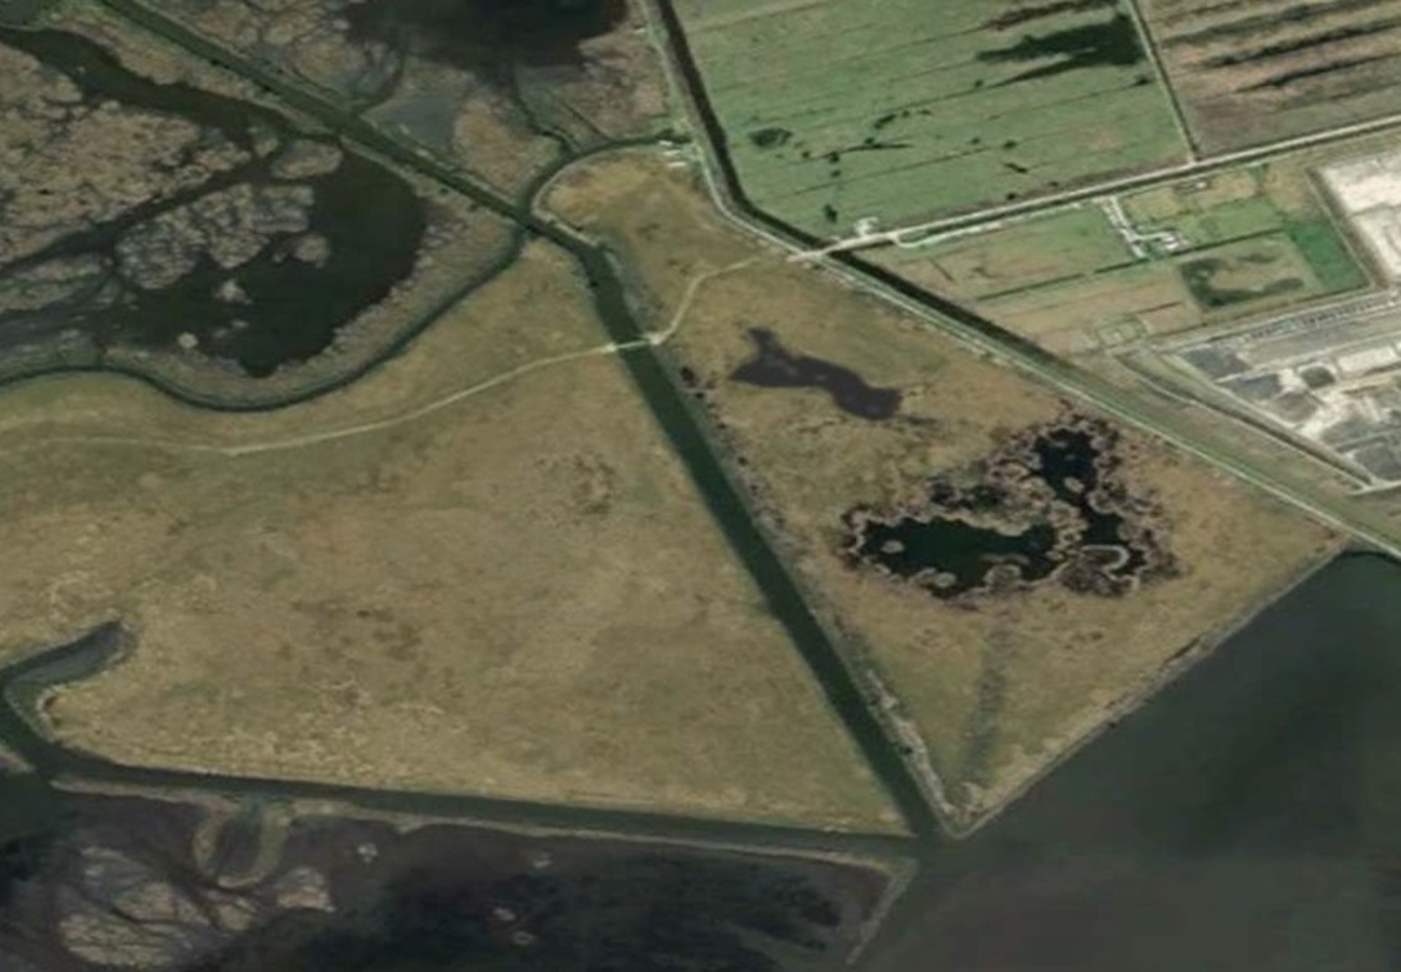
Planning for Uncertainty – Sea Level Rise Predictions
Target Marsh Elevations
Design Capacity
Timing/Location of Projects
Hard v Soft Infrastructure
Bayou Dupont, 2012

Slide 6
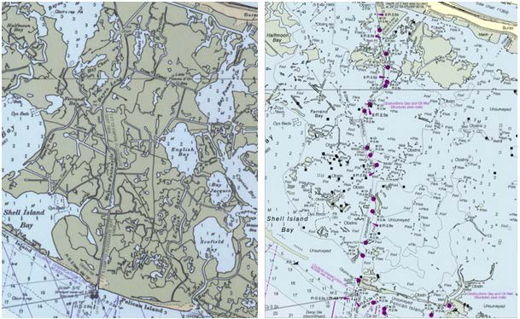
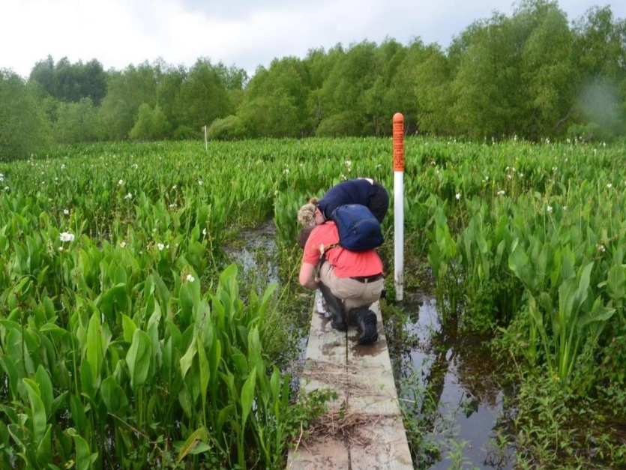
Future Efforts:
- Cooperatives like the EESLR Program
- Increases to real-time monitoring
- Increases to sampling frequency
- Coordination across data platforms
- Specific NOS-led teams to interrogate
SLR data
1965
2013

Slide 7
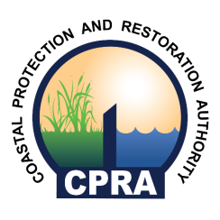
Brian Lezina
Brian.Lezina@la.gov
SUBSCRIBE
@LouisianaCPRA
www.coastal.la.gov

