Slide 1
VDatum
Vertical Datum Transformation Tool
HSRP Briefing
August 27, 2019

Slide 2
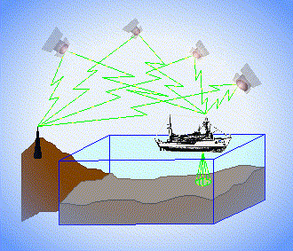
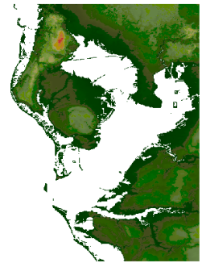
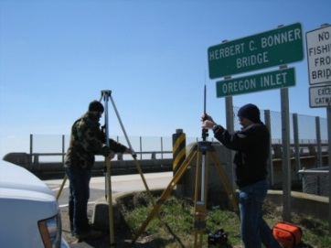
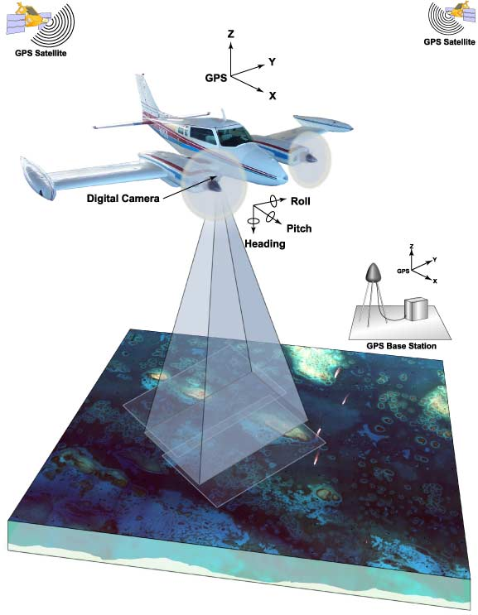
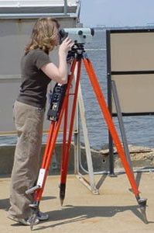
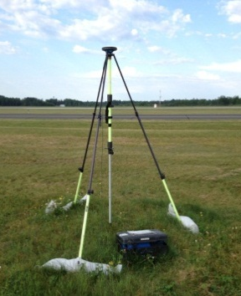
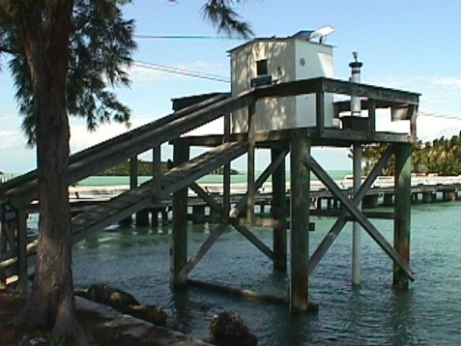
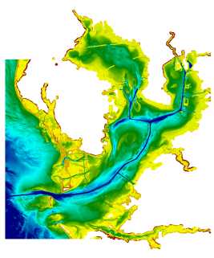
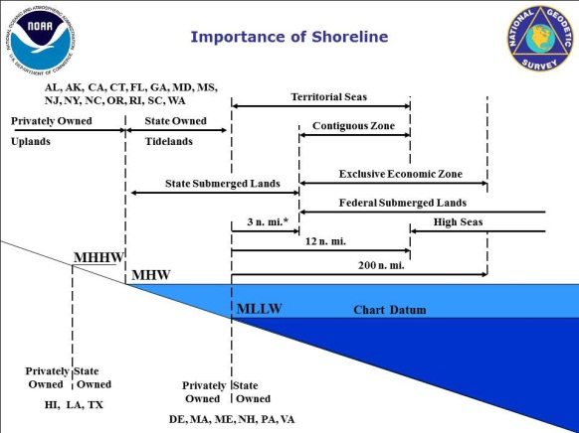
What Vertical Datum is My Data in?
Ellipsoidal Datums
Orthometric Datums
RTK-GPS vertical referencing
Hydrographic Surveys
?
USGS
Topography
GPS
Lidar
NOAA Bathymetry (MLLW)
Tidal Datums

Slide 3
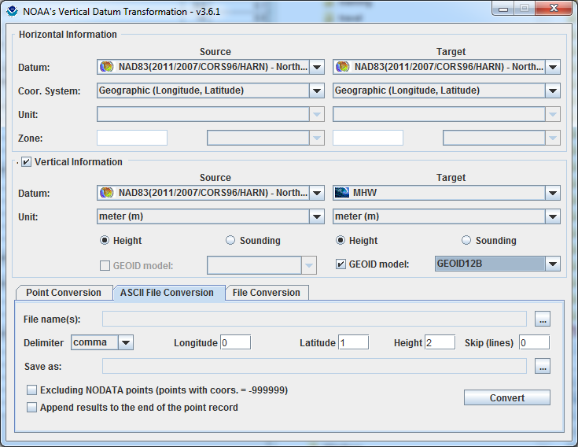
Development and Use of VDatum
Mapping the Land-Sea Interface: VDatum converts elevation data (heights and soundings) among different vertical datums
USGS Topography
NOAA Bathymetry
VDatum is a Java application developed jointly by :
National Geodetic Survey (NGS)
Office of Coast Survey (OCS)
Center for Operational Oceanographic
Products & Services (CO-OPS)
Notes:
Vertical Datum Transformation (VDatum) is a free software tool under development jointly by NOAA's National Geodetic Survey (NGS), Office of Coast Survey (OCS) and Center for Operational Oceanographic Products and Services (CO-OPS). VDatum is designed to vertically transform geospatial data among a variety of tidal, orthometric and ellipsoidal vertical datums - allowing users to convert their data from different vertical references to a common system , enabling the fusion of diverse geospatial data onto a preferred vertical datum.

Slide 4
Foundational Data
Observations
(Geodetic and Tidal)
Modeling
(Hydrodynamic and
TSS)
and Uncertainty Development
Software Development
and Outreach/
Training/
Coordination
VDatum

Slide 5
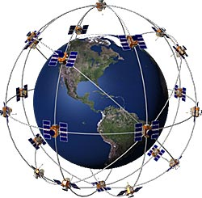
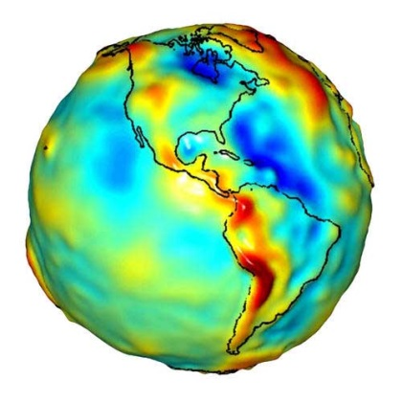
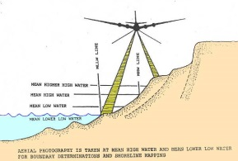
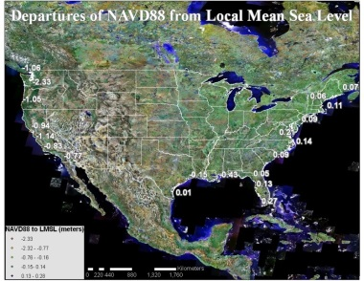
3 Categories of Vertical Datums:
3D/Ellipsoid
realized through space-based systems, such as GPS
Orthometric (GEOID)
based on a form of
global mean sea level
Tidal Datums
based on tidally-derived surfaces such as high or low water
National Water Level Observation Network (NWLON)

Slide 7
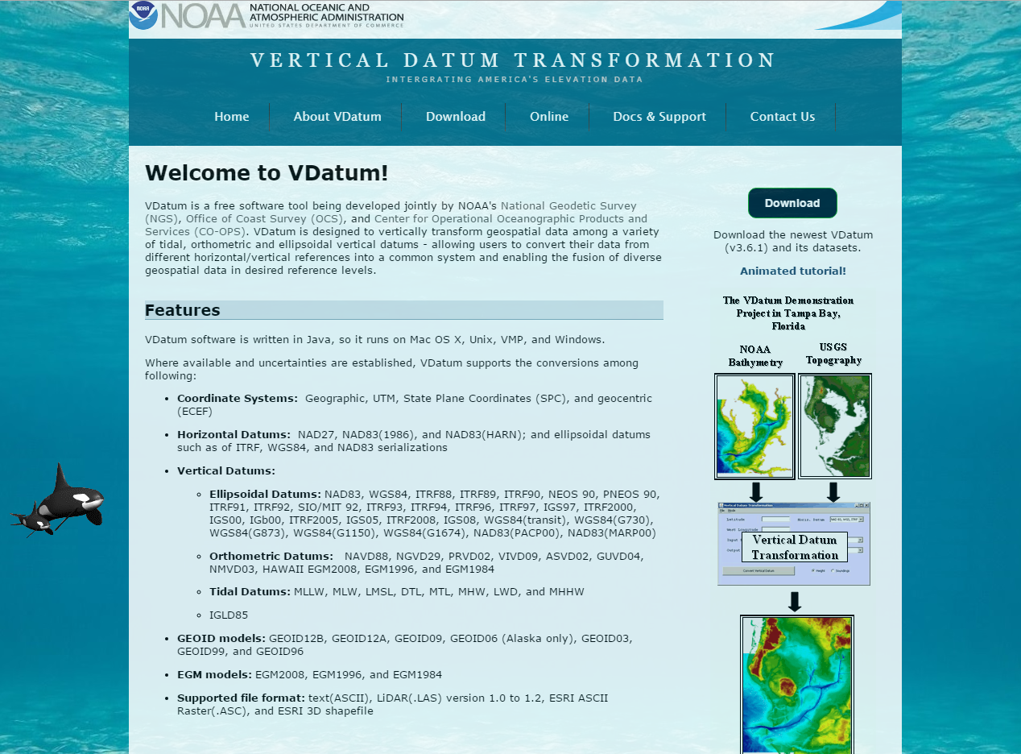
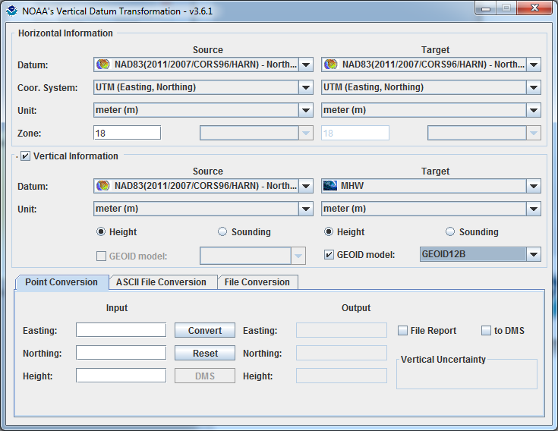
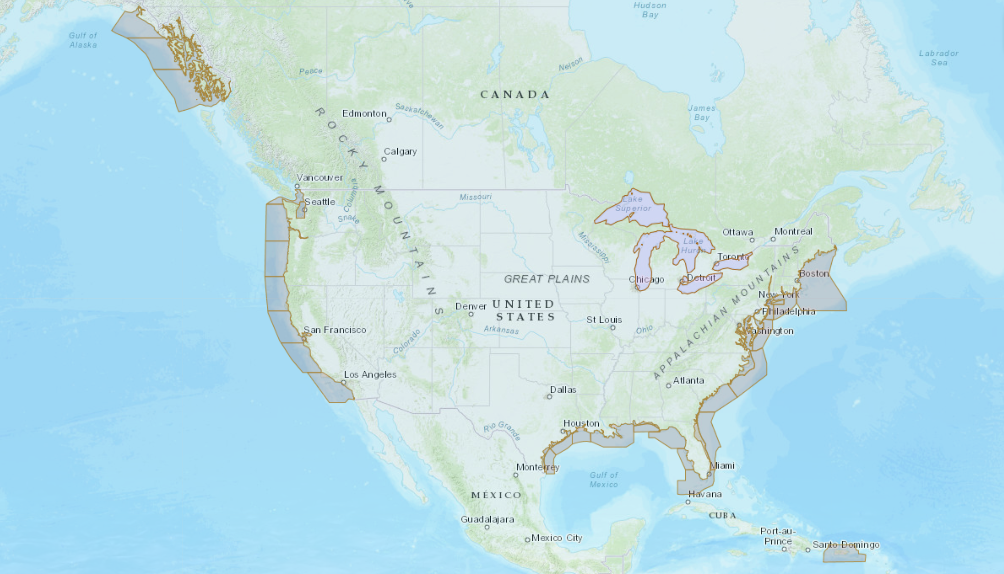
VDatum Website: vdatum.noaa.gov (Version 4.0, August 5, 2019)

Slide 8
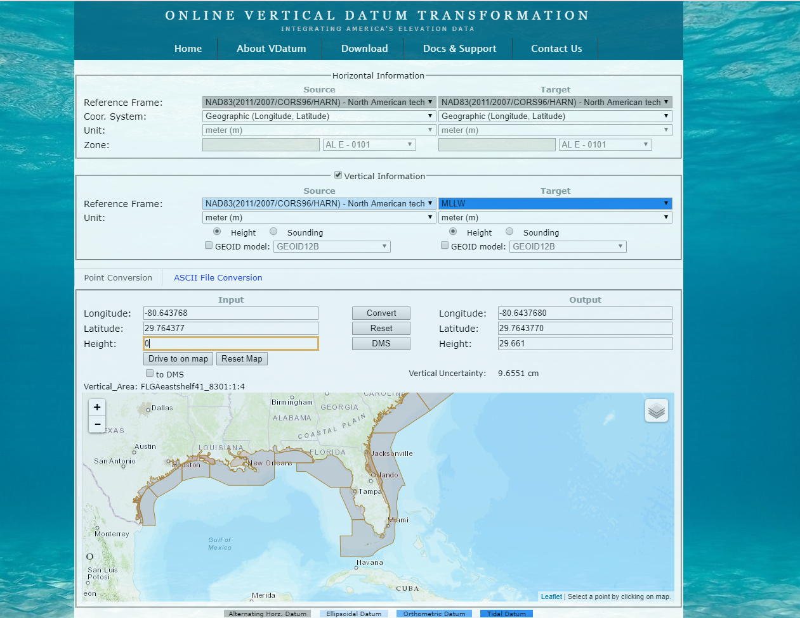
VDatum: Interfaces

Slide 9
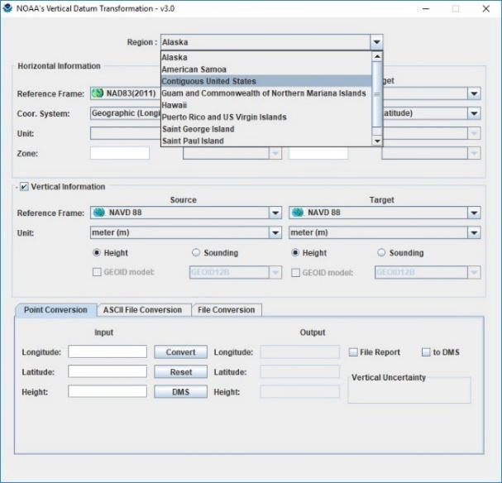
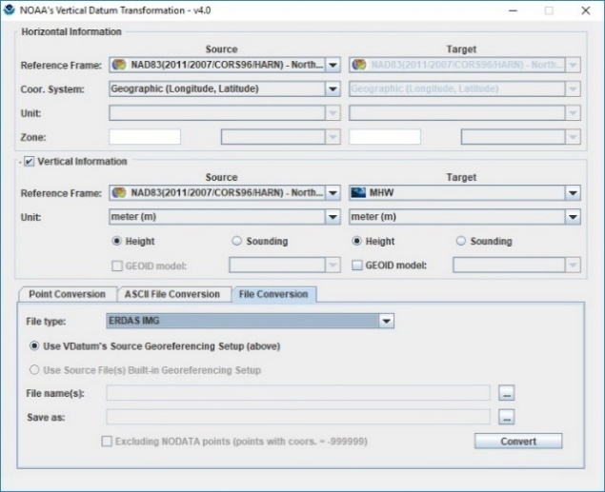
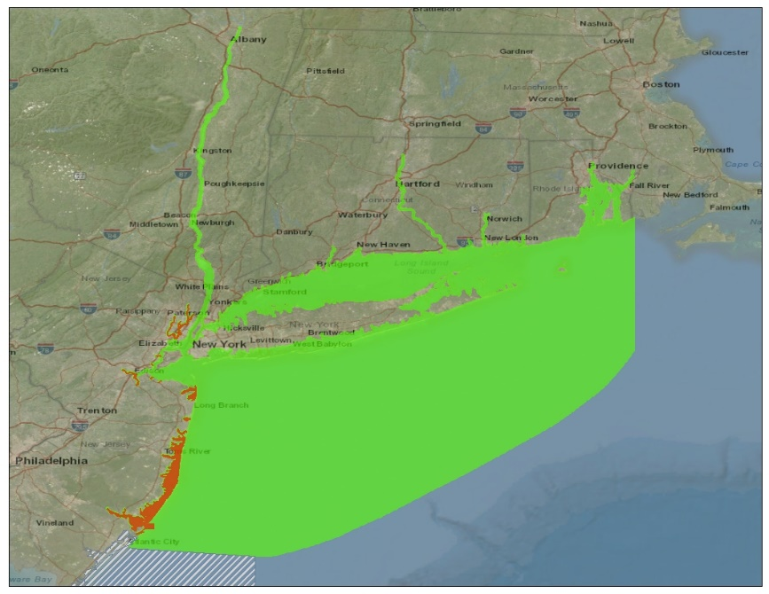
VDatum: vdatum.noaa.gov (Version 4.0, August 5, 2019)
NADCON 5.0 Integration:
SE Alaska Regional
Model Release:
NY/LIS Regional Model
Update Release:
ERDAS IMG Format Support:

Slide 10
VDatum Summary
The VDatum transformations tool from NOAA allows us to transform vertical datasets between ellipsoidal, orthometric and tidal datums...
Assuring data is transformed correctly
Enabling multiple uses for datasets across applications (Coastal Resilience, Intelligence, and place-based)
Permitting merging of disparate data sets to a common reference
And providing transformation uncertainty estimates for intelligent decision-making and analysis.

Slide 11
What’s Next: Strategic Priorities
Create Consistency between Regional Models
Reducing Regional Model Uncertainty to <10cm
Increasing Coverage
Next Generation TSS Model (utilizing gravimetric GEOID transformation roadmap) – GPS on Tidal Benchmarks
Spatially Varying Uncertainty
Software Development
Communication and Outreach

Slide 12
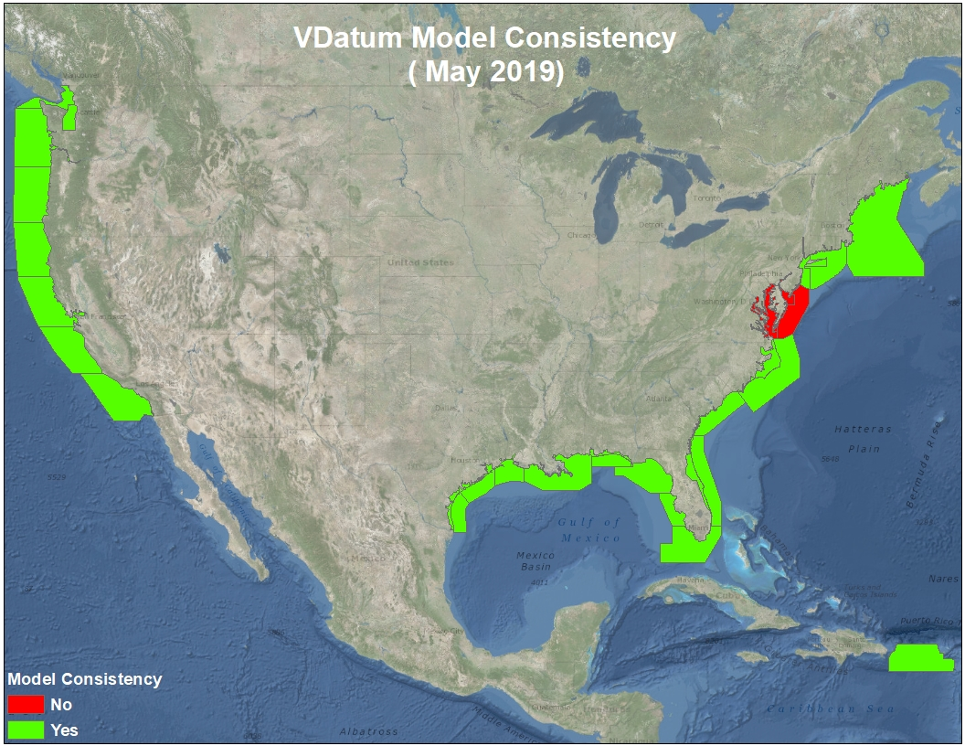

Slide 16
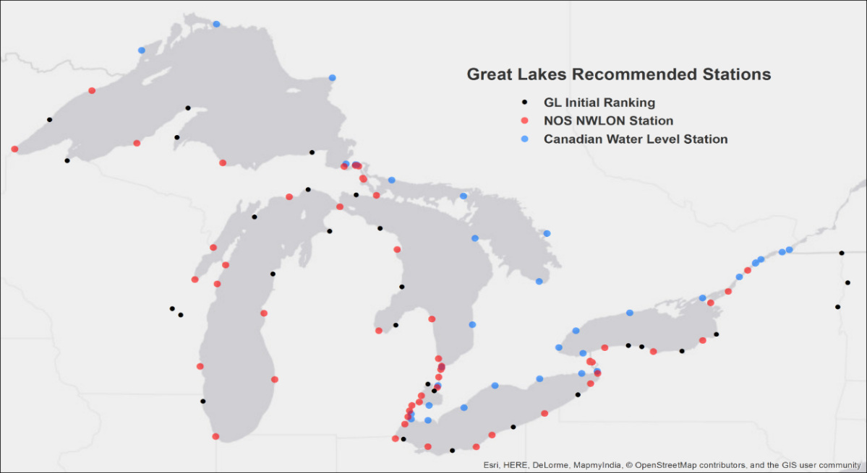
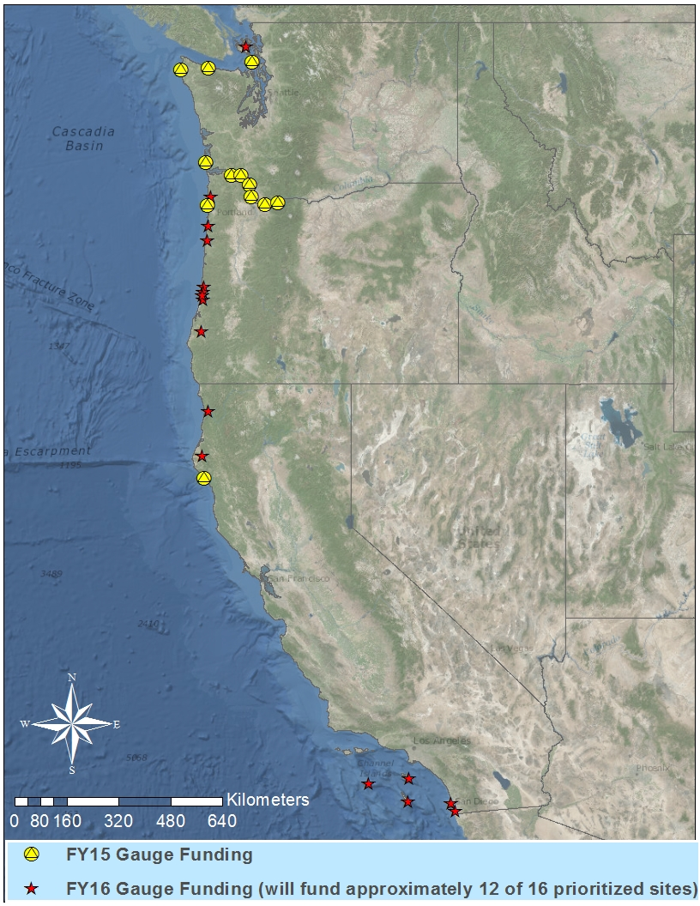
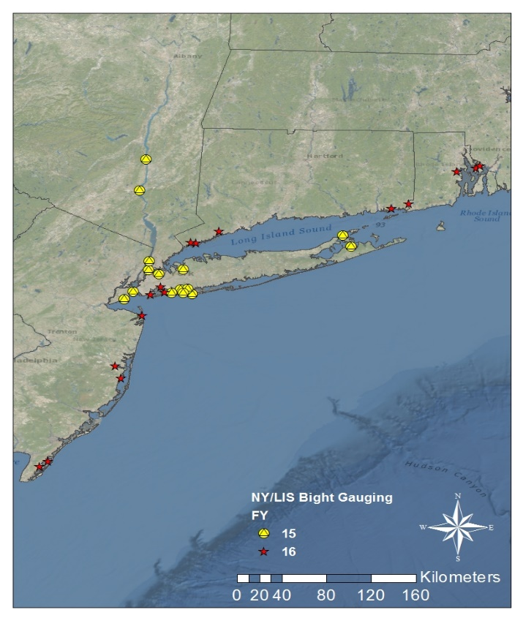
Foundational Data: Tidal

Slide 17
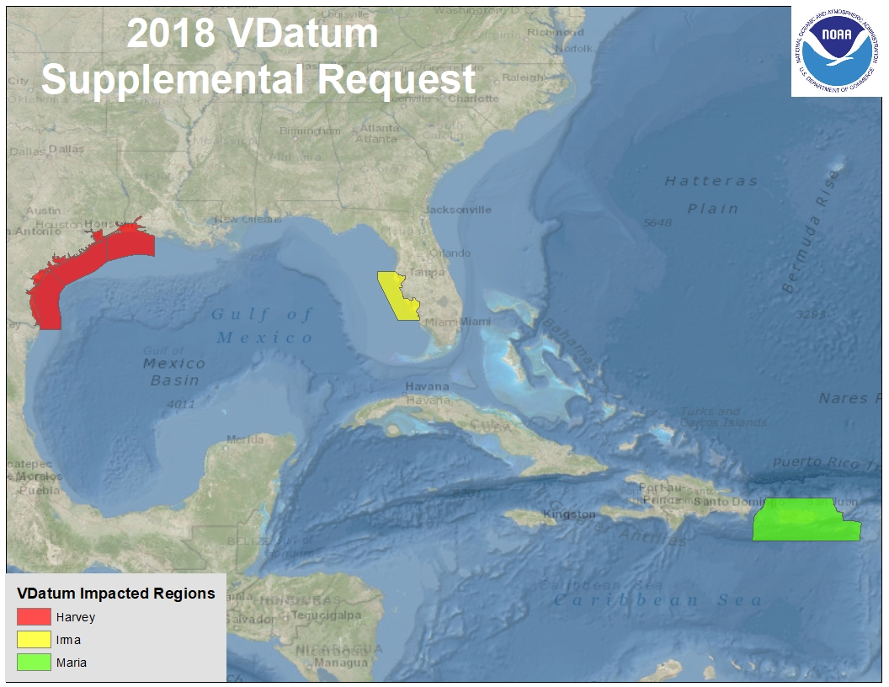
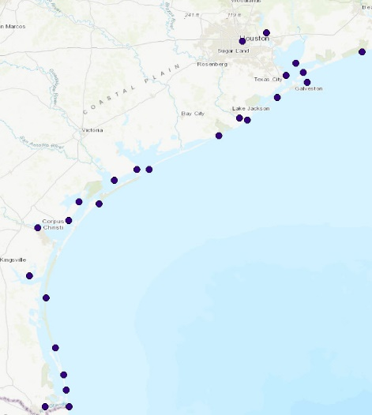
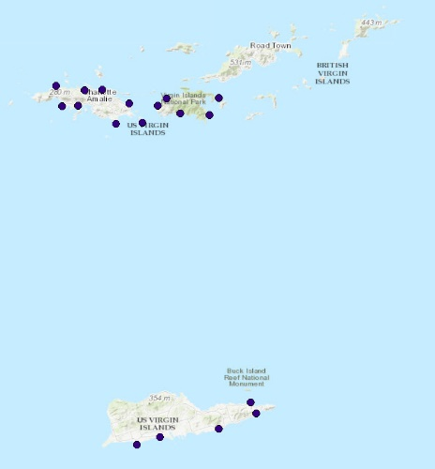
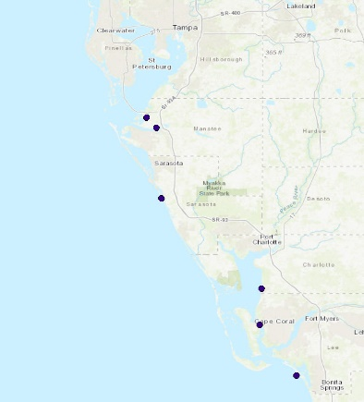
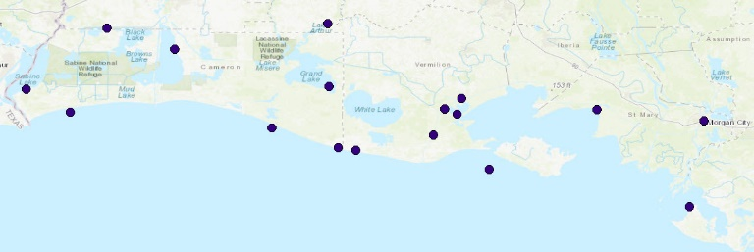
Supplemental

Slide 18
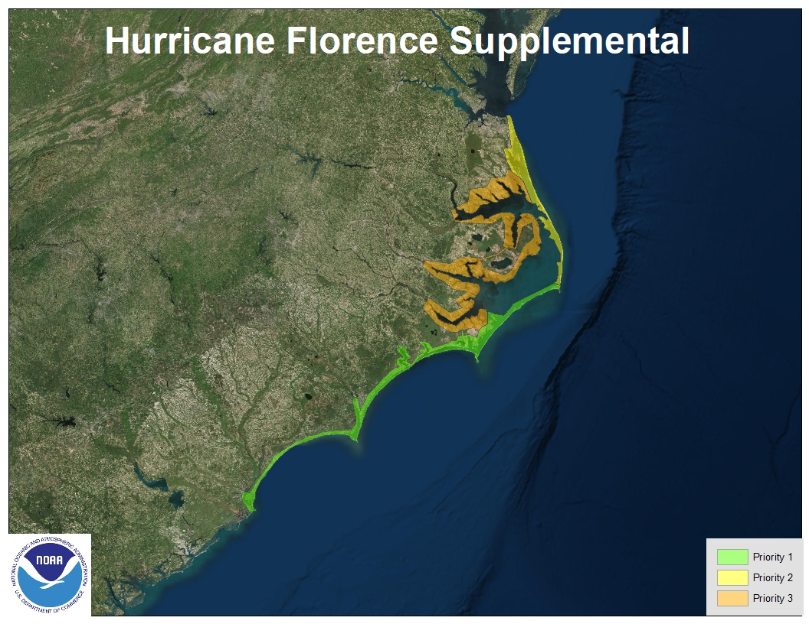
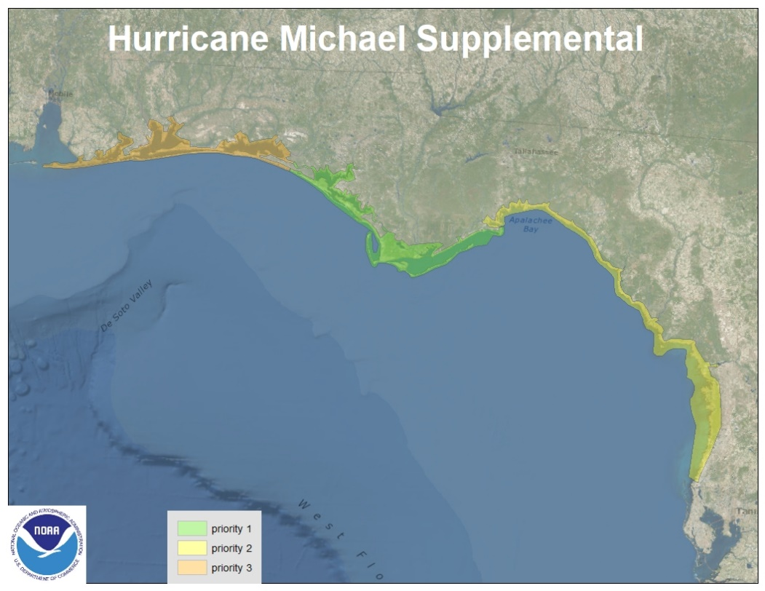
Supplemental

Slide 19
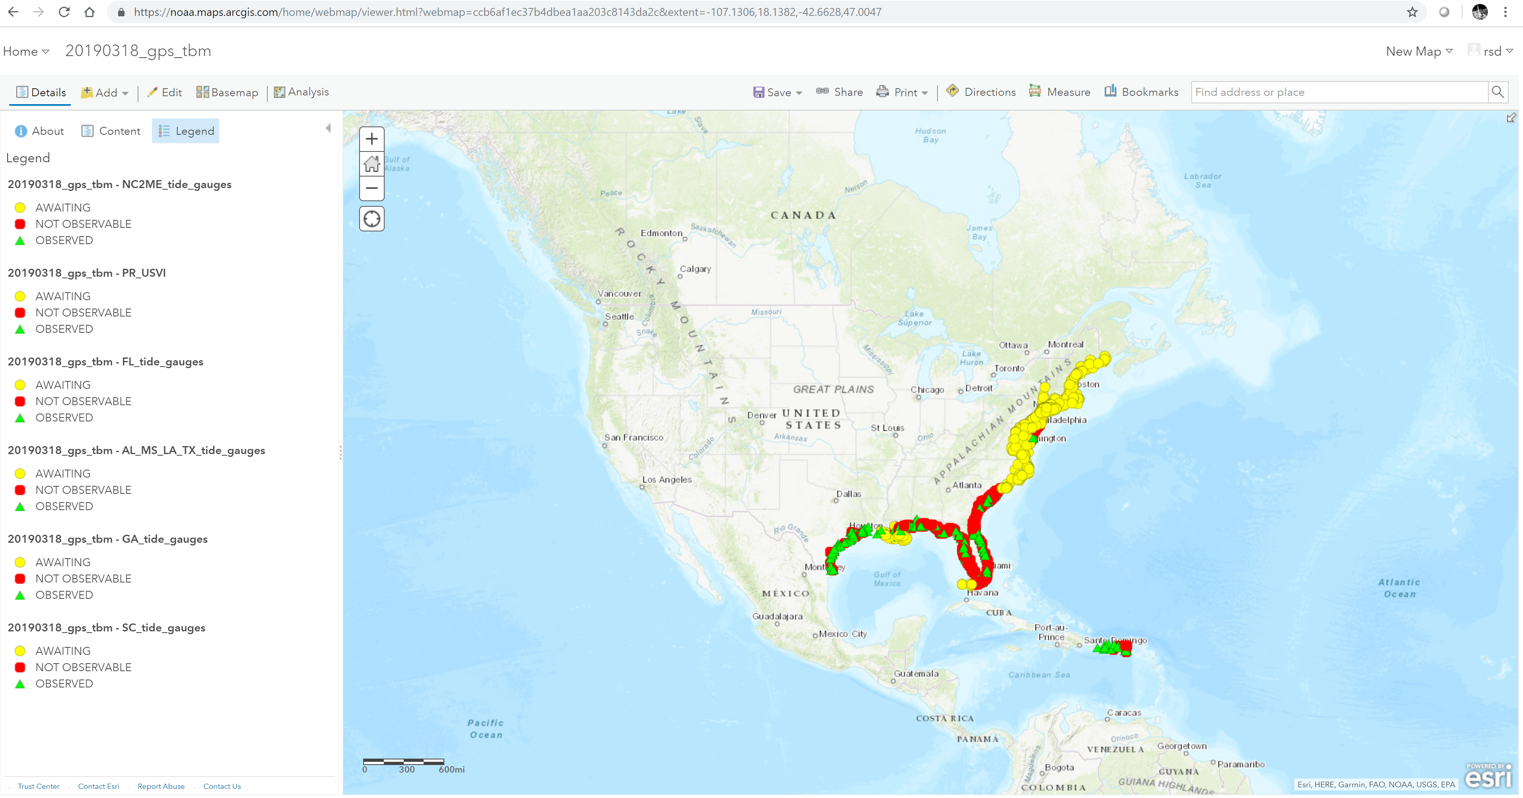
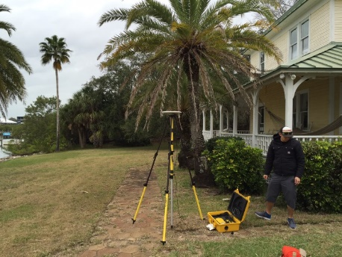
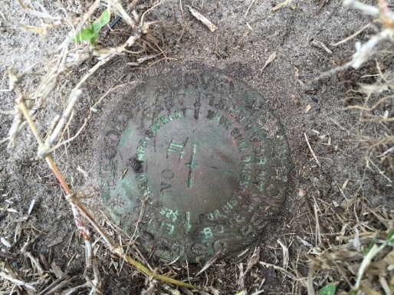
Foundational Data: Geodetic

Slide 20
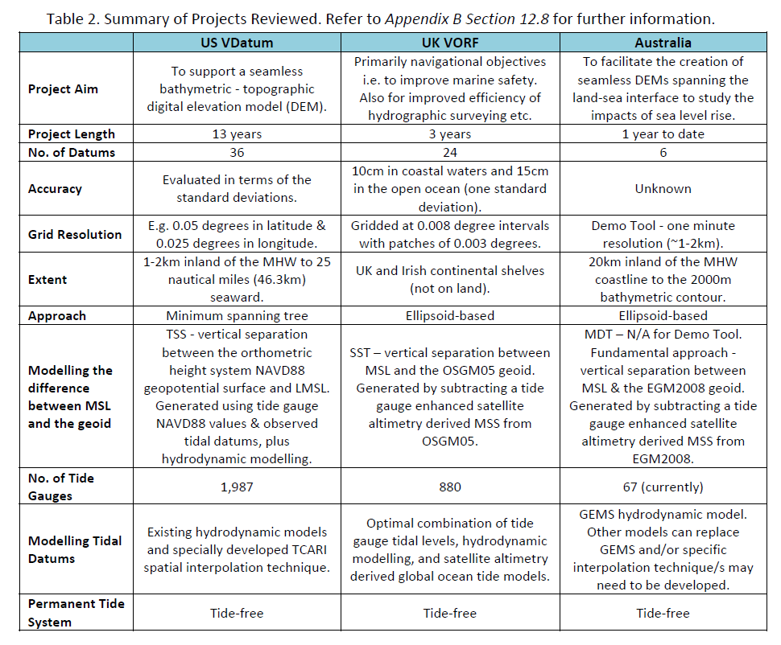
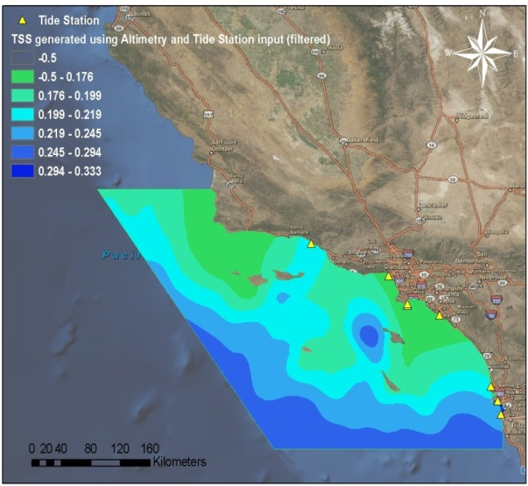
GPS Observations: for determination of Geodetic to Tidal Relationships
Original efforts were for NAVD88 linkages at stations without defined relationships
New Proposed VDatum Transformation Roadmap
based on a purely Gravimetric GEOID

Slide 21
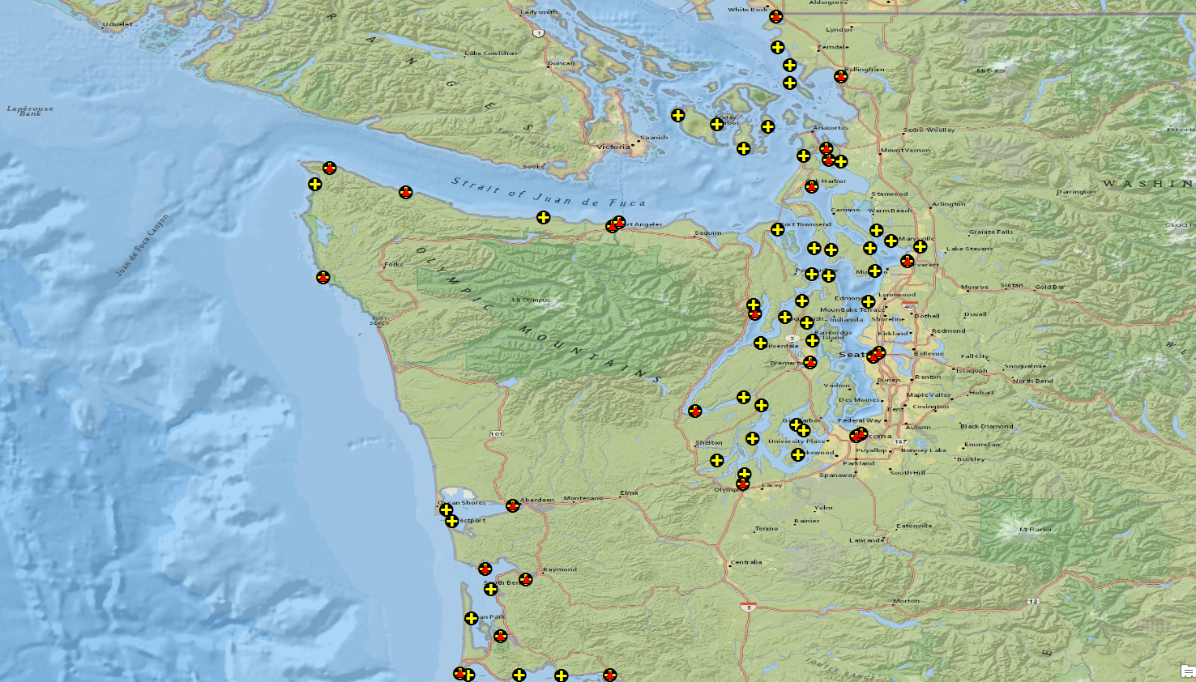
Hydrodynamic vs. TSS Modeling

Slide 22
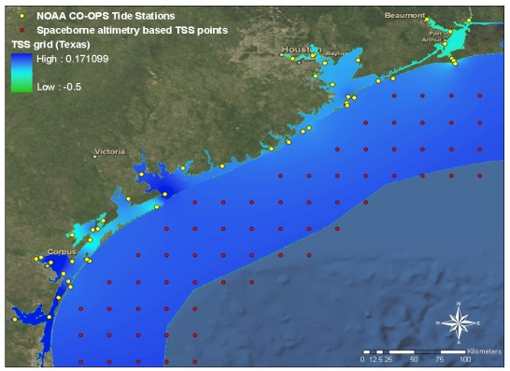
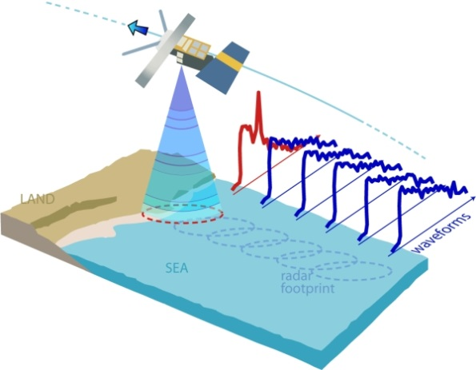
Future Enhancements: Next Generation TSS Development
New GEOID: Coastal gravity field improvement
New Proposed Transformation Roadmap
based on a purely Gravimetric GEOID
A Must: GPS Campaign on bench marks to determine new relationships
Wish List: GPS tide buoys to be utilized for data input and validation
Satellite Altimetry/Derived Products to better understand offshore TSS
Re-tracked coastal altimetry data to capture nearshore sea surface height signal

Slide 23
Southeast Alaska (Released 2019)

Slide 24
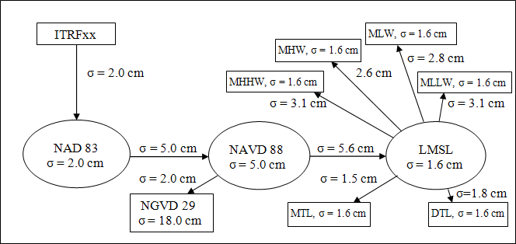
VDatum Uncertainty Modeling (Phase 1)
See: vdatum.noaa.gov/docs/est_uncertainties.html

Slide 25
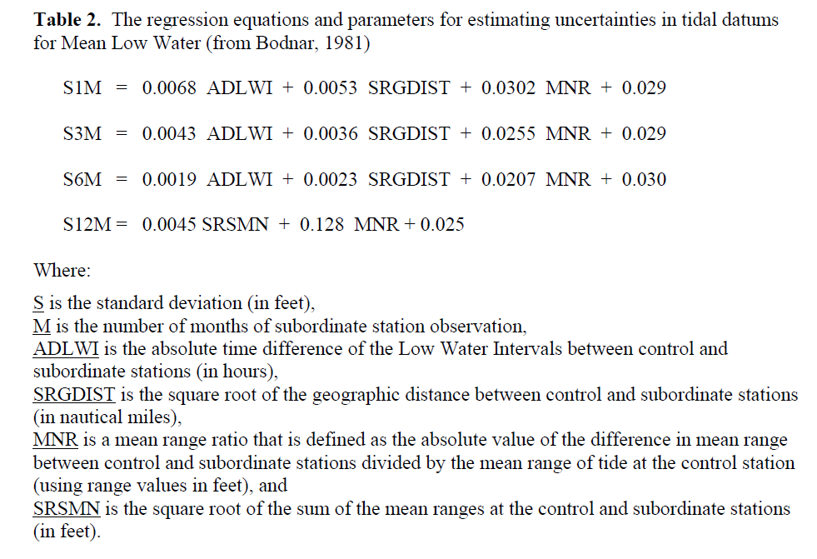
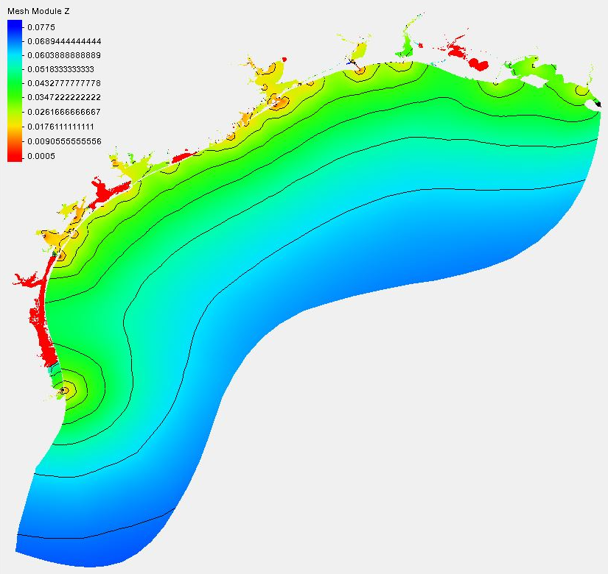
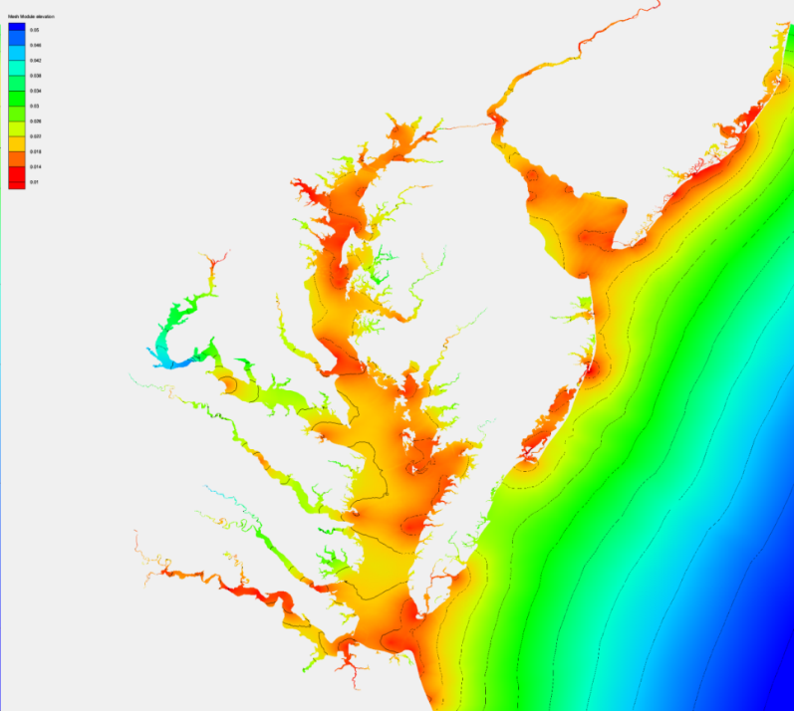
Spatially Varying Uncertainty
(Phase 2: Transition to Operations)
Statistical data assimilation is used to blend model results and data, also providing the associated uncertainty.
Uncertainty in one standard derivation (m)

Slide 26
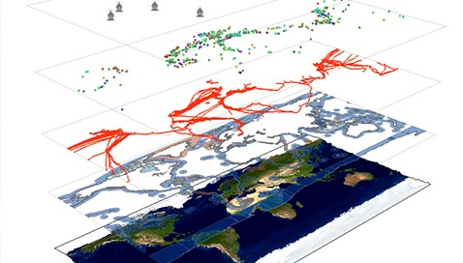
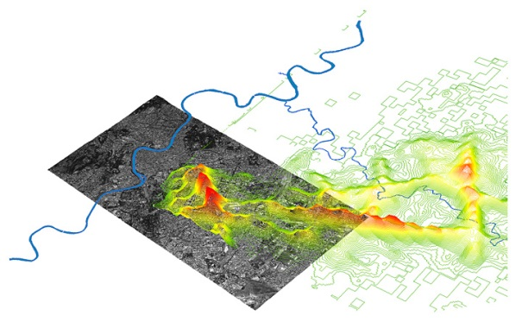
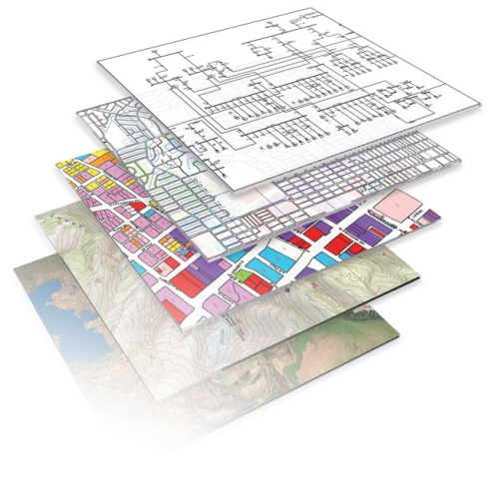
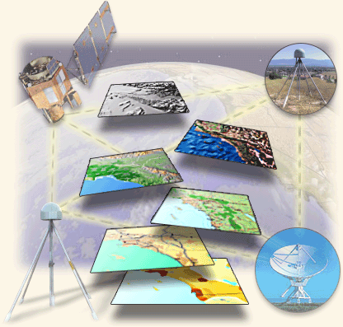
Software: Future Enhancements
Bug Fixes
Change Request
SVU Implementation
Directed Assistance for Datum Selection with enhanced Logic/Validation
NADCON5
VERTCON3
New Datums !!!
Columbia River Datum
Mississippi Low Water Reference Plane 2007

Slide 27
HSRP Recommendations

Slide 28
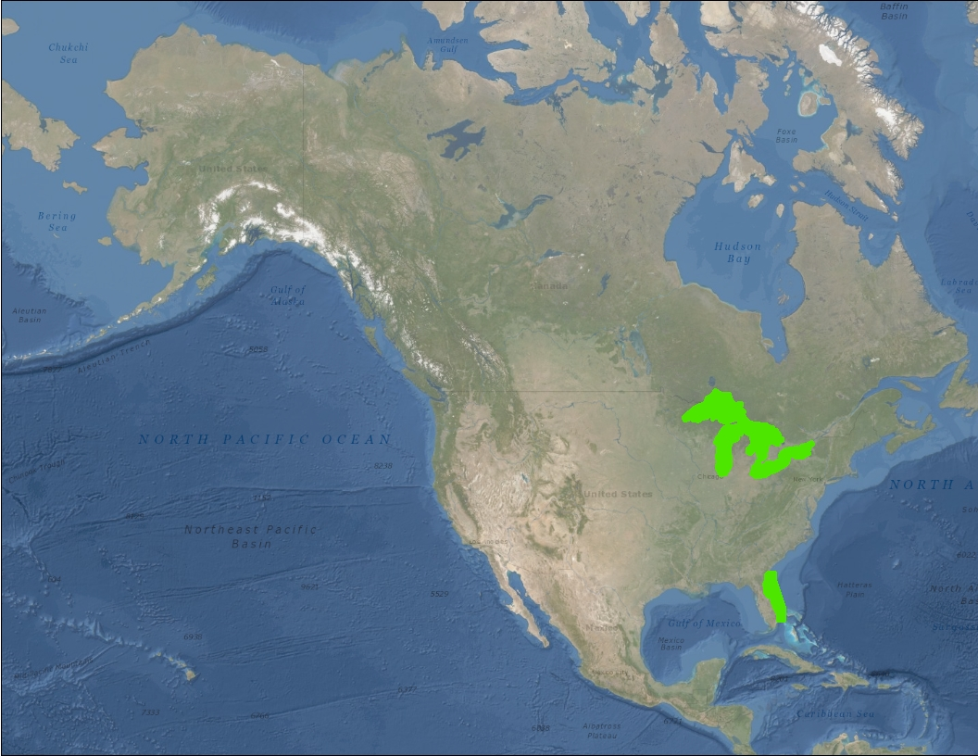
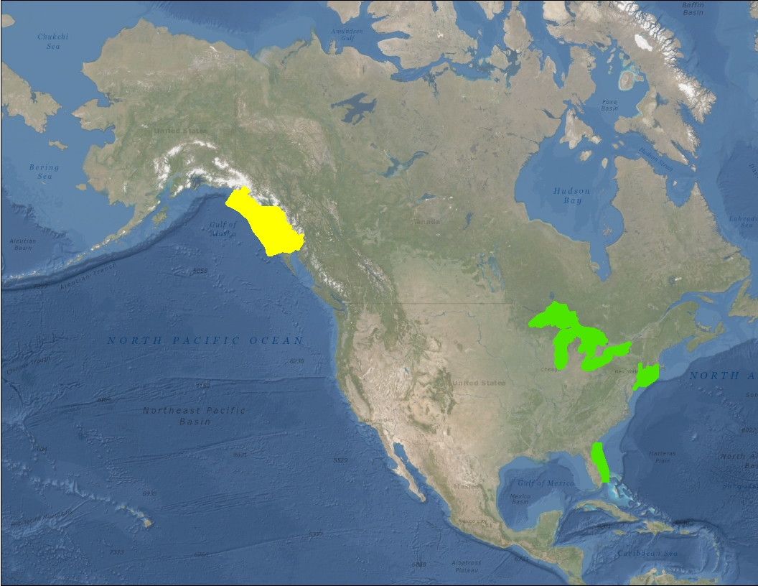
VDatum:
Production and Maintenance

Slide 29
Thank You!
Contact Information:
Email: vdatum.info@noaa.gov
Website: http://vdatum.noaa.gov
Stephen White
Email: stephen.a.white@noaa.gov
Phone: (240) 533-9588

