Slide 1
Office of Coast Survey
CAPT Elizabeth Kretovic
August 27, 2019

Slide 2
Coast Survey Strategic Plan
Goals:
Deliver world class digital navigation services to the maritime community
Map the unseen America
Sustain high performance of people and systems for mission success
Notes:
Key messages from OCS Strategic Plan foreword.
As the volume, value, and size of marine vessels in U.S. waters continues to grow, it is essential that Coast Survey resolves critical data gaps, and that we increase the accuracy and frequency of our surveys.
It is a pivotal time in ocean mapping and while we continue our work to deliver realtime data and high-resolution bathymetry for ports and maintain nautical charts for the U.S. marine highway infrastructure, we are also working toward building a comprehensive and high-resolution bathymetric dataset of the unseen America.
The continued strength of Coast Survey’s valued partners, its highly skilled and dedicated workforce, and its ability to fully leverage technology is key to achieving this substantial modernization effort. Coast Survey leads a coalition of U.S. federal offices that provide hydrographic and meteorological services working in close coordination to achieve shared mapping objectives.

Slide 3
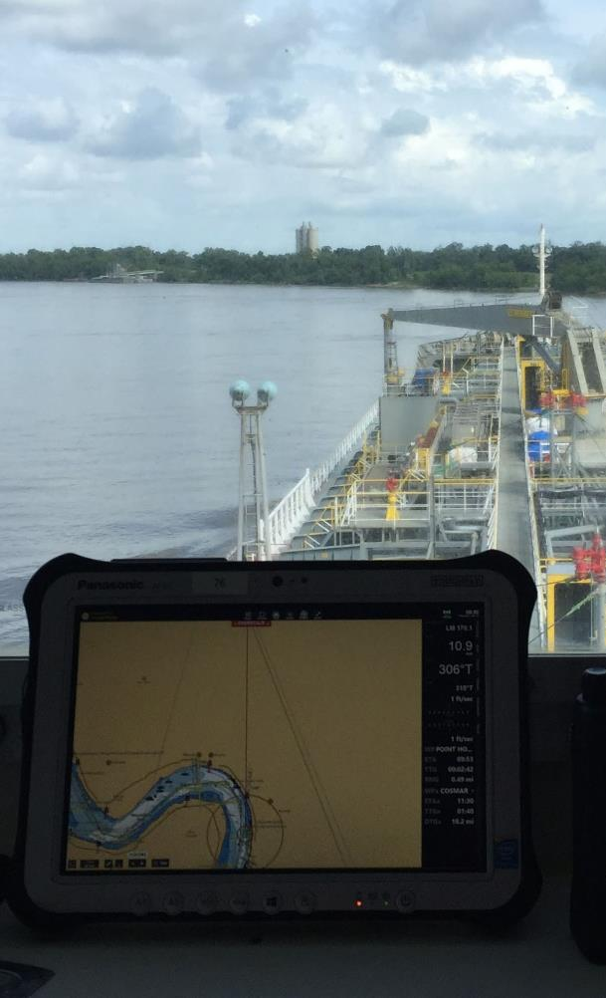
Goal 1
Deliver world class digital navigation services to the maritime community
Build a second-generation electronic navigational chart (ENC) suite.
Produce new Precision Navigation products.
Expand the access and usability of navigation services and data.
Notes:
Our commitment to delivering world class digital navigation services is essential to the safety and economic success of the maritime community, particularly as the volume, value, and size of commercial ships continues to grow.
Successfully delivering these Precision Navigation services will require a redesign of the current chart suite, the development of new products, and more easily accessible dissemination systems.
Coast Survey aims to establish a National Bathymetric Source database to feed the production of new high definition charts for priority ports and other multiuse requirements.
An integrated cloudbased dissemination system will then enable users to access products and data in easily discoverable, interoperable, and user-friendly formats for use in navigation, research, or commercial purposes.
Objectives in full:
Build a second-generation electronic navigational chart (ENC) suite for U.S. waters.
Produce new Precision Navigation products for improved navigation safety, competitiveness, and capacity in commercial ports.
Expand the access and usability of navigation services and data.

Slide 4
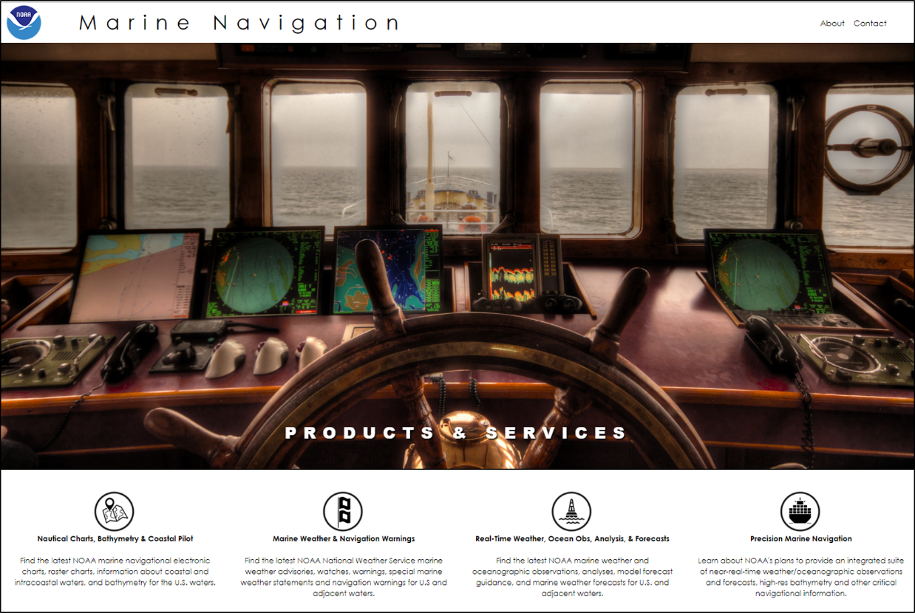
Precision Navigation - Data Dissemination Website
Notes:
Precision Navigation talk will have occurred prior to this presentation.

Slide 5
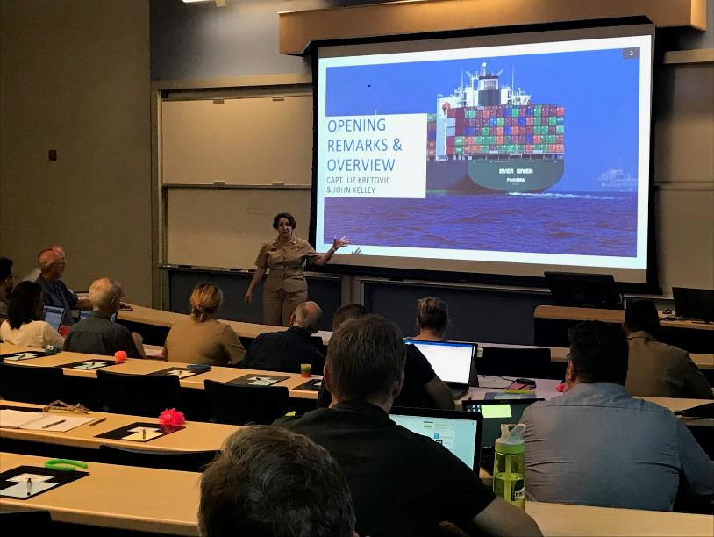
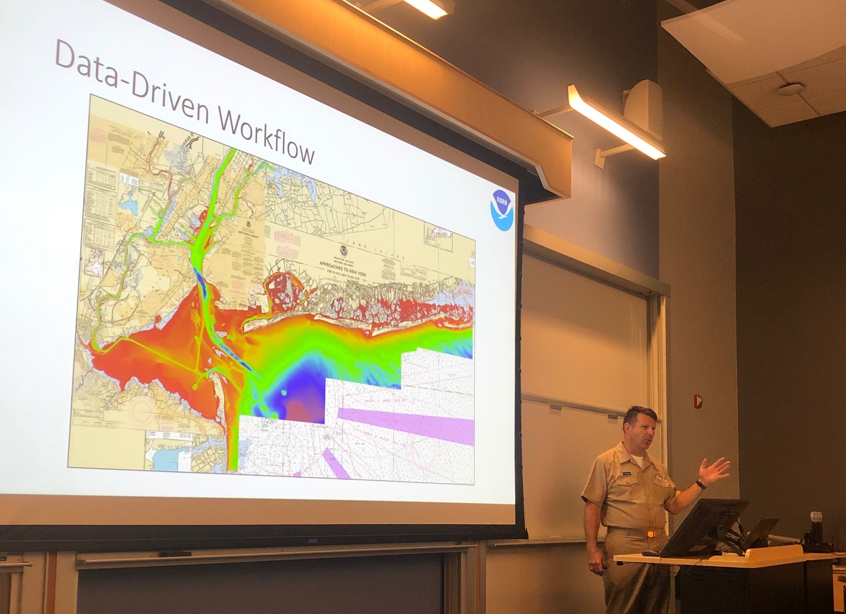
Precision Navigation – Industry Workshop
Notes:
Touch on the success of the workshop, including major outcomes.

Slide 6
Goal 2
Map the unseen America
Lead a national coalition to double the rate of surveying in unmapped U.S. waters
Maintain federal channels, anchorages, and fairways within high volume U.S. ports at CATZOC A1.
Reduce the backlog of 10,000 chart discrepancies.
Notes:
Mapping the unseen America including the nation’s seafloor, coasts, ports, harbors, and approaches is essential to Coast Survey’s ability to provide accurate and reliable charts and models to support safe and efficient marine navigation.
This mapping is also critical to other missions across NOAA and the federal government. As a result, Coast Survey is deeply committed to working in close collaboration with its federal partners to ensure that surveys are coordinated and conducted as efficiently as possible.
This means sharing survey data, joint planning, and the elimination of chart discrepancies or data duplication, especially in underserved areas like the Great Lakes, the Arctic, and Pacific Islands and Territories. As an organization with a deep history and expertise in surveying, Coast Survey is in a unique position to lead these efforts and maximize value for both marine navigation and partner data needs.
Objectives in full:
Lead a national coalition to double the rate of surveying in unmapped U.S. waters to increase coverage from 42% to 52%.
Maintain federal channels, anchorages, and fairways within high volume U.S. ports at Category – Zone of Confidence (CATZOC) A1. The CATZOC rating helps the mariner determine the accuracy, date, and extent of the bathymetry.
Reduce the backlog of 10,000 chart discrepancies through hydrographic surveys and cartographic analysis.

Slide 7
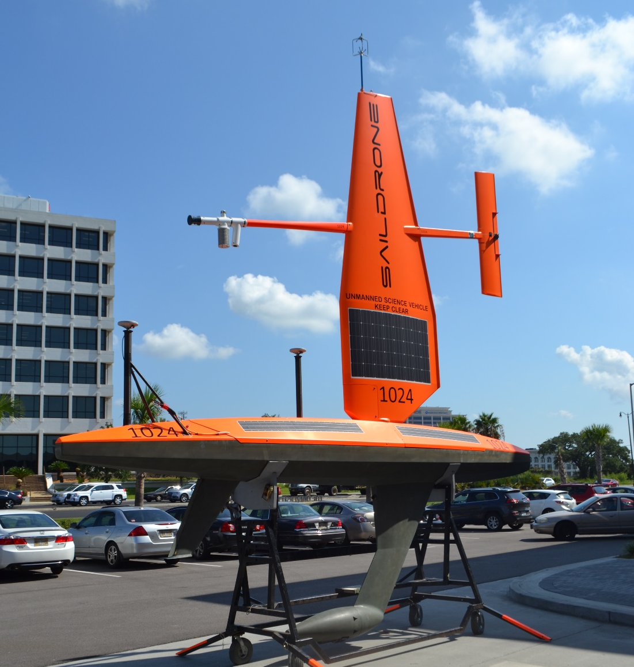
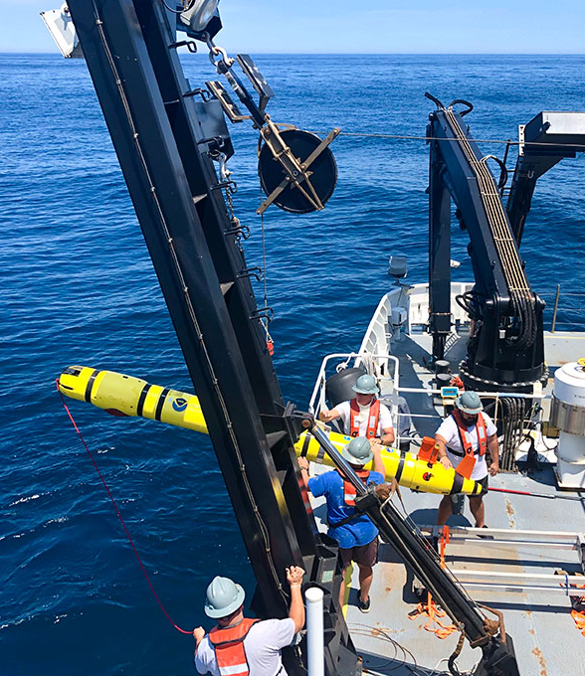
Autonomous Systems
Notes:
With nearly two million square nautical miles in need of mapping in addition to the U.S. ports, harbors, and fairways that require continual maintenance, it is clear that Coast Survey cannot accomplish the task of mapping the full extent of U.S. waters using the same methods of the last two hundred years.
There will be a panel discussion on autonomous systems tomorrow…

Slide 8
Goal 3
Sustain high performance of people and systems for mission success
Be a model federal workplace as measured by the Federal Employee Viewpoint Survey.
Lead the world in marine geospatial expertise.
Respond to changing customer needs.
Develop and maintain critical infrastructure.
Integrate new and innovative technologies into mission priorities.
Notes:
At the core of Coast Survey’s ability to deliver world class digital navigation services and mapping the unseen America are the dedicated, passionate, and highly skilled men and women who give their all to Coast Survey and its mission every day.
Coast Survey is committed to establishing a model federal workplace – a workplace that supports the training and development of its employees, a culture of diversity, inclusivity, and flexibility, and which attracts and retains world renown talent.
Other mission underpinnings include the development and sustainment of Coast Survey’s IT and fleet infrastructure, as well as the integration of new technologies into operations, such as unmanned systems and other emerging opportunities as they arise.
As technology requirements change over time, Coast Survey will continue to leverage new and existing technology capabilities to meet mission objectives.
Objectives in full:
Be a model federal workplace as measured by the Federal Employee Viewpoint Survey.
Lead the world in marine geospatial expertise.
Respond to changing customer needs.
Develop and maintain critical infrastructure.
Integrate new and innovative technologies into mission priorities.

Slide 9
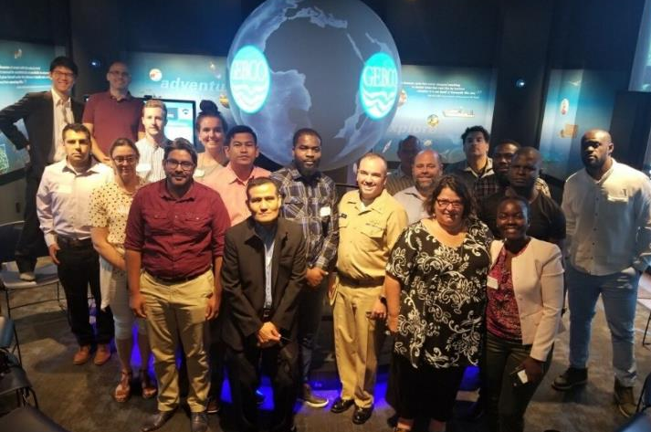
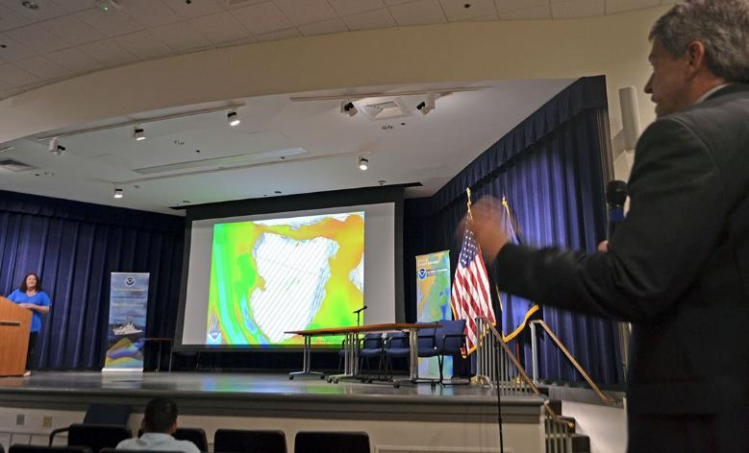
Capacity Building and Leadership
Notes:
NOAA Nautical Cartography Open House – In July we held our third annual Nautical Cartography Open House welcoming over 250 attendees from the U.S. and abroad. Government agencies, industry and academic partners, and members of the public attended. The open house featured posters, presentations, tours, and exhibits centered around four themes: Bathymetric Databases, Custom Charting, Innovative Cartography, and Precision Navigation.
Chart Adequacy Workshop - Just prior to the open house, NOAA held its fifth annual Chart Adequacy Workshop. The workshop trains professional cartographers from international offices on techniques for assessing nautical chart adequacy using publicly available information such as satellite images and maritime automatic identification system (AIS) data. This is an important technique for hydrographic offices around the world, particularly for developing countries, who may be resource constrained.
NOAA’s certification program in nautical cartography (CAT-B) - The second class of NOAA’s certification program in nautical cartography (CAT-B) is in the final month of their program. This internationally-approved training program certifies NOAA nautical cartographers academically, making NOAA an expert in the global cartographic community. The announcement for next year’s (2020-2021) CAT-B certification program will be announced in January 2020.

Slide 10
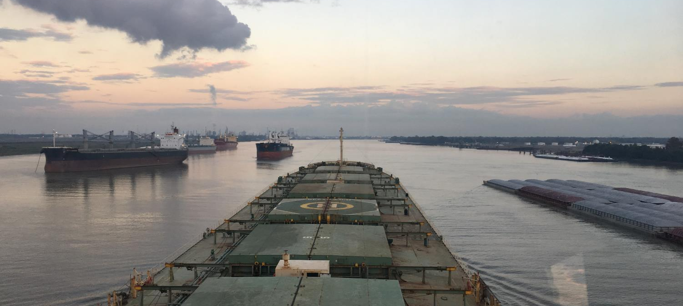
Questions?
nauticalcharts.noaa.gov
@NOAAcharts
NOAAcharts
Notes:
We appreciate comments on the Strategic Plan.

