Slide 1
National Geodetic Survey Update
Juliana Blackwell
Director, National Geodetic Survey
August 27, 2019
New Orleans, LA

Slide 2
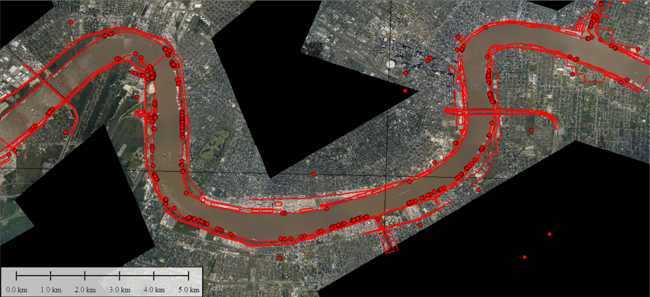
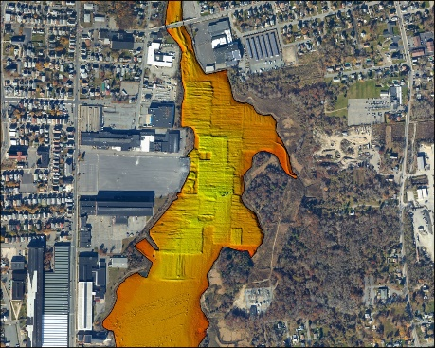
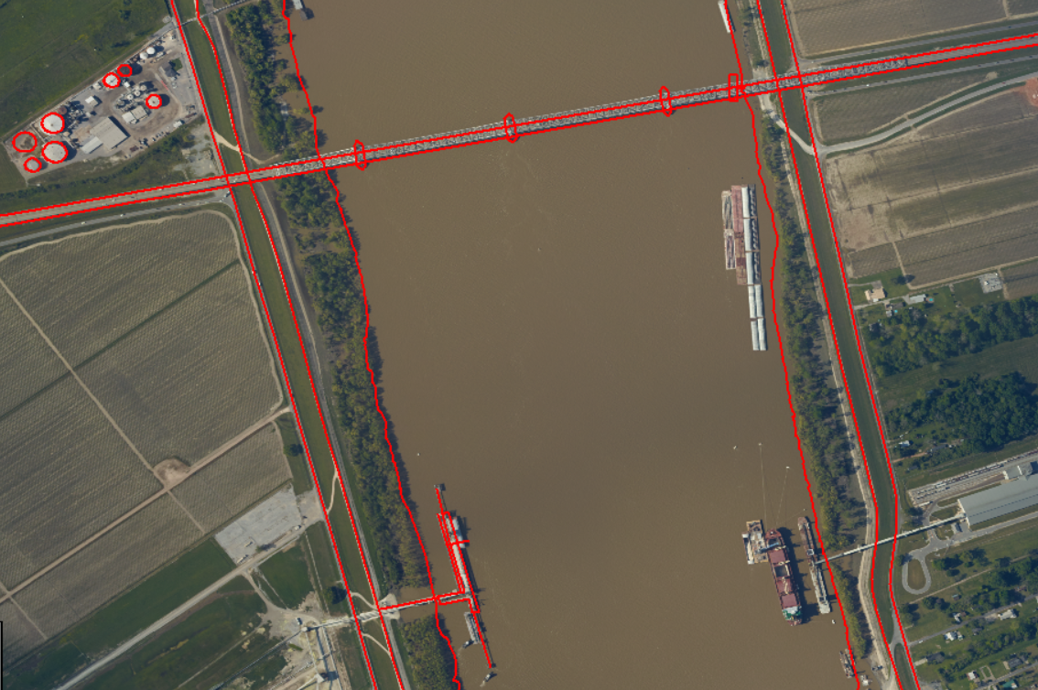
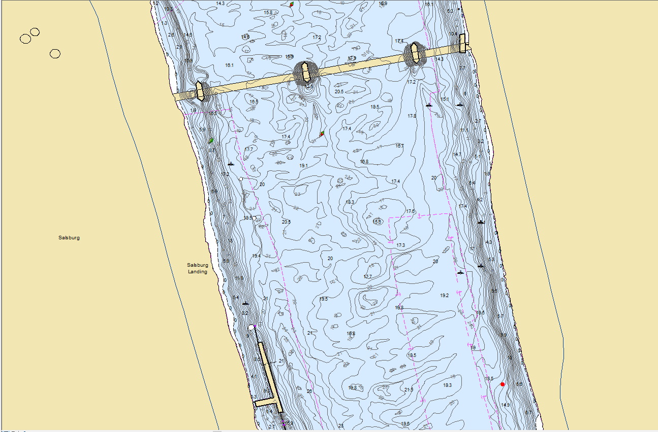
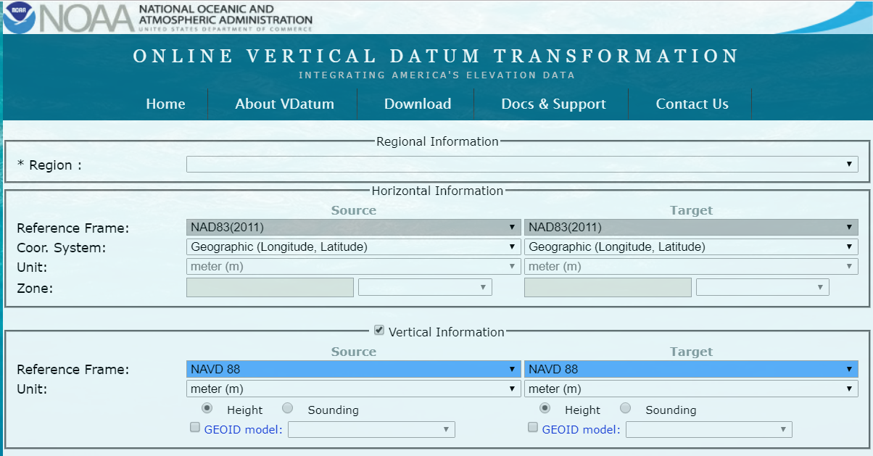
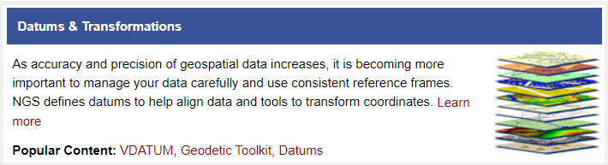

Coastal Mapping Program Updates
Support for Precision Navigation
Marine Chart Division HD Chart
Shoreline and topobathy lidar
=
+
Datums and Transformations
Notes:
NGS plays an important role in NOAA Precision Navigation effort as it does with most if not all Safety of Navigation products in the form of foundation data and products that ensure the data are in reliable, consistent, accurate reference frames.
NGS does this by providing the National Spatial Reference Frame that serves as the foundation for the datums used in Precision Navigation Products and also is the entry point into Vdatum and transformation to orthometric heights, which NGS provides through its Geoid products, and then into the tidal datums provided by COOPS.
NGS further provides support to Precision Navigation and other charting products by providing a up to date and accurate shoreline for not only the ports being served by Precision navigation but all 175 major ports within the U.S. with new and updated shoreline every 3 years. The shoreline that NGS provides to OCS currently meets the scale and accuracy of the Precision Navigation products but stand by to support efforts where needed. Note upper right NGS shoreline of NOLA that supported the HD Chart of the same area.
FY19 CMP Goal (100%) 6.6% 10925 miles; Ports 57
Expected CMP Delivery 7.4% 12112 miles; Ports 52 (Due to shutdown)

Slide 3
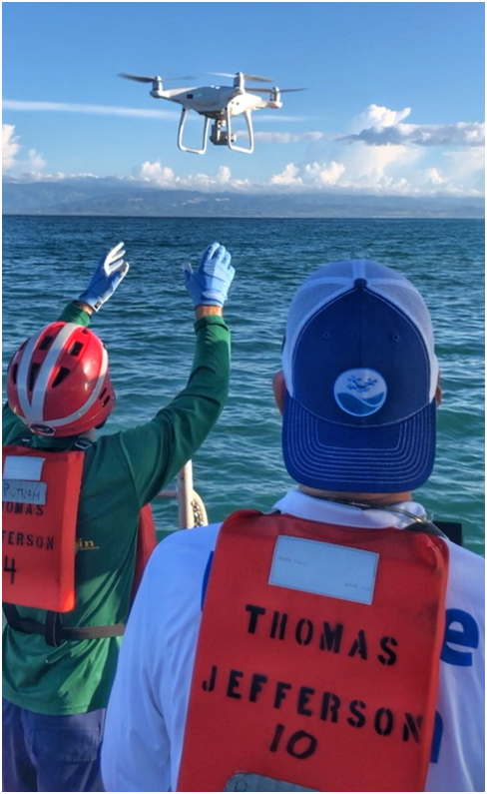
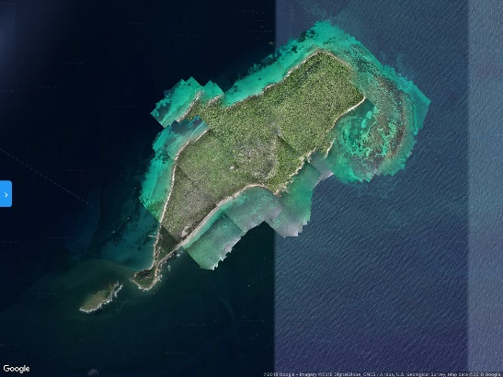
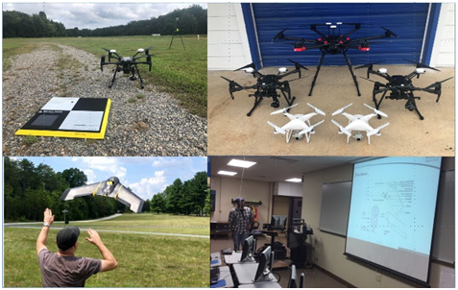
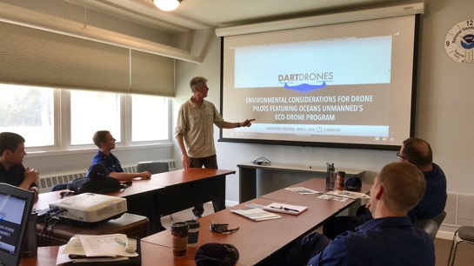
Coastal Mapping Program Updates
Unmanned Aircraft Systems
NGS UAS Testing and Training Center Operational:
  Sensor Testing
  Platform Evaluation and Training
  Proficiency
Established NOS UAS IT Risk Acceptance procedures:
  Enables NOAA operations for DJI sUAS
  Used by several other NOAA offices
Training and Support for other NOAA Offices and Partners:
  OCS/HSD – NOAA Ship TJ – UAS and shoreline mapping
  OCS/HSD – Basic UAS Flight Training
  OCS/HSD – Established MOC-P UAS Training Location
  OCS/HSD – Upcoming UAS Mapping Field Ops Training
  UNH – UAS Vessel Operations Training
  NMFS – Salmon Habitat Mapping – American River
  USACE – Proficiency flights at the Training Center
Notes:
Recommend going through the bullets and emphasizing the following:
Led the effort and obtain approval to operate DJI sUAS platforms by developing procedures to ensure IT security and privacy. Has allowed NOAA access to affordable capable platforms and meet internal and external security concerns.
NGS has led the development and implementation (R2O) of sUAS in NOAA that has included developing and sharing testing, training, and proficiency curriculum and standards that is responsible for implementation into the NOAA hydrographic fleet.

Slide 4
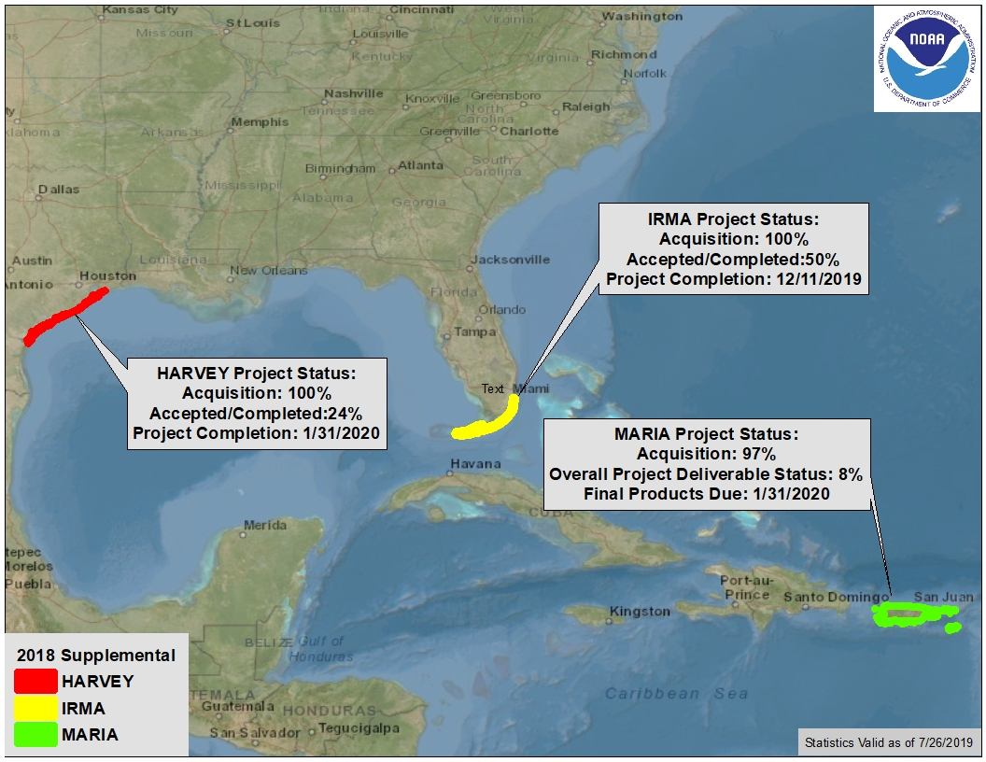
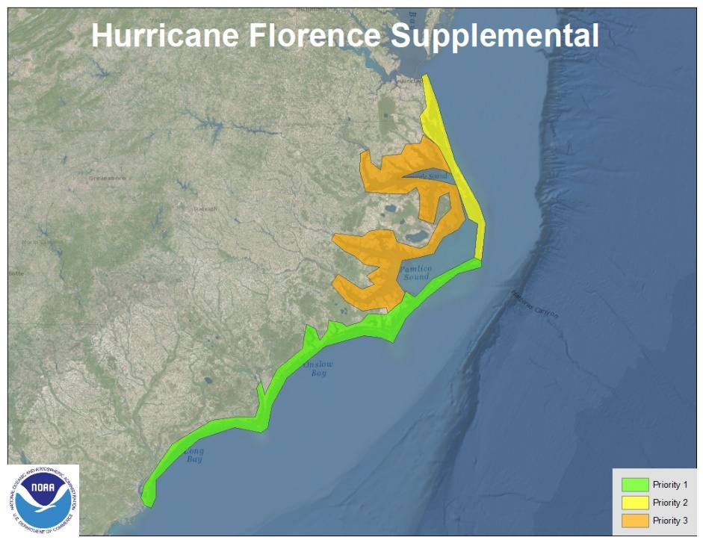
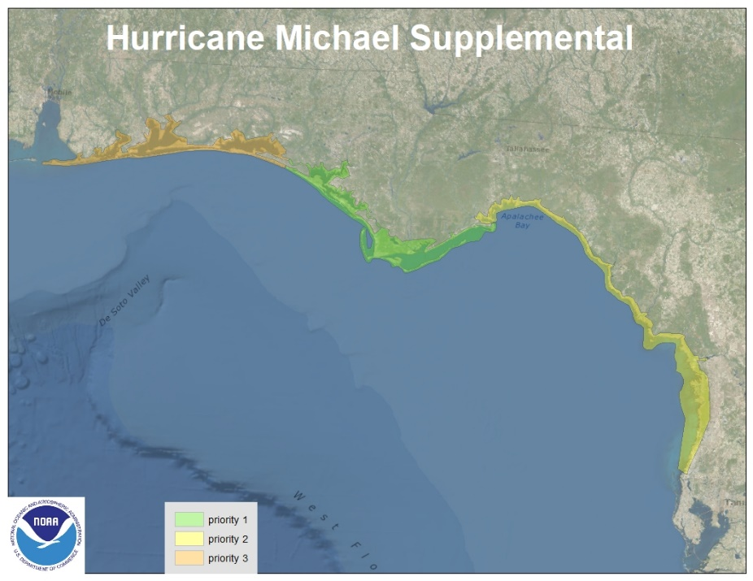
Coastal Mapping Program Updates
FY17 Supplemental
FY19 Supplemental
Notes:
Three areas are currently getting Hurricane Supplemental Funds to Support the Coastal Mapping Program products:
High resolution topobathy lidar
Red,Green, Blue and Near-Infrared Imagery (both in Stereo and OrthoImagery deliverable formats) acquired,
Updated National Shoreline produced.
Areal extents in Texas are associated with Hurricane Harvey, the Florida Keys from Miami to Marquesas for Hurricane Irma, and the islands of Puerto Rico and U.S. Virgin Islands in response to Hurricane Maria.
Current acquisition and overall project completion percentages are presented here for the respective projects.This data will be utilized to produce updated highly accurate near shore depths and shoreline products to update nautical charting products for safe and efficient navigation and commerce. Data will be disseminated to support multi-use of the data from storm-surge and inundation mapping, to community resilience planning and decision-making, benthic and habitat mapping, as well as numerous other applications.

Slide 5
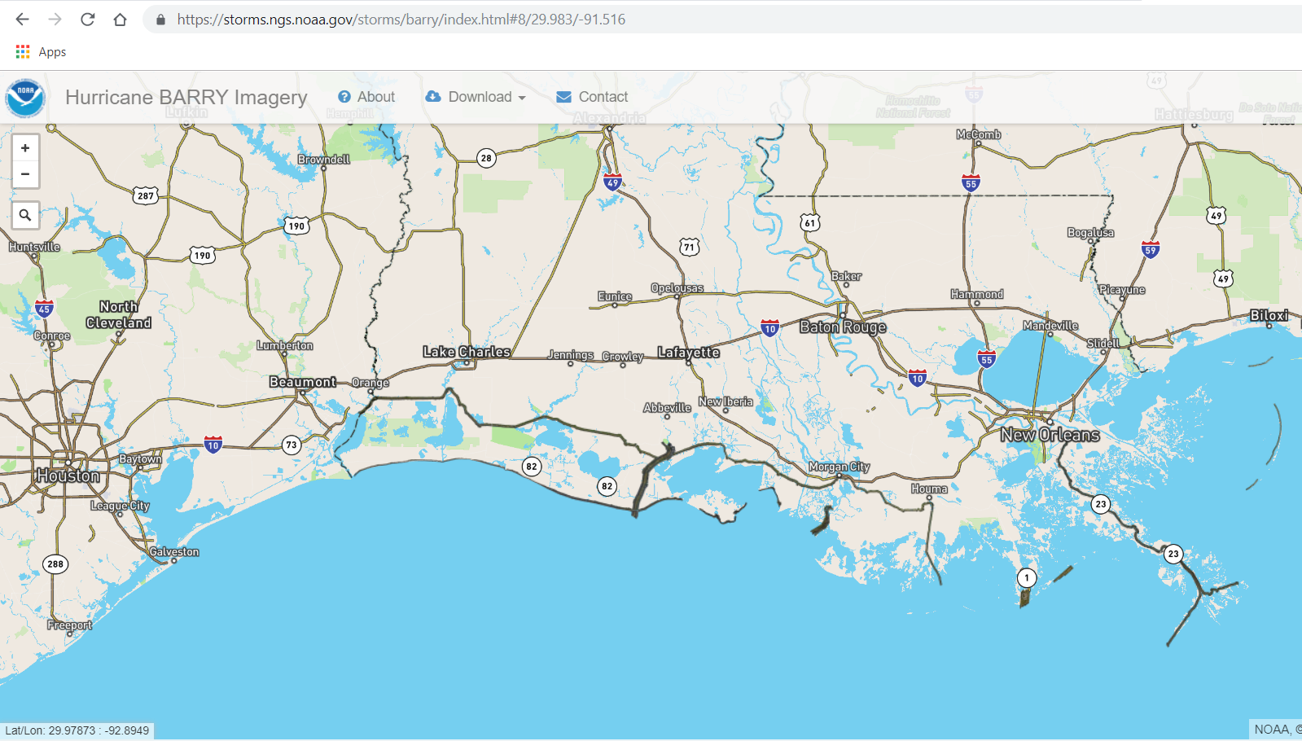
Coastal Mapping Program Updates
Hx Barry Emergency Response Imagery
Coverage of major waterways and ports

Slide 6

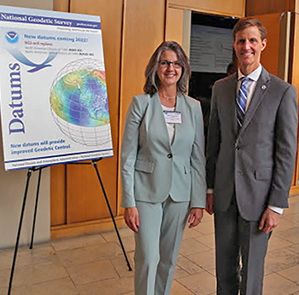
NSRS Modernization Updates
April
Blueprint for 2022, Part 3: Working in the Modernized NSRS (NOAA Technical Report NOS NGS 67) released
May
2019 Geospatial Summit held
State Plane Coordinate System for 2022 (SPCS2022) policy and procedure published

Slide 7
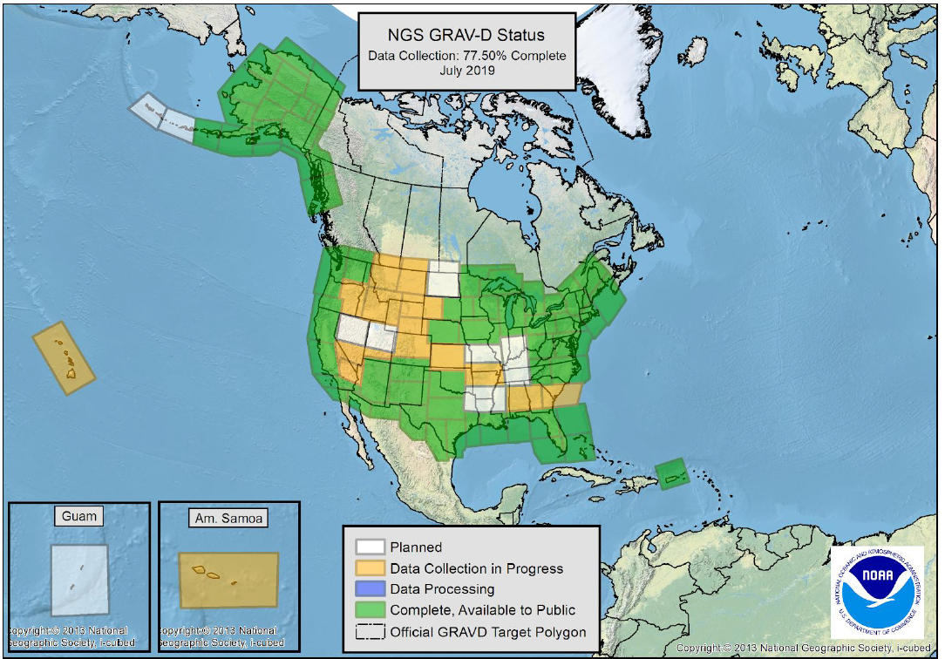
NSRS Modernization Updates
June
Status Report on the Products and Services of the Upcoming Modernized NSRS (NOAA Technical Memorandum NOS NGS 78) released
NGS Research Plan updated
August
Airborne gravity (GRAV-D) 77.5% complete
VDatum 4.0 released

Slide 8
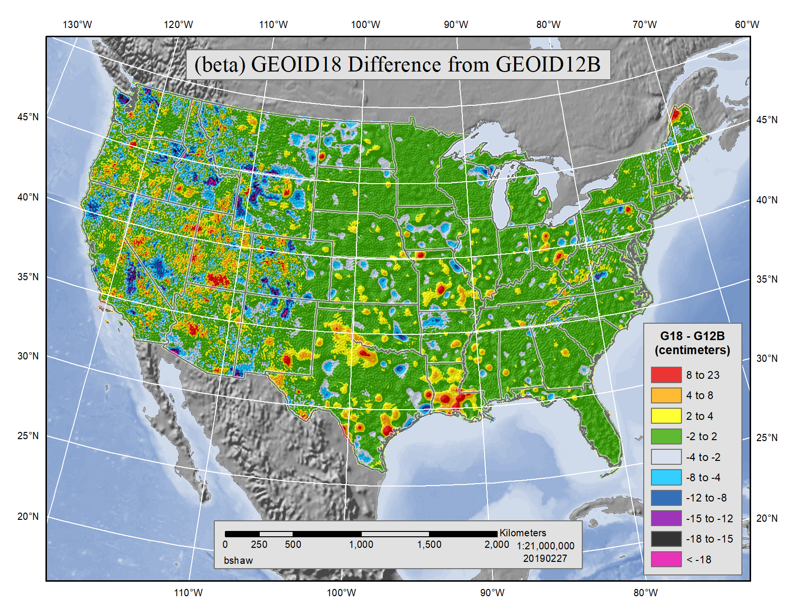
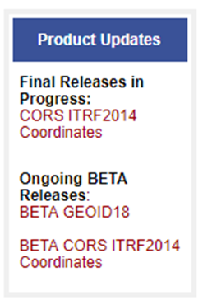
NSRS Modernization Updates
Ongoing: “GPS on Bench Marks” campaign
Provides updated geodetic information on survey marks
Improves 2022 transformation tool
Coming soon:
New (and last) “hybrid” geoid model (GEOID18)
Updated coordinates and velocities for the NOAA Continuously Operating Reference Station (CORS) Network, aligned with the latest international terrestrial reference frame (ITRF2014)

Slide 9
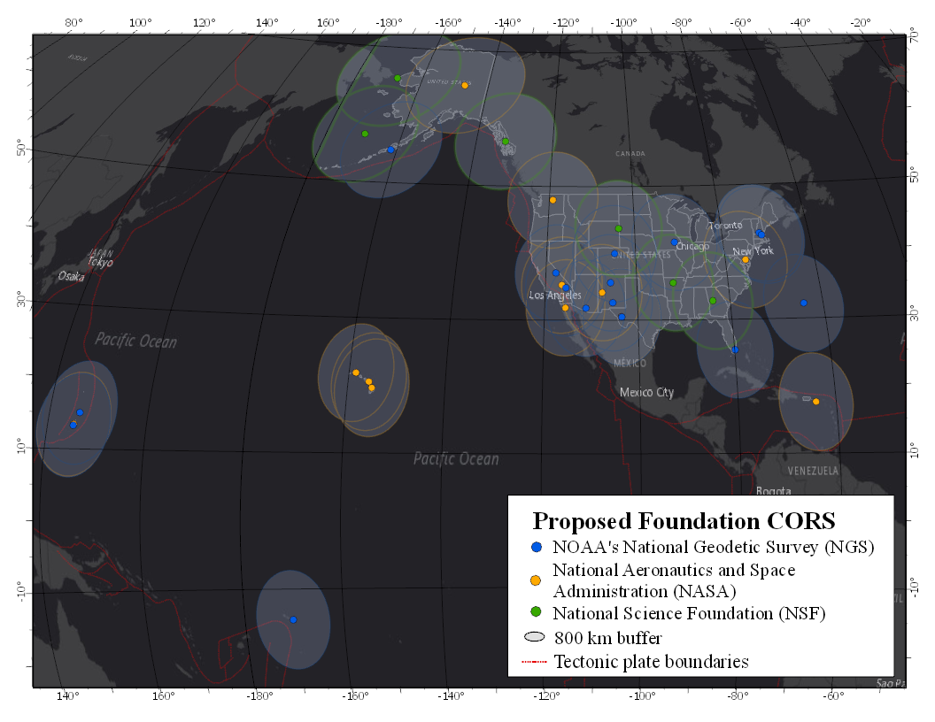
NSRS Modernization Updates
NOAA CORS Network Program:
Hired CORS Program Manager
Established 5 of the 8 Foundation CORS (FCORS) sites planned for FY19
Initiated FCOR interagency agreements
Prioritized 8 CORS program vacancies in staffing plan

Slide 10
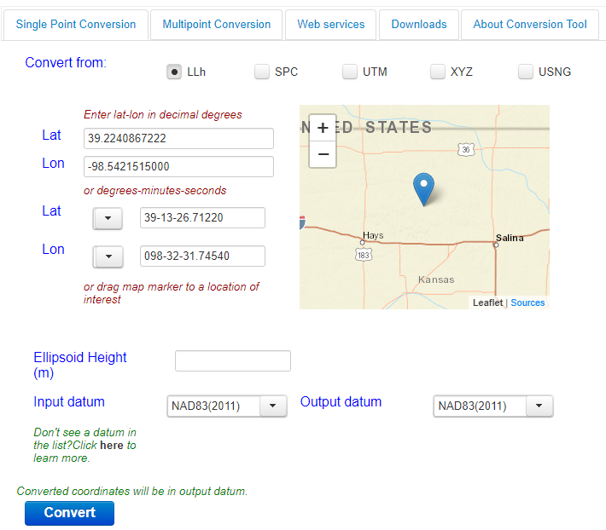
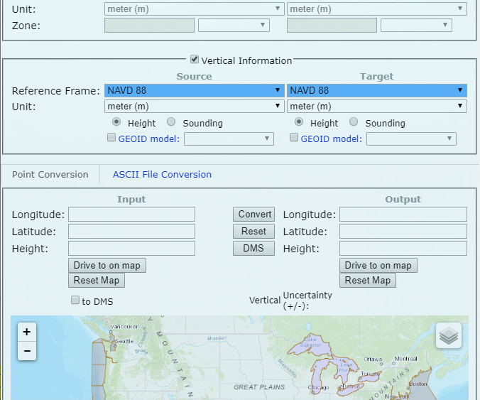
Preparing Geospatial Data for NSRS Modernization
NGS Coordinate Conversion and Transformation Tool (NCAT)
Carefully manage metadata
Reference frame and epoch
Geoid model
Project control method
Survey dates
Retain original GPS data to support reprocessing
Support NGS transformation tool development
BETA testing and recommendations
GPS on Bench Marks campaign
VDATUM

Slide 11
Managing Multiple Datum Updates
2022 NSRS Modernization (late 2022)
    NAD 83 (2011) to various xxTRF 2022 frames
    NAVD 88 to NAPGD2022 (includes geoid products)
2023 National Tidal Datum Epoch (NTDE) update (late 2023)
    NTDE 1983-2001 epoch to 2002-2020 epoch
    5 year datums for SE Louisiana and SE Alaska (late 2023)
    2012-2016 observations to 2017-2021 observations
2025 International Great Lakes Datum (IGLD) (late 2025)
    IGLD85 to IGLD2020
11
Notes:
North American Terrestrial Reference Frame of 2022 (NATRF2022)
Pacific Terrestrial Reference Frame of 2022 (PATRF2022)
Mariana Terrestrial Reference Frame of 2022 (MATRF2022)
Caribbean Terrestrial Reference Frame of 2022 (CATRF2022)
North American-Pacific Geopotential Datum of 2022 (NAPGD2022)

Slide 12

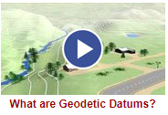
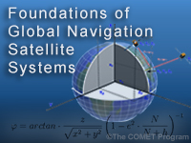
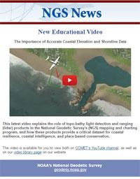

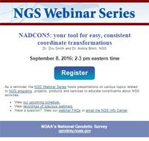
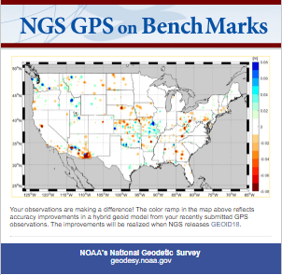
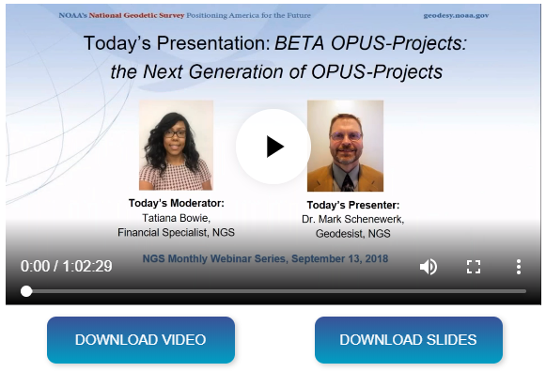
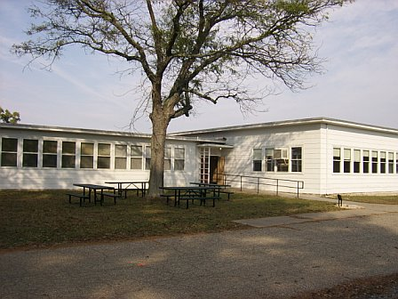
Learn more at geodesy.noaa.gov
Educational Videos
Online Lessons
NGS Testing and Training Center
Monthly Webinar Series
12
Notes:
Videos are 5 minutes or less
More than 185,000 views
Lessons
More than 1,200 quizzes
More than 6,200 sessions
More than 40 recorded webinars
More than 7,500 webinar attendees
Training webinars and In-person classes on OPUS Projects and Geodetic Leveling

