Slide 1
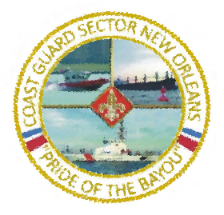
Hydrographic Services Review Panel Meeting
Coast Guard Sector New Orleans 27 Aug 19

Slide 2
Overview
Sector Commander Authorities
Managing the Waterway
High/Low Water
Hurricanes
Working with NOAA (NWS, PORTS System, SSCs/MC20)

Slide 3
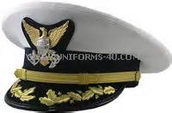
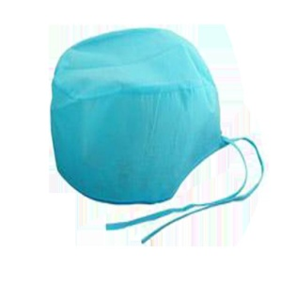
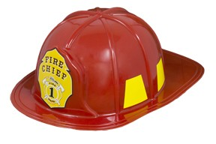
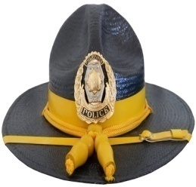
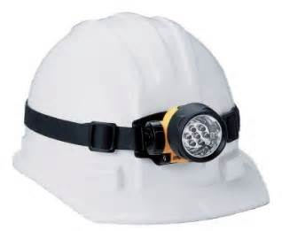
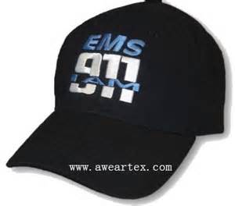
Sector Commander Authorities
Maritime: Doctor EMS/911 Fire Chief Police Chief Building Inspector
COTP SMC FOSC FMSC OCMI

Slide 4
Historic High Water on Lower MS River
Record number of days above flood stage
Tow size and horsepower restrictions
Challenges at SW Pass for deep draft due to silting
Low water equally as challenging

Slide 5
Hurricanes
When to close the Port?
Enacting the Regulated Navigation Areas (RNAs)
Port Coordination Team Calls
NOAA National Weather Service forecasts critical
Opening the Port harder than closing it
Communicate to mariners via the MSIB

Slide 6
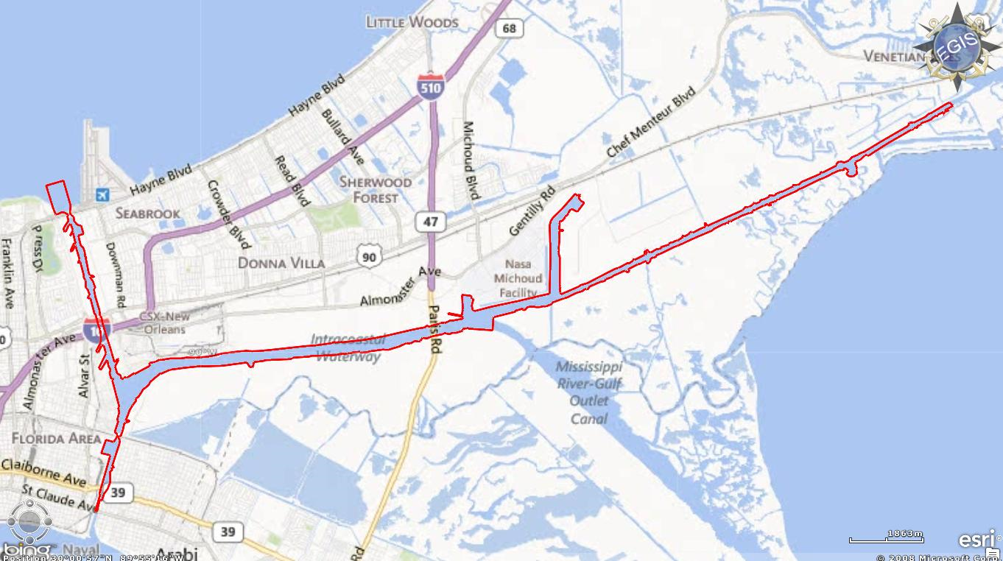
Regulated Navigation Area (East)

Slide 7
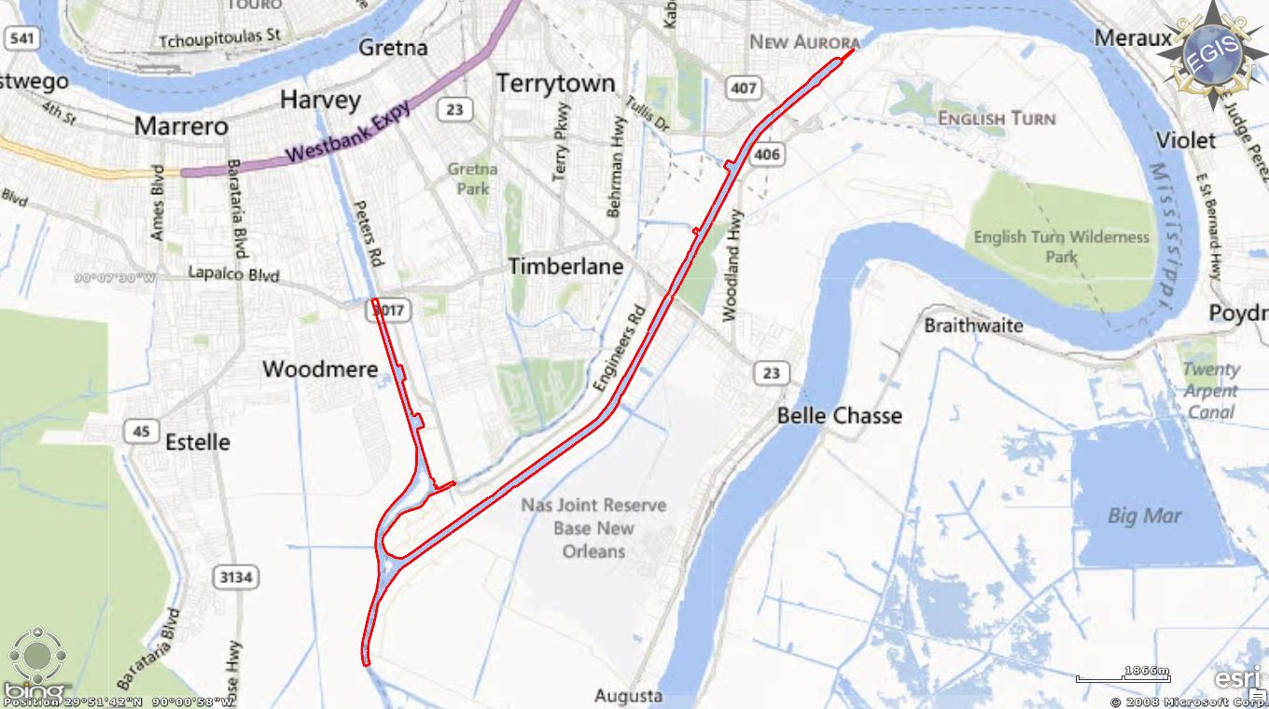
Regulated Navigation Area (West)

Slide 8
Hurricanes
When to close the Port?
NOAA National Weather Service forecasts critical
Enacting the Regulated Navigation Areas (RNAs)
Port Coordination Team Calls
Opening the Port harder than closing it
Communicate to mariners via the MSIB

Slide 9
Marine Safety Information Broadcast (MSIB)

Slide 10
Working with NOAA
National Weather Service Reports & Products (Slidell Office)
Weather Forecast Center
LMR Forecast Center
PORTS System
The objectives of the PORTS® program are to promote navigation safety, improve the efficiency of U.S. ports and harbors, and ensure the protection of coastal marine resources
Oceanographic Research Vessels (ORVs) (Pisces, Gordon Gunter)
Scientific Support Coordinators (SSCs)
MC20 Oil Spill Response Case

