Slide 1
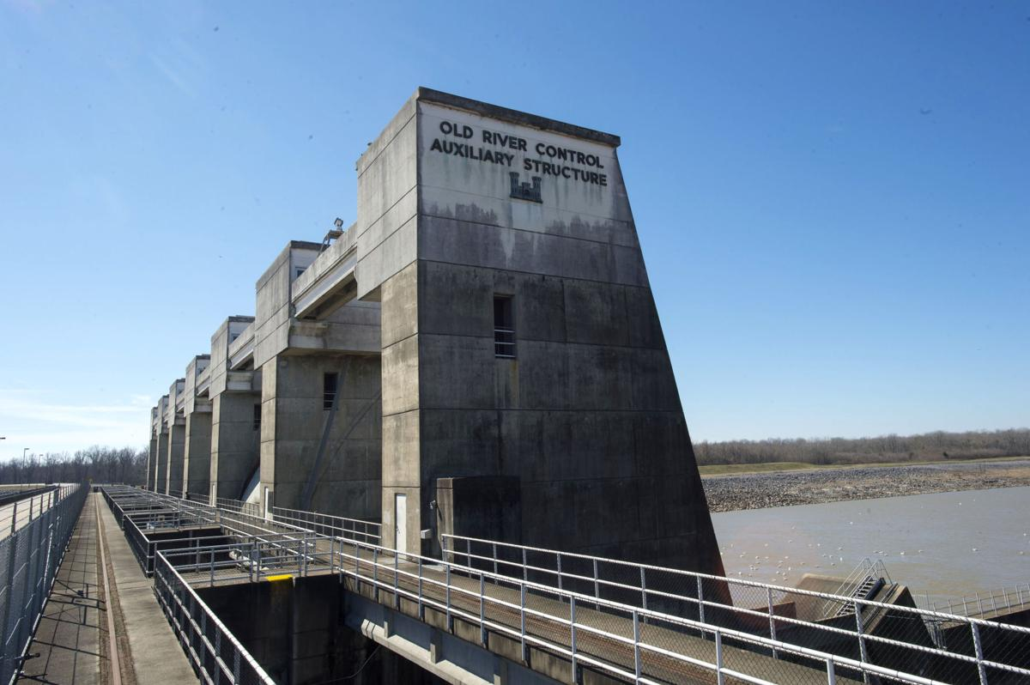
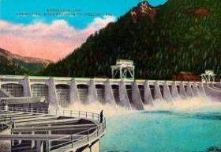
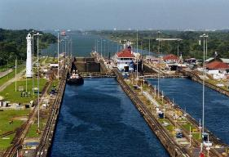
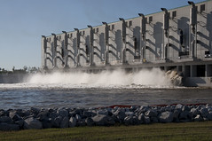
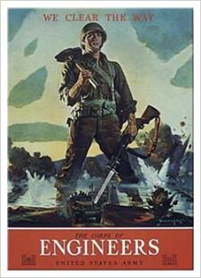
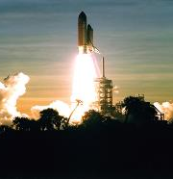
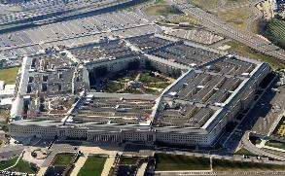
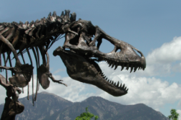
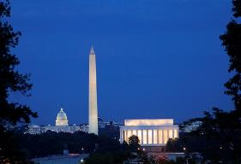
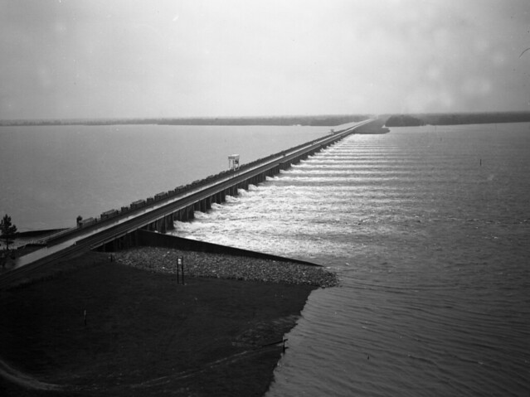
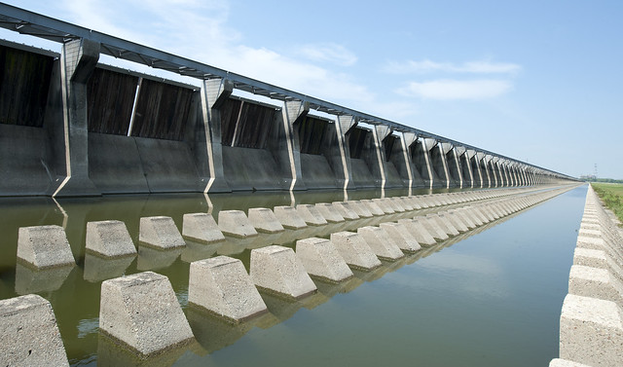
U.S. Army Corps of Engineers
Over 244 Years of Service to the Nation
Bonneville Dam - 1937
Panama Canal - 1914
Old River Control Auxiliary Structure - 1986
West Closure Complex- 2014
U.S. Capitol - 1800
Washington Monument - 1884
Lincoln Memorial - 1922
The Pentagon - 1941
Kennedy Space Center –
1962
Wankel T. Rex – 1988
Loaned to Smithsonian - 2019
Morganza Control Structure - 1954
Bonnet Carre Spillway –
1931

